Slide 1
Basic Concepts and Linear Regression
Lecture 2

Slide 2
RECAP
Training Data
Testing Data
Supervised Learning
Regression
Classification

Slide 3
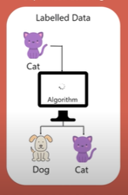
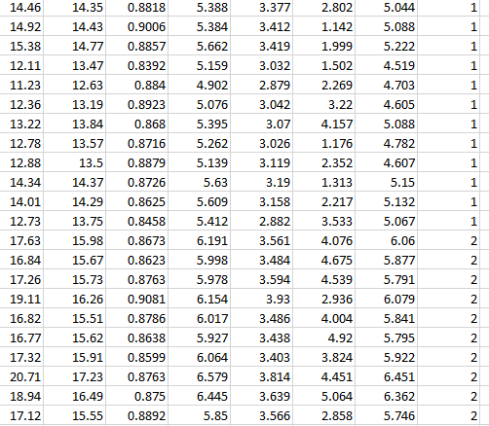
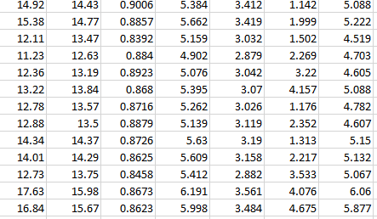
Basic Concepts
Output Data/Labels
Input Data /features
Labelled Data/Training Data: In the labelled data/training data we have inputs and corresponding outputs of the inputs
The training data are used to train the machine learning algorithm.
In the training process we give the inputs to the machine and then tell the machine that these are the outputs of the corresponding inputs
In this way the machine learning algorithm learns and then
Testing Data: In the testing data we have only inputs data
and the output data or labelled are missing.
We only feed input data to the machine learning alroithm and the machine learning algorithm provides the predicted/estimated output based on the input data.
Real Output/
Actual Output

Slide 4
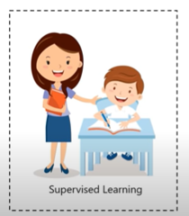
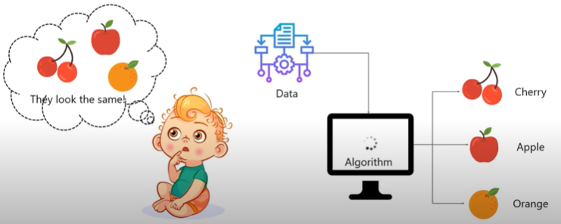
Supervised Learning
Outputs /Labels
Input Data /features
In this case machine learns under guidance
As in the school, teacher guide us and taught us
In the supervised learning machine learns by feeding labelled data
And explicitly telling that this is the input, and this is exactly how the output must look.

Slide 5
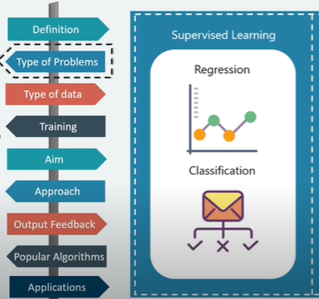
Supervised Learning Algorithm
Supervised Learning algorithms are normally use for regression or classification purposes as illustrated in the below Figure.

Slide 6
What is Regression
Types of Machine Learning Regression Models
Linear Regression
Multiple Regression
Polynomial Regression
Logistic Regression
Support Vector Regression (SVR)
Regression Tree (CART)
ANN
Quantile Regression
Ridge Regression
Lasso Regression
Elastic Net Regression
Principal Components Regression (PCR)
Partial Least Squares (PLS) Regression
Ordinal Regression
Poisson Regression
Negative Binomial Regression
Quasi Poisson Regression
Cox Regression
Tobit Regression
In regression models (both linear and non-linear) are used for predicting real values
The type of regression depends on the output data developed from the relation between dependent and independent variables

Slide 7
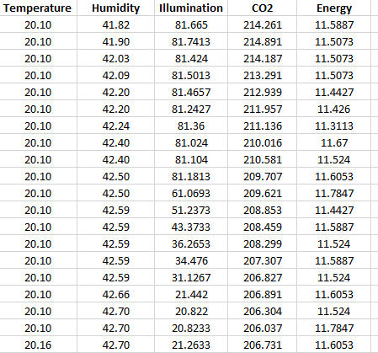
Regression
In regression target/output variable is real
Infinite number of possibilities
Example: Weight, Price in upcoming years
Naming Convention:
Features = Predictor variables = Independent Variables
Target variables = dependent variable = response variable
Input Data /features
Output Data /Labels
Regressor
Predict
real #
Inputs

Slide 8
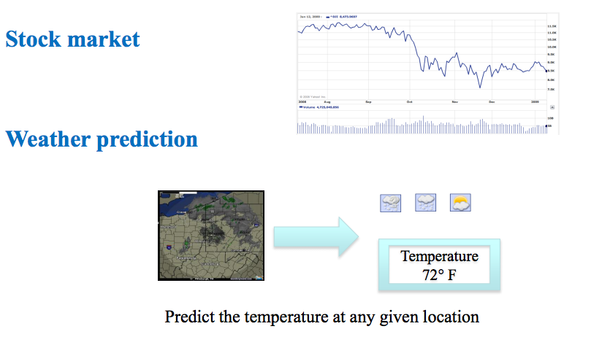
Applications of Regression
Evaluating trends and sales estimation
Stock Market Trend Prediction
Weather Prediction
Energy Consumption Prediction
Earthquake Prediction

Slide 9

Simple Linear Regression
Simple Linear Regression is a statistical method that allows us to summarize and study relationship between two continuous (quantitative) variables.
It estimates the relationship between dependent (target) and independent variable (predictor)
Given an input x we would like to compute an output y
Examples:
- Predict height from age
- Predict Salary from Experience
Dependant Variable
$$y=mx+b$$
Constant
Coefficient
Independent Variable

Slide 10
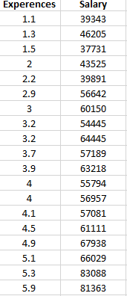
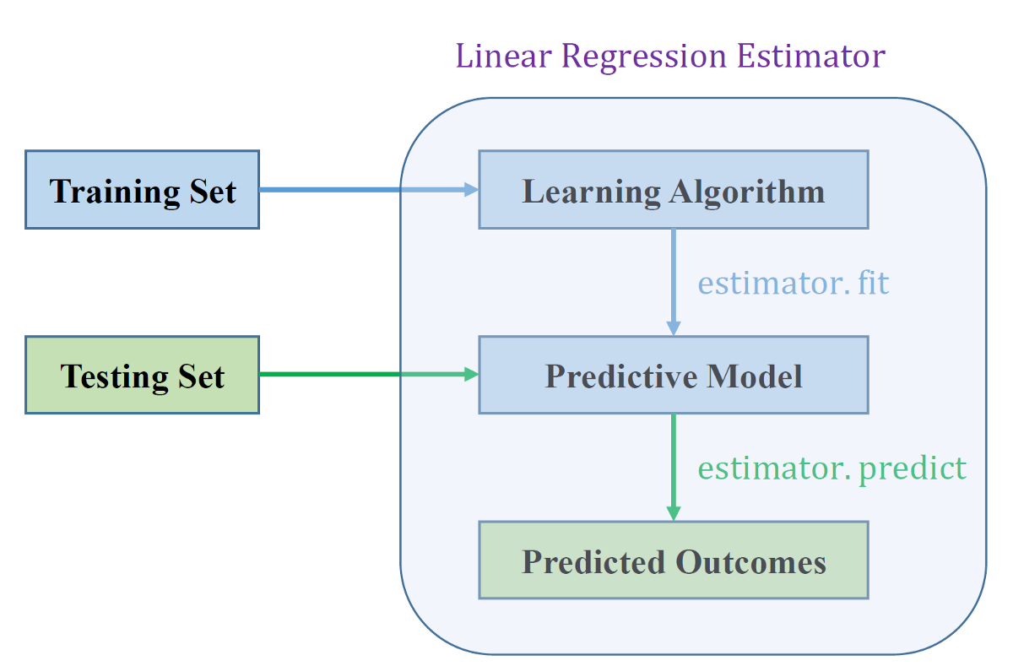

Simple Linear Regression in Machine Learning
In machine learning the linear regression works as follow.

Slide 11
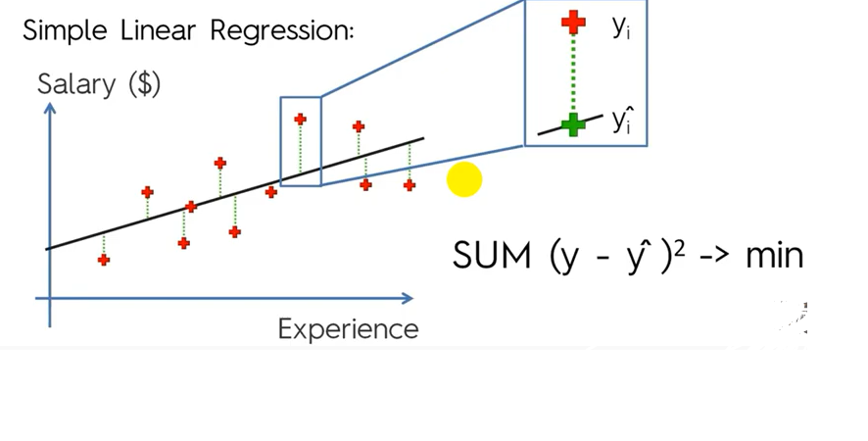
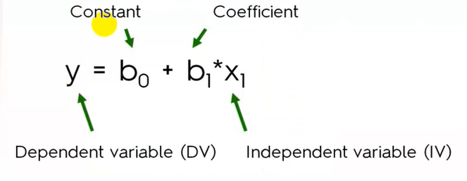
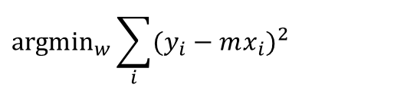

Simple Linear Regression
Our goal is to estimate m from a training data of <x_{i},y_{i}> pairs
The objective is to minimize the error difference between actual parameter values and predicted parameter values.
Minimize Square Error:
$$y=mx+b$$
Y
$${argmin}_{w}{\sum_{i}{(y_{i}−mx_{i})^{2}}}$$
Why least squares?
minimizes squared distance between measurements and predicted line
X

Slide 12
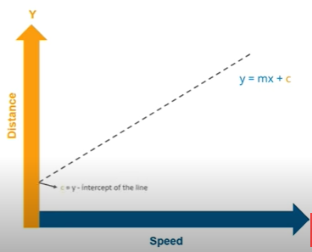
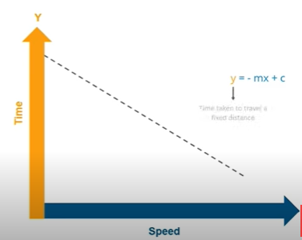
Simple Linear Regression
Linear Regression shows the relationship between independent and dependent variables.

Slide 13
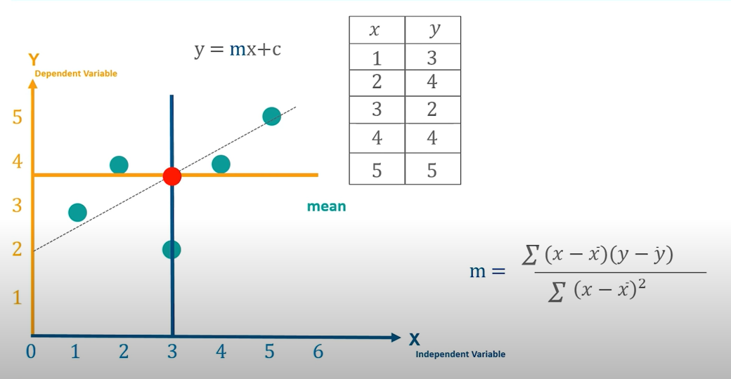
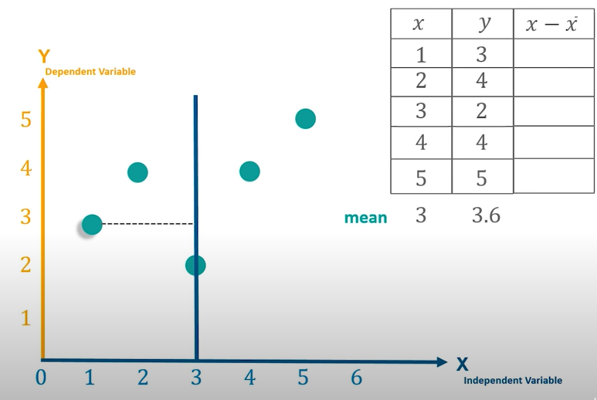
Understanding Linear Regression Algorithm
Linear Regression shows the relationship between independent and dependent variables.

Slide 14
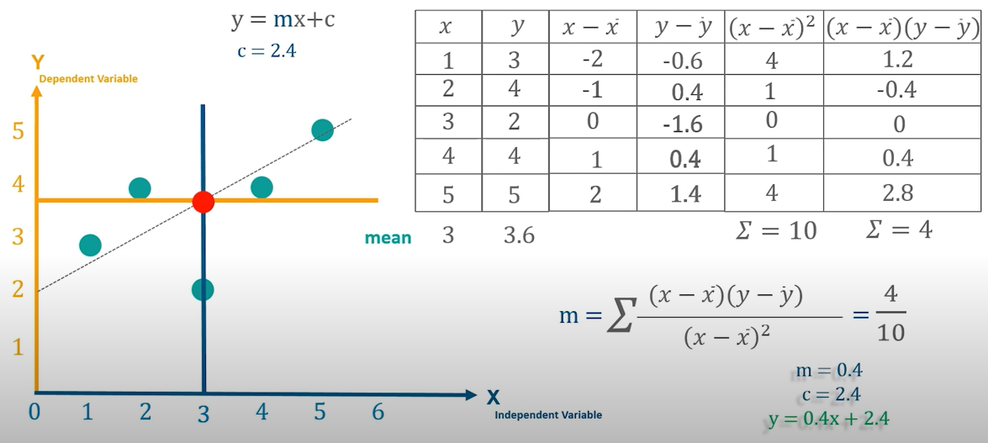

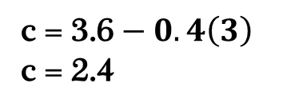
Understanding Linear Regression Algorithm
Calculate the Linear Regression
c = $\overline{y}−m\overline{x}$
c = 3.6 $− 0.4\left(3\right)$
c = 2.4

Slide 15
Understanding Linear Regression Algorithm
Linear Regression shows the relationship between independent and dependent variables.

Slide 16
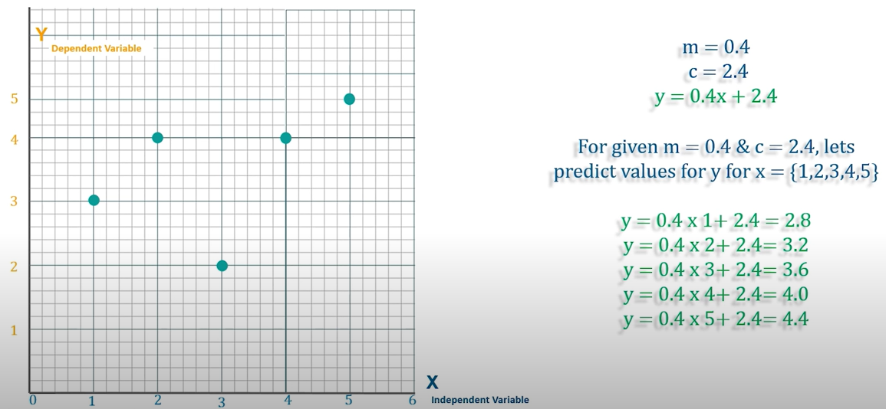

Understanding Linear Regression Algorithm

Slide 17
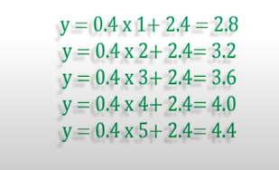
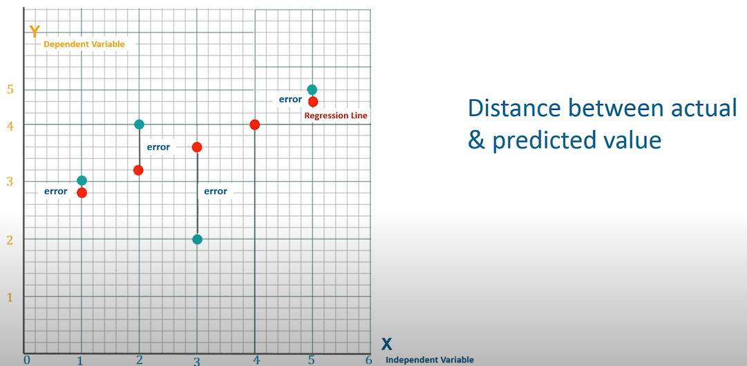


Understanding Linear Regression Algorithm
Predicted
Actual

Slide 18
Implementation
Scikit-learn (formerly scikits.learn and also known as sklearn) is a free software machine learning library for the Python programming language.
It features various classification, regression and clustering algorithms including support vector machines, random forests, gradient boosting, k-means and DBSCAN, and is designed to interoperate with the Python numerical and scientific libraries NumPy and SciPy.

Slide 19
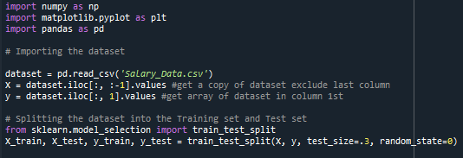
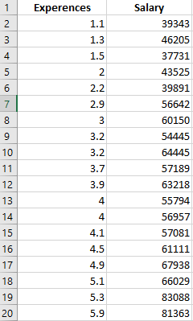
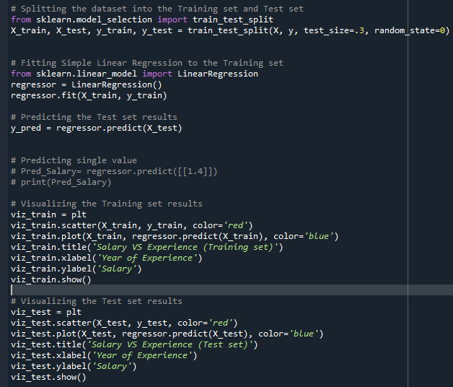
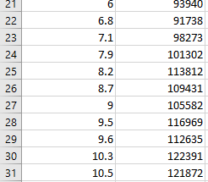

Slide 20
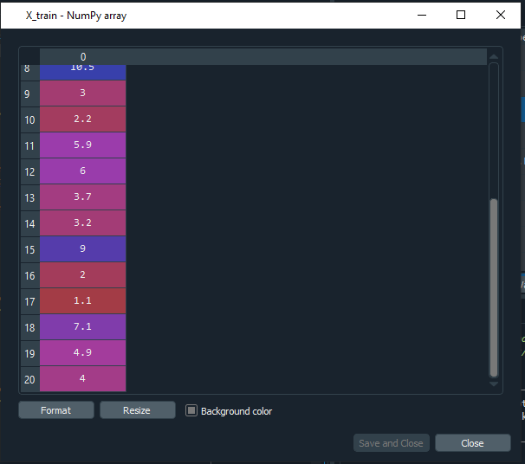
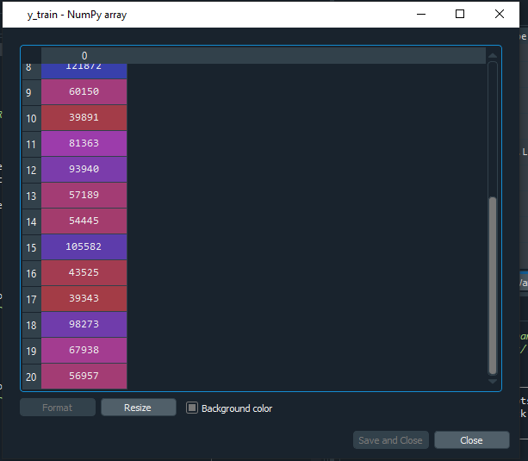
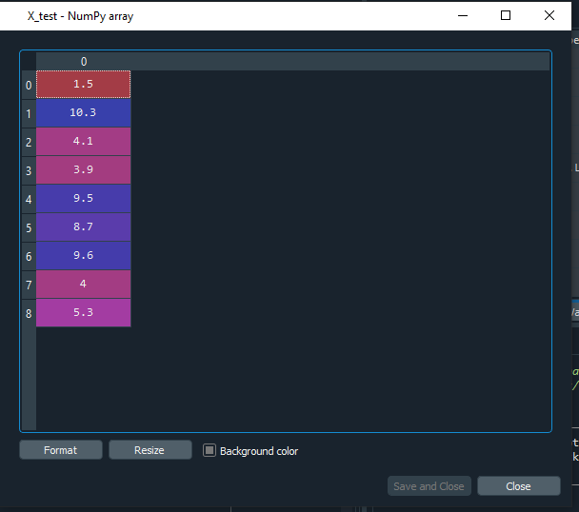
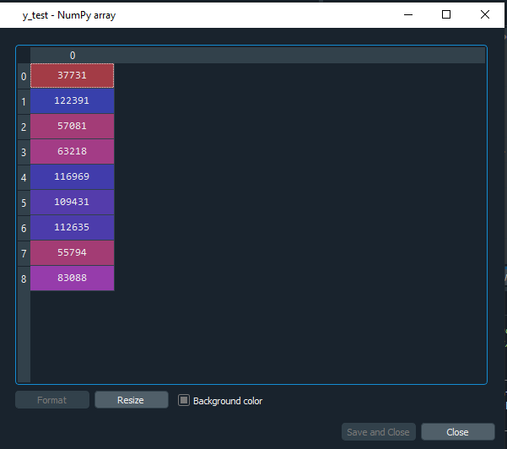
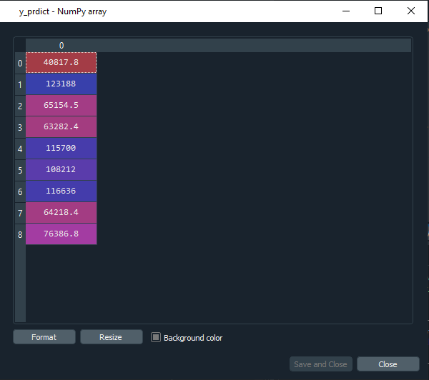
Implementation
Training Data
Testing Data

Slide 21
Activity #1
I have uploaded the simple linear regression code and data to Moodle.
Mathematically calculate the simple regression by using the data
I have provided a link on Moodle, upload the solution to Moodle.
Run the code on your system, I will check in the next class of Machine Learning.
Deadline: 31/01/2021

Slide 22
https://www.socscistatistics.com/tests/regression/default.aspx
Linear Regression Calculator
https://www.desmos.com/calculator

