Slide 1
MULTIPLE LINEAR REGRESSION, PERFORMANCE EVALUATORS, AND CLASSIFICATION
Lecture# 3
Dr. Muhammad Fayaz

Slide 2
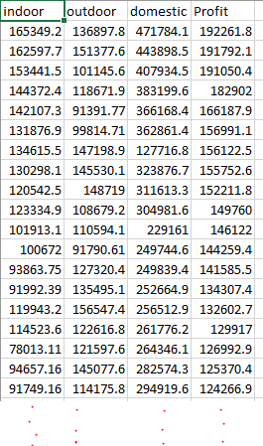
RECAP
Inputs
Output
Simple Linear Regression
Supervised Learning
Training Data
Testing Data
Marks | Remarks
35 | F
44 | P
23.5 | F
87 | P
76 | P
87 | P
98 | P
22 | F
15 | F
89 | P
65 | P

Slide 3
What is Multiple Regression?
Predicting an outcome (dependent variable) based upon several independent variables simultaneously.
Why is this important?
Behavior is rarely a function of just one variable, but is instead influenced by many variables.
So, the idea is that we should be able to obtain a more accurate predicted score if using multiple variables to predict our outcome.

Slide 4

The Multiple Linear Regression Model
Applications in which there are several independent variables, x₁, x₂, … , x_{k} .
A multiple linear regression model with p independent variables has the equation
β₀ is constant and β_{i} determines the coefficients of the independent variable x_{i}

Slide 5
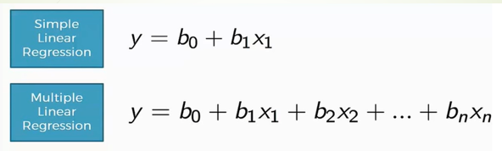
The Multiple Linear Regression Model
Inputs
Output

Slide 6
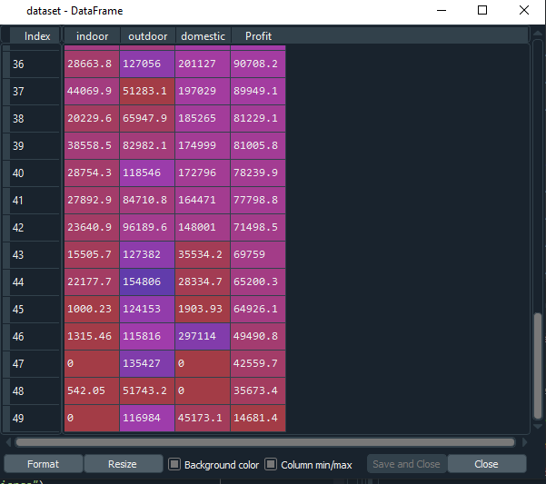
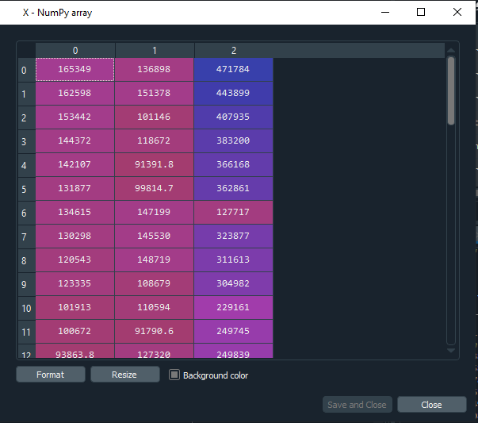
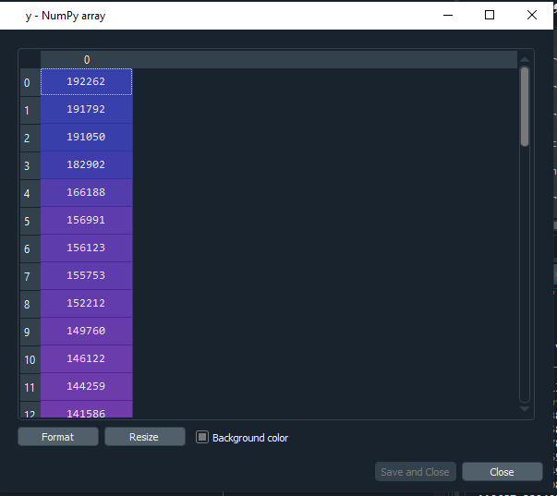
The Multiple Linear Regression Model

Slide 7
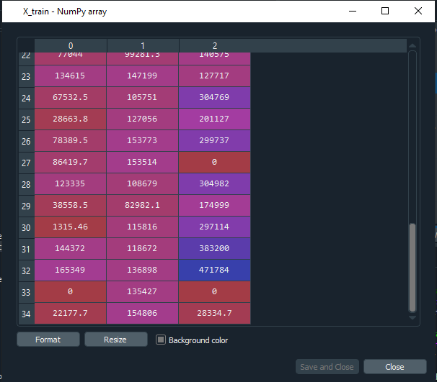
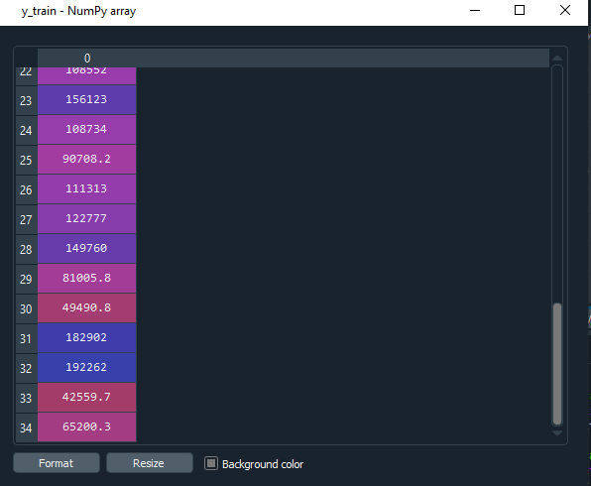
The Multiple Linear Regression Model
Input Training Data
Output/Labels of Training Data

Slide 8
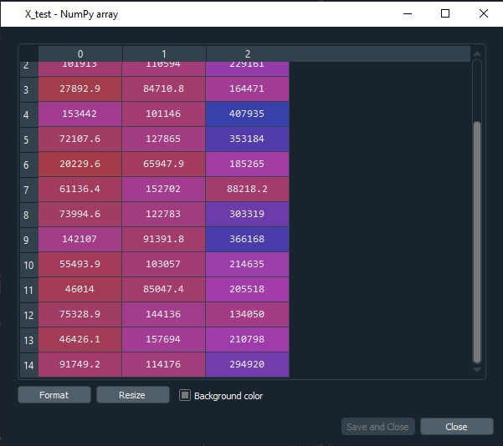

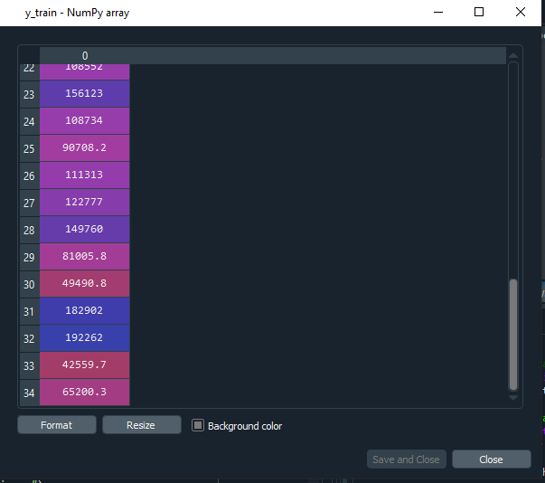
The Multiple Linear Regression Model
Input Training Data
Inputs Data for Testing
Multiple Linear Regression Algo Outputs for testing
Output Training Data

Slide 9
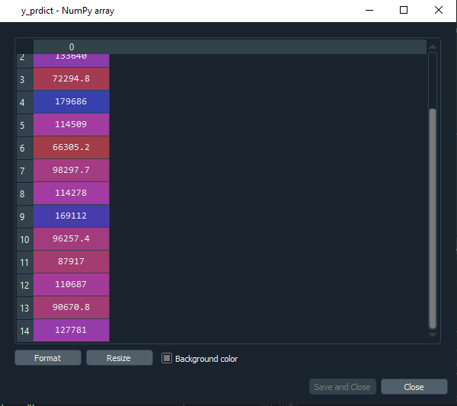
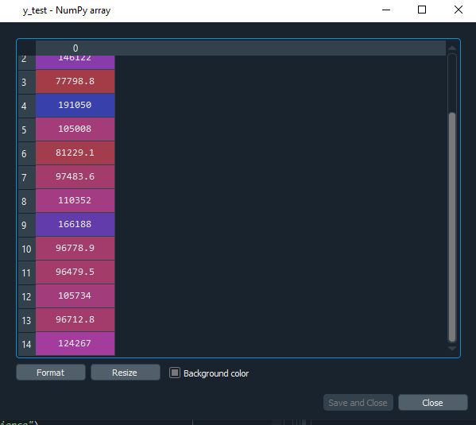
Input Training Data
Inputs Data for Testing
Multiple Linear Regression Algo Outputs
First the MLR Algorithm is trained on the training data.
In training data the inputs along with corresponding outputs data are provided to the MLR algorithm.
In testing only the input data is provided to the MLR algorithm and the MLR provides the predicted results based on the trained model.
Here, we have given the actual outputs, these actual outputs are just for comparison.
.
.
.
Output Training Data
Actual Outputs

Slide 10
Regression Evaluation Metrics
In order to measure the performance of algorithms when the outputs of the data different evaluation metrices for regression are used, such as:
Mean absolute error (MAE),
Mean square error (MSE),
Root mean square error (RMSE)

Slide 11
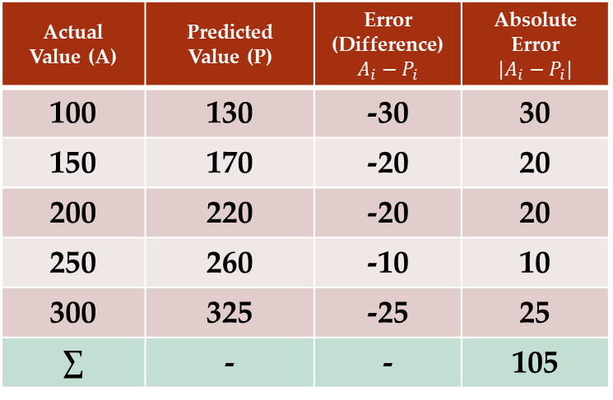
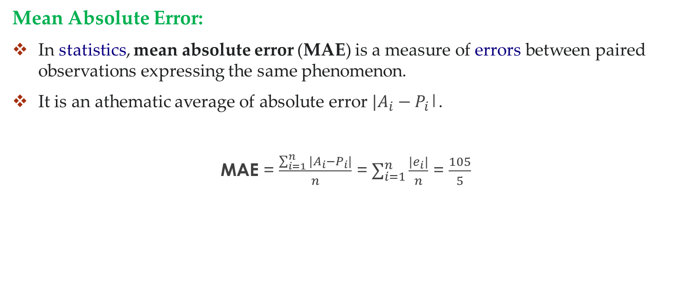
Performance Evaluation Metrics
Mean Absolute Error:
In statistics, mean absolute error (MAE) is a measure of errors between paired observations expressing the same phenomenon.
It is an athematic average of absolute error $|A_{i}−P_{i}$|.
MAE = $\frac{\sum_{i=1}^{n}{|A_{i}−P_{i}|}}{n}$ = $\sum_{i=1}^{n}{\frac{|e_{i}|}{n}}$ = $\frac{105}{5}$
Actual Value (A) | Predicted Value (P) | Error (Difference) $$A_{i}−P_{i}$$ | Absolute Error $$|A_{i}−P_{i}|$$
100 | 130 | -30 | 30
150 | 170 | -20 | 20
200 | 220 | -20 | 20
250 | 260 | -10 | 10
300 | 325 | -25 | 25
∑ | - | - | 105

Slide 12
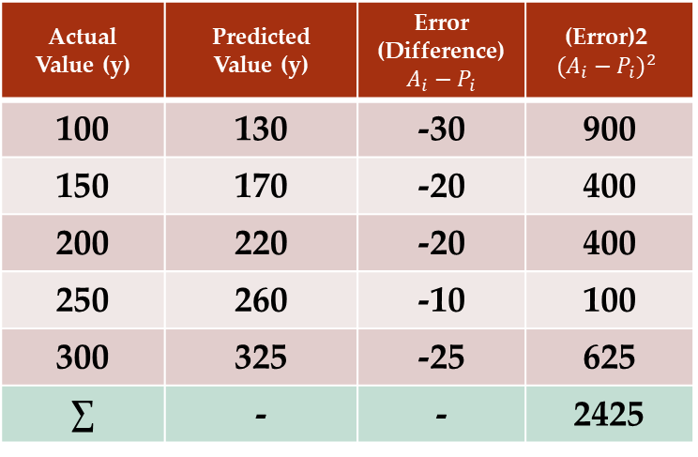
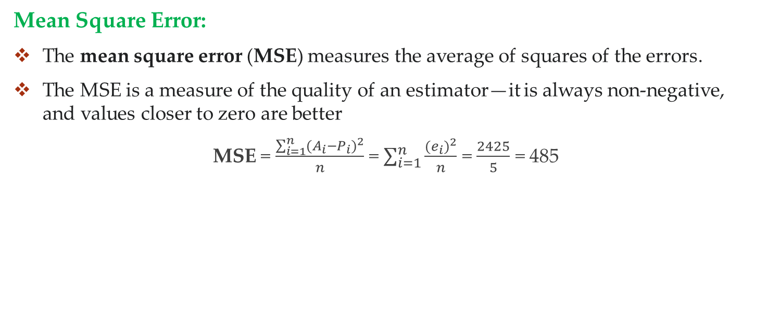
Performance Evaluation Metrics
Mean Square Error:
The mean square error (MSE) measures the average of squares of the errors.
The MSE is a measure of the quality of an estimator—it is always non-negative, and values closer to zero are better
MSE = $\frac{\sum_{i=1}^{n}{{(A_{i}−P_{i})}^{2}}}{n}$ = $\sum_{i=1}^{n}{\frac{{(e_{i})}^{2}}{n}}$ = $\frac{2425}{5}$ = 485
Actual Value (y) | Predicted Value (y) | Error (Difference) $$A_{i}−P_{i}$$ | (Error)2 $${(A_{i}−P_{i})}^{2}$$
100 | 130 | -30 | 900
150 | 170 | -20 | 400
200 | 220 | -20 | 400
250 | 260 | -10 | 100
300 | 325 | -25 | 625
∑ | - | - | 2425

Slide 13
Activity

Slide 14
Actual | Predicted
54 | 35
76 | 46
64 | 24.5
22 | 22
54 | 52
76 | 74
64 | 62
22 | 21
15 | 14
21 | 20
54 | 32
76 | 51
64 | 40
47 | 42
88 | 82
65 | 66
45 | 49
Actual and Predicted values are given, please find the following performance evaluators.
Mean absolute error (MAE),
Mean square error (MSE),
Root mean square error (RMSE)
Explain the following Terms
Predicted
Actual

Slide 15
Classification

Slide 16
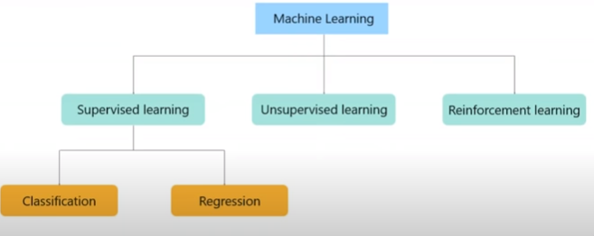
Classification in Supervised Learning
Machine learning algorithms can be divided into different classes based on learning.
Supervised Learning
Unsupervised Learning
Reinforcement Learning
Supervised learning algorithms are used for classification and regression purposes.

Slide 17
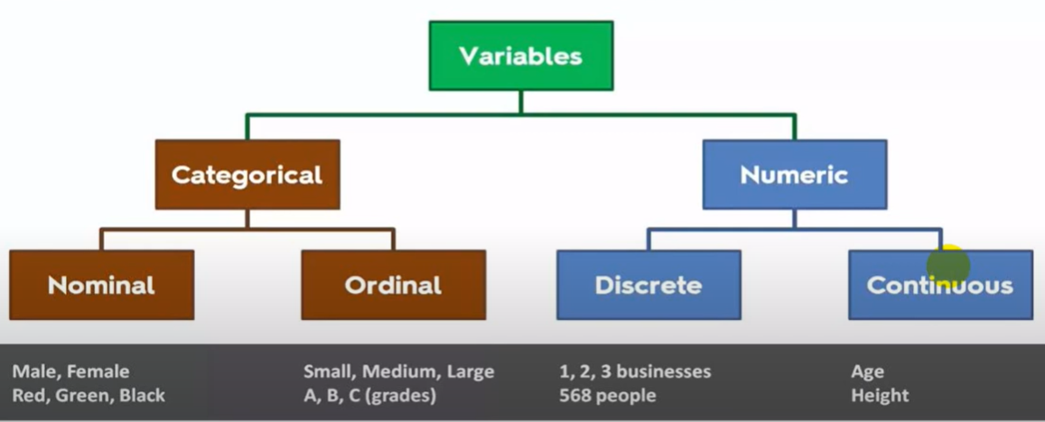
Classification in Supervised Learning
First, we need to understand data and types of data.
Variables are used to store data
According to below figure, the data can be divided into different types
1. Categorical
2. Numerical

Slide 18
Types of Classification
Binary Classification problem: When we have two categories in the output variable/class/depend variable
Multiclass Classification Problem: When we have when we have more than two categories in the output variable/class/depend variable
Input-1 | Input-2 | Input-3 | Input-4 | Class
 |  |  |  | a
 |  |  |  | a
 |  |  |  | b
 |  |  |  | b
 |  |  |  | c
 |  |  |  | c
 |  |  |  | b
 |  |  |  | a
Input-1 | Input-2 | Input-3 | Input-4 | Class
 |  |  |  | a
 |  |  |  | a
 |  |  |  | b
 |  |  |  | b
 |  |  |  | a
 |  |  |  | a
 |  |  |  | b
 |  |  |  | a

Slide 19


Classification in Supervised Learning
Unlike regression where you predict a continues number, you use classification to predict a category.
There is a wide variety of classification applications from medicine to marketing.
Classification models include linear models like logistic regression, and nonlinear ones K-NN, Kernel SVM and Random Forests.
Learning Classification Models.
Logistic Regression
K-Nearest Neighbors (K-NN)
Support Vector Machine (SVM)
Naive Bayes
Decision Tree Classification
Random Forest Classification

Slide 20
Multiple Linear Regression Calculator
https://stats.blue/Stats_Suite/multiple_linear_regression_calculator.html

