Slide 1
PERFORMANCE EVALUATORS for Regression, AND CLASSIFICATION
Lecture# 4
Dr. Muhammad Fayaz

Slide 2
RECAP
Simple Linear Regression
Multiple Linear Regression Model
Regression
Classification
Performance Evaluation metrices for Regression

Slide 3
Evaluation Metrics (Regression )
Different evaluation metrices for regression are used in order to measure the performance of algorithms , such as:
Mean absolute error (MAE),
Mean square error (MSE),
Root mean square error (RMSE)

Slide 4
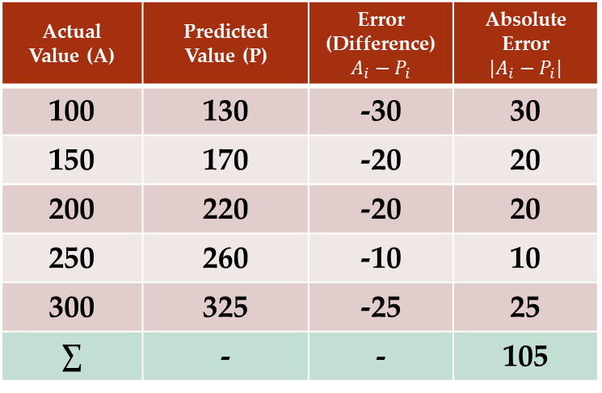
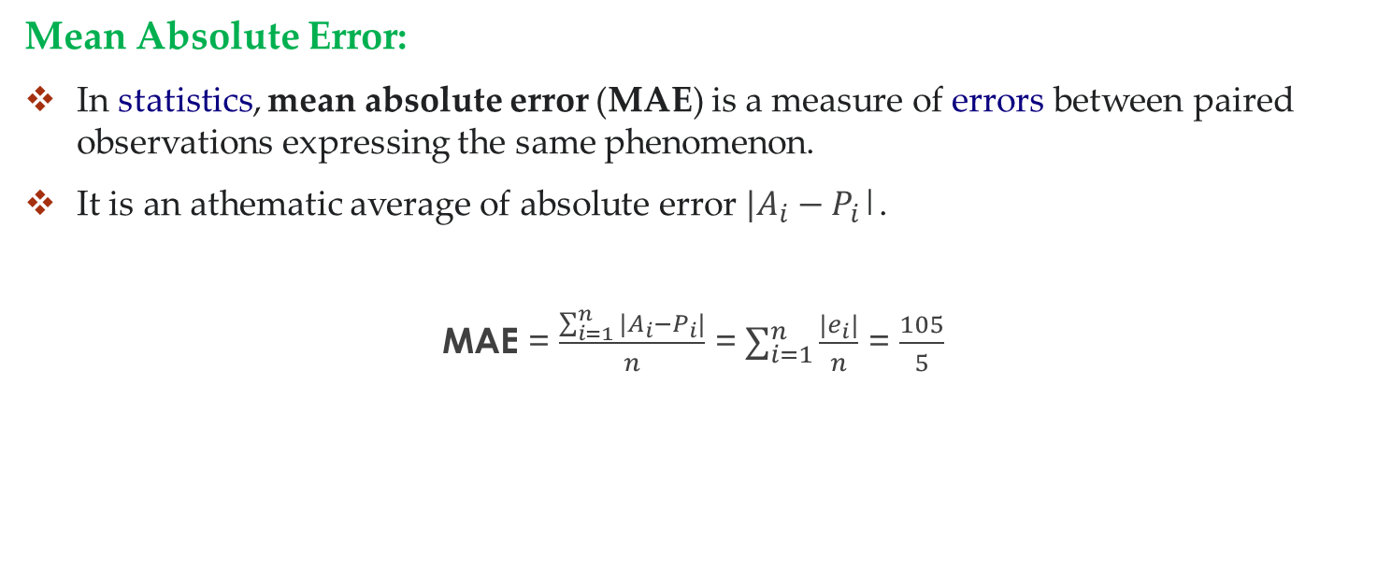
Performance Evaluation Metrics
Mean Absolute Error:
In statistics, mean absolute error (MAE) is a measure of errors between paired observations expressing the same phenomenon.
It is an athematic average of absolute error $|A_{i}−P_{i}$|.
MAE = $\frac{\sum_{i=1}^{n}{|A_{i}−P_{i}|}}{n}$ = $\sum_{i=1}^{n}{\frac{|e_{i}|}{n}}$ = $\frac{105}{5}$
Actual Value (A) | Predicted Value (P) | Error (Difference) $$A_{i}−P_{i}$$ | Absolute Error $$|A_{i}−P_{i}|$$
100 | 130 | -30 | 30
150 | 170 | -20 | 20
200 | 220 | -20 | 20
250 | 260 | -10 | 10
300 | 325 | -25 | 25
∑ | - | - | 105

Slide 5
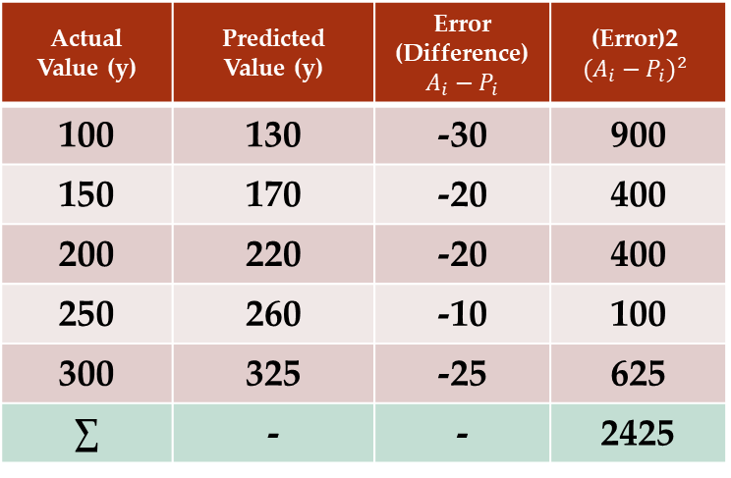
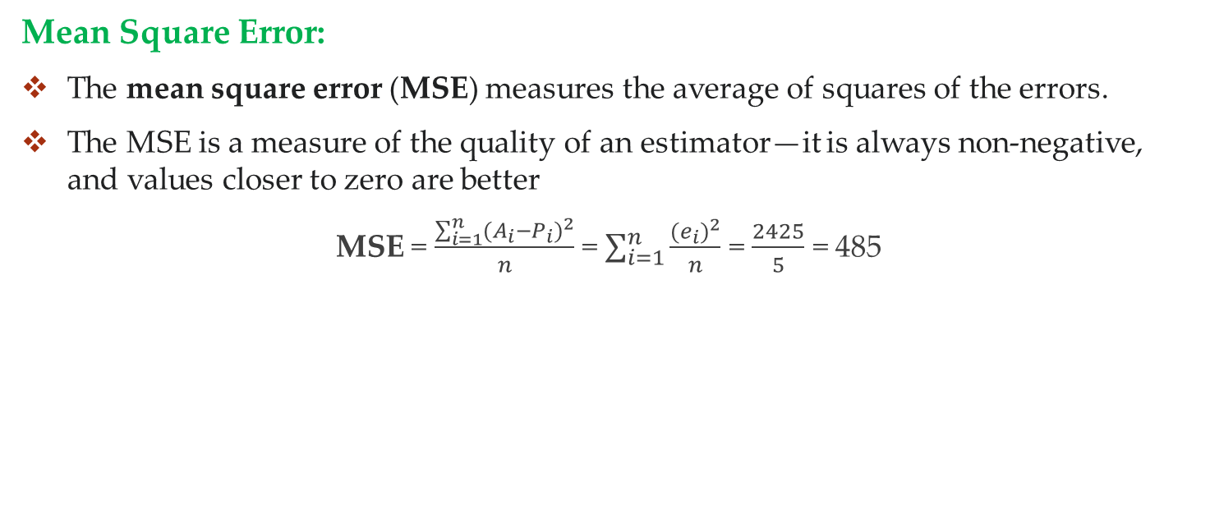

Performance Evaluation Metrics
Mean Square Error:
The mean square error (MSE) measures the average of squares of the errors.
The MSE is a measure of the quality of an estimator—it is always non-negative, and values closer to zero are better
MSE = $\frac{\sum_{i=1}^{n}{{(A_{i}−P_{i})}^{2}}}{n}$ = $\sum_{i=1}^{n}{\frac{{(e_{i})}^{2}}{n}}$ = $\frac{2425}{5}$ = 485
Actual Value (y) | Predicted Value (y) | Error (Difference) $$A_{i}−P_{i}$$ | (Error)2 $${(A_{i}−P_{i})}^{2}$$
100 | 130 | -30 | 900
150 | 170 | -20 | 400
200 | 220 | -20 | 400
250 | 260 | -10 | 100
300 | 325 | -25 | 625
∑ | - | - | 2425
Root Mean Square Error = $\sqrt{MSE}$

Slide 6
Practice

Slide 7
Practice
Actual | Predicted
54 | 35
76 | 46
64 | 24.5
22 | 22
54 | 52
76 | 74
64 | 62
22 | 21
Actual and Predicted values are given, please find the following performance evaluators.
Mean absolute error (MAE),
Mean square error (MSE),
Root mean square error (RMSE)
Explain the following Terms
Predicted
Actual

Slide 8
Classification

Slide 9
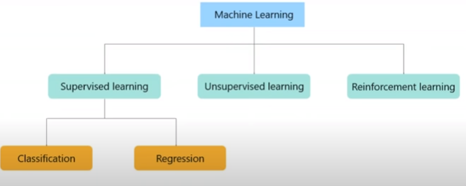
Classification in Supervised Learning
Machine learning algorithms can be divided into different classes based on learning.
Supervised Learning
Unsupervised Learning
Semi-Supervised Learning
Reinforcement Learning
Supervised learning algorithms are used for classification and regression purposes.

Slide 10
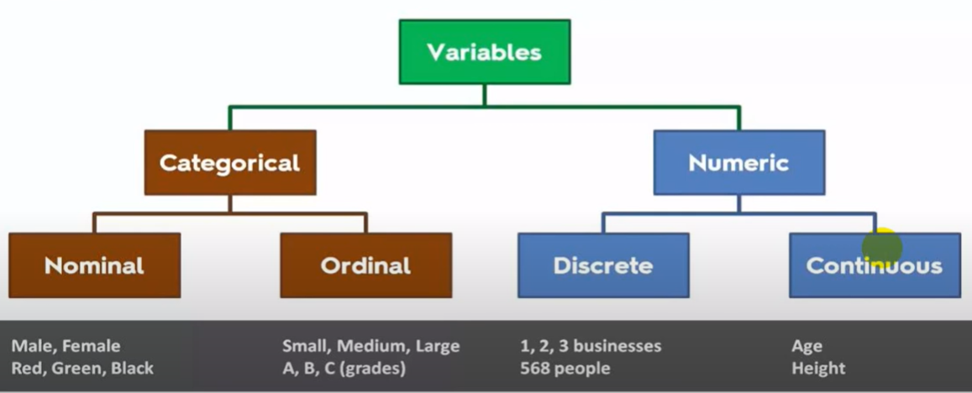
Classification in Supervised Learning
First, we need to understand data and types of data.
Variables are used to store data
According to below figure, the data can be divided into different types
1. Categorical
2. Numerical

Slide 11
Types of Classification
Binary Classification problem: When we have two categories in the output variable/class/depend variable
Multiclass Classification Problem: When we have more than two categories in the output variable/class/depend variable
Input-1 | Input-2 | Input-3 | Input-4 | Class
 |  |  |  | a
 |  |  |  | a
 |  |  |  | b
 |  |  |  | b
 |  |  |  | c
 |  |  |  | c
 |  |  |  | b
 |  |  |  | a
Input-1 | Input-2 | Input-3 | Input-4 | Class
 |  |  |  | a
 |  |  |  | a
 |  |  |  | b
 |  |  |  | b
 |  |  |  | a
 |  |  |  | a
 |  |  |  | b
 |  |  |  | a

Slide 12
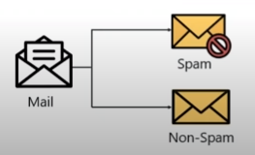

Classification in Supervised Learning
Unlike regression where you predict a continues number, you use classification to predict a category.
There is a wide variety of classification applications from medicine to marketing.
Classification models include linear models like logistic regression, and nonlinear ones K-NN, Kernel SVM and Random Forests.
Learning Classification Models.
Logistic Regression
K-Nearest Neighbors (K-NN)
Support Vector Machine (SVM)
Naive Bayes
Decision Tree Classification
Random Forest Classification

Slide 13
K-NEAREST NEIGHBOR(kNN) CLASSIFICATION ALGORITHM

Slide 14
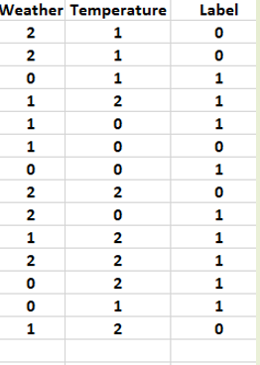
1. K-Nearest Neighbor Classifier
A K-Nearest Neighbor algorithm, often abbreviated K-NN, is an approach to data classification that estimates how likely a data point is to be a member of one group or the other depending on what group the data points nearest to it are in.
The k-nearest-neighbor is an example of a "lazy learner" algorithm, meaning that it does not build a model using the training set.

Slide 15
K-Nearest Neighbor Classifier
Used for classification
The unseen instance is classified based on distance from seen classes of training set
Procedure:
We have a training data set in which classes are known (Labels are given)
We have a new instance with class label unknown
Steps:
Find distance of this unknown class from all the known instances
There are few distance finding methods e.g., Euclidean distance, Manhattan distance or city block distance and maximum dimension distance, etc.
We will use only Euclidean distance for finding the distance between instances

Slide 16
K-Nearest Neighbor Classifier
Why do we need KNN?
How do we choose the factor ‘K’?
When do we use KNN?
How does KNN algorithm work?
Application: Male/Female Classification

Slide 17
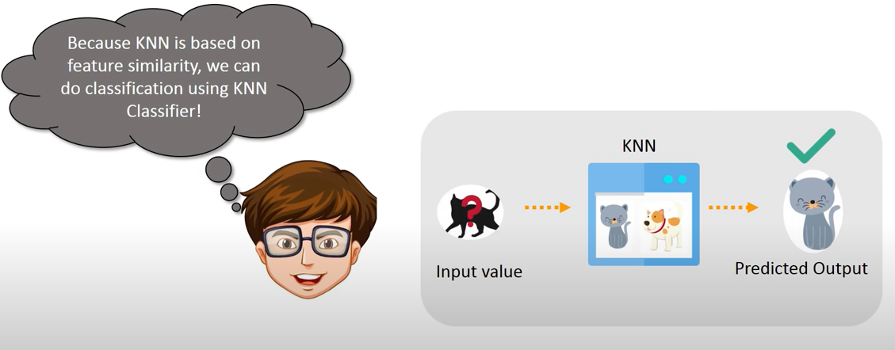
Why KNN?

Slide 18
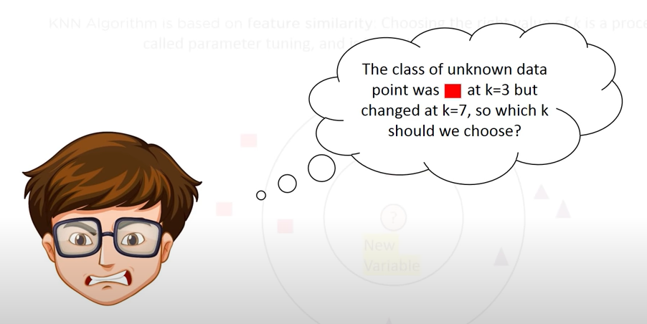
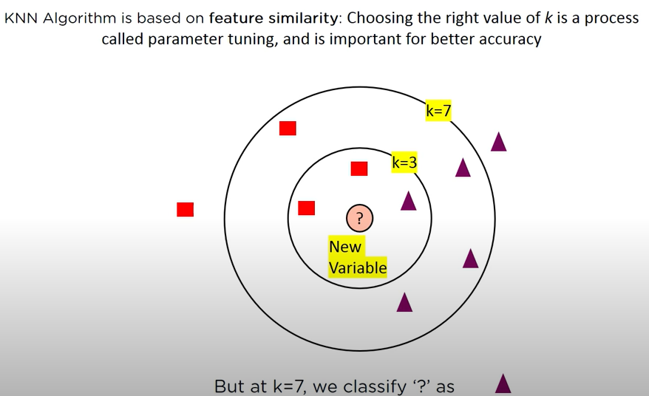
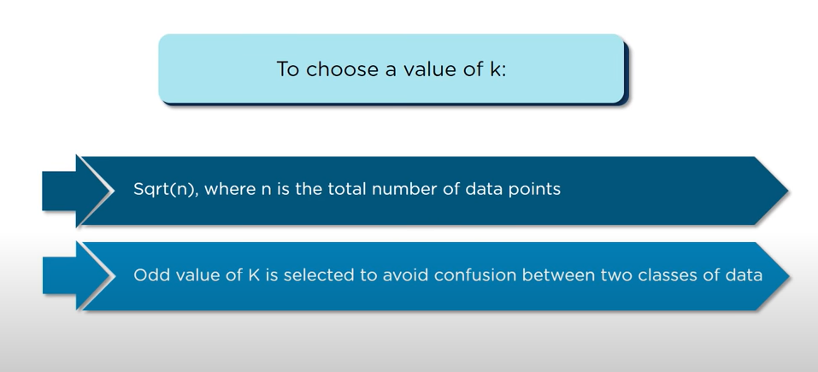
How do we choose the factor ‘k’?

Slide 19
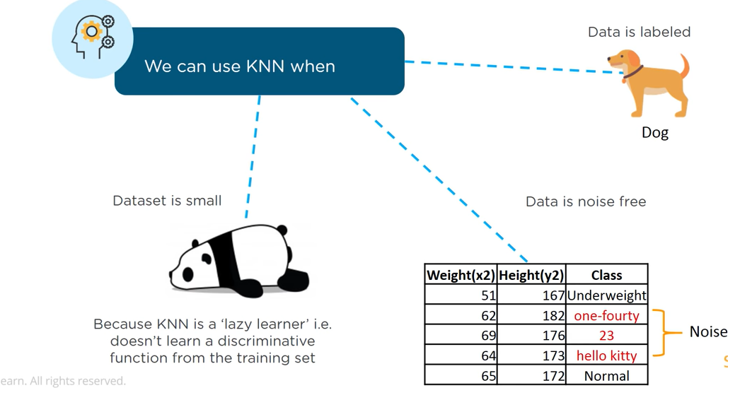
When do we use KNN algorithm?

Slide 20
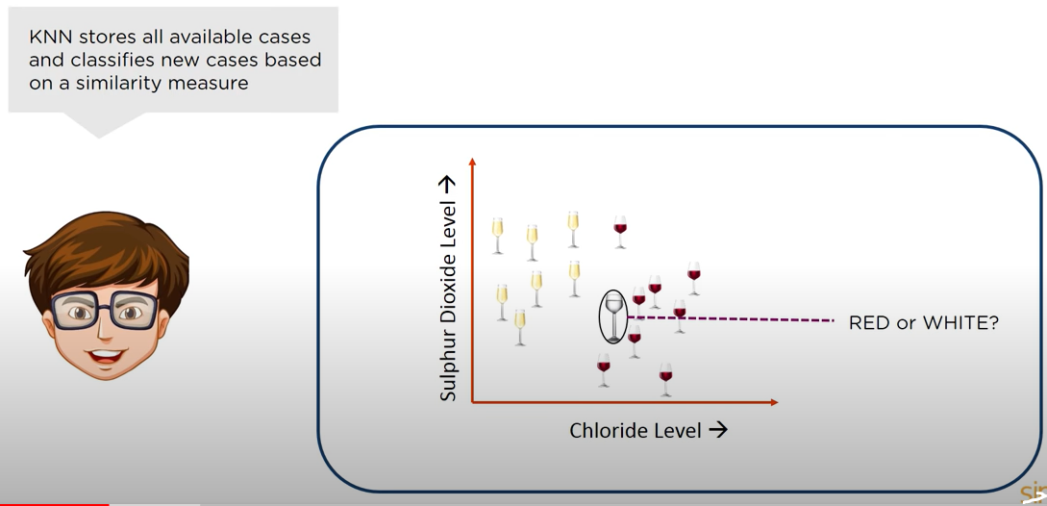
What is KNN Algorithm?

Slide 21
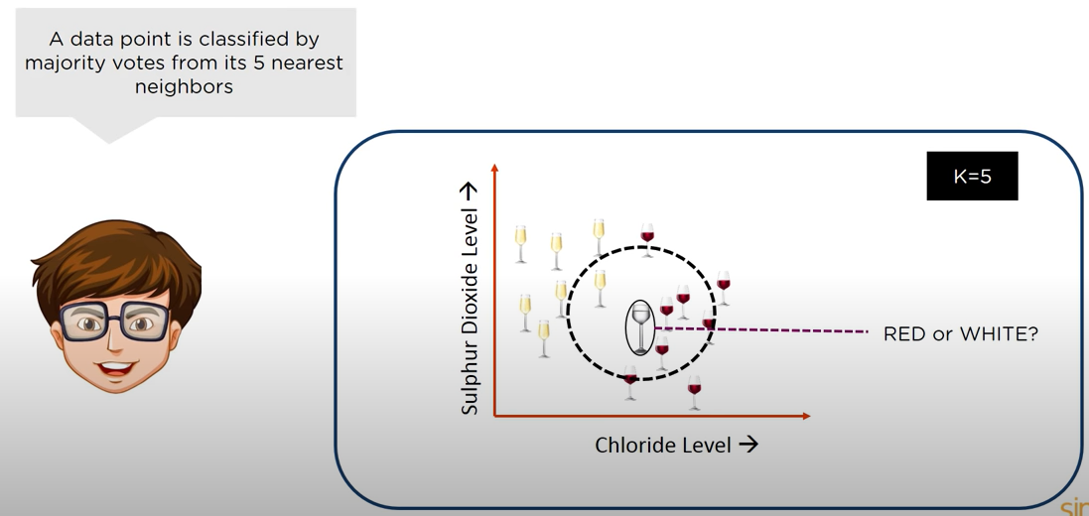
What is KNN Algorithm?

Slide 22
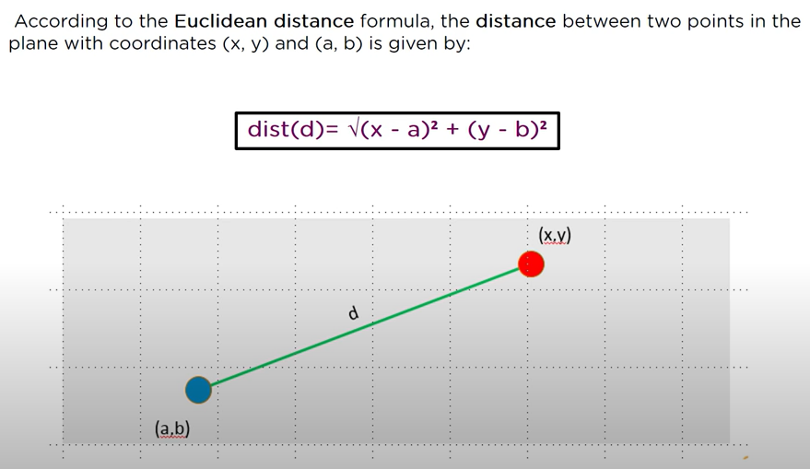
How Does KNN Algorithm Works?

Slide 23
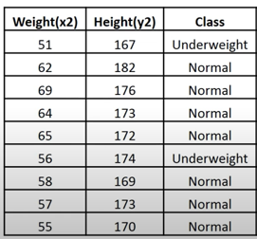
Example 1
57 170 ?

Slide 24
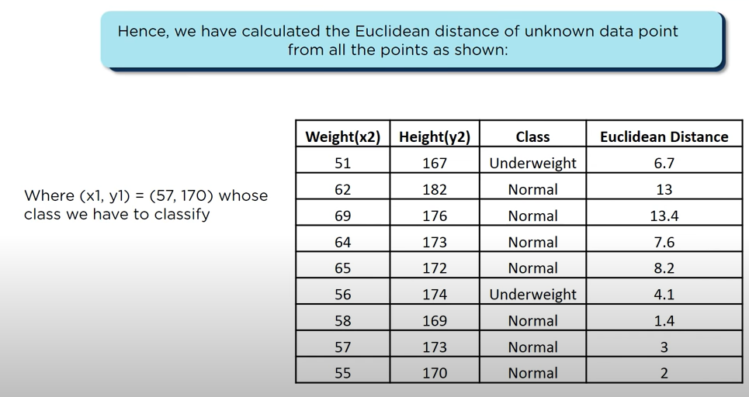
How Does KNN Algorithm Work?
57 170 ?

Slide 25
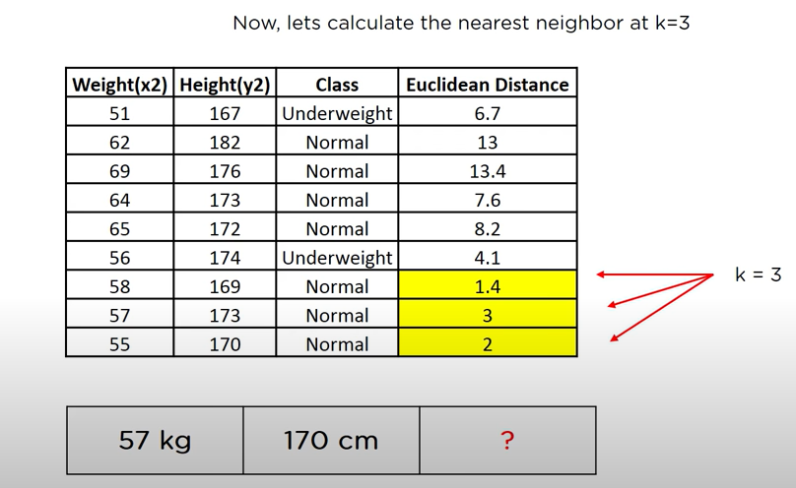
How Does KNN Algorithm Work?

Slide 26
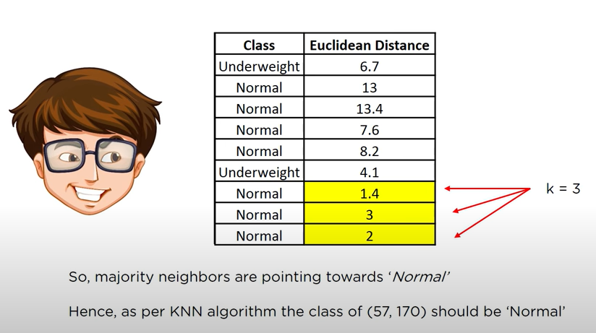
How Does KNN Algorithm Work?

Slide 27
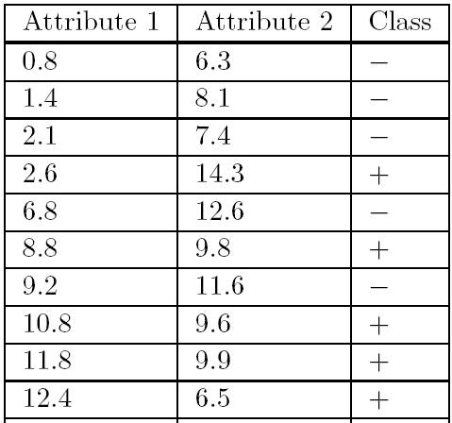

Example 2
We will start by illustrating the formula for Euclidean distance in two dimensions.
If we denote an instance in the training set by (a1, a2)
Unseen instance by (b1, b2)
If there are three variables (a1, a2, a3) and (b1, b2, b3)
If there are n variables (a1, a2, . . . , an) and (b1, b2, . . . , bn)
C1
C2
C3
C4
C5
C6
C7
C8
C9
C10
b1 b2
5 10 ???

Slide 28
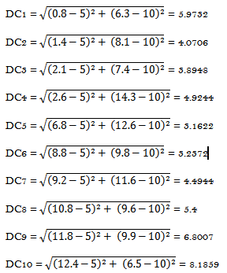
K-Nearest Neighbors Classifier
Step 1: Find Euclidean distance of unseen instance from all the instances
DC1 = = 5.9732
DC2 = = 4.0706
DC3 = = 3.8948
DC4 = = 4.9244
DC5 = = 3.1622
DC6 = = 3.2372
DC7 = = 4.4944
DC8 = = 5.4
DC9 = = 6.8007
DC10 = = 8.1859
Step 2: Specify number of K. Suppose, we take k=3
Step 3: Find 3 (K) records with least distance
These are DC3, DC5, DC6
DC3 = = 3.8948
DC5 = = 3.1622
DC6 = = 3.2372
Step 4: Find class labels of DC3, DC5, DC6
C3 = -
C5 = -
C6 = +
So the new instance will be assigned class – because in K, the classes with – are more than the classes with +
What if K=1?

Slide 29
THANKS

