Slide 1
IMPLEMENTATION OF KNN ALGORITHM, AND PERFORMANCE EVALUATION OF CLASSIFICATION
Lecture# 5
Dr. Muhammad Fayaz

Slide 2
RECAP
Binary Classification
Multiclass Classification
KNN Classifier

Slide 3
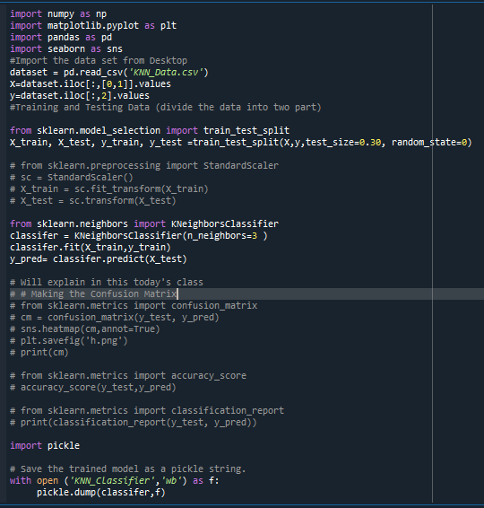
Implementation of KNN Algorithm

Slide 4
PERFORMANCE EVALUATION OF BINARY CLASSIFICATION

Slide 5
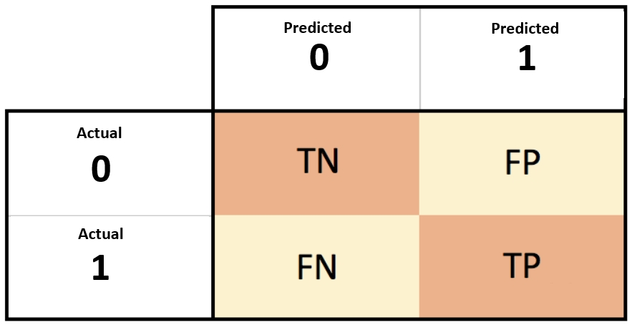
Confusion Matrix
The Confusion matrix is one of the most intuitive and easiest (unless of course, you are not confused)metrics used for finding the correctness and accuracy of the model.
It is used for Classification problem where the output can be of two or more types of classes.

Slide 6
Terms associated with Confusion matrix
Actual | Predicted
1 | 1
1 | 1
0 | 1
0 | 0
1 | 0
1 | 1
True Positive (TP): A true positive is an outcome where the model correctly predicts the positive class
True Negative (TN): A true negative is an outcome where the model correctly predicts the negative class
False Negative (FN): A false negative is an outcome where the model incorrectly predicts the negative class
False Positive (FP): A false negative is an outcome where the model incorrectly predicts the positive class.
Predicted
 | Negative | Positive
Negative | TN | FP
Positive | FN | TP
Predicted
Actual
Actual
Predicted
Output
Actual
1
1
True Positive
Predicted
0
0
True Negative
0 1 | 0 | 1
0 | 1 | 1
1 | 1 | 3
1
0
False Negative
Actual
0
1
False Positive

Slide 7
Terms associated with Confusion matrix
Actual | Predicted
1 | 1
1 | 1
0 | 1
0 | 0
1 | 0
1 | 1
True Positive (TP): 3
True Negative (TN): 1
False Positive (FP): 1
False Negative (FN): 1
Predicted
 | Negative | Positive
Negative | TN | FP
Positive | FN | TP
Predicted
Actual
Actual
Predicted
0 1 | 0 | 1
0 | 1 | 1
1 | 1 | 3
Actual

Slide 8


Accuracy
Accuracy in classification problems is the number of correct predictions made by the model over all kind's predictions made.
Accuracy is a good measure when the target variable classes in the data are nearly balanced.
Accuracy should NEVER be used as a measure when the target variable classes in the data are a majority of one class.

Slide 9

Accuracy
Actual | Predicted
1 | 1
1 | 1
0 | 1
0 | 0
1 | 0
1 | 1
Accuracy = $\frac{\text{3 + 1}}{3+1+1+1}$ = $\frac{4}{6}$
Predicted
 | Negative | Positive
Negative | TN | FP
Positive | FN | TP
Predicted
Actual
Actual
Predicted
0 1 | 0 | 1
0 | 1 | 1
1 | 1 | 3
Actual

Slide 10
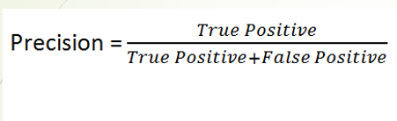

Precision (positive predictive value)
It tells you what fraction of predictions as a positive class were actually positive.
To calculate precision, use the following formula:

Slide 11

Precision (positive predictive value)
Actual | Predicted
1 | 1
1 | 1
0 | 1
0 | 0
1 | 0
1 | 1
True Positive (TP): 3
True Negative (TN): 1
False Positive (FP): 1
Predicted
 | Negative | Positive
Negative | TN | FP
Positive | FN | TP
Predicted
Actual
Actual
Precision = $\frac{\text{3 }}{3+1}$ = $\frac{\text{3}}{4}$
Predicted
0 1 | 0 | 1
0 | 1 | 1
1 | 1 | 3
Actual

Slide 12


Recall
It tells you what fraction of all positive samples were correctly predicted as positive by the classifier.
It is also known as True Positive Rate (TPR), Sensitivity, Probability of Detection.
To calculate Recall, use the following formula

Slide 13

Recall
Actual | Predicted
1 | 1
1 | 1
0 | 1
0 | 0
1 | 0
1 | 1
True Positive (TP): 3
False Negative (FN): 1
Predicted
 | Negative | Positive
Negative | TN | FP
Positive | FN | TP
Predicted
Actual
Actual
Recall = $\frac{\text{3 }}{3+1}$ = $\frac{\text{3}}{4}$
Predicted
0 1 | 0 | 1
0 | 1 | 1
1 | 1 | 3
Actual

Slide 14

Specificity
It tells you what fraction of all negative samples are correctly predicted as negative by the classifier.
It is also known as True Negative Rate (TNR).
To calculate specificity, use the following formula:

Slide 15

Specificity
Actual | Predicted
1 | 1
1 | 1
0 | 1
0 | 0
1 | 0
1 | 1
True Negative (TN): 1
False Positive (FP): 1
Predicted
 | Negative | Positive
Negative | TN | FP
Positive | FN | TP
Predicted
Actual
Actual
Specificity = $\frac{\text{1 }}{1+1}$ = $\frac{\text{1}}{2}$
Predicted
0 1 | 0 | 1
0 | 1 | 1
1 | 1 | 3
Actual

Slide 16
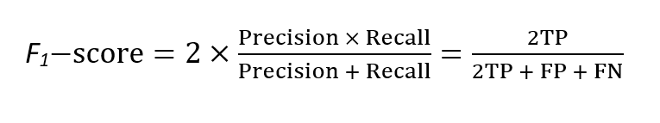
F-Score
It combines precision and recall into a single measure.
It can be calculated as follows:

Slide 17
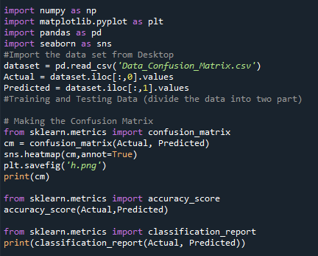
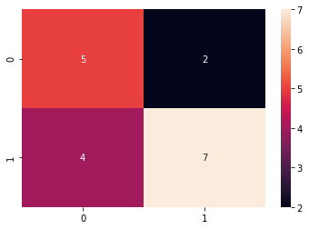
IMPLEMENTATION

Slide 18
Activity
Actual | Predicted
1 | 1
0 | 0
0 | 0
0 | 0
1 | 0
1 | 1
1 | 1
1 | 1
1 | 0
1 | 1
0 | 1
1 | 0
0 | 0
1 | 1
1 | 1
1 | 0
0 | 0
0 | 1
1 | 1
Find Confusion Matrix
True Positive
True Negative
False Positive
False Negative
Accuracy
Precision
Recall
Specificity
F₁-Score

Slide 19
Multiclass Classification
Predicted
 | A | B | C | D
A | AA | AB | AC | AD
B | BA | BB | BC | BD
C | CA | CB | CC | CD
D | DA | DB | DC | DD
True Positive (FP): Sum of Diagonal Values
TP = AA + BB + CC + DD
False Positive (FP): Sum of Values in Corresponding Column (Excluding TP)
FP = (BA + CA + DA) + ( AB + CB + DB )+ (AC + BC + DC )+ (AD + BD + CD)
False Negative (FN): Sum of Values in Corresponding Row (Excluding TP)
FN = (AB + AC + AD) + (BA + BC + BD) + (CA + CB + CD)+ (DA + DB + DC)
True Negative (TN): Sum of All Columns and Rows (Excluding that column’s and row)
TN = (BB + BC + BD + CB+ CC + CD + DB + DC + DD) + (AA + AC + AD + CA + CC + CD + DA + DC + DD ) + ( AA + AB + AD + BA + BB + BD + DA + DB + DD) + (AA, AB, AC + BA + BB + BC + CA + CB + CC)
Actual

Slide 20

Multiclass Classification
Predicted
 | A | B | C
A | AA | AB | AC
B | BA | BB | BC
C | CA | CB | CC
True Positive (TP): Sum of Diagonal Values
${TP}_{2}=$ 23
${TP}_{1}=$ 29
${TP}_{0}=$ 24
${TP}_{overall}=$ 23 + 29 + 24 = 76
Actual
 | 2 | 1 | 0
2 | 23 | 12 | 7
1 | 11 | 29 | 13
0 | 4 | 10 | 24
 | 2 | 1 | 0
2 | 23 | 12 | 7
1 | 11 | 29 | 13
0 | 4 | 10 | 24

Slide 21
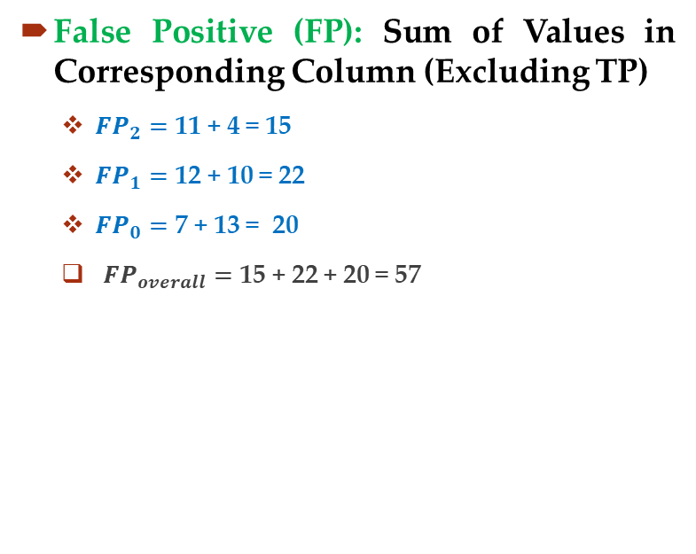
Multiclass Classification
 | A | B | C
A | AA | AB | AC
B | BA | BB | BC
C | CA | CB | CC
False Positive (FP): Sum of Values in Corresponding Column (Excluding TP)
${FP}_{2}=$ 11 + 4 = 15
${FP}_{1}=$ 12 + 10 = 22
${FP}_{0}=$ 7 + 13 = 20
${FP}_{overall}=$ 15 + 22 + 20 = 57
 | 2 | 1 | 0
2 | 23 | 12 | 7
1 | 11 | 29 | 13
0 | 4 | 10 | 24
 | 2 | 1 | 0
2 | 23 | 12 | 7
1 | 11 | 29 | 13
0 | 4 | 10 | 24
 | 2 | 1 | 0
2 | 23 | 12 | 7
1 | 11 | 29 | 13
0 | 4 | 10 | 24
 | 2 | 1 | 0
2 | 23 | 12 | 7
1 | 11 | 29 | 13
0 | 4 | 10 | 24

Slide 22

Multiclass Classification
Predicted
 | A | B | C
A | AA | AB | AC
B | BA | BB | BC
C | CA | CB | CC
False Negative (FN): Sum of Values in Corresponding Row (Excluding TP)
Actual
${FN}_{2}=$ 12 + 7 = 19
${FN}_{1}=$ 11 + 13 = 24
${FN}_{0}=$ 4+ 10 = 14
${FN}_{overall}=$ 19 + 24 + 14 = 57
 | 2 | 1 | 0
2 | 23 | 12 | 7
1 | 11 | 29 | 13
0 | 4 | 10 | 24
 | 2 | 1 | 0
2 | 23 | 12 | 7
1 | 11 | 29 | 13
0 | 4 | 10 | 24
 | 2 | 1 | 0
2 | 23 | 12 | 7
1 | 11 | 29 | 13
0 | 4 | 10 | 24
 | 2 | 1 | 0
2 | 23 | 12 | 7
1 | 11 | 29 | 13
0 | 4 | 10 | 24

Slide 23
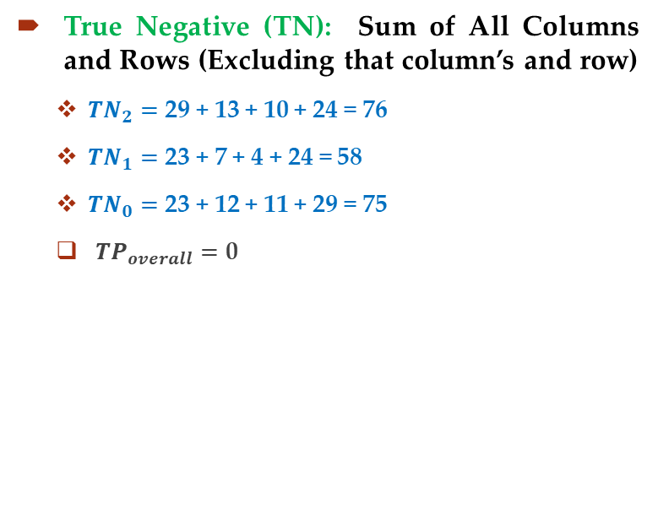
Multiclass Classification
 | A | B | C
A | AA | AB | AC
B | BA | BB | BC
C | CA | CB | CC
True Negative (TN): Sum of All Columns and Rows (Excluding that column’s and row)
${TN}_{2}=$ 29 + 13 + 10 + 24 = 76
${TN}_{1}=$ 23 + 7 + 4 + 24 = 58
${TN}_{0}=$ 23 + 12 + 11 + 29 = 75
${TP}_{overall}=$ 0
 | 2 | 1 | 0
2 | 23 | 12 | 7
1 | 11 | 29 | 13
0 | 4 | 10 | 24
 | 2 | 1 | 0
2 | 23 | 12 | 7
1 | 11 | 29 | 13
0 | 4 | 10 | 24
 | 2 | 1 | 0
2 | 23 | 12 | 7
1 | 11 | 29 | 13
0 | 4 | 10 | 24
 | 2 | 1 | 0
2 | 23 | 12 | 7
1 | 11 | 29 | 13
0 | 4 | 10 | 24

Slide 24
Activity#2
Find Confusion Matrix
True Positive
True Negative
False Positive
False Negative
Accuracy
Precision
Recall
Specificity
F₁-Score

Slide 25
Multiclass Classification
Actual | Predicted
2 | 2
0 | 0
0 | 0
0 | 0
2 | 0
1 | 0
1 | 1
1 | 1
1 | 1
2 | 1
0 | 1
2 | 2
0 | 2
2 | 2
2 | 2
1 | 2
0 | 0
0 | 0
1 | 1
 | A | B | C
A | AA | AB | AC
B | BA | BB | BC
C | CA | CB | CC
True Positive (TP): Sum of Diagonal Values
 | 2 | 1 | 0
2 | 4 | 1 | 1
1 | 1 | 4 | 1
0 | 1 | 1 | 5
 | 2 | 1 | 0
2 | 4 | 1 | 1
1 | 1 | 4 | 1
0 | 1 | 1 | 5

Slide 26
Multiclass Classification
Actual | Predicted
2 | 2
0 | 0
0 | 0
0 | 0
2 | 0
1 | 0
1 | 1
1 | 1
1 | 1
2 | 1
0 | 1
2 | 2
0 | 2
2 | 2
2 | 2
1 | 2
0 | 0
0 | 0
1 | 1
 | A | B | C
A | AA | AB | AC
B | BA | BB | BC
C | CA | CB | CC
False Positive (FP): Sum of Values in Corresponding Column (Excluding TP)
 | 2 | 1 | 0
2 | 4 | 1 | 1
1 | 1 | 4 | 1
0 | 1 | 1 | 5
 | 2 | 1 | 0
2 | 4 | 1 | 1
1 | 1 | 4 | 1
0 | 1 | 1 | 5

Slide 27
Multiclass Classification
Actual | Predicted
2 | 2
0 | 0
0 | 0
0 | 0
2 | 0
1 | 0
1 | 1
1 | 1
1 | 1
2 | 1
0 | 1
2 | 2
0 | 2
2 | 2
2 | 2
1 | 2
0 | 0
0 | 0
1 | 1
 | A | B | C
A | AA | AB | AC
B | BA | BB | BC
C | CA | CB | CC
False Negative (FN): Sum of Values in Corresponding ROW (Excluding TP)
 | 2 | 1 | 0
2 | 4 | 1 | 1
1 | 1 | 4 | 1
0 | 1 | 1 | 5
 | 2 | 1 | 0
2 | 4 | 1 | 1
1 | 1 | 4 | 1
0 | 1 | 1 | 5

Slide 28
Multiclass Classification
Actual | Predicted
2 | 2
0 | 0
0 | 0
0 | 0
2 | 0
1 | 0
1 | 1
1 | 1
1 | 1
2 | 1
0 | 1
2 | 2
0 | 2
2 | 2
2 | 2
1 | 2
0 | 0
0 | 0
1 | 1
 | A | B | C
A | AA | AB | AC
B | BA | BB | BC
C | CA | CB | CC
True Negative (TN): Sum of All Columns and Rows (Excluding that column’s and row)
 | 2 | 1 | 0
2 | 4 | 1 | 1
1 | 1 | 4 | 1
0 | 1 | 1 | 5
 | 2 | 1 | 0
2 | 4 | 1 | 1
1 | 1 | 4 | 1
0 | 1 | 1 | 5
 | 2 | 1 | 0
2 | 4 | 1 | 1
1 | 1 | 4 | 1
0 | 1 | 1 | 5
 | 2 | 1 | 0
2 | 4 | 1 | 1
1 | 1 | 4 | 1
0 | 1 | 1 | 5

