Slide 1
Naive Bayes Classifier
Lecture# 7
Dr. Muhammad Fayaz

Slide 2
RECAP
Multiclass Classification
Binary Classification
Confusion Matrix
True Positive
True Negative
False Positive
False Negative
Accuracy
Precision
Recall
Specificity
F₁-Score

Slide 3
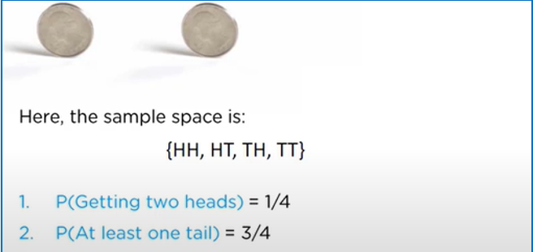
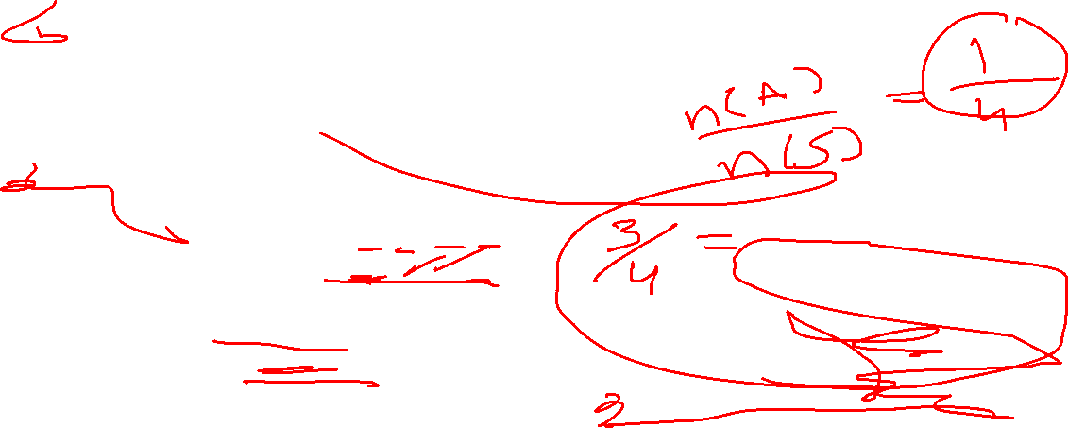
Naive Bayes Classifier
Before we move ahead, let us go through some of the simple concepts in the probability that will be using in this algorithm
Let us considered the following example of tossing two coins

Slide 4
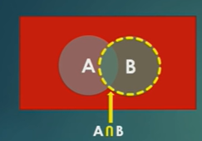
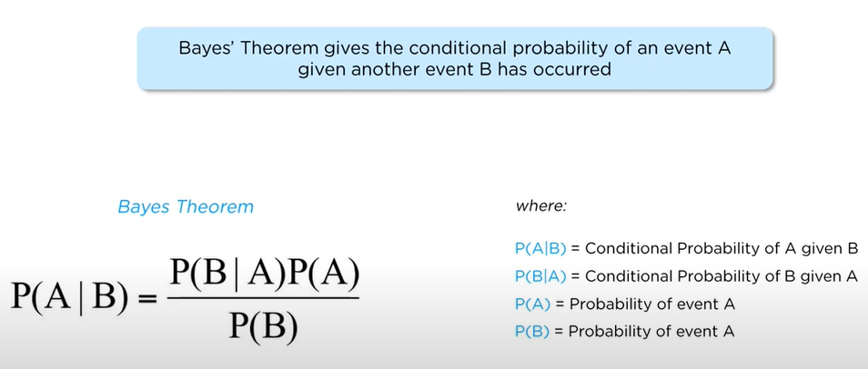

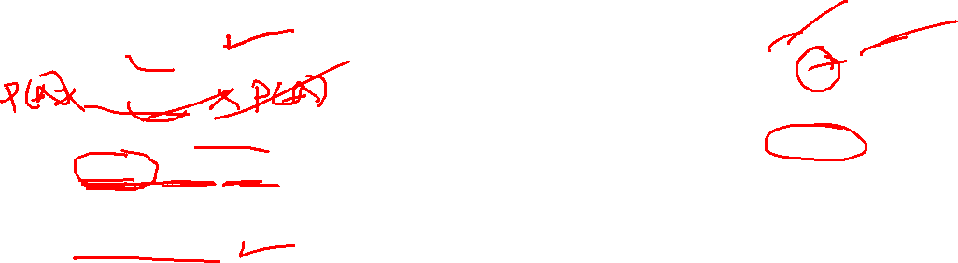
Introduction to Bayes Theorem
P(A|B) = $\frac{P (A⋂B)}{P(B)}$ (1)
P(B|A) = $\frac{P (B\bigcap{A})}{P(A)}$ (2)
P(B|A) $P(A$) = $P (B\bigcap{A})$
P (A$\bigcap{B}$) = P(B|A) $P(A$) (3)
By Putting Equation (3) in (1)
P(A|B)= $\frac{P\left(B|A\right)P(A)}{P(B)}$

Slide 5



Introduction to Bayes Theorem
Let us apply Bayes Theorem to our example
S = {1, 2, 3, 4, 5, 6, 7, 8, 9}
A = {1, 2, 3, 4, 5}
B = {4, 5, 6, 7, 8, 9}
P (A | B) = ?
P(A|B)= $\frac{P\left(B|A\right)P(A)}{P(B)}$
P (A) = $\frac{5}{9}$
P (B) = $\frac{6}{9}$
P (B | A) = $\frac{P (B\bigcap{A}) }{P(A)}$ = $\frac{2}{5}$
P(A|B)= $\frac{\frac{2}{5} × \frac{5}{9}}{\frac{5}{9}}$ = $\frac{1}{3}$
P(A|B) = ?
P(B|A) = $\frac{P (A⋂B)}{P(A)}$ = $\frac{\frac{2}{9} }{\frac{5}{9} }=\frac{2}{5}$
A
B
1, 2,
3
4
5
6 7
8 9

Slide 6

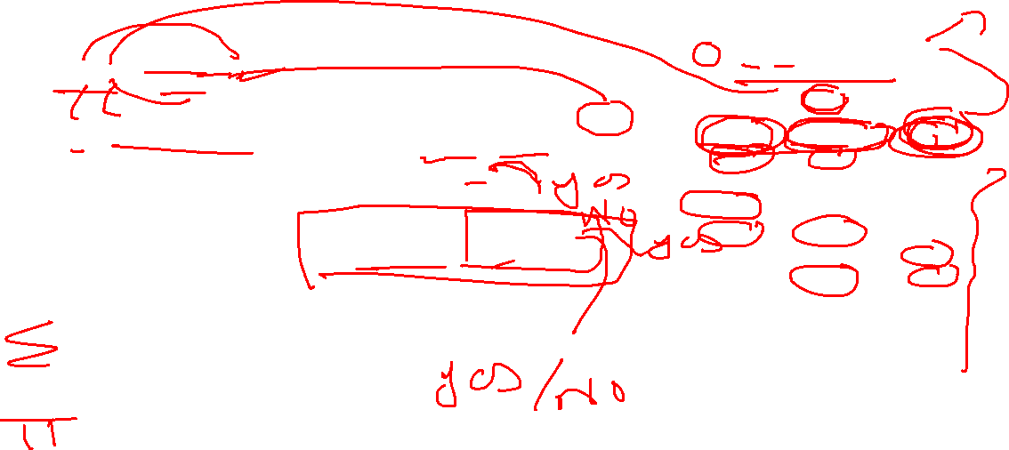
Naïve Bayes Classifier
Dataset
x = {x₁, x₂, x₃, x₄….. x_{n}} {y}
P(A|B)= $\frac{P\left(B|A\right)P(A)}{P(B)}$
P (y | x₁, x₂, x₃, x₄….. x_{n} ) = $\frac{P\left(\text{x}\text{1}|y\right)P\left(\text{x}\text{2}|y\right)P\left(\text{x}3 | y\right)………. P\left(\text{x}\text{n}|y\right)×P(y)}{P\left(\text{x}\text{1}\right)P\left(\text{x}\text{2}\right)P\text{(}\text{x}3)………. P\left(\text{x}\text{n}\right)}$
= $\frac{\text{P}\text{ (}\text{y}\text{)} × \prod_{i=1}^{n}{P\left(\text{x}\text{i}|y\right)}}{\prod_{i=1}^{n}{P\left(\text{x}\text{i}\right)}}$
y = ${argmax}_{y}$( $\frac{P\left(\text{y}\right)\prod_{i=1}^{n}{P\left(\text{x}\text{i}|y\right)}}{\prod_{i=1}^{n}{P\left(\text{x}\text{i}\right)}}$)
B
A
Outlook | Temperature | Play
Sunny | hot | No
sunny | hot | No
overcast | hot | Yes
rainy | mild | Yes
rainy | cool | Yes
rainy | cool | No
overcast | cool | Yes
Sunny | mild | No
Sunny | cool | yes
rainy | mild | yes
Sunny | mild | yes
overcast | mild | yes
overcast | hot | yes
rainy | mild | no
Sunny | hot | ?

Slide 7
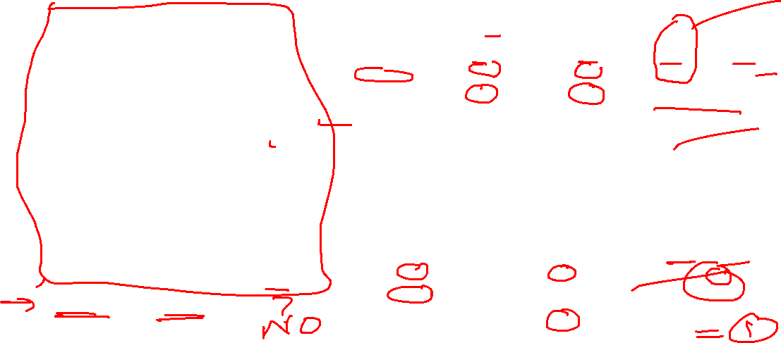
Outlook | Temperature | Play
Sunny | hot | No
sunny | hot | No
overcast | hot | Yes
rainy | mild | Yes
rainy | cool | Yes
rainy | cool | No
overcast | cool | Yes
Sunny | mild | No
Sunny | cool | yes
rainy | mild | yes
Sunny | mild | yes
overcast | mild | yes
overcast | hot | yes
rainy | mild | no
Sunny | hot | ?
Outlook
 | Yes | No | P(Yes) | P(No)
sunny | 2 | 3 | 2/9 | 3/5
overcast | 4 | 0 | 4/9 | 0/5
rainy | 3 | 2 | 3/9 | 2/5
total | 9 | 5 | 100% | 100%
Temperature
 | Yes | No | P(Yes) | P(No)
Hot | 2 | 2 | 2/9 | 2/5
Mild | 4 | 2 | 4/9 | 2/5
Cool | 3 | 1 | 3/9 | 1/5
Total | 9 | 5 | 100% | 100%
Play |  | P(Yes)&P(No)
Yes | 9 | 9/14
No | 5 | 5/14
Total | 14 | 100%
$$\text{P}\text{ (}\text{y}\text{ | }\text{x}\text{1}\text{, }\text{x}\text{2}\text{, }\text{x}\text{3}\text{, }\text{x}\text{4}\text{….. }\text{xn}\text{ )}=\frac{P\left(\text{x}\text{1}|y\right)P\left(\text{x}\text{2}|y\right)P\left(\text{x}3 | y\right)………. P\left(\text{x}\text{n}|y\right)×P(y)}{P\left(\text{x}\text{1}\right)P\left(\text{x}\text{2}\right)P\text{(}\text{x}3)………. P\left(\text{x}\text{n}\right)}$$

Slide 8
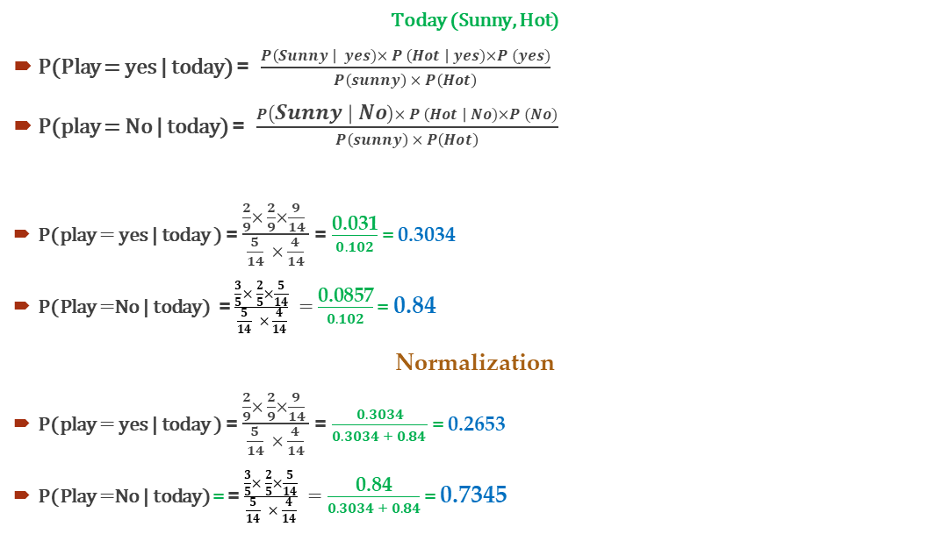
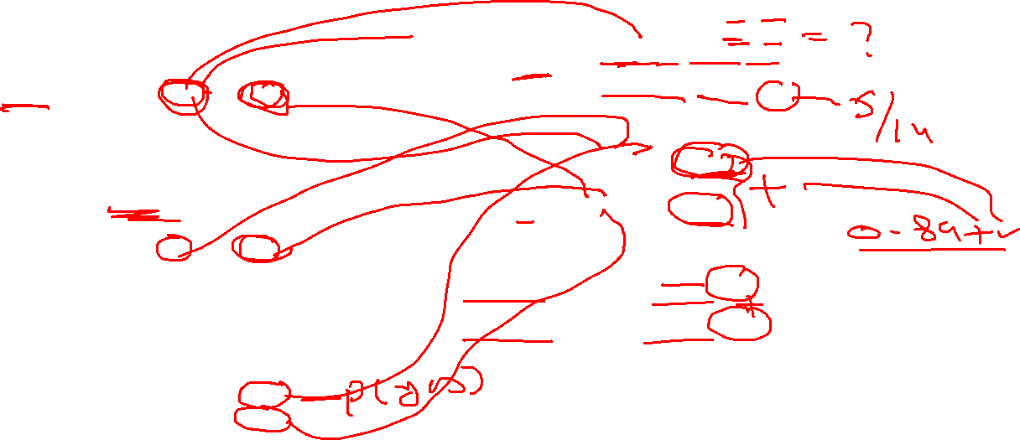
Outlook
 | Yes | No | P(Yes) | P(No) | P(X)
sunny | 2 | 3 | 2/9 | 3/5 | 5/14
overcast | 4 | 0 | 4/9 | 0/5 | 4/14
rainy | 3 | 2 | 3/9 | 2/5 | 5/14
total | 9 | 5 | 100% | 100% | 100%
Today (Sunny, Hot)
P(Play = yes | today) = $\frac{P\left(Sunny \right| yes)× P \left(Hot \right| yes)×P (yes)}{P\left(sunny\right) × P\left(Hot\right)}$
P(play = No | today) = $\frac{P\left(Sunny | No\right)× P \left(Hot \right| No)×P (No)}{P\left(sunny\right) × P\left(Hot\right)}$
P(play = yes | today ) = $\frac{\frac{2}{9}× \frac{2}{9}×\frac{9}{14} }{\frac{5}{14} × \frac{4}{14}}$ = $\frac{\text{0.031}}{0.102}$ = 0.3034
P(Play =No | today) = $\frac{\frac{3}{5}× \frac{2}{5}×\frac{5}{14}}{\frac{5}{14} × \frac{4}{14}} =$ $\frac{\text{0.0857}}{0.102}$ = 0.84
Normalization
P(play = yes | today ) = $\frac{\frac{2}{9}× \frac{2}{9}×\frac{9}{14} }{\frac{5}{14} × \frac{4}{14}}$ = $\frac{0.3034}{0.3034 + 0.84 }$ = 0.2653
P(Play =No | today) = = $\frac{\frac{3}{5}× \frac{2}{5}×\frac{5}{14}}{\frac{5}{14} × \frac{4}{14}} =$ $\frac{\text{0.}\text{84}}{0.3034 + 0.84}$ = 0.7345
Temperature
 | Yes | No | P(Yes) | P(No) | P(X)
Hot | 2 | 2 | 2/9 | 2/5 | 4/14
Mild | 4 | 2 | 4/9 | 2/5 | 6/14
Cool | 3 | 1 | 3/9 | 1/5 | 4/14
Total | 9 | 5 | 100% | 100% | 100%
Play |  | P(Yes) & P(No)
Yes | 9 | 9/14
No | 5 | 5/14
Total | 14 | 100%
0.7345 > 0.2653
So, we can’t play today
$$\text{P}\text{ (}\text{y}\text{ | }\text{x}\text{1}\text{, }\text{x}\text{2}\text{, }\text{x}\text{3}\text{, }\text{x}\text{4}\text{….. }\text{xn}\text{ )}=\frac{P\left(\text{x}\text{1}|y\right)P\left(\text{x}\text{2}|y\right)P\left(\text{x}3 | y\right)………. P\left(\text{x}\text{n}|y\right)×P(y)}{P\left(\text{x}\text{1}\right)P\left(\text{x}\text{2}\right)P\text{(}\text{x}3)………. P\left(\text{x}\text{n}\right)}$$

Slide 9
Example #2
Outlook | Temperature | Humidity | Windy | Play
Sunny | hot | high | false | No
sunny | hot | high | true | No
overcast | hot | high | false | Yes
rainy | mild | high | false | Yes
rainy | cool | normal | false | Yes
rainy | cool | normal | true | No
overcast | cool | normal | true | Yes
Sunny | mild | high | false | No
Sunny | cool | normal | false | Yes
rainy | mild | normal | false | Yes
Sunny | mild | normal | true | Yes
overcast | mild | high | true | Yes
overcast | hot | normal | false | Yes
rainy | mild | high | true | No
Sunny | cool | high | true | ?

Slide 10
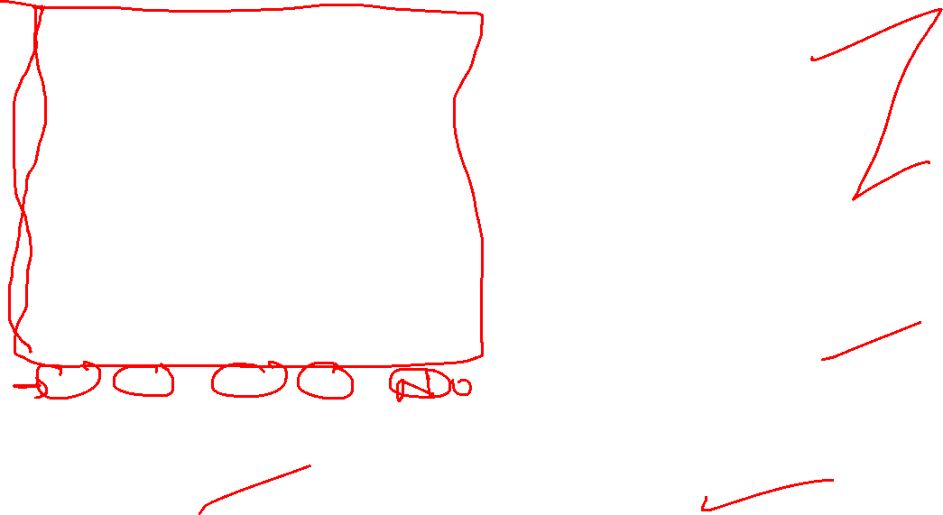
Outlook | Temperature | Humidity | Windy | Play
Sunny | hot | high | false | No
sunny | hot | high | true | No
overcast | hot | high | false | Yes
rainy | mild | high | false | Yes
rainy | cool | normal | false | Yes
rainy | cool | normal | true | No
overcast | cool | normal | true | Yes
Sunny | mild | high | false | No
Sunny | cool | normal | false | yes
rainy | mild | normal | false | yes
Sunny | mild | normal | true | yes
overcast | mild | high | true | yes
overcast | hot | normal | false | yes
rainy | mild | high | true | no
Sunny | cool | high | true | ?
Temperature
 | Yes | No | P(Yes) | P(No) | P(X)
Hot | 2 | 2 | 2/9 | 2/5 | 4/14
Mild | 4 | 2 | 4/9 | 2/5 | 6/14
Cool | 3 | 1 | 3/9 | 1/5 | 4/14
Total | 9 | 5 | 100% | 100% | 100%
Humidity
 | Yes | No | P(Yes) | P(No) | P(X)
High | 3 | 4 | 3/9 | 4/5 | 7/14
Normal | 6 | 1 | 6/9 | 1/5 | 7/14
Total | 9 | 5 | 100% | 100% | 100%
Wind
 | Yes | No | P(Yes) | P(No)
False | 6 | 2 | 6/9 | 2/5
True | 3 | 3 | 3/9 | 3/5
Total | 9 | 5 | 100% | 100%
Outlook
 | Yes | No | P(Yes) | P(No) | P (X)
sunny | 2 | 3 | 2/9 | 3/5 | 5/14
overcast | 4 | 0 | 4/9 | 0/5 | 4/14
rainy | 3 | 2 | 3/9 | 2/5 | 5/14
total | 9 | 5 | 100% | 100% | 100%
Play |  | P(Yes)/P(No)
Yes | 9 | 9/14
No | 5 | 5/14
Total | 14 | 100%

Slide 11
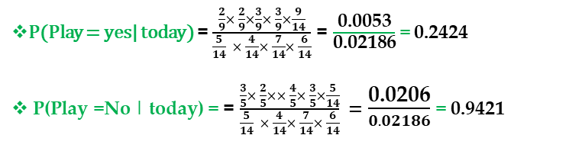
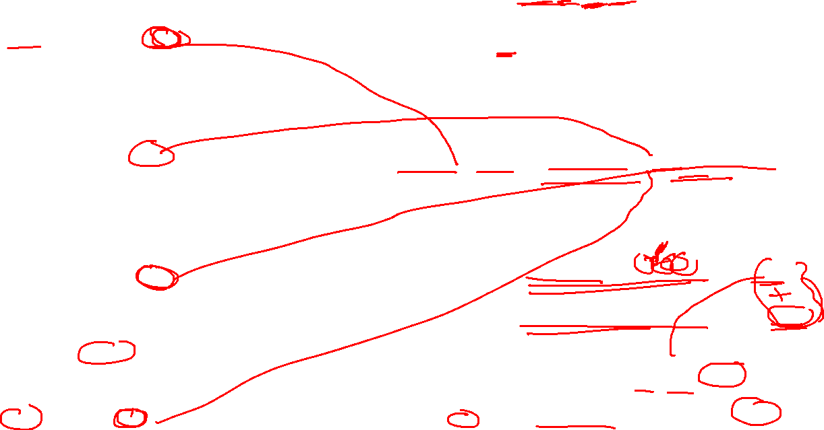
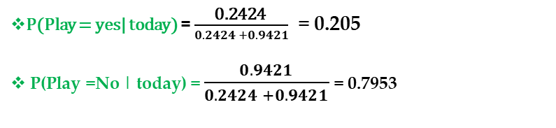
Outlook
 | Yes | No | P(Yes) | P(No) | P (X)
sunny | 2 | 3 | 2/9 | 3/5 | 5/14
overcast | 4 | 0 | 4/9 | 0/5 | 4/14
rainy | 3 | 2 | 3/9 | 2/5 | 5/14
total | 9 | 5 | 100% | 100% | 100%
Today (Sunny, Hot High, True)
Portability that we can play the game:
P(Outlook = Sunny| Play = Yes) = 2/9
P(Temperature = Hot| Play = Yes) = 2/9
P(Humidity = High | Play =Yes) = 3/9
P(Wind = Strong | Play =Yes) =3/9
P(Play = Yes)=9/14
Portability that we can’t play the game:
P(Outlook = Sunny| Play = No) = 3/5
P(Temperature = Hot | Play = No) = 2/5
P(Humidity = High | Play = No) = 4/5
P(Wind = Strong | Play = No) = 3/5
P(Play = No) = 5/14
Temperature
 | Yes | No | P(Yes) | P(No) | P(X)
Hot | 2 | 2 | 2/9 | 2/5 | 4/14
Mild | 4 | 2 | 4/9 | 2/5 | 6/14
Cool | 3 | 1 | 3/9 | 1/5 | 4/14
Total | 9 | 5 | 100% | 100% | 100%
$$\frac{\begin{aligned}P\left(Outlook=Sunny \right|play= yes)× P \left(Temperature=Hot \right|play= yes)×\left(Humidity=High\right|play= yes)× \\ P \left(Wind=Strong \right|play= yes)×P (yes)\end{aligned}}{P\left(outlook=sunny\right) × P\left(Temperature=Hot\right)× P\left(Humidity=High\right)× P\left(Wind=Strong\right)}$$
P(Play = yes | today) =
$$\frac{\begin{aligned}P\left(Outlook=Sunny \right|play=No)× P \left(Temperature=Hot \right|play=No)×\left(Humidity=High \right|play=No)× \\ P \left(Wind=Strong \right|play=No)×P (No)\end{aligned}}{P\left(outlook=sunny\right) × P\left(Temperature=Hot\right)× P\left(Humidity=High\right)× P\left(Wind=Strong\right)}$$
Humidity
 | Yes | No | P(Yes) | P(No) | P(X)
High | 3 | 4 | 3/9 | 4/5 | 7/14
Normal | 6 | 1 | 6/9 | 1/5 | 7/14
Total | 9 | 5 | 100% | 100% | 100%
P(Play = No | today) =
P(Play = yes| today) = $\frac{\frac{2}{9}× \frac{2}{9}×\frac{3}{9}× \frac{3}{9}×\frac{9}{14}}{\frac{5}{14} × \frac{4}{14}× \frac{7}{14}× \frac{6}{14}}$ = $\frac{\text{0.0053}}{\text{0.02186}}$ = 0.2424
P(Play =No | today) = = $\frac{\frac{3}{5}× \frac{2}{5}×× \frac{4}{5}× \frac{3}{5}×\frac{5}{14}}{\frac{5}{14} × \frac{4}{14}× \frac{7}{14}× \frac{6}{14}} =$ $\frac{\text{0.0206}}{0.02186}$ = 0.9421
Normalization
Wind
 | Yes | No | P(Yes) | P(No) | P(X)
False | 6 | 2 | 6/9 | 2/5 | 8/14
True | 3 | 3 | 3/9 | 3/5 | 6/14
Total | 9 | 5 | 100% | 100% | 100%
P(Play = yes| today) = $\frac{\text{0.2424} }{0.2424 +0.9421}$ = 0.205
P(Play =No | today) = $\frac{0.9421}{0.2424 +0.9421}$= 0.7953
Play |  | P(Yes)/P(No)
Yes | 9 | 9/14
No | 5 | 5/14
Total | 14 | 100%
0.79531 > 0.205
So, we can’t play today

Slide 12

Activity#2
Deadline: Sunday (3-10-2021)
Outlook | Temperature | Humidity | Windy | Play
Sunny | hot | high | false | No
sunny | hot | high | true | No
overcast | hot | high | false | Yes
rainy | mild | high | false | Yes
rainy | cool | normal | false | Yes
rainy | cool | normal | true | No
overcast | cool | normal | true | Yes
Sunny | mild | high | false | No
Sunny | cool | normal | false | yes
rainy | mild | normal | false | yes
Sunny | mild | normal | true | yes
overcast | mild | high | true | yes
overcast | hot | normal | false | yes
rainy | mild | high | true | no
rainy | Hot | Normal | false | ?
Rainy | cool | High | True | ?
Upload to Moodle

Slide 13
Multiclass Classification

Slide 14
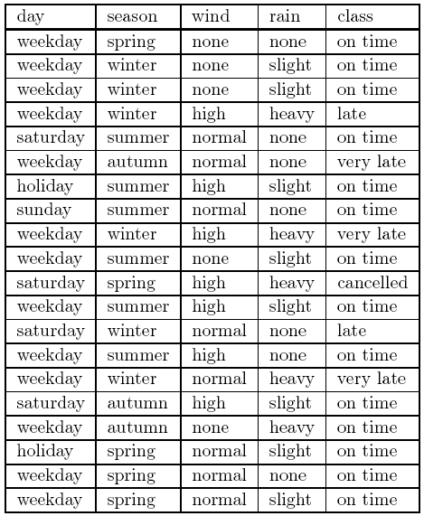
Naïve Bayes Classifier
For classification tasks, the usual terminology is to call a table (dataset)
Each row of the training set is called an instance.
An instance comprises the values of a number of attributes and
The corresponding classification.
Suppose that our training set consists of 20 instances,
each recording the value of four attributes as well as the classification.
cancelled,
very late,
late
on time

Slide 15

Day
 | On time | Late | Very Late | Cancelled | P(on time) | P(late) | P(Very Late) | P(Cancelled)
Weekday | 9 | 1 | 3 | 0 | 9/14 | 1/2 | 3/3 | 0/1
Saturday | 2 | 1 | 0 | 1 | 2/14 | 1/2 | 0/3 | 1/1
Sunday | 1 | 0 | 0 | 0 | 1/14 | 0/2 | 0/3 | 0/1
Holiday | 2 | 0 | 0 | 0 | 2/14 | 0/2 | 0/3 | 0/1
Total | 14 | 2 | 3 | 1 | 100% | 100% | 100% | 100%
Season
 | On time | Late | Very Late | Cancelled | P(on time) | P(late) | P(Very Late) | P(Cancelled)
Spring | 4 | 0 | 0 | 1 | 4/14 | 0/2 | 0/1 | 1/1
Summer | 6 | 0 | 0 | 0 | 6/14 | 0/2 | 0/1 | 0/1
Autumn | 2 | 0 | 1 | 0 | 2/14 | 0/2 | 1/1 | 0/1
Winter | 2 | 2 | 0 | 0 | 2/14 | 2/2 | 0/1 | 0/1
Total | 14 | 2 | 1 | 1 | 100% | 100% | 100% | 100%
Wind
 | On time | Late | Very Late | Cancelled | P(on time) | P(late) | P(Very Late) | P(Cancelled)
None | 5 | 0 | 0 | 0 | 5/14 | 0/2 | 0/3 | 0/1
High | 4 | 1 | 1 | 1 | 4/14 | 1/2 | 1/3 | 1/1
Normal | 5 | 1 | 2 | 0 | 5/14 | 1/2 | 2/3 | 0/1
Total | 14 | 2 | 3 | 1 | 100% | 100% | 100% | 100%

Slide 16
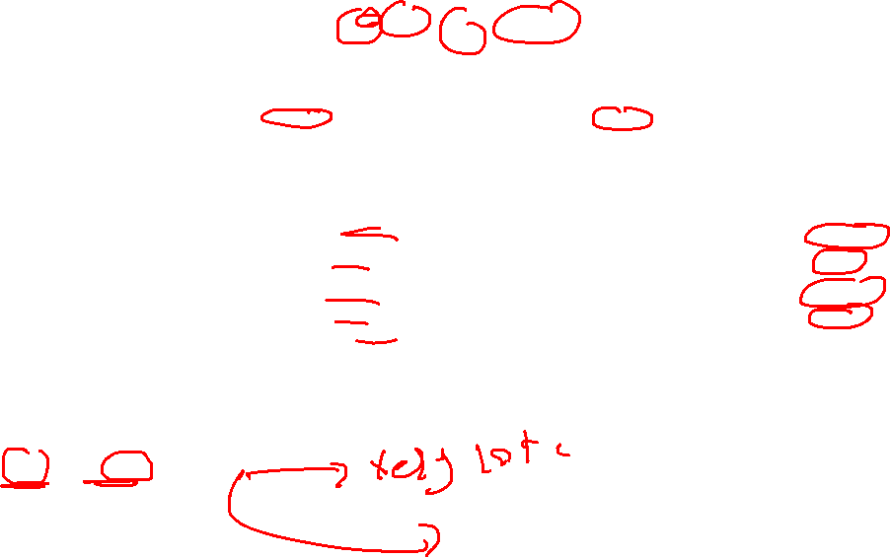
Rainy
 | On time | Late | Very Late | Cancelled | P(on time) | P(late) | P(Very Late) | P(Cancelled) | P(X)
None | 5 | 1 | 0 | 1 | 5/14 | 1/2 | 0/2 | 1/2 | 7/20
Slight | 8 | 0 | 0 | 0 | 8/14 | 0/2 | 0/2 | 0/2 | 8/20
Heavy | 1 | 1 | 2 | 1 | 1/14 | 1/2 | 2/2 | 1/1 | 5/20
Total | 14 | 2 | 2 | 2 | 100% | 100% | 100% | 100% | 100%
Class |  | P(C)/P(Total)))
On time | 14 | 14/20
Late | 2 | 2/20
Very Late | 3 | 3/20
Cancelled | 1 | 1/20
Total | 20 | 100%

Slide 17
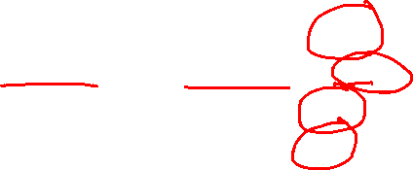
Portability that the class is on time:
P(Day = Weekday| Class = Ontime) = 9/14
P(Season = Winter | Class = Ontime) = 2/14
P(Wind = High | Class = Ontime) = 4/14
P(Rain = Heavy | Class =Ontime) =1/14
P(Class = on Time)=14/20
Portability that the class is Late
P(Day = Weekday| Class = Late) = 1/2
P(Season = Winter | Class = Late) = 2/2
P(Wind = High | Class = Late) = 1/2
P(Rain = Heavy | Class = Late) =1/2
P(Play = Yes)=2/20
Portability that the class is very late:
P(Day = Weekday| Class = very late) = 3/3
P(Season = Winter | Class = very late) = 2/3
P(Wind = High | Class = very late) = 1/3
P(Rain = Heavy | Class = very late) =2/2
P(Play = Yes)=3/20
Portability that the class is cancelled:
P(Day = Weekday| Class = cancelled) = 0/1
P(Season = Winter | Class = cancelled) = 0/1
P(Wind = High | Class = cancelled) = 1/1
P(Rain = Heavy | Class =cancelled) =1/2
P(Play = Yes)=1/20

Slide 18
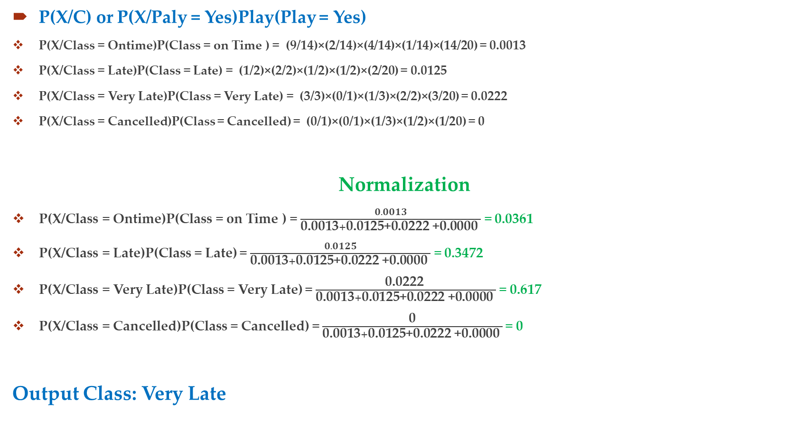
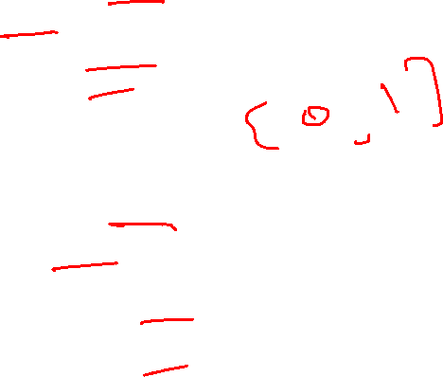
P(X/C) or P(X/Paly = Yes)Play(Play = Yes)
P(X/Class = Ontime)P(Class = on Time ) = (9/14)×(2/14)×(4/14)×(1/14)×(14/20) = 0.0013
P(X/Class = Late)P(Class = Late) = (1/2)×(2/2)×(1/2)×(1/2)×(2/20) = 0.0125
P(X/Class = Very Late)P(Class = Very Late) = (3/3)×(0/1)×(1/3)×(2/2)×(3/20) = 0.0222
P(X/Class = Cancelled)P(Class = Cancelled) = (0/1)×(0/1)×(1/3)×(1/2)×(1/20) = 0
Normalization
P(X/Class = Ontime)P(Class = on Time ) = $\frac{0.0013}{\text{0.0013}+\text{0.0125}\text{+}\text{0.0222}\text{ +}\text{0.0000 }}$ = 0.0361
P(X/Class = Late)P(Class = Late) = $\frac{0.0125}{\text{0.0013}+\text{0.0125}\text{+}\text{0.0222}\text{ +}\text{0.0000 }}$ = 0.3472
P(X/Class = Very Late)P(Class = Very Late) = $\frac{\text{0.0222} }{\text{0.0013}+\text{0.0125}\text{+}\text{0.0222}\text{ +}\text{0.0000 }}$ = 0.617
P(X/Class = Cancelled)P(Class = Cancelled) = $\frac{\text{0}}{\text{0.0013}+\text{0.0125}\text{+}\text{0.0222}\text{ +}\text{0.0000 }}$= 0
Output Class: Very Late

Slide 19
Thanks

Slide 20
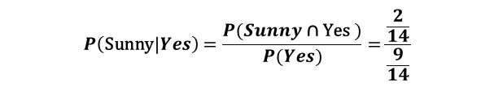

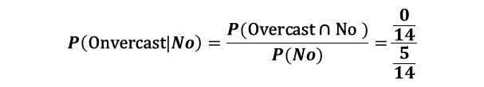
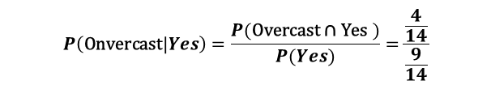

Appendix
$$P\left(\text{Sunny}|Yes\right)=\frac{P(Sunny \text{∩} \text{Yes} )}{P(Yes)}=\frac{\frac{2}{14}}{\frac{9}{14}}$$
P(A|B) = $\frac{P (A⋂B)}{P(B)}$
$$P\left(\text{Sunny}|No\right)=\frac{P(Sunny \text{∩} \text{No} )}{P(No)}=\frac{\frac{3}{14}}{\frac{5}{14}}$$
Outlook
 | Yes | No | P(O/Y) | P(O/N)
sunny | 2 | 3 | 2/9 | 3/5
overcast | 4 | 0 | 4/9 | 0/5
rainy | 3 | 2 | 3/9 | 2/5
total | 9 | 5 | 100% | 100%
Outlook | Temperature | Play
Sunny | hot | No
sunny | hot | No
overcast | hot | Yes
rainy | mild | Yes
rainy | cool | Yes
rainy | cool | No
overcast | cool | Yes
Sunny | mild | No
Sunny | cool | yes
rainy | mild | yes
Sunny | mild | yes
overcast | mild | yes
overcast | hot | yes
rainy | mild | no
Sunny | hot | ?
$$P\left(\text{Onvercast}|Yes\right)=\frac{P(\text{Overcast}\text{ ∩ }\text{Yes} )}{P(Yes)}=\frac{\frac{4}{14}}{\frac{9}{14}}$$
$$P\left(\text{Onvercast}|No\right)=\frac{P(\text{Overcast}\text{ ∩ }\text{No} )}{P(No)}=\frac{\frac{0}{14}}{\frac{5}{14}}$$
Temperature
 | Yes | No | P(Yes) | P(No)
Hot | 2 | 2 | 2/9 | 2/5
Mild | 4 | 2 | 4/9 | 2/5
Cool | 3 | 1 | 3/9 | 1/5
Total | 9 | 5 | 100% | 100%
Play |  | P(Yes)&P(No)
Yes | 9 | 9/14
No | 5 | 5/14
Total | 14 | 100%
$$\text{P}\text{ (}\text{y}\text{ | }\text{x}\text{1}\text{, }\text{x}\text{2}\text{, }\text{x}\text{3}\text{, }\text{x}\text{4}\text{….. }\text{xn}\text{ )}=\frac{P\left(\text{x}\text{1}|y\right)P\left(\text{x}\text{2}|y\right)P\left(\text{x}3 | y\right)………. P\left(\text{x}\text{n}|y\right)×P(y)}{P\left(\text{x}\text{1}\right)P\left(\text{x}\text{2}\right)P\text{(}\text{x}3)………. P\left(\text{x}\text{n}\right)}$$

