Slide 1
Logistic Regression and Random Forest Classifiers
Lecture# 09
Dr. Muhammad Fayaz

Slide 2
Revision and Comparative Analysis of Different Algorithms

Slide 3
Recap
Classification: Target(dependent) variable is categorical
Example: Gender Classification , Diseases classification, etc.
Regression: Target (dependent) variable is continuous
Example: Weight, Price
Optimization: Optimization is the process of finding the best solution in all feasible solutions.
Example: Shortest Path, etc.

Slide 4
Simple Linear Regression
Simple Linear Regression is a statistical method that allows us to summarize and study relationship between two continuous (quantitative) variables.
It estimate the relationship between dependent (target) and independent variable (predictor)
Given an input x we would like to compute an output y
For example:
- Predict height from age
- Predict Google’s price from Yahoo’s price
- Predict distance from wall from sensors

Slide 5
The Multiple Linear Regression Model
Regression applications in which there are several independent variables, x₁, x₂, … , x_{k} .
A multiple linear regression model with p independent variables has the equation
β_{i} is the intercept and β_{i} determines the contribution of the independent variable x_{i}
The ε is a random variable

Slide 6
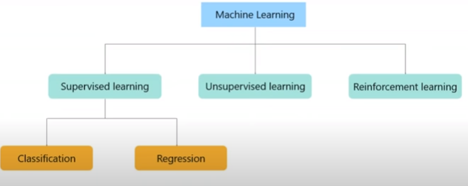
Classification in Supervised Learning
The machine learning algorithms can be divided in different classes based on the learning process.
Supervised Learning
Unsupervised Learning
Reinforcement Learning
The supervised learning can be further divided into classification and regression classes.

Slide 7
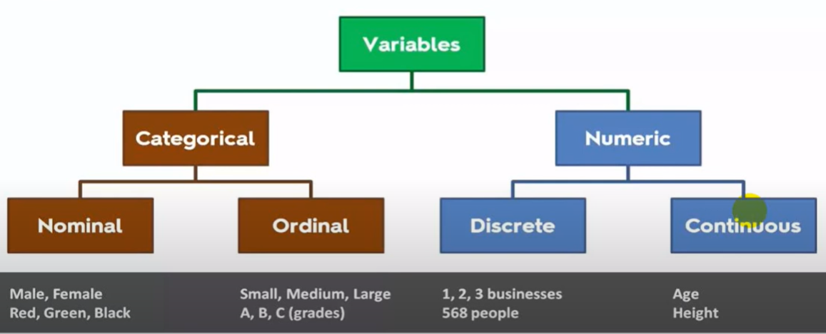
Classification in Supervised Learning
First, we need to understand what is data and what its types
Variables are used to store the data
According to below figure the data can be divided into different types
1. Categorical
2. Numerical

Slide 8
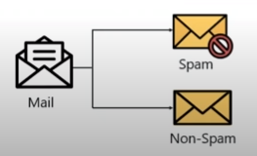

Classification in Supervised Learning
Unlike regression where you predict a continues number, you use classification to predict a category.
There is a wide variety of classification applications from medicine to marketing.
Classification models include linear models like logistic regression, and nonlinear ones K-NN, Kernel SVM and Random Forests.
Logistic Regression
K-Nearest Neighbors (K-NN)
Support Vector Machine (SVM)
Naive Bayes
Decision Tree Classification
Random Forest Classification

Slide 9
Comparative Analysis of Different Machine Learning Algorithms
Linear Regression
Usage Scenario:
1. Linear relationship between independent and dependent variables
2. Regression
Performance: Performs better when data is less
Application: Salary, etc.
Advantage
Simple
Fast
Disadvantage
Applicable only if the solution in linear, In many real life scenarios,
it may not be the case.

Slide 10
Linear Regression
Usage Scenario:
1. Linear relationship between independent and dependent variables
2. Regression
Advantage
Simple
Fast
Disadvantage
Applicable only if the solution in linear, In many real life scenarios,
it may not be the case.

Slide 11
KNN Algorithm
Usage Scenarios:
1. Nonlinear relationship between independent and dependent variables
2. Regression/Classification
Advantage
Simple
Perform better on less data
Disadvantage
Selection of K
Slow

Slide 12
Decision Tree
Usage Scenarios:
1. Non linear relationship between independent and dependent variables
2. Regression/Classification
Advantage
No preprocessing is required
Perform better on large dataset
Disadvantage
Overfitting
Not suitable for complex dataset

Slide 13
Logistic Regression
Usage Scenarios:
1. Nonlinear relationship between independent and dependent variables
2. Classification
Advantage
Easy
Fast
Can be used for multiclass classification problem
Perform better on large dataset
Disadvantage
Cannot be applied on non-linear classification problems

Slide 14
Naïve Bayes
Usage Scenarios:
1. Nonlinear relationship between independent and dependent variables
2. Classification
Advantage
Perform well on less data
Handle irrelevant features
Support binary and multiclass classification problems
Disadvantage
Expects the features to be strictly independent to each other, which is not applicable in real life scenarios.

Slide 15
Random Forest
Usage Scenarios:
1. Small Data
2. Complex data
Advantage
Accuracy
Can handle complex relationship
Disadvantage
Slow
Good choice on small amount of data

Slide 16
Logistic Regression

Slide 17
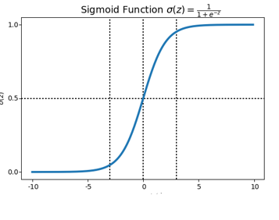

Sigmoid Function
A sigmoid function is a mathematical function having a characteristic "S"-shaped curve or sigmoid curve.
Sigmoid functions most often show a return value (y axis) in the range 0 to 1
Always Positive
Bounded
Strictly Increasing

Slide 18
Sigmoid Function
Let x = 0.3775
Apply Activation Function (Sigmoid)
Sigmoid = 1/(1+e^{-x} )
Sigmoid = 1/(1+ 2.71828 ^{-0.3775} )
Sigmoid = 0.396

Slide 19
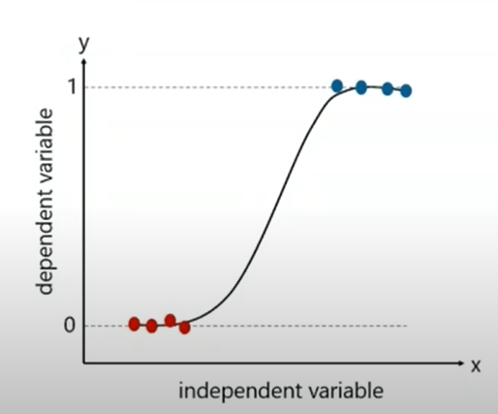
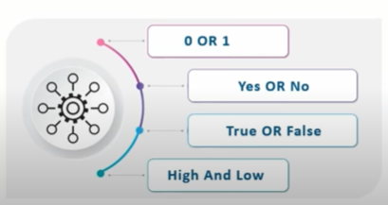
Logistic Regression
Logistic Regression produces results in a binary format which is used to predict the outcome of a categorical dependent variable. So, the output should be categorical such as:
In logistic regression the dependent variable is categorical, like 0 or 1, Yes or No, A, B or C.

Slide 20
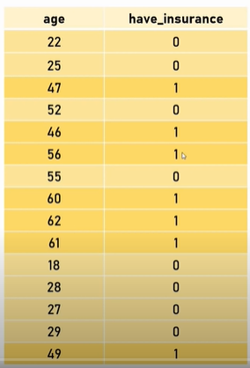
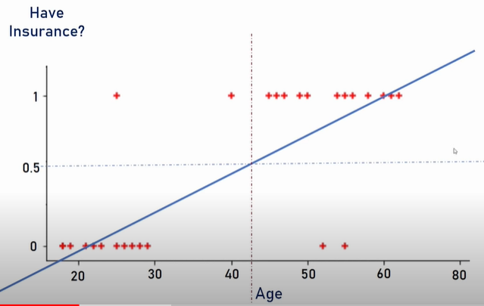
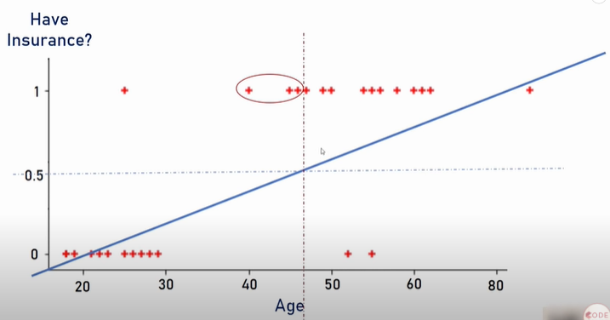
Logistic Regression
Is it a classification algorithm?
So why is it called regression?
If we see the dataset some values are presented on 1 line and some are presented on 0 line
Now we need to draw a line which is called a best fitted line
If I draw a line just like Linear Regression so the center line will be useless
If we predict by using the linear regression so the prediction accuracy will be very bad
In order to remove this problem the sigmoid function is used.

Slide 21
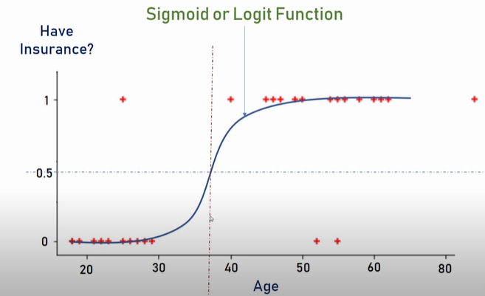
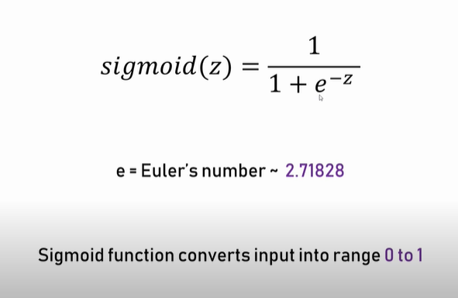
Logistic Regression
If we draw an S shape line then the situation will be better
You can clearly say that this model is far better than linear regression model

Slide 22
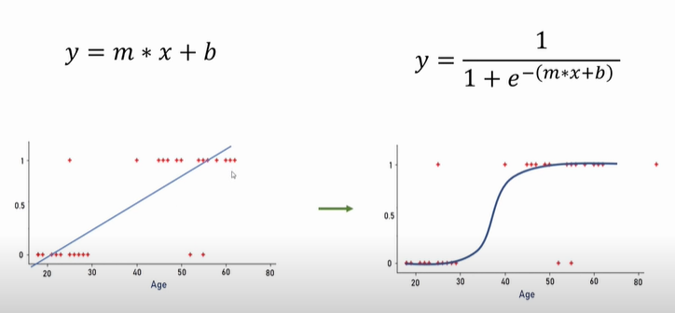
Logistic Regression
If we draw an S shape line the situation will be better
You can clearly say that this model is far better than linear regression model

Slide 23
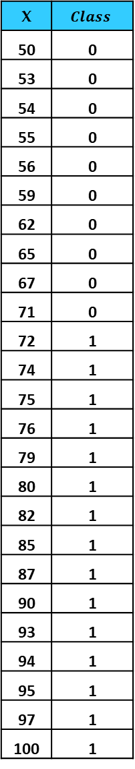
Example
X | $$Class$$
50 | 0
53 | 0
54 | 0
55 | 0
56 | 0
59 | 0
62 | 0
65 | 0
67 | 0
71 | 0
72 | 1
74 | 1
75 | 1
76 | 1
79 | 1
80 | 1
82 | 1
85 | 1
87 | 1
90 | 1
93 | 1
94 | 1
95 | 1
97 | 1
100 | 1

Slide 24


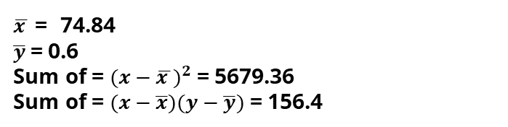
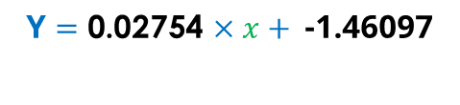
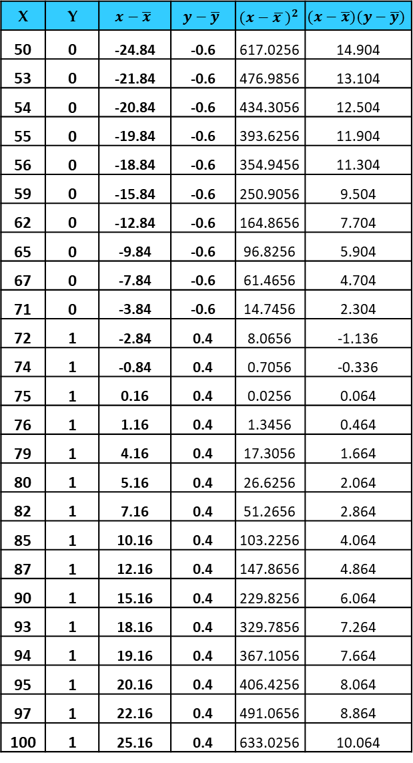
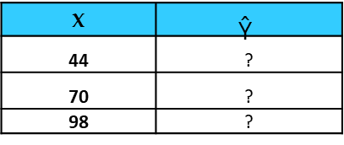
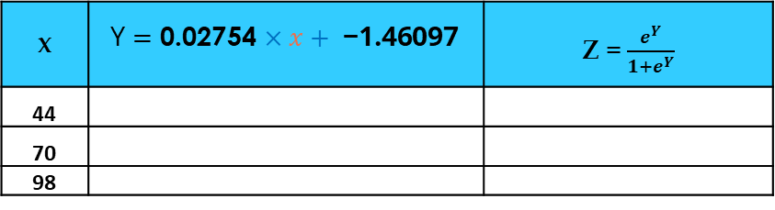




Example
X | Y | $$x−\overline{x}$$ | $$y−\overline{y}$$ | $${(x−\overline{x })}^{2}$$ | $$(x−\overline{x})(y−\overline{y})$$
50 | 0 | -24.84 | -0.6 | 617.0256 | 14.904
53 | 0 | -21.84 | -0.6 | 476.9856 | 13.104
54 | 0 | -20.84 | -0.6 | 434.3056 | 12.504
55 | 0 | -19.84 | -0.6 | 393.6256 | 11.904
56 | 0 | -18.84 | -0.6 | 354.9456 | 11.304
59 | 0 | -15.84 | -0.6 | 250.9056 | 9.504
62 | 0 | -12.84 | -0.6 | 164.8656 | 7.704
65 | 0 | -9.84 | -0.6 | 96.8256 | 5.904
67 | 0 | -7.84 | -0.6 | 61.4656 | 4.704
71 | 0 | -3.84 | -0.6 | 14.7456 | 2.304
72 | 1 | -2.84 | 0.4 | 8.0656 | -1.136
74 | 1 | -0.84 | 0.4 | 0.7056 | -0.336
75 | 1 | 0.16 | 0.4 | 0.0256 | 0.064
76 | 1 | 1.16 | 0.4 | 1.3456 | 0.464
79 | 1 | 4.16 | 0.4 | 17.3056 | 1.664
80 | 1 | 5.16 | 0.4 | 26.6256 | 2.064
82 | 1 | 7.16 | 0.4 | 51.2656 | 2.864
85 | 1 | 10.16 | 0.4 | 103.2256 | 4.064
87 | 1 | 12.16 | 0.4 | 147.8656 | 4.864
90 | 1 | 15.16 | 0.4 | 229.8256 | 6.064
93 | 1 | 18.16 | 0.4 | 329.7856 | 7.264
94 | 1 | 19.16 | 0.4 | 367.1056 | 7.664
95 | 1 | 20.16 | 0.4 | 406.4256 | 8.064
97 | 1 | 22.16 | 0.4 | 491.0656 | 8.864
100 | 1 | 25.16 | 0.4 | 633.0256 | 10.064
$$\text{Y}=mx+c$$
$\overline{x }$= 74.84 $\overline{y}$= 0.6 Sum of = ${(x−\overline{x })}^{2}$= 5679.36 Sum of = $(x−\overline{x})(y−\overline{y})$ = 156.4
$$m=\sum{\frac{(x−\overline{x})(y−\overline{y})}{{(x−\overline{x })}^{2}}}$$
$$= \frac{\text{156.4}}{\text{ 5679.36}}$$
$$\text{Y}=\text{0.02754}×x+ \text{−1.46097}$$
$$=$$
$$\text{0.02754}$$
X | $$\text{Ŷ}$$
44 | ?
70 | ?
98 | ?
c = $\overline{y}−m\overline{x}$
c = 0.6 - (0.03*74.84) = -1.46097
X | $$\text{Y}=\text{0.02754}×x+ \text{−1.46097}$$ | Z = $\frac{e^{Y}}{1+e^{Y}}$
44
70
98

Slide 25
Random Forest Algorithm

Slide 26
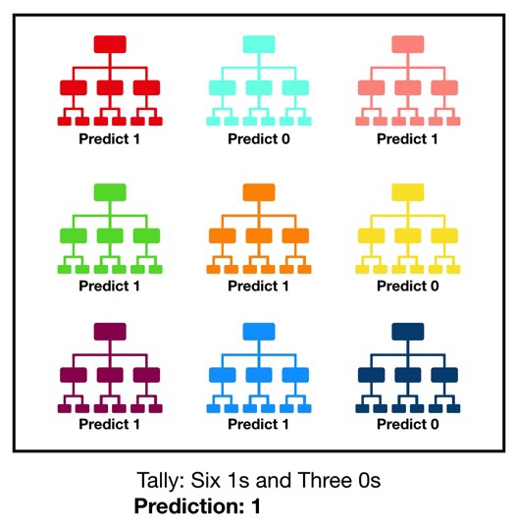
Random Forest Classifier
Random forest (RF) can be made in two ways
Randomly taking subsets from the whole data set and developing trees from all subsets (In previous data set, 26 records)
Randomly taking features from all the features set and developing trees from all set of features (In previous data set, there are 2 features)
In both cases, each tree separately decides the class of new sample
The final class will be that class for which majority of trees recommend that class
In order to understand the two scenarios, suppose we have a data set of 600 records which are made of 30 features
In case of 1st scenario, we can e.g. develop 6 trees each consists of 100 random records
In case of 2nd scenario, we can e.g. develop 6 trees each consists of 5 random features

Slide 27
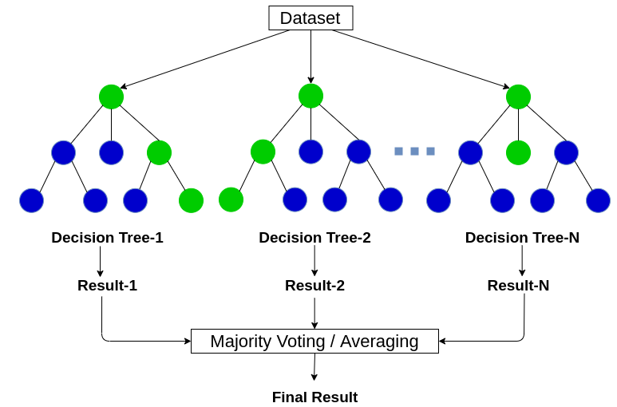
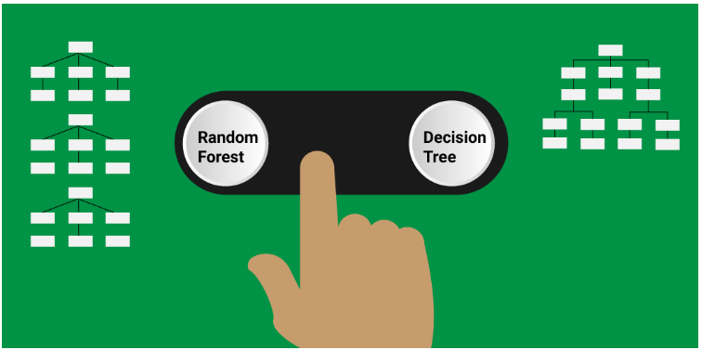
Random Forest Classifier
Data set can be divided randomly by
Respective to records
Respective to features
This process of combining the output of multiple individual models (also known as weak learners) is called Ensemble Learning.

Slide 28
Revision
Supervised Learning
Training Data
Testing Data,
Classification
Binary Classification
Multiclass Classification
Regression
Performance Evaluators for Classification
Performance Evaluation for Regression

Slide 30
Assignment

Slide 31
Thanks

