Slide 1
Artificial Neural Network Lecture#12 Dr. Muhammad Fayaz

Slide 2
Contents
Neural Network
Biological Neural System
Architecture of Neural Network
Feed Forward Neural Networks
Internal Structure of The Neural Network
Input Layer
Artificial Neural Network
Information processing in a neural network
Single Layer Neural Network
Multiple Layer Neural Network
Hidden Layers
Neurons, etc.
Examples
Map Images to Input Layer
Solve Activation Functions
Solved Examples on Neural Network

Slide 3
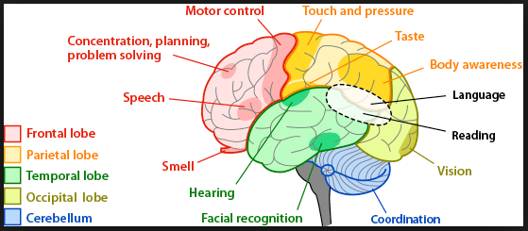
Artificial Neural Network
Human brain
The brain is a complex, nonlinear and parallel computer.
ability to perform tasks such as pattern recognition, perception and control much faster than any computer
In addition to these characteristics, others such as the ability to learn, memorize and generalize,
Algorithmic modeling of biological neural systems - referred to as artificial neural networks (ANN).
Developed in 50s
One of the oldest techniques
Is considered as the foundation of AI and ML
There are more than 30 different variants

Slide 4
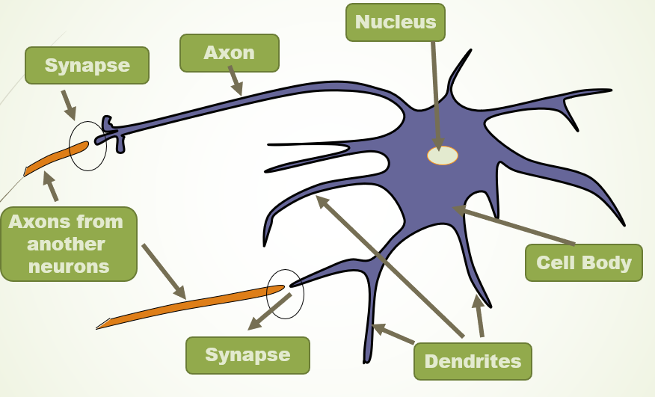
Artificial Neural Network
Neuron
The basic building blocks of biological neural systems are nerve cells, referred to as neurons.
It is estimated that there is in the order of 10-500 billion neurons in the human cortex, with 60 trillion synapses.
The neurons are arranged in approximately 1000 main modules, each having about 500 neural networks.
A neuron consists of a cell body, dendrites and an axon.
Neurons are massively interconnected, where an interconnection is between the axon of one neuron and a dendrite of another neuron.
This connection is referred to as a synapse.
A signal is transmitted to the axon of a neuron only when the cell "fires".
A neuron can either inhibit (stop) or excite a signal.

Slide 5
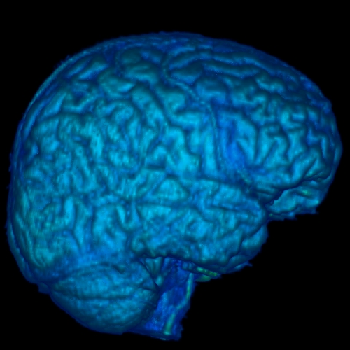

Information Processing in a Neural Network
Flow of Information
A few Neurons and their synaptic junctions

Slide 6
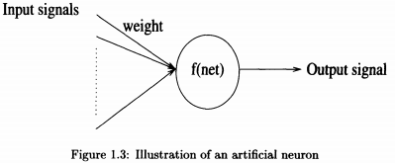
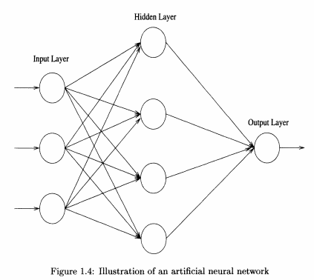
Artificial Neural Network
Neuron
An artificial neuron (AN) is a model of a biological neuron (BN).
Each AN receives signals from the environment or other ANs, gathers these signals, and when fired, transmits a signal to all connected ANs
An artificial neural network (NN) is a layered network of ANs.
An ANN may consist of an input layer, hidden layers and an output layer.
ANs in one layer are connected, fully or partially, to the ANs in the next layer.
Feedback connections to previous layers are also possible
Summary
Mathematical model
Inspired from human nervous system
Like human neuron converts inputs to outputs
Work in layers
Used for solving complex problems
Applications::regressions, classification, Clustering, Reinforcement learning

Slide 7
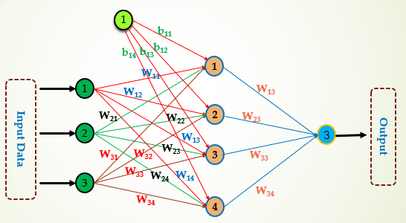
Artificial Neural Network
Inputs
The input variables
The weights associated with input variables (are provided by user depending on problem and ANN architecture)
The bias associated with each neuron in hidden layer (This is given to handle 0 value of summation because the activation function then finds problem in computing the output value)
Processing
The processing is used to map the input variables values to output variable value.
Consists of two processes
The summation process
The activation function process (Different types of activation functions are used to handle various situations)
Output
Represents the output variable value e.g. class of male, etc. in case of the gender classification
Schematic diagram of ANN

Slide 8
Artificial Neural Network
Supervised Unsupervised Reinforcement Learning
Artificial Neural Network
Regression and Classification

Slide 9
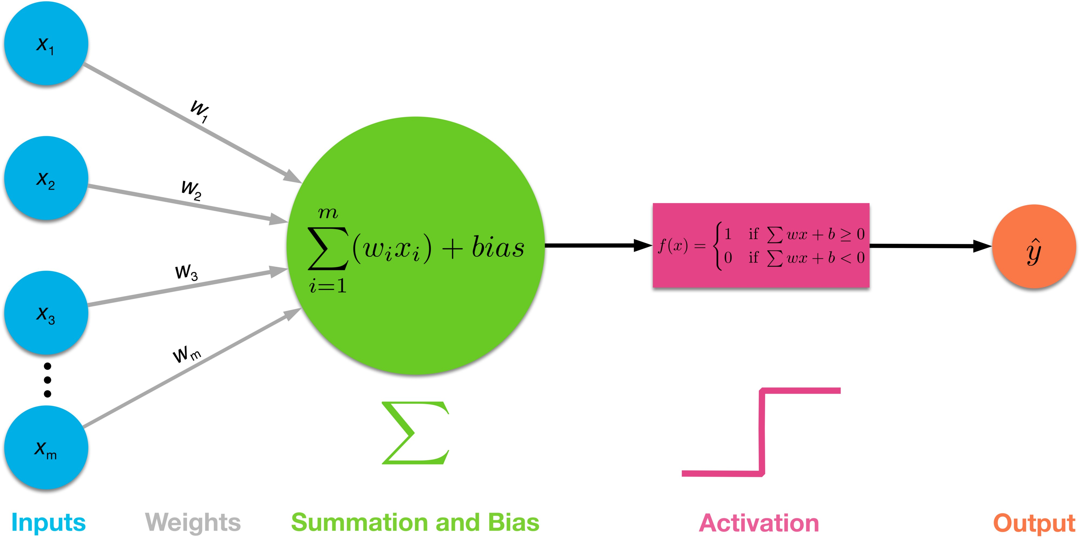
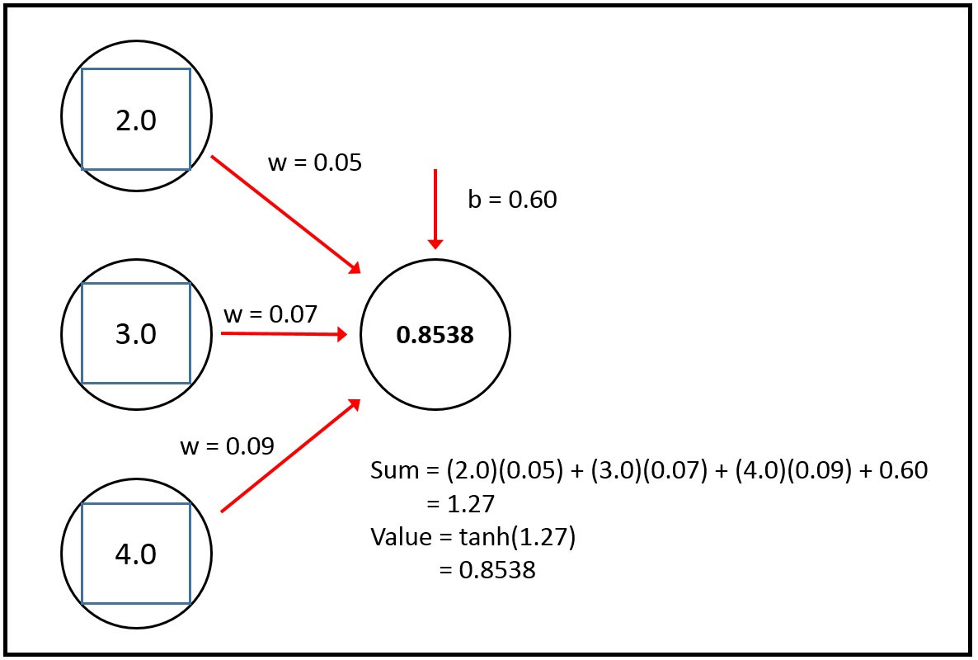
Activation Function
In artificial neural networks, the activation function of a node defines the output of that node given an input or set of inputs.
A standard integrated circuit can be seen as a digital network of activation functions that can be "ON" (1) or "OFF" (0), depending on input.
In ANN, this function actually shows the firing of neuron
In its simplest form, this function is binary—that is, either the neuron is firing or not
But the strength of firing can also be represented by different types of activation functions
The suitability of the function depends on the neural network type
E.G.
Schematic diagram of ANN
b
Mathematical Model of A Typical Neuron

Slide 10
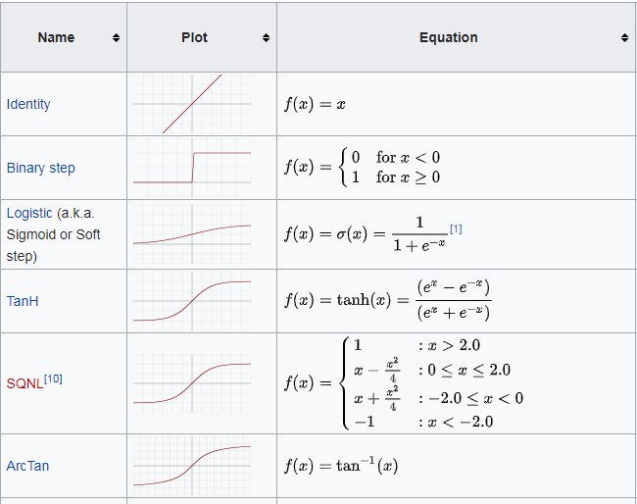
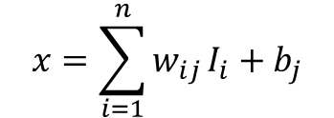
Artificial Neural Network
For all functions, the x represents the weighted sum plus bias in ANN
$$x=\sum_{i=1}^{n}{w_{ij}}I_{i}+b_{j}$$
X =
b

Slide 11
Types of Activation Functions
Threshold
Sigmoid
Tanh
ReLU
Softmax

Slide 12
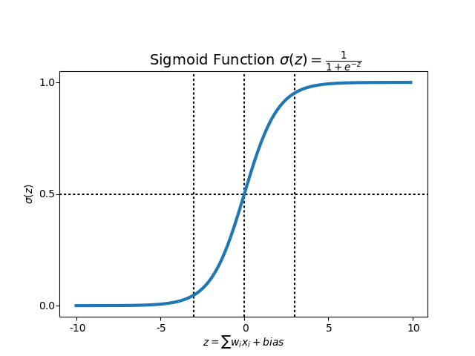


Sigmoid Function
A sigmoid function is a mathematical function having a characteristic "S"-shaped curve or sigmoid curve.
Sigmoid functions most often show a return value (y axis) in the range 0 to 1
Always Positive
Bounded
Strictly Increasing
$$x=\sum_{i=1}^{n}{w_{ij}}I_{i}+b_{j}$$

Slide 13
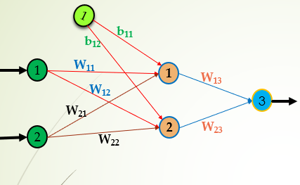
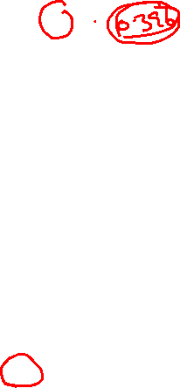
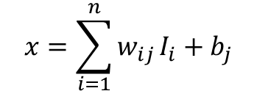
Sigmoid Function
1
0.35
0.60
0.05
0.15
0.05
H₁
0.20
0.20
3
0.10
0.3
H₂
0.10
$$x=\sum_{i=1}^{n}{w_{ij}}I_{i}+b_{j}$$
Input to H₁
X₁ = (I₁ × w₁₁ + I₂ × w₂₁ ) + b₁₁
X₁ = (0.05 × 0.15 + 0.10 × 0.20 ) + 0.35
0.3775
Apply Activation Function (Sigmoid)
OH₁ = 1/(1+e^{-x} )
OH₁ = 1/(1+ 2.71828 ^{-0.3775} )
OH₁ = 0.396
Output of H₁

Slide 14
Example for Practice
1
Input Layer
0.7
Hidden Layer
0.65
0.9
_{0.6}
H₁
0.23
Output Layer
0.66
0.76
0.34
_{0.7}
0.44
H₂
O
Output
0.84
0.87
_{0.8}
0.82
H₃
0.89
Apply Sigmoid Function on H₁ Neuron/Node

Slide 15
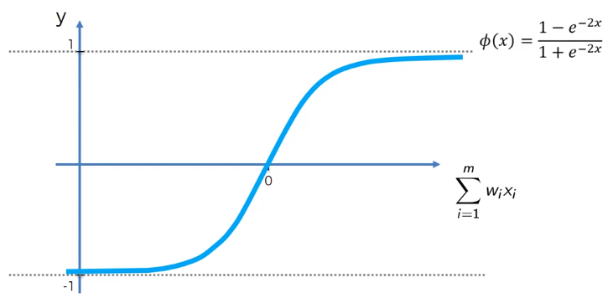

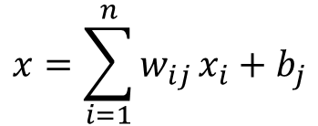
Hyperbolic tangent Function
A hyperbolic tangent function is a mathematical function having a characteristic "S"-shaped curve like sigmoid function.
A common example of a hyperbolic tangent function shown in the figure and defined by the formula
A hyperbolic tangent function returns value (y axis) in the range -1 to 1
$$x=\sum_{i=1}^{n}{w_{ij}}x_{i}+b_{j}$$

Slide 16

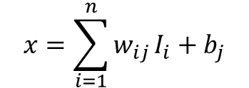
Hyperbolic tangent Function
1
0.35
0.60
0.05
0.15
0.05
H₁
0.20
0.20
3
$$x=\sum_{i=1}^{n}{w_{ij}}I_{i}+b_{j}$$
0.10
0.3
H₂
0.10
Input to H₁
X₁ = (I₁ × w₁₁ + I₂ × w₂₁ ) + b₁₁
X₁ = (0.05 × 0.15 + 0.10 × 0.20 ) + 0.35
0.3775
Apply Activation Function (Sigmoid)
OH₁ = (e^{x} - e^{-x} )/(e^{x} + e^{-x} )
OH₁ = (2.71828 ^{-0.3775} - 2.71828 ^{-0.3775} ) /(2.71828 ^{-0.377} + 2.71828 ^{-0.3775} )
OH₁ = 0.360
Output of H₁

Slide 17
Example for Practice
1
Input Layer
0.7
Hidden Layer
0.65
0.9
_{0.6}
H₁
0.23
Output Layer
0.66
0.76
0.34
_{0.7}
0.44
H₂
O
Output
0.84
0.87
_{0.8}
0.82
H₃
0.89
Apply Hyperbolic tangent Function on H₂ Neuron/Node

Slide 18
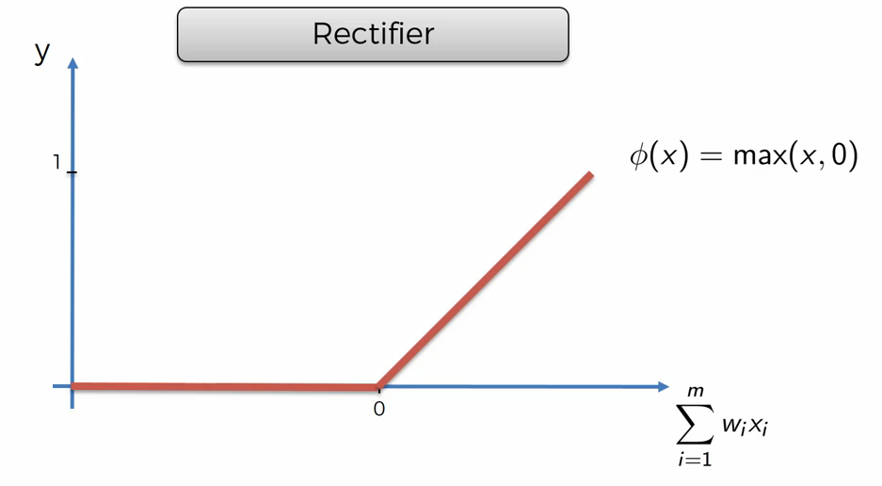
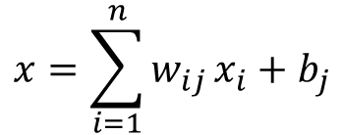
Rectified Linear Unit (ReLU)
The Rectified Linear Unit is the most commonly used activation function in deep learning models
The function returns 0 if it receives negative input, but for any positive value x it return that value back,
It can be written as:
F(x) = max (0, x)
$$x=\sum_{i=1}^{n}{w_{ij}}x_{i}+b_{j}$$

Slide 19

Rectified Linear Unit (ReLU)
1
0.35
0.60
0.05
0.15
0.05
H₁
0.20
0.25
3
0.10
0.3
H₂
0.10
Input to H₁
X₁ = (I₁ × w₁₁ + I₂ × w₂₁ ) + b₁₁
X₁ = (0.05 × 0.15 + 0.10 × 0.20 ) + 0.35
0.3775
F(x) = max (0, x)
Apply Activation Function (ReLU)
OH₁ = max (0, 0.3775)
OH₁ = 0.3775
Output of H₁

Slide 20
Example for Practice
1
Input Layer
0.7
Hidden Layer
0.65
0.9
_{0.6}
H₁
0.23
Output Layer
0.66
0.76
0.34
_{0.7}
0.44
H₂
O
Output
0.84
0.87
_{0.8}
0.82
H₃
0.89
Apply ReLU Function on H₁ , H_{2,} and H₃ Neuron/Node

Slide 21
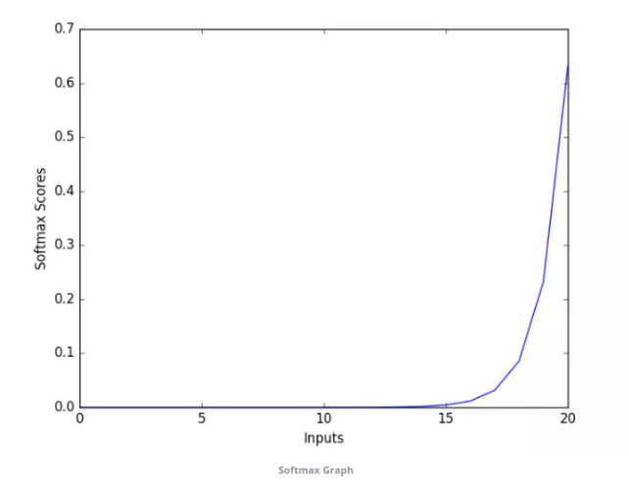
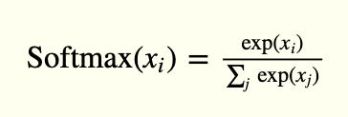
Softmax Function (for Multiple Classification)?
Softmax function calculates the probabilities distribution of the event over ‘n’ different events.
In general way of saying, this function will calculate the probabilities of each target class over all possible target classes.
The main advantage of using Softmax is the output probabilities range.
The range will 0 to 1, and the sum of all the probabilities will be equal to one.
If the softmax function used for multi-classification model it returns the probabilities of each class and the target class will have the high probability.
The formula computes the exponential (e-power) of the given input value and the sum of exponential values of all the values in the inputs.
Then the ratio of the exponential of the input value and the sum of exponential values is the output of the softmax function.

Slide 22
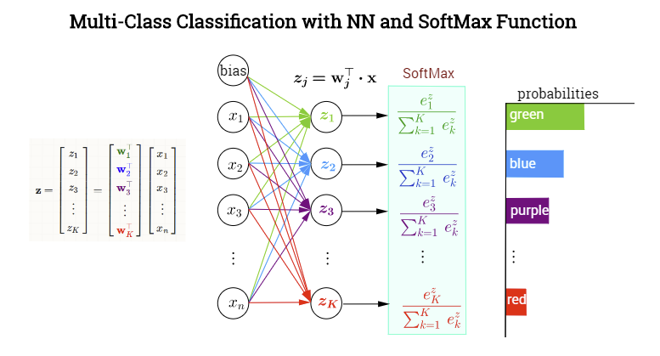
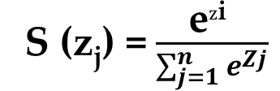
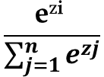

S (z_{j}) = $\frac{\text{e}z\text{i} }{\sum_{j=1}^{n}{e^{Zj}}}$
^{Total Probabilities equal to 1}
^{zi}
2.72
7.39
20.08
54.60
148.41
403.43
1
2
3
4
5
6
0.004
0.011
0.031
0.085
0.233
0.633
e^{zi}
$$\frac{\text{e}z\text{i} }{\sum_{j=1}^{n}{e^{zj}}}$$
^{Sum}
636.63
$$\sum_{j=1}^{n}{e^{zj}}$$

Slide 23
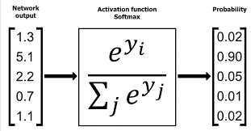
Example for Practice

Slide 24
Quiz#03

