Slide 1
Artificial Neural Network Lecture#11 Dr. Muhammad Fayaz

Slide 2
Revision
Artificial Neural Network
Structure of Artificial Neural Network
Activation Functions
Sigmoid
Tangent Sigmoid
Rectified Linear Unit (ReLU)
SoftMax

Slide 3
Types of Activation Functions
Threshold
Sigmoid
Tanh
ReLU
Softmax
Linear/Identical

Slide 4
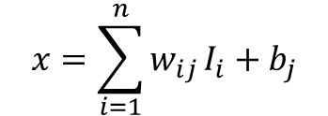
Linear/Identical Function
It is the simplest activation function.
It takes an input value x and provides same value x
F(x) = x
$$x=\sum_{i=1}^{n}{w_{ij}}I_{i}+b_{j}$$

Slide 5













Example
1
Supposed Values
X₁ | 0.05
X₂ | 0.10
B₁ | 0.35
B₂ | 0.60
W₁₁ | 0.15
W₁₂ | 0.25
W₂₁ | 0.20
W₂₂ | 0.30
$$B_{1}$$
$$B_{2}$$
$$X_{1}$$
$$W_{11}$$
$$H_{1}$$
$$OH_{1}$$
$$W_{12}$$
O
$$OO$$
$$W_{21}$$
$$H_{2}$$
$$OH_{2}$$
$$X_{2}$$
$$W_{22}$$

Slide 6
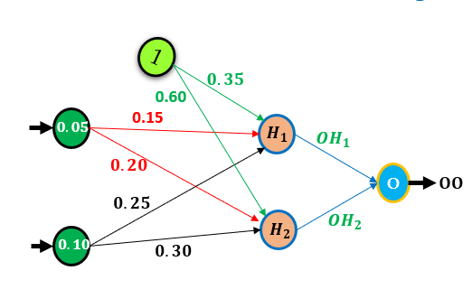
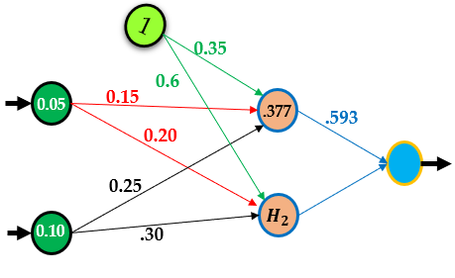
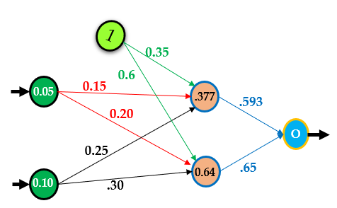
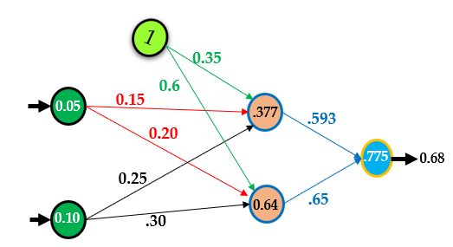

















Simple Example (ANN)
Supposed Values
X₁ | 0.05
X₂ | 0.10
B₁ | 0.35
B₂ | 0.60
W₁₁ | 0.15
W₁₂ | 0.20
W₂₁ | 0.25
W₂₂ | 0.30
$$Calculate{ H}_{1}and {OH}_{1}$$
$$\left[H_{1}=X_{1}×W_{11}+X_{2}×W_{21}+b_{1}\right]$$
$$\left[H_{1}=0.05×0.15+0.10×0.20+0.35\right]$$
$$\left[H_{1}=0.3775\right]$$
.25
$Apply Activation Function$ (Sigmoid)
.20
$$\left[{OH}_{1}=\frac{1}{1+ e^{H_{1}}}\right]$$
$$\left[{OH}_{1}=\frac{1}{1+{2.72}^{−0.3775}}\right]$$
OH₂
$$\left[{OH}_{1}=0.593\right]$$
$$Calculate O$$
$$\left[O=H_{1}×{OH}_{1}+ H_{2}×{OH}_{2}\right]$$
$$Calculate{ H}_{2} and {OH}_{2}$$
$$\left[O=0.3775×0.593+0.64×0.65\right]$$
$$\left[H_{2}=X_{1}×W_{12}+X_{2}×W_{22}+b_{2}\right]$$
$$\left[O=0.7757\right]$$
$Apply Activation Function$ (Sigmoid)
OO
$$\left[H_{2}=0.05×0.25+0.10×0.30+0.60\right]$$
$$\left[OO=\frac{1}{1+ e^{O}}\right]$$
$$\left[H_{2}=0.64\right]$$
$Apply Activation Function$ (Sigmoid)
$$\left[OO=\frac{1}{1+{2.72}^{−0.7757}}\right]$$
$$\left[{OH}_{2}=\frac{1}{1+ e^{H_{2}}}\right]$$
$$\left[{OH}_{2}=\frac{1}{1+{2.72}^{−0.64}}\right]$$
$$\left[OO=0.68\right]$$
$$\left[{OH}_{2}=0.65\right]$$

Slide 7
Quiz#05

