Slide 1
Artificial Neural Network Lecture#13 Dr. Muhammad Fayaz

Slide 2
Revision
Artificial Neural Network
Structure of Artificial Neural Network
Activation Functions
Sigmoid
Tangent Hyperbolic Sigmoid
Rectified Linear Unit (ReLU)
Linear/Identical
SoftMax
Example
Types of Artificial Neural Network w.r.t. Hidden Layers
Perceptron
Multilayer Perceptron
Deep Neural Network
Specification of Nodes and Activation Functions
Specification of input layer’s nodes, hidden layer’s nodes, and output layer’ node(s)
Specification of activation functions on hidden layer’s nodes, and output layer node(s).
Epoch
Batch
Iteration

Slide 3
Terminologies

Slide 4
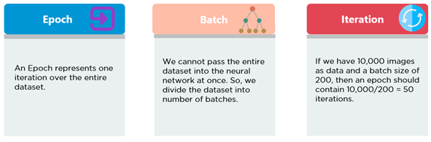
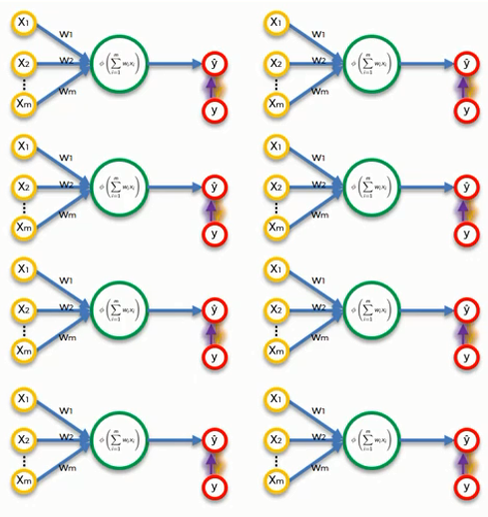
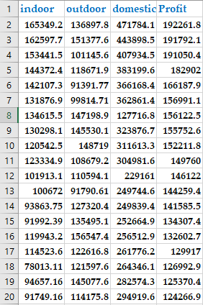
Terminologies

Slide 5
Scaling
Data Scaling Methods
i. Normalization
ii. Standardization
i. Normalization:
Normalization is another scaling technique in which values are shifted and rescaled so that they end up ranging between 0 and 1. It is also known as Min-Max scaling.
ii. Standardization:
Standardization is a scaling technique where the values are cantered around the mean with a unit standard deviation. This means that the mean of the attribute becomes zero and the resultant distribution has a unit standard deviation.

Slide 6
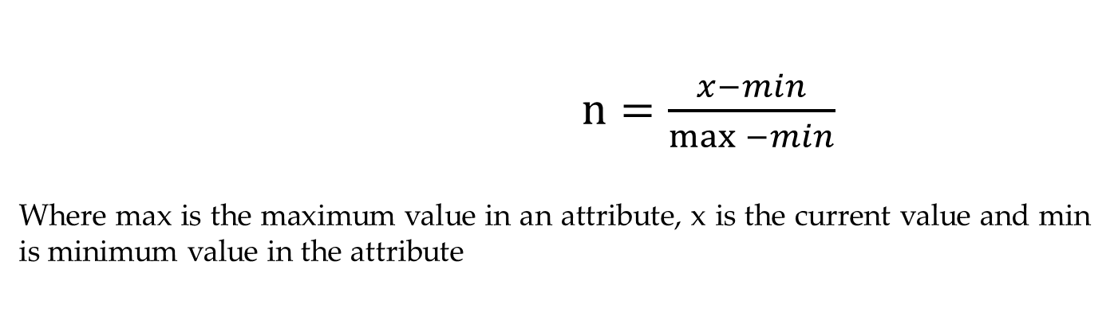
Normalization
$n=\frac{x−min}{\max{−min}}$
Where max is the maximum value in an attribute, x is the current value and min is minimum value in the attribute
Input
44
55
8
50
45
66
18
Output
0.620689655
0.810344828
0
0.724137931
0.637931034
1
0.172413793
Max = 66
Min = 8

Slide 7

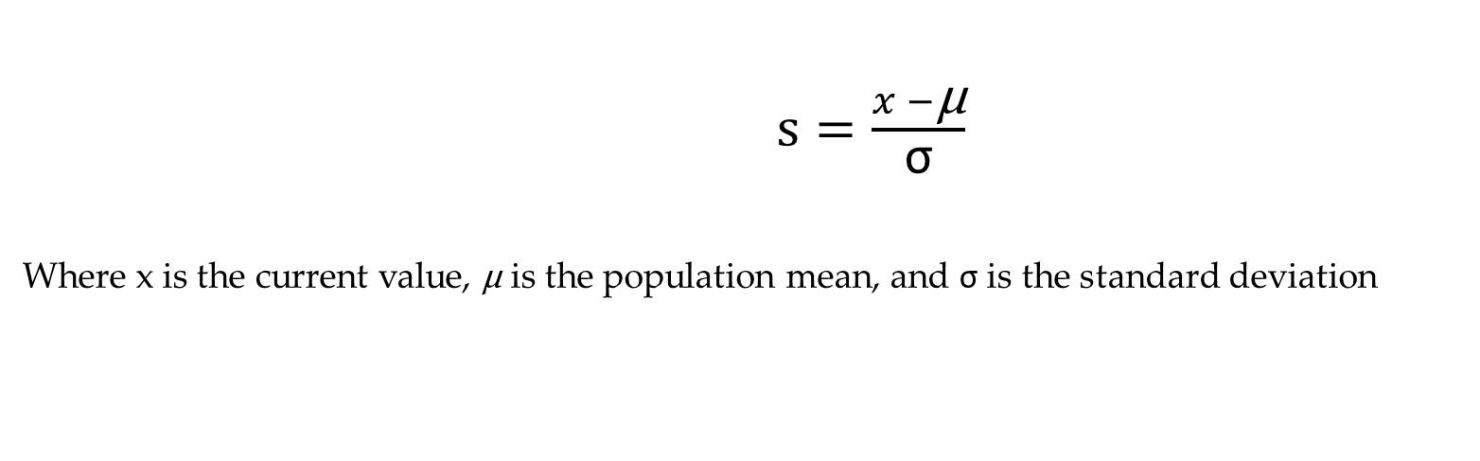

Standardization
$s=\frac{x −\text{μ}}{\text{σ}}$
Where x is the current value, $\text{μ}$ is the population mean, and $\text{σ}$ is the standard deviation
Input
44
55
8
50
45
66
18
Output
0.164832163
0.741744732
-1.723245337
0.479511746
0.21727876
1.318657301
-1.198779365
$\text{μ}$ = 40.85714
$\text{σ}$ = 19.06701
$\text{μ}$ = 0
$\text{σ}$ = 1

Slide 8
LOSS

Slide 9
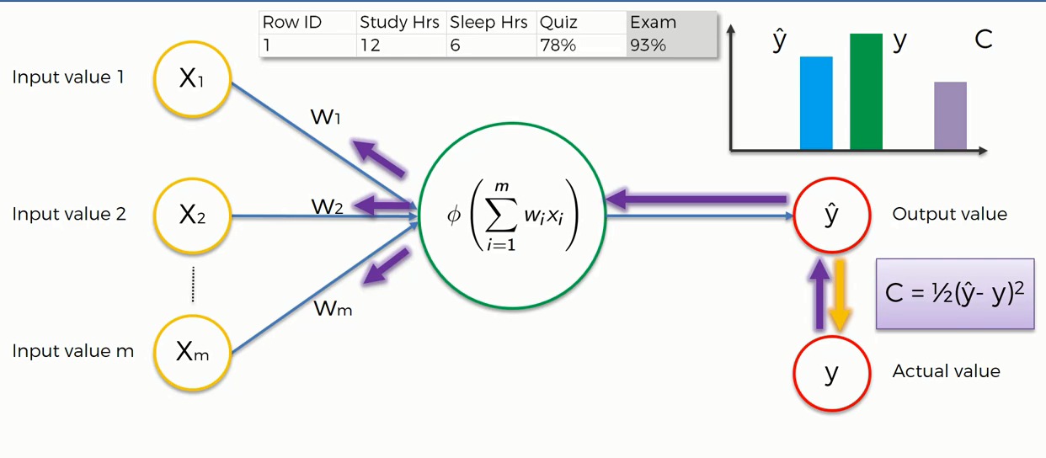
Loss

Slide 10
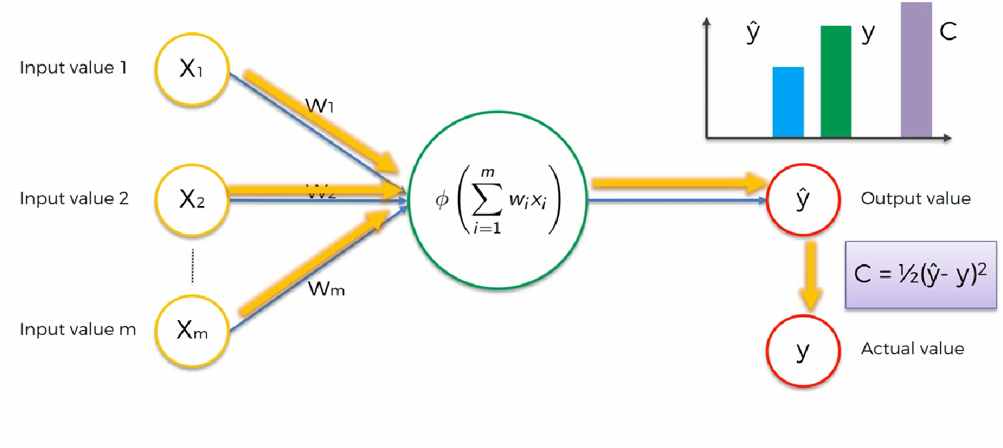
LOSS

Slide 11
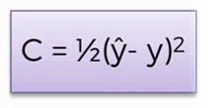

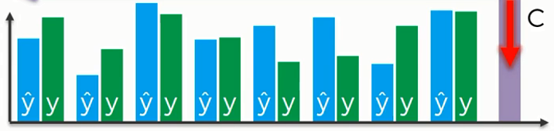
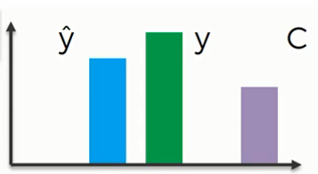
LOSS
Cost/Loss
Predicted
Actual
Predicted
Actual

Slide 12
Different Ways for Loss Calculation
Regression Loss Functions
Mean Squared Error Loss
Mean Squared Logarithmic Error Loss
Mean Absolute Error Loss
Binary Classification Loss Functions
Binary Cross-Entropy
Hinge Loss
Squared Hinge Loss
Multi-Class Classification Loss Functions
Categorical Cross-Entropy Loss
Sparse Multiclass Cross-Entropy Loss
Kullback Leibler Divergence LossThis tutorial is divided into three parts; they are:

Slide 13
Loss function…
Cross-entropy is commonly used in machine learning as a loss function. .
Two types of cross entropies are used in the machine learning:
Binary_crossentropy – uses for loss calculation in binary classification
categorical_crossentropy- uses for loss calculation in multiclass classification

Slide 14
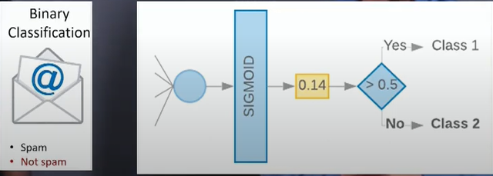

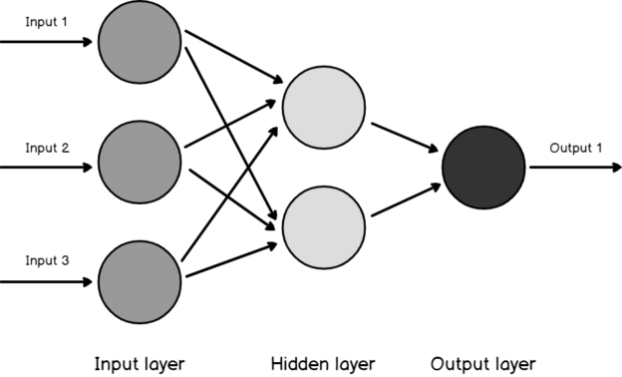




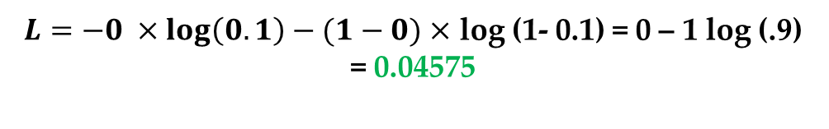
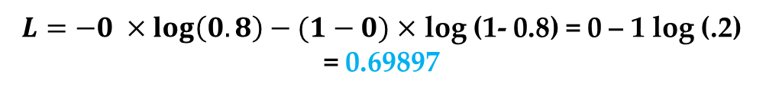
Binary Classification
Binary-Cross Entropy
$$L_{cross−entropy}\left(\hat{y},y\right)=−y log\left(\hat{y}\right)−\left(1−y\right)log (1−\hat{y})$$
Predicted Output
Actual Output
$$\hat{y}=\left[.8\right]$$
$$y=\left[0\right]$$
$L=−0 ×\log\left(0.8\right)−(1−0)$ $×$ log (1- 0.8) = 0 – 1 log (.2) = 0.69897
Sigmoid Function
Predicted Output
Actual Output
$$\hat{y}=\left[.1\right]$$
$$y=\left[0\right]$$
$L=−0 ×\log\left(0.1\right)−(1−0)$ $×$ log (1- 0.1) = 0 – 1 log (.9) = 0.04575

Slide 15
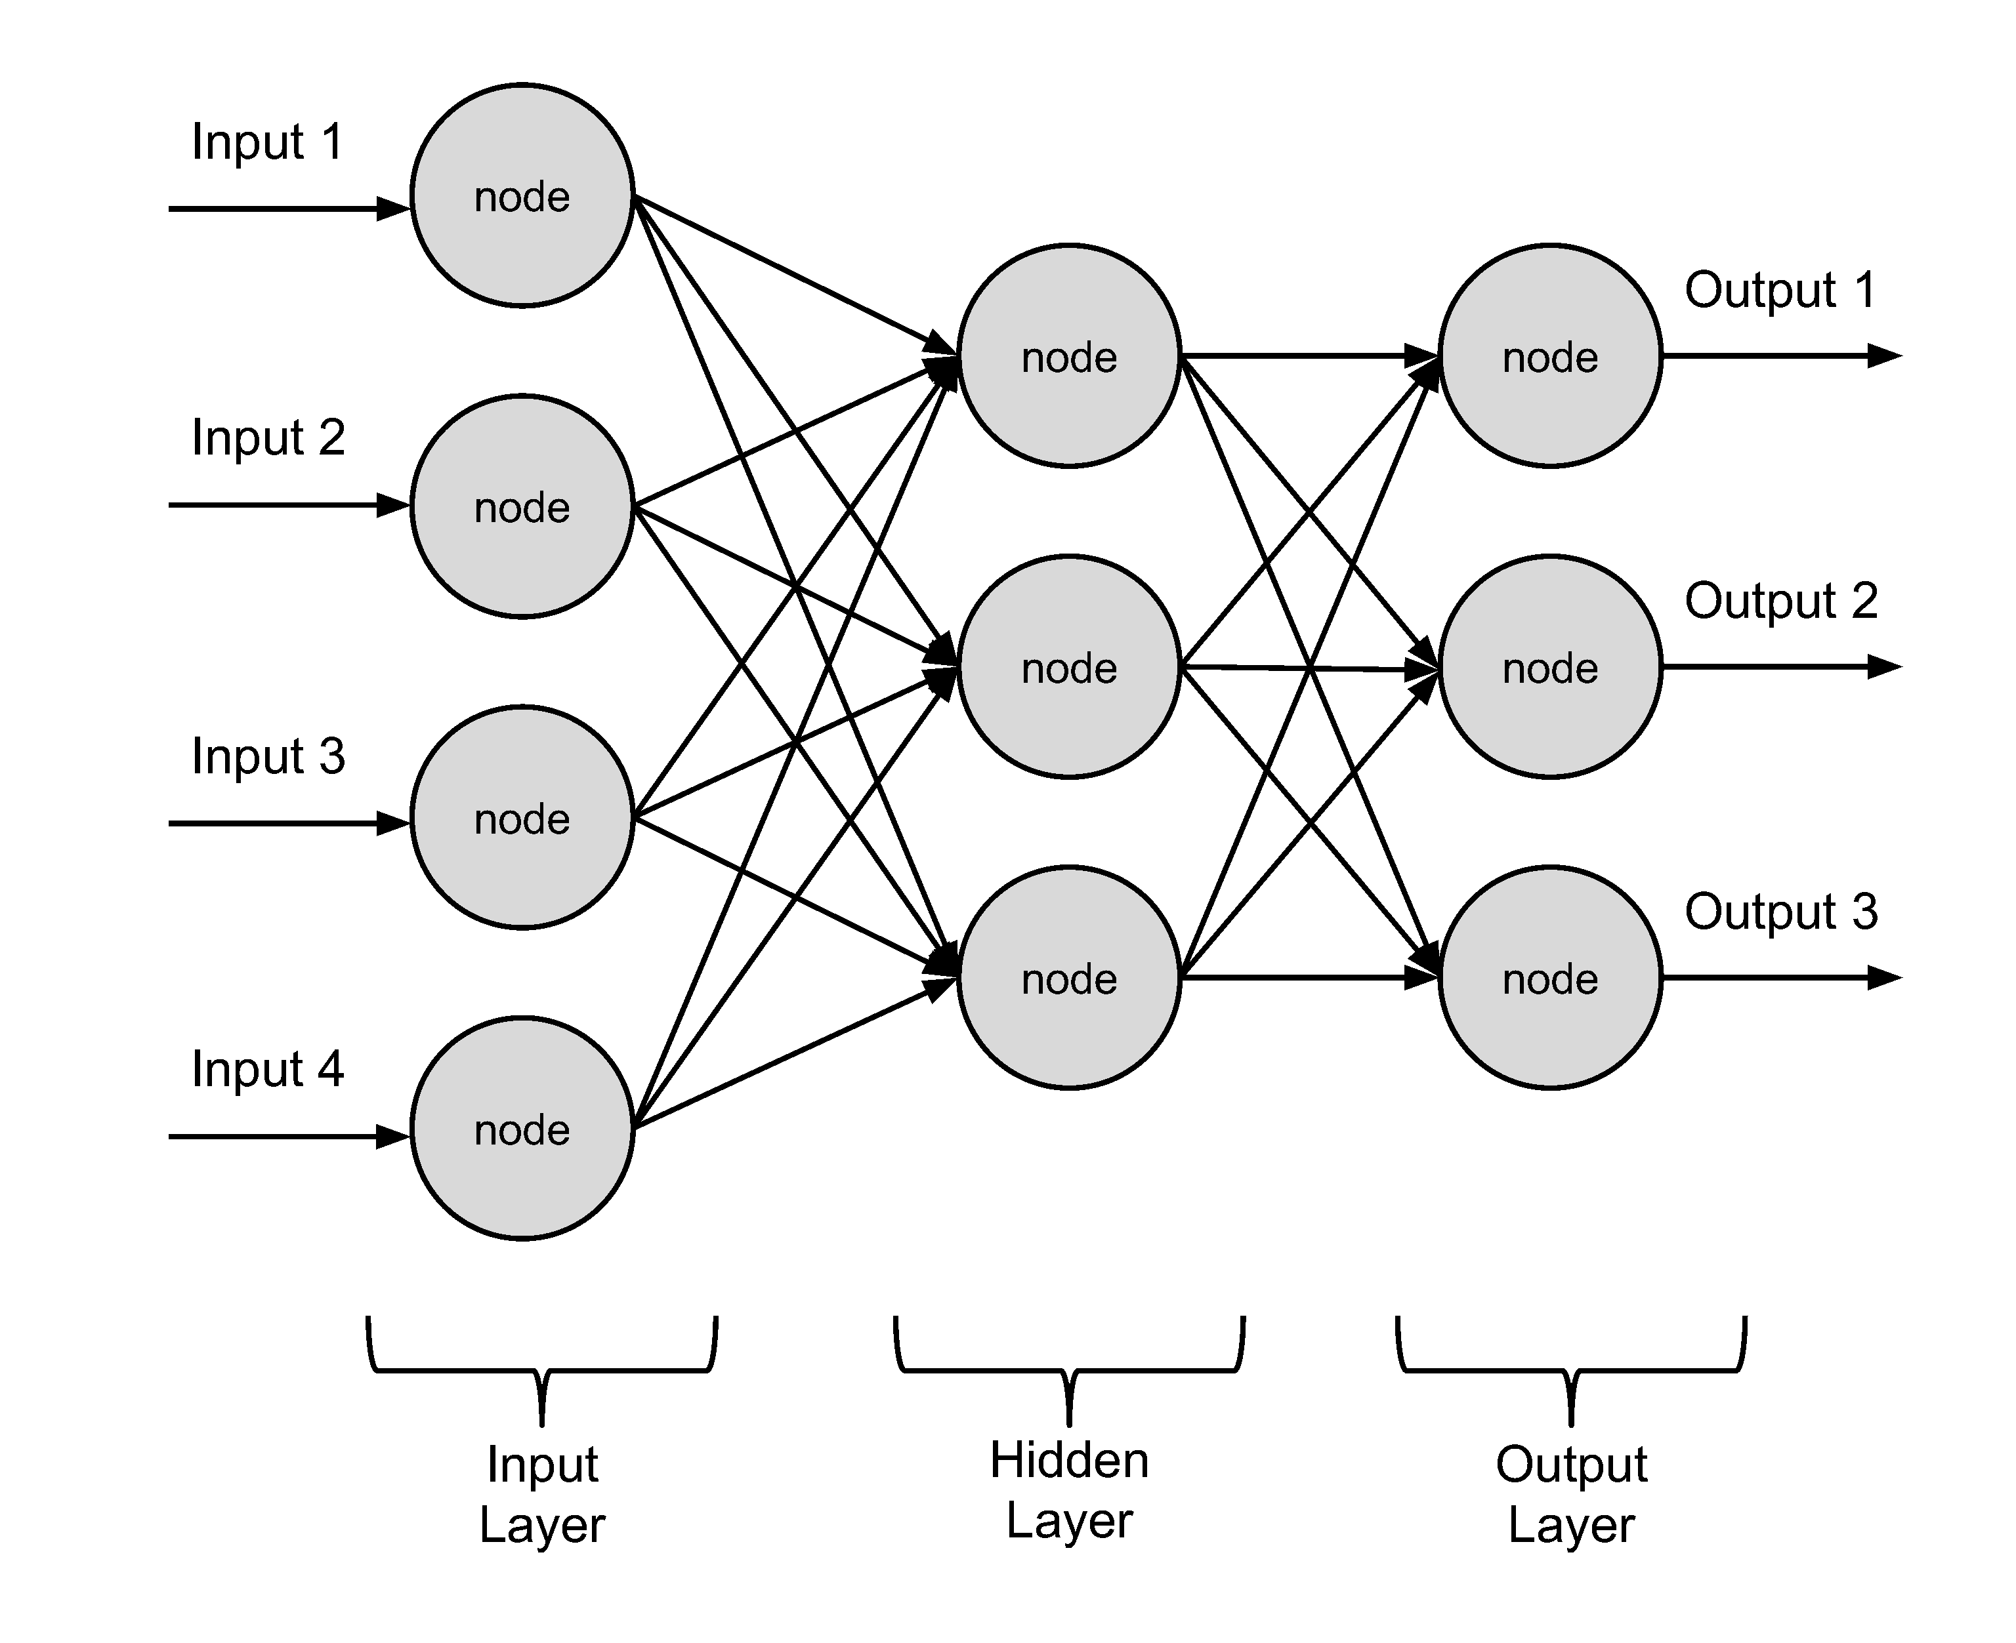
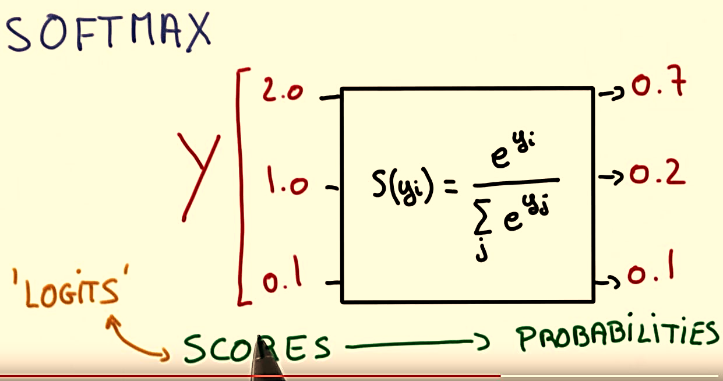
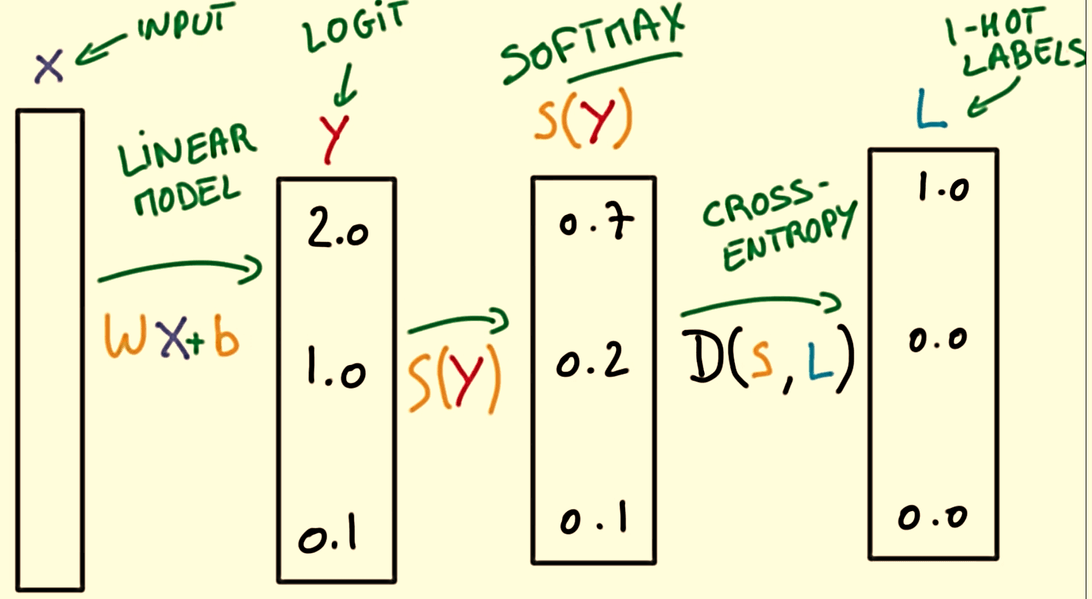
SoftMax Activation Function

Slide 16
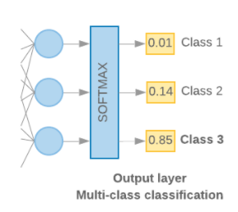
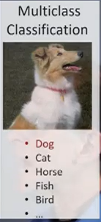
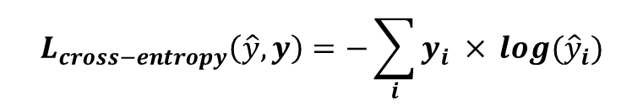

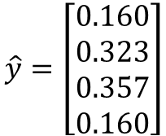
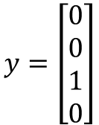
Multiclass Classification
$Softmax=\frac{e^{zj}}{\sum_{k=1}^{k}{e^{zk}}}$ for j = 1,……, k
Categorical_Crossentropy/Logistic Loss
$$L_{cross−entropy}\left(\hat{y},y\right)=−\sum_{i}{y_{i} ×} log({\hat{y}}_{i})$$
Predicted Output
Actual Output
$$\hat{y}=\left[\begin{aligned}0.160 \\ 0.323 \\ 0.357 \\ 0.160\end{aligned}\right]$$
$$y=\left[\begin{aligned}0 \\ 0 \\ 1 \\ 0\end{aligned}\right]$$
$L=−0 ×\log\left(0.160\right)−0$ $×$ log (0.323) – 1 $×\log\left(0.357\right)−0×\log{(0.160)}$
$$L=1.5$$

Slide 17
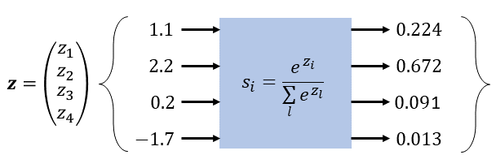
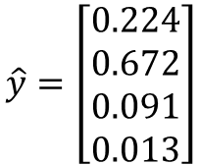
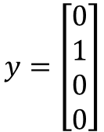
Multiclass Classification
$Softmax=\frac{e^{zj}}{\sum_{k=1}^{k}{e^{zk}}}$ for j = 1,……, k
Categorical_Crossentropy
$$L_{cross−entropy}\left(\hat{y},y\right)=−\sum_{i}{y_{i} ×} log({\hat{y}}_{i})$$
Predicted Output
Actual Output
$$\hat{y}=\left[\begin{aligned}0.224 \\ 0.672 \\ 0.091 \\ 0.013\end{aligned}\right]$$
$$y=\left[\begin{aligned}0 \\ 1 \\ 0 \\ 0\end{aligned}\right]$$
$L=−0 ×\log\left(0.224\right)−1$ $×$ log ($0.672$) – 0 $×\log{(0.091)−0×\log{(0.013)}}$
L= 0.173

Slide 18
Different types of Neural Network
Feedforward Neural Network – Artificial Neuron
Feed Forward Back Propagation Neural Network
Convolutional Neural Network
Recurrent Neural Network(RNN) –
Long Short-Term Memory

Slide 19
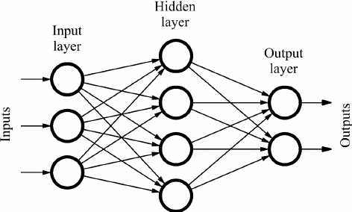
Feedforward Neural Network
It is one of the simplest types of artificial neural networks.
In a feedforward neural network, the data passes through different input nodes, hidden layer nodes until it reaches the output node.
In other words, the data moves in only one direction from the first range until it reaches the output node.
Data move in only one direction.
A feedforward neural network may consist of a single layer or may contain hidden layers.
In a feed forward neural network, the products of the inputs and their weights are calculated. This is then fed to the output.

Slide 20
Feed Forward Neural Network

Slide 21
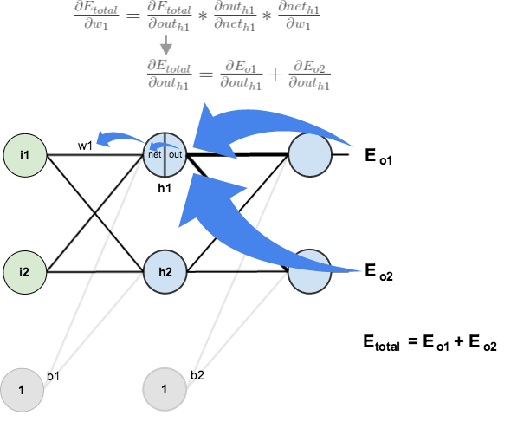
Back Propagation
Back-propagation is the essence of neural net training. It is the method of fine-tuning the weights of a neural net based on the error rate obtained in the previous epoch (i.e., iteration).
Proper tuning of the weights allows you to reduce error rates and to make the model reliable by increasing its generalization.
Backpropagation is a training algorithm consisting of 2 steps:
Feedforward the values.
Calculate the error and propagate it back to the earlier layers.

Slide 22
Appendix

Slide 23
Structure Diagram of Neural Network
http://alexlenail.me/NN-SVG/index.html

