Slide 1
Artificial Neural Network Lecture # 16 Dr. Muhammad Fayaz

Slide 2
Revision
Artificial Neural Network
Structure of Artificial Neural Network
Activation Functions
Sigmoid
Tangent Hyperbolic Sigmoid
Rectified Linear Unit (ReLU)
Linear/Identical
SoftMax
Example
Types of Artificial Neural Network w.r.t. Hidden Layers
Perceptron
Multilayer Perceptron
Deep Neural Network
Specification of Nodes and Activation Functions
Specification of input layer’s nodes, hidden layer’s nodes, and output layer’ node(s)
Specification of activation functions on hidden layer’s nodes, and output layer node(s).
Epoch
Batch
Iteration
Weight Initialization Methods
Xavier/Glorot
Scaling Methods
Normalization
Standardization
LOSS Methods
Regression Loss Function
Binary Classification Loss Function
Multi-Class Classification Loss Functions

Slide 3
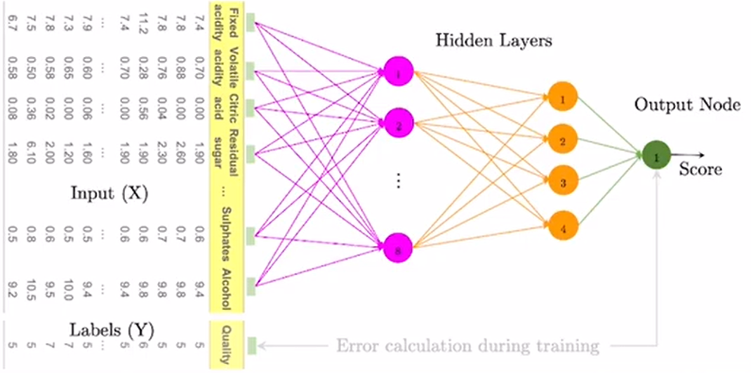
Artificial Neural Network Working Mechanism
STEP 1: Randomly initialize the weights to small numbers close to 0 (but not 0)
STEP 2: Input the first observation of your dataset in the input layer, each feature in one input node.
STEP 3: Forward-Propagation: from left to right, the neurons are activated in a way that the impact of each neuron's activation is limited by the weights. Propagate the activations until getting the predicted result y.
STEP 4: Compare the predicted result to the actual result. Measure the generated error.
STEP 5: Repeat Steps 1 to 5 and update the weights after each observation.

Slide 4
Implementation

Slide 5
Keras
Keras is a high-level neural networks API, written in Python and capable of running on top of TensorFlow, CNTK, or Theano.
It was developed with a focus on enabling fast experimentation.
Allows for easy and fast prototyping (through user friendliness, modularity, and extensibility).
Supports both convolutional networks and recurrent networks, as well as combinations of the two.
Runs seamlessly on CPU and GPU.
https://keras.io/
https://pypi.org/project/Keras/
https://www.youtube.com/watch?v=CcKf-iZ8umk

Slide 6
Binary Classification

Slide 7
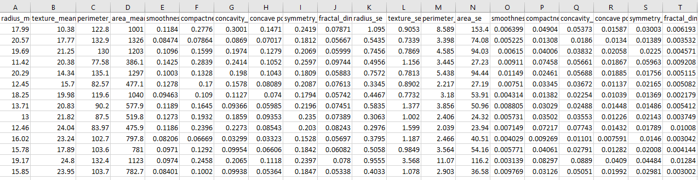
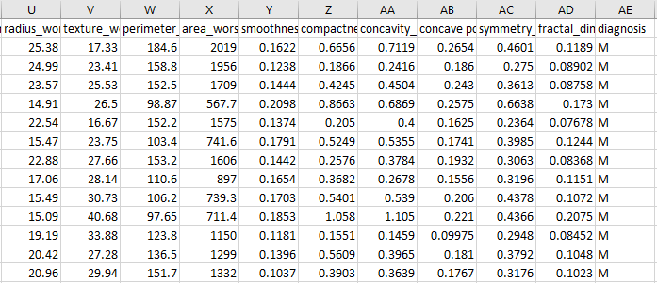
Design
Inputs
Output

Slide 8
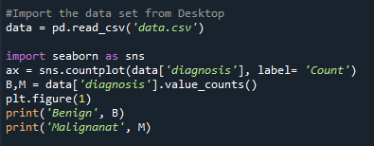
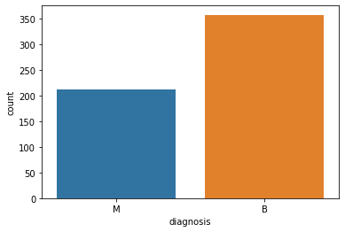
Code
This chunk of code is for visualization, in order to find the quantity of two categories namely Benign and Malignant in the dependent variable

Slide 9
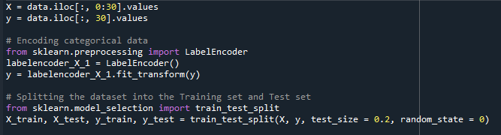
Code
The data consisted of 31 attributes, the first 30 attributes represent the independent variables, and the last attribute represents the dependent variable.
It is used to convert non-numeric labels to numeric labels.
M
M
B
B
B
M
M
M
M
1
1
0
0
0
1
1
1
1
It is used to divide the data into training and testing.
0.2 represents that the 20% data will be used for testing and the remaining 80% data will be used to training
X_train indicates the input training data
X_test represents the input testing data
y_train indicates the output training data
y_test represents the output testing data (using for comparison)

Slide 10
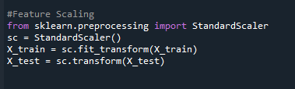
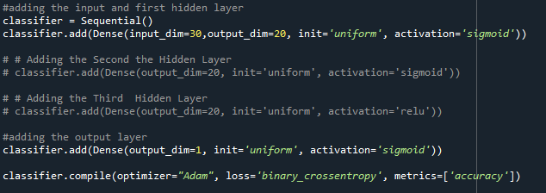
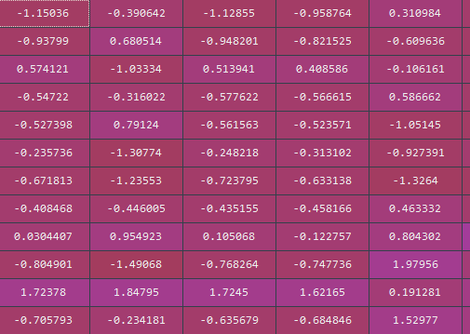
Code
Standarization: To bring the data into a specific range, i.e.
17.99 | 10.38 | 122.8 | 1001 | 0.1184
20.57 | 17.77 | 132.9 | 1326 | 0.08474
19.69 | 21.25 | 130 | 1203 | 0.1096
11.42 | 20.38 | 77.58 | 386.1 | 0.1425
20.29 | 14.34 | 135.1 | 1297 | 0.1003
12.45 | 15.7 | 82.57 | 477.1 | 0.1278
18.25 | 19.98 | 119.6 | 1040 | 0.09463
13.71 | 20.83 | 90.2 | 577.9 | 0.1189
13 | 21.82 | 87.5 | 519.8 | 0.1273
12.46 | 24.04 | 83.97 | 475.9 | 0.1186
16.02 | 23.24 | 102.7 | 797.8 | 0.08206
15.78 | 17.89 | 103.6 | 781 | 0.0971
input_dim = 30: represents the input layer’s neurons
output_dim=16: represents the hidden layer’s neurons
init=‘uniform’ : uses for initializing of weights uniformly
Sigmoid: activation function applied on hidden layer nodes

Slide 11
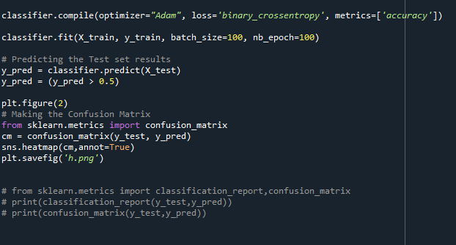
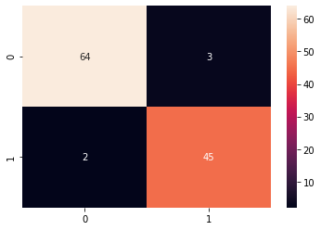


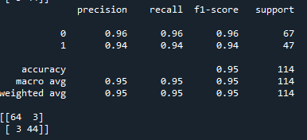

Code
Loss/Cost: Different methods can be used .
In case of binary classification binar_crossentropy is used.
Predicted
 | Positive | Negative
Positive | TP | FP
Negative | FN | TN
Predicted
Actual
Actual

Slide 12
Multiclass Classification

Slide 13
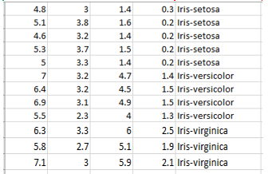
Design
Inputs
Output

Slide 14

Code
In the iris dataset we have four independent variables and a dependent variable
Hence, all the independent variables are assigned to X and the dependent variable is assign to y

Slide 15

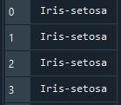
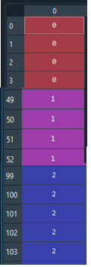
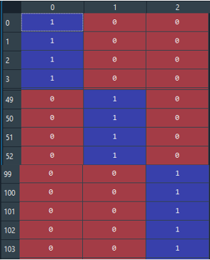
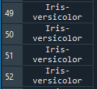
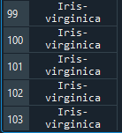
Code
In independent variable of iris dataset we have three categories, namely Iris-setona, Isir-versicolor and Iris-virginica
By using this line of code the these strings will be converted to 0, 1 and 2 correspondingly.
y
y1
y1
Y

Slide 16
Code
It is used to divide the data into training and testing.
0.2 represents that the 20% data will be used for testing and the remaining 80% data will be used to training
X_train indicates the input training data
X_test represents the input testing data
y_train indicates the output training data
y_test represents the output testing data (it is not fed to the algorithm, just are using for comparison)

Slide 17
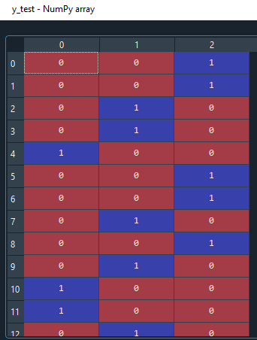
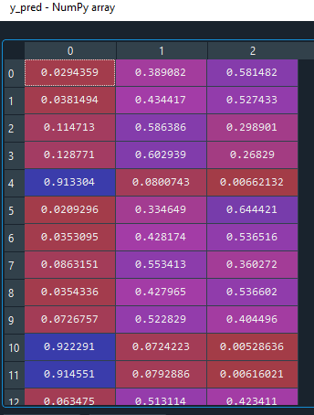
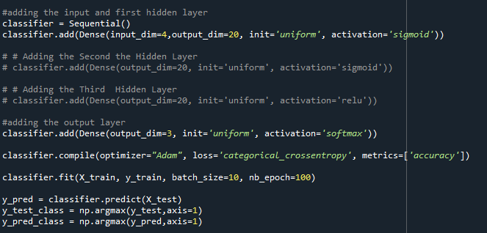
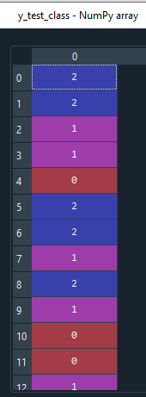
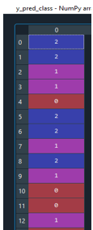
Code
input_dim = 4: represents the input layer’s neurons
20: represents the hidden layer’s neurons
3: represents the output layer’s neurons

Slide 18
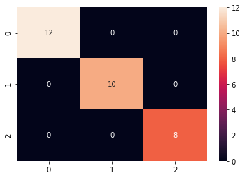
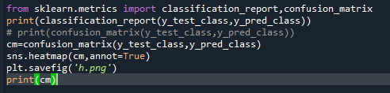
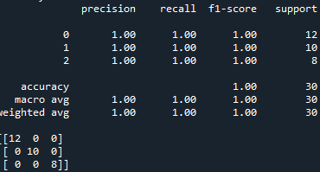

Code

Slide 19
Regression

Slide 20
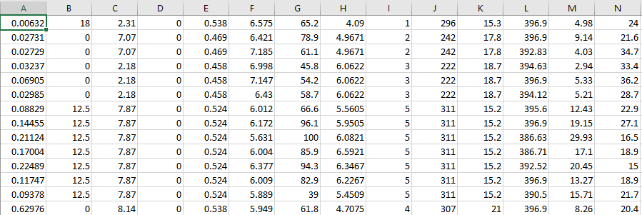
Design
Inputs
Output

Slide 21
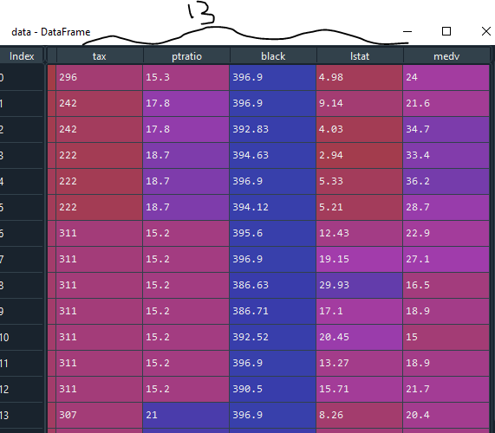
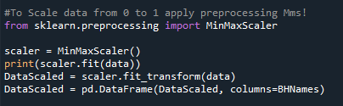
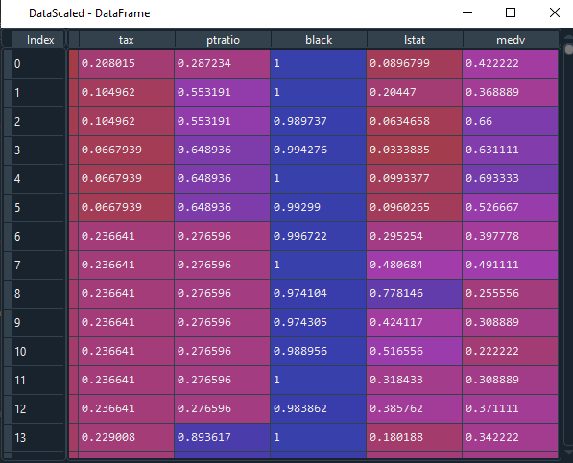
Code
To Scale the data in (0,1) range
Input Data where the number of independent variables are 13 and there is only one dependent attribute (medv)

Slide 22
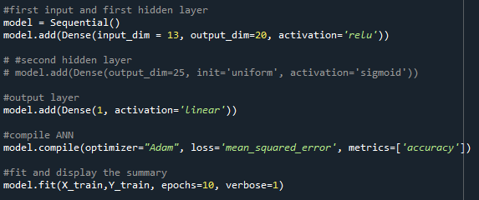
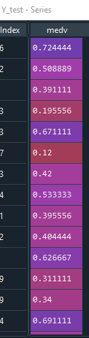
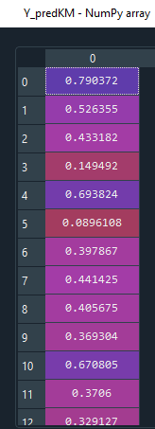
Code
Verbose =0 will show you nothing (silent)
Verbose =1 will show you an animated progress bar like this:
Verbose = 2 will just mention the number of epoch like this: Epoch 1/10

Slide 23
Assignment-4
Implement the classification and the regression algorithms on yours's systems and apply on the data uploaded to Moodle (DataforPractice1 and DataforPractice2)
Send me a video of your implementation with explanation through teams
I have also Provided and Assignment#4 Submission Link on Moodle, Submit your code there.
Note: I have already uploaded codes for regression (Binary_Classification) and classification algorithms to Moodle, apply on the data (DataforPractice1 and DataforPractice2)
Deadline: Sunday (18-04-2021)

Slide 24
Design
Inputs
Output

Slide 25
Code
Preprocessing
To Scale the data in (0,1) range
Input Data: 13 input features
Output Data: 1 output

Slide 26
Code
Verbose =0 will show you nothing (silent)
Verbose =1 will show you an animated progress bar like this:
Verbose = 2 will just mention the number of epoch like this: Epoch 1/10

Slide 27
Convolutional Neural Network

Slide 28
What is an Image?
An image may be defined as a two-dimensional function f(x , y) where x and y are spatial coordinates and amplitude of f at any pair of coordinates (x , y) is called the intensity or Gray level of the image at that point.

Slide 29
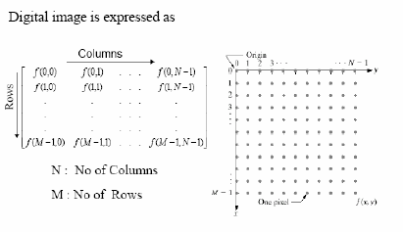
Digital Image
When x , y and the amplitude values of f are all finite, discrete quantities, we call the image a Digital Image.
A digital Image is composed of a finite number of elements each of which has a particular location and value
These elements are referred to as Picture Elements, Image Elements, Pels or Pixels
Further we will explain different image types with respect to colorization

Slide 30
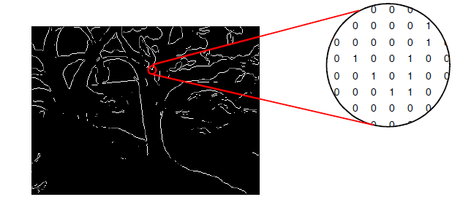
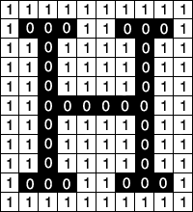
Types of Digital Image
Binary Image: A binary image is one that consists of pixels that can have one of exactly two colors, usually black and white.
Binary images are also called bi-level or two-level. This means that each pixel is stored as a single bit—i.e., a 0 or 1.
Here the 0 represents black and 1 represents white

Slide 31
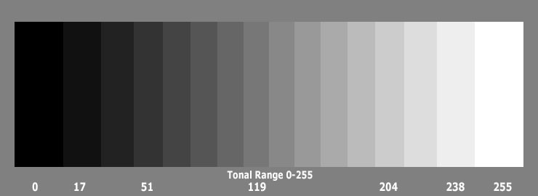
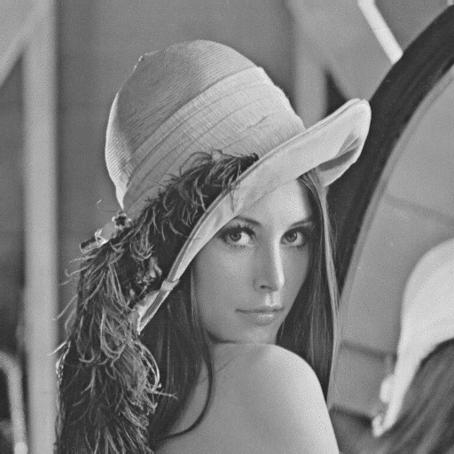
Types of Digital Image
Grayscale Image: A grayscale image (also called gray-scale, gray scale, or gray-level) is a data matrix whose values represent intensities within some range.

Slide 32
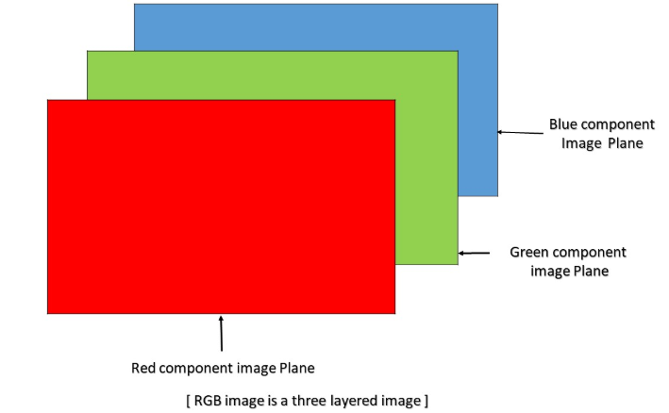
Types of Digital Image
Color (RGB) Image: An RGB image can be viewed as three different images(a red scale image, a green scale image and a blue scale image) stacked on top of each other, and when feed into the red, green and blue inputs of a color monitor, it produces a color image on the screen.
An RGB image is sometimes referred to as a true color image as the precision with which a real-life image can be replicated has led to the nickname “true color image.”

Slide 33
Convolutional Neural Network

Slide 34
Why Convolutional Neural Network?

Slide 35
Prerequisite
Convolution
Pooling
ReLU Activation Function
Flattening
ANN

Slide 36
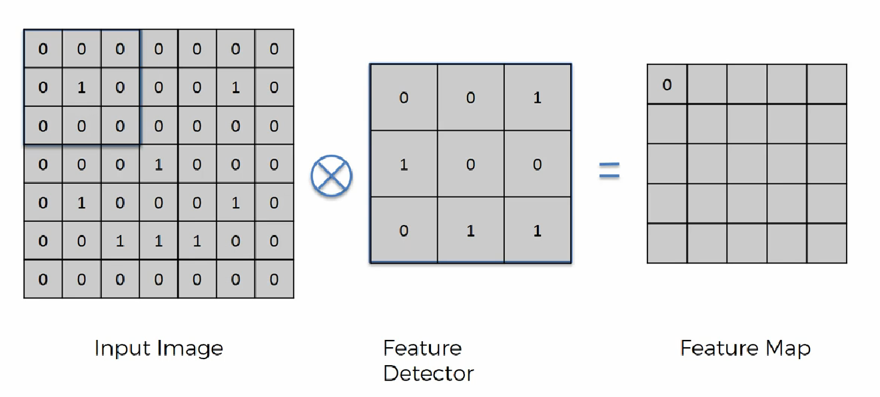
Convolution

Slide 37
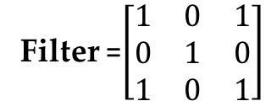
Convolutional
Filter =$\left[\begin{matrix}1 & 0 & 1 \\ 0 & 1 & 0 \\ 1 & 0 & 1\end{matrix}\right]$

Slide 38
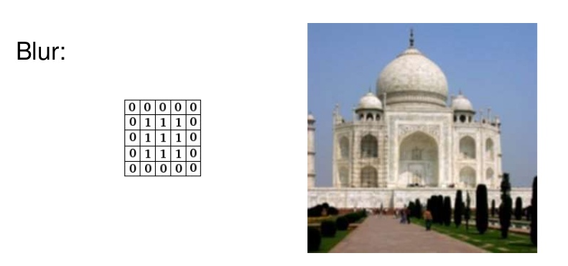
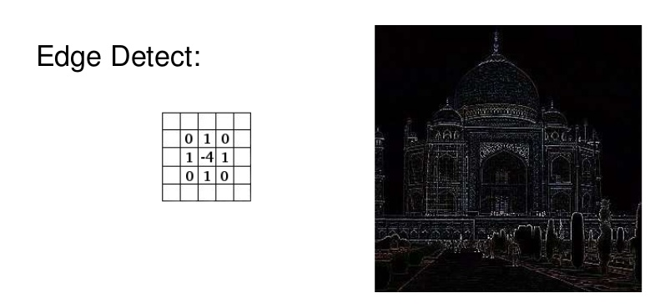
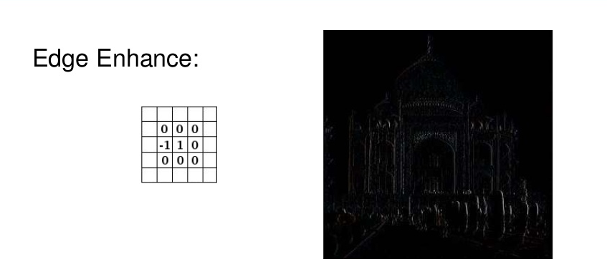
Convolutional
Different kind of filters / kernels in image processing!
http://setosa.io/ev/image-kernels/

Slide 39
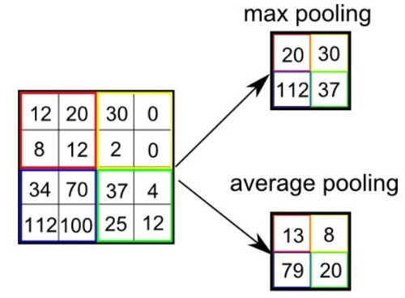
Pooling

Slide 40
Rectified Linear Unit
F(x) = max (0, x)
X
5
-4
0
4
10
-3

Slide 41
Convolutional Neural Network (Definition)
Definition: The name “convolutional neural network” indicates that the network employs a mathematical operation called convolution.
Convolutional networks are simply neural networks that use convolution in place of general matrix multiplication in at least one of their layers.

Slide 42
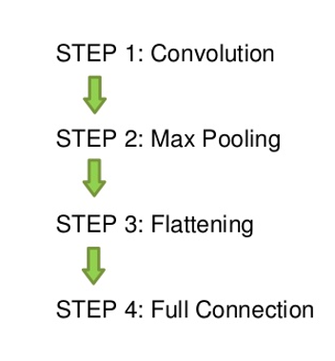
Steps in CNN

Slide 43
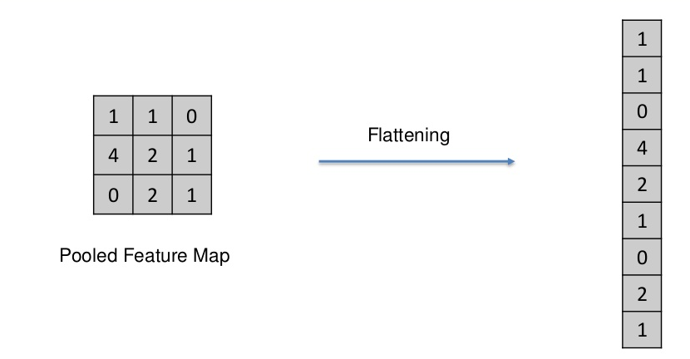
Flattening

Slide 44
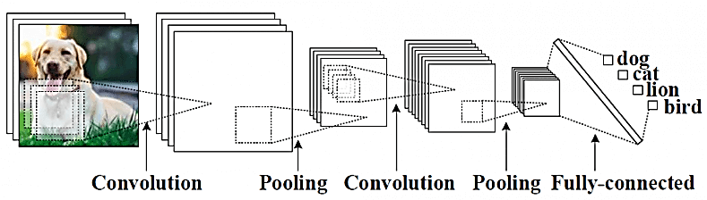
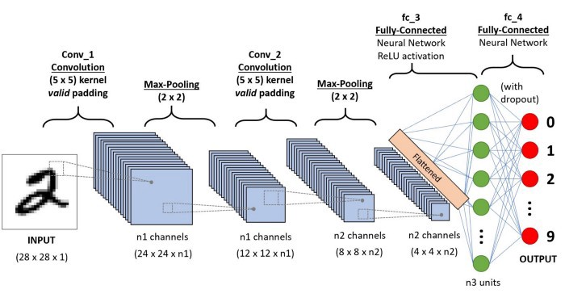
Architecture
A convolutional neural network consists of an input and an output layer, as well as multiple hidden layers.
The hidden layers of a CNN typically consist of a series of convolutional layers that convolve with a multiplication or other dot product.
ReLU is used comely as an activation function.

Slide 45
Thanks

