Slide 1
Convolutional Neural Network Lecture # 15 Dr. Muhammad Fayaz

Slide 2
Convolutional Neural Network

Slide 3
What is an Image?
An image may be defined as a two-dimensional function f(x , y) where x and y are spatial coordinates and amplitude of f at any pair of coordinates (x , y) is called the intensity or Gray level of the image at that point.

Slide 4
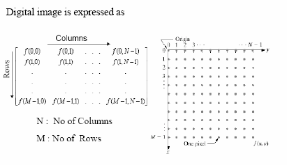
Digital Image
When x , y and the amplitude values of f are all finite, discrete quantities, we call the image a Digital Image.
A digital Image is composed of a finite number of elements each of which has a particular location and value
These elements are referred to as Picture Elements, Image Elements, Pels or Pixels
Further we will explain different types of images with respect to colorization

Slide 5
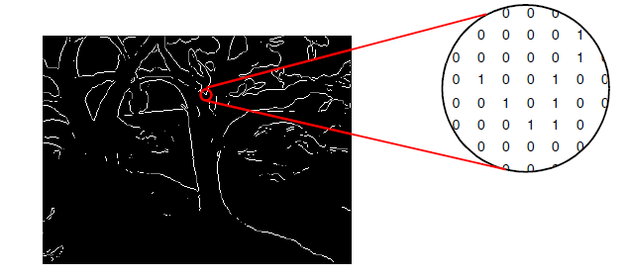
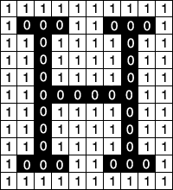
Types of Digital Image
Binary Image: A binary image is one that consists of pixels that can have one of exactly two colors, usually black and white.
Binary images are also called bi-level or two-level. This means that each pixel is stored as a single bit—i.e., a 0 or 1.
Here the 0 represents black and 1 represents white

Slide 6
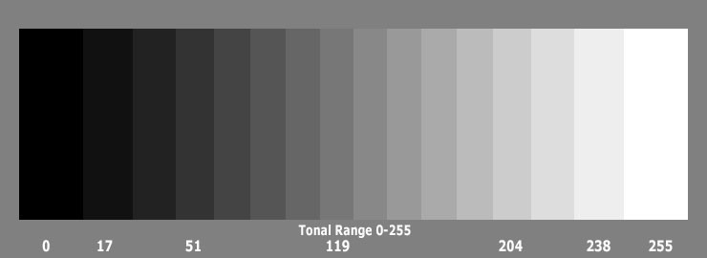
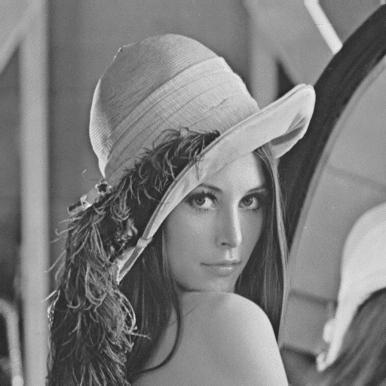
Types of Digital Images
Grayscale Image: A grayscale image (also called gray-scale, gray scale, or gray-level) is a data matrix whose values represent intensities within some range.

Slide 7
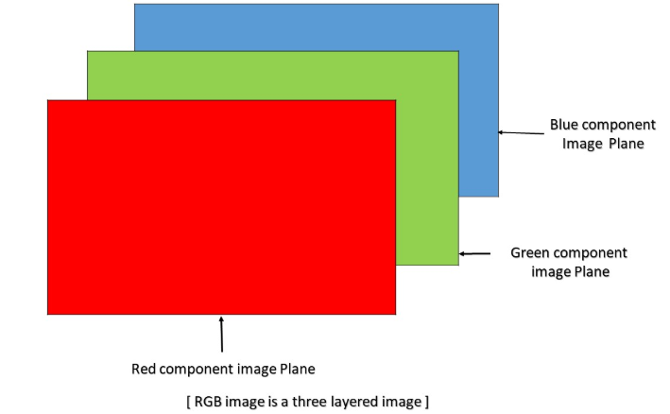
Types of Digital Image
Color (RGB) Image: An RGB image can be viewed as three different images(a red scale image, a green scale image and a blue scale image) stacked on top of each other, and when feed into the red, green and blue inputs of a color monitor, it produces a color image on the screen.
An RGB image is sometimes referred to as a true color image as the precision with which a real-life image can be replicated has led to the nickname “true color image.”

Slide 8
Convolutional Neural Network

Slide 9
Why Convolutional Neural Network?

Slide 10
Prerequisite
Convolution
Pooling
ReLU Activation Function
Flattening
ANN

Slide 11
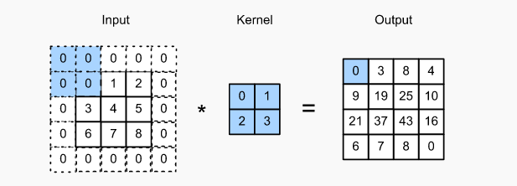
Convolutional
Convolution is a simple mathematical operation which is fundamental to many common image processing operators.
Convolution provides a way of `multiplying together' two arrays of numbers, generally of different sizes, but of the same dimensionality, to produce a third array of numbers of the same dimensionality.

Slide 12
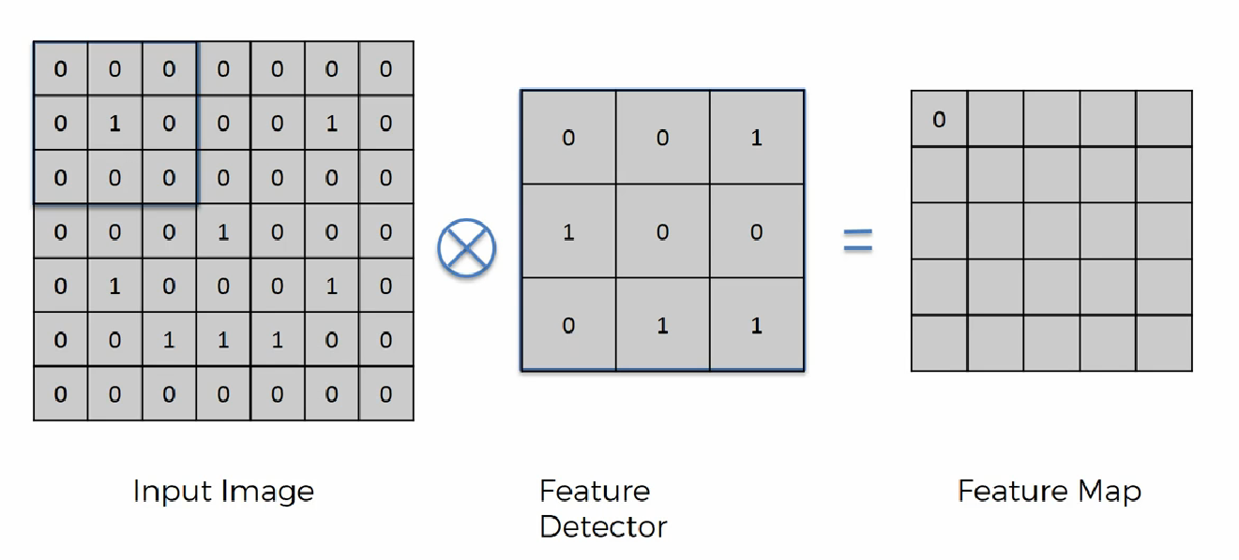
Convolution

Slide 13
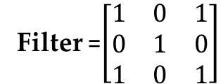
Convolutional
Filter =$\left[\begin{matrix}1 & 0 & 1 \\ 0 & 1 & 0 \\ 1 & 0 & 1\end{matrix}\right]$

Slide 14
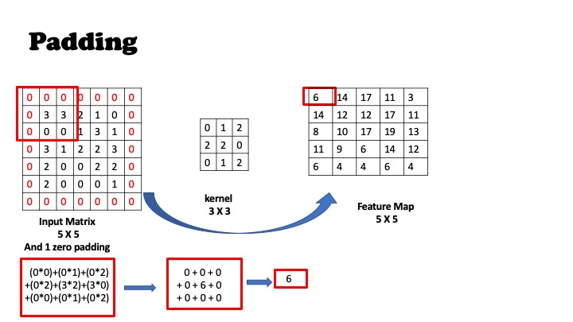
Convolution
Padding: Padding is a term relevant to convolutional as it refers to the number of pixels added to an image when it is being processed by the kernel/filter.
Padding is used to obtain the image of original size.

Slide 15
Apply Convolution Operation with Padding and without Padding
25 | 53 | 55 | 126
44 | 54 | 110 | 40
0 | 7 | 0 | 0
4 | 4 | 5 | 2
10 | 9 | 2 | 3
30 | 90 | 53 | 23
1 | 0 | 1
0 | 1 | 0
1 | 0 | 1
Filter
Input Image

Slide 16
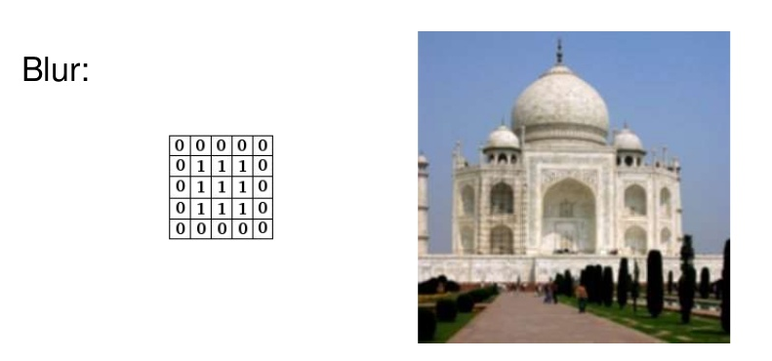
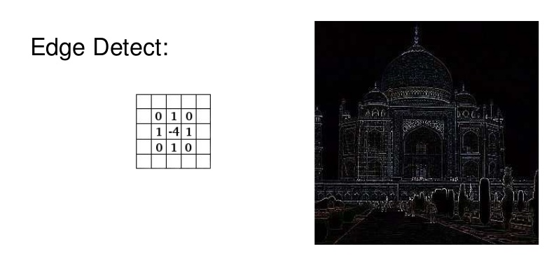
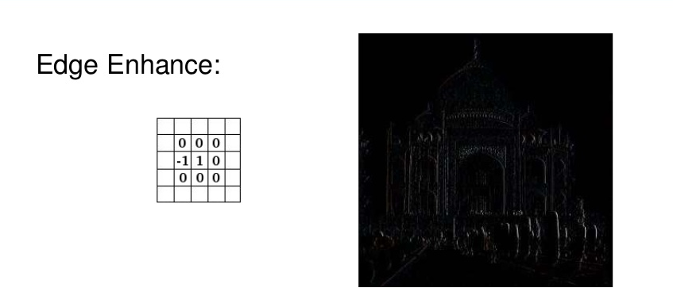
Convolutional
Different kind of filters / kernels in image processing!
http://setosa.io/ev/image-kernels/

Slide 17
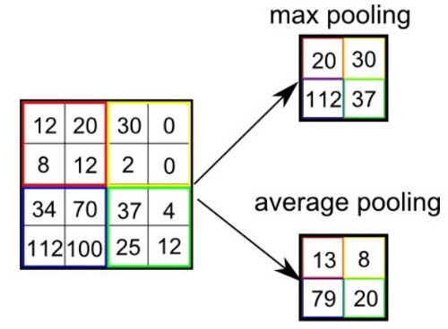
Pooling

Slide 18
Apply Max Pooling Operation
25 | 53 | 55 | 126 | 55
44 | 54 | 110 | 40 | 30
0 | 7 | 0 | 0 | 32
4 | 4 | 5 | 2 | 12
10 | 9 | 2 | 3 | 5
Input Image

Slide 19
Rectified Linear Unit
F(x) = max (0, x)
X
5
-4
0
4
10
-3

Slide 20
Apply Rectified Linear Unit
F(x) = max (0, x)
5 | 5 | 5 | 6
-4 | -4 | -10 | -4
0 | 7 | 0 | 0
4 | 4 | 5 | 2
10 | 9 | 2 | 3
-3 | -9 | -3 | -3

Slide 21
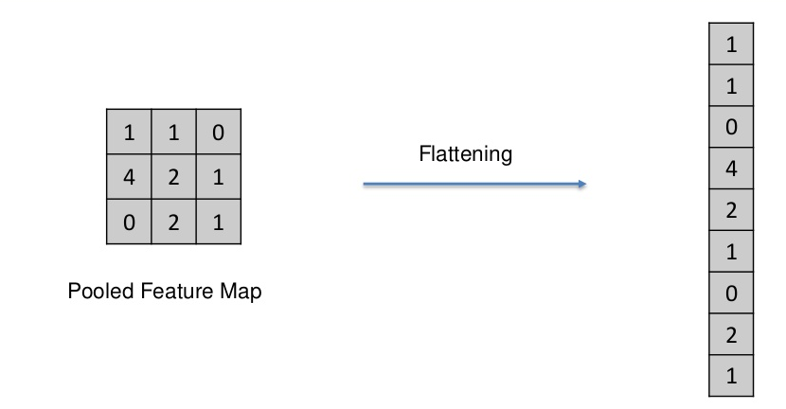
Flattening

Slide 22
Apply Flatting Operation
5 | 5 | 5 | 6
-4 | -4 | -10 | -4
0 | 7 | 0 | 0
4 | 4 | 5 | 2
10 | 9 | 2 | 3
-3 | -9 | -3 | -3

Slide 23
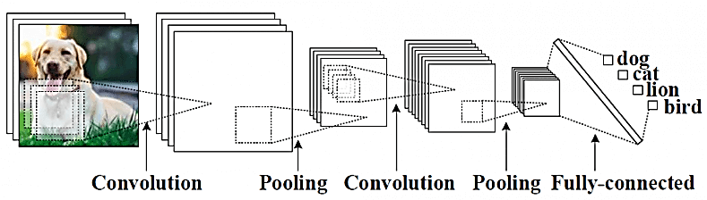
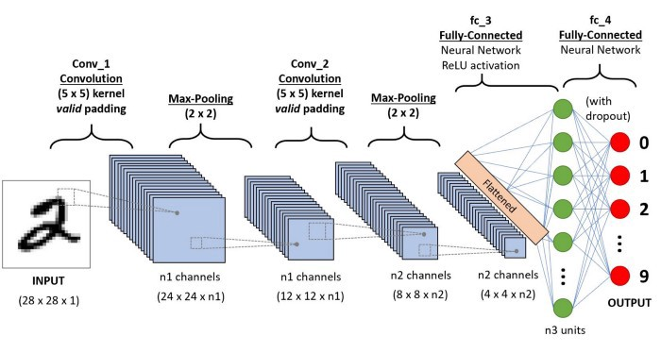
Architecture
A convolutional neural network consists of an input and an output layer, as well as multiple hidden layers.
The hidden layers of a CNN typically consist of a series of convolutional layers that convolve with a multiplication or other dot product.
ReLU is used comely as an activation function.

Slide 24
Convolutional Neural Network (Definition)
Definition: The name “convolutional neural network” indicates that the network employs a mathematical operation called convolution.
Convolutional networks are simply neural networks that use convolution in place of general matrix multiplication in at least one of their layers.

Slide 25
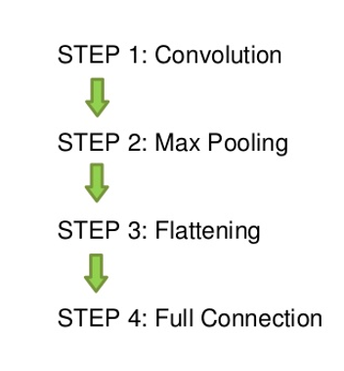
Steps in CNN

Slide 26
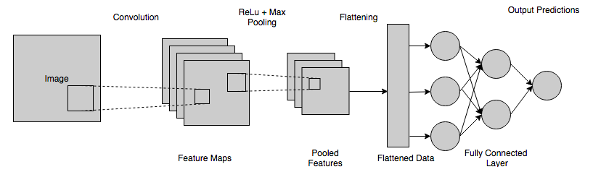

Architecture
A convolutional neural network consists of an input and an output layer, as well as multiple hidden layers.
The hidden layers of a CNN typically consist of a series of convolutional layers that convolve with a multiplication or other dot product.
ReLU is used comely as an activation function.
Filters

Slide 27
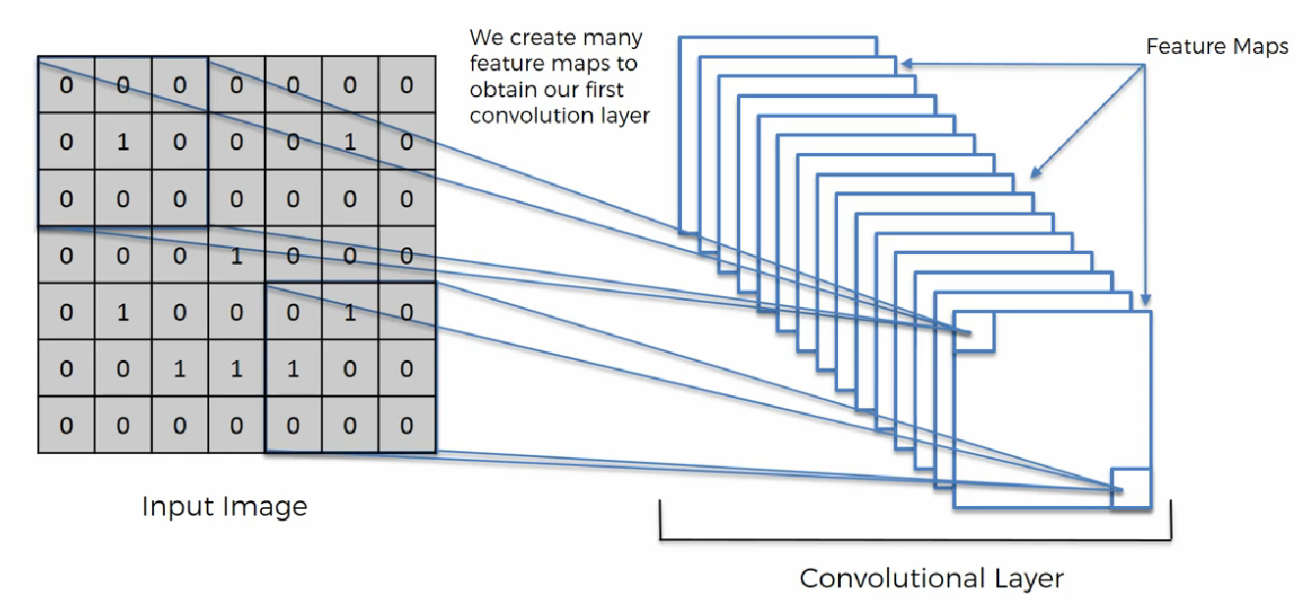
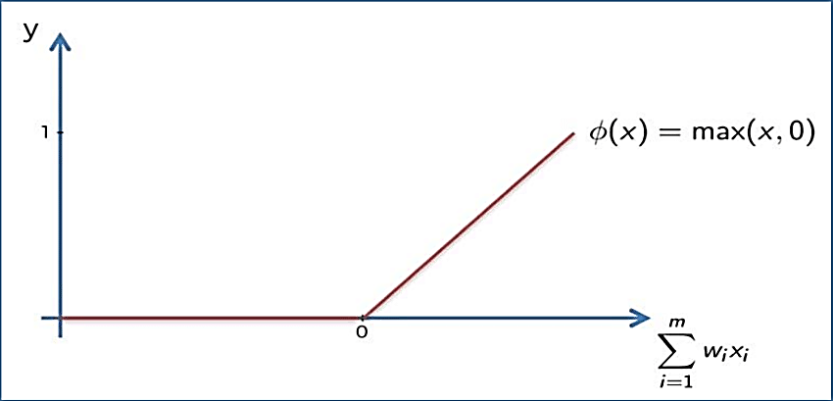
1. Convolutional Layer
The main purpose of a convolutional layer is to detect features or visual features in images such as edges, lines, color drops, etc.
This is a very interesting property because, once it has learned a characteristic at a specific point in the image, it can recognize it later in any part of it.
Appling ReLu Activation function to decrease the linearity in the image, because the image originally nonlinear!

Slide 28
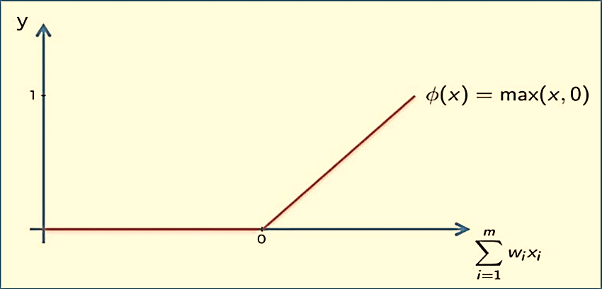
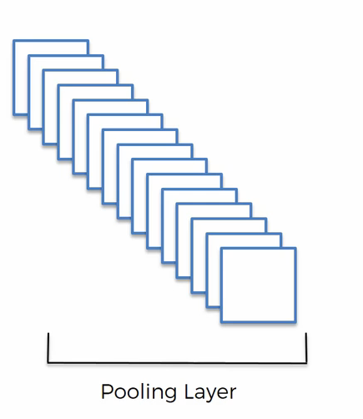
2. Pooling Layer
A pooling layer is another building block of a CNN. Its function is to progressively reduce the spatial size of the representation to reduce the number of parameters and computation in the network. Pooling layer operates on each feature map independently.
The most common approach used in pooling is max pooling.

Slide 29
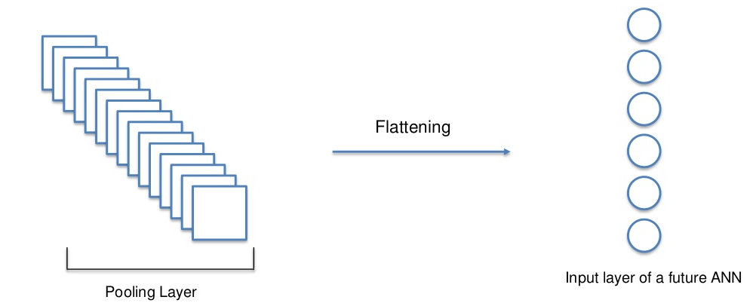
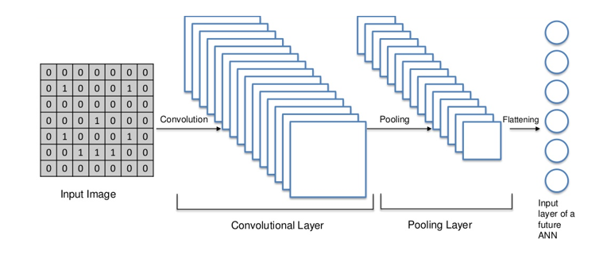
Flattening Layer

Slide 30
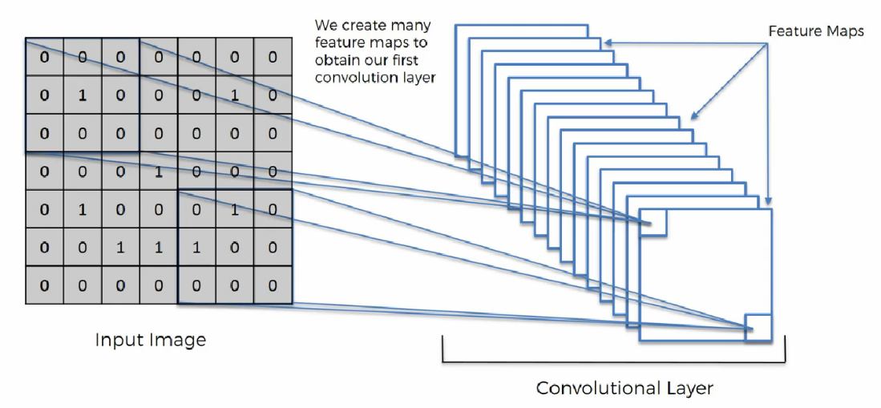
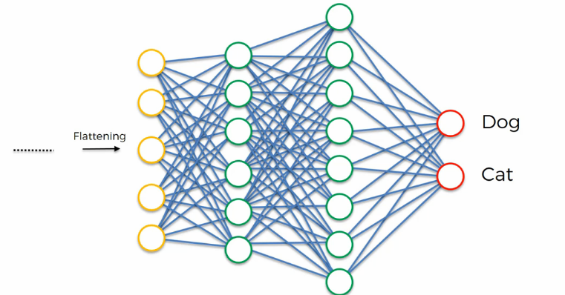
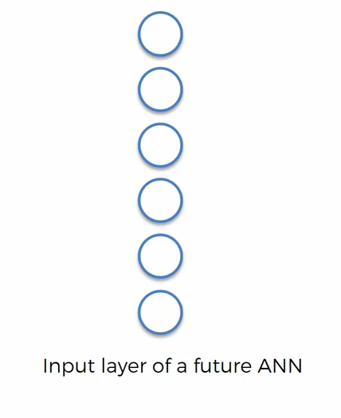
Complete Convolutional Neural Network in one View
Flattening Layer
Fully Connected Layer

Slide 31
Links
https://www.kdnuggets.com/2020/06/introduction-convolutional-neural-networks.html

Slide 32
Thanks

