Slide 1
Convolutional Neural Network Lecture # 16 Dr. Muhammad Fayaz

Slide 2
Convolutional Neural Network

Slide 3
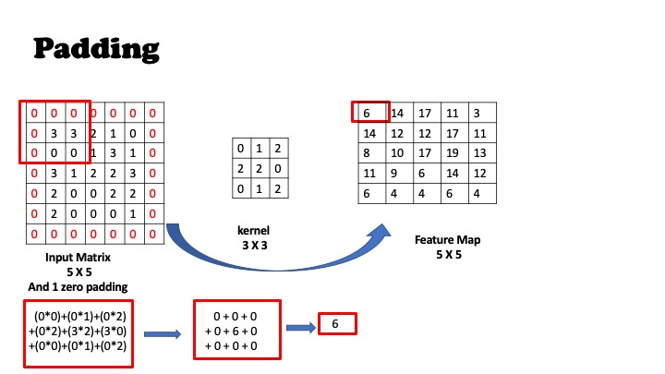
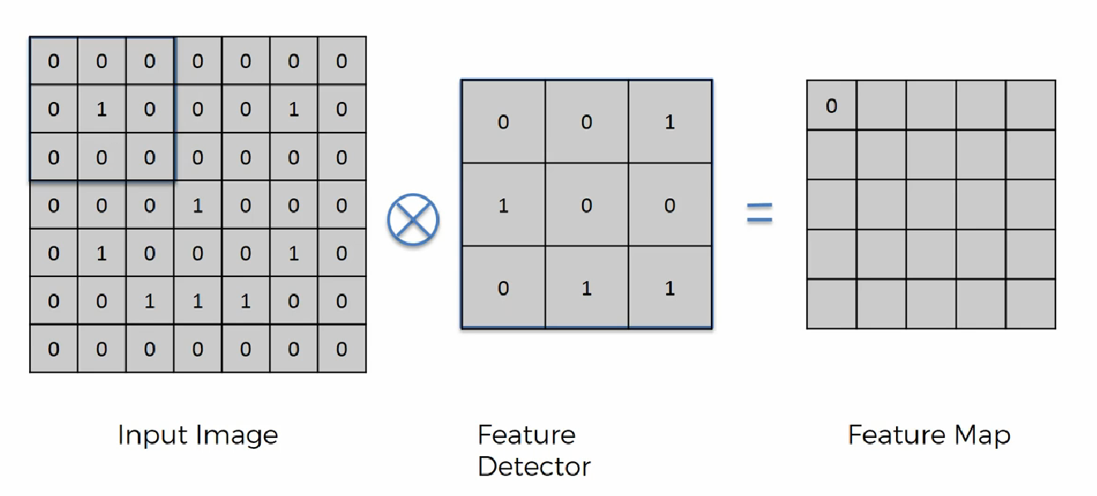
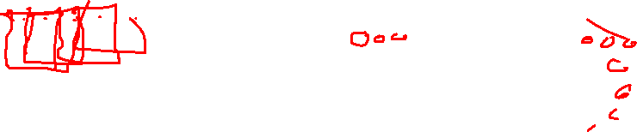
Convolution
Padding: Padding is a term relevant to convolutional as it refers to the number of pixels added to an image when it is being processed by the kernel/filter.
Padding is used to obtain the image of original size.

Slide 4
Apply Convolution Operation with Padding and without Padding
25 | 53 | 55 | 126
44 | 54 | 110 | 40
0 | 7 | 0 | 0
4 | 4 | 5 | 2
10 | 9 | 2 | 3
30 | 90 | 53 | 23
1 | 0 | 1
0 | 1 | 0
1 | 0 | 1
Filter
Input Image

Slide 5
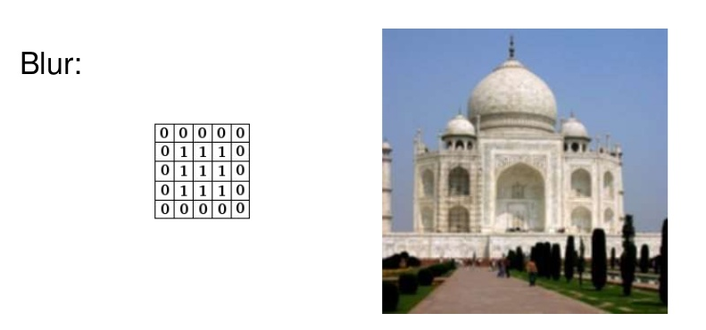
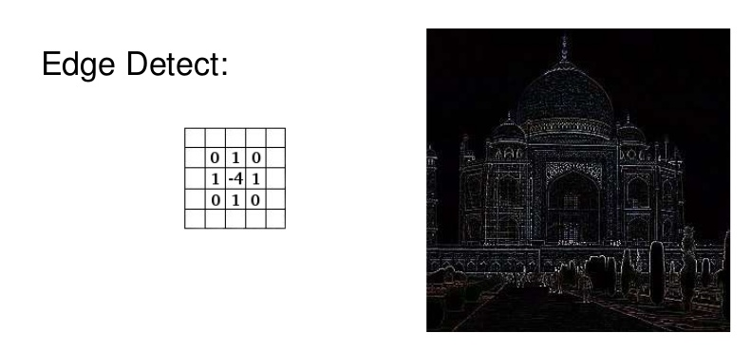
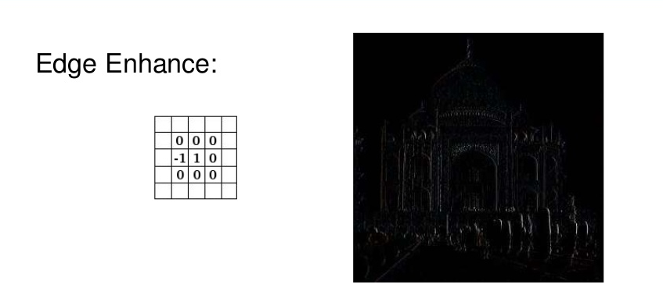
Convolutional
Different kind of filters / kernels in image processing!
http://setosa.io/ev/image-kernels/

Slide 6
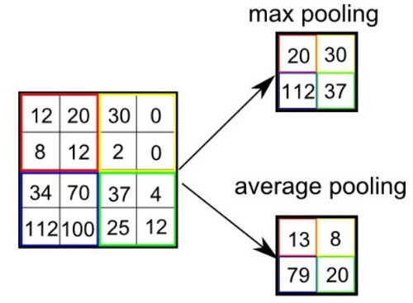
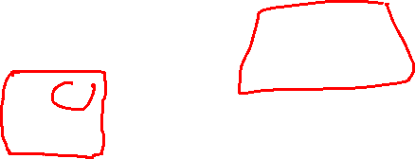
Pooling

Slide 7
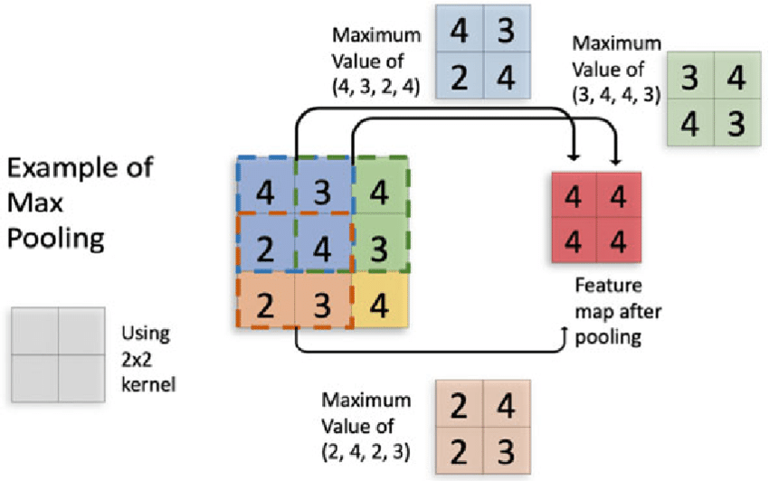
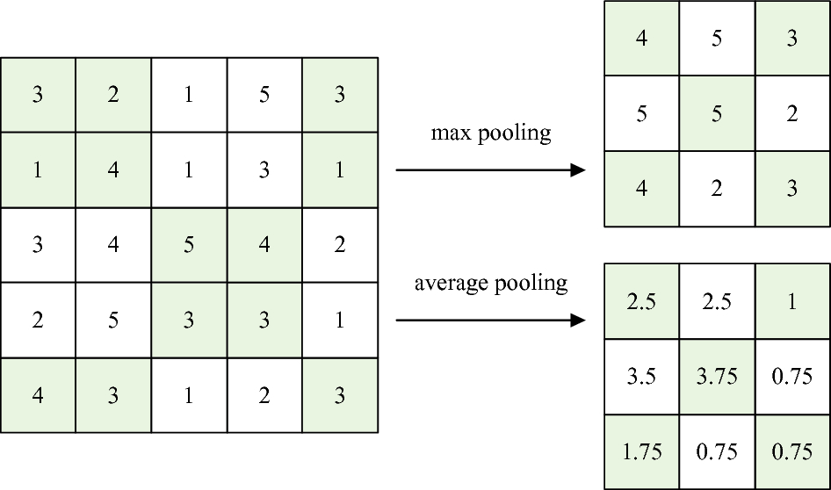
Pooling

Slide 8
Apply Max Pooling Operation
25 | 53 | 55 | 126 | 55
44 | 54 | 110 | 40 | 30
0 | 7 | 0 | 0 | 32
4 | 4 | 5 | 2 | 12
10 | 9 | 2 | 3 | 5
Input Image

Slide 9
Rectified Linear Unit
F(x) = max (0, x)
X
5
-4
0
4
10
-3

Slide 10
Apply Rectified Linear Unit
F(x) = max (0, x)
5 | 5 | 5 | 6
-4 | -4 | -10 | -4
0 | 7 | 0 | 0
4 | 4 | 5 | 2
10 | 9 | 2 | 3
-3 | -9 | -3 | -3

Slide 11
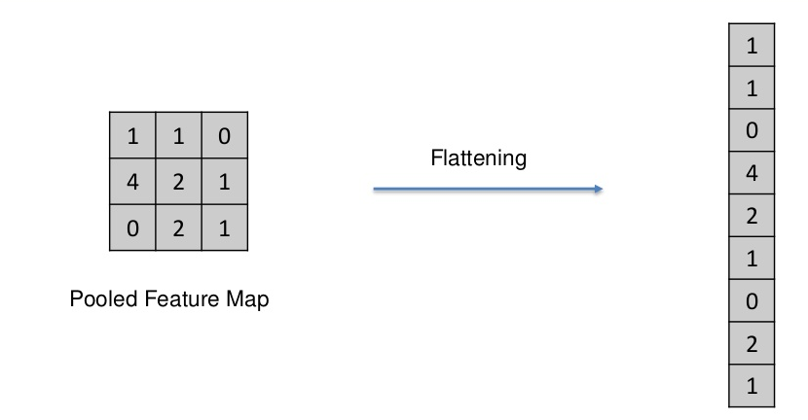
Flattening

Slide 12
Apply Flatting Operation
5 | 5 | 5 | 6
-4 | -4 | -10 | -4
0 | 7 | 0 | 0
4 | 4 | 5 | 2
10 | 9 | 2 | 3
-3 | -9 | -3 | -3

Slide 13
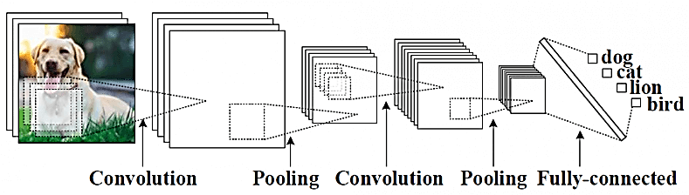
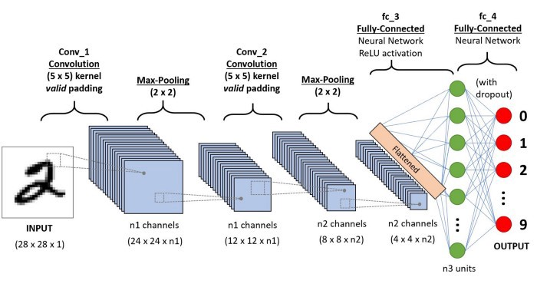
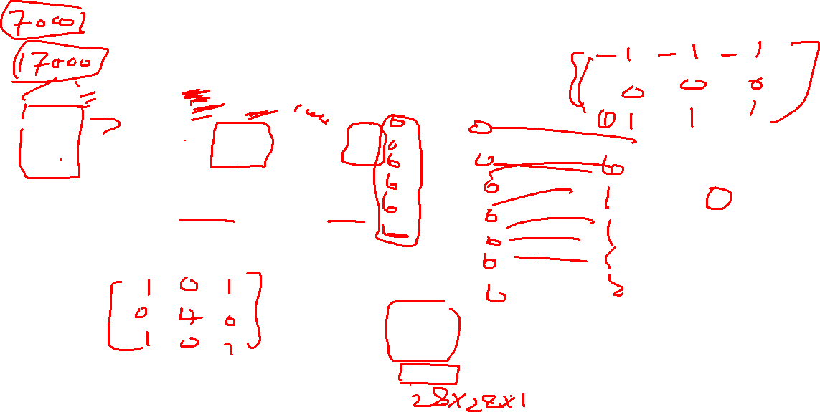
Architecture
A convolutional neural network consists of an input and an output layer, as well as multiple hidden layers.
The hidden layers of a CNN typically consist of a series of convolutional layers that convolve with a multiplication or other dot product.
ReLU is used comely as an activation function.

Slide 14
Convolutional Neural Network (Definition)
Definition: The name “convolutional neural network” indicates that the network employs a mathematical operation called convolution.
Convolutional networks are simply neural networks that use convolution in place of general matrix multiplication in at least one of their layers.

Slide 15
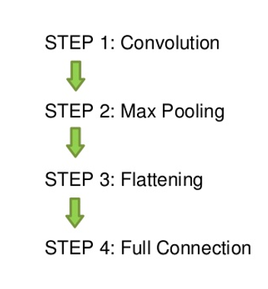
Steps in CNN

Slide 16
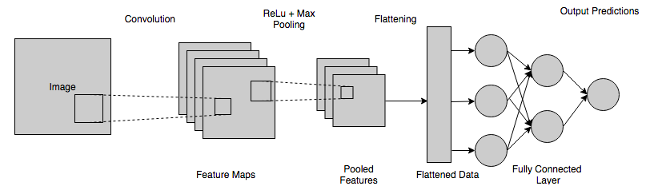

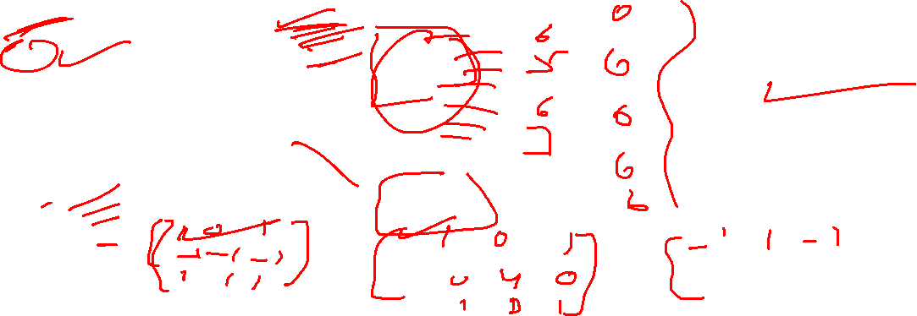
Architecture
A convolutional neural network consists of an input and an output layer, as well as multiple hidden layers.
The hidden layers of a CNN typically consist of a series of convolutional layers that convolve with a multiplication or other dot product.
ReLU is used comely as an activation function.
Filters

Slide 17
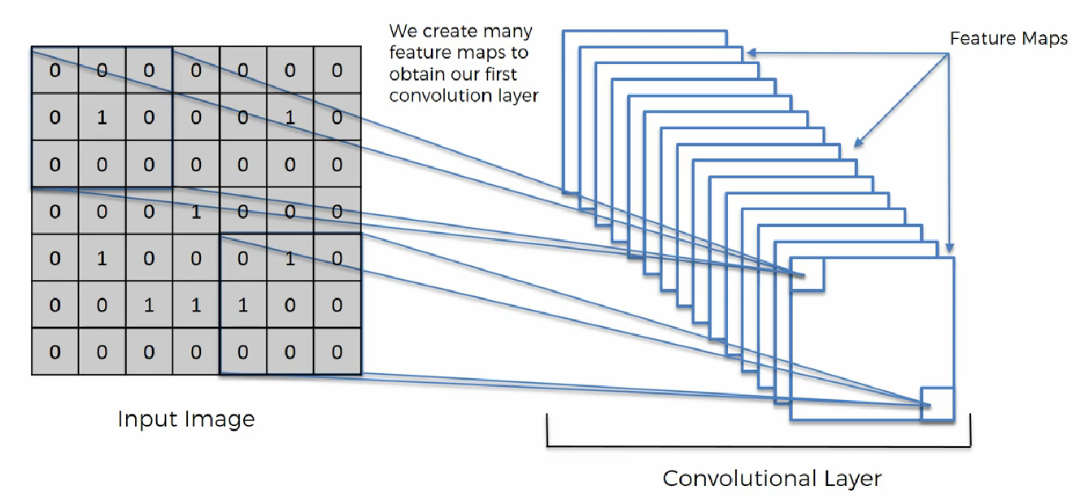
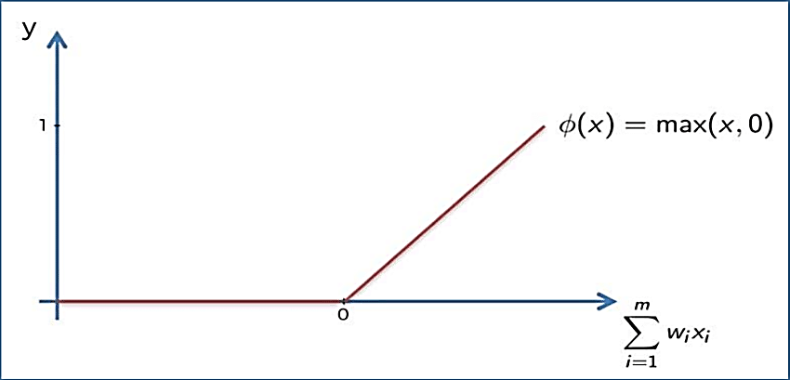
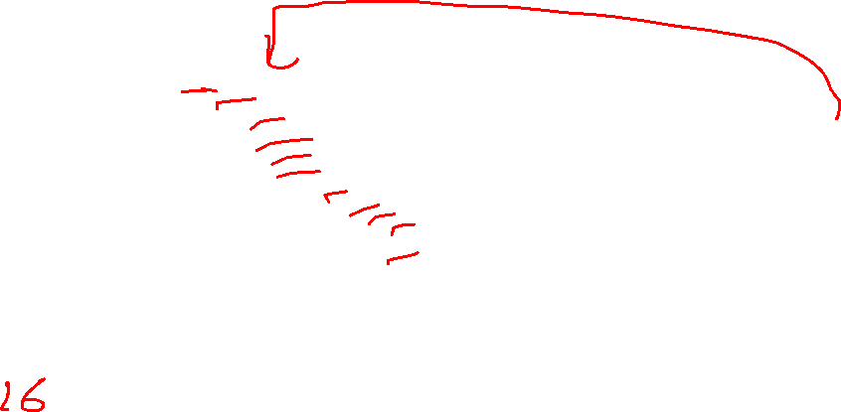
1. Convolutional Layer
The main purpose of a convolutional layer is to detect features or visual features in images such as edges, lines, color drops, etc.
This is a very interesting property because, once it has learned a characteristic at a specific point in the image, it can recognize it later in any part of it.
Appling ReLu Activation function to decrease the linearity in the image, because the image originally nonlinear!

Slide 18
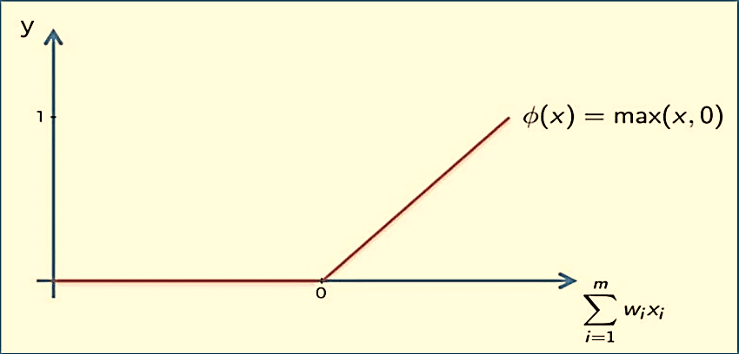
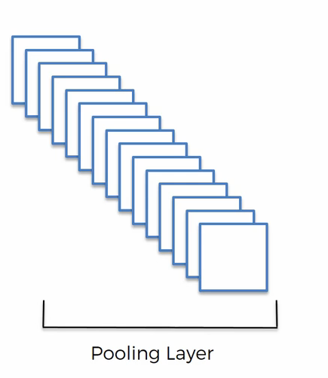
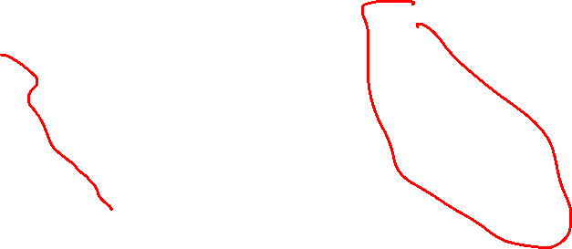
2. Pooling Layer
A pooling layer is another building block of a CNN. Its function is to progressively reduce the spatial size of the representation to reduce the number of parameters and computation in the network. Pooling layer operates on each feature map independently.
The most common approach used in pooling is max pooling.

Slide 19
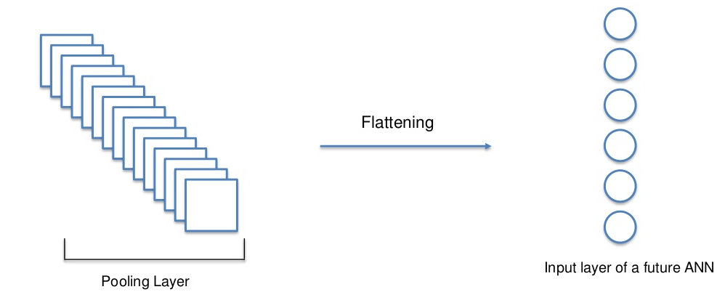
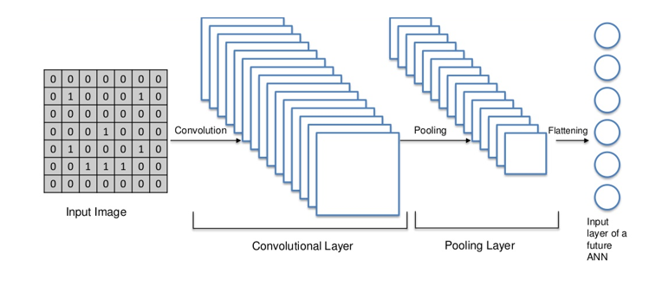
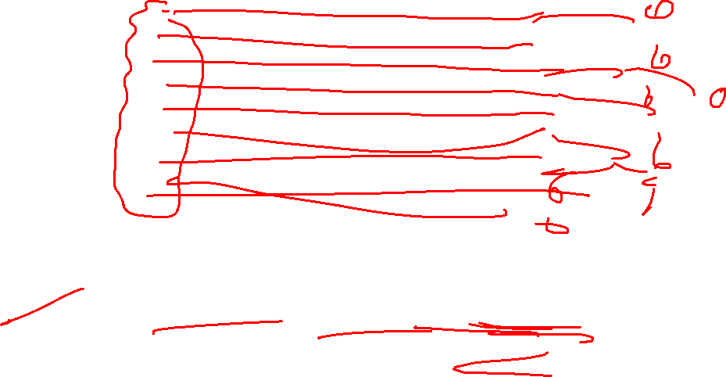
Flattening Layer

Slide 20
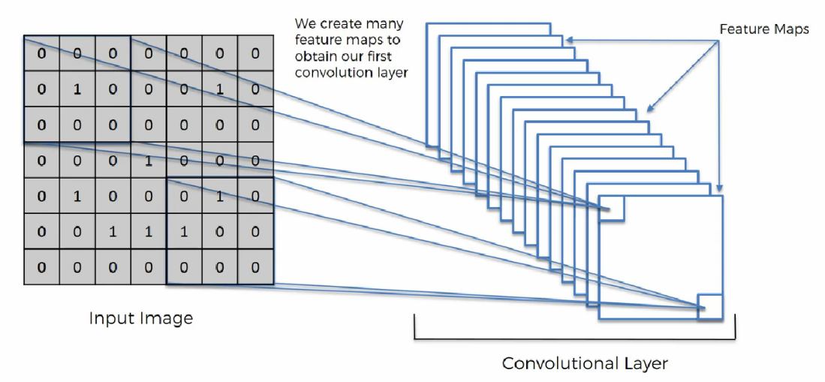
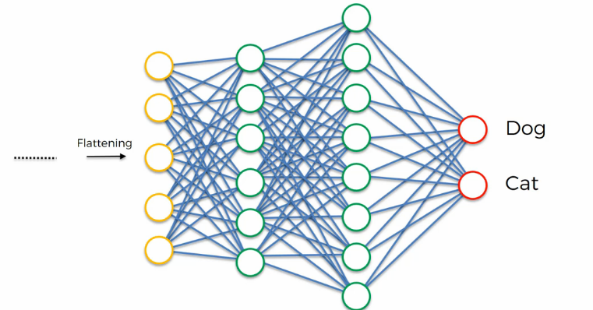
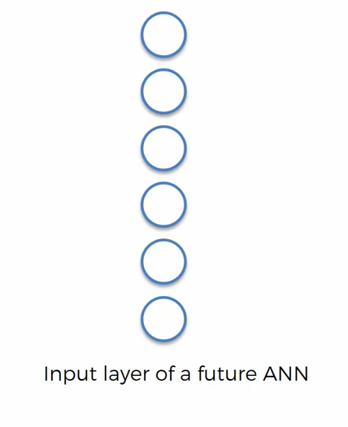

Complete Convolutional Neural Network in one View
Flattening Layer
Fully Connected Layer

Slide 21

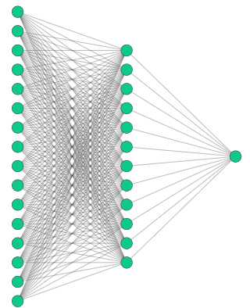
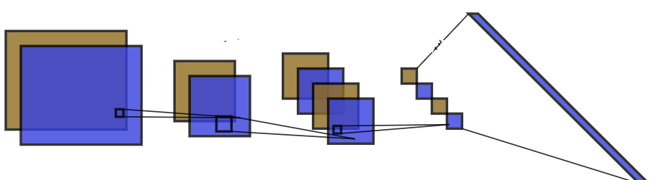
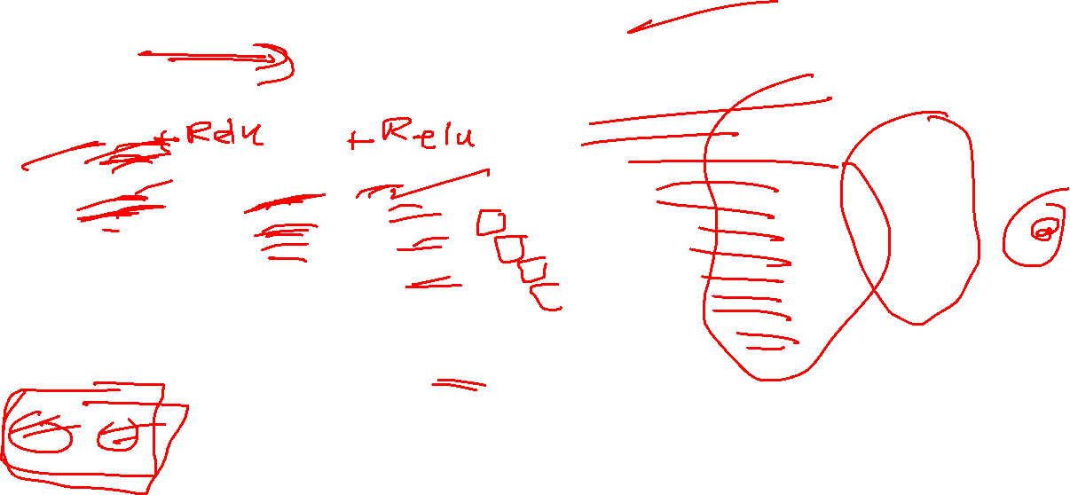
Complete Convolutional Neural Network Multiple Layers
Fully Connected Layer
Flattening Layer
Convolution Layer-1
Convolution Layer-2
Pooling Layer-1
Pooling Layer-2
Cat/Dog
Convolution-1 two filters + ReLU
Pooling (Max)
Convolution 2 two filters + ReLU
Pooling (Max)
Flattening
Artificial Neural Network
Filter 1
Filter 2

Slide 22
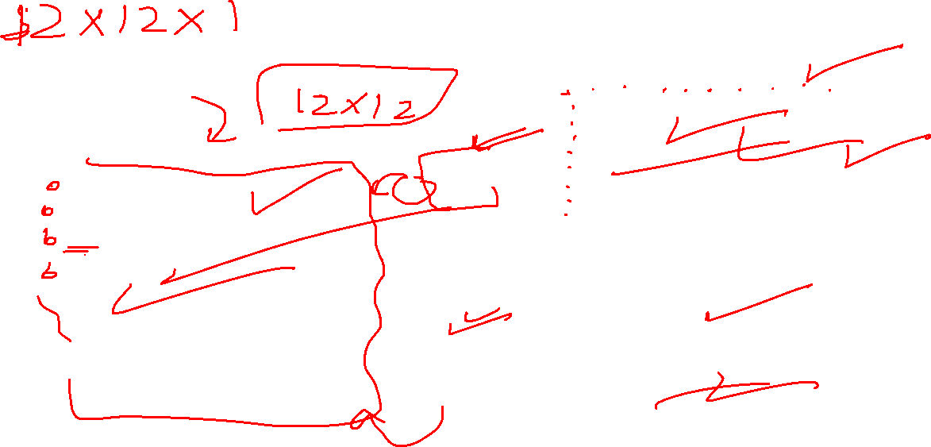
Example
Convolution (using filter 1)
86 | 6 | -127 | -135 | -76 | -33 | -65 | -105 | -84 | -22
-98 | -119 | -120 | -130 | -91 | -8 | 29 | 40 | 2 | 16
-134 | -23 | 70 | 97 | 19 | -56 | -92 | -20 | 19 | 81
126 | 44 | 70 | 71 | 77 | 12 | 5 | -7 | 27 | 5
-10 | -26 | -43 | -38 | 66 | 91 | 173 | 77 | 9 | -40
-4 | -10 | -63 | -47 | 15 | 27 | 16 | -46 | 32 | 44
83 | 46 | 44 | 13 | -80 | -51 | -102 | -63 | -12 | 13
-131 | 12 | 3 | 18 | -45 | 7 | -18 | -38 | -165 | -171
-71 | -83 | -64 | -60 | 59 | 110 | 65 | 79 | 17 | 11
73 | 42 | 83 | 77 | 8 | -63 | -45 | 18 | 94 | 128
Image (12 x 12)
46 | -30 | -7 | 45 | 27 | 12 | 16 | 25 | 20 | 39 | -17 | -42
-17 | 21 | 10 | 16 | 29 | 25 | -41 | 19 | 3 | 18 | 2 | 5
50 | 40 | 5 | -31 | -36 | 16 | -1 | 5 | -8 | -18 | -16 | -8
-26 | -43 | -15 | -14 | -36 | -10 | -32 | 37 | 5 | 38 | -18 | 21
-13 | -17 | -9 | 17 | 0 | 29 | -31 | -34 | -31 | 24 | -16 | 31
40 | -14 | 16 | -30 | 19 | 22 | -42 | 27 | 30 | 16 | 6 | 24
-46 | 45 | -48 | -32 | 45 | -5 | 24 | 36 | 17 | -17 | -14 | 30
41 | -7 | 4 | -35 | -27 | 26 | 15 | -7 | 23 | 11 | 50 | 29
14 | 18 | 2 | -9 | 16 | 14 | -46 | 36 | -15 | -48 | 37 | 23
-46 | 2 | -49 | 21 | -27 | -12 | 8 | 45 | -40 | -16 | -25 | -40
-15 | -45 | 23 | -50 | -28 | 39 | 32 | 43 | -35 | 44 | -18 | -3
-4 | 21 | -37 | 32 | 33 | -6 | -50 | 34 | -16 | -11 | 40 | 18
Filter 1
-1 | -1 | -1
0 | 0 | 0
1 | 1 | 1
*
=
Filter 2
1 | 0 | -1
1 | 0 | -1
1 | 0 | -1
Convolution (using filter 2)
71 | 1 | -12 | -23 | 46 | 4 | -41 | 10 | 46 | 84
7 | 47 | 43 | -60 | 31 | -30 | -74 | 23 | 32 | 20
30 | 8 | 53 | -63 | -8 | 27 | -30 | -36 | 16 | 0
9 | -47 | 9 | -68 | 88 | 11 | -109 | -48 | 32 | 2
22 | 59 | -105 | -91 | 113 | 17 | -65 | 6 | 40 | -62
63 | 121 | -65 | -140 | 40 | -13 | -73 | 46 | 28 | -73
51 | 132 | -76 | -111 | 41 | -30 | -32 | 119 | -48 | -136
52 | 36 | -5 | -51 | -15 | -46 | 9 | 127 | -94 | -65
-23 | 13 | 15 | -79 | -33 | -83 | 84 | 144 | -84 | 0
-2 | -25 | -41 | -18 | -12 | -101 | 81 | 105 | -88 | 42
*
=

Slide 23
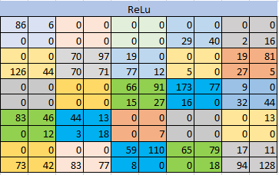
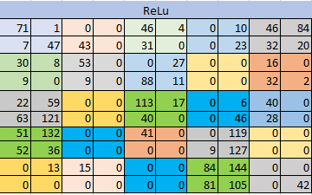
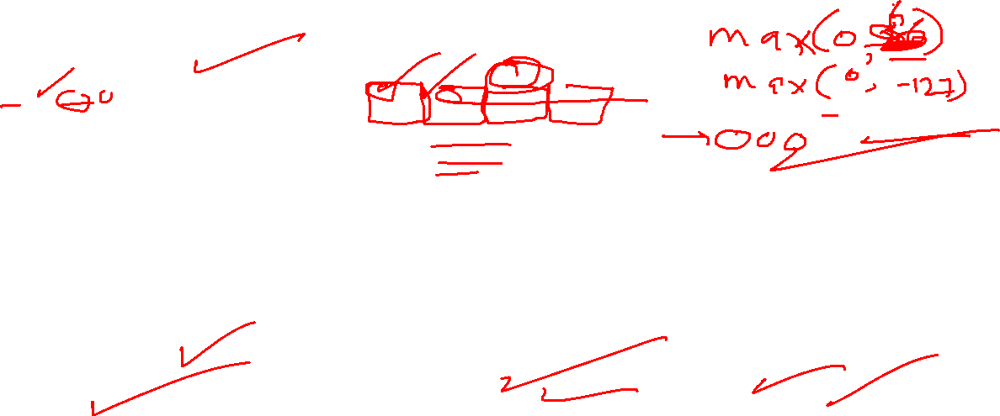
Example
Convolution (using filter 1)
86 | 6 | -127 | -135 | -76 | -33 | -65 | -105 | -84 | -22
-98 | -119 | -120 | -130 | -91 | -8 | 29 | 40 | 2 | 16
-134 | -23 | 70 | 97 | 19 | -56 | -92 | -20 | 19 | 81
126 | 44 | 70 | 71 | 77 | 12 | 5 | -7 | 27 | 5
-10 | -26 | -43 | -38 | 66 | 91 | 173 | 77 | 9 | -40
-4 | -10 | -63 | -47 | 15 | 27 | 16 | -46 | 32 | 44
83 | 46 | 44 | 13 | -80 | -51 | -102 | -63 | -12 | 13
-131 | 12 | 3 | 18 | -45 | 7 | -18 | -38 | -165 | -171
-71 | -83 | -64 | -60 | 59 | 110 | 65 | 79 | 17 | 11
73 | 42 | 83 | 77 | 8 | -63 | -45 | 18 | 94 | 128
Max pooling (2x2)
86 | 0 | 0 | 40 | 16
126 | 97 | 77 | 5 | 81
0 | 0 | 91 | 173 | 44
83 | 44 | 7 | 0 | 13
73 | 83 | 110 | 79 | 128
Convolution (using filter 2)
71 | 1 | -12 | -23 | 46 | 4 | -41 | 10 | 46 | 84
7 | 47 | 43 | -60 | 31 | -30 | -74 | 23 | 32 | 20
30 | 8 | 53 | -63 | -8 | 27 | -30 | -36 | 16 | 0
9 | -47 | 9 | -68 | 88 | 11 | -109 | -48 | 32 | 2
22 | 59 | -105 | -91 | 113 | 17 | -65 | 6 | 40 | -62
63 | 121 | -65 | -140 | 40 | -13 | -73 | 46 | 28 | -73
51 | 132 | -76 | -111 | 41 | -30 | -32 | 119 | -48 | -136
52 | 36 | -5 | -51 | -15 | -46 | 9 | 127 | -94 | -65
-23 | 13 | 15 | -79 | -33 | -83 | 84 | 144 | -84 | 0
-2 | -25 | -41 | -18 | -12 | -101 | 81 | 105 | -88 | 42
Max pooling (2x2)
47 | 43 | 46 | 23 | 84
30 | 53 | 88 | 0 | 32
63 | 0 | 113 | 46 | 40
132 | 0 | 41 | 127 | 0
13 | 15 | 0 | 144 | 42

Slide 24




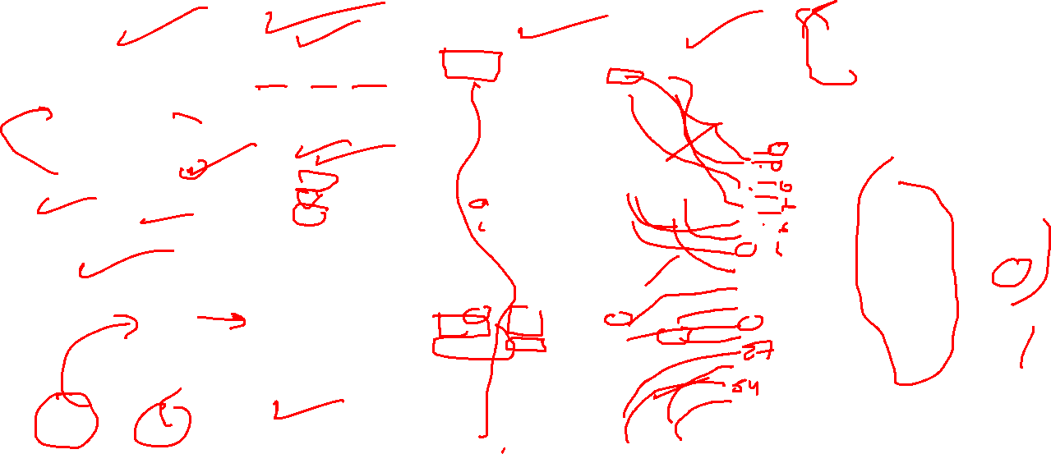
Example
Max pooling (2x2)
86 | 0 | 0 | 40 | 16
126 | 97 | 77 | 5 | 81
0 | 0 | 91 | 173 | 44
83 | 44 | 7 | 0 | 13
73 | 83 | 110 | 79 | 128
Convolution image 1 filter 1
5 | 224 | 252
-209 | -128 | -143
175 | 8 | 9
Max Pool (2 × 2)
224 | 252
175 | 9
Flattening Layer
224
252
175
9
44
37
125
23
47
48
148
13
107
170
302
72
Filter 1
-1 | -1 | -1
0 | 0 | 0
1 | 1 | 1
Filter 2
1 | 0 | -1
1 | 0 | -1
1 | 0 | -1
Convolution image 1 filter 2
44 | -121 | 27
34 | -37 | 37
-52 | -125 | 23
Max Pool (2 × 2)
121 | 37
0 | 23
Max pooling (2x2)
47 | 43 | 46 | 23 | 84
30 | 53 | 88 | 0 | 32
63 | 0 | 113 | 46 | 40
132 | 0 | 41 | 127 | 0
13 | 15 | 0 | 144 | 42
Convolution image 2 filter 1
40 | 47 | 46
2 | 27 | 48
-148 | 0 | -13
Max Pool (2 × 2)
47 | 48
0 | 13
0/1
Filter 1
-1 | -1 | -1
0 | 0 | 0
1 | 1 | 1
Filter 2
1 | 0 | -1
1 | 0 | -1
1 | 0 | -1
Convolution image 2 filter 2
-107 | 27 | 91
-17 | -120 | 170
54 | -302 | 72
Max Pool (2 × 2)
27 | 170
54 | 72

Slide 25
Links
https://www.kdnuggets.com/2020/06/introduction-convolutional-neural-networks.html

Slide 26
Thanks

