Slide 1
Convolutional Neural Network Lecture # 17 Dr. Muhammad Fayaz

Slide 2
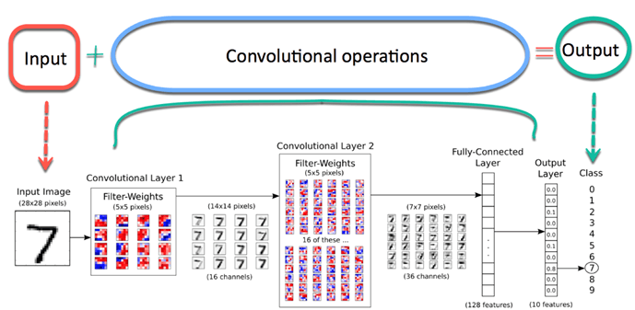
MNIST CNN
https://www.guru99.com/convnet-tensorflow-image-classification.html

Slide 3
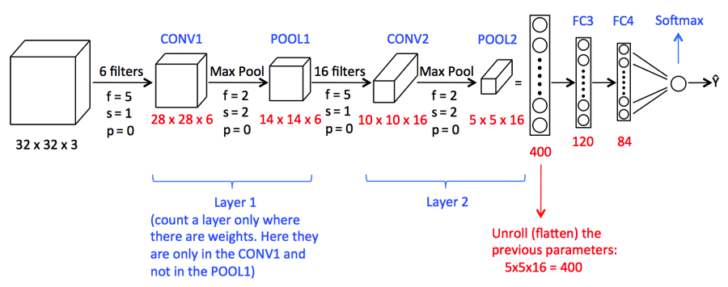
Image Classification using Convolutional Neural Network
https://www.analyticsvidhya.com/blog/2021/06/image-classification-using-convolutional-neural-network-with-python/

Slide 4
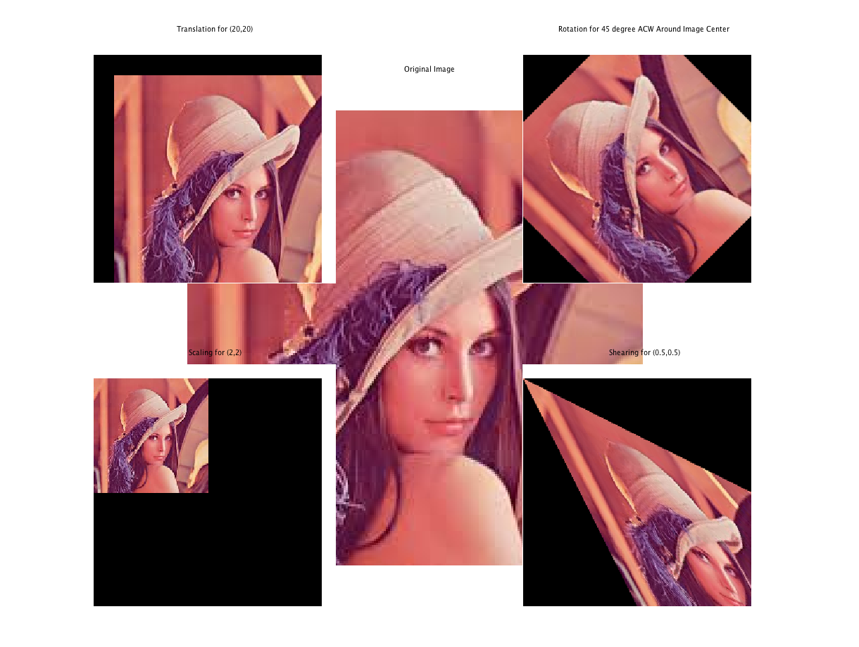
Shear of an Image

Slide 5
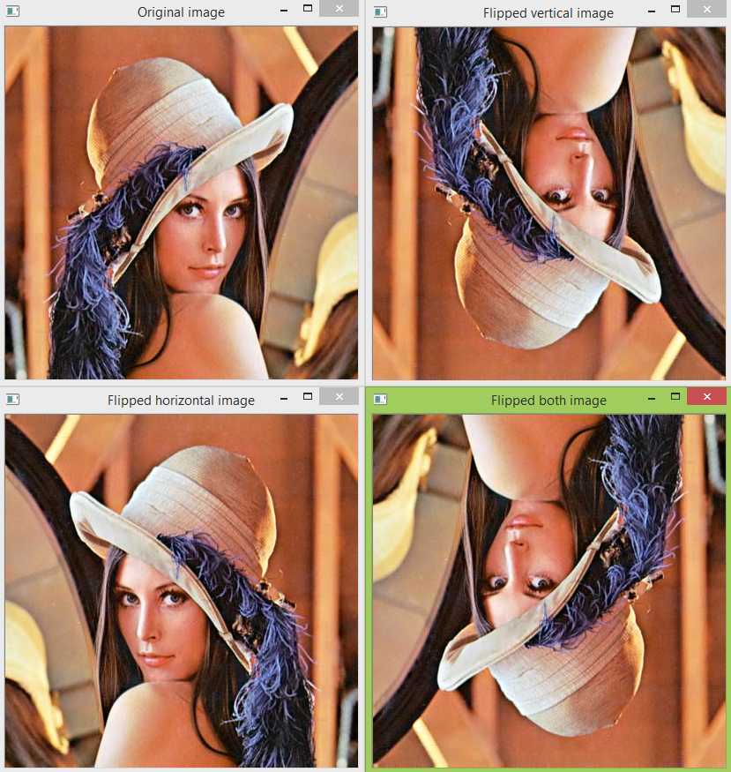
Flipping an Image

Slide 6
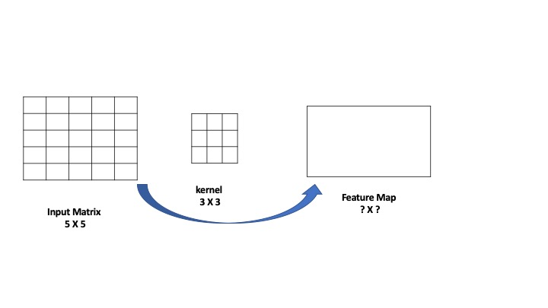
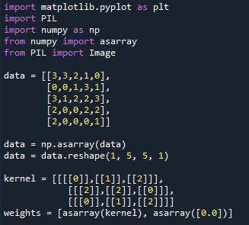
Step-1: Convolution Layer

Slide 7
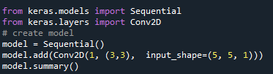
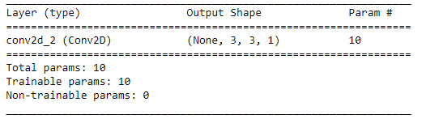
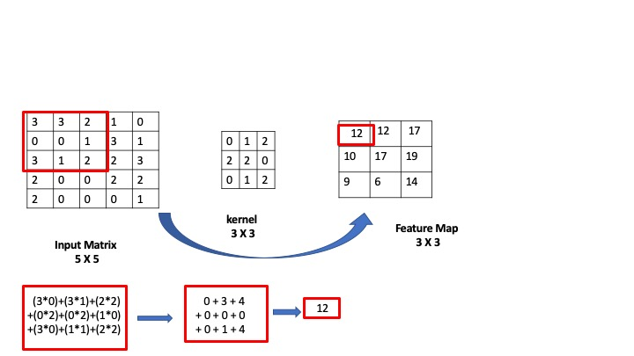
Step-1: Convolution Layer-without padding
Convolution without Padding

Slide 8
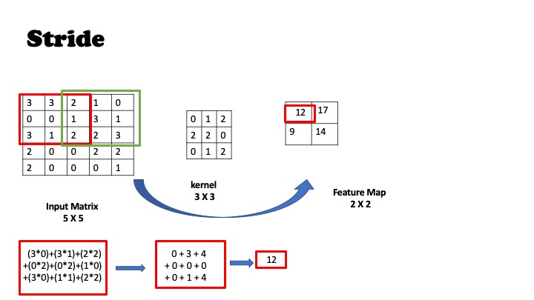
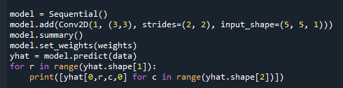
Step-1: Convolution Layer
Stride
Convolution with [2,2] strides

Slide 9
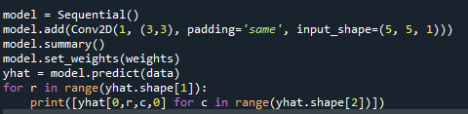
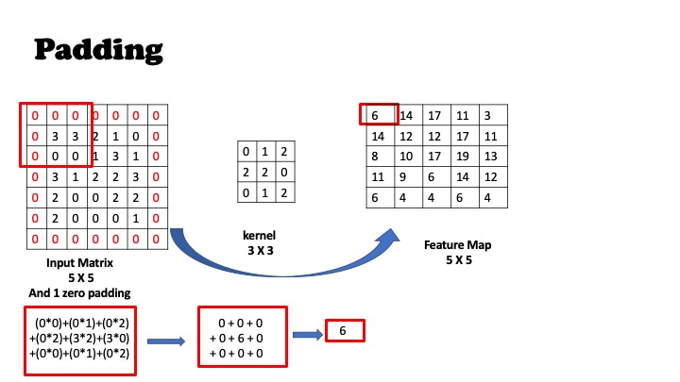
Step-1: Convolution Layer-with padding
Convolution without Padding
Convolution with Padding

Slide 10
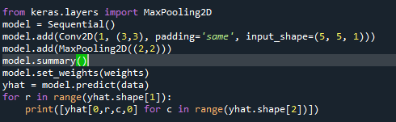
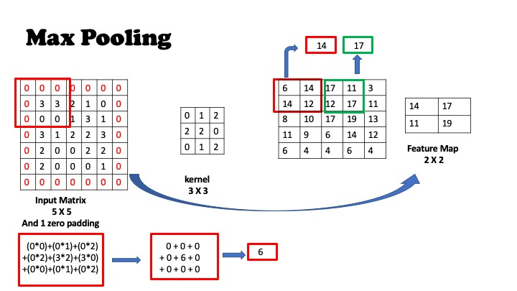

Step-2: Pooling Layer-Max Pooling

Slide 11
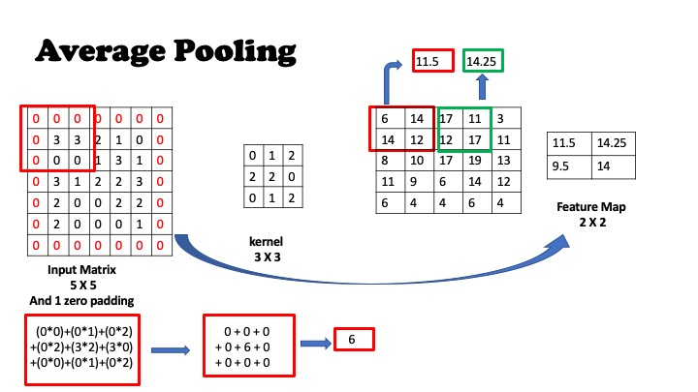

Step-2: Pooling Layer-Average Pooling

Slide 12
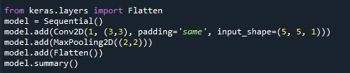
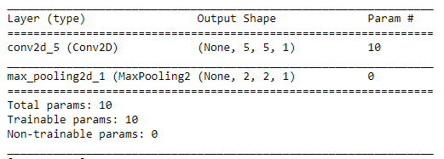
Step-3: Flattening Layer

Slide 13
Link
https://github.com/binodsuman/deep-learning/blob/master/CNN_Kernel_Stride_Padding_Pooling.ipynb

Slide 14
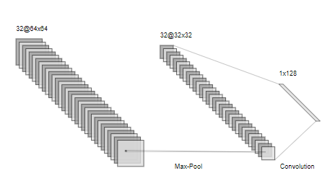
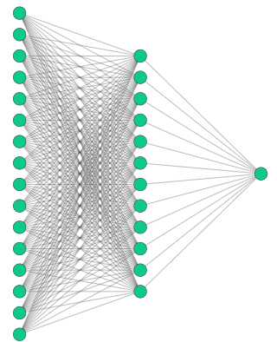
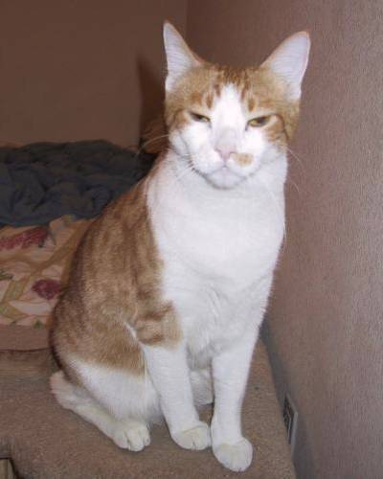
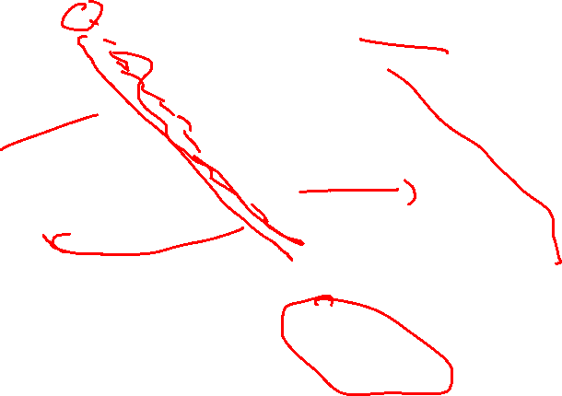
Implementation
Convolution Layer 1
(Convolution + ReLU)
Pooling Layer
Fully Connected Layer
Flattening Layer
Input Image
128 Nodes
32 Filters

Slide 15
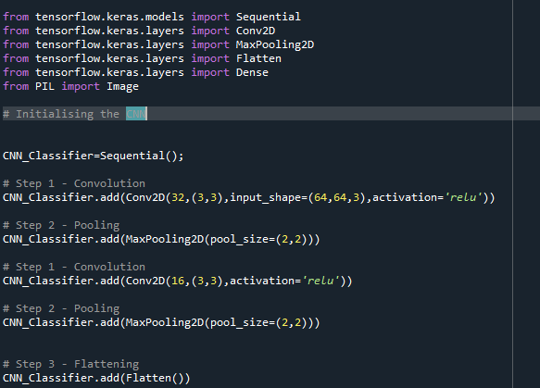

Implementation

Slide 16
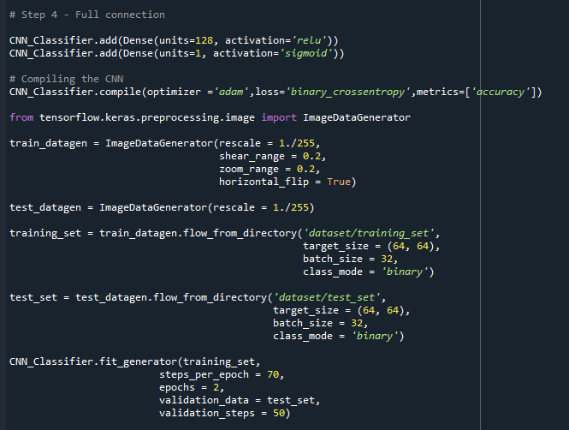
Implementation

Slide 17
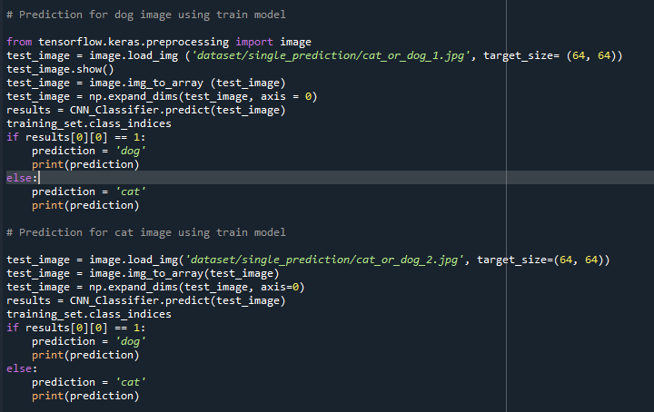
Implementation

Slide 18
Cats and Dog Dataset
https://www.kaggle.com/c/dogs-vs-cats/data

Slide 19
Thanks

