Slide 1
Recurrent Neural Network (RNN) Lecture # 18 Dr. Muhammad Fayaz

Slide 2
Machine Learning Algorithms
Linear Regression
Multiple Regression
Logistic Regression
K-Nearest Neighbor Algorithm
Naïve Bayes Classifier
Decision Tree
Random Forest
Logistic Regression
Artificial Neural Network
Convolution Neural Network

Slide 3
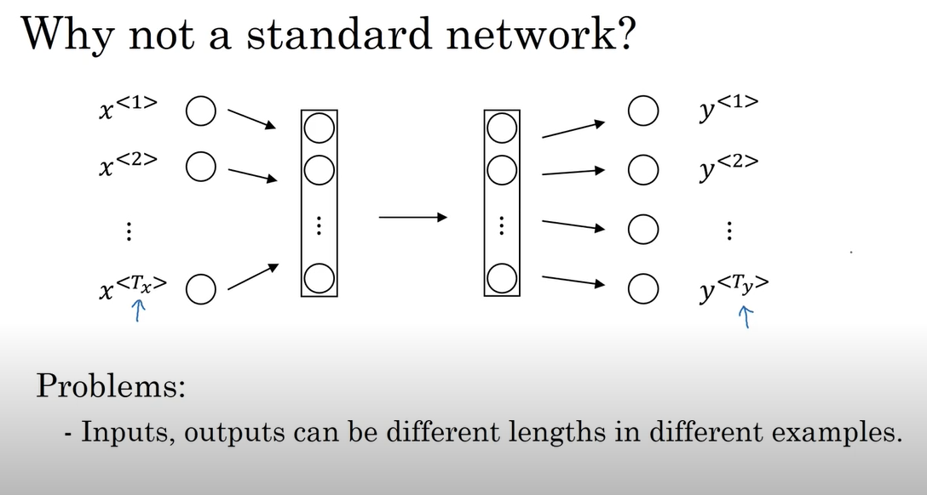
Why not a standard network?

Slide 4
Recurrent Neural Network (RNN)
Recurrent Neural Network is a generalization of feedforward neural network that has an internal memory.
RNN is recurrent in nature as it performs the same function for every input of data while the output of the current input depends on the past one computation.
After producing the output, it is copied and sent back into the recurrent network. For making a decision, it considers the current input and the output that it has learned from the previous input.
Unlike feedforward neural networks, RNNs can use their internal state (memory) to process sequences of inputs.
This makes them applicable to tasks such as unsegmented, connected handwriting recognition or speech recognition.
In other neural networks, all the inputs are independent of each other. But in RNN, all the inputs are related to each other.

Slide 5
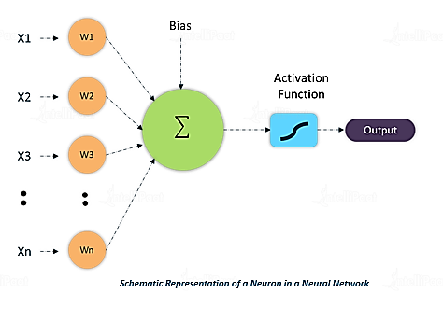
RECAP of ANN
1
b₁₁
Hidden Layer
b₁₅
b₁₂
b₁₃
Input Layer
b₁₄
1
W₁₁
W * x + b
1
W₁₂
W₁₃
W₂₁
W₂₂
2
W₂₃
Output Layer
2
W₁₃
W₃₂
W₂₃
W₃₃
3
Output
W₃₁
3
W₃₃
W₂₄
W₁₄
3
W₄₂
W₄₃
W₄₁
W₃₄
4
W₅₃
4
W₄₃
W₄
4

Slide 6
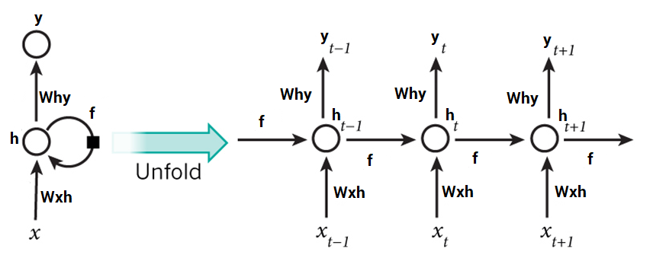
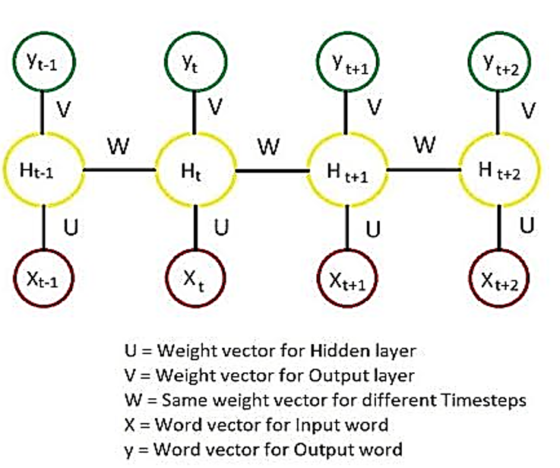
Unfold the RNN Layers

Slide 7
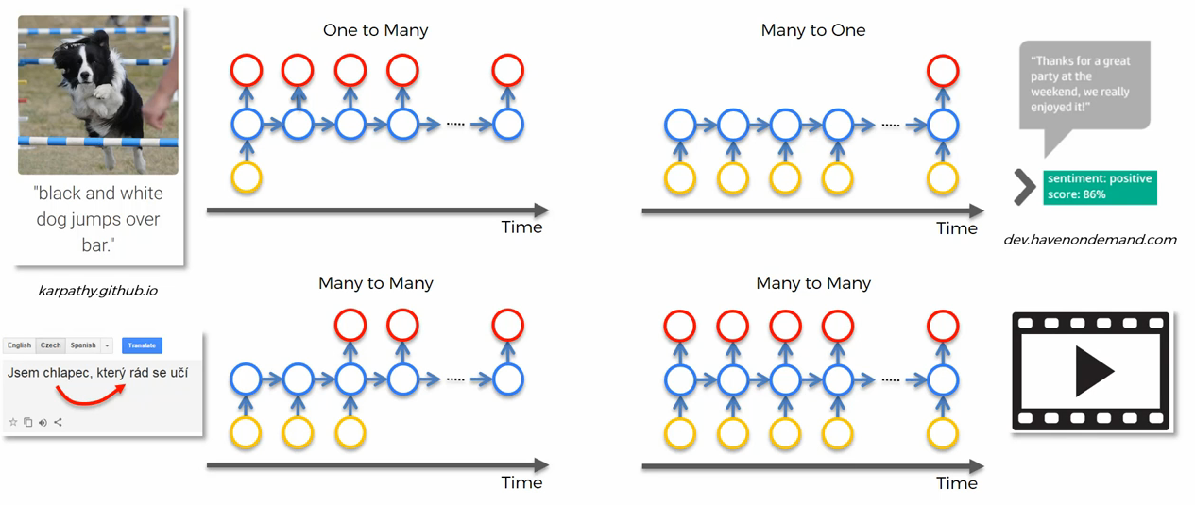
Examples of RNN with respect to relationships
Input: Mice Eats Cheese
Output: English

Slide 8
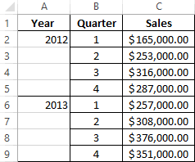
What is Time series Analysis, How relate it is RNN to
A time series is a series of data points indexed in time order.
Most commonly, a time series is a sequence taken at successive equally spaced points in time.
Thus it is a sequence of discrete-time data
Time series model is purely dependent on the idea that past behavior and price patterns can be used to predict future price behavior.

Slide 9
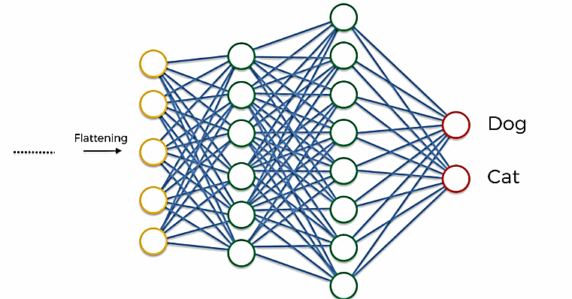
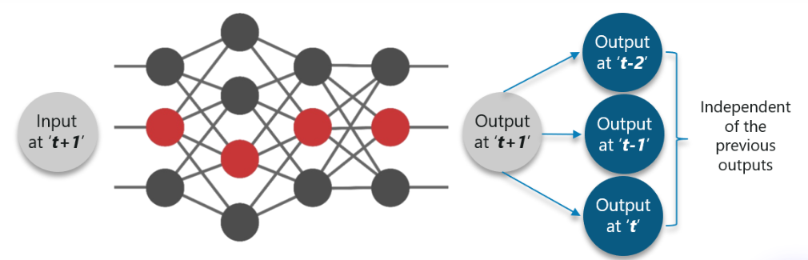
Why RNN and what is difference between
ANN & RNN
This is a cat, and _____
is a good pet animal

Slide 10



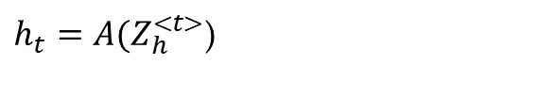






Unfold the RNN Layers
$$y$$
$$b$$
$$w_{1}$$
$$w_{2}$$
$$x_{1}$$
$$x_{2}$$
$Z_{h}^{<t>}=[x_{t}∗wh$ + ${h_{t−1}∗f]}_{ }$+ $b_{h}$
$h_{t}=A(Z_{h}^{<t>}$)
$y={{A(x}_{1}w}_{1}$+ ${x_{2}w}_{2 }$+ b)
$Z_{y}^{<t>}=[h_{t}∗wh$y $]_{ }$+ $b_{y}$
$y_{t}=A(Z_{y}^{<t>}$)
https://colah.github.io/posts/2015-08-Understanding-LSTMs/

Slide 11
Unsupervised Learning
Unsupervised learning is a type of machine learning that looks for previously undetected patterns in a data set with no pre-existing labels and with a minimum of human supervision.
Some of the most common algorithms used in unsupervised learning are:
Clustering
Hierarchical Clustering
K-means
Mixture models
DBSCAN
OPTICS Algorithm

Slide 12
Unsupervised Learning
Anomaly Detection
Local Outlier Factor
Isolation Forest
Neural Network
Autoencoder
Deep Belief Network
Hebbian Learning
Generative Adversarial Networks
Self-organization map

