Slide 1
Performance Evaluation of Multiclass Classification, and Quiz-1
Lecture# 6
Dr. Muhammad Fayaz

Slide 2
RECAP
Confusion Matrix
True Positive
True Negative
False Positive
False Negative
Accuracy
Precision
Recall
Specificity
F₁-Score

Slide 3
Multiclass Classification
Predicted
 | A | B | C | D
A | AA | AB | AC | AD
B | BA | BB | BC | BD
C | CA | CB | CC | CD
D | DA | DB | DC | DD
True Positive (FP): Sum of Diagonal Values
TP = AA + BB + CC + DD
False Positive (FP): Sum of Values in Corresponding Column (Excluding TP)
FP = (BA + CA + DA) + ( AB + CB + DB )+ (AC + BC + DC )+ (AD + BD + CD)
False Negative (FN): Sum of Values in Corresponding Row (Excluding TP)
FN = (AB + AC + AD) + (BA + BC + BD) + (CA + CB + CD)+ (DA + DB + DC)
True Negative (TN): Sum of All Columns and Rows (Excluding that column’s and row)
TN = (BB + BC + BD + CB+ CC + CD + DB + DC + DD) + (AA + AC + AD + CA + CC + CD + DA + DC + DD ) + ( AA + AB + AD + BA + BB + BD + DA + DB + DD) + (AA, AB, AC + BA + BB + BC + CA + CB + CC)
Actual

Slide 4
Multiclass Classification
Predicted
 | A | B | C
A | AA | AB | AC
B | BA | BB | BC
C | CA | CB | CC
True Positive (TP): Sum of Diagonal Values
${TP}_{2}=$ 23
${TP}_{1}=$ 29
${TP}_{0}=$ 24
${TP}_{overall}=$ 23 + 29 + 24 = 76
Actual
 | 2 | 1 | 0
2 | 23 | 12 | 7
1 | 11 | 29 | 13
0 | 4 | 10 | 24
 | 2 | 1 | 0
2 | 23 | 12 | 7
1 | 11 | 29 | 13
0 | 4 | 10 | 24

Slide 5
Multiclass Classification
 | A | B | C
A | AA | AB | AC
B | BA | BB | BC
C | CA | CB | CC
False Positive (FP): Sum of Values in Corresponding Column (Excluding TP)
${FP}_{2}=$ 11 + 4 = 15
${FP}_{1}=$ 12 + 10 = 22
${FP}_{0}=$ 7 + 13 = 20
${FP}_{overall}=$ 15 + 22 + 20 = 57
 | 2 | 1 | 0
2 | 23 | 12 | 7
1 | 11 | 29 | 13
0 | 4 | 10 | 24
 | 2 | 1 | 0
2 | 23 | 12 | 7
1 | 11 | 29 | 13
0 | 4 | 10 | 24
 | 2 | 1 | 0
2 | 23 | 12 | 7
1 | 11 | 29 | 13
0 | 4 | 10 | 24
 | 2 | 1 | 0
2 | 23 | 12 | 7
1 | 11 | 29 | 13
0 | 4 | 10 | 24

Slide 6
Multiclass Classification
Predicted
 | A | B | C
A | AA | AB | AC
B | BA | BB | BC
C | CA | CB | CC
False Negative (FN): Sum of Values in Corresponding Row (Excluding TP)
Actual
${FN}_{2}=$ 12 + 7 = 19
${FN}_{1}=$ 11 + 13 = 24
${FN}_{0}=$ 4+ 10 = 14
${FN}_{overall}=$ 19 + 24 + 14 = 57
 | 2 | 1 | 0
2 | 23 | 12 | 7
1 | 11 | 29 | 13
0 | 4 | 10 | 24
 | 2 | 1 | 0
2 | 23 | 12 | 7
1 | 11 | 29 | 13
0 | 4 | 10 | 24
 | 2 | 1 | 0
2 | 23 | 12 | 7
1 | 11 | 29 | 13
0 | 4 | 10 | 24
 | 2 | 1 | 0
2 | 23 | 12 | 7
1 | 11 | 29 | 13
0 | 4 | 10 | 24

Slide 7
Multiclass Classification
 | A | B | C
A | AA | AB | AC
B | BA | BB | BC
C | CA | CB | CC
True Negative (TN): Sum of All Columns and Rows (Excluding that column’s and row)
${TN}_{2}=$ 29 + 13 + 10 + 24 = 76
${TN}_{1}=$ 23 + 7 + 4 + 24 = 58
${TN}_{0}=$ 23 + 12 + 11 + 29 = 75
${TP}_{overall}=$ 0
 | 2 | 1 | 0
2 | 23 | 12 | 7
1 | 11 | 29 | 13
0 | 4 | 10 | 24
 | 2 | 1 | 0
2 | 23 | 12 | 7
1 | 11 | 29 | 13
0 | 4 | 10 | 24
 | 2 | 1 | 0
2 | 23 | 12 | 7
1 | 11 | 29 | 13
0 | 4 | 10 | 24
 | 2 | 1 | 0
2 | 23 | 12 | 7
1 | 11 | 29 | 13
0 | 4 | 10 | 24

Slide 8
Multiclass Classification
Actual | Predicted
2 | 2
0 | 0
0 | 0
0 | 0
2 | 0
1 | 0
1 | 1
1 | 1
1 | 1
2 | 1
0 | 1
2 | 2
0 | 2
2 | 2
2 | 2
1 | 2
0 | 0
0 | 0
1 | 1
 | A | B | C
A | AA | AB | AC
B | BA | BB | BC
C | CA | CB | CC
True Positive (TP): Sum of Diagonal Values
TP = 4 + 4 + 5 = 13
 | 2 | 1 | 0
2 | 4 | 1 | 1
1 | 1 | 4 | 1
0 | 1 | 1 | 5
 | 2 | 1 | 0
2 | 4 | 1 | 1
1 | 1 | 4 | 1
0 | 1 | 1 | 5

Slide 9
Multiclass Classification
Actual | Predicted
2 | 2
0 | 0
0 | 0
0 | 0
2 | 0
1 | 0
1 | 1
1 | 1
1 | 1
2 | 1
0 | 1
2 | 2
0 | 2
2 | 2
2 | 2
1 | 2
0 | 0
0 | 0
1 | 1
 | A | B | C
A | AA | AB | AC
B | BA | BB | BC
C | CA | CB | CC
False Positive (FP): Sum of Values in Corresponding Column (Excluding TP)
FP = (1+1) + (1+1) + (1 + 1) = 6
 | 2 | 1 | 0
2 | 4 | 1 | 1
1 | 1 | 4 | 1
0 | 1 | 1 | 5
 | 2 | 1 | 0
2 | 4 | 1 | 1
1 | 1 | 4 | 1
0 | 1 | 1 | 5

Slide 10
Multiclass Classification
Actual | Predicted
2 | 2
0 | 0
0 | 0
0 | 0
2 | 0
1 | 0
1 | 1
1 | 1
1 | 1
2 | 1
0 | 1
2 | 2
0 | 2
2 | 2
2 | 2
1 | 2
0 | 0
0 | 0
1 | 1
 | A | B | C
A | AA | AB | AC
B | BA | BB | BC
C | CA | CB | CC
False Negative (FN): Sum of Values in Corresponding ROW (Excluding TP)
FN = (1+1) + (1+1) + (1 + 1) = 6
 | 2 | 1 | 0
2 | 4 | 1 | 1
1 | 1 | 4 | 1
0 | 1 | 1 | 5
 | 2 | 1 | 0
2 | 4 | 1 | 1
1 | 1 | 4 | 1
0 | 1 | 1 | 5

Slide 11


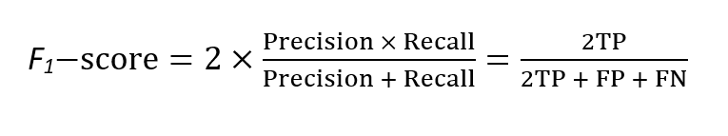
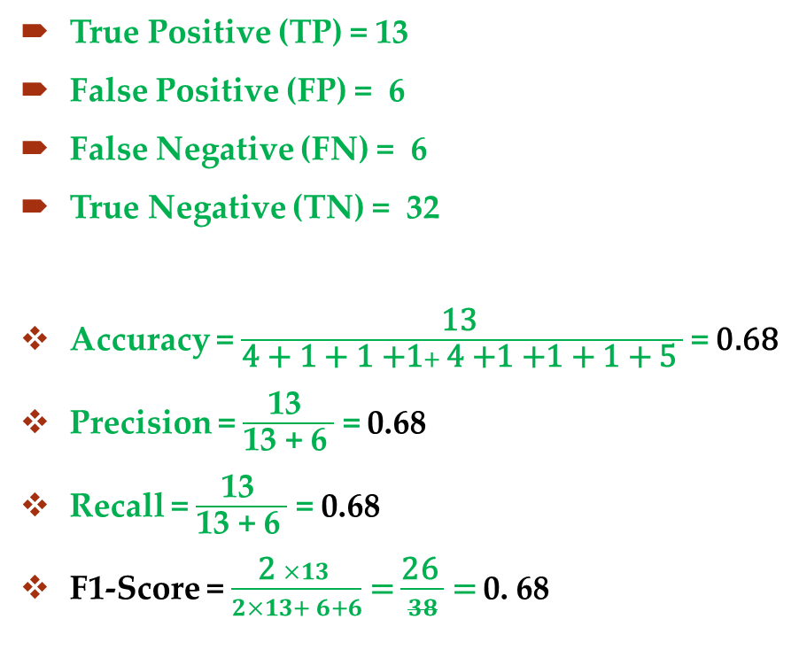

Multiclass Classification
$\frac{\text{TP} }{\text{Sum} \text{of} \text{All} \text{Confusion} \text{Matrix}\text{′}\text{s} \text{Values} }$
True Positive (TP) = 13
False Positive (FP) = 6
False Negative (FN) = 6
True Negative (TN) = 32
Accuracy = $\frac{\text{13} }{\text{4 + 1 + 1 +}\text{1}+ \text{4 +}\text{1 +1 + 1 + 5} }$ = 0.68
Precision = $\frac{\text{13 }}{\text{13 +}\text{ 6} }$ = 0.68
Recall = $\frac{\text{13 }}{\text{13 +}\text{ 6} }$ = 0.68
F1-Score = $\frac{\text{2} ×13 }{2×13+ 6+6}$ = $\frac{\text{2}\text{6} }{38}$ = 0. 68
Accuracy For
Multiclass Classification
 | 2 | 1 | 0
2 | 4 | 1 | 1
1 | 1 | 4 | 1
0 | 1 | 1 | 5

Slide 12
Implementation

Slide 13
Thanks

