Slide 1
Project Proposal
ArCare
A secure, robust and automated research platform
for proteomics labs
Presenters : Dr. Muzzamil Aziz
Amirreza Fazely
March 6th 2018

Slide 2
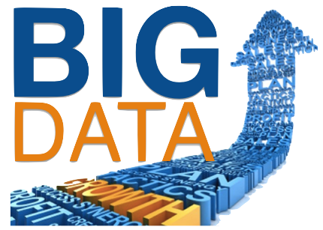
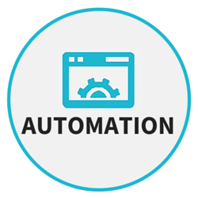
State of the Art
1- Heterogeneous Data
- Many vendor specific sources.
- Plenty of different file formats.
- Many Analytic processes.
2 - Automation and Reproducibility
- Penty manual Tasks , ex. file converting , analytical process.
- Manual task is prone to error.
- Different policies (SOPs, privacy issues) for different working group.
3- Lack of collaboration with other department
- due to non centralized solution.

Slide 3

Comments and Highlights
1- Data Identification
- Personal or clinical ?
2- Trustworthy Data adaptors
- How reliable for each use case.
3- Consider the order entry system for proteomics labs
- Data from animal in first phase.
4- Integration with Data repository of HighMed project
- MEDKS Database.

Slide 4


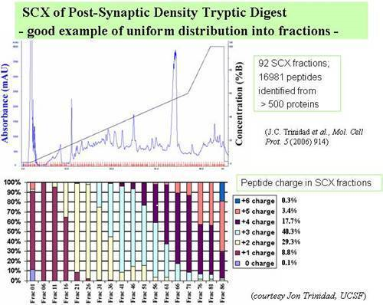
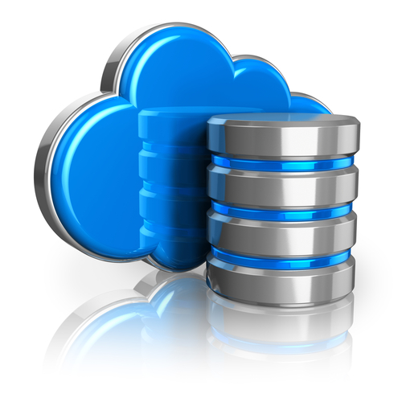




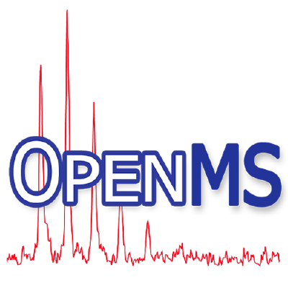





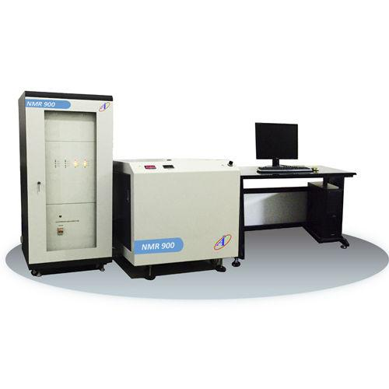
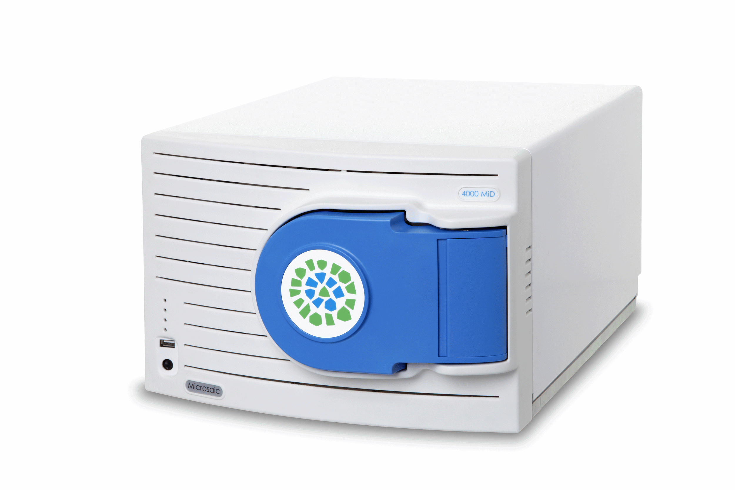
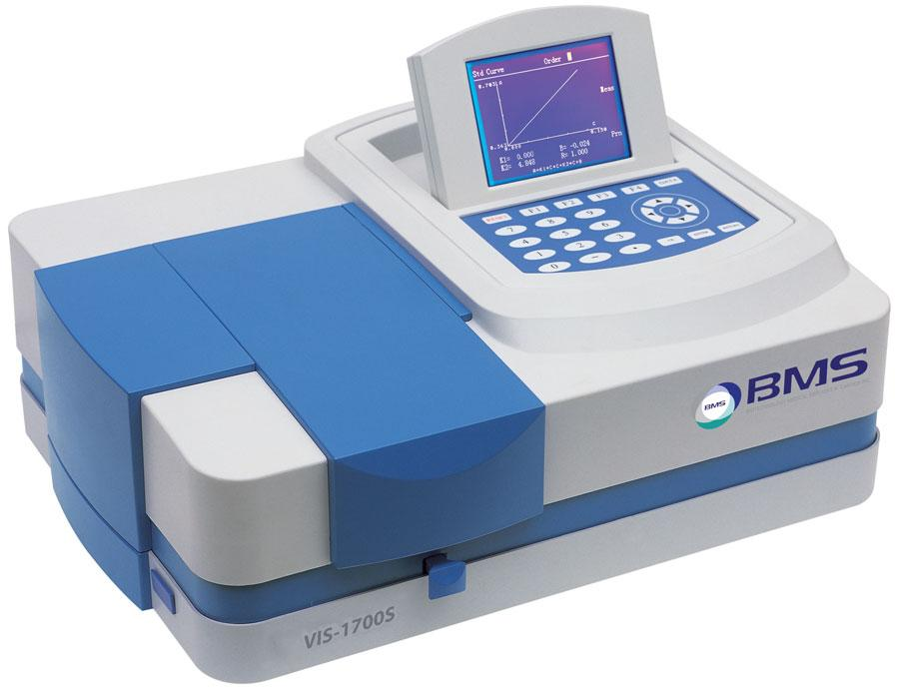
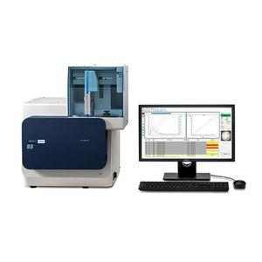
Application Engine
App:1
App:2
App:3
App:4
RESTCONF/NETCONF
ArCare Controller
Policies
Rules
Datastore
Data Repository
SDN Agent
ArCare Dashboard
Data Channel
(Meaningful Data)
MS Application
Data Channel
(Raw Data)
Device Agent
Device Agent
Device Agent
Device Agent
Control Channel
Network Links
Processing Links
Mass Spectrometry Devices

Slide 5

Application Engine
App:1
App:2
App:3
App:4
RESTCONF/NETCONF
ArCare Controller
Policies
Rules
Datastore
Data Repository
SDN Agent
ArCare Dashboard
Data Channel
(Meaningful Data)
MS Application
Data Channel
(Raw Data)
Device Agent
Device Agent
Device Agent
Device Agent
Control Channel
Network Links
Processing Links
Mass Spectrometry Devices

