Slide 1

An Introduction to Serpent
April Novak
4/3/2015
Updated by T. Kozlowski
4/24/2016
11/17/2016
4/3/2017

Slide 2

Why do we need Monte Carlo codes?
Geometric inhomogeneities
Difficult geometries
Problems with no analytical solution
http://erez-gilad.me/research/beavrs/

Slide 3
How do Monte Carlo codes work?
Rely on repeated random sampling to obtain numerical results

Slide 4
How do Monte Carlo codes work?
Specify your input domain (geometry and materials).
Randomly select a population within the domain based on a probability distribution.
Use deterministic methods to compute what “happens” to your population.
Interpret the results.

Slide 5
Serpent – Basic input information
Write input in a text editor
Specify:
Geometry
Materials
Boundary conditions
Calculation options, other special options

Slide 6
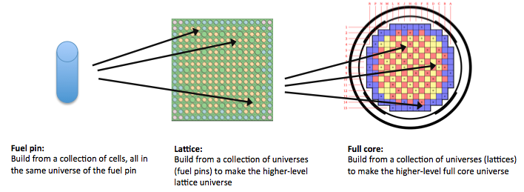
Serpent - Geometry
Universe-based geometry composed of homogeneous cells

Slide 7
Serpent - Geometry
Possible Surfaces:
Cylinders (infinite in z)
Plane, sphere, cube, cone, dodecagon, etc.

Slide 8
Serpent – Materials
Declare an overall material density
atomic ((10^24)-atoms/cm³)
weight (g/cm³)
Declare the atomic or weight density (or fractions) of the constituent nuclides

Slide 9
Running Serpent
All interaction is done through the terminal or command line
sss2 is the name of the Serpent executable:
sss2 input_file
Should be the location of sss
Should be the location of your input file

Slide 10
How to access Serpent through the UIUC network
Can be accessed from:
EWS computer
Personal computer when connected to UIUC network (use UIUC VPN when off-campus)

Slide 11
Connecting from EWS (Windows)
1. Open WinSCP

Slide 12
Connecting from EWS (Windows)
2. Use the IP address or server name and login with your account information.

Slide 13
Connecting from EWS (Windows)
3. Drag files from Illinois EWS station to /home/<username>

Slide 14
Connecting from EWS (Windows)
3. Drag files from Illinois EWS station to /home/<username>

Slide 15
Connecting from EWS (Windows)
3. Drag files from Illinois EWS station to /home/<username>

Slide 16
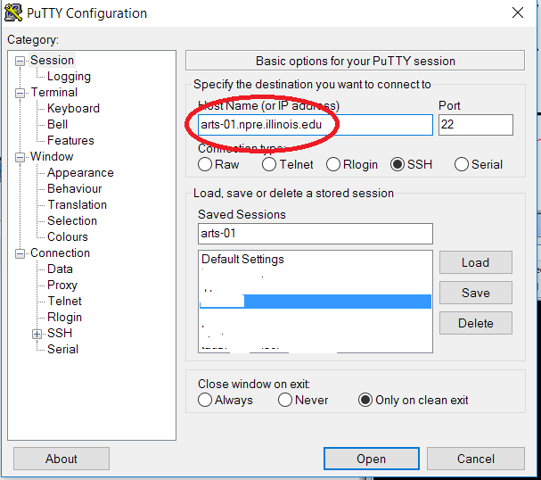
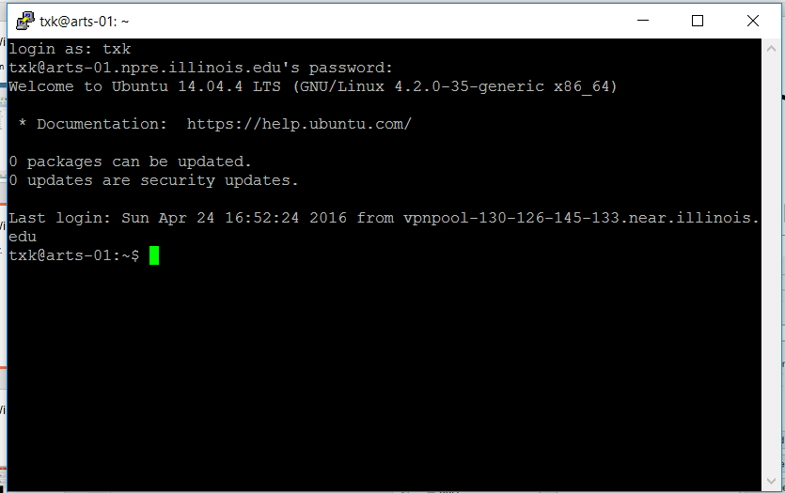
Connecting from EWS (Windows)
4. Open command line in ssh client (e.g. PuTTY).

Slide 17
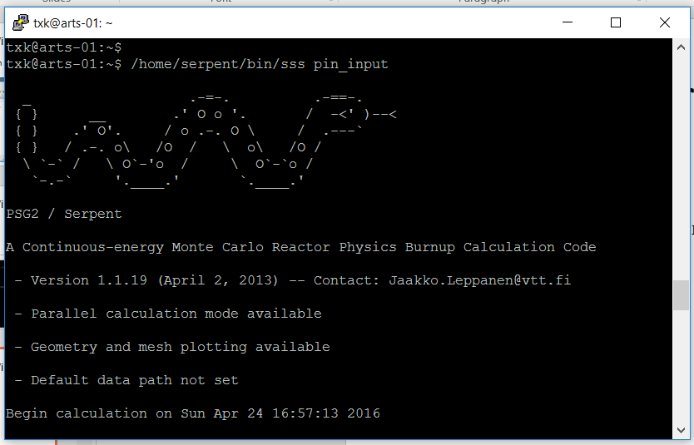
Connecting from EWS (Windows)
5. Execute your file:
/home/serpent/bin/sss2 pin_input

Slide 18
Connecting from Personal Computer
If off-campus, connect to UIUC VPN
Connect to the server with scp/sftp client (e.g. WinSCP) for file transfer
Connect to the server with ssh client (e.g. PuTTY) for command line
The other instructions are the same as EWS

Slide 19
How to access Serpent from a personal computer
Compile the code (already done for you)
Run through terminal or command line.

Slide 20
More Advanced Uses
More complex geometries
Full LWR core
Hexagonal cores (VVER)
Pebble bed cores
Burnup (fuel depletion)
https://goo.gl/VLy91S

