Slide 1


PRACTICAL TRAINING REPORT
Practical Training
Presentation
Muhammad Arif Danial Bin Mohd Anuar
2024933617
KYROL Security Labs Sdn. Bhd. · Cyberjaya, Selangor
Diploma in Computer Science (CDCS110)
Faculty of Computer and Mathematical Sciences · UiTM Malacca Branch Jasin Campus
Notes:
Good morning/afternoon. My name is Muhammad Arif Danial. This is my practical training report presentation for my 24-week internship at KYROL Security Labs, where my main project was building an Automated Email Reminder System.

Slide 2
OVERVIEW
Presentation Outline
01
02
03
The Organization
Main Project
System Design
KYROL Security Labs Sdn. Bhd.
Automated Email Reminder System
SDLC & five UML diagrams
04
05
06
Project Interface
Other Tasks
Conclusion
Dynamic HTML email template
Joomla revamp & graphic design
Outcomes & recommendations
Muhammad Arif Danial Bin Mohd Anuar · 2024933617
KYROL Security Labs
Notes:
I'll start with a brief look at the company, then spend most of the time on my main project before covering my two other tasks and wrapping up with what I learned.

Slide 3
CHAPTER 1
Introduction to Practical Training
Practical training is a compulsory 24-week course in the Diploma of Computer Science, giving students real working experience under professional supervision.
MY PLACEMENT
COMPANY
KYROL Security Labs Sdn. Bhd.
OBJECTIVES OF THE TRAINING
FIELD
▸ Build students' confidence after graduation
▸ Improve both soft skills and hard skills
▸ Strengthen communication and management skills
▸ Expose students to the real working environment
IT Technical, System and Web Developement
LOCATION
Cyberjaya, Selangor
DURATION
24 weeks
SUPERVISOR
Iskhandar Shah Mohammad Yunus
Muhammad Arif Danial Bin Mohd Anuar · 2024933617
KYROL Security Labs
Notes:
Practical training is a required part of the diploma. I completed my 24 weeks at KYROL Security Labs, an IT and cybersecurity firm in Cyberjaya, under the supervision of their system engineer.

Slide 4
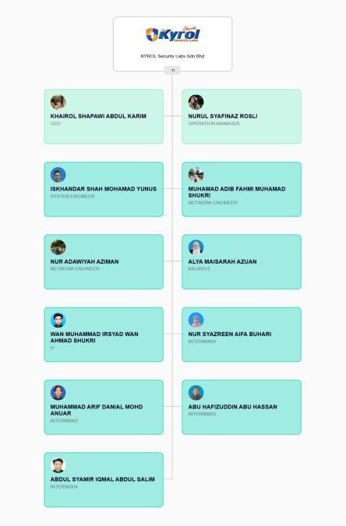
CHAPTER 2
About the Organization
KYROL Security Labs Sdn. Bhd.
An established IT solutions provider and cybersecurity advisory firm in Cyberjaya, with over a decade of industry presence, delivering IT infrastructure deployment, systems integration, and proactive network defence across single-site, multi-site, and multinational scales.
VISION
To be the trusted partner of choice in exceptional IT and cybersecurity solutions.
MISSION
To enhance customers' competitive positioning with state-of-the-art security solutions, built on integrity, teamwork, and continuous innovation.
Figure 2.1: Organizational Chart
Muhammad Arif Danial Bin Mohd Anuar · 2024933617
KYROL Security Labs
Notes:
KYROL Security Labs has been in the IT and cybersecurity industry for over a decade. The org chart on the right shows where I sat as an intern under the system engineering team.

Slide 5
CHAPTER 3 · MAIN PROJECT
Introduction
The rapid growth of customer-focused operations requires efficient and timely communication to maintain service quality and operational standards. Manual tracking of client information particularly expiry dates and contractual deadlines is susceptible to human error, leading to missed notifications and operational inefficiencies.
This project utilises a combination of robust scripting techniques and cloud-based automation tools to provide a scalable solution that reduces administrative workload, executing a strict multi-tier notification schedule that dispatches renewal alerts at three critical milestones: D-30, D-7, and D-1.
PROJECT AT A GLANCE
TYPE
Automated Email Notification System
TRIGGER
Daily, via Windows Task Scheduler
SCHEDULE
D-30 · D-7 · D-1 milestones
DELIVERY
Secure SMTP relay (TLS)
Muhammad Arif Danial Bin Mohd Anuar · 2024933617
KYROL Security Labs

Slide 6
CHAPTER 3 · MAIN PROJECT
The Problem & The Solution
THE PROBLEM
THE SOLUTION
▸ Client renewals & expiry dates tracked manually
▸ Manual tracking is prone to human error
▸ Missed notifications lead to lapsed licenses
▸ Repetitive scheduling wastes staff time
An automated system that tracks client timelines and dispatches renewal alerts at three critical milestones:
D-30
D-7
D-1
Early warning
Urgent reminder
Final notice
Scripted in Python, packaged with Docker, and run automatically every day, reducing workload while guaranteeing consistent, timely communication.
Muhammad Arif Danial Bin Mohd Anuar · 2024933617
KYROL Security Labs
Notes:
The core problem was that client license renewals were tracked by hand, which is easy to get wrong. My system checks every client's expiry date daily and sends reminders at 30, 7, and 1 day before expiry, so nothing slips through.

Slide 7
CHAPTER 3 · MAIN PROJECT
Project Objectives
1
Eliminate manual errors
2
Increase operational efficiency
Ensure no reminder is ever missed or delayed due to human oversight.
Automate email generation and delivery so staff focus on higher-priority work.
3
Improve communication consistency
4
Build a scalable framework
Every client receives professional, timely, and uniform renewal information.
Reliably handle current workload while remaining easy to update or expand.
Muhammad Arif Danial Bin Mohd Anuar · 2024933617
KYROL Security Labs
Notes:
The project had four objectives: remove human error, save staff time, keep client communication consistent, and make sure the system can scale as the client list grows.

Slide 8









CHAPTER 3 · MAIN PROJECT
Hardware & Software Requirements
LANGUAGE & TOOLS
DEPLOYMENT
DATA & PROTOCOLS
▸ Python 3.12 — core automation logic
▸ Visual Studio Code — IDE
▸ pandas — parse clients.xlsx
▸ smtplib — secure mail transport
▸ Docker — containerized packaging
▸ GitHub Actions — CI/CD pipeline
▸ Windows Server 2019 — production
▸ Task Scheduler — daily trigger
▸ .xlsx / .csv — client records (CRUD)
▸ .json — sent-log state (dedup)
▸ SMTP over TLS (port 587)
▸ noreply@kyrolsecuritylabs.com
Muhammad Arif Danial Bin Mohd Anuar · 2024933617
KYROL Security Labs
Notes:
The system is built in Python using pandas and smtplib. Everything is packaged in Docker so it runs identically in testing and production, and the server triggers it daily through Windows Task Scheduler over a secure SMTP connection.

Slide 9
CHAPTER 3 · MAIN PROJECT
System Development (SDLC)
01
Planning & Analysis
02
System Design
03
Implementation
Replace manual contract tracking with an autonomous tool that verifies expiry milestones.
Containerized Docker architecture to prevent environment drift; map the data-flow.
Core logic in Python 3.12 — pandas for spreadsheets, smtplib for secure mail.
04
Testing & QA
05
Deployment
06
Operations & Maintenance
Rigorous local testing on mock data, no live emails sent to real clients.
Packaged into a production Docker image on the Kyrol server as a daily task.
Error-logging, uptime monitoring, and version-controlled updates.
Muhammad Arif Danial Bin Mohd Anuar · 2024933617
KYROL Security Labs
Notes:
I followed a standard software development life cycle: planning and design, a Docker-based architecture, implementation in Python, thorough testing on mock data so no real client was emailed by accident, then deployment to the production server with logging for maintenance.

Slide 10
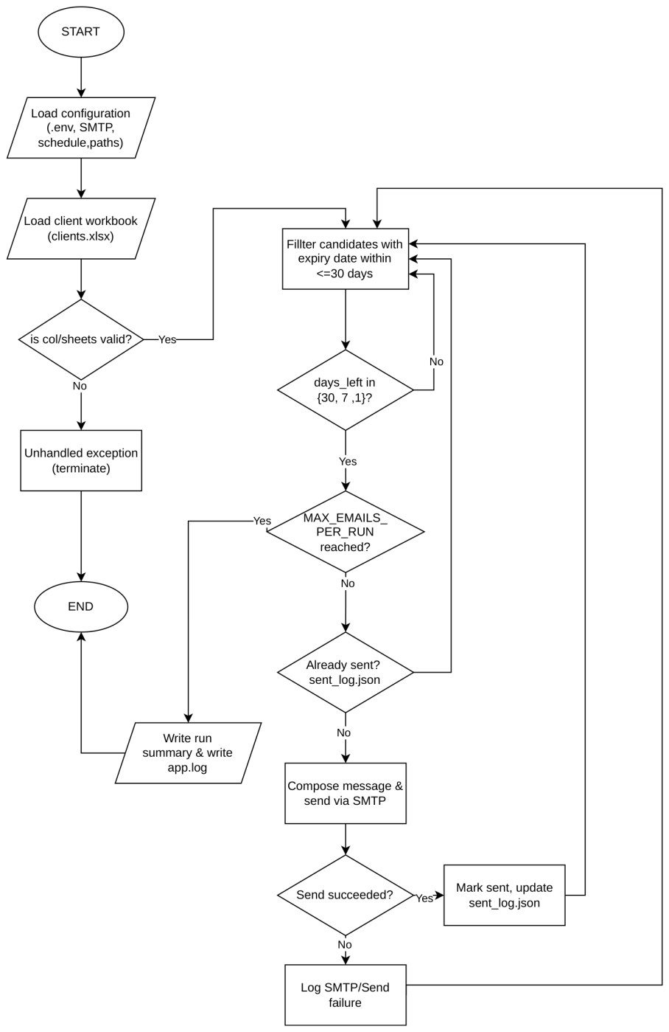
CHAPTER 3 · SECTION 3.4.2
Flowchart Diagram
KEY POINTS
▸ Loads config (.env) then the client workbook
▸ Invalid sheets/columns → safe stop, no emails
▸ Filters clients expiring within 30 days
▸ Sends only on 30 / 7 / 1-day milestones
▸ Skips duplicates via sent_log.json
▸ MAX_EMAILS_PER_RUN safety cap
Figure 3.1: Complete System Automation & Runtime Execution Flowchart
Muhammad Arif Danial Bin Mohd Anuar · 2024933617
KYROL Security Labs
Notes:
The flowchart shows the exact runtime logic. It loads config and the workbook, validates the data, then loops through each client. It only sends on the 30, 7, or 1-day marks, skips anyone already emailed, and has a hard cap so a data mistake can never spam clients.

Slide 11
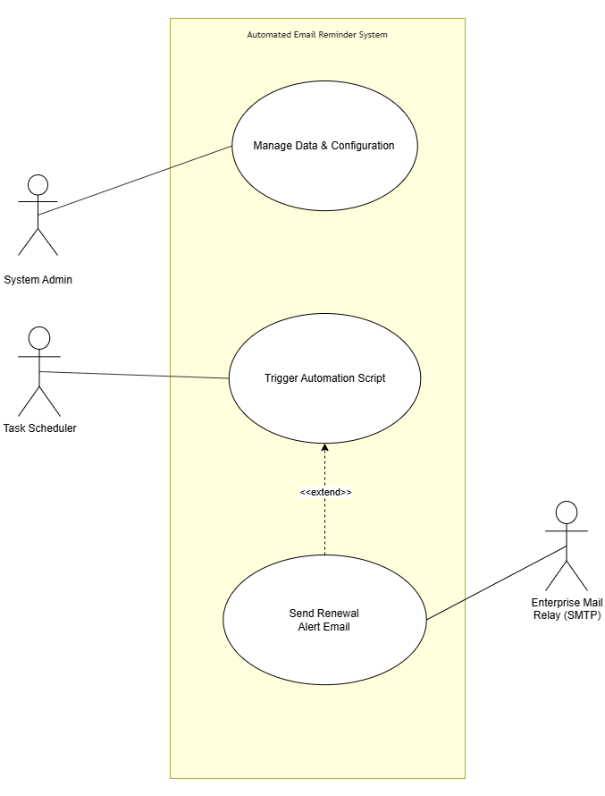
CHAPTER 3 · SECTION 3.4.3
Use Case Diagram
KEY POINTS
▸ System Admin maintains data & configuration
▸ Task Scheduler triggers the daily run
▸ "Send Renewal Alert" extends "Trigger Script"
▸ Only fires when a milestone matches
▸ Mail Relay (SMTP) is an external actor
Figure 3.2: System Functional Requirements & Actor Interactions
Muhammad Arif Danial Bin Mohd Anuar · 2024933617
KYROL Security Labs
Notes:
The use case diagram has three actors: the admin maintains the data, the Task Scheduler runs the script automatically, and the mail relay is external. Sending an alert is an extend use case — it only happens when a run finds a matching client.

Slide 12
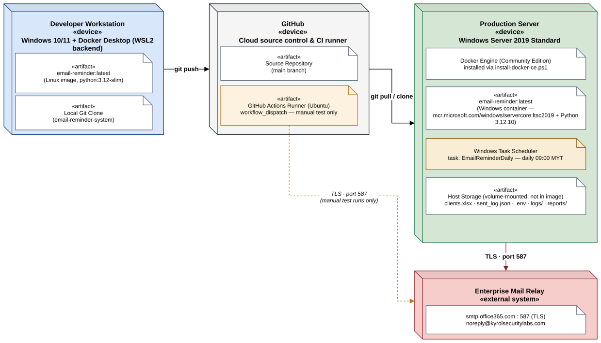
CHAPTER 3 · SECTION 3.4.4
Deployment Diagram
KEY POINTS
▸ Dev workstation pushes code to GitHub
▸ Production server: Windows Server 2019 + Docker
▸ Windows container with Python 3.12.10
▸ Data volume-mounted → editable in Excel
▸ TLS · port 587 to smtp.office365.com
▸ Dashed path = manual test runs only
Figure 3.3: Production Deployment Diagram
Muhammad Arif Danial Bin Mohd Anuar · 2024933617
KYROL Security Labs
Notes:
This shows the physical setup. I develop and push to GitHub; the production server pulls the code, builds a Windows container, and runs it daily. Client data stays on the server's disk so it's still editable in Excel, and email goes out over TLS on port 587.

Slide 13
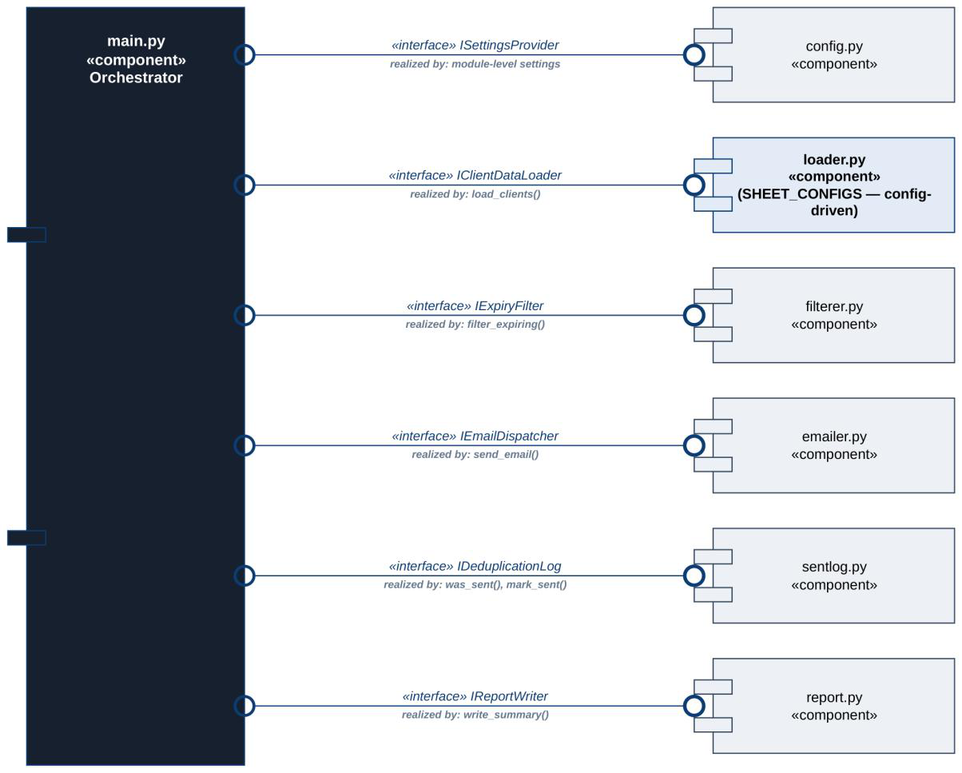
CHAPTER 3 · SECTION 3.4.5
Component Diagram
KEY POINTS
▸ main.py is the single orchestrator
▸ Six modules, each one clear interface
▸ loader.py uses SHEET_CONFIGS mapping
▸ filterer.py selects due records
▸ emailer.py sends with retry support
▸ sentlog.py prevents duplicates
Figure 3.4: UML Component Diagram of the Source Modules (src/)
Muhammad Arif Danial Bin Mohd Anuar · 2024933617
KYROL Security Labs
Notes:
The code is organized into components. main.py is the orchestrator and the only module tying everything together. Each of the six supporting modules does one job with one clear interface, which keeps the program easy to test and maintain.

Slide 14
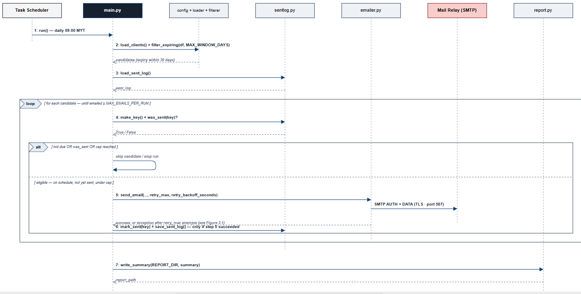
CHAPTER 3 · SECTION 3.4.6
Sequence Diagram
KEY POINTS
▸ Traces one full daily run end-to-end
▸ loop: every candidate is checked first
▸ alt: skip if not due / already sent / capped
▸ emailer.py retries up to retry_max times
▸ sent_log updated only on success
▸ report.py writes the run summary
Figure 3.5: Sequence Diagram of a Single Daily Reminder Run
Muhammad Arif Danial Bin Mohd Anuar · 2024933617
KYROL Security Labs
Notes:
The sequence diagram traces one daily run in time order. main.py loads the data and dedup log, loops over candidates, and for eligible clients calls the emailer, which retries on failure. It only records a client as sent if delivery succeeded, then writes a summary at the end.

Slide 15
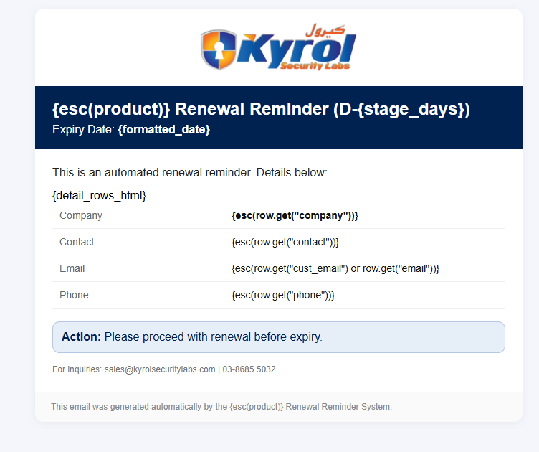
CHAPTER 3 · SECTION 3.4.7
Main Project Interface
Dynamic HTML Email
The user-facing output is a branded HTML email generated fresh for each client, using placeholder tags replaced at runtime:
{esc(product)}
Product name
{stage_days}
Milestone (30 / 7 / 1)
{formatted_date}
Client's expiry date
{detail_rows_html}
Company · Contact · Email · Phone
Figure 3.6: HTML Structure of the Reminder Email Template
The esc() wrapper sanitizes every value, protecting the email from malformed HTML.
Muhammad Arif Danial Bin Mohd Anuar · 2024933617
KYROL Security Labs
Notes:
The only user-facing part is the email itself — a branded HTML template with placeholder tags filled in for each client at runtime: the product, the milestone, the expiry date, and the client's contact details from the spreadsheet. Every value is escaped so a stray character can't break the layout.

Slide 16
CHAPTER 4 · TASK A
Website Revamp — Muzium Petaling Jaya
The official website for Muzium Petaling Jaya needed a major update. The old website had an outdated look, was difficult to navigate, and did not work well on mobile phones. My industrial supervisor assigned me to revamp the entire website using the Joomla Content Management System (CMS) along with a page builder to give it a clean, modern look.
TOOLS & TECHNOLOGIES USED
▸ Content Management System: Joomla CMS
▸ Page Builder: SP Page Builder (Newsberg Template)
▸ Web Languages: HTML5 and Custom CSS
OBJECTIVES
▸ Modernise the Website — fresh, clean, grid-based design using a news-style template.
▸ Improve Navigation — organise opening hours, history, and exhibitions for easy access.
▸ Make it Mobile-Friendly — layout adapts across smartphones, tablets, and computers.
▸ Simplify Content Updates — an easy page builder so staff can edit without writing code.
Muhammad Arif Danial Bin Mohd Anuar · 2024933617
KYROL Security Labs

Slide 17
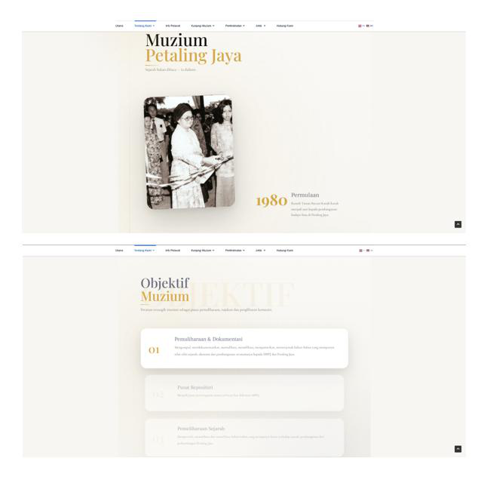
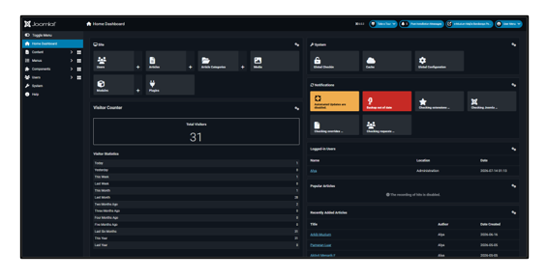
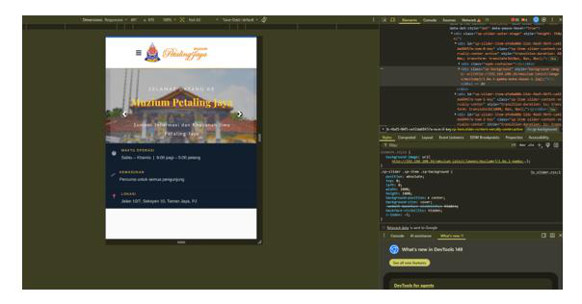
CHAPTER 4 · SECTION 4.1.4
Results of Task A
I completed the revamp in three clear steps:
▸ Setting Up the Joomla Template — installed Joomla with a news-oriented grid template.
▸ Building Pages with SP Page Builder — designed the main landing pages visually.
▸ Adding Custom CSS — adjusted spacing, padding, and colours to match requirements.
Fig 4.3: Revamped homepage
Fig 4.2: Mobile-responsive view
Fig 4.1: Joomla admin backend
Muhammad Arif Danial Bin Mohd Anuar · 2024933617
KYROL Security Labs
Notes:
For Task A, I rebuilt the Muzium Petaling Jaya website. The old one looked dated and didn't work on phones. I used Joomla with SP Page Builder and custom CSS to give it a clean, modern, fully responsive layout that staff can update themselves without coding.

Slide 18
CHAPTER 4 · TASK B
Graphic Design — Branding & Festive Greetings
In addition to the technical assignments, I was also entrusted with graphic design tasks to support KYROL Security Labs' corporate identity and external communications designing corporate polo shirt uniforms for staff and a series of festive greeting posters marking Malaysian public holidays, used for client-facing communications and social media.
TOOLS & TECHNOLOGIES USED
▸ Design Software: Canva, including Canva AI
▸ Image Formats: .PNG / .JPG for finished exports
OBJECTIVES
▸ Professional Apparel — corporate polo shirts reflecting the company's cybersecurity branding.
▸ Festive Greeting Posters — visually appealing designs for clients and social media.
▸ Brand Consistency — logo, colour scheme, and tagline applied across all designs.
Muhammad Arif Danial Bin Mohd Anuar · 2024933617
KYROL Security Labs

Slide 19

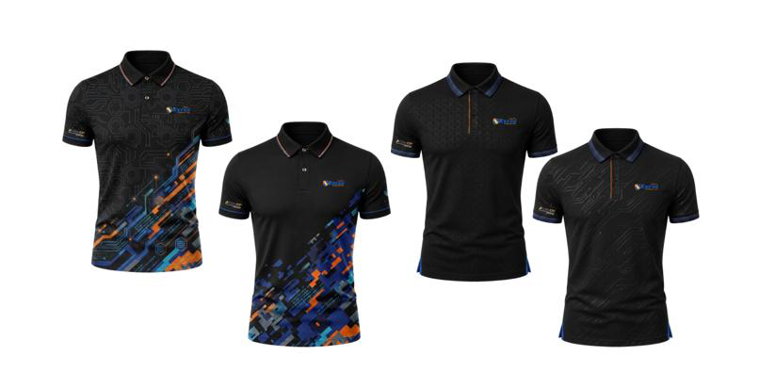
CHAPTER 4 · SECTION 4.2.4
Results of Task B
▸ Corporate Polo Shirt Design — Canva mockups incorporating the KYROL logo with a tech-inspired theme.
▸ Festive Greeting Poster Design — Canva AI used for Agong's birthday, Labour Day, and Wesak Day posters.
Fig 4.5: Corporate polo designs
Fig 4.6: Festive greeting posters
BRAND CONSISTENCY
Company logo, colour scheme, and tagline applied consistently across all corporate apparel and festive designs, also produced event jerseys and branded corporate materials.
Muhammad Arif Danial Bin Mohd Anuar · 2024933617
KYROL Security Labs
Notes:
Task B was graphic design. I designed corporate polo uniforms and festive greeting posters for Malaysian holidays, all keeping the company logo, colours, and tagline consistent. I mainly used Canva, including its AI tools, exporting each poster in banner and portrait versions.

Slide 20
CHAPTER 5
Conclusion
The 24-week training at KYROL Security Labs was a valuable bridge between classroom learning and real industry practice, giving me hands-on exposure across software development, cybersecurity, systems administration, and creative design.
Main Project
Technical Breadth
Creative & Soft Skills
Full SDLC experience, Python scripting, Docker containerization, secure SMTP, and CI/CD via GitHub Actions.
Cybersecurity & pen-testing (TryHackMe, CTF), Active Directory, VMware, on-site hardware maintenance, Power BI, Joomla CMS.
Corporate graphic design plus communication, time management, and adaptability in a client-facing environment.
Muhammad Arif Danial Bin Mohd Anuar · 2024933617
KYROL Security Labs
Notes:
To conclude — this training let me apply what I learned in the diploma to real work. My main project took me through the entire software development life cycle, and beyond it I was exposed to cybersecurity, systems administration, and design.

Slide 21
CHAPTER 5
Recommendations
To the University
i
Actively secure internship placements by expanding partnerships with IT and cybersecurity firms, as some students struggle to find suitable placements in time.
To Future Students
ii
Be proactive, ask questions and seek responsibilities beyond assigned tasks. This leads to broader exposure to different tools and workflows.
On Flexible Work
iii
Embrace varied working arrangements remote days, client site visits, and after-hours maintenance give a far more realistic picture of IT industry life.
Muhammad Arif Danial Bin Mohd Anuar · 2024933617
KYROL Security Labs
Notes:
My recommendations: the university could help more with securing placements; future students should be proactive and ask for extra responsibilities; and they should embrace flexible working arrangements, because that variety taught me the most.

Slide 22
Thank You
Questions & Discussion
Muhammad Arif Danial Bin Mohd Anuar · 2024933617
Practical Training at KYROL Security Labs Sdn. Bhd. · Diploma in Computer Science (CDCS110)
Notes:
That's the end of my presentation. Thank you for listening — I'm happy to take any questions.

