Slide 1
Welcome Everyone

Slide 2

Presentation Topic: Responsive E-Commerce Website
Presented By:
Presented To:
Md. Ariful Hasan
ID:193002037
DEPT. of CSE
Green University of Bangladesh
Name: Mr. Montaser Abdul Quader
Des: Lecturer
Green University of Bangladesh

Slide 3

Introduction
The purpose of this project is that any person can buy product through online from this website. E-commerce is the buying and selling goods and services, or the transmitting of funds or data, over an electronic network, primarily the Internet.

Slide 4

Our System
This System is an e-commerce website from where people can buy products through online.
Where Admin monitors the activity of the users and checks the order and transactions.

Slide 5
Features
Home
Search Box
Shopping Cart
EASY SETUP ACCOUNT
BUYERS REVIEW

Slide 6

Programming
HTML
CSS
PHP
MYSQL
JavaScript

Slide 7
TOOLS
Visual Code Studio
Xampp

Slide 8
Graphical User Interface

Slide 9
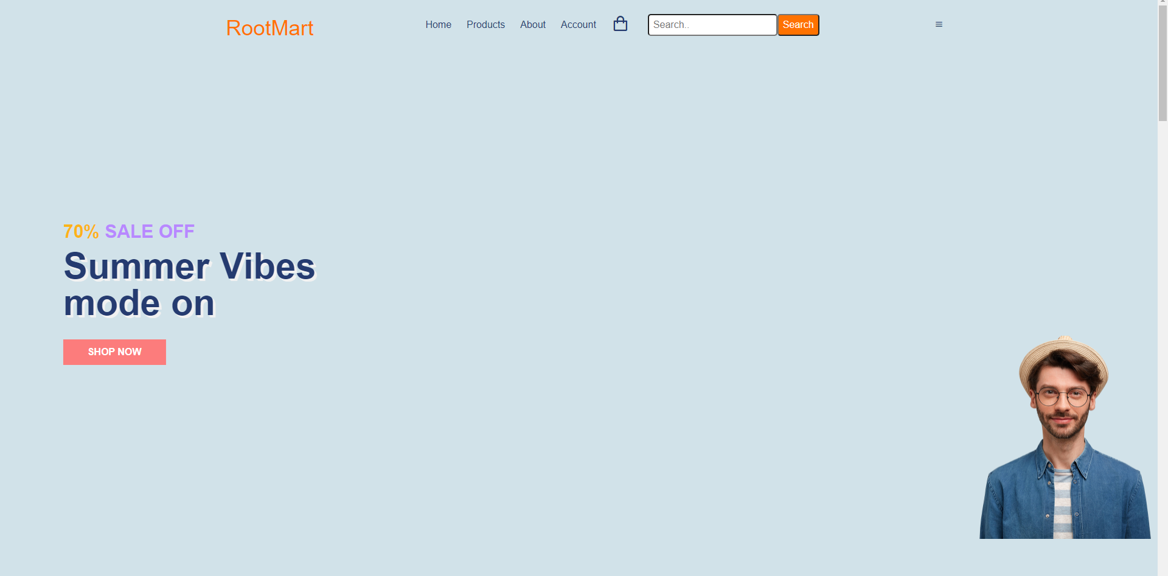
Homepage

Slide 10
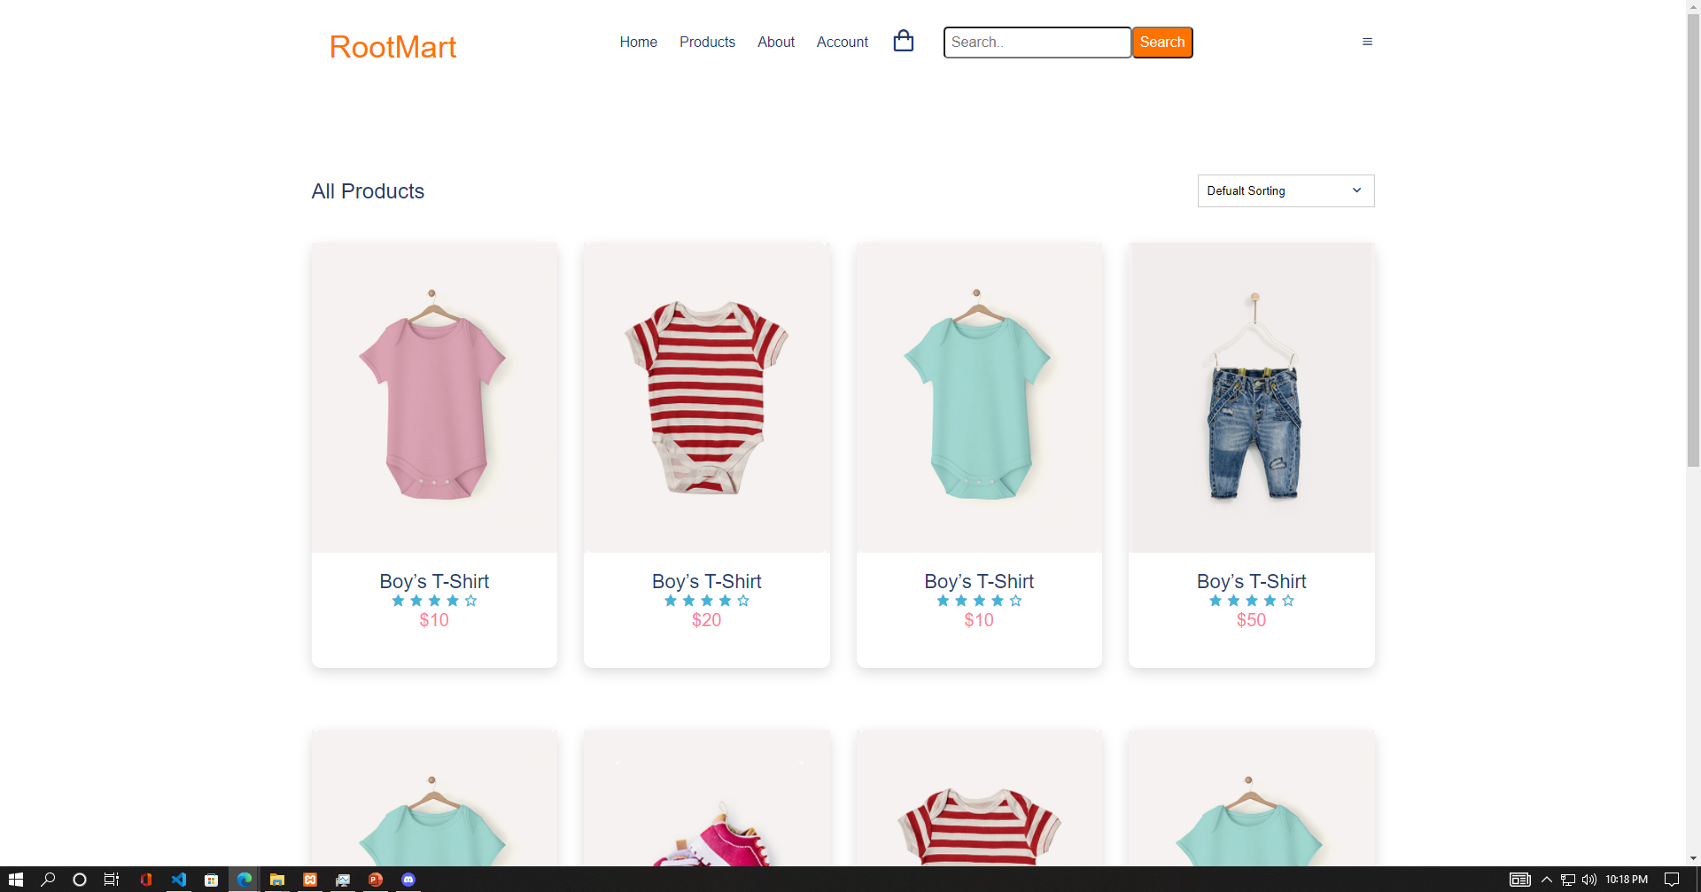
Products Page

Slide 11
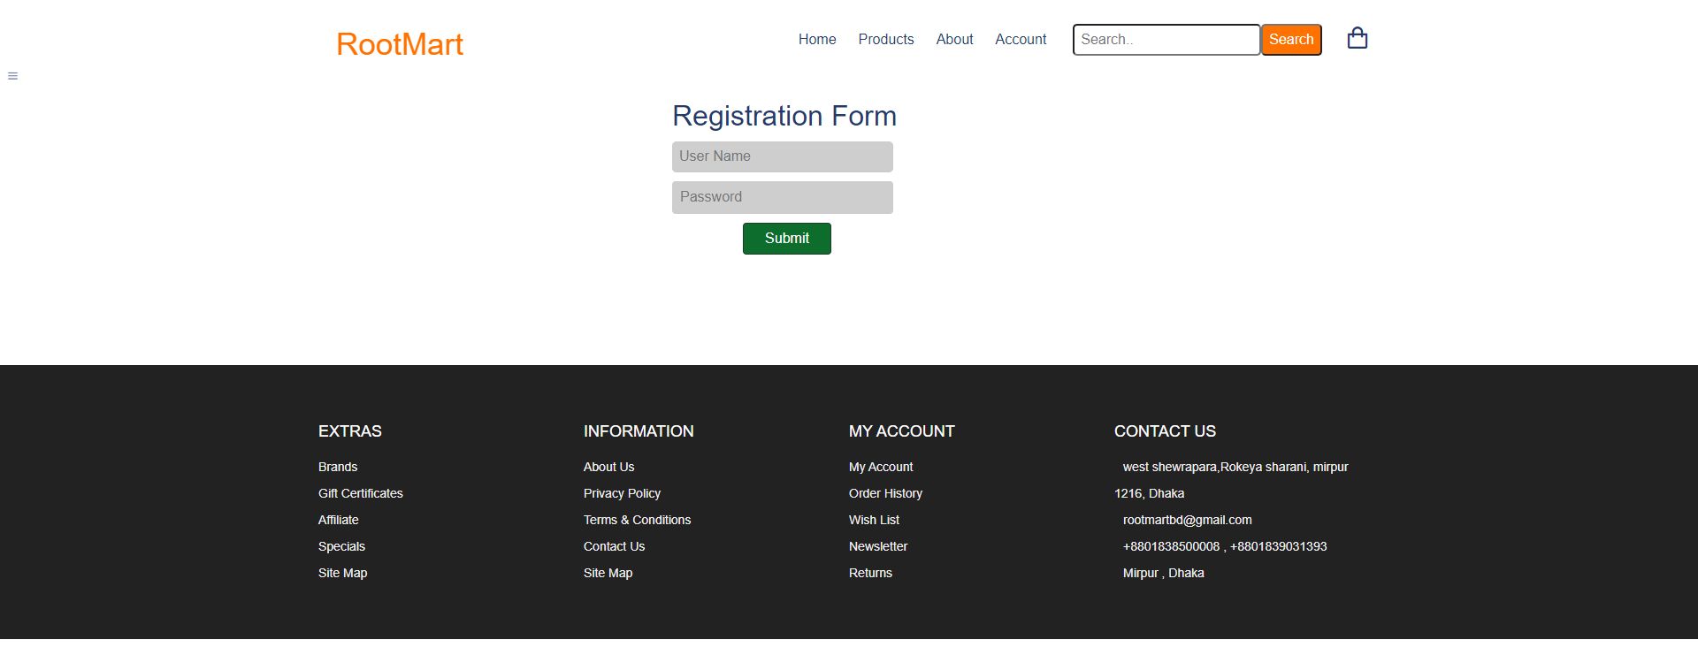
Account Section

Slide 12
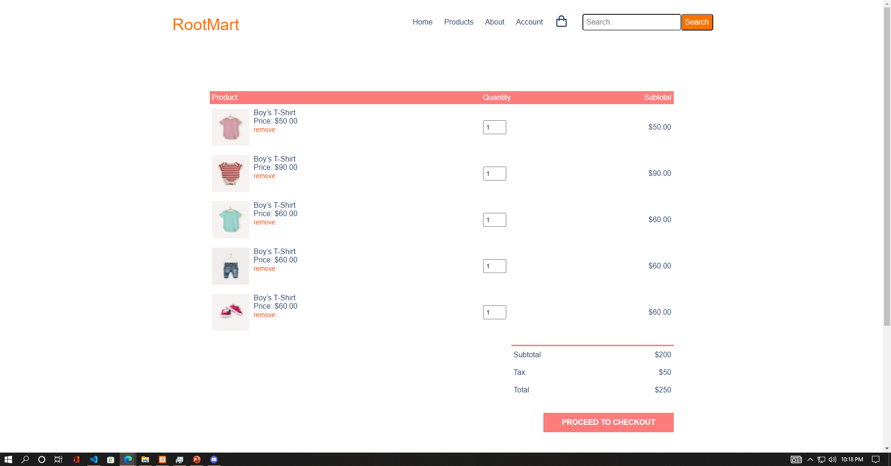
Shopping Cart Page

Slide 13
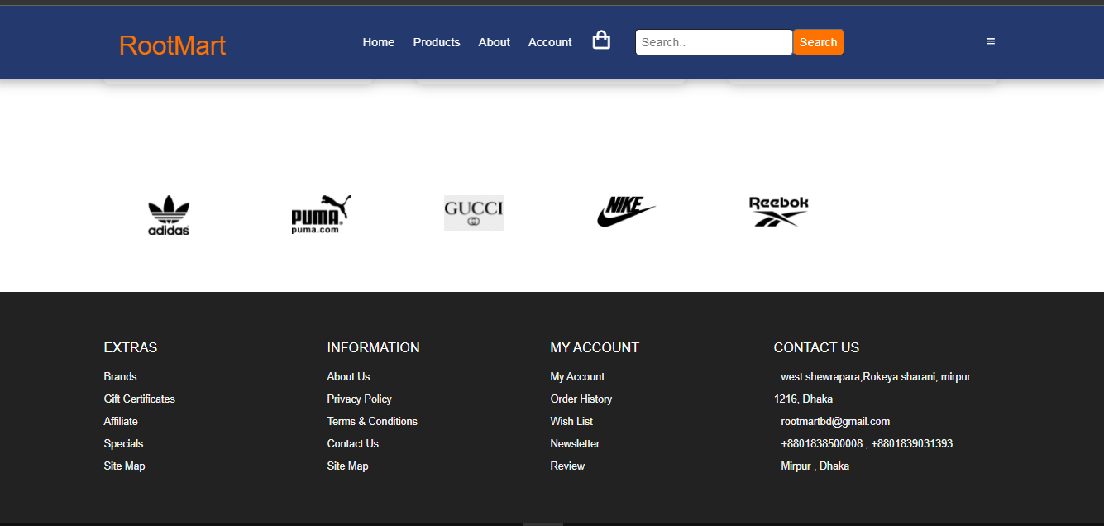
About Us/Contact Information Section

Slide 14
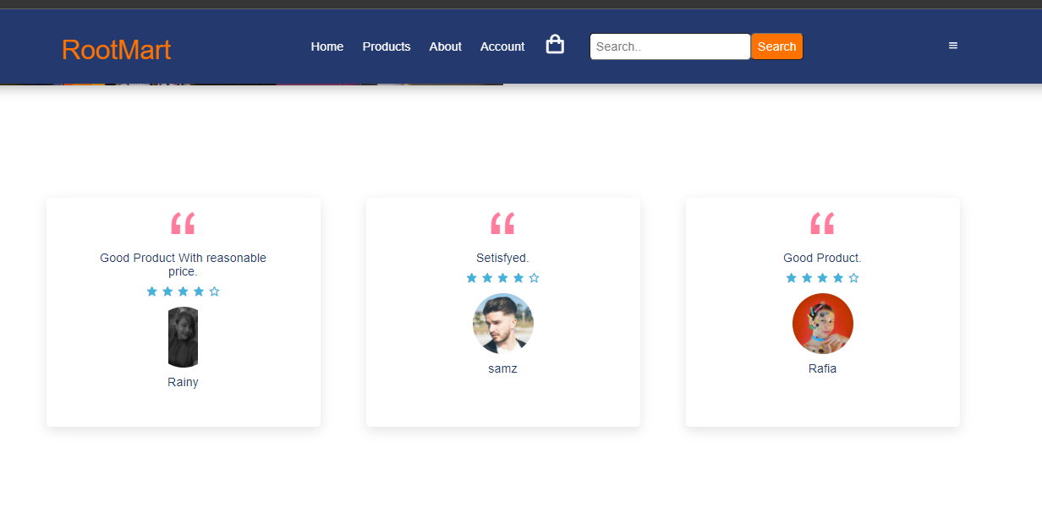
Customer's Review

Slide 15
What is our future plan?
We are thinking of some modifications and adding some advanced new features in our system. Some of them are:
GUI modification(more user friendly)
User can sell their products.
Users can sign up/ login using their social media API account such as Facebook, Gmail etc.
Chat Widget for Messaging option.

Slide 16

Any Question?

Slide 17

Thank You

