Slide 1
REPORT TEMPLATE
[Report title]
[Section list]
[Section 1]
[Section 2]
[Section 3]
[Section 4]
[Add subtitle, scope, or one-paragraph framing here.]
[Optional notes / metadata]
01

Slide 2
Method
[Method / framework slide]
[Add method summary or leave blank.]
1. Verification
2. Solution Verification
3. Validation
[Add criterion]
[Add criterion]
[Add criterion]
[Checklist / notes]
[Item 1]
[Item 2]
[Item 3]
02

Slide 3
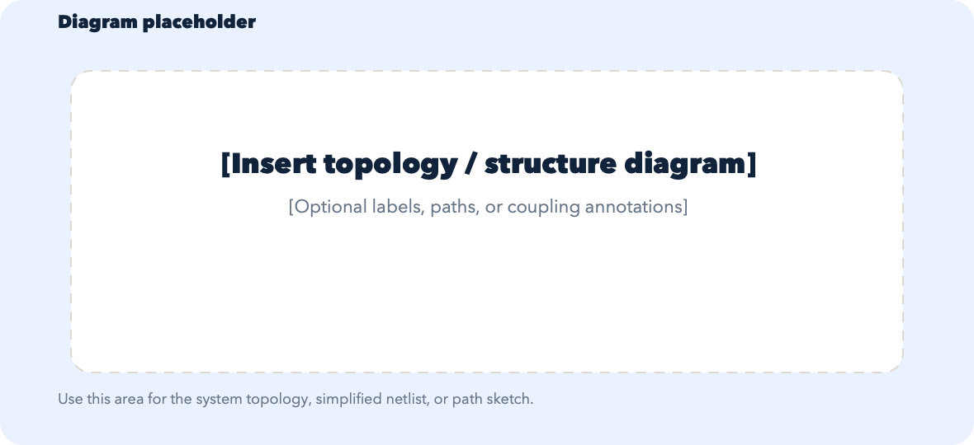
Topology
[Topology / diagram slide]
[Add context or leave blank.]
03

Slide 4
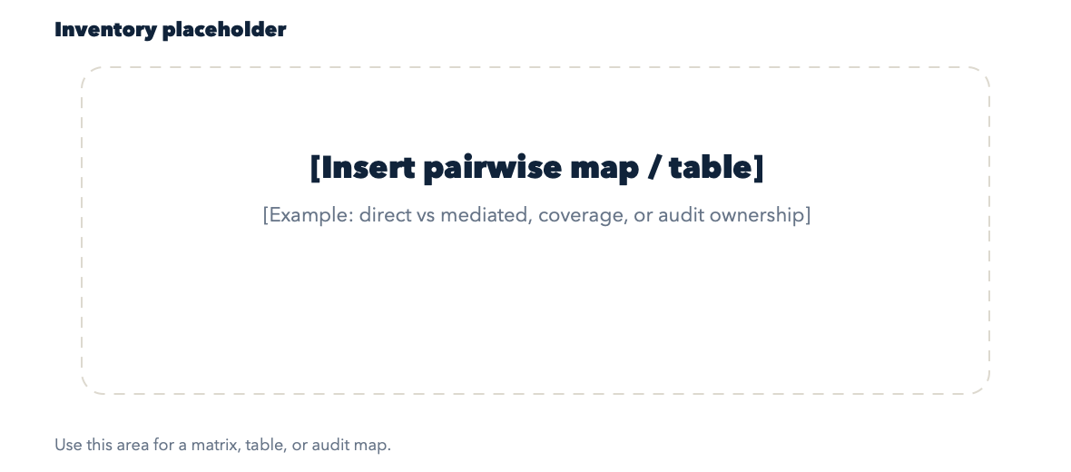
Inventory
[Inventory / matrix slide]
[Add context or leave blank.]
04

Slide 5
Subsystem
Qubit
[Add one-line framing for this structure.]
Knobs In This Study
Expected Qualitative Response
[Parameter 1]
[Parameter 2]
[Parameter 3]
[Expected response 1]
[Expected response 2]
[Expected response 3]
[Plot / notes area]
Paste plot, table, or notes here.
[Optional checklist]
[Add visual 1]
[Add visual 2]
[Add short takeaway]
Primary Matrix View
[Add primary matrix / observable for this structure.]
What Counts As A Good Sign
[Pass signal 1]
[Pass signal 2]
[Pass signal 3]
05

Slide 6
Subsystem
Readout Resonator
[Add one-line framing for this structure.]
Knobs In This Study
Expected Qualitative Response
[Parameter 1]
[Parameter 2]
[Parameter 3]
[Expected response 1]
[Expected response 2]
[Expected response 3]
[Plot / notes area]
Paste plot, table, or notes here.
[Optional checklist]
[Add visual 1]
[Add visual 2]
[Add short takeaway]
Primary Matrix View
[Add primary matrix / observable for this structure.]
What Counts As A Good Sign
[Pass signal 1]
[Pass signal 2]
[Pass signal 3]
06

Slide 7
Subsystem
XY Line
[Add one-line framing for this structure.]
Knobs In This Study
Expected Qualitative Response
[Parameter 1]
[Parameter 2]
[Parameter 3]
[Expected response 1]
[Expected response 2]
[Expected response 3]
[Plot / notes area]
Paste plot, table, or notes here.
[Optional checklist]
[Add visual 1]
[Add visual 2]
[Add short takeaway]
Primary Matrix View
[Add primary matrix / observable for this structure.]
What Counts As A Good Sign
[Pass signal 1]
[Pass signal 2]
[Pass signal 3]
07

Slide 8
Subsystem
Readout Line With Purcell Filter
[Add one-line framing for this structure.]
Knobs In This Study
Expected Qualitative Response
[Parameter 1]
[Parameter 2]
[Parameter 3]
[Expected response 1]
[Expected response 2]
[Expected response 3]
[Plot / notes area]
Paste plot, table, or notes here.
[Optional checklist]
[Add visual 1]
[Add visual 2]
[Add short takeaway]
Primary Matrix View
[Add primary matrix / observable for this structure.]
What Counts As A Good Sign
[Pass signal 1]
[Pass signal 2]
[Pass signal 3]
08

Slide 9
Interface
Direct Interface
Qubit ↔ XY Line
[Add one-line framing for this interface.]
Controlling Knobs
Expected Behavior
[Controlling knob 1]
[Controlling knob 2]
[Controlling knob 3]
[Expected behavior 1]
[Expected behavior 2]
[Expected behavior 3]
[Plot / notes area]
Paste plot, table, or notes here.
[Optional checklist]
Primary Matrix View
[Add visual 1]
[Add visual 2]
[Add short takeaway]
[Add primary matrix / observable for this interface.]
If This Fails, Suspect
[Failure signature 1]
[Failure signature 2]
[Failure signature 3]
09

Slide 10
Interface
Direct Interface
Qubit ↔ Readout Resonator
[Add one-line framing for this interface.]
Controlling Knobs
Expected Behavior
[Controlling knob 1]
[Controlling knob 2]
[Controlling knob 3]
[Expected behavior 1]
[Expected behavior 2]
[Expected behavior 3]
[Plot / notes area]
Paste plot, table, or notes here.
[Optional checklist]
Primary Matrix View
[Add visual 1]
[Add visual 2]
[Add short takeaway]
[Add primary matrix / observable for this interface.]
If This Fails, Suspect
[Failure signature 1]
[Failure signature 2]
[Failure signature 3]
10

Slide 11
Interface
Direct Interface
Readout Resonator ↔ Readout Line + Purcell Filter
[Add one-line framing for this interface.]
Controlling Knobs
Expected Behavior
[Controlling knob 1]
[Controlling knob 2]
[Controlling knob 3]
[Expected behavior 1]
[Expected behavior 2]
[Expected behavior 3]
[Plot / notes area]
Paste plot, table, or notes here.
[Optional checklist]
Primary Matrix View
[Add visual 1]
[Add visual 2]
[Add short takeaway]
[Add primary matrix / observable for this interface.]
If This Fails, Suspect
[Failure signature 1]
[Failure signature 2]
[Failure signature 3]
11

Slide 12
Interface
Mediated Interface
Qubit ↔ Readout Line + Purcell Filter
[Add one-line framing for this interface.]
Controlling Knobs
Expected Behavior
[Controlling knob 1]
[Controlling knob 2]
[Controlling knob 3]
[Expected behavior 1]
[Expected behavior 2]
[Expected behavior 3]
[Plot / notes area]
Paste plot, table, or notes here.
[Optional checklist]
Primary Matrix View
[Add visual 1]
[Add visual 2]
[Add short takeaway]
[Add primary matrix / observable for this interface.]
If This Fails, Suspect
[Failure signature 1]
[Failure signature 2]
[Failure signature 3]
12

Slide 13
Interface
Mediated Interface
Readout Resonator ↔ XY Line
[Add one-line framing for this interface.]
Controlling Knobs
Expected Behavior
[Controlling knob 1]
[Controlling knob 2]
[Controlling knob 3]
[Expected behavior 1]
[Expected behavior 2]
[Expected behavior 3]
[Plot / notes area]
Paste plot, table, or notes here.
[Optional checklist]
Primary Matrix View
[Add visual 1]
[Add visual 2]
[Add short takeaway]
[Add primary matrix / observable for this interface.]
If This Fails, Suspect
[Failure signature 1]
[Failure signature 2]
[Failure signature 3]
13

Slide 14
Interface
Mediated Interface
XY Line ↔ Readout Line + Purcell Filter
[Add one-line framing for this interface.]
Controlling Knobs
Expected Behavior
[Controlling knob 1]
[Controlling knob 2]
[Controlling knob 3]
[Expected behavior 1]
[Expected behavior 2]
[Expected behavior 3]
[Plot / notes area]
Paste plot, table, or notes here.
[Optional checklist]
Primary Matrix View
[Add visual 1]
[Add visual 2]
[Add short takeaway]
[Add primary matrix / observable for this interface.]
If This Fails, Suspect
[Failure signature 1]
[Failure signature 2]
[Failure signature 3]
14

Slide 15
Execution
[Execution / appendix slide]
[Add instructions or leave blank.]
[Left panel title]
[Right panel title]
[Item 1]
[Item 2]
[Item 3]
[Item 4]
[Item 1]
[Item 2]
[Item 3]
[Item 4]
[Item 5]
[Table / fields]
[Field 1]
[Field 2]
[Field 3]
[Field 4]
[Field 5]
[Decision / notes]
[Add final note or rule.]
15

