Slide 1
Have you ever needed to access AWS resources from another account securely?
Whether it’s S3 buckets, security groups, VPCs, or EC2 instances, cross-account access is a common requirement. In this video, we’ll set up IAM roles, use STS AssumeRole, and automate the entire process with Terraform.

Slide 2
Cross-Account AWS Access Using IAM Roles, EC2, and Terraform
Securely access AWS resources across accounts

Slide 3
Introduction
Cross-Account AWS Access enables secure resource sharing between AWS accounts.
Use cases: Accessing S3, EC2, VPCs, and security groups from another account.
Solution: IAM Roles, STS AssumeRole, and Terraform for automation.
In this session, we will set up cross-account access step-by-step.

Slide 4
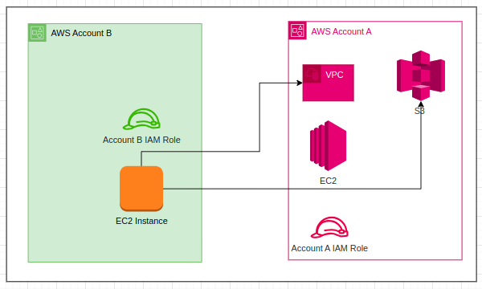
AWS Cross-Account Setup
AWS Cross-Account Setup

Slide 5
Conclusion:
To recap, today we:
✅ Set up cross-account IAM roles in AWS.
✅ Used Terraform to automate role creation and EC2 deployment.
✅ Tested cross-account access using AWS CLI.
✅ Configured AWS CLI profiles for automation.This method ensures secure and scalable cross-account access.

