Slide 1
Decoupling and the possibility of green growth

Slide 2
Readings
Robert Pollin ( 2019) : Advancing a Viable Global Climate Stabilization Project: Degrowth versus the Green New Deal
Review of Radical Political Economics
Enno Schröder & Servaas Storm ( 2020) : Economic Growth and Carbon Emissions: The Road to “Hothouse Earth” is Paved with Good Intentions
International Journal of Political Economy

Slide 3
Green Growth and the decoupling strategy
Since Green House Gas emissions have been established as the single most important source of climate change, there has been a concerted effort to ‘green and clean’ the growth process by reducing harmful emissions i.e. decoupling
Relative decoupling: when the rate of growth of emissions is less than the rate of economic growth ( due to increase in energy efficiency or use of cleaner energy sources)
Absolute decoupling: when the rate of growth of emissions is zero or negative i.e. output is ‘decoupled’ from emission in a net sense
Green growth is seen a strategy in accelerating the transition towards cleaner and more efficient energy sources and making decoupling a feasible reality

Slide 4
The evidence on decoupling
Most of positive evidence on decoupling (both relative & absolute) come from the richer OECD countries
As expected, much of the hopeful findings pertain to relative decoupling and there is less evidence on absolute decoupling
Decoupling can be calculated with respect to various GhG emissions and thus performance can vary across multiple dimensions
Schröder and Storm ( 2020) provide a comprehensive overview of decoupling trajectories using different available data sets
They use a modified Kaya identity to decompose Co₂ emissions into the various drivers
They also use regression methodology to test a Carbon Kuznets Curve(CKC) hypothesis and try to identify relevant turning points

Slide 5
The Kaya decomposition exercise
C^ = P^ + y^ + c^ + e^ ( equation in terms of growth rates)
C= carbon emissions, P = population size, y = per capita income, c = Co2 emissions per unit of energy use and e = energy efficiency of production
Green growth has possible impacts on both c ( renewable energy) and e ( energy efficient technology)
In table 1 the projections are calculated with targets proposed in climate policy negotiations and economic growth rates derived as the residual.

Slide 6
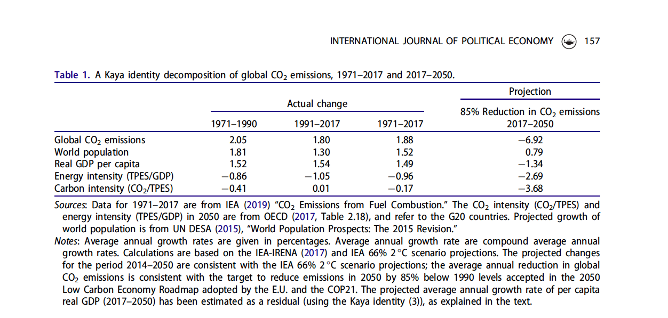

Slide 7
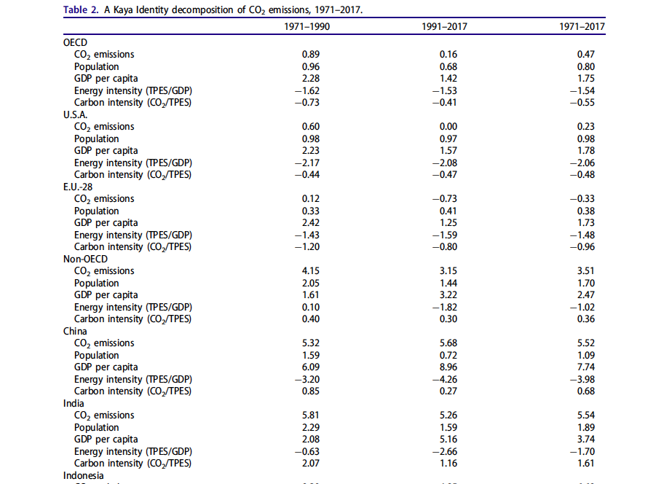

Slide 8
The CKC and difference between Consumption based and Production based carbon emissions
Typically testing for an inverted U shaped CKC relationship is done using production-based emission information
But production-based estimates do not take into account the effect of international trade and the possibility of outsourcing carbon intensive production to countries of the global South
Consumption based estimates incorporate the carbon content of goods and services consumed by a country and is therefore more authentic in capturing the genuine carbon footprint of a national population

Slide 9
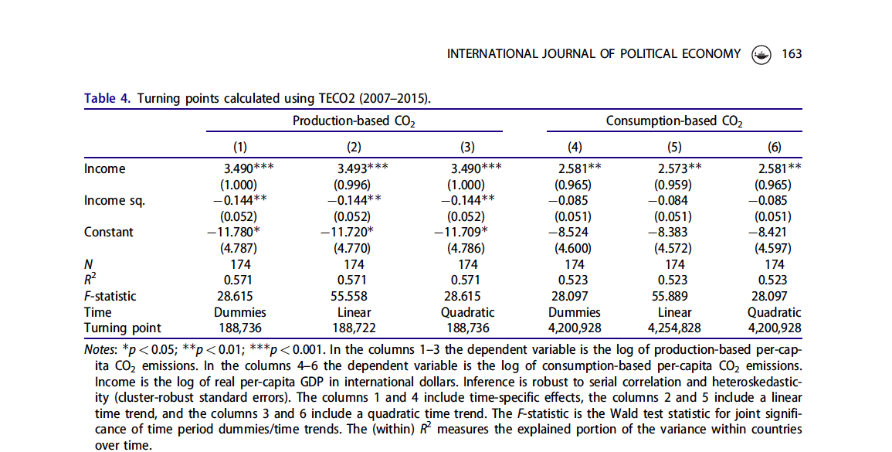

Slide 10
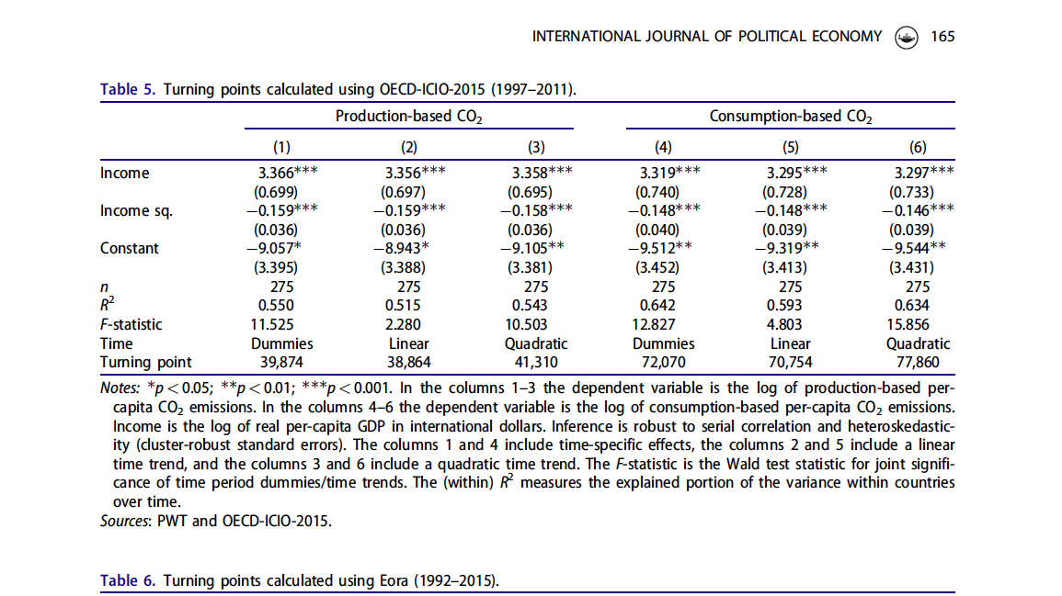

Slide 11
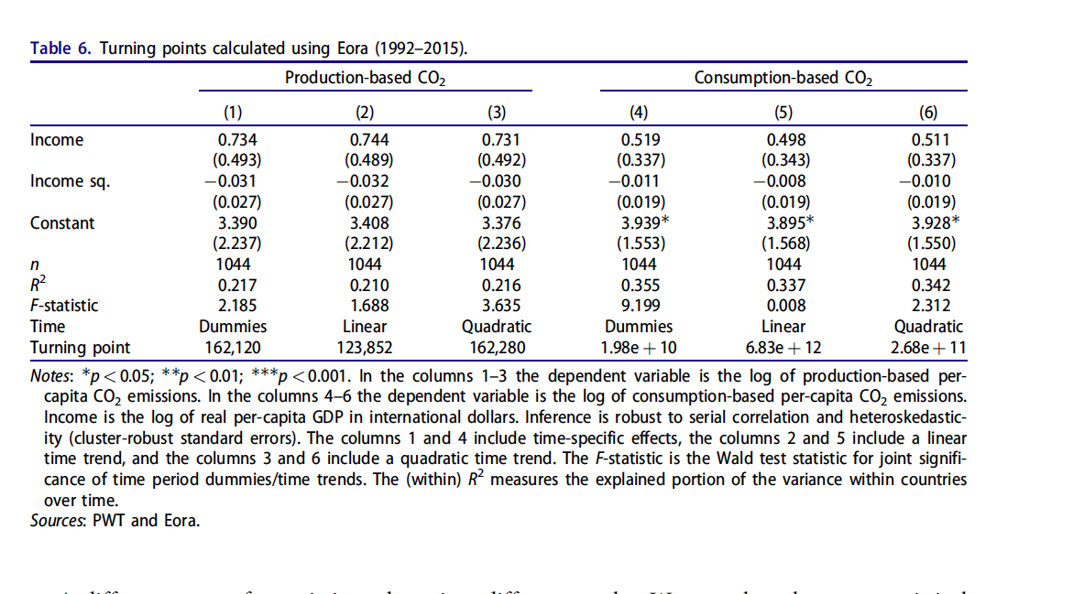

Slide 13
Key takeaways
The CKC relationship does not hold up statistically universally for the different data sets.
The consumption-based estimates yield significantly higher ( often impossibly high ) turning points
Decoupling in any real sense is not likely in the foreseeable future without transformative change
Degrowth as the only answer?

Slide 14
Green Growth vs. Degrowth: The Contours of the Debate

Slide 15
Readings
Giorgos Kallis et. al. ( 2018) Research on Degrowth
Annual Review of Environment and Resources
Robert Pollin ( 2019) : Advancing a Viable Global Climate Stabilization Project: Degrowth versus the Green New Deal
Review of Radical Political Economics

Slide 16
Egalitarian green growth or the ‘Green New Deal’
‘ …a worldwide program whose central aim is to invest 1.5–2 percent of global GDP per year in raising energy-efficiency standards and expanding clean renewable energy supply could realistically bring global CO₂ emissions down by 40 percent relative to today within 20 years, while also supporting rising living standards and expanding job opportunities.’ (Pollin, 2019)
Two-pronged strategy of increasing energy efficiency and transition towards clean energy
This strategy will imply transformation in the growth process ( from fossil fuel production to renewable energy production, more energy-efficient production and consumption ) driven by significant investment
Directed Public investment is key to crowd in private investment and kickstart the process (Green Keynesianism)
Important additional role of public investment in generating jobs and ensuring resource transfers to those who lose out from the greening process ( Resembling original New Deal in the USA during the Great Depression)
This approach is cognizant of intra and international inequalities and proposes a progressive financial burden of green investment on wealthy countries and wealthy citizens

Slide 17
Degrowth
‘Degrowth is a new term that signifies radical political and economic reorganization leading to drastically reduced resource and energy throughput.’ ( Kallis et.al. 2018)
Though the objective is not on negative growth directly, it is likely to be an outcome of effectively and significantly reducing resource and energy use
Sacrificing growth does not imply sacrificing well-being as long as that can be delinked from consumption of commodities with a resource depletion and carbon emitting trail.
The utopianism of the degrowth is recognized by the proponents themselves as they acknowledge the inherent growth imperative of a capitalist system but they maintain a radical rethink at a systemic level is essential given the seriousness of the climate emergency
Green growth is not a feasible alternative as faith on absolute decoupling through clean energy transition and energy efficiency is not realistic

Slide 18
What is the basis of a choice?
Ecological
Economic
Political

