Slide 1

The why’s, the how’s, and the retrospective
Adam Gaudreau

Slide 2




What is fastack?
fa[st]stack
Elevator pitch
4 supported frameworks
“A fast, user-friendly way to generate a new web technology stack project.”
Angular 6+
NodeJS
ReactJS
VueJS

Slide 3
Why?
Problems
Solution
CLIs for each framework have no standardization (parameters, install processes, etc.)
They use the same languages and package managers…
Starting a project is boring and repetitive
Almost always starts with looking at docs
CLIs change over time
CLIs are not user-friendly (even though they may be simple)
Most web-based projects share common features, but they take a while to set up
i.e. DB connections, user management, etc.

Slide 4
Design
Pick a framework
Configure options
Add features
Generate
Download

Slide 5
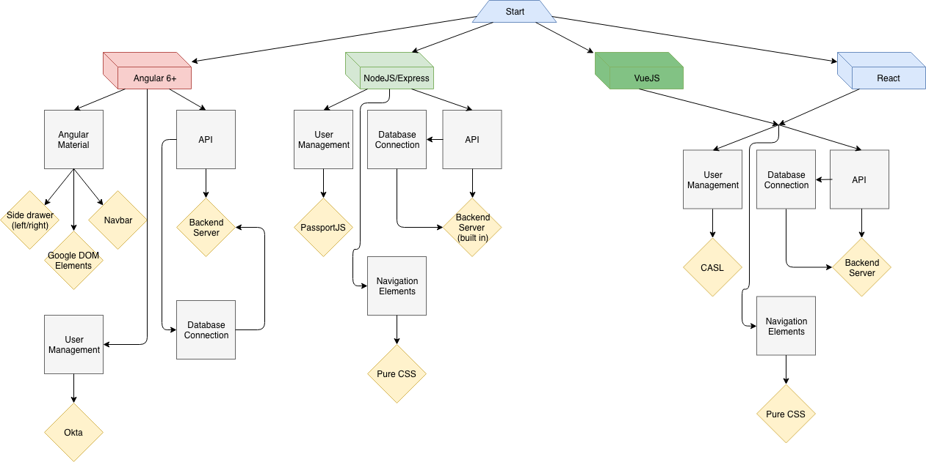
Design of Options and Features

Slide 6
Why I Chose Node
Relatively simple web app
Front-end is single page
Backend uses sockets and didn’t need an API
ExpressJS provided server/back-end
Familiar to me
Fast
No need for compilation like Angular
Didn’t need strong typing or advanced services

Slide 7
socket.io
A node library that “…enables real-time, bidirection and event-based communication”
“Emulates” WebSocket protocol, not a direct implementation
WebSocket protocol provides full-duplex communication channels over a single TCP connection

Slide 8
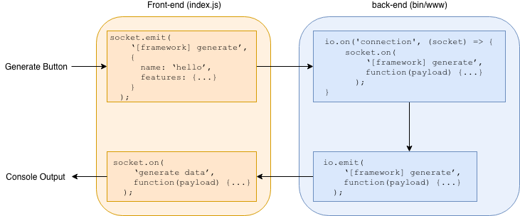
socket.io in fastack

Slide 9
Generating the apps
Each framework has it’s own node package that procedurally generates a new web app
Angular => ng new [app name] [options]
Node/Express => express [app name] [options]
React => npx create-react-app [app name] [options]
Vue => vue create [app name] [options]
The back-end asynchronously spawns a child process that runs one of the commands
As the process produces an output (stdout or stderr), it emits that data via socket.io over to the front-end
Once the process completes, the zipping process starts
Once zipped, the file is ready for download and a link is provided to the user

Slide 10
Deleting old files
After the project is generated, there’s the directory and zip file left over
This clouds up valuable space over time
cron was the solution
Every 15 minutes a script executes that deletes everything in the temp/ directory
This is NOT the best solution

Slide 11
Demo

Slide 12
Retrospective
Took a lot longer than I thought it would
Was able to add configurable options, not so much features
Platform is ready for more features (if given time)
It doesn’t solve a problem per se, just makes life a little easier
No need to go from web, to CLI, back to web
Developers would like this app, but is no where near being the new norm
”hard core” developers may not (whatever that means)

Slide 13
The Good
First of its kind from what I’ve seen
The core functionality was implemented
It’s fast too
UI looks okay, could be simplified and improved in places
Give users of this site are here for the UX, it may be fine too
Scalable
Simple

Slide 14
The Bad
Needed much more time to implement certain features
DB connections
User management
Many required simple text manipulation (programmatically of course)
Back-end is slightly cluttered
Most socket logic is under one single function
Issues between NodeJS and pure JS
Missing validation for files already generated
Can take up a lot of space is site is compromised
Needs more protection

Slide 15
Thanks! Questions?

