Slide 1
To Play and Cooperate in Imperfect Information Game with Machine Learning
Ng Argens

Slide 2
Timeline
Literature Review
Reinforcement Learning
Dissertation Writing
Study of Basic Machine Learning Methodologies
Double Dummy Analyzer
Construct of Supporting Framework

Slide 3
Timeline
Literature Review
Reinforcement Learning
Dissertation Writing
Study of Basic Machine Learning Methodologies
Double Dummy Analyzer
Construct of Supporting Framework

Slide 4
Scope / Point of Interest
In Contract Bridge
Players are teamed 2 vs 2
Players hold 13 cards, known only to oneself
Bids to show information (transparent to partner and opponent)
To land a contract with greatest EV to the pair

Slide 5
Plan
Let agents bid (show information) randomly
Update by difference with par value

Slide 6
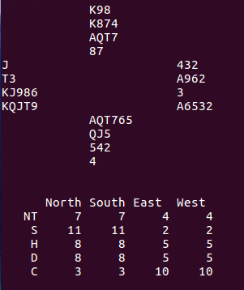
Example
1D: 3+ D, 11-21 HCP

Slide 7
Example
1D: 3+ D, 11-21 HCP
1S: 4+S, 6+HCP

Slide 8
Example
1D: 3+ D, 11-21 HCP
2N: 5+C, 5+D
1S: 4+S, 6+HCP

Slide 9
Example
4S + 1: 650

Slide 10
Example
4S + 1: 650
6C X - 2: -500

Slide 11
Literature Review
Mastering Chess and Shogi by Self Play with a General Reinforcement Learning
https://arxiv.org/pdf/1712.01815.pdf
Artificial Neural Networks for Solving Double Dummy Bridge Problem
http://www.mini.pw.edu.pl/~mandziuk/PRACE/ICAISC04-2.pdf
Arcade Game Environment: An Evaluation Platform for General Agents
https://arxiv.org/pdf/1207.4708

Slide 12
Takeaway – AlphaZero
Policy Network is updated by Monte Carlo Tree Search search probability

Slide 13
Takeaway – AlphaZero
Policy Network is updated by Monte Carlo Tree Search search probability
Value Network is updated by difference between predicted outcome and game outcome

Slide 14
Takeaway – AlphaZero
Policy Network is updated by Monte Carlo Tree Search search probability
Value Network is updated by difference between predicted outcome and game outcome
Go is a game suitable for RL/ML because:

Slide 15
Takeaway – AlphaZero
Policy Network is updated by Monte Carlo Tree Search search probability
Value Network is updated by difference between predicted outcome and game outcome
Go is a game suitable for RL/ML because:
Pieces are invariant

Slide 16
Takeaway – AlphaZero
Policy Network is updated by Monte Carlo Tree Search search probability
Value Network is updated by difference between predicted outcome and game outcome
Go is a game suitable for RL/ML because:
Pieces are invariant
Game is symmetric

Slide 17
Takeaway – AlphaZero
Policy Network is updated by Monte Carlo Tree Search search probability
Value Network is updated by difference between predicted outcome and game outcome
Go is a game suitable for RL/ML because:
Pieces are invariant
Game is symmetric
Rules are simple

Slide 18
Takeaway – AlphaZero
Policy Network is updated by Monte Carlo Tree Search search probability
Value Network is updated by difference between predicted outcome and game outcome
Go is a game suitable for RL/ML because:
Pieces are invariant
Game is symmetric
Rules are simple
It is binary win or loss

Slide 19
Adaptation – AlphaZero
Policy Network will be updated by Monte Carlo Tree Search search probability

Slide 20
Adaptation – AlphaZero
Policy Network will be updated by Monte Carlo Tree Search search probability
Value Network will be updated by difference between predicted outcome and par value

Slide 21
Adaptation – AlphaZero
Policy Network will be updated by Monte Carlo Tree Search search probability
Value Network will be updated by difference between predicted outcome and par value
Bridge faces the following challenges in RL/ML:

Slide 22
Adaptation – AlphaZero
Policy Network will be updated by Monte Carlo Tree Search search probability
Value Network will be updated by difference between predicted outcome and par value
Bridge faces the following challenges in RL/ML:
Game is asymmetric

Slide 23
Adaptation – AlphaZero
Policy Network will be updated by Monte Carlo Tree Search search probability
Value Network will be updated by difference between predicted outcome and par value
Bridge faces the following challenges in RL/ML:
Game is asymmetric
Chances are involved

Slide 24
Adaptation – AlphaZero
Policy Network will be updated by Monte Carlo Tree Search search probability
Value Network will be updated by difference between predicted outcome and par value
Bridge faces the following challenges in RL/ML:
Game is asymmetric
Chances are involved
Players and teamed with incomplete information

Slide 25
Adaptation – AlphaZero
Policy Network will be updated by Monte Carlo Tree Search search probability
Value Network will be updated by difference between predicted outcome and par value
Bridge faces the following challenges in RL/ML:
Game is asymmetric
Chances are involved
Players and teamed with incomplete information
Wins and losses have values (-27 to +27 IMPS)

Slide 26
Adaptation – AlphaZero
Policy Network will be updated by Monte Carlo Tree Search search probability
Value Network will be updated by difference between predicted outcome and par value
Bridge faces the following challenges in RL/ML:
Game is asymmetric
Chances are involved
Players and teamed with incomplete information
Wins and losses have values (-27 to +27 IMPS)
Information representation has to be devised

Slide 27
Adaptation – AlphaZero
Policy Network will be updated by Monte Carlo Tree Search search probability
Value Network will be updated by difference between predicted outcome and par value
Bridge faces the following challenges in RL/ML:
Game is asymmetric
Chances are involved
Players and teamed with incomplete information
Wins and losses have values (-27 to +27 IMPS)
Information representation has to be devised
Bridge is suitable for RL/ML:
Rules/Legal Moves are simple

Slide 28
Takeaway – ANN for Double Dummy Solver
Simple network is sufficient (52-25-1)

Slide 29
Takeaway – ANN for Double Dummy Solver
Simple network is sufficient (52-25-1)
One output neuron is sufficient

Slide 30
Takeaway – ANN for Double Dummy Solver
Simple network is sufficient (52-25-1)
One output neuron is sufficient
Lots of deals are needed

Slide 31
Takeaway – ANN for Double Dummy Solver
Simple network is sufficient (52-25-1)
One output neuron is sufficient
Lots of deals are needed
Sigmoid activation, even for output neuron, might be good

Slide 32
Takeaway – Arcade Game Environment
There is barely overlapping of domains in the two

Slide 33
Takeaway – Arcade Game Environment
There is barely overlapping of domains in the two
The main focus of the paper was

Slide 34
Takeaway – Arcade Game Environment
There is barely overlapping of domains in the two
The main focus of the paper was
effective feature extraction from pixels

Slide 35
Takeaway – Arcade Game Environment
There is barely overlapping of domains in the two
The main focus of the paper was
effective feature extraction from pixels
proper evaluation of results

Slide 36
Progress - Double Dummy Analyzer
A c++ double dummy solver was found
https://github.com/dds-bridge/dds
Large number of training deals can thus be generated

Slide 37
Progress – Card Representation
In ANN for Double Dummy Solver
Card Representation includes:
N: 1.0, S: 0.8, W: -1.0, E: -0.8
=> Input = (52, )

Slide 38
Progress – Card Representation
In ANN for Double Dummy Solver
Card Representation includes:
Mapping (2-A) to (0.1 – 0.9)
Mapping (Clubs – Spades) to (0.1 – 0.9)
=> Input = (104, )

Slide 39
Progress – Card Representation
Matrix of 0s and 1s to represent the presence of card
To encourage interaction with neighboring opponents, it is stacked as
W – S – E – N – W – S – E
To discourage interaction with other suits, they are entered as channels, CNN is then used

Slide 40
Progress – Genetic Algorithm
Accuracy is low with serious cases of overtraining

Slide 41
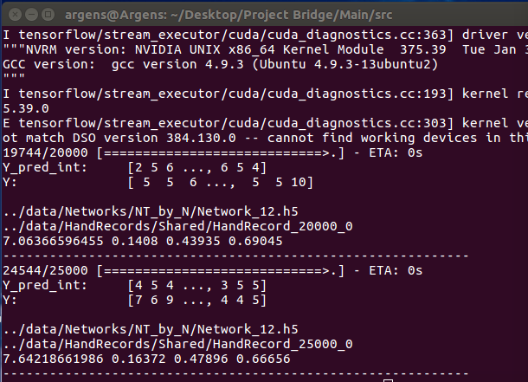
Progress – Genetic Algorithm
34.6 | 81.0 | 96.3
MSE, Accuracy, Acc (diff by 1 trick), Acc (diff by 2 tricks)

Slide 42
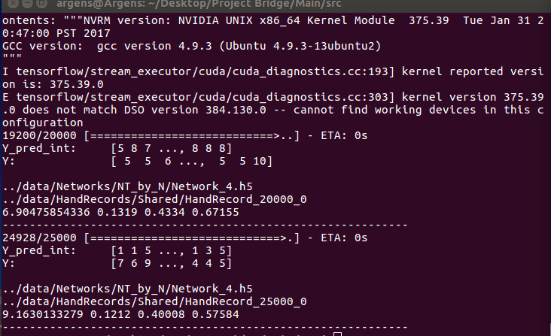
Progress – Genetic Algorithm
---- >
---- >

Slide 43
Progress – Genetic Algorithm
Initialize randomly
Selection by elitism (0.1)
Cross-breed with mutation chance of 0.05 per variable
If mutate, variable is increased or decreased by (-100 to 100)
Offspring’s variables are chosen between parents equally
Evaluation (by MSE)

Slide 44
Progress – Genetic Algorithm
MSE dropped from (4.599, 4.81) to (4.016, 4.045)
The MSE of 4.599 was an abnormality among 6 to 8 MSE

Slide 45
Progress – Bidding System
Bidding system is based on Hong Kong Youth Team system 2019
Constructed using dictionary {Bidding: Meaning}
Meaning can only be:
Length of suit
Shortness of suit
Forcing
Relay

Slide 46
Progress – Bidding System
Meaning can only be combination of:
Length of suit (Specify lower or upper range)
Forcing (Partner must bid)
Relay (Meaningless)
BAL (2+ for all suits)
HCP (Specify lower or upper range or both)
Presence / Absence of Specific Card

Slide 47
Work to be Done – Self Play
4 x 4 x
4 x 4 x
38 x 16 x
Lowest No. of Cards
Highest No. of Cards

Slide 48
Work to be Done – Self Play
4 x 4 x
4 x 4 x
38 x 16 x
38 X X
Presence of Ace
Presence of King
Presence of Queen

Slide 49
Work to be Done – Self Play
4 x 4 x
4 x 4 x
38 x 16 x
Lower Range of HCP
Higher Range of HCP

Slide 50
Work to be Done – Self Play
4 x 4 x
4 x 4 x
X
38 x 16 x
38 X 8X
Relay Flag
Forcing Flag

Slide 51
Work to be Done – Self Play
4 x 4 x
4 x 4 x
38 x 16 x
Bidding History

Slide 52
Work to be Done – Self Play
4 x 4 x
4 x 4 x
38 x 16 x
Expected Value

Slide 53
Work to be Done – Self Play
4 x 4 x
4 x 4 x
38 x 16 x
Policy Vector

Slide 54
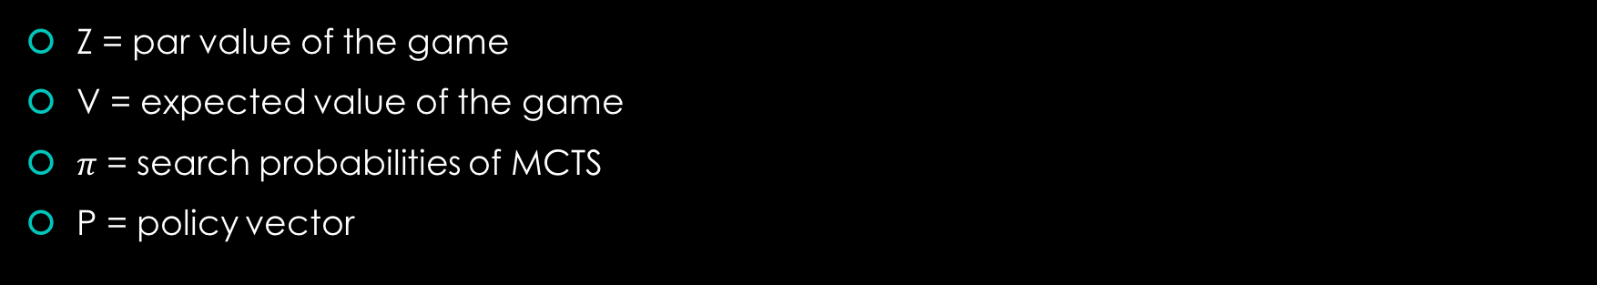
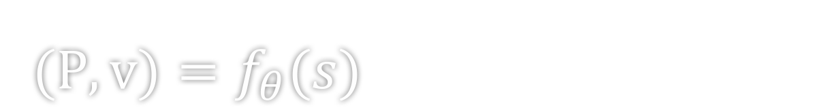
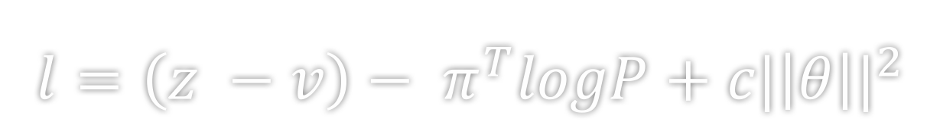
Loss Function
$(P, v)=f_{θ}(s)$
$l=\left(z −v\right)− π^{T}logP+c{|\left|θ\right||}^{2}$
Z = par value of the game
V = expected value of the game
$π$ = search probabilities of MCTS
P = policy vector

Slide 55
Question / Challenge
How should information from Bidding and Cards be encoded together?
Does the scaled scoring affect learning?
Can agents learn to provide not-so-accurate information?

