Slide 1
Programming assignment tutorial
COMP7305 Multimedi Technologies
by Kevin Lam (yklam2)

Slide 2
Overview
Written assignment (mean: 15.7/20 s.d.: 3.4 )
Quiz (mean: 30.9/40 s.d.: 6.4)
Group assignment (2 students)
Programming part:
RGB ←→ YUV conversion
Compression and decompression
Written part:
Compression algorithm
Experiment and results

Slide 3
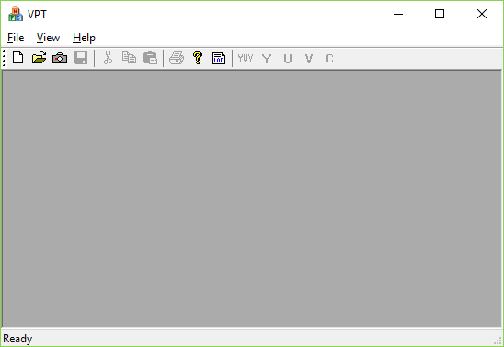
The program
You can download the template from Moodle and open the project (VPT.sln) in Visual Studio
If you see nothing when the project is loaded, right click on the solution explorer and install missing package
You can build and run the program immediately.

Slide 4
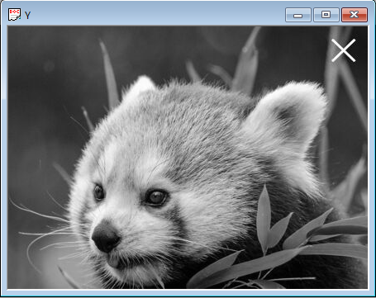
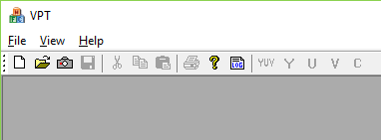
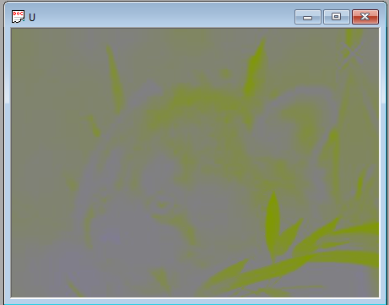
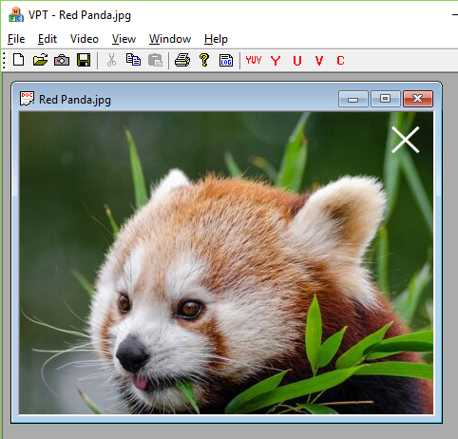
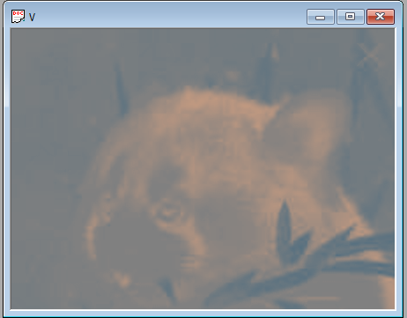
Example run (1)

Slide 5
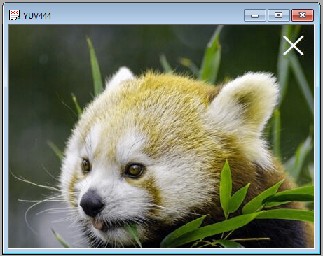
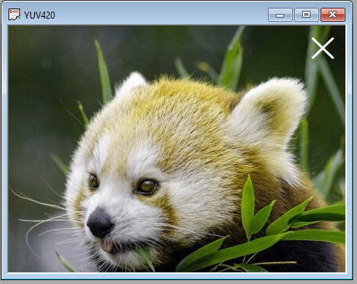
Example run (2)

Slide 6
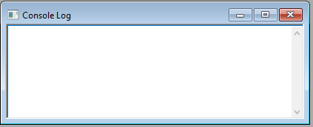
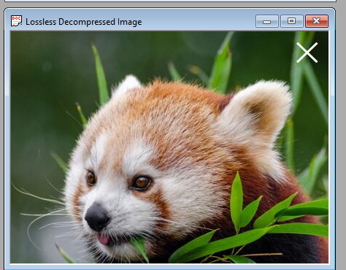

Example run (3)

Slide 7
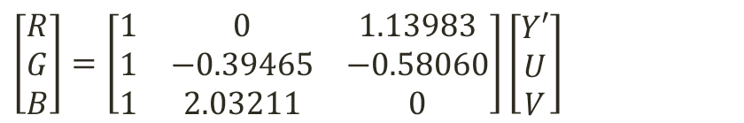
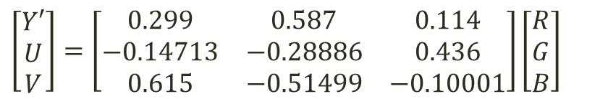
Programming task 1
Complete RGBtoYUV() and YUVtoRGB() in AppConvert.cpp
$$\left[\begin{matrix}Y′ \\ U \\ V\end{matrix}\right]=\left[\begin{matrix}0.299 & 0.587 & 0.114 \\ −0.14713 & −0.28886 & 0.436 \\ 0.615 & −0.51499 & −0.10001\end{matrix}\right]\left[\begin{matrix}R \\ G \\ B\end{matrix}\right]$$
$$\left[\begin{matrix}R \\ G \\ B\end{matrix}\right]=\left[\begin{matrix}1 & 0 & 1.13983 \\ 1 & −0.39465 & −0.58060 \\ 1 & 2.03211 & 0\end{matrix}\right]\left[\begin{matrix}Y′ \\ U \\ V\end{matrix}\right]$$
Note: If range of R, G, B are [0, 1],
Range of Y’ will be [0, 1],
Range of U will be [-0.436, 0.436],
Range of V will be [-0.615, 0.615].

Slide 8
Programming task 2 + Written task
Complete Compress() and Decompress() in AppCompress.cpp
You need to decide which method to use.
Write a report on:
Details of your algorithm
Result of the two experiments, as well as your corresponding comments.

Slide 9

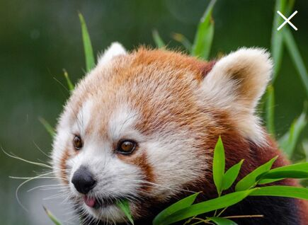


Example result
These are the result of my first attempt.
 | Beach | Red Panda | Sunset | Tuxinu
Original | 1.24:1 | 1.24:1 | 1.30:1 | 1.29:1
Y | 1.25:1 | 1.24:1 | 1.30:1 | 1.29:1
U | 1.31:1 | 1.33:1 | 1.33:1 | 1.29:1
V | 1.33:1 | 1.33:1 | 1.33:1 | 1.33:1

Slide 10
Picking a compression algorithm
Before you start your implementation, you need to decide how you will compress the image.
You are expected to use a compression algorithm that is suitable of compressing an image.
You will lose some marks if you choose an algorithm that is not suitable for image compression.
Unless you have a very strong reason that your algorithm should work on images.

Slide 11
Compress()
In case the compressed data size is not known before compression, you need to dynamically allocate the required memory and update cDataSize
Calculate the size of compressed data, update cDataSize
Allocate enough memory to compressedData
Compress the image from pInput and store the result in compressedData
return compressedData
After running compress(), it is expected that :
cDataSize holds the data size of the returned data
the returned data consists of the compressed image with of size not more than cDataSize, and the corresponding memory is properly allocated.
Remember to remove the sample code in the function!
There should not be any other side effects, you should not store any other information in the program to be used in decompression of the data

Slide 12
Decompress()
Given cDataSize as the data size of compressedData, decompress the compressedData and store it into uncompressedData.
The function should decompress the image solely from compressData and cDataSize
Do not assume that decompression is done right after compression. In testing your code, we may simply provide a pre-stored set of compressedData and cDataSize from your Compress() function.
Memory to uncompressedData is already allocated for you, you should not reallocate it.

Slide 13
Limitation
You can only modify these four files:
AppConvert.h
AppConvert.cpp
AppCompress.h
AppCompress.cpp
Modification is limited to:
Modification of implementation of RGBtoYUV(), YUVtoRGB(), Compress(), and Decompress()
You must not change the parameter list
Adding of helper functions, either as a class member or a global function in any of the four files
You are not allow to make any other changes
You are not allow to include other libraries, you must implement your own code.
The Process() function suggests one of the way your functions will be called. Although you can modify this function, your program must work perfectly with the given Process() function.

