Slide 1
React Native
TeCH 314, Components

Slide 2
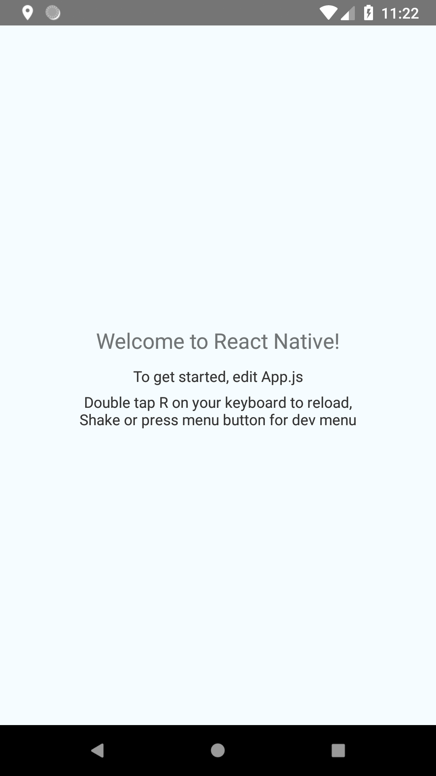
When we last left our intrepid coders…

Slide 3
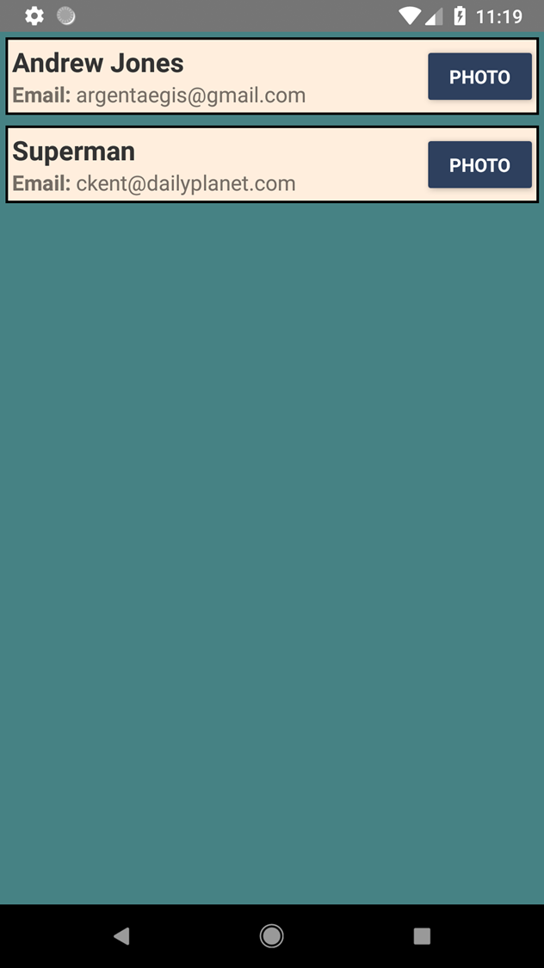
Where are we going today?

Slide 4
Components
Text
Style
Dimension
Button
Props

Slide 5
Links
https://github.com/argentaegis/ReactNativeClass

