Slide 1
React Native
TeCH 314, Components

Slide 2
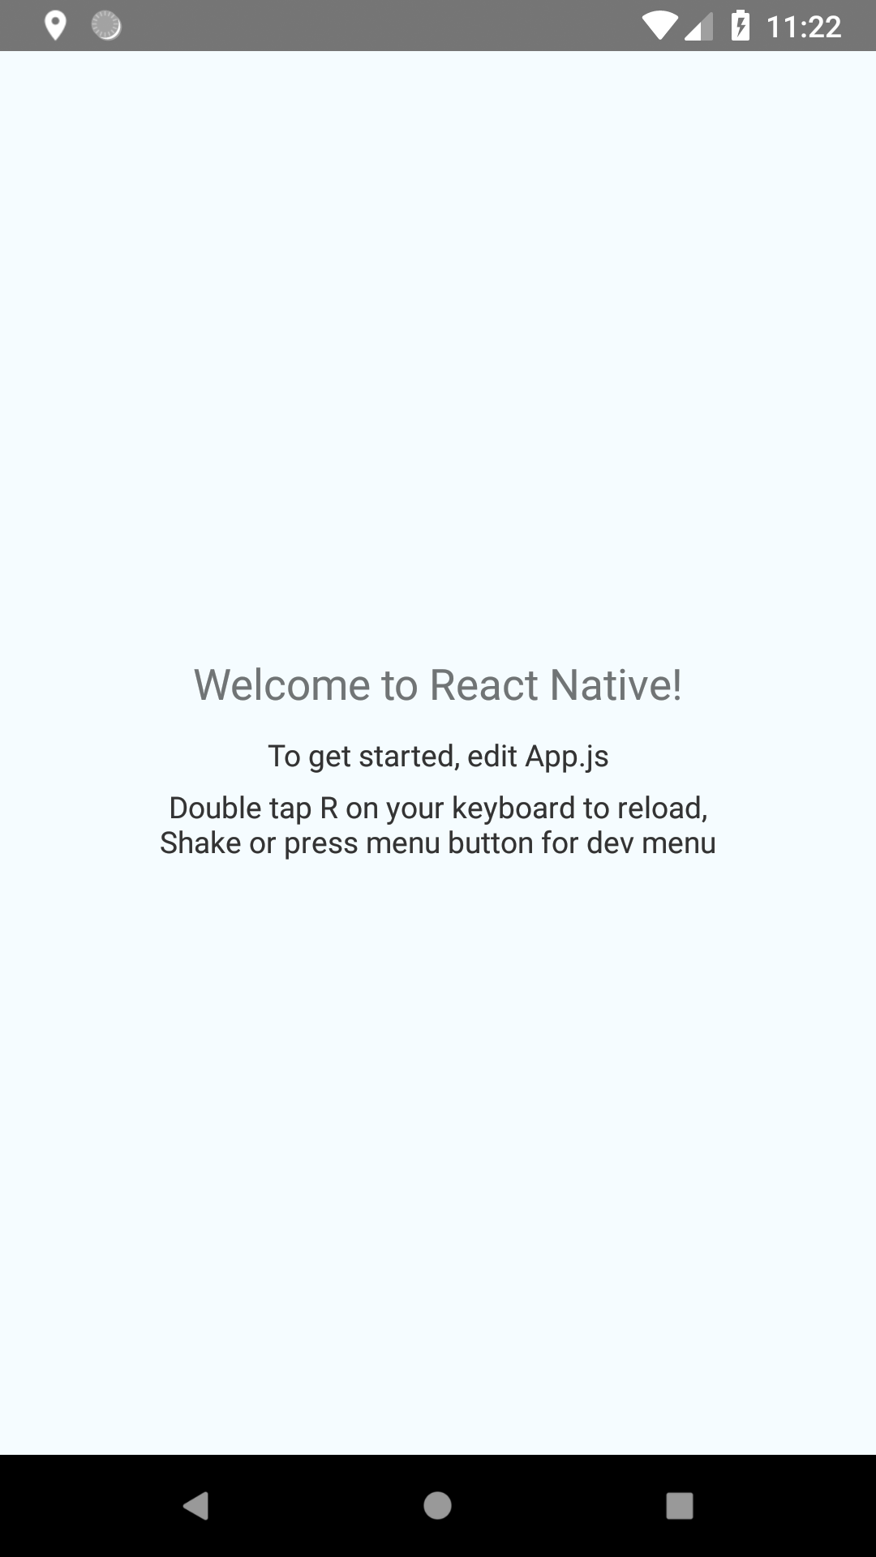
When we last left our intrepid coders…

Slide 3
Where are we going today?

