Slide 1
React Native
TeCH 314, FlatList, Life Cycle and Navigation

Slide 2
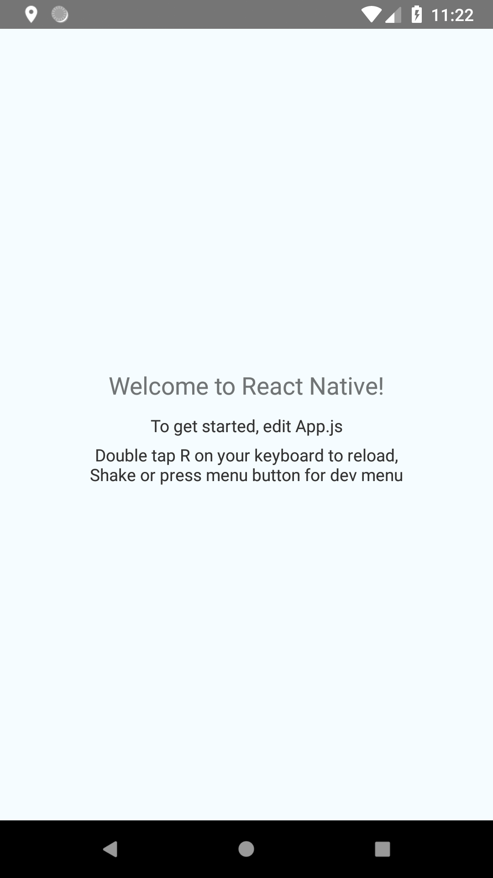
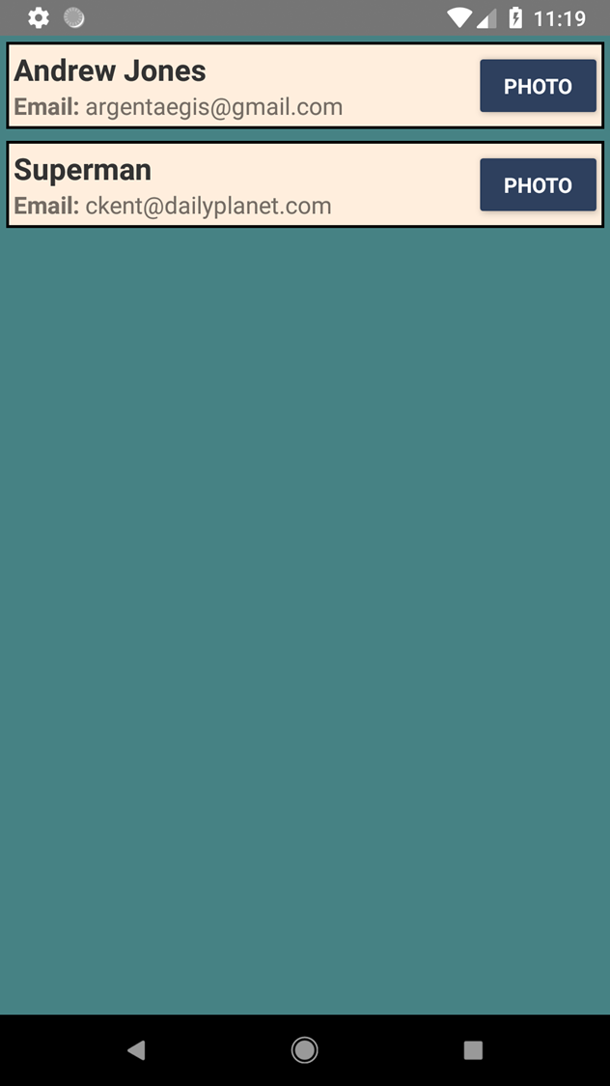
Last week on React Native…

Slide 3
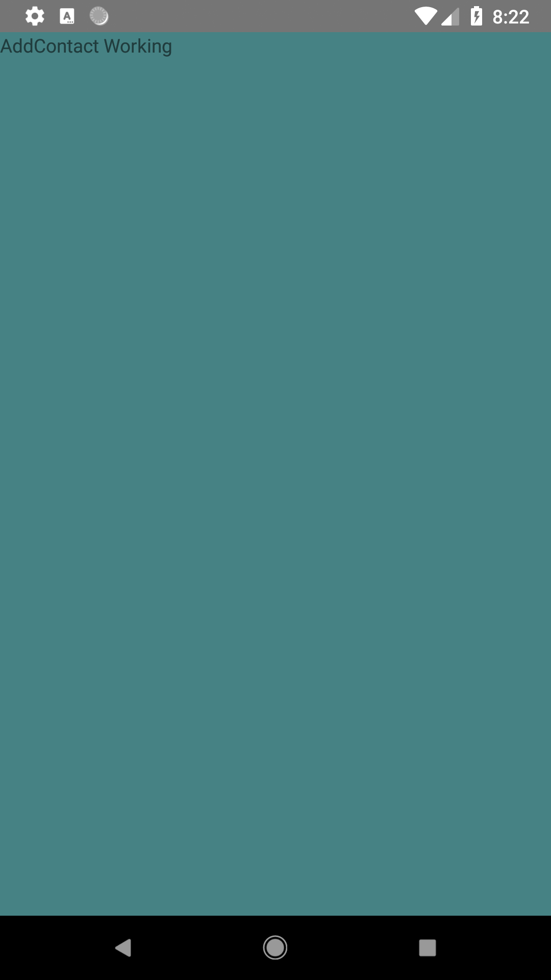
Where are we going today?

Slide 4
Topics
FlatList
State
Life Cycle
React Navigation

Slide 5
Life Cycle Events
componentWillMount
componentDidMount
componentWillReceiveProps
shouldComponentUpdate
componentWillUpdate
render
componentDidUpdate
componentWillUnmount
https://engineering.musefind.com/react-lifecycle-methods-how-and-when-to-use-them-2111a1b692b1

Slide 6
Links
https://github.com/argentaegis/ReactNativeClass
https://engineering.musefind.com/react-lifecycle-methods-how-and-when-to-use-them-2111a1b692b1

