Slide 1
React Native
TeCH 314, First Steps

Slide 2
Where are we going?
Learning together to build an app
From Zero to Hello World
Where’s my <div>?
There and back again
Save me
Say Cheese
Share the love
Pocket full of sunshine

Slide 3
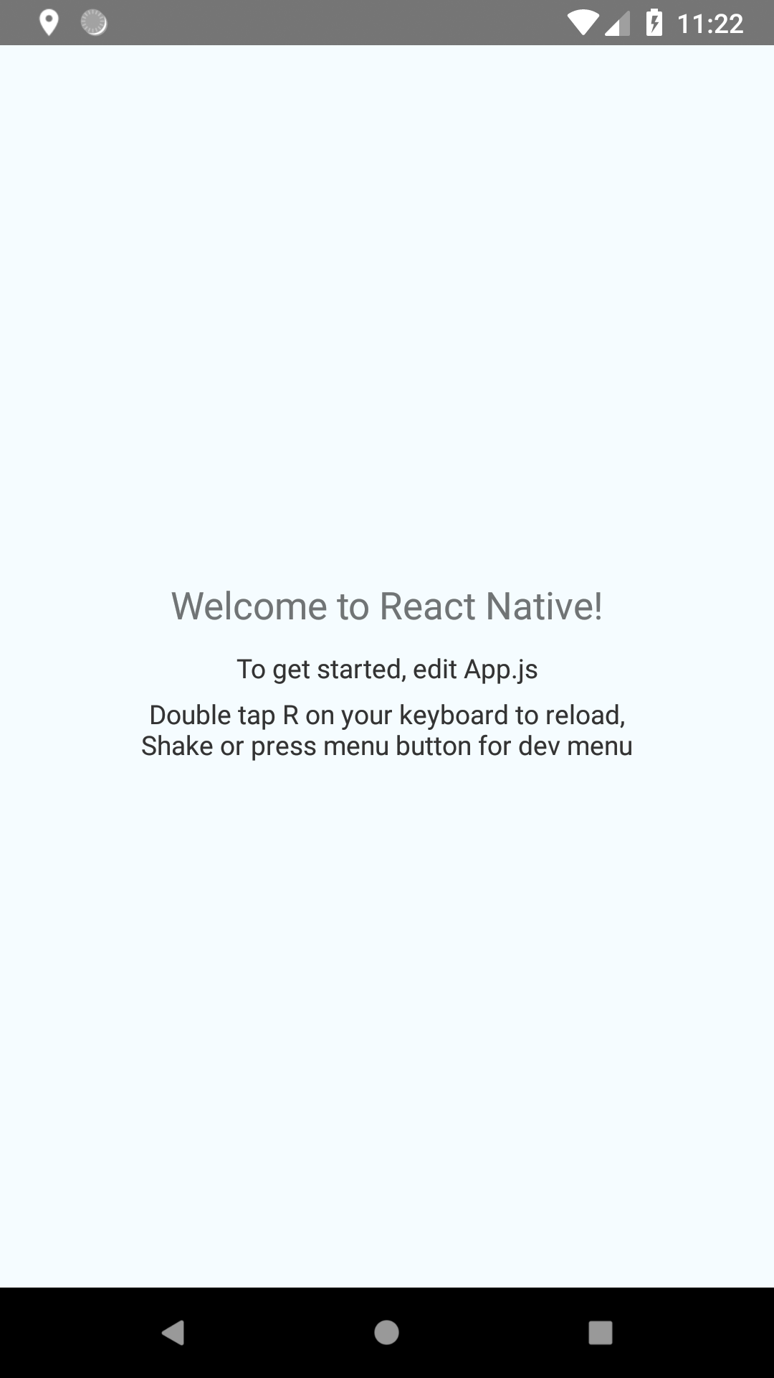
Where are we going today?

Slide 4
Getting Started
Helpful, but not essential, prior experience
React Native
React
Mobile
We’re all in the boat together
Pair Up

Slide 5
Reference
https://facebook.github.io/react-native/docs/getting-started.html
Building Projects with Native Code

Slide 6
Download the tools
Git
Node
Python 2
Java SE Development Kit (JDK)
Android Studio
SDK Platform 26
SDK Tools 26.0.3
HAXM
Google APIs Intel Atom_64 System Image

Slide 7
Environment Variables
ANDROID_HOME
C:\Users\USERNAME\AppData\Local\Android\Sdk
PATH
…Sdk\tools
…Sdk\tools\bin
…Sdk\platform-tools
…Sdk\emulator

Slide 8
Emulator
AVD
Oreo (API 26), x86_64
Press Play

Slide 9
NPM React Native
react-native-cli
react-native init PROJECTNAME
react-native run-android
This went boom last week…
npm install –save babel/runtime fixed it

Slide 10
Reference Links
Git: https://git-scm.com/downloads
Node: https://nodejs.org
Python 2: https://www.python.org/
Android Dev Studio: https://developer.android.com/studio/
React Native: https://facebook.github.io/react-native/docs/getting-started.html
Andrew’s Github for Tech 314: https://github.com/argentaegis/ReactNativeClass

Slide 11
Helpful Tips
Emulator Dev Menu: ctrl-m
Hot Reload
“r,r” reload
After checking out from git,
npm install
You may want to react-native upgrade as it’s the simplest way around some of the gradle issues. Use care.

