Slide 1
React Native
TeCH 314, EMAIL

Slide 2
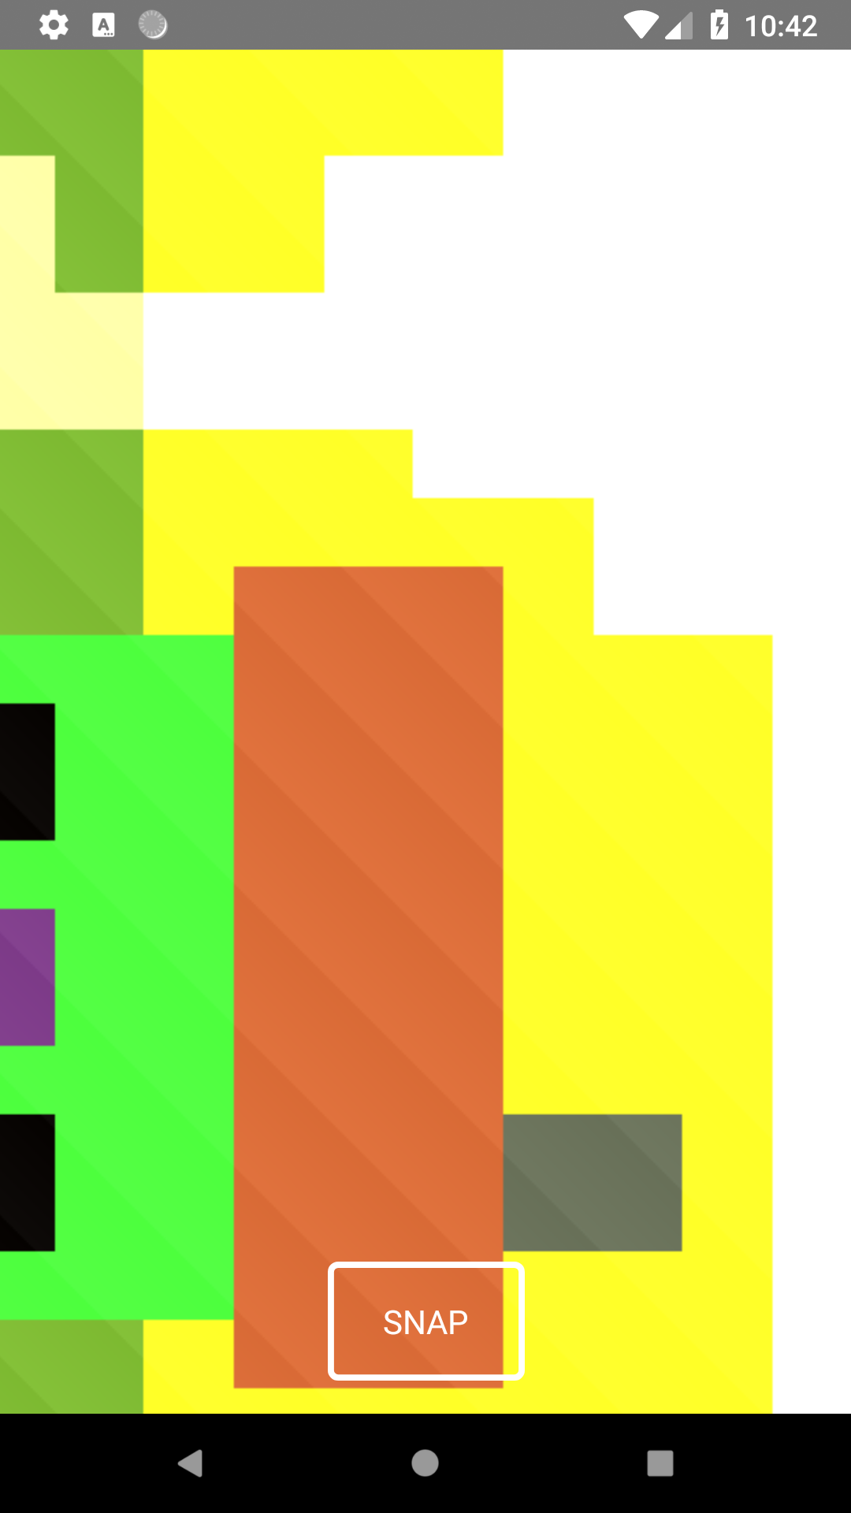
When last we left our intrepid coders…

Slide 3
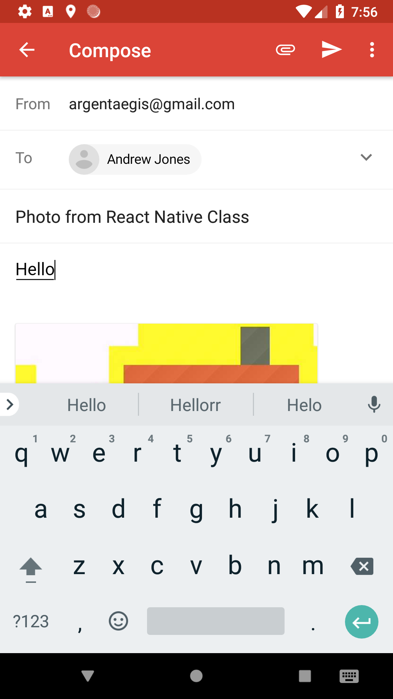
Where are we going today?

Slide 4
Topics
react-native-mail
react-native-fs
Navigation props

Slide 5
Links
https://github.com/argentaegis/ReactNativeClass
https://www.npmjs.com/package/react-native-email

