Slide 1
Testing with SAS @ argenx
Introduction to Testing with SAS
Phil Mason
STAR team
November 2022

Slide 2
AGENDA
Introduction​
Getting Started
​Documenting headers
Using the Doxygen Wizard
Suggested Template
Deploying to sharepoint
​Useful Links​

Slide 3
Introduction
Doxygen can automatically generate documentation from headers in source code.
It can generate online (HTML) or offline (e.g. MS Word, PDF) documentation.
It has a wizard forgetting started.
It supports markdown for making general documentation, not based on source code.

Slide 4
Getting started
Set up your environment

Slide 5
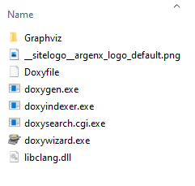
Install software
Download doxygen.zip
Extract it to C:\doxygen
Doxywizard.exe is run to use a User Interface
Doxygen.exe can be run on command line to generate documentation
Graphviz/bin/dot.exe is used for generating graphs in documentation
Doxyfile contains suggested settings
Download doxygen_manual-1.9.5.pdf
Optionally download some samples from doxygen-test.zip

Slide 6
Documenting headers
Using tags in SAS comment blocks

Slide 7
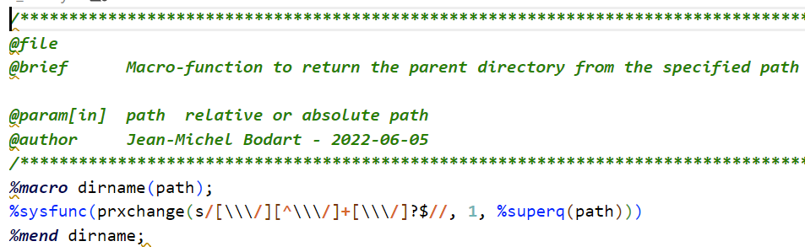
How it works
A single special comment block, starting with /**, ending with */
Tags start with @
@file
Makes a documentation entry for this source code
@brief this is a short description
Brief description of code
@details this is a longer description that can go over many lines
Detailed description
@author phil mason (pmason)
Name of author or user-id
@date 2023-01-01
Date code created
Tags are optional, except for @file
Programmers should at least use @file and @brief

Slide 8
Other useful parameters
@param[in] name description
Input parameters.
@param[out] name description
Output parameters
@param[in,out] name description
Parameters used for input and output
@returns things returned by program such as datasets, files, macro variables
@code proc print data=sashelp.class;run; @endcode
Can put lots of code between the tags to show a code block
@pre this is a pre-condition for this code to run
@warning this is a warning about something

Slide 9
Handling example code
Most header doc should go before the SAS code
We like example code after the SAS code
@cond stops Doxygen processing until @endcond is encountered
This allows skipping over the SAS code
@file is needed to continue documentation for the program
#### is markdown to make a level 4 header
@code / @endcode puts the example code into a coloured block
/**
@file
@brief this is a brief description.
@cond
*/
%macro nobs(dsid) ;
%sysfunc(attrn(&dsid,nobs))
%mend nobs ;
/**
@endcond
@file
#### Examples ####
@code
%put This dataset has %nobs(1) observations ;
@endcode
*/

Slide 10
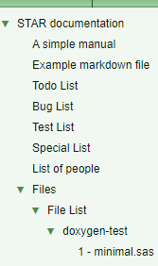
Making lists
Some tags not only show information in their own documentation page, but contribute to lists
Lists collect common information (e.g. bugs) from multiple program headers
@todo fix something later
Contributes to the Todo list
@bug here is something that doesn’t work
Adds to the Bugs list
@test here is a test to run
@xrefitem special "Special" "Special List" I can make special lists to gather items from multiple programs documentation.
This allows creating a custom list

Slide 11
Formatting text
Doxygen tags
@li list item (bullet point)
@b bold @c code @e emphasized @a argument
Using HTML
Most html tags are supported, - e.g. we can make tables for showing update history
Using Markdown
Markdown is supported so some useful conventions can be used, e.g.
##### Level 4 header ####
> block quote
- list item
`code block`
Read more about all this in documentation - Doxygen Manual: Special Commands - Doxygen Manual: HTML Commands - Doxygen Manual: Markdown support

Slide 12
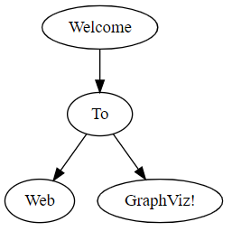
Diagrams
Diagrams can be made using the dot language – DOT Language | Graphviz
For example
@dot
digraph G {
"Welcome" -> "To"
"To" -> "Web"
"To" -> "GraphViz!"
}
@enddot

Slide 13
Using the Doxygen Wizard
or else you can use the command line

Slide 14
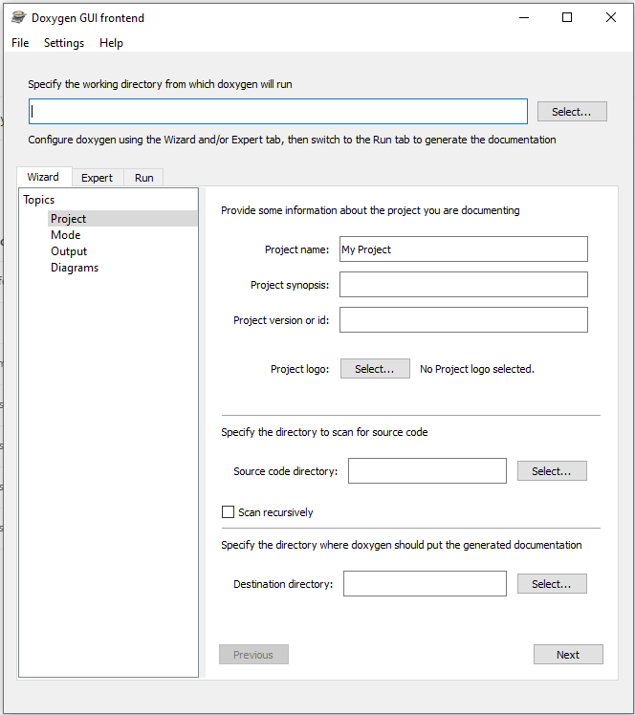
Start the wizard
Run doxywizard.exe
It opens the user interface
Quick way to start is use settings we have prepared
File/Open
Select Doxyfile from the doxygen directory
You will see lots of settings have been populated

Slide 15
Key settings
Wizard tab
Source code directory should point to where your source code is
Scan recursively can be ticked if you want to use sub-directories too
Destination directory is where generated documentation will be put
Advanced tab
HTML
HTML_FILE_EXTENSION
can be set to .html if you are generating documentation to look at on your computer
Set to .aspx if you are generating documentation to deploy to SharePoint
Run tab
Run Doxygen to generate the documentation
Show HTML output will open browser to show you the documentation

Slide 16
Suggested template
Refer to this to see most of the tags you are likely to need

Slide 17
/**
@file
@brief This is the brief description of the code.
@version optional info
@copyright optional info
@details This is a more detailed description of what happens in the program.
Which can go over multiple lines,
and can have SAS code sections:
@code
Proc print ;
run;
@endcode
And then can continue on with more description.
This is a highlighted block which could be used for code
because it is indented by some spaces
And back to normal documentation when there is no indent.
I can highlight things like @b bold text, an @a argument, some @e emphasized text,
some @c code.
You can use html too like: <tt>Some code could be here</tt><p/>
Or <u>Underlined</u>, <b>bold</b>, <br/>
<A HREF="https://doxygen.nl/manual/htmlcmds.html">HTML Commands</a>
@author name goes here
@author another author name goes here
@date 21 Oct 2022 first version of program
@date 1 Jan 2023 next version
@param parm1 this is a parameter description
@param[in] parm2 this is an input parameter description
@param[out] parm3 this is an output parameter description
@param[in,out] parm4 this is a parameter description for something that is input and output
@returns This describes what the code returns
@pre Pre-condition for using the code, for instance some macro variables need to be set first
@warning Warning about how to use the code
@test talk about testing here
@todo Record things here that are still to do
@bug Record any known bugs here
@xrefitem special "Special" "Special List" I can make special lists to gather items from multiple programs documentation.
<h4>Update History</h4>
<table>
<tr><th>Date</th><th>Name</th><th>Description</th></tr>
<tr><td> ---- </td><td> ---- </td><td> ---- </td></tr>
</table>
<h4>Examples</h4>
@code
@endcode
<h4>SAS Called</h4>
@li gplot.sas is used in some way
@li b.sas some comments about it
@li c.sas (this one does not exist yet, so doesn't get a link)
<h4>Diagram(s)</h4>
@dot
digraph example {
in -> out
out -> report
}
@enddot
**/

Slide 18
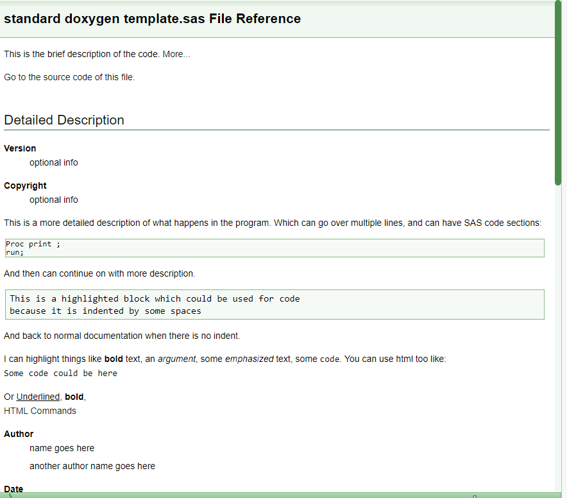

Slide 19
/**
@file
@brief This is the brief description of the code.
@version optional info
@copyright optional info
@details This is a more detailed description of what happens in the program.
Which can go over multiple lines,
and can have SAS code sections:
@code
Proc print ;
run;
@endcode
And then can continue on with more description.
This is a highlighted block which could be used for code
because it is indented by some spaces
And back to normal documentation when there is no indent.
I can highlight things like @b bold text, an @a argument, some @e emphasized text,
some @c code.
You can use html too like: <tt>Some code could be here</tt><p/>
Or <u>Underlined</u>, <b>bold</b>, <br/>
<A HREF="https://doxygen.nl/manual/htmlcmds.html">HTML Commands</a>
@author name goes here
@author another author name goes here
@date 21 Oct 2022 first version of program
@date 1 Jan 2023 next version
@param parm1 this is a parameter description
@param[in] parm2 this is an input parameter description
@param[out] parm3 this is an output parameter description
@param[in,out] parm4 this is a parameter description for something that is input and output
@returns This describes what the code returns
@pre Pre-condition for using the code, for instance some macro variables need to be set first
@warning Warning about how to use the code
@test talk about testing here
@todo Record things here that are still to do
@bug Record any known bugs here
@xrefitem special "Special" "Special List" I can make special lists to gather items from multiple programs documentation.
<h4>Update History</h4>
<table>
<tr><th>Date</th><th>Name</th><th>Description</th></tr>
<tr><td> ---- </td><td> ---- </td><td> ---- </td></tr>
</table>
<h4>Examples</h4>
@code
Proc Print data=sashep.class ; run ; @endcode
<h4>SAS Called</h4>
@li gplot.sas is used in some way
@li b.sas some comments about it
@li c.sas (this one does not exist yet, so doesn't get a link)
<h4>Diagram(s)</h4>
@dot
digraph example {
in -> out
out -> report
}
@enddot
**/

Slide 20
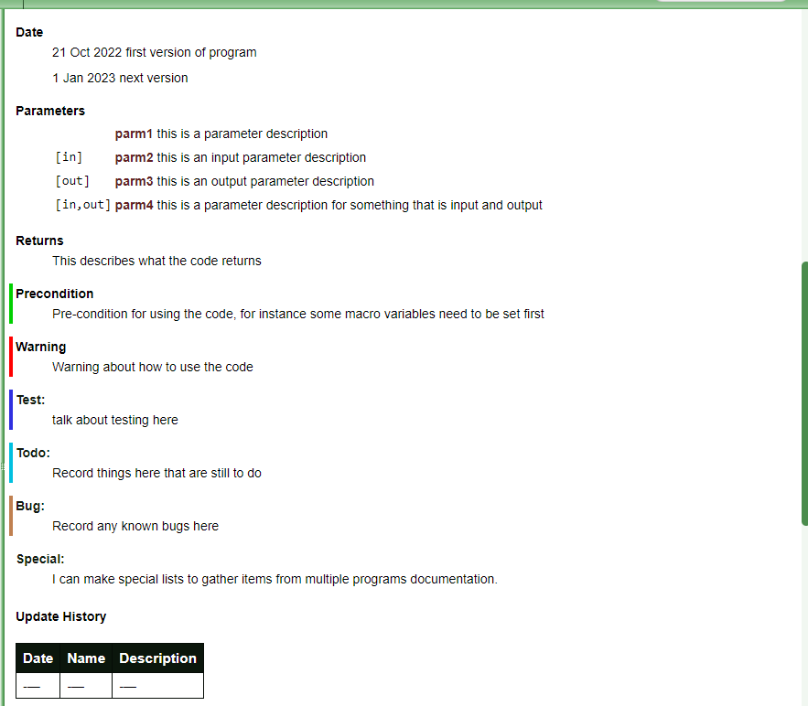

Slide 21
/**
@file
@brief This is the brief description of the code.
@version optional info
@copyright optional info
@details This is a more detailed description of what happens in the program.
Which can go over multiple lines,
and can have SAS code sections:
@code
Proc print ;
run;
@endcode
And then can continue on with more description.
This is a highlighted block which could be used for code
because it is indented by some spaces
And back to normal documentation when there is no indent.
I can highlight things like @b bold text, an @a argument, some @e emphasized text,
some @c code.
You can use html too like: <tt>Some code could be here</tt><p/>
Or <u>Underlined</u>, <b>bold</b>, <br/>
<A HREF="https://doxygen.nl/manual/htmlcmds.html">HTML Commands</a>
@author name goes here
@author another author name goes here
@date 21 Oct 2022 first version of program
@date 1 Jan 2023 next version
@param parm1 this is a parameter description
@param[in] parm2 this is an input parameter description
@param[out] parm3 this is an output parameter description
@param[in,out] parm4 this is a parameter description for something that is input and output
@returns This describes what the code returns
@pre Pre-condition for using the code, for instance some macro variables need to be set first
@warning Warning about how to use the code
@test talk about testing here
@todo Record things here that are still to do
@bug Record any known bugs here
@xrefitem special "Special" "Special List" I can make special lists to gather items from multiple programs documentation.
<h4>Update History</h4>
<table>
<tr><th>Date</th><th>Name</th><th>Description</th></tr>
<tr><td> ---- </td><td> ---- </td><td> ---- </td></tr>
</table>
<h4>Examples</h4>
@code
@endcode
<h4>SAS Called</h4>
@li gplot.sas is used in some way
@li b.sas some comments about it
@li c.sas (this one does not exist yet, so doesn't get a link)
<h4>Diagram(s)</h4>
@dot
digraph example {
in -> out
out -> report
}
@enddot
**/

Slide 22
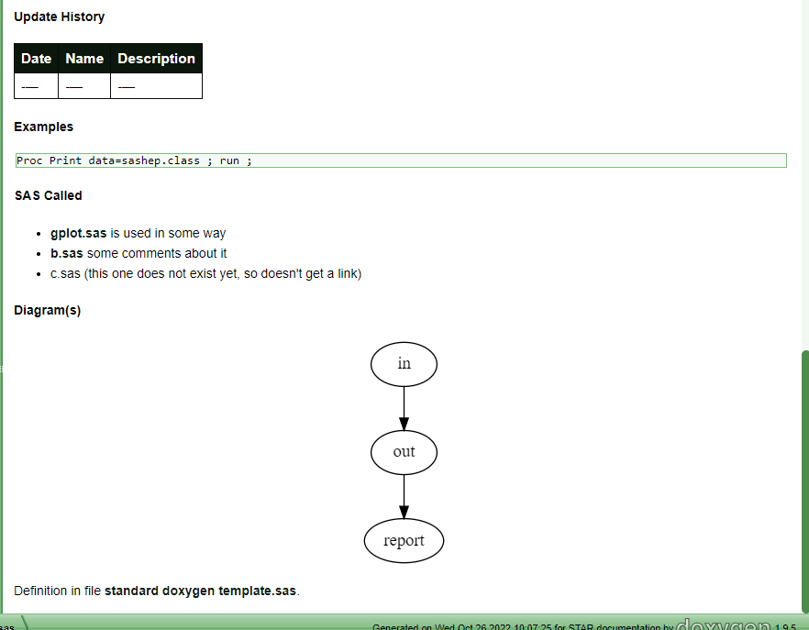

Slide 23
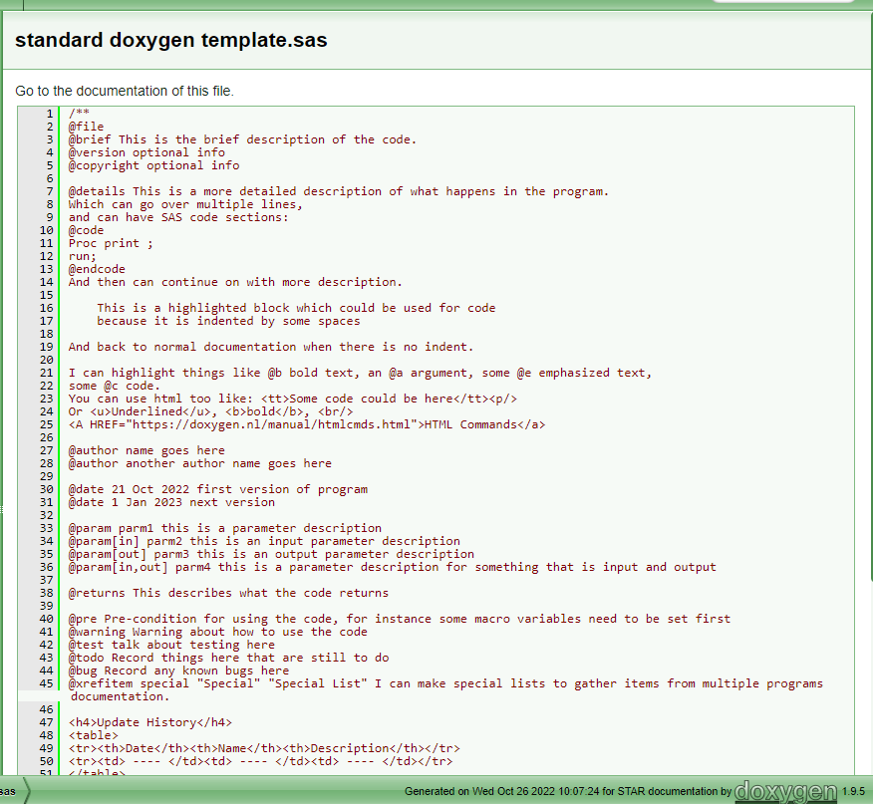
Clicking on source code link from documentation will show this

Slide 24
Deploying to sharepoint
Making documentation available to all

Slide 25
Steps
Download code from LSAF
Open the doxygen wizard
Under the Project tab, ensure Source code directory is pointing to directory holding the code
Under the Expert tab, in the HTML topic, ensure the HTML_FILE_EXTENSION is set to .aspx
Under the Run tab, run doxygen.
Go to the Destination directory (defined under Wizard tab) where you will find the generated documentation
Copy that documentation to SharePoint
Biostatistics - Programming documentation - All Documents (sharepoint.com)
You should be able to go to index.aspx in the documentation you uploaded to see the documentation you generated.

Slide 26
Useful links
Doxygen Home Page
Example - SASjs Documentation
Example - code from SASjs using doxygen
Special Doxygen commands
Graphviz examples
Examples
WebGraphViz
Graphviz Gallery
GraphvizFiddle

Slide 27
THANK YOU
Phil Mason​
pmason@argenx.com

