Slide 1

Malignant-Comments-Classifier
BY: ARGHA KR MAITI

Slide 2
Objective:
Our goal is to build a prototype of online hate and abuse comment classifier which can used to classify hate and offensive comments so that it can be controlled and restricted from spreading hatred and cyberbullying.

Slide 3
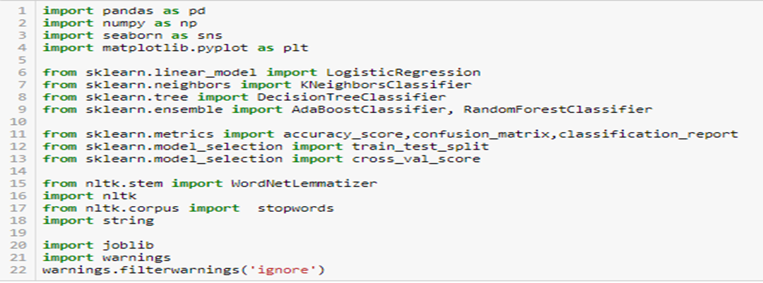
Importing required libraries and database:

Slide 4
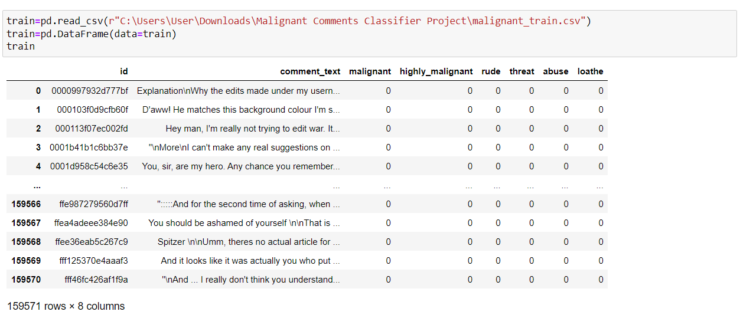
Dataset has 159571 rows and 8 columns.

Slide 5
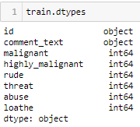
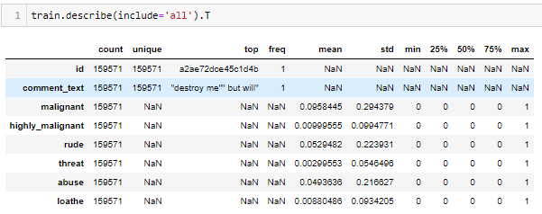
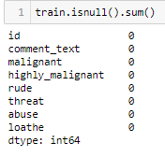
We can see both type of columns numerical and object type.
We can see in feature Id and comment_text all values are unique. And for all other features named malignant, highly_malignant, rude, threat, abuse and loathe we can see only 2 unique values 0 and 1 hence we getting 0 as min and 1 as max for these features.
Dataset does not contains null values
We can see id feature also has all unique values like serial number hence we don’t require feature for future analysis

Slide 6
Visualization:

Slide 7
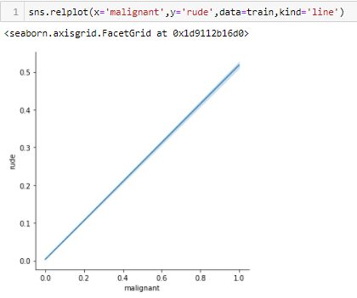
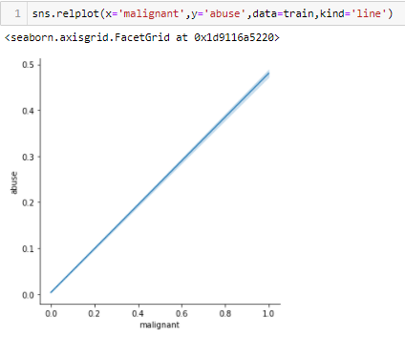
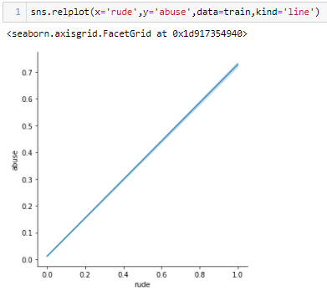
We can see positive relation in features malignant and rude.
We can see positive relation in features malignant and abuse.
We can see positive relation in features rude and abuse.

Slide 8
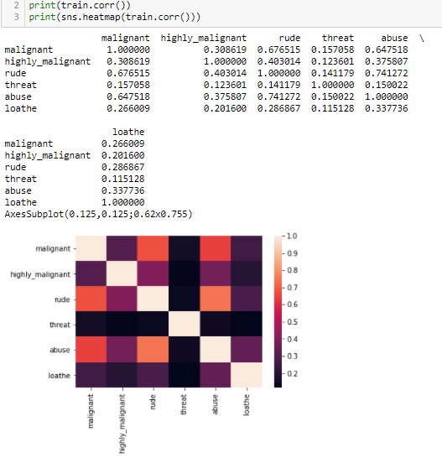
Checking correlation in dataset:

Slide 9
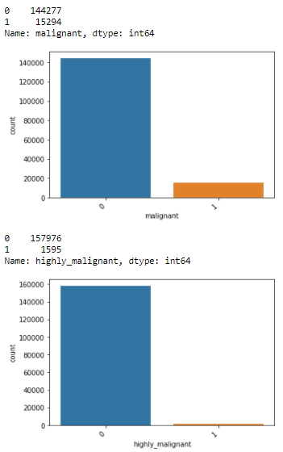
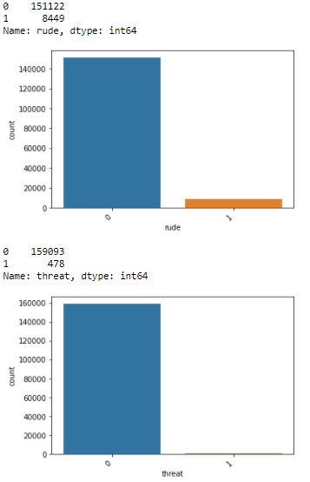
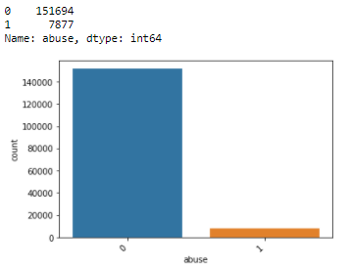
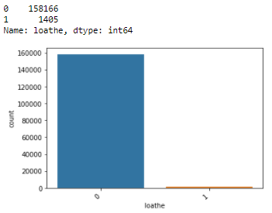
For feature malignant, we have 0 value 144277 times and 1 for 15294 times.
For feature highly_malignant, we have 0 value 157976 times and 1 for 1595 times.
For feature rude, we have 0 value 151122 times and 1 for 8449 times.
For feature threat, we have 0 value 159093 times and 1 for 478 times.
For feature abuse, we have 0 value 151694 times and 1 for 7877 times.
For feature loathe, we have 0 value 158166 times and 1 for 1405 times.

Slide 10
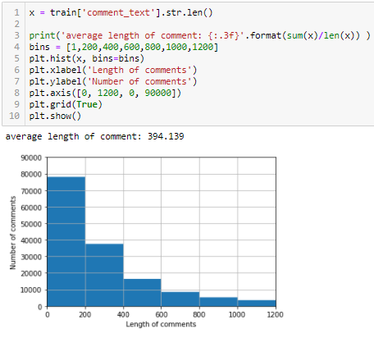
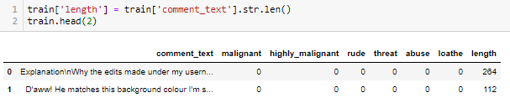
Above graph shows us the length of comments vs the number of comments. Maximum comments are with length 200 and very less comments are with length 1200.
Added a new feature where we can see length of the particular comment.

Slide 11
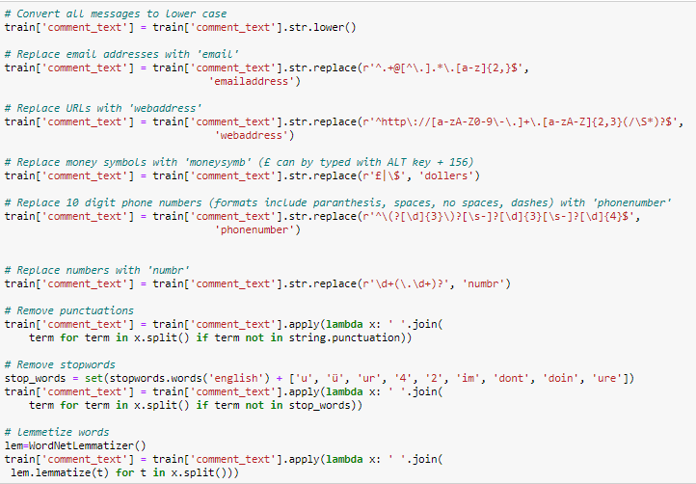
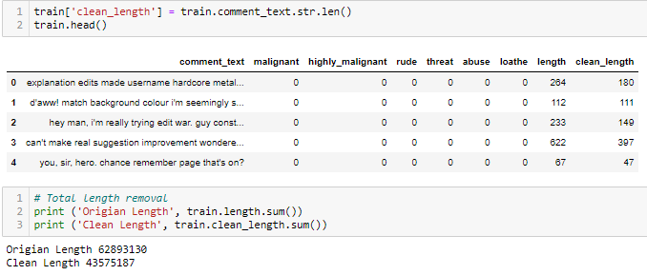
After cleaning the comment text, let’s have a look at comment length now.

Slide 12
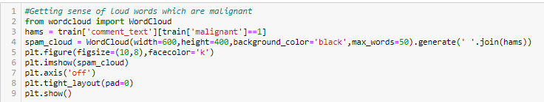
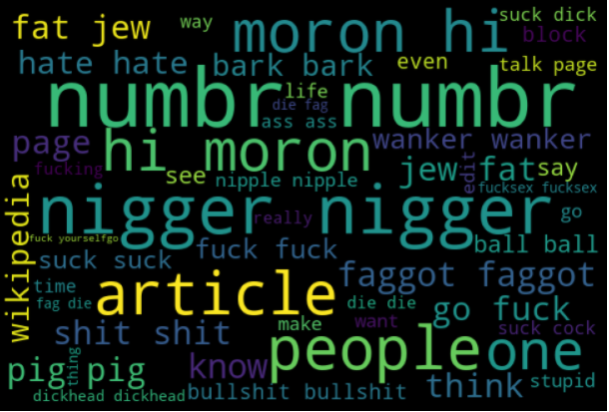
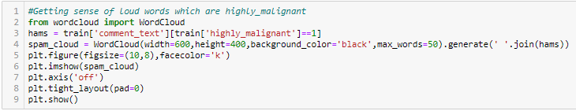
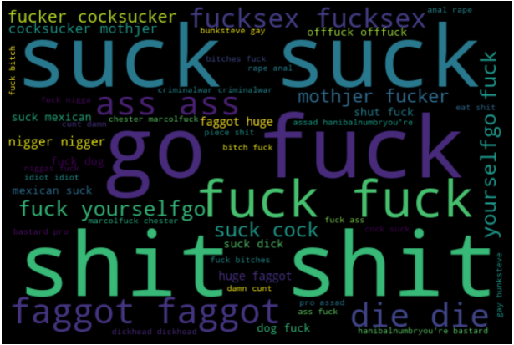
With respect to malignant feature the loud words are article, hi moron, moron hi, numbr, people and nigger.
With respect to highly_malignant feature the loud words are fuck, shit, suck, go fuck etc.

Slide 13
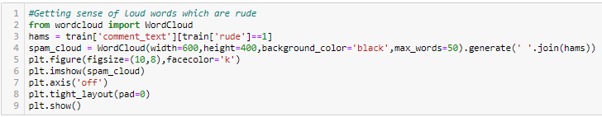
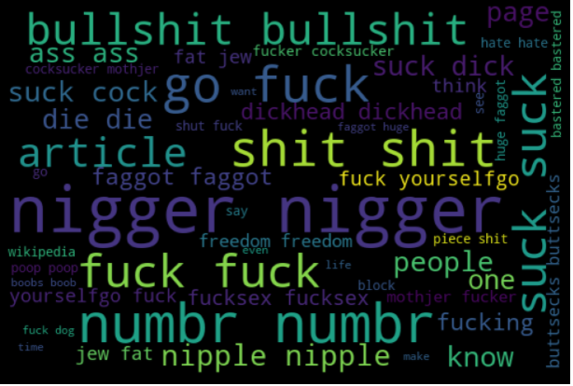
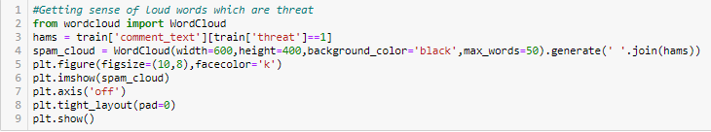
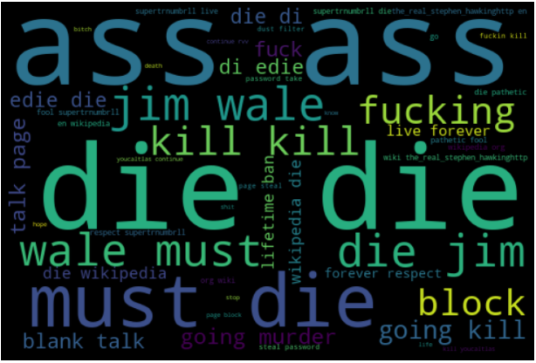
With respect to rude feature the loud words are nigger, suck, people, fuck, bullshit, shit and numbr.
With respect to threat feature the loud words are ass, kill, must die, jim wale, block, die die.

Slide 14

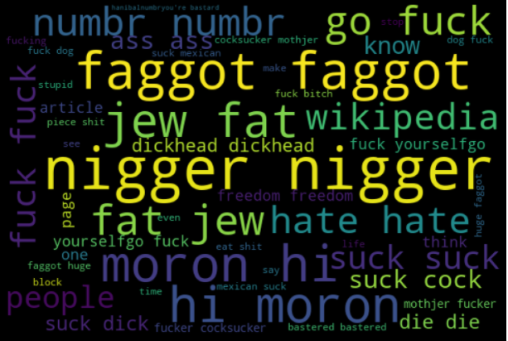
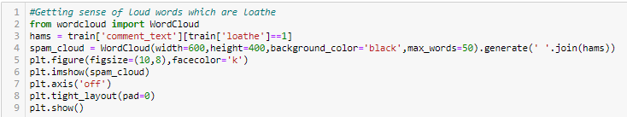
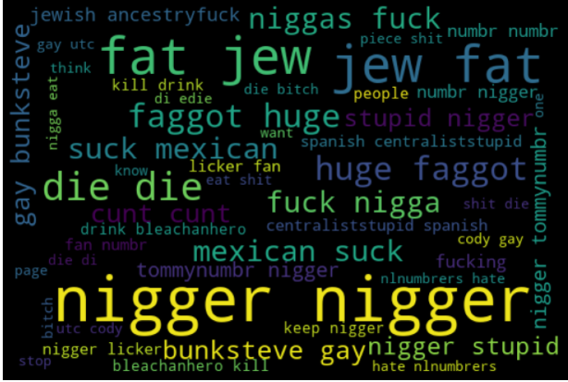
With respect to abuse feature the loud words are mororn hi, fat jew, hi mororn, nigger, faggot.
With respect to loathe feature the loud words are nigger, fat jew, die die, jew fat.

Slide 15
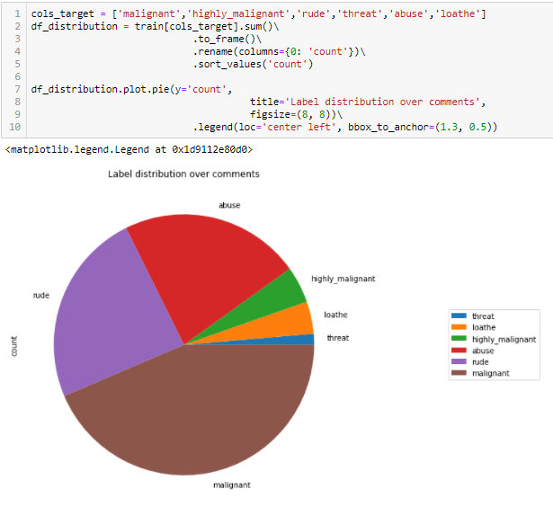
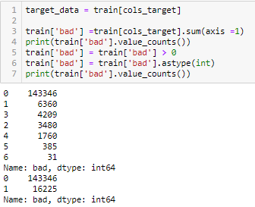
In the above pie chart, we can see very high number for malignant then rude and abuse are almost with same numbers. Then highly_malignant and loathe are almost with same numbers. Lastly, we can see very less numbers for feature threat.
I have created a new feature name bad and it is the combination of features malignant, highly_malignant, rude, threat, abuse, loathe where the where value is 1.

Slide 16
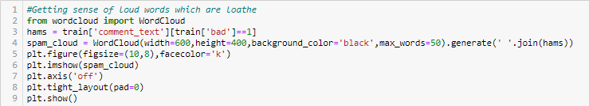
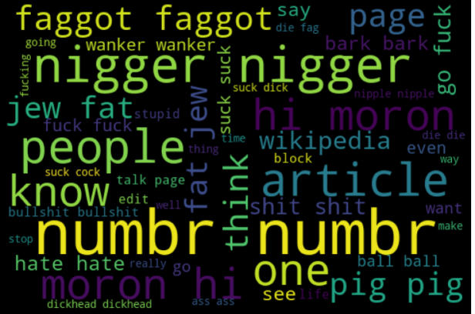
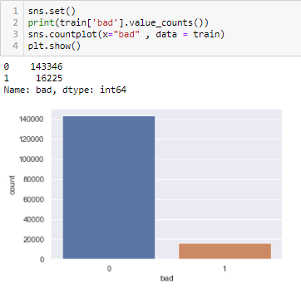
Now with respect to bad feature the loud words are nigger, numbr, artivle, peoplr, hi moron one.
We can see value count of target column is not same. We will work on this now.

Slide 17
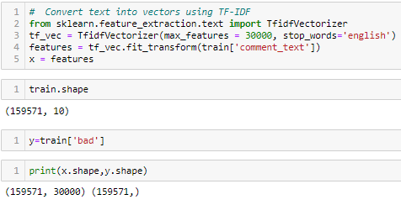
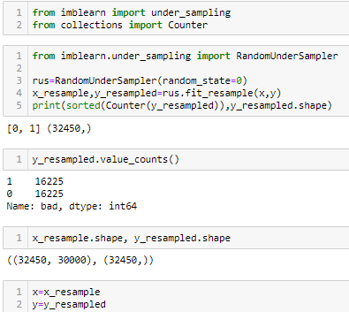
Let's use TFidf method to transform data into vectors:
We will use under sampling method to balance the target column value counts:

Slide 18

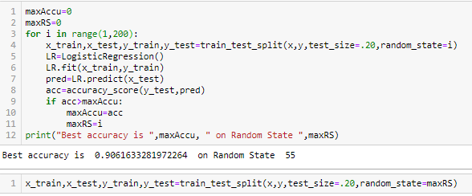
Let's split data into train and test set:
Model/s Development and Evaluation
Finding best random state:

Slide 19
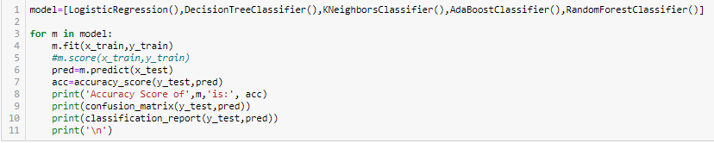
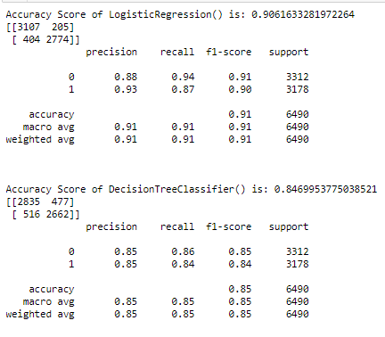
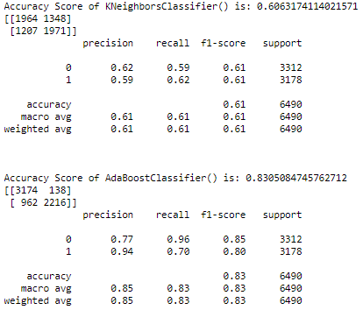
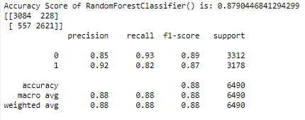
Accuracy for LogisticRegression model is 90.62%
Accuracy for DecisionTreeClassifier model is 84.70%
Accuracy for SVC model is 60.63%
Accuracy for AdaBoostClassifier is 83.05%
Accuracy for RandomForestClassifier is 87.90%

Slide 20
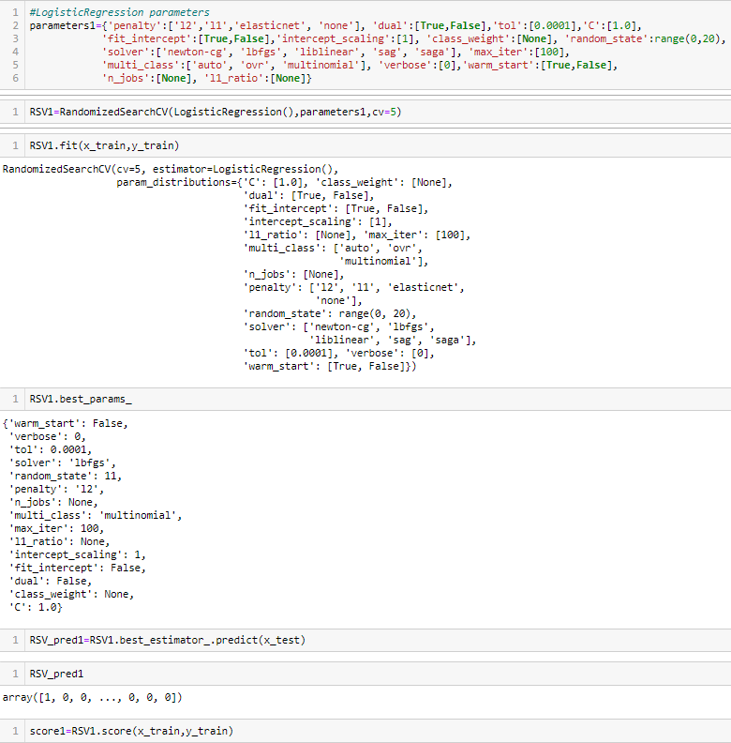
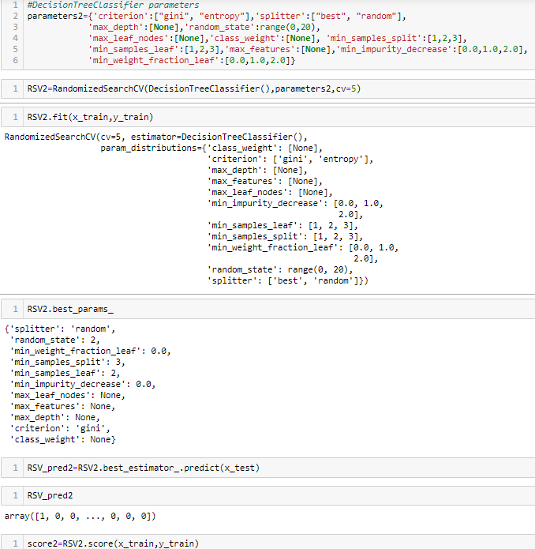
Hyper parameter tunning:

Slide 21
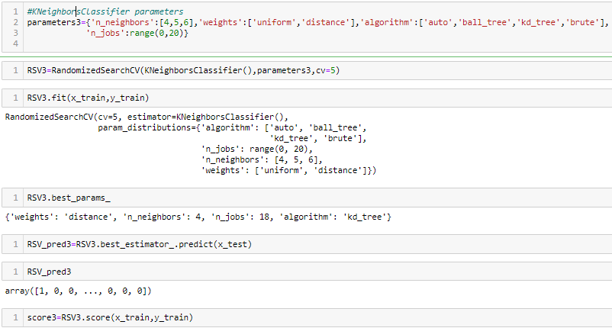
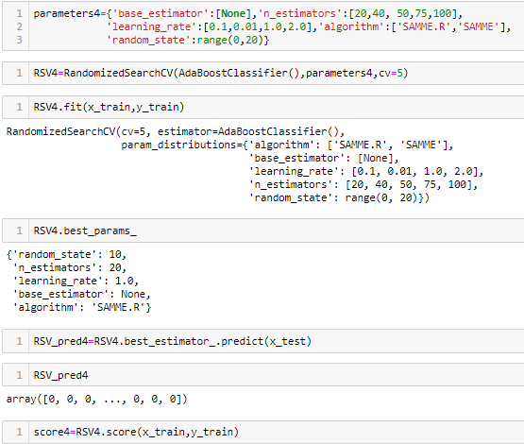

Slide 22
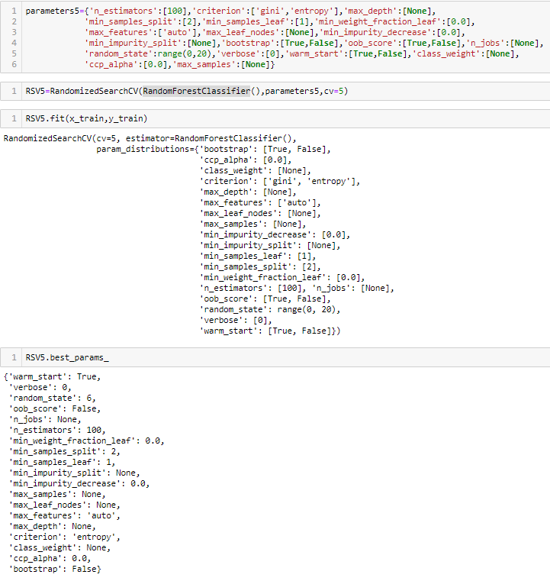
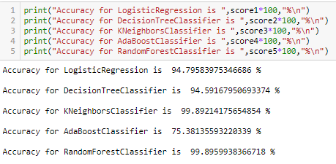
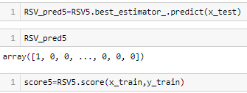

Slide 23
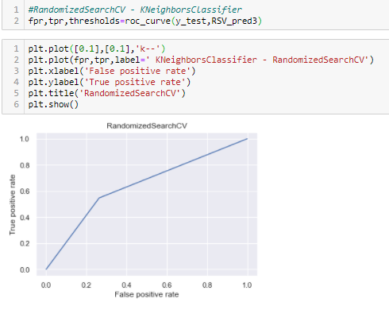
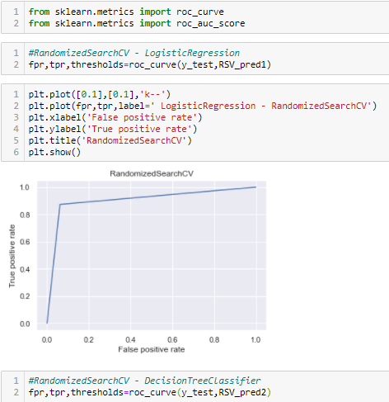
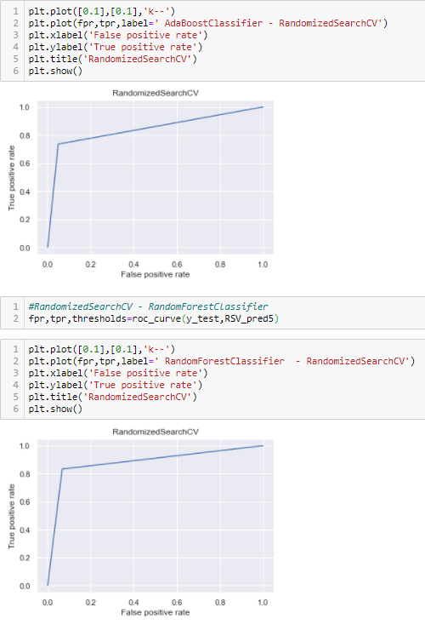

AUC_ROC:

Slide 24

Considering LogisticRegression with RandomizedSearchCV as final model for saving model as we have got best accuaracy score with RandomForestClassifier - logistic regression and AUC_roc score is graph also is better than other models.
Saving the model:

Slide 25



We will import the test file now:
Test dataset consists of 153164 rows and 2 columns.
We can see both type of columns object type.

Slide 26



We can see count is all same for all variable, let's check for null values now:
Id feature also has all unique values like serial number hence we dont require feature for future analysis
Above graph shows us the length of comments vs the number of comments. Maximum comments are with length 200 and very less comments are with length 1200.

Slide 27


Added a new feature where we can see length of the particular comment.

Slide 28


After cleaning the comment text, let’s have a look at comment length now.

Slide 29


Dropping newly created columns because it's not required for further analysis:
Let's use TFidf method to transform data into vectors:

Slide 30


Load the model
Prediction over test dataset

Slide 31
THANK YOU

