Slide 1
Breast Cancer Detection
Argha Mondal

Slide 2
Project Goal
Data about biopsied breast cells whether it is benign or malignant
Help doctors diagnose breast cancer

Slide 3
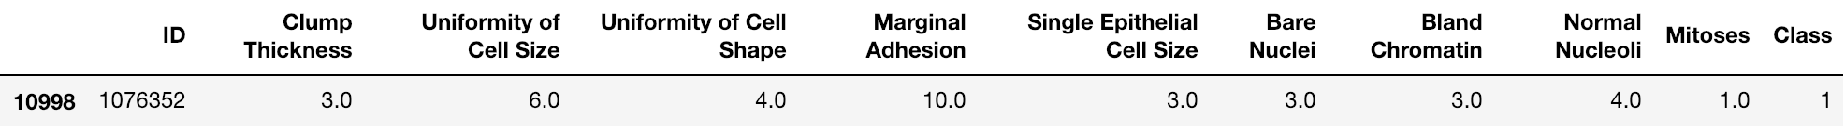
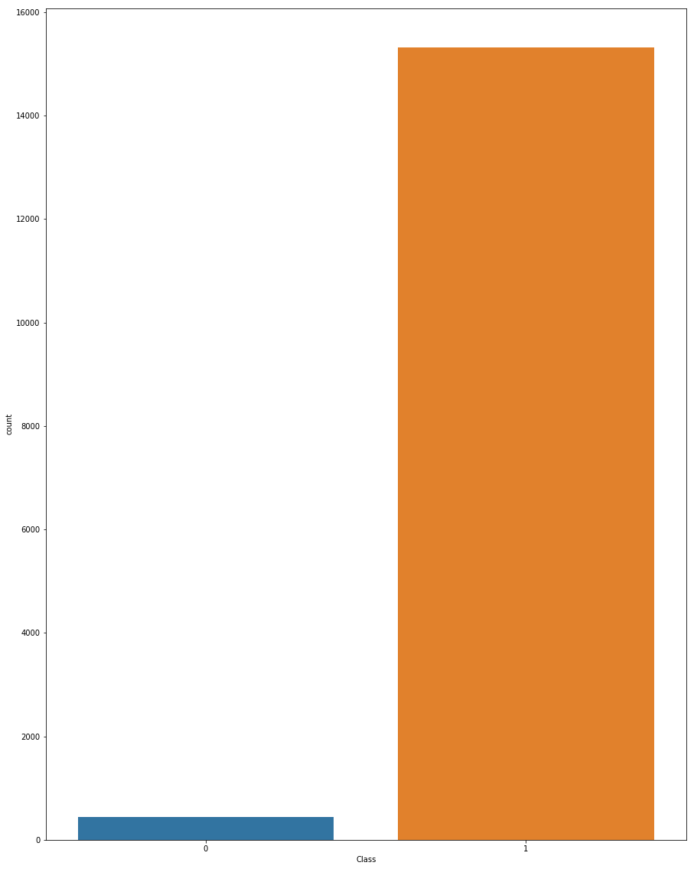
Looking at the data
9 features available for each data point
~15K data points
Highly imbalanced data: 97% malignant
Mismatched data: “No idea”, “#”, “?”
Scaling mismatch: 1-10 NOT 1-100

Slide 4
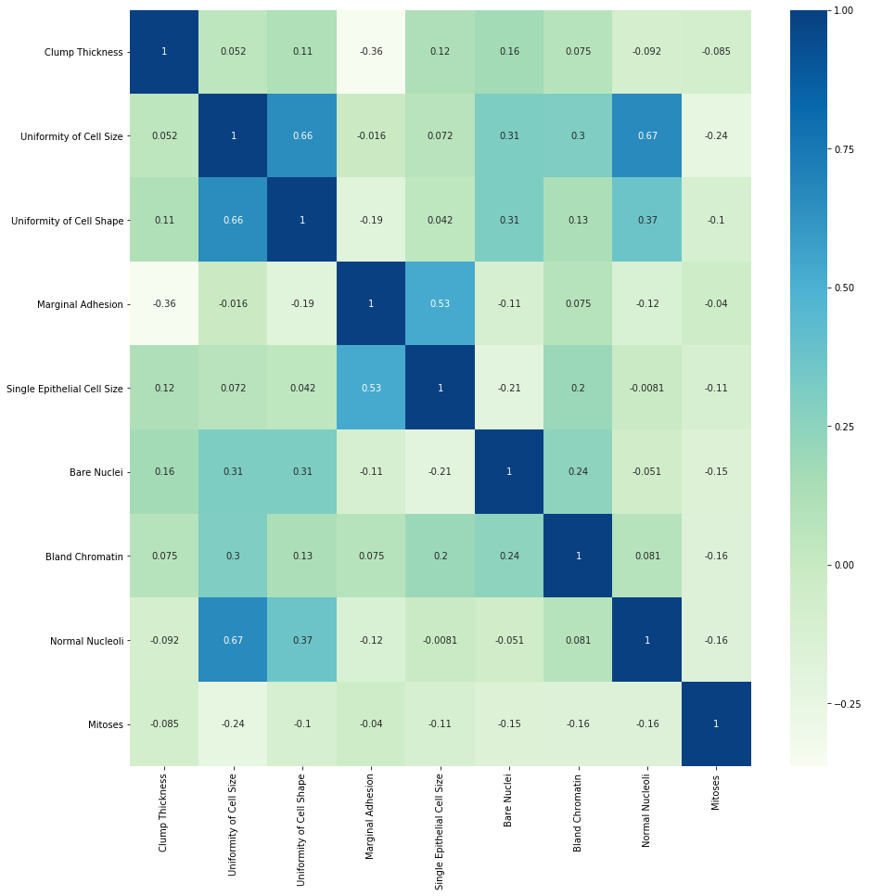
Correlated features

Slide 5
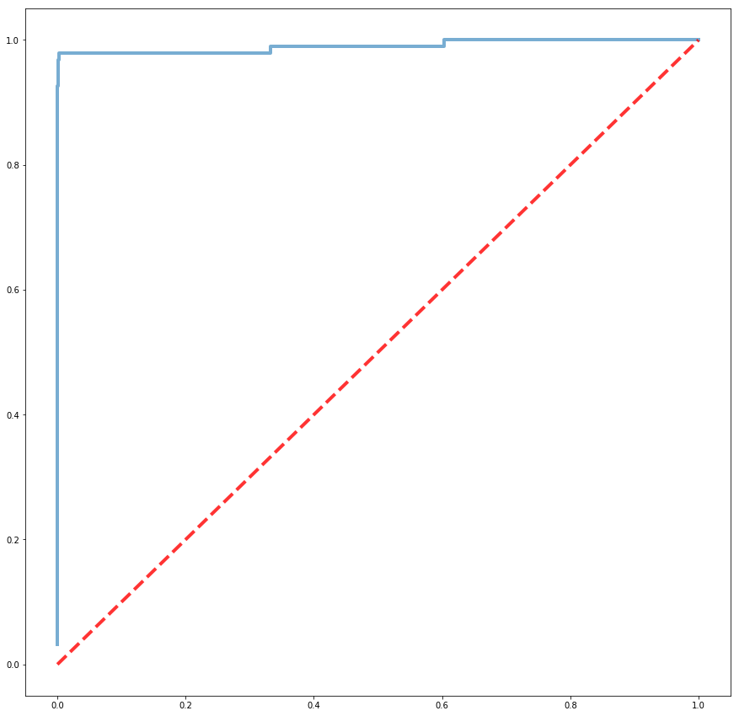
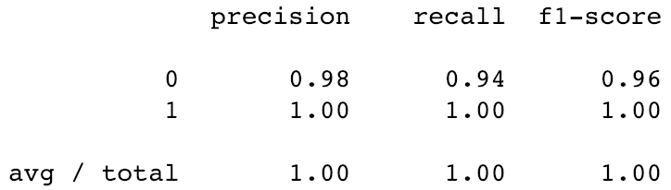
Logistic Regression
Test on 20% of the dataset
 | Benign (-) | Malignant (+)
Benign | 89 | 6
Malignant | 2 | 3055

Slide 6
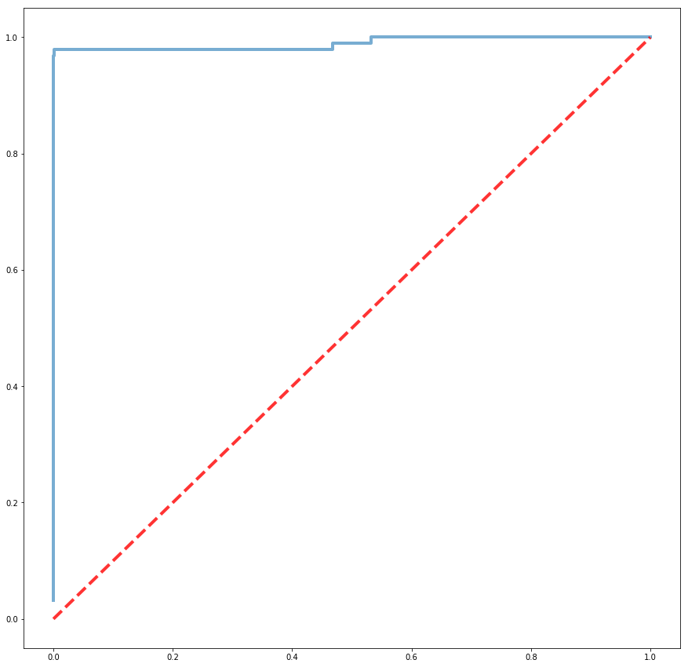
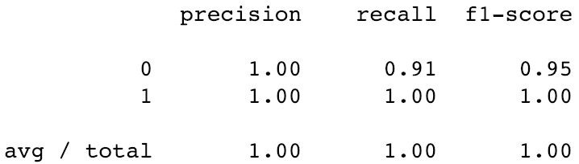
Weighted Logistic Regression
1
20
 | Benign (-) | Malignant (+)
Benign | 86 | 9
Malignant | 0 | 3057

Slide 7
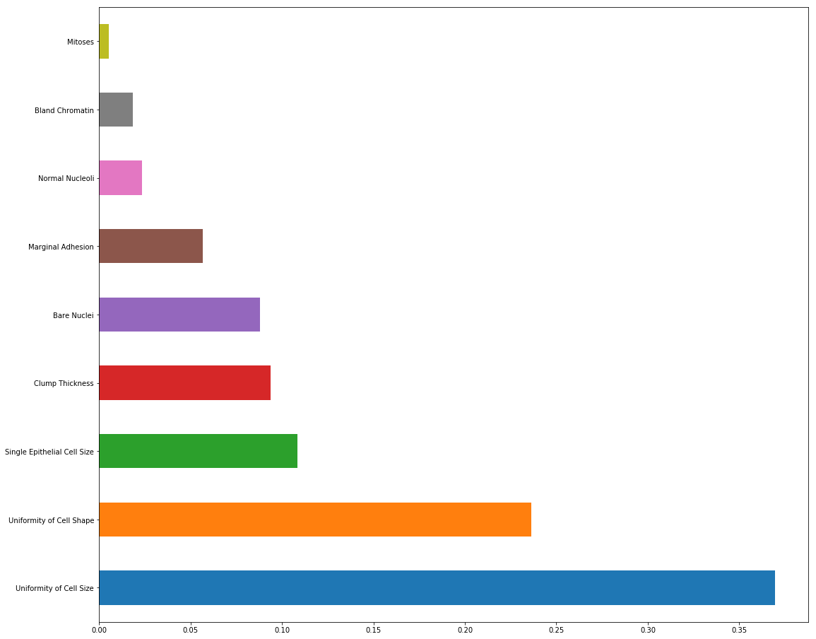
Feature Importance : Random Forest
Mitoses
Bland Chromatin
Normal Nucleoli
Marginal Adhesion
Notes:
There is a non-zero cost in time and money to collect each feature about a given cell. How would you go about determining the most cost-effective method of detecting malignancy?

Slide 8
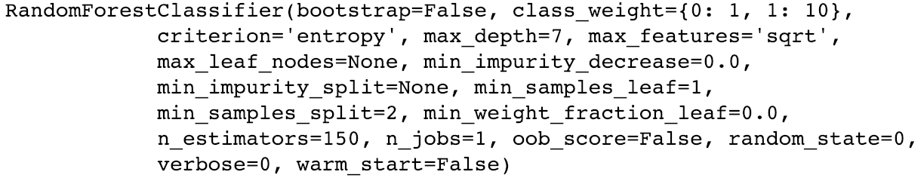
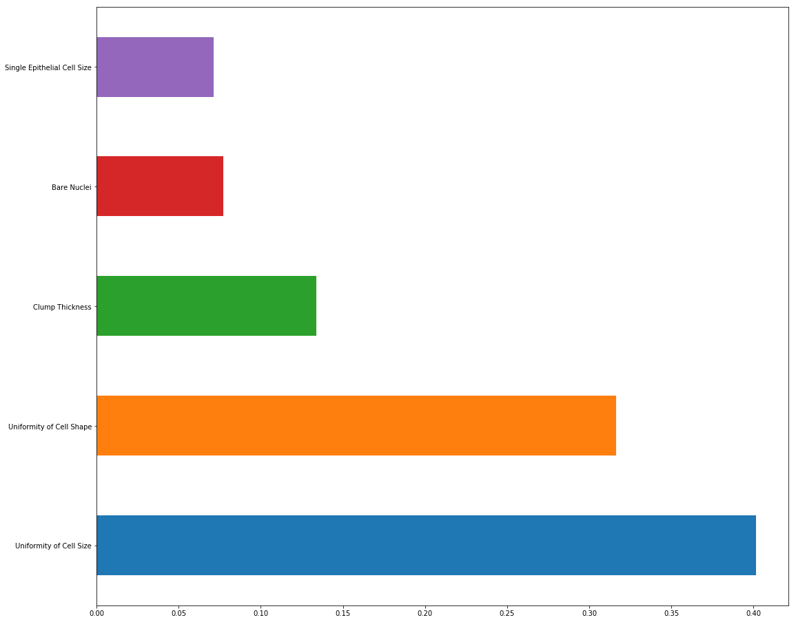
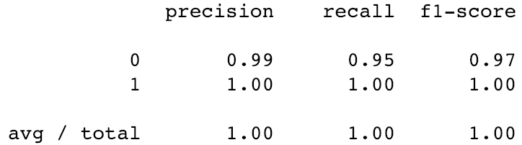
Weighted Random Forest
1
10
 | Benign (-) | Malignant (+)
Benign | 90 | 5
Malignant | 1 | 3056

Slide 9
How would a physician use your product?
classifier.predict_proba(X)
array([2.98105378e-06, 9.99997019e-01])

