Slide 1
CITYBRAIN
AI-Assisted Emergency Response Coordination
Chennai SUMO Digital Twin and 3D Visualization
Final academic project report · V3.2
Krishna Verma
Project contributions: Argh Sahai (original Core/SUMO foundation)
Subhashini (agents and planner)
18 October 2026 · Research software prototype
Notes:
Opening: CityBrain is a bounded research software prototype. It combines a Chennai-area SUMO digital twin, the existing planning/execution path and a 3D visualization. It is not an emergency-response service. Attribution follows docs/krishna/CONTRIBUTION_MAP.md.
Sources: Contribution map: https://github.com/arghsahai/CityBrain/blob/feature/citybrain-v3-roadmap/docs/krishna/CONTRIBUTION_MAP.md

Slide 2
The problem: routes meet changing conditions
Research question: how should a simulated response system observe, reassess and verify a route?
A route can become unsuitable after dispatch
(blocked edge or cost change)
Reacting to every short-lived change can create route churn
Need an auditable loop: observe → decide → execute → read back
→
→
This project evaluates an integrated software workflow in SUMO. It does not establish research novelty or real-world emergency benefit.
CITYBRAIN · RESEARCH PROTOTYPE · NOT FOR EMERGENCY DISPATCH
Notes:
Emphasize this is an engineering and research integration problem, not a novelty claim. Conditions in the study are simulated.
Sources: Implementation report: https://github.com/arghsahai/CityBrain/blob/feature/citybrain-v3-roadmap/docs/V31_IMPLEMENTATION_REPORT.md ; SUMO overview: https://sumo.dlr.de/docs/SUMO_at_a_Glance.html

Slide 3
Proposed solution: a verified simulation loop
One control path; a separate advisory visualization path
SUMO
simulated city
CityBrain
state + agents
Planner
validate plan
Executor
apply to SUMO
Read-back
accept only if verified
→
→
→
→
Cesium / SVG dashboard
Traffic adapters + offline replay
Advisory only · no planner cost write
SUMO remains the simulated physical truth. The dashboard observes; route execution stays on the existing verified path.
CITYBRAIN · RESEARCH PROTOTYPE · NOT FOR EMERGENCY DISPATCH
Notes:
The read-back between SUMO and logical plan acceptance is an important boundary. Provider adapters and replay feed a separate evaluator, not planner scores or route execution. References: docs/V31_IMPLEMENTATION_REPORT.md; docs/FINAL_INTEGRATION.md.
Sources: Implementation report: https://github.com/arghsahai/CityBrain/blob/feature/citybrain-v3-roadmap/docs/V31_IMPLEMENTATION_REPORT.md ; integration: https://github.com/arghsahai/CityBrain/blob/feature/citybrain-v3-roadmap/docs/FINAL_INTEGRATION.md

Slide 4
System architecture and data boundaries
Control, telemetry and external traffic remain visibly separate
OSM-derived
Chennai network
SUMO
vehicles + signals
TraCI →
CityState
Agents +
existing planner
Verified route
executor
→
→
→
→
Provider adapters + replay
normalize · freshness · directed road match
Opt-in evaluator
DISPLAY-ONLY suggestion
No provider observation directly changes planner cost or triggers ambulance replanning.
CITYBRAIN · RESEARCH PROTOTYPE · NOT FOR EMERGENCY DISPATCH
Notes:
Architecture reflects actual implementation and documented isolation. The traffic advisor is opt-in and display-only. Signal suggestions are also not applied physically.
Sources: Architecture and provider boundary: https://github.com/arghsahai/CityBrain/blob/feature/citybrain-v3-roadmap/docs/CHENNAI_LIVE_TRAFFIC.md

Slide 5
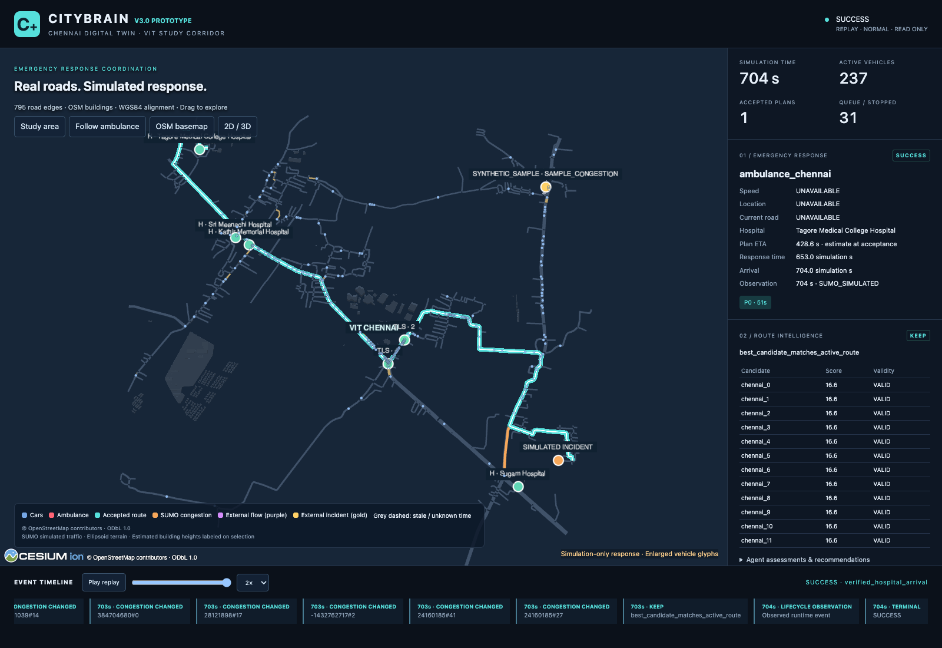
Chennai digital twin: real geometry, simulated response
Fresh local read-only replay at 704 simulated seconds
OSM-derived roads; bounded study area
SUMO vehicles, congestion, incidents and signals
Configured hospital access-road success
Replay status: REPLAY / SYNTHETIC_SAMPLE
The dashboard’s legacy V3.0 branding is visible in this captured application. The capture is a V3.2 submission-time replay view, not a new UI release.
CITYBRAIN · RESEARCH PROTOTYPE · NOT FOR EMERGENCY DISPATCH
Notes:
Fresh capture on 18 Oct 2026 from saved /tmp/citybrain-v32-final-replay served locally; no provider APIs. Terminal ambulance fields show unavailable at the terminal frame. CityBrain success is road-level. Screenshot is not evidence of live traffic.
Sources: OSM license: https://www.openstreetmap.org/copyright ; implementation report: https://github.com/arghsahai/CityBrain/blob/feature/citybrain-v3-roadmap/docs/V31_IMPLEMENTATION_REPORT.md

Slide 6
Agents and replanning: stability without delaying hard failures
The existing planner and execution path are preserved
Traffic agent
Ambulance agent
Hospital agent
Police agent
Signal agent
Assessments feed planning context
KEEP
Retain verified route
REPLAN
Validate → execute → read back
NO_ROUTE
Handle genuine planning failure
Soft cost changes: 20-second Chennai confirmation guard | Hard invalidation: existing immediate handling
CITYBRAIN · RESEARCH PROTOTYPE · NOT FOR EMERGENCY DISPATCH
Notes:
Distinguish soft-change confirmation from hard route invalidation. The guard is not applied as an arbitrary delay to hard failures. The V3.1 study did not isolate the guard as a treatment.
Sources: Viva and guard behavior: https://github.com/arghsahai/CityBrain/blob/feature/citybrain-v3-roadmap/docs/V31_VIVA_QA.md ; implementation report: https://github.com/arghsahai/CityBrain/blob/feature/citybrain-v3-roadmap/docs/V31_IMPLEMENTATION_REPORT.md

Slide 7
Dashboard: inspection, provenance and fallback
Human-readable state is part of the evidence trail
Map & motion
Operations
Provenance
Fallback
OSM road geometry
SUMO vehicles
Ambulance and accepted route
Simulated signals
Incident + hospital markers
Route decision and execution
LIVE / REPLAY / SYNTHETIC
UNKNOWN / STALE / EXPIRED
Road match and direction
Cesium 3D when available
2D / SVG alternative
Telemetry failure isolation
Traffic signals, capacity and traffic conditions are simulated. Signal-priority suggestions are advisory and never physically applied.
CITYBRAIN · RESEARCH PROTOTYPE · NOT FOR EMERGENCY DISPATCH
Notes:
Browser replay validation documented in V31_IMPLEMENTATION_REPORT.md. The fresh capture shows a REPLAY synthetic sample classified stale/expired. The project has no real signal controller.
Sources: CesiumJS entities: https://cesium.com/learn/cesiumjs-learn/cesiumjs-creating-entities/ ; demo script: https://github.com/arghsahai/CityBrain/blob/feature/citybrain-v3-roadmap/docs/V31_DEMO_SCRIPT.md

Slide 8
Experimental design: 60 synthetic SUMO trials
Three scenarios × ten matched seeds × two arms
S05
static × dynamic
S06
static × dynamic
S08
static × dynamic
10 paired seeds
10 paired seeds
10 paired seeds
NORMAL profile · fixed synthetic inputs
60 total trial cells · no provider / GPS / signal actuation
All outcomes remain in completion denominators. TELEPORTED = failure. Successful-time summaries condition on SUCCESS; matched differences require success in both arms.
CITYBRAIN · RESEARCH PROTOTYPE · NOT FOR EMERGENCY DISPATCH
Notes:
Study source is the preregistered V31_EXPERIMENT_PROTOCOL.md and v31-analysis.md. This is separate from fresh seed-17 smoke runs and from dashboard demos.
Sources: Protocol: https://github.com/arghsahai/CityBrain/blob/feature/citybrain-v3-roadmap/docs/V31_EXPERIMENT_PROTOCOL.md ; analysis: https://github.com/arghsahai/CityBrain/blob/feature/citybrain-v3-roadmap/data/output/v3-experiments/v31-matched-sumo-10seed-20261018/v31-analysis.md

Slide 9
Results: scenario-specific completion, no broad superiority claim
Observed successes out of ten runs; teleports count as failures
Scenario
Static
Dynamic
Failures (S / D)
Matched time result
S05
7/10
10/10
3 / 0
7 pairs: 0 s mean delta
S06
0/10
0/10
10 / 10
No matched successes
S08
0/10
10/10
10 / 0
No matched successes
S05 response time: 35.0 s static (n=7), 35.0 s dynamic (n=10). S08 dynamic: 124.5 s (n=10).
95% Wilson intervals are wide at n=10. No successful paired comparison exists for S06 or S08.
Result: mixed, scenario-dependent outcomes from a small synthetic study. No real-world performance inference.
CITYBRAIN · RESEARCH PROTOTYPE · NOT FOR EMERGENCY DISPATCH
Notes:
Exact results from v31-analysis.md. S05 Wilson: static 39.7–89.2%, dynamic 72.2–100%; S06 0–27.8% both; S08 static 0–27.8%, dynamic 72.2–100%. In seven S05 matched successes, mean/median difference and bootstrap interval are zero. Do not claim universal superiority.
Sources: V3.1 matched SUMO analysis: https://github.com/arghsahai/CityBrain/blob/feature/citybrain-v3-roadmap/data/output/v3-experiments/v31-matched-sumo-10seed-20261018/v31-analysis.md

Slide 10
Traffic integration status: adapters are not live coverage
No genuine provider response is evidenced in this release
HERE adapter
Implemented
Live coverage / accuracy unverified
TomTom adapter
Implemented
Live coverage / accuracy unverified
Offline replay
Implemented
Synthetic sample; visibly labeled
External evaluator
Opt-in
Display-only; no planner or route control
Browser GPS marker
Consent-only
Tab-local; not runtime routing input
Provider requests require explicit authorization; no HERE/TomTom API was called for this package.
CITYBRAIN · RESEARCH PROTOTYPE · NOT FOR EMERGENCY DISPATCH
Notes:
Adapter status and request safety are documented in CHENNAI_LIVE_TRAFFIC.md and V3.1 report. Do not imply actual live traffic integration is operational.
Sources: Provider boundary: https://github.com/arghsahai/CityBrain/blob/feature/citybrain-v3-roadmap/docs/CHENNAI_LIVE_TRAFFIC.md ; HERE API: https://docs.here.com/traffic-api/reference/traffic-api-v7-getflow ; TomTom API: https://docs.tomtom.com/traffic-api/documentation/tomtom-maps/v1/traffic-flow/flow-segment-data

Slide 11
Limitations and responsible next steps
Prototype evidence does not establish field readiness
No live-provider response, corridor coverage or cost verification
Simulated demand, incidents, signal programs and hospital availability
Hospital arrival means configured simulated access-road arrival
No signal movement / clearance contract or physical actuation
No real-world calibration, clinical validation or deployment safety case
Next: literature review · calibration · cost-authorized provider study · safety and human-factors validation
CITYBRAIN · RESEARCH PROTOTYPE · NOT FOR EMERGENCY DISPATCH
Notes:
Every limitation is supported by implementation documentation. Future work is proposed, not completed. Operational release would require independent oversight and validation.
Sources: Limitations and validation: https://github.com/arghsahai/CityBrain/blob/feature/citybrain-v3-roadmap/docs/V31_IMPLEMENTATION_REPORT.md ; provider boundaries: https://github.com/arghsahai/CityBrain/blob/feature/citybrain-v3-roadmap/docs/CHENNAI_LIVE_TRAFFIC.md

Slide 12
What is verified—and how to reproduce it
A bounded academic prototype with explicit evidence boundaries
Verified in simulation
60-cell study · 447 pytest tests
10 compatibility scripts
2,172/2,172 historical entries
Not established
Live Chennai traffic coverage
Real signal control
Clinical readiness / emergency dispatch
Demo command (synthetic replay-assisted mode)
./tools/run_chennai.sh --mode replay-assisted --experimental-traffic-evaluation
Show source/freshness labels · explain route read-back · close with the limitations
CITYBRAIN · RESEARCH PROTOTYPE · NOT FOR EMERGENCY DISPATCH
Notes:
Close by distinguishing verified software paths from live operations. Historical integrity was validated at 2,172/2,172. Current package changes only documentation and deliverables; no research trials regenerated.
Sources: Implementation report: https://github.com/arghsahai/CityBrain/blob/feature/citybrain-v3-roadmap/docs/V31_IMPLEMENTATION_REPORT.md ; reproducible demo: https://github.com/arghsahai/CityBrain/blob/feature/citybrain-v3-roadmap/docs/V31_DEMO_SCRIPT.md

