Slide 1


CHURN ANALYSIS
Certification In Data Analytics
Batch: DAB15

Slide 2
INTRODUCTION
Customer churn is a major challenge for businesses, directly impacting revenue and long-term growth. To develop effective retention strategies, it is essential to understand the key factors driving customer attrition. This analysis examines customer behavior, service usage, and demographics to identify patterns influencing churn. Factors such as contract type, tenure, billing methods, and engagement with services play a crucial role in customer retention. A structured data-cleaning process ensures accurate insights, highlighting key indicators like payment preferences, internet service usage, and demographic details that impact customer decisions. By analyzing relationships between these factors, businesses can identify high-risk segments and take proactive measures to improve retention. Strategies such as enhancing customer experience, offering personalized plans, and addressing service gaps can significantly reduce churn. A data-driven approach enables companies to predict churn likelihood and implement timely interventions, strengthening customer relationships. Ultimately, transforming raw data into actionable insights helps businesses enhance loyalty, optimize services, and improve customer satisfaction. By leveraging analytics, companies can make informed decisions that not only minimize churn but also foster long-term engagement. This study serves as a strategic foundation for businesses aiming to retain customers and drive sustainable success in an increasingly competitive market.

Slide 3
OVERVIEW
Customer churn poses a significant challenge for businesses, requiring a deep understanding of customer behavior and service usage patterns. This analysis focuses on identifying the key drivers of churn by examining various attributes such as demographic details, contract types, payment methods, and service preferences. By analyzing historical data, trends emerge that help distinguish customers who are likely to leave from those who remain loyal. The study explores patterns related to tenure, billing cycles, and engagement with different services, revealing crucial insights into customer retention. Findings indicate that short-term contracts, high monthly charges, and limited service usage are often linked to higher churn rates, while long-term commitments and bundled services contribute to customer retention. By leveraging this data-driven approach, businesses can proactively implement strategies such as personalized offers, improved service quality, and targeted engagement campaigns. This structured analysis not only helps in reducing churn but also enhances customer satisfaction, ultimately leading to long-term business growth. The insights derived from this study serve as a foundation for better decision-making, ensuring companies can adapt their services and marketing efforts to meet customer expectations and improve overall retention rates.

Slide 4



Tools & Technologies Used
MS EXCEL
POWER BI
JUPYTER NOTEBOOK

Slide 5
Data Collection
Data Collection:-
Data Sources: The company provided four datasets—Customer Data, Churn Data, Internet Data, and The Telecom Churn Data Dictionary—containing essential customer and service-related information for analysis.
File Types:
Text Files (.txt): Customer Data and Churn Data, which include individual customer details and churn history.
CSV Files (.csv): Internet Data and Telecom Churn Data Dictionary, providing structured insights into service usage and variable definitions.
Analysis Goal: This project aims to analyze customer behavior, service patterns, and demographic trends to uncover key drivers of churn. The findings will help design data-driven strategies to enhance customer retention and reduce attrition.

Slide 6
Data Preparation
Data Preparation:-
In Excel:-
To import the Customer_data.text and Churn_data.text files into Excel, go to Data > Get Data > From Text/CSV, select Customer_data.text and Churn_data.text, choose the delimiter, and click Load to display the data.
Check for duplicate customer ID values across all datasets and remove them if found.
Identify and handle missing or null values in key columns such as TotalCharges, tenure, InternetService, and PaymentMethod.
DOB should be in a proper date format rather than a string.
SeniorCitizen should be numeric (0/1) instead of categorical (Yes/No).
TotalCharges seems to be a mix of numbers and text; convert it to numeric.
Ensure consistent formatting for values like PhoneService, InternetService, and Contract to avoid case mismatches (e.g., Yes vs. yes).
DOB should be in a proper date format rather than a string.
All data marge by power quary
In Python:-
Identify missing values in the dataset using .isnull().sum().
If a column has too many missing values, consider dropping it.
For numerical columns, fill missing values using the mean or median.
For categorical columns, replace missing values with the most frequent category.
Check for duplicate rows using .duplicated().sum().
Remove duplicates using .drop_duplicates().
Ensure numerical columns (e.g., TotalCharges, MonthlyCharges) are in the correct format using .astype(float).
Convert categorical variables (e.g., Churn, Contract) into proper categories.
Convert date columns (if any) to datetime format using pd.to_datetime().
Ensure consistency in categorical values (e.g., Yes/No should not have mixed cases like yes, No)
Convert Yes/No values to 1/0 if needed for analysis.
Detect outliers using box plots or standard deviation analysis.Consider removing or capping extreme values in numerical columns.

Slide 7
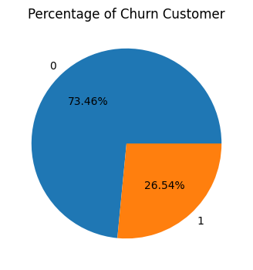
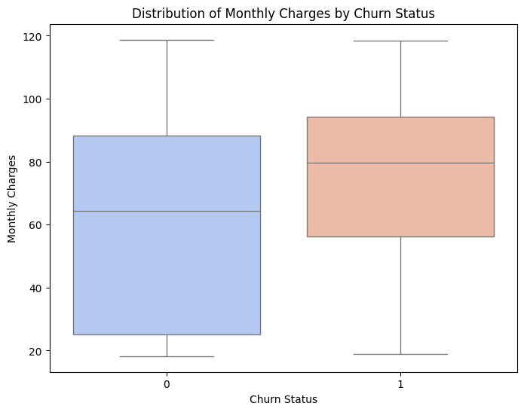
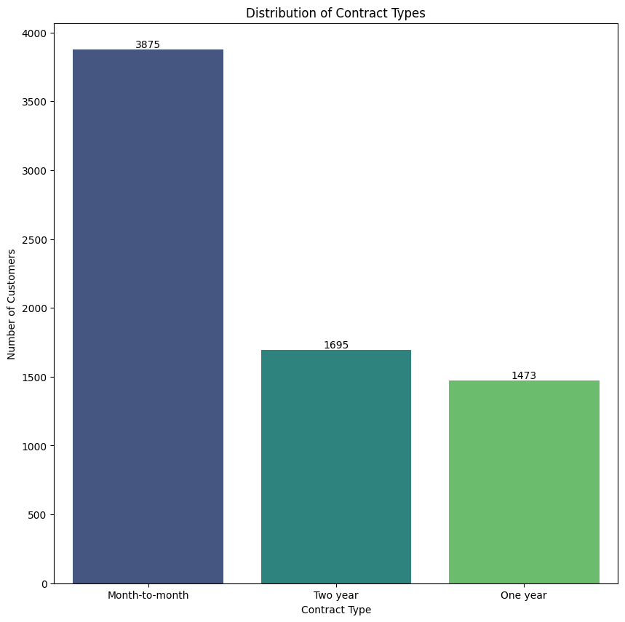
Exploratory Data Analysis (EDA) in Python
This pie chart shows that 73.46% of customers did not churn (represented by '0'), while 26.54% did churn (represented by '1'). The majority of customers remained, but a significant portion experienced churn.
Customers who churned (1) tend to have higher monthly charges on average compared to those who didn't (0). The distribution of monthly charges is also slightly wider for churned customers, indicating more variability in their spending.
Month-to-month contracts are significantly more common than two-year or one-year contracts, indicating a preference for shorter-term commitments. The number of customers with two-year contracts is slightly higher than those with one-year contracts, but both are considerably lower than the month-to-month segment.

Slide 8
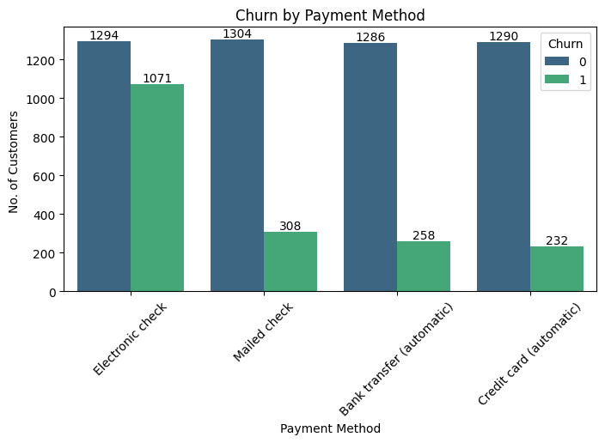
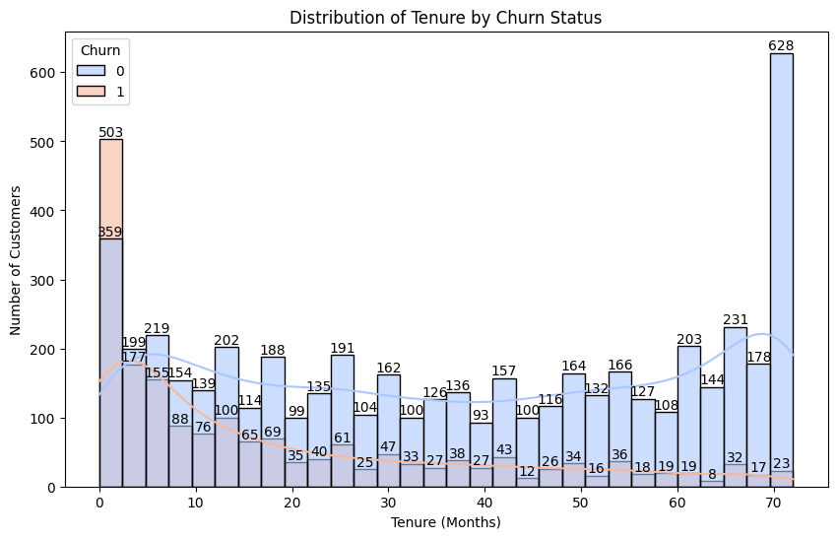
Exploratory Data Analysis (EDA) in Python
Customers using electronic checks and mailed checks have the highest churn rates compared to those using bank transfers or credit card automatic payments. Automatic payment methods (bank transfer and credit card) show significantly lower churn, suggesting a correlation between automatic payments and customer retention.
Customers who churn (1) tend to have shorter tenures, with a significant spike in churn within the first few months. Customers who remain (0) have a more varied tenure distribution, with a noticeable increase in the number of customers at the very end of the tenure range.

Slide 9
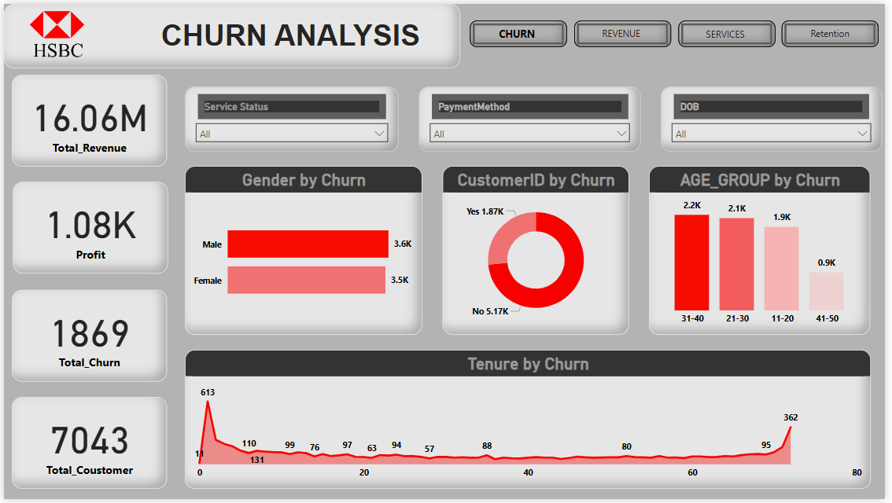
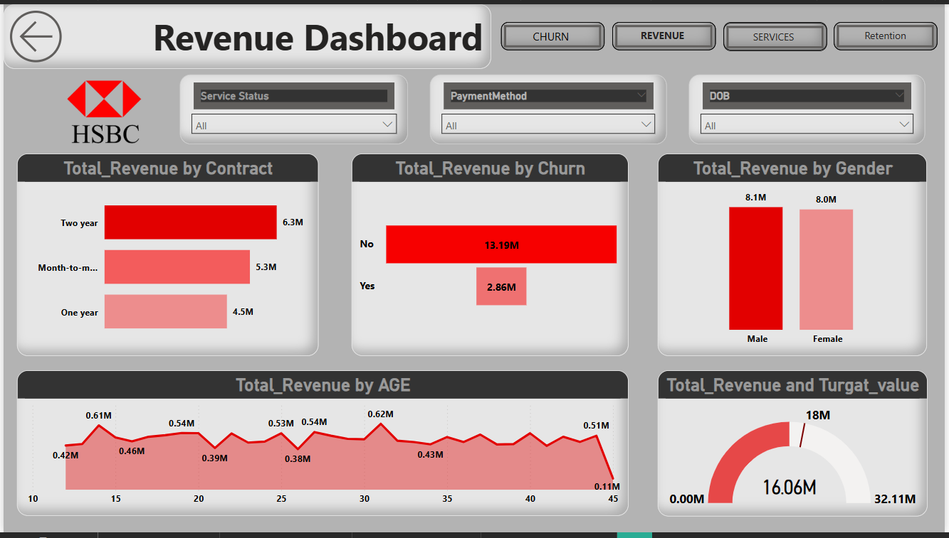
Data Visualization in Power BI
This dashboard clearly illustrates a significant churn problem, primarily concentrated among customers with shorter tenures, demanding immediate attention to mitigate financial losses. The provided demographic insights and filter options enable targeted strategies to improve customer retention and overall profitability.
This dashboard emphasizes the need to focus on acquiring and retaining customers on longer-term contracts to maximize revenue, as churn significantly impacts profitability. Understanding the demographic nuances and leveraging the available filters will allow for targeted strategies to improve revenue performance and meet set targets.

Slide 10
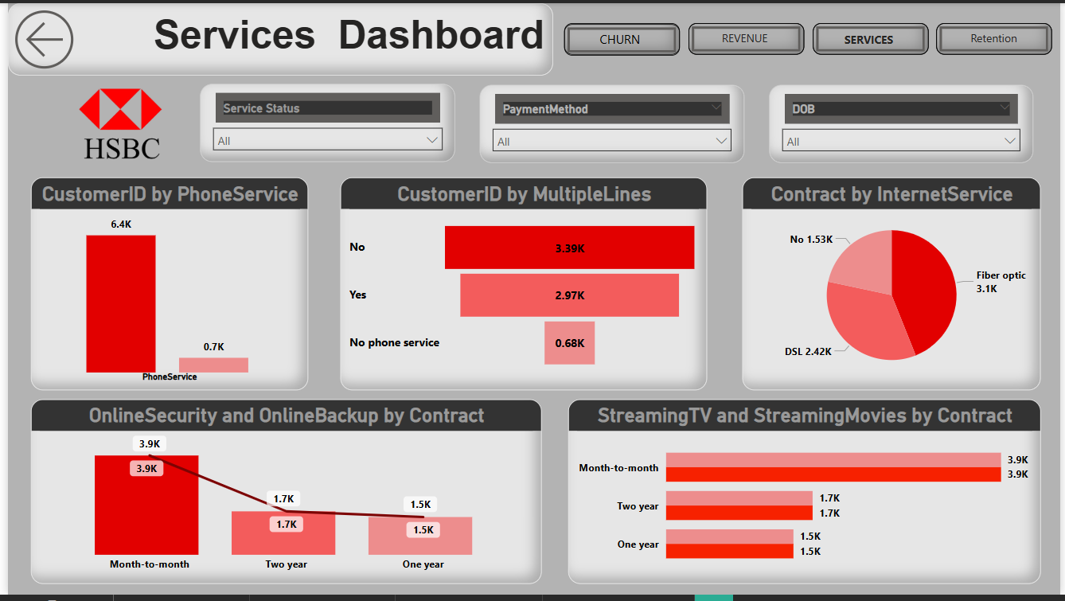
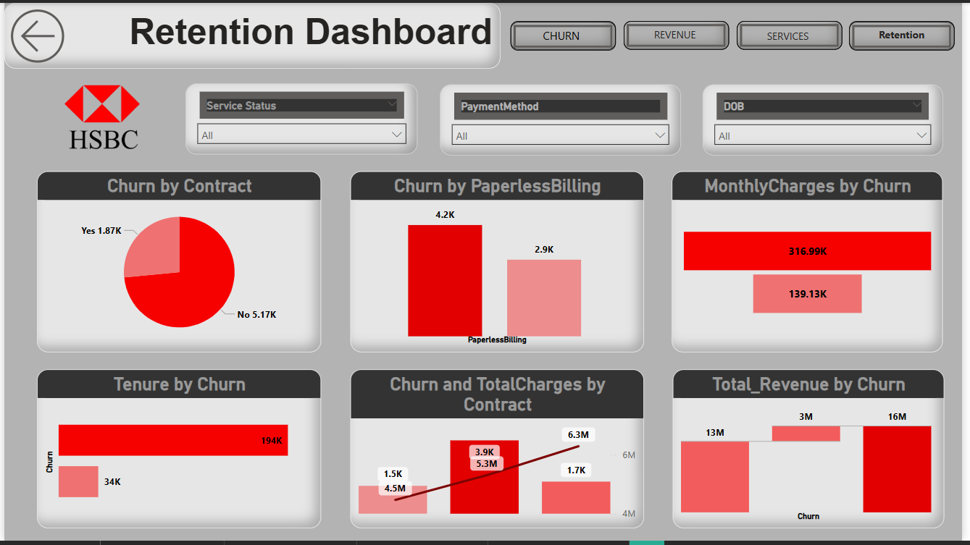
Data Visualization in Power BI
This dashboard emphasizes the importance of understanding service adoption patterns across core offerings, value-added services, and contract types to optimize service delivery and revenue. Utilizing the provided filters to analyze service adoption based on service status and payment methods will further refine strategies to improve customer engagement and profitability.
This dashboard emphasizes the critical need to address churn by focusing on contract structures, billing preferences, and pricing strategies, as these factors significantly influence customer retention. Analyzing churn across tenure and demographics, along with the financial impact, will enable the development of targeted and effective retention programs to minimize customer loss.

Slide 11
Conclusion & Recommendations
Conclusion:
The churn analysis integrates data from customer profiles, churn history, and internet usage to identify key factors influencing customer attrition. The analysis involves processing and merging multiple datasets, checking for missing values and duplicates, and conducting exploratory assessments to uncover churn patterns. Visual insights further highlight customer behavior, segment-wise churn rates, and predictive trends. Common churn indicators often include factors such as contract type, monthly charges, and customer tenure. Organizations can utilize these insights to implement targeted retention strategies, such as personalized offers for high-risk customers or improving service quality in critical areas. A combination of statistical assessment and visualization ensures a data-driven approach to reducing churn, ultimately enhancing customer satisfaction and business profitability.
Recommendation:
To effectively reduce customer churn, businesses should focus on proactive retention strategies. Identifying high-risk customers through data analysis allows for targeted interventions, such as offering personalized discounts or improved service plans. Enhancing customer engagement by addressing common pain points, such as billing transparency or service reliability, can also improve retention. Predictive modeling should be utilized to anticipate churn patterns and take preemptive actions. Providing flexible contract options and loyalty rewards can further encourage long-term commitment. Additionally, regular feedback collection and sentiment analysis will help businesses understand customer concerns and make necessary improvements. By continuously refining data-driven strategies and optimizing customer experiences, organizations can minimize churn rates and sustain long-term profitability.

Slide 12

Thank You
,
- By Arghyadip Pandey
(Gmail : pandeyarghyadip@gmail.com)

