Slide 1
Power BI Finance Dashboard
This presentation offers an overview of a Power BI finance dashboard, highlighting essential elements like data comprehension, sales analysis, discount strategies, shipping expenses, and product base margin assessment. The dashboard aims to deliver actionable insights for informed financial decision-making.
by Arghyadip Pandey

Slide 2
Introduction to the Finance Dashboard
This file is a Finance Dashboard advertisement created using Power BI Desktop. It presents a clear, visual overview of key financial data to help businesses understand and manage their performance. The dashboard features several charts and graphs that break down important metrics such as total sales, discounts, shipping costs, and product base margins.it breaks down these metrics by regions - East, South, Central, and West, it also examines performance at the city level and across different product categories.
These visuals include various graphs and charts such as line graphs showing monthly sales trends, bar charts for top cities by sales, and maps linking geographic data. Additional insights are provided into discount patterns by product category, shipping cost distribution by different delivery methods, and profitability segmented by customer types and product names. Overall, the file effectively summarizes complex financial data into an easily digestible format, enabling data-driven decisions for business improvements.

Slide 3
Understanding the Data-Finance Dashboard
In addition to these standard metrics, the general report states that:
Sales Amount: Total sales figures (i.e. 2.64M overall sales), with breakdowns by city, state, region, and month.
Discount: Overall discount figures along with detailed views by product category, customer segment, and shipping mode.
Shipping Cost: Figures segmented by ship mode, month, region, and even by city.
Product Base Margin: Values that help understand profitability across product categories and regions.
Every metric has been further categorized by using dimensi-ons technically known as:
Data Profiling: Examining sampling records and distributions to have an idea of what the typical values are, then identifying key data sources (likely from financial transaction systems or ERP systems).
Defining a Data Dictionary: Describe what each metric signifies (for example, understand if “Discount” is an absolute value or a percentage and how “Product Base Margin” has been calculated).
Tracing Data Lineage: A way of recognizing how the raw data from several sources get transformed and combined before the dashboard displays them.

Slide 4
Cleaning the Data- Finance Dashboard
A. Data Quality Checks
Before data can be reliably visualized, it must be verified for quality:
Duplication: Identify and remove duplicate records to ensure that each transaction is counted only once.
Missing Values: Detect gaps in the data (e.g., missing sales figures or incomplete records) and decide whether to fill in, estimate, or exclude these records.
Outlier Detection: Look for abnormal entries such as unusually high discounts or shipping costs that might be data entry errors or require further investigation.
B. Standardization and Consistency
Formatting: Ensure dates, currencies, and numerical values are consistently formatted. For example, all monetary values should follow the same currency and decimal formatting.
Uniform Naming Conventions: Harmonize the labels for dimensions. For instance, “New York City” should not appear as “NYC” in some records and “New York” in others.
Data Transformation: Utilize tools like Power Query (within Power BI) to perform necessary transformations, such as:
Converting raw transactional data into aggregated measures (e.g., summing sales amounts per region or month).
Pivoting or unpivoting data so that it fits the dashboard’s design.
Creating calculated fields (such as Profit by Region) that are based on multiple underlying metrics.
C. Integration and Validation
Merging Datasets: If data comes from multiple sources (sales, shipping, product details), it’s crucial to ensure that all datasets align properly through consistent keys (like product IDs or region codes).
Recalculation and Cross-Verification: After cleaning, recalculate totals and subtotals to verify that the cleaned data produces the expected summaries. For example, the overall Sales Amount should equal the sum of the sales reported by month or region.

Slide 5
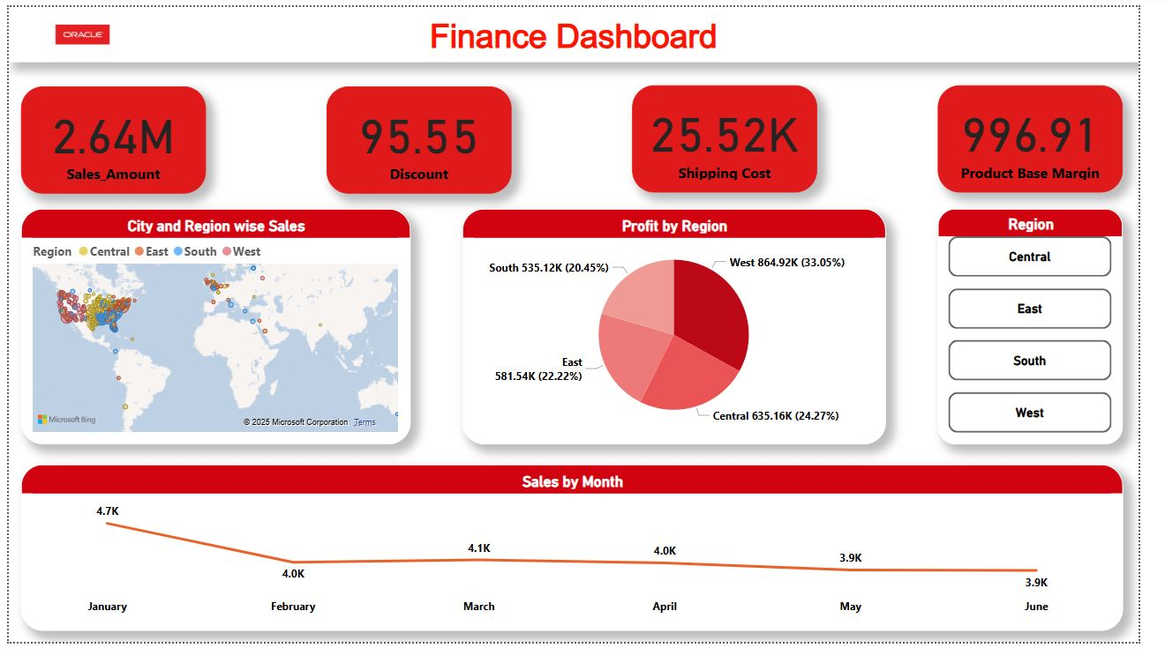
Finance Dashboard
This finance dashboard provides an overview of key metrics such as total sales, shipping costs, product margin and discounts. It includes visualization like KPI cards, a world map showing sales distribution, and a pie chart for profit by region. The line chart further highlights sales trends, showing that the central region has the highest sales while the south has the lowest. Interactive filters and an AI-powered Q&A make it easy to explore specific insights.
City and Region-wise Sales: A map visualization displays sales distribution across cities and regions. The regions are color-coded (Central, East, South, and West) to highlight geographical sales trends.
Profit by Region: A pie chart breaks down profit distribution across different regions. The West region contributes the highest profit (33.05%), followed by Central (24.27%), East (22.22%), and South (20.45%).
Sales by Month: A line chart tracks sales trends over six months, showing a slight decline from January (4.7K) to June (3.9K), indicating seasonal fluctuations.
Sales Amount, Discount, Shipping Cost, and Product Base Margin: The top four key metrics highlight the total sales amount (2.64M), total discount (95.55), shipping cost (25.52K), and product base margin (996.91), providing a quick snapshot of financial performance.
Region Filter: A button-based filter on the right allows users to analyze financial performance by selecting specific regions (Central, East, South, and West), enabling a more detailed analysis of regional trends.

Slide 6
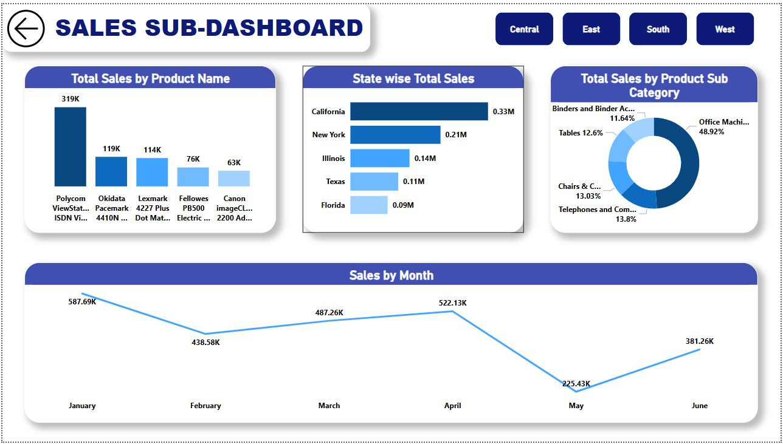
SALES SUB-DASHBOARD
This Sales Sub-Dashboard provides an insightful analysis of sales performance based on different parameters, including product sales, state-wise sales, sales by product sub-category
Total Sales by Product Name: A bar chart displays the top-selling products, with Polycom View Station ISDN leading at 319K, followed by Ok I data Pace mark 4410N (119K) and Lexmark 4227 Plus Dot Matrix (114K).
State-wise Total Sales: A horizontal bar chart highlights sales distribution across different states, showing California as the top contributor with 0.33M in sales, followed by New York (0.21M) and Illinois (0.14M).
Total Sales by Product Sub-Category: A pie chart shows the percentage contribution of different sub-categories. Office Machines dominate with 48.92%, followed by Telephones & Communication (13.8%), Chairs & Chairmats (13.03%), and Tables (12.6%).
Sales by Month: A line chart represents sales trends over six months, showing January as the highest month at 587.69K, followed by fluctuations, with a significant drop in May (225.43K) and a recovery in June (381.26K).
Region Selection Filters: Buttons at the top allow users to filter sales data by different regions, including Central, East, South, and West, providing flexibility for deeper analysis.

Slide 7
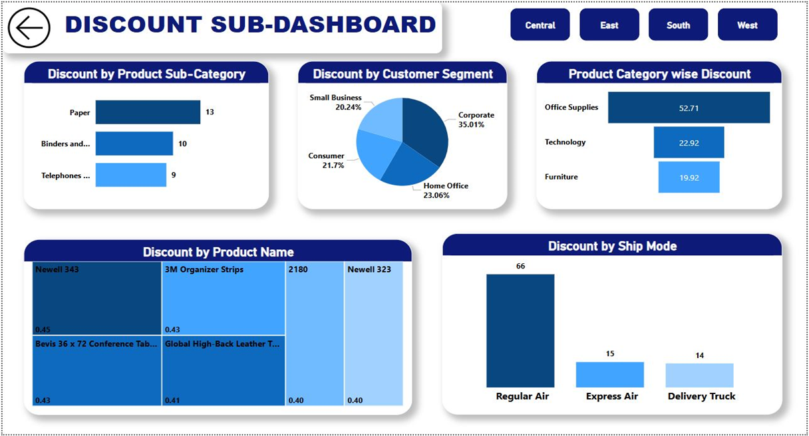
Discount Sub-Dashboard
This Discount Dashboard provides an overview of discount distributions across various dimensions, including product subcategories, customer segments, product categories, product names, and shipping modes
Discount by Product Sub-Category: A bar chart highlights the highest discounts given in different sub-categories, with Paper (13%) receiving the highest discount, followed by Binders (10%) and Telephones (9%).
Discount by Customer Segment: A pie chart showcases the distribution of discounts among customer segments, with Corporate customers (35.01%) receiving the highest discount, followed by Home Office (23.06%), Consumers (21.7%), and Small Businesses (20.24%).
Product Category-wise Discount: A horizontal bar chart indicates that Office Supplies (52.71%) received the highest discount, followed by Technology (22.92%) and Furniture (19.92%).
Discount by Product Name: A treemap visualization highlights the top discounted products, including Newell 343 (0.45), 3M Organizer Strips (0.43), Bevis 36 x 72 Conference Table (0.43), and Global High-Back Leather T (0.41).Discount by Ship Mode: A bar chart displays discount distribution by shipping mode, with Regular Air (66%) having the highest discount compared to Express Air (15%) and Delivery Truck (14%).Region Selection Filters: Buttons at the top allow users to filter discount data by different regions, including Central, East, South, and West, providing flexibility for detailed regional analysis.
Discount by Product Name: A treemap visualization highlights the top discounted products, including Newell 343 (0.45), 3M Organizer Strips (0.43), Bevis 36 x 72 Conference Table (0.43), and Global High-Back Leather T (0.41).
Discount by Ship Mode: A bar chart displays discount distribution by shipping mode, with Regular Air (66%) having the highest discount compared to Express Air (15%) and Delivery Truck (14%).
Region Selection Filters: Buttons at the top allow users to filter discount data by different regions, including Central, East, South, and West, providing flexibility for detailed regional analysis.

Slide 8
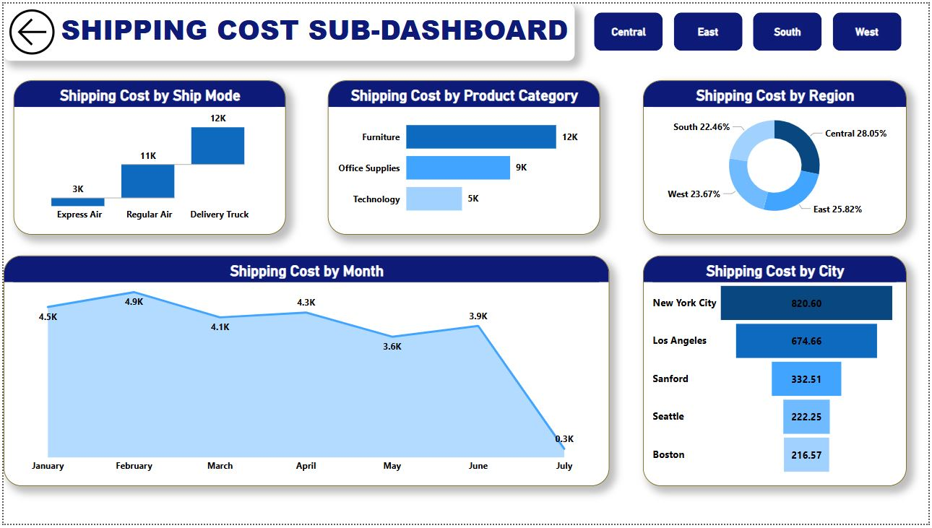
SHIPPING COST SUB-DASHBOARD
The Shipping Cost Sub-Dashboard provides an overview of shipping expenses across various factors, including shipping mo-des, product categories, regions, months, and cities.
Shipping Cost by Month: A line chart displays the shipping cost trends over seven months, showing fluctuations with the highest cost in February (4.9K) and a significant drop in July (0.3K).
Shipping Cost by Ship Mode: A bar chart indicates that Delivery Truck (12K) has the highest shipping cost, followed by Regular Air (11K) and Express Air (3K).
Shipping Cost by Product Category: A horizontal bar chart shows that Furniture (12K) incurs the highest shipping cost, followed by Office Supplies (9K) and Technology (5K).
Shipping Cost by Region: A donut chart represents the regional distribution of shipping costs, with Central (28.05%) having the highest share, followed by East (25.82%), West (23.67%), and South (22.46%).
Shipping Cost by City: A horizontal bar chart highlights that New York City (820.60) has the highest shipping cost, followed by Los Angeles (674.66), Sanford (332.51), Seattle (222.25), and Boston (216.57).
Region Selection Filters: Buttons at the top allow users to filter shipping cost data by different regions, including Central, East, South, and West, enabling detailed regional analysis.

Slide 9
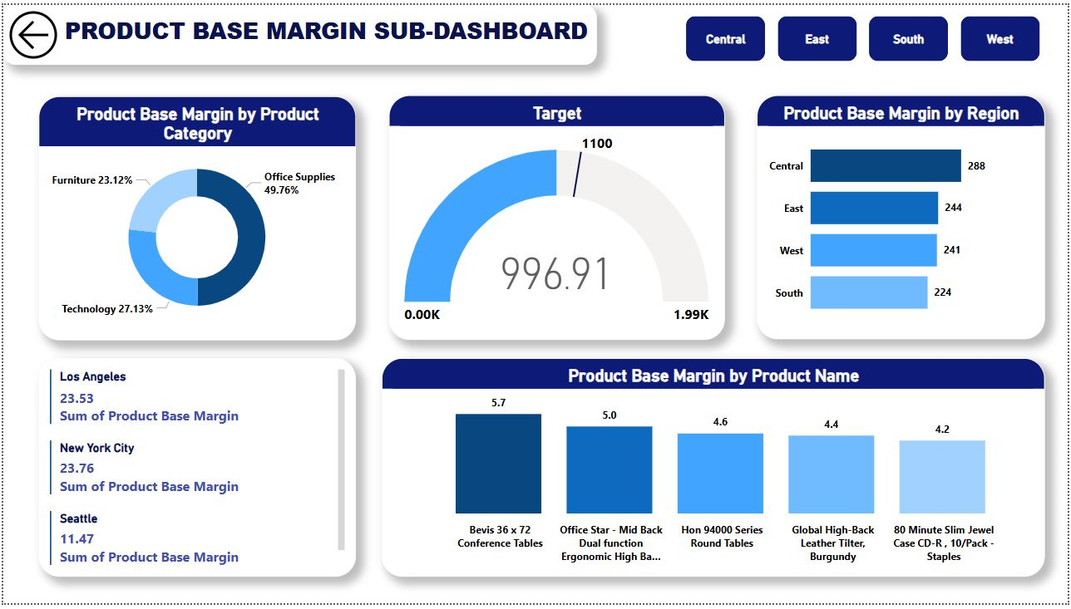
PRODUCT BASE MARGIN SUB-DASHBOARD
The Product Base Margin Sub-Dashboard provides a detailed analysis of product base margin across different product categories, regions, cities, and specific p-roduct names.
Product Base Margin by Product Category: A donut chart displays the distribution of base margin among product categories, showing that Office Supplies (49.76%) contributes the highest margin, followed by Technology (27.13%) and Furniture (23.12%).
Target Performance: A gauge chart highlights the current base margin value of 996.91, approaching the target of 1100, with a maximum possible value of 1.99K.
Product Base Margin by Region: A horizontal bar chart shows regional variations in base margin, with Central (288) leading, followed by East (244), West (241), and South (224).
Product Base Margin by Product
Name: A bar chart illustrates product-level contrib
-unions to base margin, with Bevis 36 x 72 Conference
Tables (5.7) generated the highest margin, followed
by Office Star - Mid Back Dual Function Chair (5.0), Hon 94000 Series Round Tables (4.6), Global High-Back Leather Tilter (4.4),
City-Level Product Base Margin: A list highlights the total base margin for key cities, with New York City (23.76) and Los Angeles (23.53) leading, while Seattle (11.47) follows.
Region Selection Filters: Buttons at the top allow users to filter product base margin data by different regions, including Central, East, South, and West, enabling a more detailed analysis.

Slide 10
CONCLUSION
The Finance Dashboard provides a comprehensive overview of sales performance, discount distribution, shipping costs, and product base margins across regions, customer segments, and product categories. The West region leads in profitability (33.05%), while Central (24.27%), East (22.22%), and South (20.45%) follow. California contributes the highest sales, while Office Supplies dominates product margins (49.76%). Discounts are primarily given on Office Supplies (52.71%), with corporate clients receiving the most (35.01%). Regular Air shipping incurs the highest cost (12K), making logistics an area for potential optimization. While sales trends remain strong, balancing discount strategies and shipping efficiency will further enhance profitability.

Slide 11
THANK YOU

