Slide 1
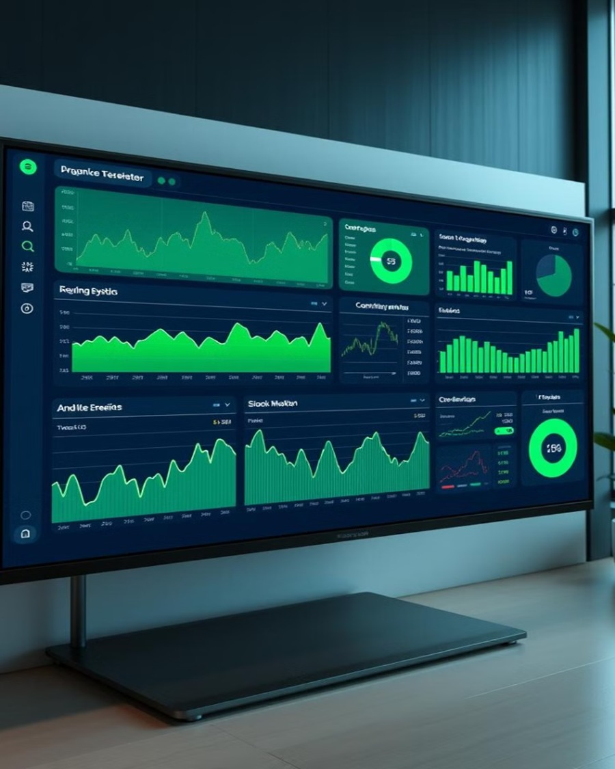
Power BI Desktop Stock Market Analysis Dashboard
-BY ARGHYADIP PANDEY

Slide 2
INTRODUCTION
This stock market analysis provides insights into the performance of major technology stocks, including Apple (AAPL), Microsoft (MSFT), Google (GOOG), and Netflix (NFLX). The report highlights key financial metrics such as high and low prices, opening prices, adjusted closing prices, and trading volumes. Netflix leads in volatility with the highest high-low difference, while Apple dominates trading volume at 46.98%. A time-series analysis of adjusted closing prices shows trends over recent months, reflecting market fluctuations. This data-driven approach enables investors to make informed decisions based on stock trends, price movements, and comparative market performance.

Slide 3
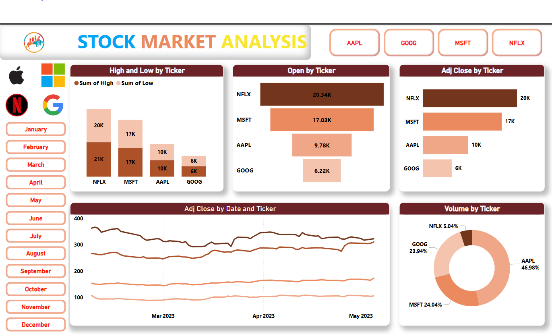
Overview
This Power BI dashboard provides a comprehensive analysis of major technology stocks, including Apple (AAPL), Microsoft (MSFT), Google (GOOG), and Netflix (NFLX). Key insights include:
High and Low by Ticker: Netflix exhibits the highest price fluctuations, followed by Microsoft and Apple.
Opening Prices: Netflix leads with the highest opening value.
Adjusted Closing Prices: Netflix maintains the highest closing value.
Volume by Ticker: Apple dominates trading volume at 46.98%, followed by Microsoft and Google.

Slide 4
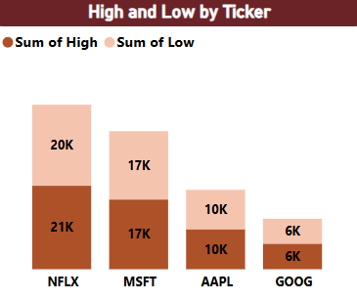
The bar chart presents the sum of high and low stock prices for four major tech companies: Netflix (NFLX), Microsoft (MSFT), Apple (AAPL), and Google (GOOG).
Key Observations:
Netflix (NFLX) shows the highest price volatility, with a high of 21K and a low of 20K. This suggests strong price fluctuations.
Microsoft (MSFT) follows closely, with both high and low values at 17K.
Apple (AAPL) maintains stability, with both high and low values at 10K, indicating minimal volatility.
Google (GOOG) has the lowest values, with a high and low of 6K, showing relative stability in price movement.

Slide 5
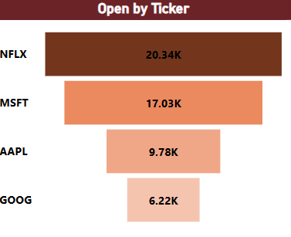
This chart displays the opening prices for four major technology stocks: Netflix (NFLX), Microsoft (MSFT), Apple (AAPL), and Google (GOOG).
Key Observations:
Netflix (NFLX) has the highest opening price at 20.34K, indicating strong market interest and valuation.
Microsoft (MSFT) follows at 17.03K, showing a solid position in the market.
Apple (AAPL) opens at 9.78K, reflecting moderate demand compared to Netflix and Microsoft.
Google (GOOG) has the lowest opening price at 6.22K, suggesting a relatively lower market valuation.

Slide 6
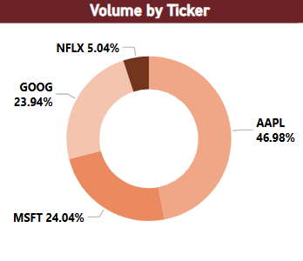
This donut chart represents the trading volume distribution among four major tech stocks: Apple (AAPL), Microsoft (MSFT), Google (GOOG), and Netflix (NFLX).
Key Observations:
Apple (AAPL) dominates the trading volume with 46.98%, indicating strong investor interest and high liquidity.
Microsoft (MSFT) follows with 24.04% of the volume, reflecting stable market activity.
Google (GOOG) holds 23.94% of the total trading volume, making it the third most traded stock in this group.
Netflix (NFLX) has the lowest trading volume at just 5.04%, suggesting lower investor activity and liquidity.

Slide 7
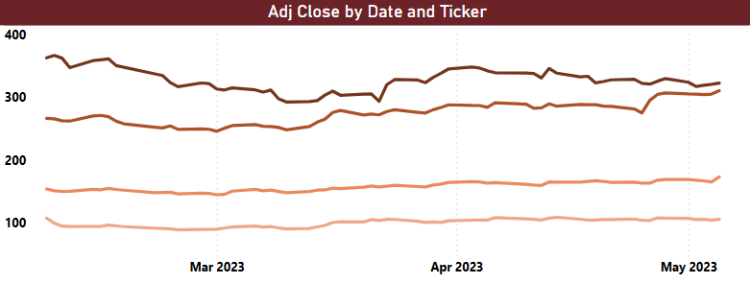
This line chart represents the adjusted closing prices of multiple stocks over time, from March 2023 to May 2023.
Key Observations:
The topmost line represents the highest-valued stock, showing some fluctuations but maintaining an upward trend toward May 2023.
The second-highest stock follows a similar trend, with slight dips and recoveries.
The lower two stocks exhibit relative stability, with minor fluctuations and a slight upward trend in May 2023.
Overall, the stock prices show resilience, with some volatility but a general upward movement.

Slide 8

CONCLUTION
Apple (AAPL) dominates trading volume (46.98%), indicating strong investor interest. Netflix (NFLX) shows the highest volatility, while Microsoft (MSFT) and Google (GOOG) remain stable. NFLX leads in adjusted close prices, but AAPL remains the most actively traded, making it the preferred stock for liquidity-focused investors.

Slide 9
THANK YOU

