Slide 1
✒
SCRIPTURA
Handwritten Sentence Recognition with a CRNN + CTC Deep Learning Pipeline
Project Demonstration • Dataset: IAM Sentence Dataset • Model: CNN + BiLSTM + CTC
From a photo of handwriting → clean, editable digital text

Slide 2
AGENDA
What We'll Cover Today
01
02
03
Problem & Objective
Dataset & Preprocessing
Model Architecture
Why handwriting recognition matters
IAM Sentence Dataset → model-ready tensors
CRNN: CNN + BiLSTM + CTC loss
04
05
06
Training & Evaluation
Inference Pipeline
Web App & Live Demo
30 epochs, CER / WER results
app.py, preprocessing.py, decoder.py
index.html + main.js, then conclusion
Scriptura — Handwritten Sentence Recognition (CRNN + CTC)
2

Slide 3
THE PROBLEM
Handwriting Is Everywhere — But Computers Can't Read It
Notes, forms, letters, and historical documents are still written by hand every day.
Handwriting is not typed text: no fixed font, variable spacing, joined letters, and personal style.
Manually re-typing handwritten content is slow, repetitive, and error-prone.
Simple OCR built for printed text (fixed fonts) performs poorly on cursive / natural handwriting.
We need a system that looks at a photo of a handwritten sentence and directly outputs digital, editable text.
“
Given a photo of a handwritten sentence, automatically recognize and output the text it contains — without any manual typing.
This is the core problem
our project solves.
Scriptura — Handwritten Sentence Recognition (CRNN + CTC)
3

Slide 4
OBJECTIVE
Project Objectives
1
Train an accurate recognizer
2
Use a real, standard dataset
Build a deep-learning model that reads full handwritten sentences (not just single words or characters).
Train and evaluate on the IAM Sentence Dataset, a widely used handwriting-recognition benchmark.
3
Handle variable-length text
4
Ship a usable application
Use CTC (Connectionist Temporal Classification) so the model doesn't need pre-segmented characters.
Wrap the trained model in a Flask web app with drag-and-drop upload and live camera capture.
Scriptura — Handwritten Sentence Recognition (CRNN + CTC)
4

Slide 5
PROPOSED SOLUTION
System Overview — From Photo to Text
📷
⚙
🧠
🔤
✓
→
→
→
→
Handwriting photo
Preprocessing
CRNN model
CTC decoding
Digital text
User uploads or captures an image
Grayscale, resize, pad to 1024×64
CNN + BiLSTM predicts per-timestep characters
Collapses repeats, removes blanks
Shown in the web UI with confidence
Two halves of the project: an offline training notebook that produces the model, and a Flask web app that uses it live.
Scriptura — Handwritten Sentence Recognition (CRNN + CTC)
5

Slide 6
DATASET
IAM Sentence Dataset
Source: Kaggle — python16/iam-sentence-dataset (downloaded in the notebook via kagglehub).
Content: scanned images of full handwritten English sentences, each paired with its ground-truth transcription.
Annotations: a sentences.csv file mapping each image to its label text; the notebook's loader also supports IAM-style .txt annotations.
Vocabulary: 79 unique characters (letters, digits, punctuation, space) built only from the training split.
16,752
13,401
image–label pairs
training sentences
3,351
82
test sentences
max label length (chars)
Sample labels (from the actual dataset):
“A MOVE to stop Mr. Gaitskell from”
“nominating any more Labour life Peers”
“Mr. Michael Foot has”
Scriptura — Handwritten Sentence Recognition (CRNN + CTC)
6

Slide 7
TECHNOLOGY STACK
Tools & Libraries Used in This Project
Model Training
Inference Backend
Frontend / UI
TensorFlow / Keras — build & train the CRNN
NumPy / Pandas — arrays & the image–label table
scikit-learn — train / test split
Matplotlib / PIL — visualize samples & training curves
kagglehub — download the IAM Sentence Dataset
Flask — web server & REST-style routes
TensorFlow / Keras — load model.keras & run predict()
OpenCV (cv2) — decode & preprocess uploaded images
NumPy — tensor manipulation, CTC decoding math
HTML5 + Bootstrap 5 — page structure & styling
Vanilla JavaScript (main.js) — upload, camera, fetch()
Bootstrap Icons — UI iconography
localStorage — client-side prediction history
Scriptura — Handwritten Sentence Recognition (CRNN + CTC)
7

Slide 8
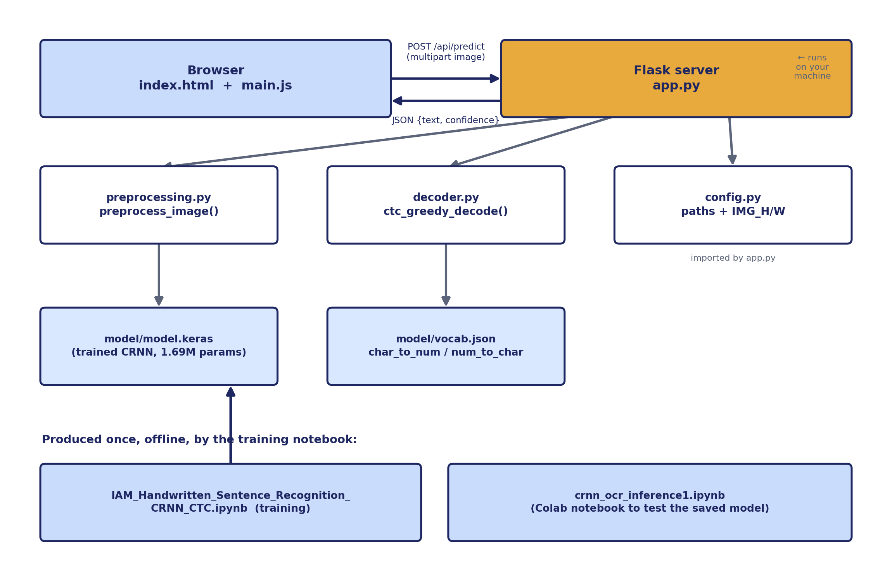
PROJECT STRUCTURE
How the Files Fit Together
Scriptura — Handwritten Sentence Recognition (CRNN + CTC)
8

Slide 9
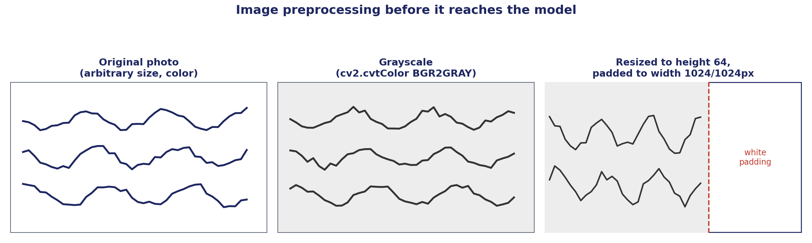
DATA PREPROCESSING
Turning Images Into Model-Ready Tensors
decode_png(channels=1) — read as single-channel grayscale PNG
convert_image_dtype(float32) — scales pixel values to [0, 1]
resize_with_pad(64, 1024) — preserves aspect ratio, avoids distortion
transpose (H,W,C) → (W,H,C) — width becomes the CTC time axis
Labels: char_to_num + pad_sequences to MAX_LEN=82 with PAD_TOKEN=79
Scriptura — Handwritten Sentence Recognition (CRNN + CTC)
9

Slide 10
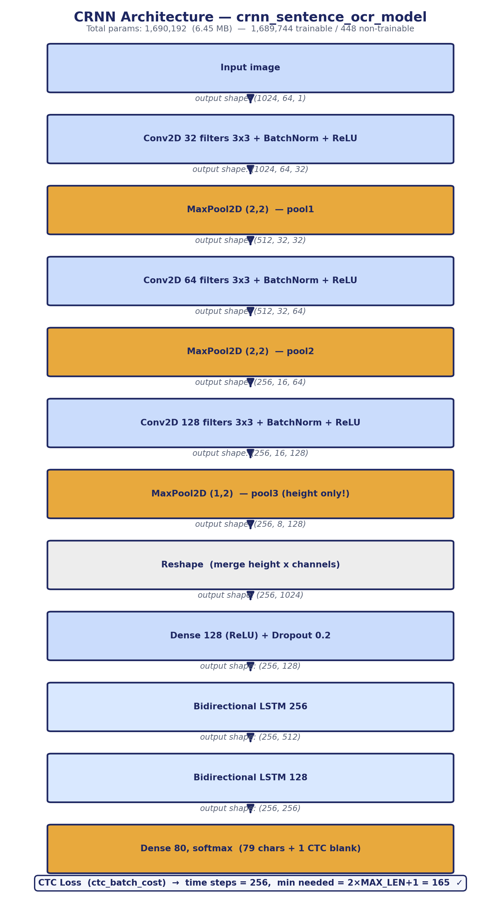
MODEL ARCHITECTURE
The CRNN: CNN + BiLSTM + CTC
Scriptura — Handwritten Sentence Recognition (CRNN + CTC)
10

Slide 11
DESIGN RATIONALE
Why CNN + BiLSTM + CTC for Handwriting?
CNN layers
Reshape to sequence
Learn local stroke/shape features (curves, loops, edges) directly from pixels — no manual feature engineering.
The feature map is reshaped into a sequence of 256 time steps, one “slice” moving left to right across the sentence.
Bidirectional LSTM
CTC loss
Reads the sequence forward and backward, so each character prediction uses context from letters before AND after it.
Lets the model learn without knowing in advance which pixels correspond to which character — no manual alignment needed.
Scriptura — Handwritten Sentence Recognition (CRNN + CTC)
11

Slide 12
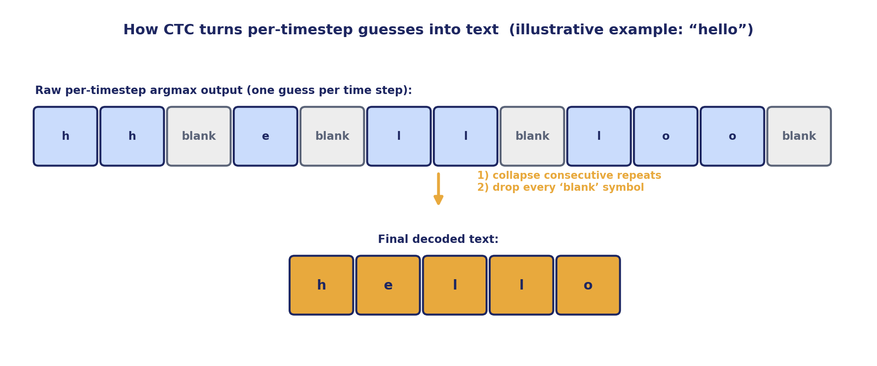
CTC LOSS
Connectionist Temporal Classification (CTC)
CTC lets the model output one guess per time step without needing pre-aligned, pre-segmented labels — it learns the alignment itself, and a special ‘blank’ class absorbs time steps between characters.
Scriptura — Handwritten Sentence Recognition (CRNN + CTC)
12

Slide 13
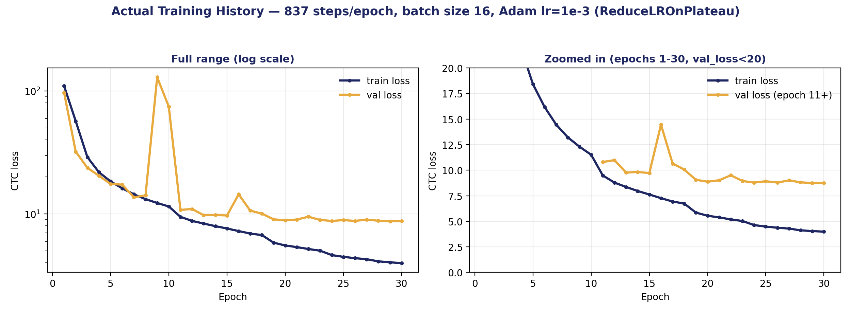
TRAINING
Training Process & Loss Curve
Optimizer: Adam, initial learning rate 1e-3
Batch size: 16 — 837 steps / epoch
Epochs: 30 (full run — no early stop needed)
Callbacks: EarlyStopping, ReduceLROnPlateau, ModelCheckpoint
Final: train loss 3.98, val loss 8.75
Scriptura — Handwritten Sentence Recognition (CRNN + CTC)
13

Slide 14
EVALUATION
How Accurate Is the Model?
6.82%
22.13%
76.44%
Character Error Rate (CER) on test set
Word Error Rate (WER) on test set
Overall per-character exact-match accuracy (separate notebook check)
CER / WER are computed as normalized edit (Levenshtein) distance — lower is better, 0 is a perfect transcription — averaged over 3,344 test sentences.
Actual: “varies from about 30 per cent in Welwyn to 85 per cent in”
Predicted: “varices fhom about 50 peicent in Welwyn to8s per cent in” (36.8% char accuracy — a harder sample)
Scriptura — Handwritten Sentence Recognition (CRNN + CTC)
14

Slide 15
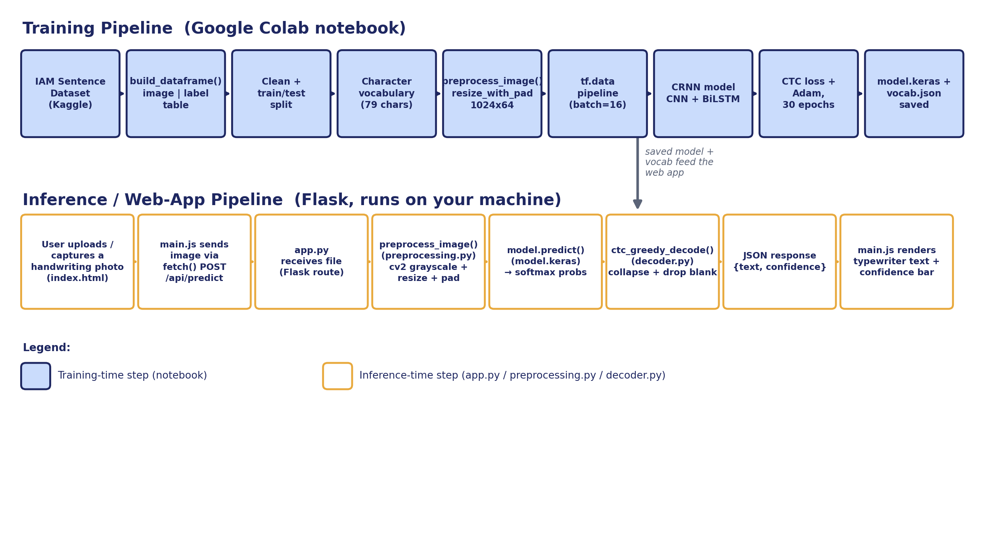
INFERENCE PIPELINE
From Uploaded Photo to Predicted Text
The full pipeline that runs the moment you click “Recognize text” in the browser.
Scriptura — Handwritten Sentence Recognition (CRNN + CTC)
15

Slide 16
BACKEND
app.py — The Flask Server
Loads vocab.json once at startup, sorted by index → charset[i] matches the class the model predicts
Loads the trained model.keras once at startup (compile=False — not retraining)
Route / — renders index.html
Routes /predict and /api/predict — both handle the same upload+predict logic
handle_prediction(): read image bytes → preprocess_image() → model.predict() → ctc_greedy_decode() → JSON response
@app.route('/api/predict', methods=['POST']) def api_predict(): return handle_prediction() # inside handle_prediction(): model_input, _ = preprocess_image( image_bytes, IMG_HEIGHT, IMG_WIDTH) preds = model.predict(model_input) text, confidence = ctc_greedy_decode( preds, charset) return jsonify({'success': True, 'text': text, 'confidence': confidence})
Scriptura — Handwritten Sentence Recognition (CRNN + CTC)
16

Slide 17
FRONTEND
index.html + main.js — The User Interface
📤
📷
✨
Upload or drag & drop
Live camera capture
Animated reveal
8MB limit, image-type validation
getUserMedia() + canvas frame grab
“ghost” handwriting → typewriter text
📊
🗂
🌙
Confidence bar
Prediction history
Light / dark theme
average per-character CTC probability
kept in the browser's localStorage
toggle, remembered across visits
Scriptura — Handwritten Sentence Recognition (CRNN + CTC)
17

Slide 18
ENGINEERING NOTES
Two Real Bugs Fixed During Development
Bug 1 — Wrong character mapping
Bug 2 — Preprocessing mismatch risk
app.py once rebuilt the correct charset from vocab.json, then overwrote it with a hardcoded alphabetical string. Since vocab.json is NOT in alphabetical order, every predicted index decoded to the wrong character (e.g. “Mr.” came out as “;B;”).
An earlier preprocessing.py hard-binarized images (pure black/white) before resizing. The model was trained on smooth grayscale strokes, so binarizing at inference time shifts the input distribution and degrades predictions.
Fix: build charset strictly from vocab.json's index order; never overwrite it.
Fix: binarization is now OFF by default (binarize=False); preprocessing matches the training pipeline's smooth grayscale.
Scriptura — Handwritten Sentence Recognition (CRNN + CTC)
18

Slide 19
LIVE DEMO
Demonstration Script
1
Start the app
Run python app.py — model + vocab load, Flask starts on port 5000
2
Open the browser
Navigate to the local URL; show the upload panel and result panel
3
Provide a sample
Drag in a handwriting photo, or open the camera tab and capture one
4
Click “Recognize text”
Explain: image → preprocessing → model → CTC decode, happening now
5
Show the result
Point out the typewriter reveal, the confidence bar, and the % score
6
Show history
Click a past entry to reload it; clear history to reset
Scriptura — Handwritten Sentence Recognition (CRNN + CTC)
19

Slide 20
CONCLUSION
Limitations, Future Scope & Conclusion
Limitations
Future Scope
Trained only on IAM English handwriting — other languages/scripts are out of scope
22% word error rate means whole-word mistakes are still common on harder samples
Greedy CTC decoding only — no beam search or language model correction in the app
Assumes reasonably legible, well-lit handwriting photos
Add beam-search CTC decoding with a language model for fewer word-level errors
Fine-tune on additional handwriting styles / languages
Deploy behind a proper WSGI server (not Flask's debug server) for production use
Add a feedback loop so corrected predictions can improve the model over time
Scriptura shows a complete, working handwriting-to-text pipeline — from a raw dataset, through a trained CRNN + CTC model, to a live web application — built and debugged end-to-end.

