Slide 1


IT - Induction
UTKAL HEALTHCARE PRIVATE LIMITED
PLOT NO.-C/3, NILADRIVIHAR, C.S.PUR, BHUBANESWAR-751021 DEPARTMENT - IT

Slide 2

IT Support Team
IT Support Services
IT Policies
Introduction to IT Applications
Agenda
Social Engineering
Cyber Security & Reporting
Ward & Bed Identification in HIS
Contact Us
FAQ

Slide 3


IT Support Team
Mr. Soumindra Kumar Gain
(Sr. Manager - IT)
Head of IT Application
Mr. Suraj Panda
(System Administrator)
Head of IT Infra
IT-Executive (Software)
IT-Executive (Hardware)

Slide 4

IT Support Services
HMIS
PACS
Email & Internet
Printer / Scanner
Laptop & Desktops
Video Conferencing
Wifi-Network
Digital Marketing
Bio-Metric m/c
End user Support
IT Provides support for:

Slide 5

IT Policies
Information Security Policy & Password
Internet Access Policy
E-mail Security Policy
End user device security Policy
Data Backup Policy
Physical & Environmental policy
Data Security Policy
Data Privacy Policy
Clear Screen & Clear Desk policy
New creation of HIS / Email id / services
Service Cancellation Policy
Some Important IT Policies:

Slide 6
IT Policies (I/III)
Information Security Policy & Password:
It ensures that patient data is protected from unauthorized access, breaches, and misuse in healthcare systems.
Password policy enforces strong, secure passwords to safeguard sensitive health information and maintain patient privacy
Internet Access Policy
Internet Access Policy defines secure and controlled use of internet resources in healthcare organizations to protect patient data.
It ensures compliance, prevents data breaches, and supports safe access to clinical and administrative systems.
E-mail Security Policy
This Policy in the healthcare sector defines to protect sensitive patient data from unauthorized access, phishing, and data breaches.
It ensures secure communication by enforcing encryption, access control, and proper e-mail usage compliance
End user device security Policy
This Policy in healthcare sector ensures that devices like computers, mobiles, and tablets accessing patient data are properly secured.
It protects sensitive health information by enforcing access control, antivirus, encryption, and safe usage practices.

Slide 7
IT Policies (II/III)
Data Backup Policy
A Data Backup Policy ensures regular, secure backups of patient and clinical data to prevent loss due to system failure or cyberattacks.
It supports data recovery, business continuity, and compliance with healthcare regulations.
Physical & Environmental policy
This Policy ensures protection of facilities, equipment, and patient data from physical threats and environmental risks.
It defines controls for access security, fire safety, and disaster preparedness to ensure uninterrupted healthcare services.
Data Security Policy
A Data Security Policy protect the patient data from unauthorized access, breaches, and misuse.
It defines standards for data access, storage, encryption, and compliance with healthcare regulations like HIPAA.
Data Privacy Policy
This policy ensures that patient information is collected, stored, and shared securely and only for authorized purposes.
It protects patient confidentiality and ensures compliance with healthcare regulations like data protection laws.

Slide 8
IT Policies (III/III)
Clear Screen & Clear Desk policy
This Policy ensures that patient information is not left visible on desks or computer screens when unattended.
It helps prevent unauthorized access to sensitive healthcare data and supports patient privacy compliance.
New creation of HIS / Email id / services
New creation of HIS / Email ID / services is the approved process for granting system access to healthcare staff.
It ensures secure, role-based access while maintaining data privacy and compliance.
Service Cancellation Policy
Service Cancellation Policy defines how and when healthcare services or appointments can be cancelled to ensure smooth patient care.
It helps optimize resources and reduce inconvenience for patients and providers.

Slide 9

Introduction to IT Applications
HMIS
EMR
PACs
Tally ERP
CRM Application
Porter Application
MRD S/w
Speech recognition s/w
Important IT Applications:

Slide 10

Social Engineering
Social engineering is the process of stealing of some confidential data/information by direct interaction or by some trick.
Social Engineering:
Important types of SE:
Phishing
Pharming

Slide 11
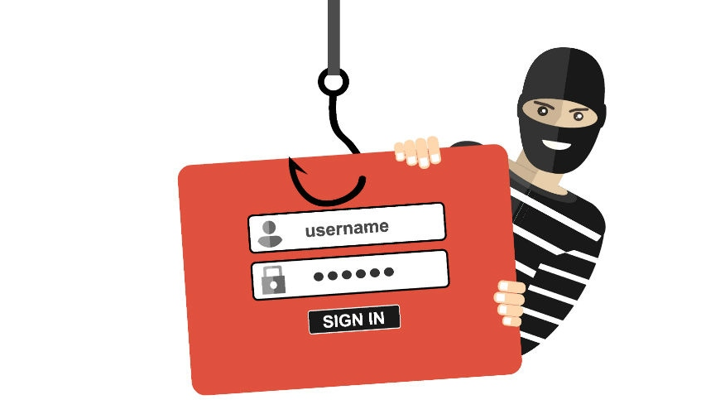
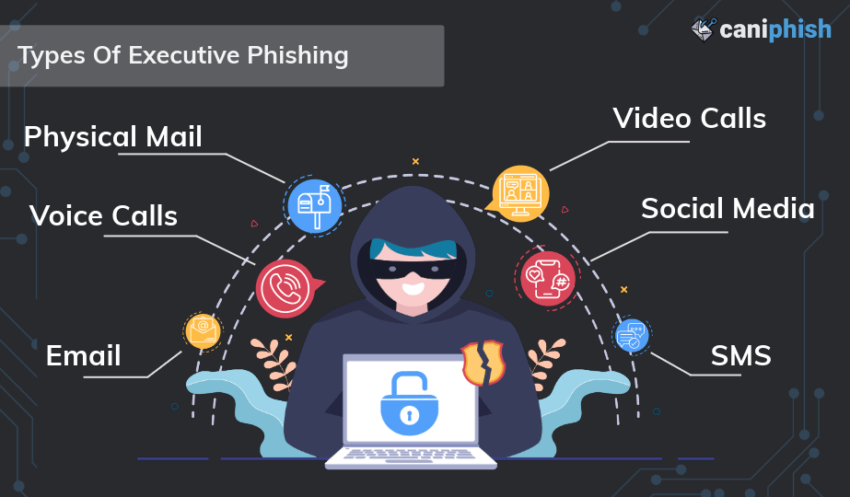
Phishing
Phishing is a type of SE where the attacker gathers confidential details like login id, password, credit card details, account deatails, etc from the victim by call/sms/WhatsApp/emails.

Slide 12
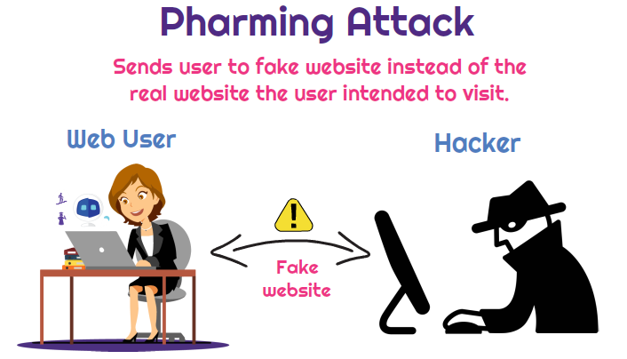
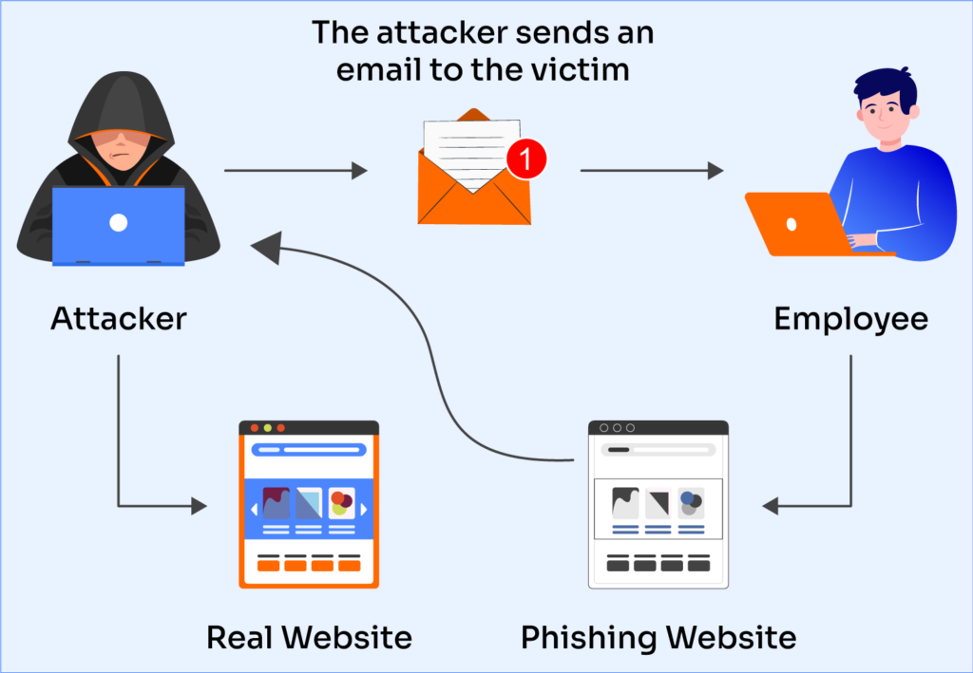
Pharming
Pharming is a type of online fraud when victims are directed to phoney websites by malicious code in an effort to obtain their login credentials and personal information.

Slide 13
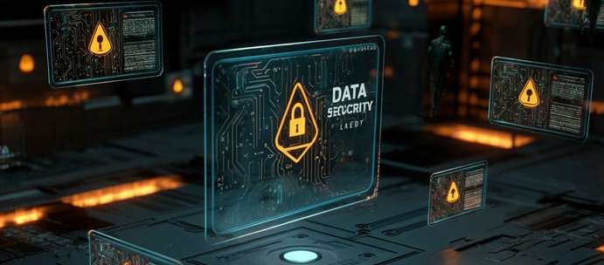

Cyber Security & Reporting
Cyberattack:
A cyberattack is a malicious and deliberate attempt by an individual or organization to breach the information system of another individual or organization.
Also we can say it is an intentional efforts to steal, expose, alter, disable, or destroy data, applications, or other assets through unauthorized access to a network, computer system or digital device
Note:
Immediately informed to your IT team without wasting of any time, without any self analysis, without closing the system.

Slide 14
WARD & BED Identification in HIS
Utkal hospital bed prefix identification
Utkal hospital ward details
FLOOR | SECTION-1 | SECTION-2 | SECTION-3 | SECTION-4
6F | ADMIN SECTION |  |  |  | ROOM NO.
5F | N5 | A5 | B5 | C5 | 45XX
4F | N4 | A4 | B4 | C4 | 44XX
3F | N3 | A3 | B3 | C3 | 43XX
2F | N2 | A2 22XX | B2 | C2 | 42XX
1F | N1 11XX | A1 | B1 | C1 | 41XX
GF | N0 | A0 | B0 | C0
B1 | NB1 | AB1 | BB1 | CB1
B2 | NB2 | AB2 | BB2 | CB2
 | N-WING | A-WING | B-WING | C-WING
Wing | Floor | WARD NAME
N-WING | 1F | WARD D
N-WING | 3F | PAEDIATRIC WARD N3
N-WING | 3F | NICU N3
N-WING | 3F | PICU N3
N-WING | 3F | PRIVATE WARD A3
N-WING | 4F | GENERAL WARD N4
N-WING | 4F | PRIVATE WARD N4
N-WING | 4F | SEMI PRIVATE WARD N4
N-WING | B2 | DAYCARE B2
N-WING | B2 | DAYCARE B2 SINGLE
A-WING | 1F | MICU A1
A-WING | 1F | SICU A1
A-WING | 2F | GENERAL WARD A2
A-WING | 2F | ICU-2 A2
A-WING | 4F | GENERAL WARD A4
A-WING | 4F | HDU-3
A-WING | GF | EMERGENCY
A-WING | GF | ISOLATION WARD B0
B-WING | 2F | ICU-3 B2
B-WING | 3F | PRIVATE WARD B3
B-WING | 4F | GENERAL WARD B4
B-WING | 5F | DIALYSIS WARD B5
B-WING | 5F | KTU B5
B-WING | 5F | BMT ICU B5
C-WING | 1F | CCU-C1
C-WING | 1F | CTVS ICU C1
C-WING | 2F | PRIVATE WARD C2
C-WING | 3F | PRIVATE WARD C3
C-WING | 3F | SEMI PRIVATE WARD C3
C-WING | 4F | GENERAL WARD C4
C-WING | 5F | GENERAL WARD C5
N-WING | 1F | HIGH DOSE N1

Slide 15
Contact Us
For Application (Software) Support:
For Infra (Hardware & Networking) Support:
Mr. Soumindra Kumar Gain
soumindra.gain@utkalhospital.in
Mob - 9337333940
Mr. Suraj Panda
Suraj.panda@utkalhospital.in
Mob- 8917387829
Rajesh Sahoo (Executive)
it@utkalhospital.in
Mob - 7894994569

Slide 16
A
K
Y
T
O
H
N
U
For Participation

