Slide 1
.NET Tutorial
OOP using C#

Slide 2
Recap…
Class & Object
Encapsulation
Method Overloading
Constructor & Destructor
Constructor Overloading
Static Constructor and usage of it
Inheritance
Method hiding
Overriding
Properties
Abstract Class
Structure
Interface
readonly & const keyword
Ref & Out parameter
Partial class
& Sample example
? Questions

Slide 3
Overview
In this tutorial we are going to cover the following
Discussion on Assessment 1
Delegate
Event
Extension Methods
2

Slide 4
Delegate
What is a delegate
A delegate is a type safe function pointer. That is, it holds a reference (Pointer) to a function.
The signature of the delegate must match the signature of the function, the delegate points to, otherwise you get a compiler error.
A Delegate is similar to a class. You can create an instance of it, and when you do so, you pass in the function name as a parameter to the delegate constructor, and it is to this function the delegate will point to.

Slide 5
Multicast Delegates
A Multicast delegate is a delegate that has references to more than one function. When you invoke a multicast delegate, all the functions the delegate is pointing to, are invoked.
There are 2 approaches to create a multicast delegate. Depending on the approach you use
+ or += to register a method with the delegate
- or -= to un-register a method with the delegate
A multicast delegate, invokes the methods in the invocation list, in the same order in which they are added.
If the delegate has a return type other than void and if the delegate is a multicast delegate, only the value of the last invoked method will be returned. Along the same lines, if the delegate has an out parameter, the value of the output parameter, will be the value assigned by the last method.

Slide 6
Event
Any object can publish a set of events to which other object can subscribe. When the publishing class raises an event, all the subscribed object are notified.
Event Handlers return void and take two parameters.
The first parameter is the source of the event; that is the publishing object.
The second parameter is an object derived from EventArgs.

Slide 7
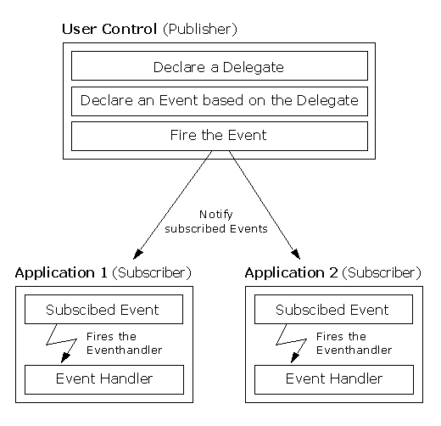
Event Continue…

Slide 8
Extension Method
Extension methods allow us to inject additional methods without modifying, deriving or recompiling the original class.
Extension methods is applicable on
class
struct
interface

Slide 9
Thank You

