Slide 1
.NET Tutorial
ASP.NET – Authentication & Authorization

Slide 2
Recap…
Usage of Web.Config
Applying common Web Form controls
Page redirection
Creating consistent layouts with Master Pages
Page Lifecycle
State Management
GridView
User Control & Custom Control
& Sample example
? Questions

Slide 3
Authentication & Authorization
Authentication
Prove genuineness
Authentication is the process of validating a user on their credentials.
Authorization
Process of granting approval or permission on resources.
After authentication a user will be verified for access to perform set of activities which is known as authorization.

Slide 4
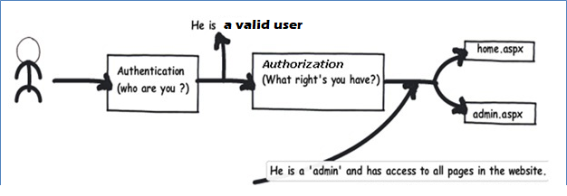
Authentication & Authorization

Slide 5
Type of Authentication
Windows authentication
Local windows users and groups to authenticate and authorize resources.
Forms Authentication
Cookie based authentication where username and password are stored on client machines
Form-based authentication presents the user with an HTML-based Web page that prompts the user for credentials.
Token authentication
External authentication provider is associated .
After checking the validity authentication provider will send a token to the application.

Slide 6
THANK YOU

