Slide 1
.NET Technology
@Arghya Biswas

Slide 2

Our Goal
Our objective to understand the following:
Visual Studio
CLR
.NET Assemblies
OOP using C#
Version Controlling
ADO .NET
TDD
Asp .NET Web Forms Application

Slide 3
.NET - What it is ?
The .NET framework is a software development platform developed by Microsoft. The framework was meant to create applications, which would run on the Windows Platform.
The .NET framework supports various programming languages such as Visual Basic and C#. So developers can choose and select the language to develop the required application.

Slide 4
Generations of .NET
Framework Version | Release Date | Development tool
1 | 13-02-2002 | Visual Studio .NET
1.1 | 24-04-2003 | Visual Studio .NET 2003
2 | 07-11-2005 | Visual Studio 2005
3 | 06-11-2006 | Expression Blend
3.5 | 19-11-2007 | Visual Studio 2008
4 | 12-04-2010 | Visual Studio 2010
4.5 | 15-08-2012 | Visual Studio 2012/2013
4.6 | 20-07-2015 | Visual Studio 2015
4.7 | 05-04-2017 | Visual Studio 2017
4.8 | 18-04-2019 | Visual Studio 2019

Slide 5
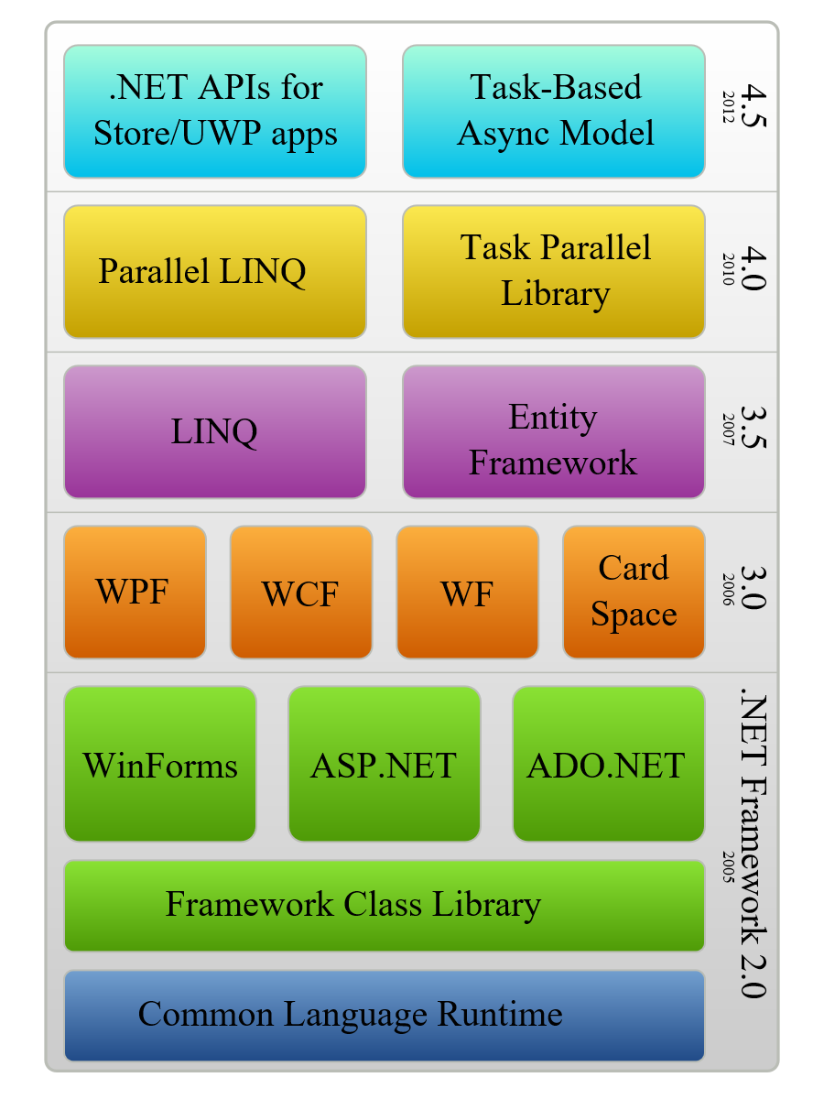


Features of the .NET

Slide 6
Metadata in Assembly
Type Descriptions
Classes
Base classes
Implemented interfaces
Data members
Methods
Assembly Description
Name
Version
Culture
Other assemblies
Security Permissions
Exported Types

Slide 7
Programming Language
C#
C++
VB.NET
Perl
J#
…
ASP .NET
Web Forms Web Services
Mobile Internet Toolkit
Windows
Forms
.NET Framework (Base Class Library)
ADO .NET and XML
Common Language Runtime
Operating System

Slide 8
.NET Framework
ASP.NET
Windows Forms
Web Services
Web Forms
Controls
Drawing
ASP.NET Application Services
Windows Application Services
Framework Class Library
ADO.NET
XML
Threading
IO
Network
Security
Diagnostics
Etc.
Common Language Runtime
Memory Management
Common Type System
Lifecycle Monitoring

Slide 9



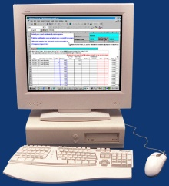








Asp .NET
Users Any device, Any place, Any time
XML Web Services Integrate business applications and processes
Authentication
Notification
Scheduling
Back Office Heterogeneous application and server infrastructure
ERP & Billing

Slide 10
Thank You

