Slide 1
Introduction to Microsoft Intune
Arghya Biswas

Slide 2
Agenda
Introduction to Microsoft Intune.
Intune Architecture.
Intune Features.
Device Management.
Windows autopilot.
Policies and Profiles.
Application Deployment.
Security and Compliance.
Reporting and Monitoring.
Troubleshooting.
Q&A.

Slide 3
Introduction to Microsoft Intune:
Microsoft Intune is a comprehensive cloud-based service designed to address the evolving challenges of modern device management. In a world where the mobile workforce is becoming increasingly prevalent, and organizations are embracing a diverse range of devices, Intune stands as a robust solution for managing and securing these devices efficiently.
Purpose of Microsoft Intune:
Microsoft Intune serves as a Unified Endpoint Management (UEM) solution, allowing organizations to manage a wide array of devices, including PCs, laptops, tablets, and smartphones, all from a single, centralized console.
Cloud-Powered Management:
Built on the foundation of Microsoft's cloud infrastructure, Intune provides the flexibility and scalability necessary to adapt to the ever-changing demands of the modern digital landscape.
Device Lifecycle Management:
Intune facilitates the entire lifecycle management of devices, from initial enrolment to ongoing monitoring, ensuring that organizations can maintain control and security throughout each stage.
Integration with Microsoft 365:
Intune seamlessly integrates with other Microsoft 365 services, creating a cohesive ecosystem that enhances productivity and collaboration. This integration extends to applications, data protection, and identity management.
Scalable Security:
Security is at the core of Intune, offering features like conditional access policies, compliance checks, and encryption to safeguard corporate data and ensure that only compliant and secure devices can access sensitive resources.

Slide 4
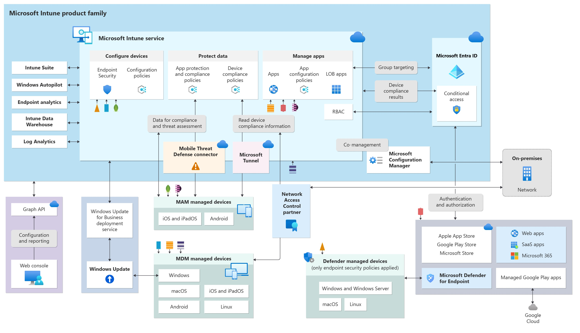

Slide 5
Intune Features.
Device Management:
Device Enrolment:Intune supports various enrolment methods, including user-driven enrolment, automatic enrolment (e.g., Windows Autopilot), and bulk enrolment.
Configuration Profiles: Intune allows administrators to create configuration profiles that define specific settings and restrictions for devices. These profiles can include Wi-Fi configurations, email settings, security policies, and other device configurations.
Device Compliance Policies:Administrators can define compliance policies to ensure that devices meet specific security and configuration standards. Intune regularly assesses devices against these policies and reports compliance status.
Conditional Access Policies:Conditional access policies in Intune provide granular control over device access to corporate resources. Access can be granted or denied based on conditions like device compliance, user location, and more. Provide fine-grained control over resource access.
Security Baselines:Intune provides security baselines that help organizations apply standardized security configurations to devices. This ensures a baseline level of security compliance across the entire device fleet.
Remote Actions:In case of lost or compromised devices, administrators can perform remote actions such as wiping data, restarting devices, or locking them down to prevent unauthorized access.
Application Deployment:Intune simplifies the deployment and management of applications on enrolled devices. This includes both Microsoft Store apps and line-of-business (LOB) applications.
Device Inventory:Intune maintains a device inventory, providing administrators with a comprehensive view of all managed devices. This inventory includes details like device status, compliance status, and hardware information.

Slide 6
Windows autopilot:Windows Autopilot is a modern deployment and provisioning service provided by Microsoft for Windows 10 devices. It simplifies the initial setup and deployment of Windows devices, making it easier for organizations to integrate new devices into their infrastructure.
Self-Service Deployment:Users can set up new Windows 10 devices without requiring IT assistance. This self-service aspect empowers end-users, reduces IT workload, and speeds up device onboarding.
Zero-Touch Provisioning:Autopilot aims to minimize IT involvement during device setup. With zero-touch provisioning, devices can be shipped directly to end-users, who can then complete the setup process without IT intervention.
Dynamic Out-of-Box Experience (OOBE):Autopilot tailors the Windows Out-of-Box Experience to the organization's requirements. This customization ensures that devices are configured with the necessary settings, applications, and security policies during the initial setup.
Cloud-Driven:Autopilot leverages cloud services, allowing organizations to manage device provisioning and configuration remotely. This is particularly beneficial for organizations with a distributed workforce or those adopting cloud-centric IT strategies.
Integration with Azure Active Directory (AAD):Autopilot integrates with Azure Active Directory, ensuring a seamless connection to organizational resources and user authentication. This integration streamlines the user authentication process during device setup.
Device Enrolment Status Page (ESP):The ESP provides real-time status updates during the device provisioning process. IT administrators can monitor progress and troubleshoot any issues that may arise.
Automatic Enrolment:Autopilot enables automatic enrolment of devices into Intune (Microsoft's cloud-based endpoint management solution) during the Out-of-Box Experience. This ensures that devices are automatically configured with the organization's policies and settings.
Customization and Branding:Organizations can customize the Autopilot deployment experience to align with their branding and provide a consistent user experience across devices.
Integration with Configuration Manager:For organizations using System Center Configuration Manager (SCCM), Autopilot integrates seamlessly, allowing for a co-management approach. This ensures flexibility for organizations with existing infrastructure investments.
In summary, Windows Autopilot simplifies and automates the deployment of Windows 10 devices, providing a user-friendly experience for end-users while allowing IT administrators to maintain control over configuration and security settings. It is particularly valuable for organizations looking to streamline device provisioning, reduce IT overhead, and embrace modern, cloud-driven approaches to device management.

Slide 7
Policies and Profiles:
Policies:Policies in Intune are sets of rules and configurations that dictate the behaviour and settings on enrolled devices. These rules are applied to ensure compliance with organizational security standards.
Types of Policies:
Compliance Policies: Define rules to ensure devices meet security and configuration standards.
Configuration Policies: Specify settings for devices, such as Wi-Fi configurations, VPN settings, and more.
Conditional Access Policies: Govern access to corporate resources based on specific conditions like device compliance.
Profiles:Profiles in Intune are containers for configuration settings that are applied to devices. They encapsulate a collection of settings, making it easier to deploy and manage configurations on a large scale.
Types of Profiles:
Device Configuration Profiles: Contain settings and configurations applied to devices. Include a wide range of device settings such as Wi-Fi, VPN, security, and compliance policies.
User Configuration Profiles: Contain settings and configurations applied to users. Define configurations tied to user profiles, such as application deployment, email settings, and more.

Slide 8
Application Deployment:
Application Types:
Microsoft Store Apps: Apps available in the Microsoft Store.
Line-of-Business (LOB) Apps: Custom-developed or third-party applications.
Deployment Methods:
User-Based Deployment: Apps are deployed to users and associated with their user accounts.
Device-Based Deployment: Apps are deployed to devices, ensuring they are available for all users on the device.
Deployment Scenarios:
Automatic Deployment: Apps can be automatically deployed upon device enrolment or user sign-in.
Required Deployment: Mandatory installation of apps based on organizational policies.
Integration with Microsoft Store for Business:
Centralized App Management: Utilize Microsoft Store for Business to centralize app acquisition and management.
Supported Platforms:
iOS and Android: Mobile devices such as smartphones and tablets.
Windows: Desktops, laptops, and tablets running Windows.
macOS: Apple Mac computers.
Deployment Monitoring and Reporting:
Visibility: Intune provides monitoring tools and reports to track the status of application deployments.
Troubleshooting: Identify and address issues through detailed deployment logs.

Slide 9
Security and Compliance:
Compliance Policies:Regular assessments to identify and report non-compliant devices. Automated actions, such as conditional access policies, based on compliance status.
Conditional Access Policies:Determine access to corporate resources based on conditions like device compliance, user location.
Security Baselines:Predefined configurations for devices to ensure a baseline level of security compliance. Encourages adherence to standardized security settings.
Application Protection Policies:Policies that secure corporate data within applications on mobile devices. Control app behaviour to prevent data leaks and enhance security.
Device Security Configuration:Apply security settings to devices, including encryption, firewall rules, and antivirus configurations.
Remote Actions:Administrators can perform remote actions such as wiping data, restarting devices, or locking them down in case of loss or compromise.
Threat Protection:Integration with Microsoft Defender Antivirus to protect devices from malware and other threats. Utilize threat intelligence for proactive threat detection and response.
Device Encryption:Ensure that device data is encrypted, enhancing data security.
Identity and Access Management:Azure Active Directory Integration ensures secure and seamless user identity management. Enhance access security with MFA for user authentication.
Monitoring and Reporting:Monitoring tools and reports to track the security and compliance status of devices. Audit logs for detailed visibility into security events and policy enforcement.

Slide 10
Reporting and Monitoring:
Dashboard Overview:The Intune dashboard provides a centralized view of the organization's device landscape. Key metrics such as device compliance, deployment status, and security posture are accessible at a glance.
Device Inventory:Maintains a comprehensive inventory of all managed devices. Includes device status, compliance status, hardware information, and other relevant details.
Compliance Monitoring:Regularly assess devices against compliance policies. Provides real-time status updates on device compliance.
Deployment Monitoring:Track the status of application deployments. Also monitor the deployment of updates and patches to ensure devices are up-to-date.
Conditional Access Reports:Access Control: Detailed reports on conditional access policies, showing which devices comply and which do not. Also gain insights into user and device access patterns.
Security Baseline Monitoring:Monitor adherence to standardized security configurations through security baselines And provide alerts for deviations from baseline settings.
Application Usage Analytics:Understand how applications are being used across the organization. Also identify opportunities for application optimization based on usage data.
Threat Detection and Response:Leverage threat intelligence for proactive threat detection. Implement response mechanisms based on detected threats.
User Activity Reports:Reports on user engagement with applications and devices. Identify trends and patterns in user activities.

Slide 11
Troubleshooting:
Diagnostic Logs:Access detailed diagnostic logs for insights into device behaviour and application deployment.
Reports and Dashboards:Utilize Intune reports and dashboards to get an overview of the status of devices, applications, and compliance. Identify trends and patterns that may indicate issues.
Conditional Access Insights:Leverage conditional access reports to understand user and device access patterns. Receive alerts for devices that are not compliant with policies.
Application Deployment Status:Monitor the status of application deployments to identify failed installations or errors. As well as encourage users to provide feedback on application deployment issues through the Company Portal.
Compliance Status Checks:Identify the reasons for non-compliance and take corrective actions.
Application Compatibility Checks:Ensure that applications are compatible with the target devices and operating systems. Review application deployment requirements and make necessary adjustments.
Azure AD Integration Checks:Check Azure AD integration for identity and access management issues. Ensure that users are properly authenticated and authorized.
User Assistance:Guide users to the Company Portal for self-service troubleshooting and application installations. Provide users with information on troubleshooting common issues.
Collaboration with Support:Engage with Microsoft Support for assistance with complex issues. Participate in community forums to seek insights and solutions from the broader Intune user community.
In summary, troubleshooting in Intune involves a combination of reviewing diagnostic data, monitoring reports, and taking proactive actions to address issues related to device management, application deployment, and security. A systematic approach to identifying and resolving problems is crucial for maintaining a well-functioning device environment within the organization.

Slide 12
Questions and Answers.

Slide 13
Thank you

