Slide 1
Statistics
Chapter 4: Probability

Slide 2
Where We’ve Been
Graphical and Numerical Descriptive Measures for Qualitative and Quantitative Data

Slide 3
Where We’re Going
Probability as a Measure of Uncertainty
Basic Rules for Finding Probabilities
Develop the notion of a random variables
Discrete and continuous random variables and their probability distributions

Slide 4
4.1: Events, Sample Spaces and Probability
An experiment is an act or process of observation that leads to a single outcome that cannot be predicted with certainty.
A sample point is the most basic outcome of an experiment.

Slide 5
4.1: Events, Sample Spaces and Probability
A sample space of an experiment is the collection of all sample points.
  Roll a single die:
  S: {1, 2, 3, 4, 5, 6}
An event is a specific collection of sample points:
  Event A: Observe an even number.

Slide 6
4.1: Events, Sample Spaces and Probability
Calculating Probabilities for Events
  Define the experiment.
  List the sample points.
  Assign probabilities to sample points.
  Collect all sample points in the event of interest.
  The sum of the sample point probabilities is the event probability.

Slide 7
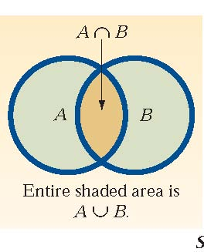
4.2: Unions, Intersections, Complements
The complement of any event A is the event that A does not occur, A^{C}.
P(Ω)=1, P(Φ)=0

Slide 8
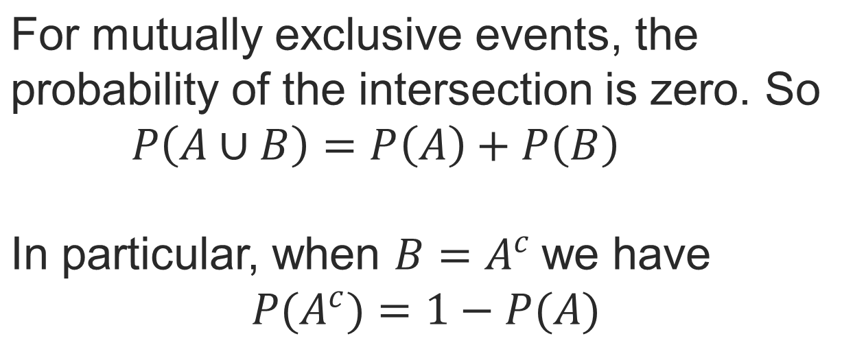
4.2: Unions, Intersections, Complements

Slide 9
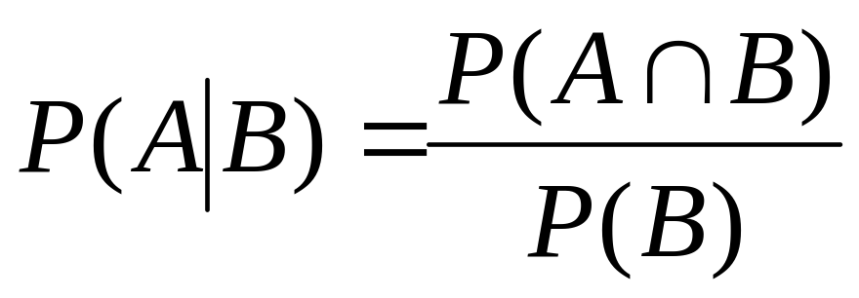
4.3: Conditional Probability and Independent Events
Additional information or other events occurring may have an impact on the probability of an event.

Slide 10
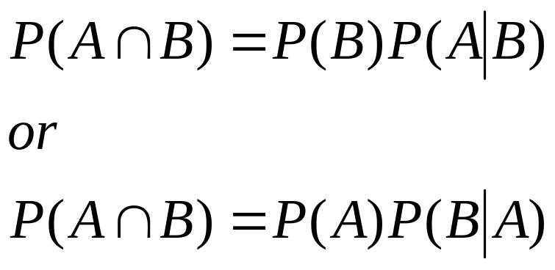
4.3: Conditional Probability and Independent Events
The conditional probability formula can be rearranged into the Multiplicative Rule of Probability to find joint probability.

Slide 11
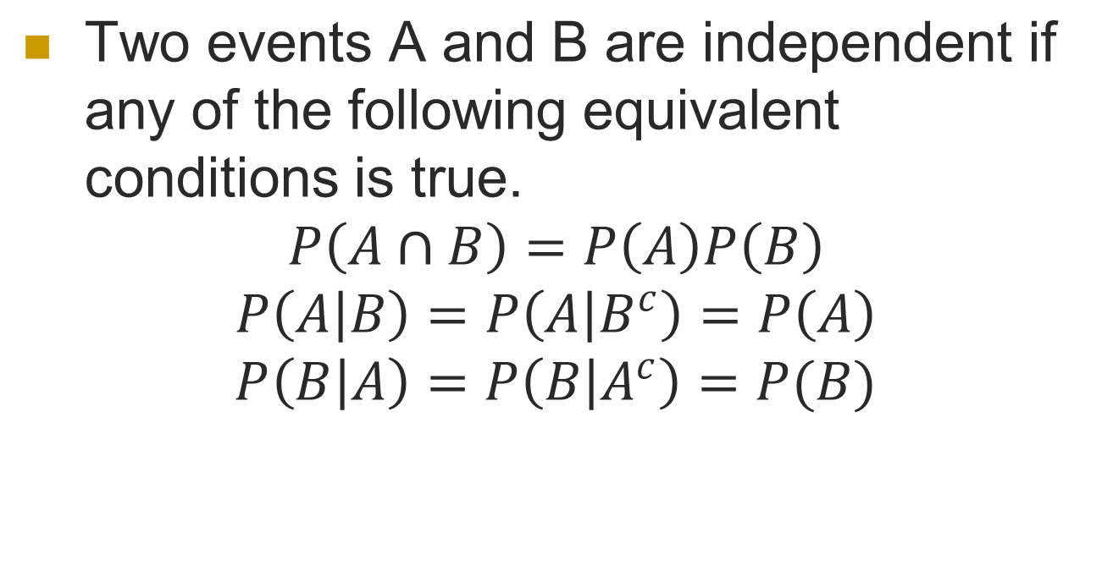
4.3: Conditional Probability and Independent Events

Slide 12
4.4: Random Sampling
If n elements are selected from a population in such a way that every set of n elements in the population has an equal probability of being selected, the n elements are said to be a (simple) random sample.

Slide 13
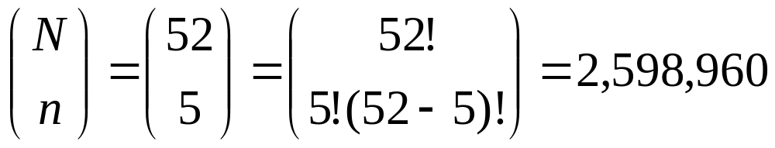
4.4: Random Sampling
How many five-card poker hands can be dealt from a standard 52-card deck?
Use the combination rule:

Slide 14
4.4: Random Sampling
Random samples can be generated by
  Mixing up the elements and drawing by hand, say, out of a hat (for small populations)
  Random number generators
  Random number tables
  Random sample/number commands on software

Slide 15
4.5: Two Types of Random Variables
A random variable is a variable that assumes numerical values associated with the random outcome of an experiment, where one (and only one) numerical value is assigned to each sample point.
Function from Ω to R

Slide 16

4.5: Two Types of Random Variables
A discrete random variable can assume a countable number of values.
  Number of steps to the top of the Eiffel Tower*
A continuous random variable can assume any value along a given interval of a number line.
  The time a tourist stays at the top
  once s/he gets there
*Believe it or not, the answer ranges from 1,652 to 1,789. See Great Buildings

Slide 17
4.6: Probability Distributions for Discrete Random Variables
The probability distribution of a discrete random variable is a graph, table or formula that specifies the probability associated with each possible outcome the random variable can assume.
  p(x) ≥ 0 for all values of x
  Σp(x) = 1

Slide 18
4.6: Probability Distributions for Discrete Random Variables
x | P(x)
1 | .30
2 | .21
3 | .15
4 | .11
5 | .07
6 | .05
7 | .04
8 | .02
9 | .02
10 | .01
Say a random variable x follows this pattern: p(x) = (.3)(.7)^{x-1}
for x > 0.
  This table gives the probabilities (rounded to two digits) for x between 1 and 10.

Slide 19
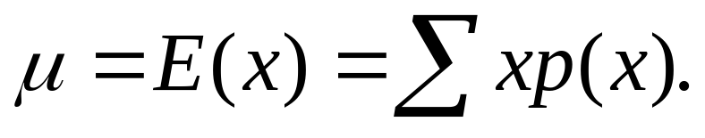
4.6: Probability Distributions for Discrete Random Variables
The mean, or expected value, of a discrete random variable is

Slide 20
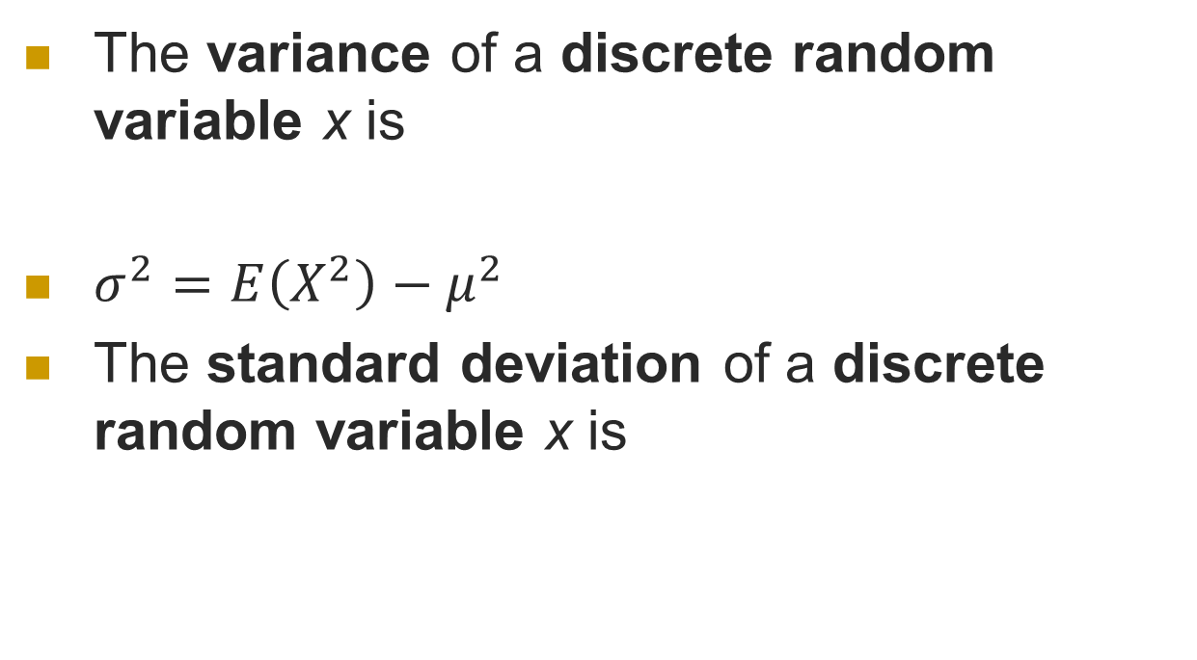
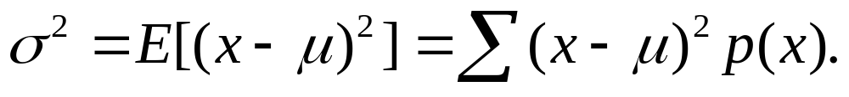
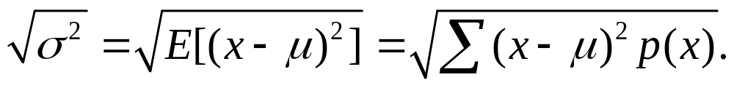
4.6: Probability Distributions for Discrete Random Variables

Slide 21
4.6: Probability Distributions for Discrete Random Variables
In a roulette wheel in a U.S. casino, a $1 bet on “even” wins $1 if the ball falls on an even number (same for “odd,” or “red,” or “black”).
The chance of winning this bet are 47.37%
38 slots numbered: 0, 00, 1-36.
0, 00 are green. Among the rest, half are red and half are black.
Place bet on even: 36/2=18 winning possibilities, 20 losing possibilities.
18/38=0.4737

Slide 22
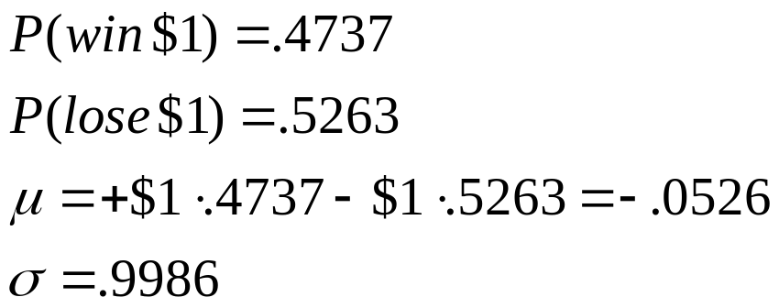
4.6: Probability Distributions for Discrete Random Variables
In a roulette wheel in a U.S. casino, a $1 bet on “even” wins $1 if the ball falls on an even number (same for “odd,” or “red,” or “black”).
The odds of winning this bet are 47.37%
On average, bettors lose about a nickel for each dollar they put down on a bet like this.
(These are the best bets for patrons.)

Slide 23
4.6: Probability Distributions for Discrete Random Variables
Binomial
The experiment consists of n identical trials.
Each trial results in one of two outcomes, success (S) or failure (F).
The probability of success on a single trial is p and remains constant from trial to trial. The probability of failure is q = 1 – p.
The trials are independent.
We are interested in x, the number of successes in n trials.

Slide 24
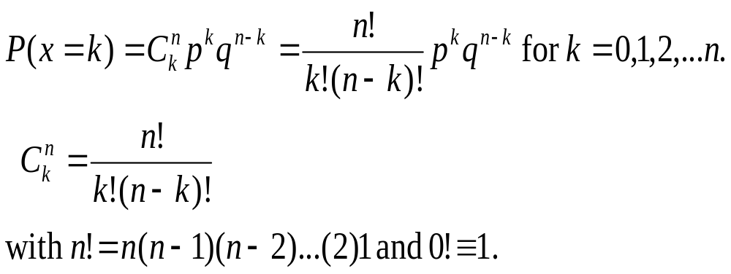
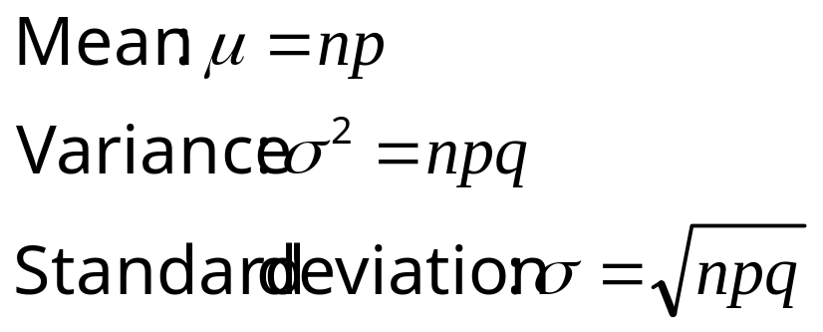
4.6: Probability Distributions for Discrete Random Variables
Binomial

Slide 25
4.6: Probability Distributions for Discrete Random Variables
Geometric
Each trial results in one of two outcomes, success (S) or failure (F).
The probability of success on a single trial is p and remains constant from trial to trial. The probability of failure is q = 1 – p.
The trials are independent.
We are interested in x, the number of trials required to get the first success.

Slide 26

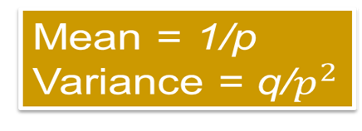
4.6: Probability Distributions for Discrete Random Variables
Geometric

Slide 27
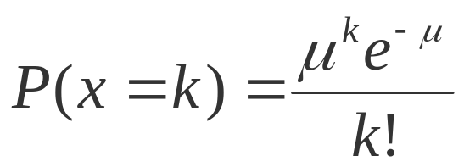
4.6: Probability Distributions for Discrete Random Variables
Poisson
The number of events that occur in a period of time or space during which an average of μ such events can be expected to occur.
For values of k = 0, 1, 2, … The mean and standard deviation of the Poisson random variable are
Mean: μ
Standard deviation: μ

Slide 28
4.6: Probability Distributions for Discrete Random Variables
Hypergemetric
The experiment consists of n identical trials.
Each trial results in one of two outcomes, success (S) or failure (F).
The trials are random draws without replacement from a population of size N of which M are marked.
Success is defined as drawing a marked element.
The random variable X is the number of successes.

Slide 29
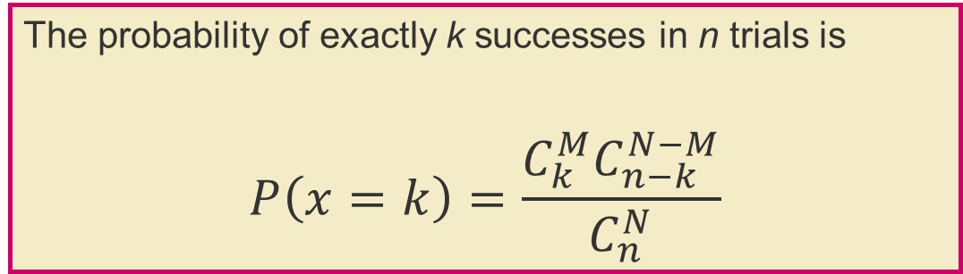
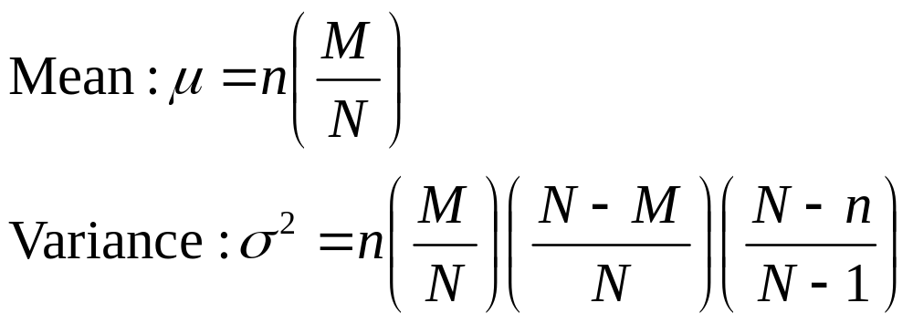
4.6: Probability Distributions for Discrete Random Variables
Hypergeometric

Slide 30
4.7: Continuous Probability Distributions
A continuous random variable can assume any numerical value within some interval or intervals.
The graph of the probability distribution is a smooth curve called a
  probability density function,
  frequency function or
  probability distribution.

Slide 31
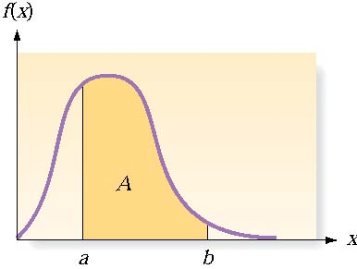
4.7: Continuous Probability Distributions
There are an infinite number of possible outcomes
  p(x) = 0
  Instead, find p(a<x<b)
    ☺ Table
    ☺ Software
    ☹ Integral calculus)

Slide 32
4.7: Continuous Probability Distributions
Uniform (special case of beta)
Exponential (special case of gamma)
Gamma (support on half real line)
Beta (bounded support)
Normal (support on R)

Slide 33
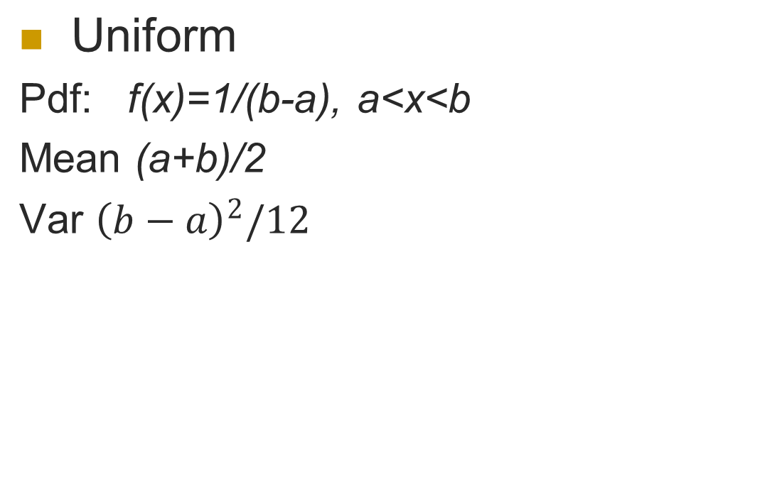
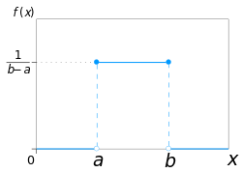
4.7: Continuous Probability Distributions

Slide 34
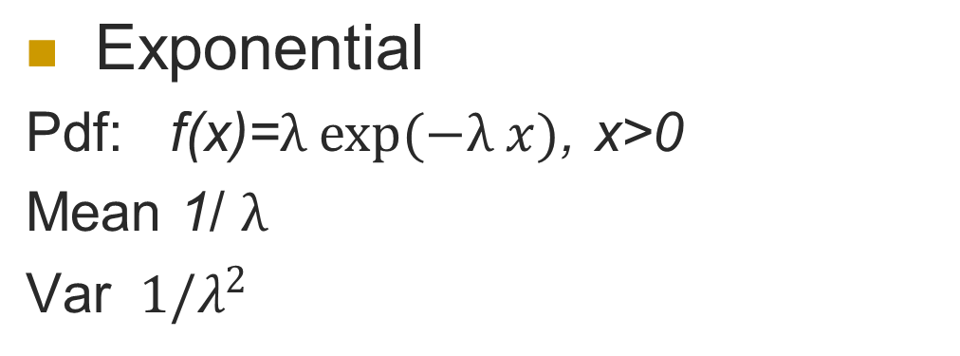
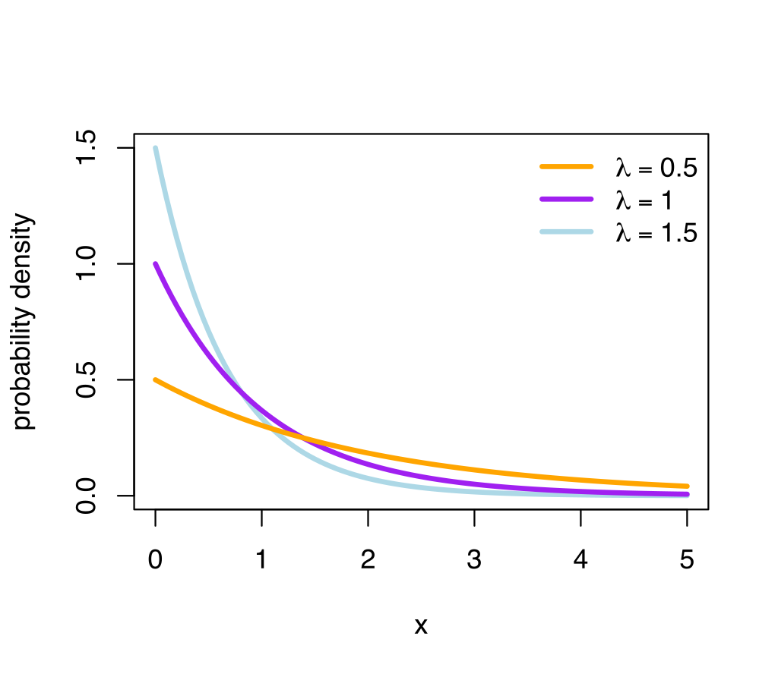
4.7: Continuous Probability Distributions

Slide 35
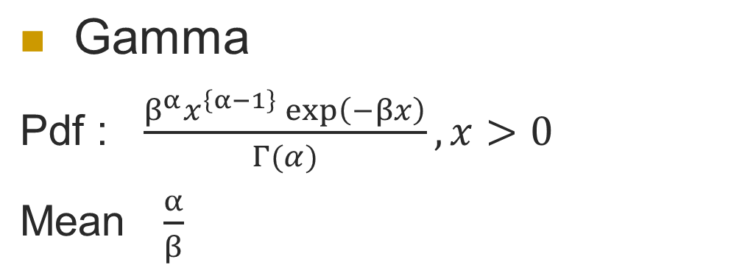
4.7: Continuous Probability Distributions

Slide 36
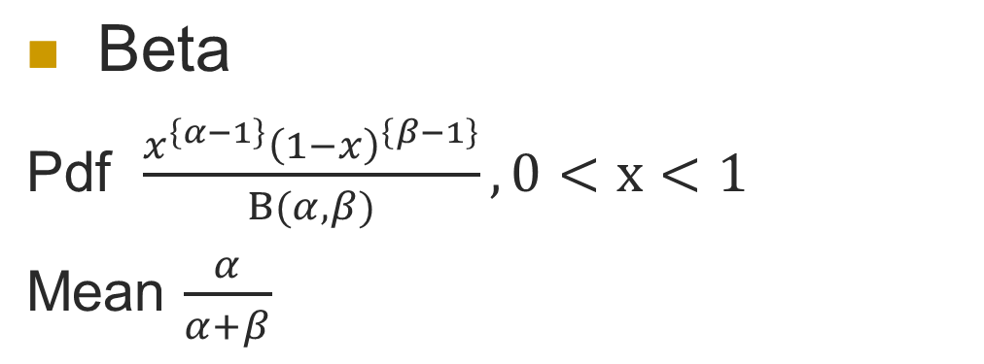
4.7: Continuous Probability Distributions

Slide 37
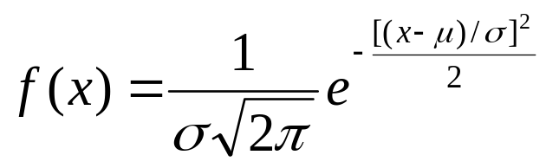
4.8: The Normal Distribution
Closely approximates many situations
  Perfectly symmetrical around its mean
The probability density function f(x):
        µ = the mean of x
        σ = the standard deviation of x

Slide 38
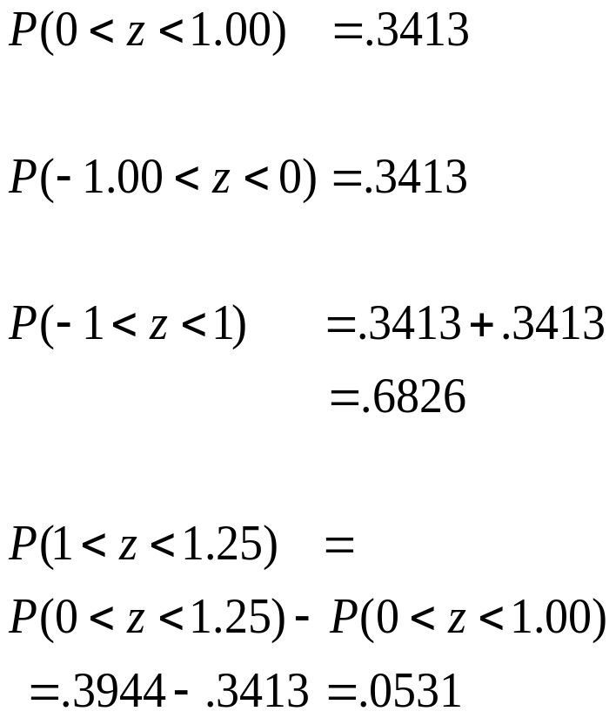
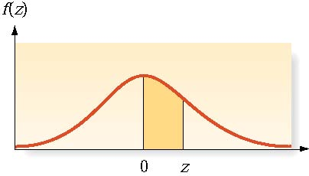
4.8: The Normal Distribution

Slide 39
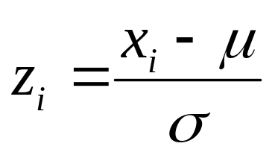
4.8: The Normal Distribution
So any normally distributed variable can be analyzed with this single distribution
For a normally distributed random variable x, if we know µ and σ, z follows normal with mean 0 and variance 1

