Slide 1
Statistics
Chapter 6: Point Estimation

Slide 2
Where We’re Going
Estimate a population parameter with a sample statistic
Method of Moments Estimator
Bias and Variance
Consistency and Asymptotic Normality

Slide 3
6.1: Point Estimation
The unknown population parameter that we are interested in estimating is called the target parameter.
Parameter | Key Word or Phrase | Type of Data
µ | Mean, average | Quantitative
p | Proportion, percentage, fraction, rate | Qualitative
σ | Standard Deviation | Quantitative

Slide 4
6.1: Point Estimation
A point estimator of a population parameter is a rule or formula that tells us how to use the sample data to calculate a single number that can be used to estimate the population parameter.

Slide 5
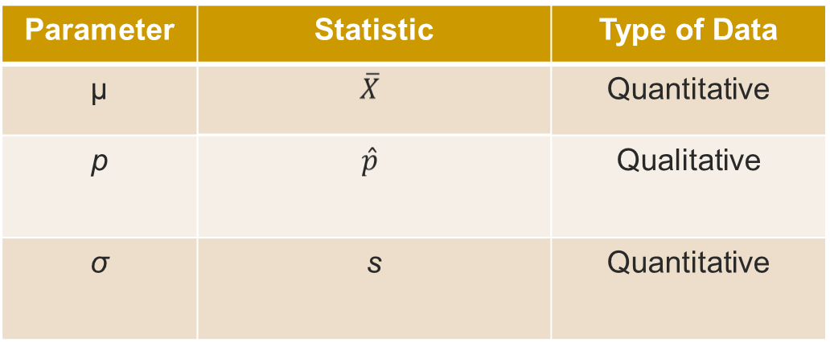
6.1: Point Estimation
We often use the corresponding sample quantity to estimate the population quantity.

Slide 6
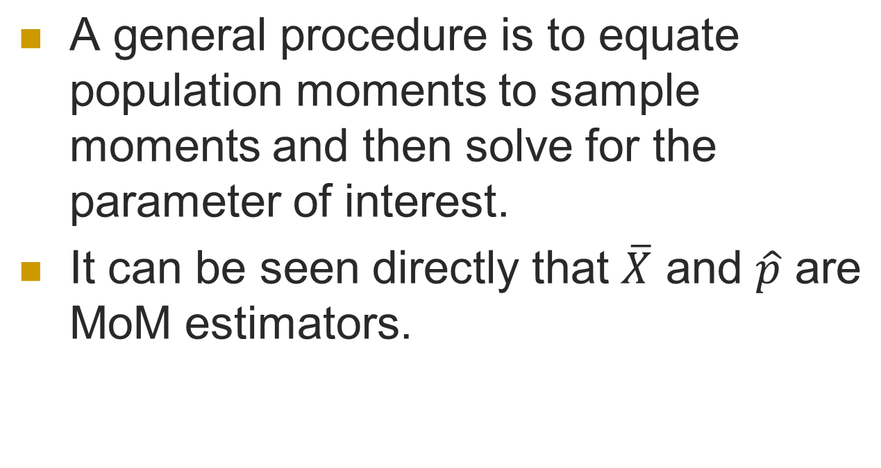
6.2 Method of moments(MoM)

Slide 7
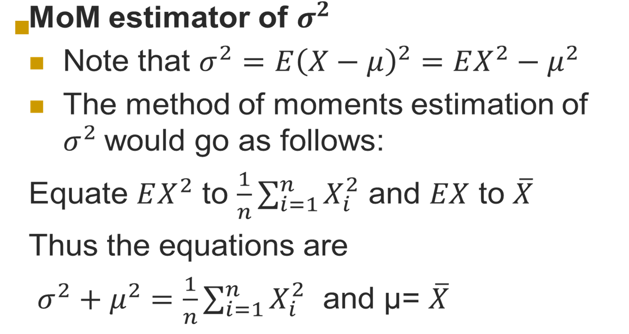
6.2 Method of moments(MoM)

Slide 8
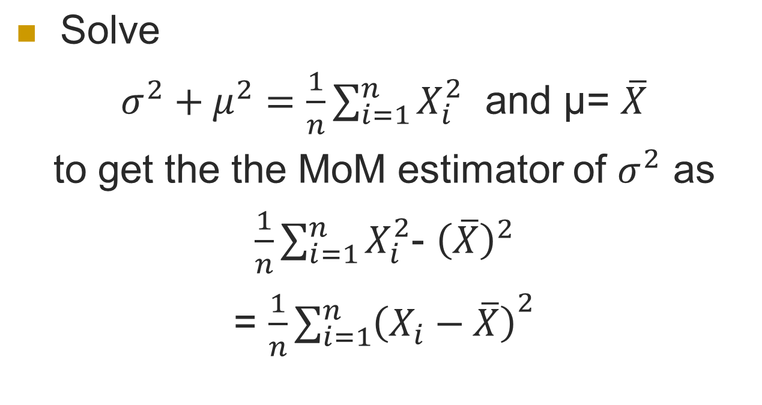
6.2 Method of moments(MoM)

Slide 9
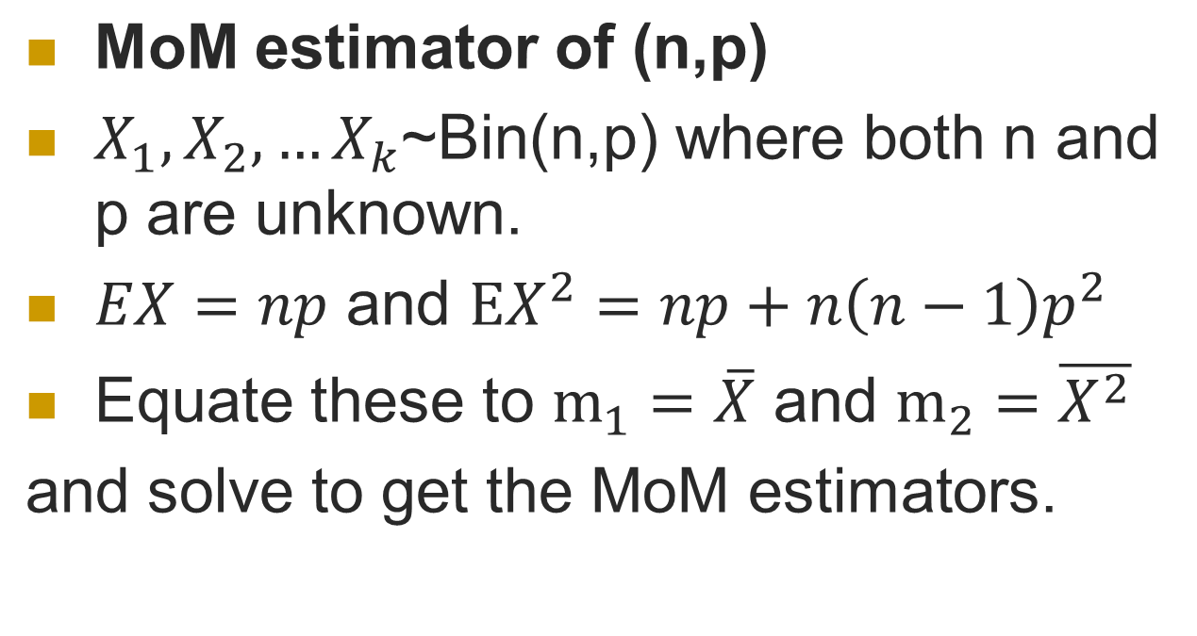
6.2 Method of moments(MoM)

Slide 10
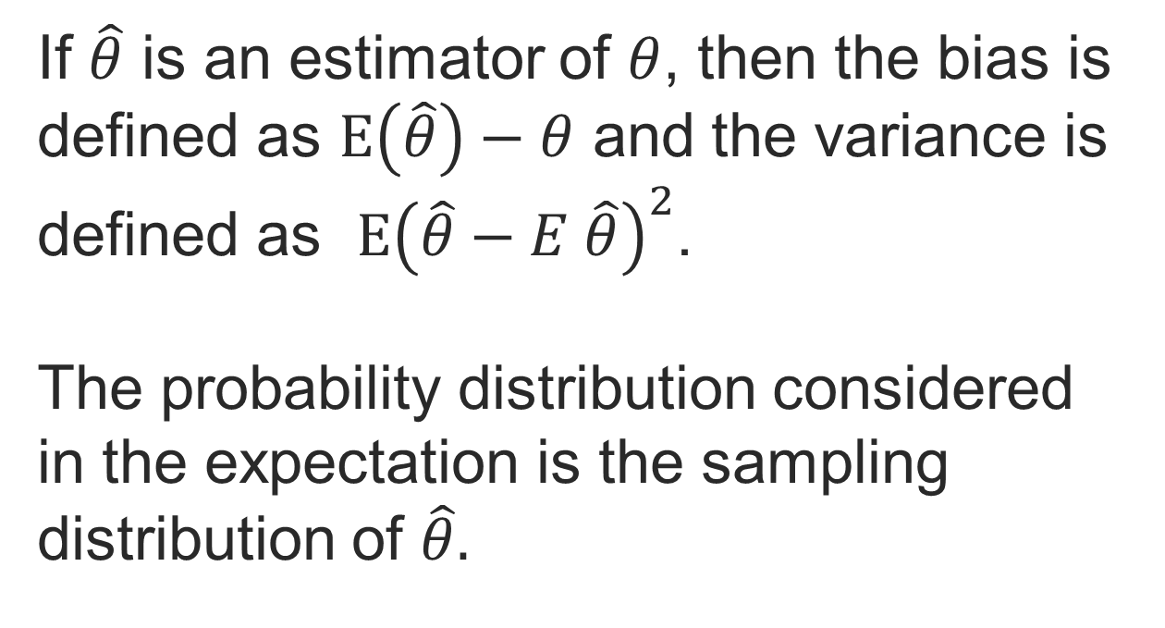
6.3 Bias and variance

Slide 11
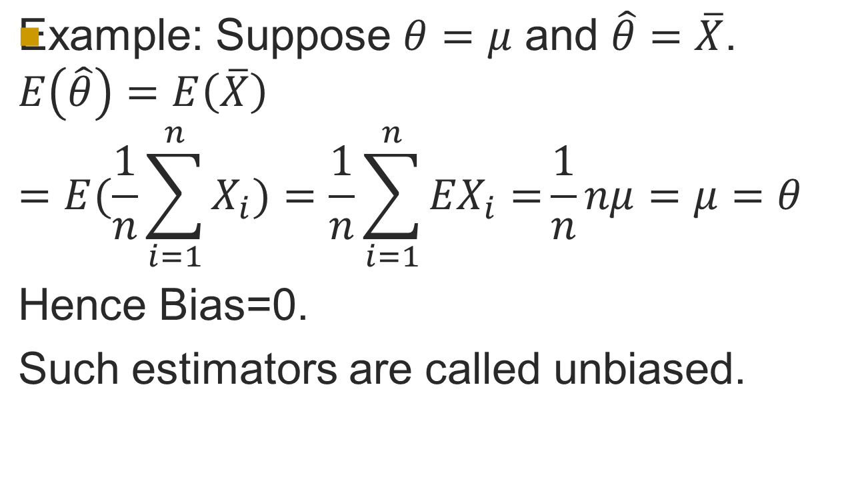
6.3 Bias and variance

Slide 12
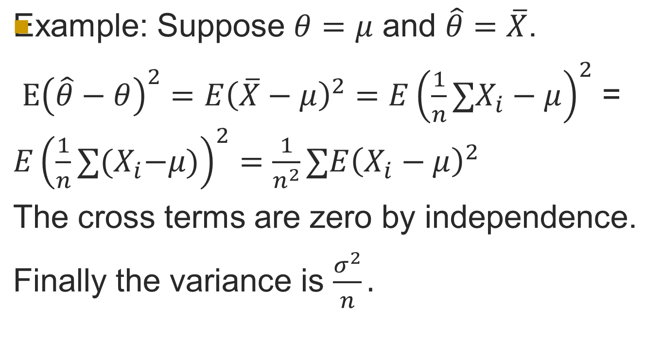
6.3 Bias and variance

Slide 13
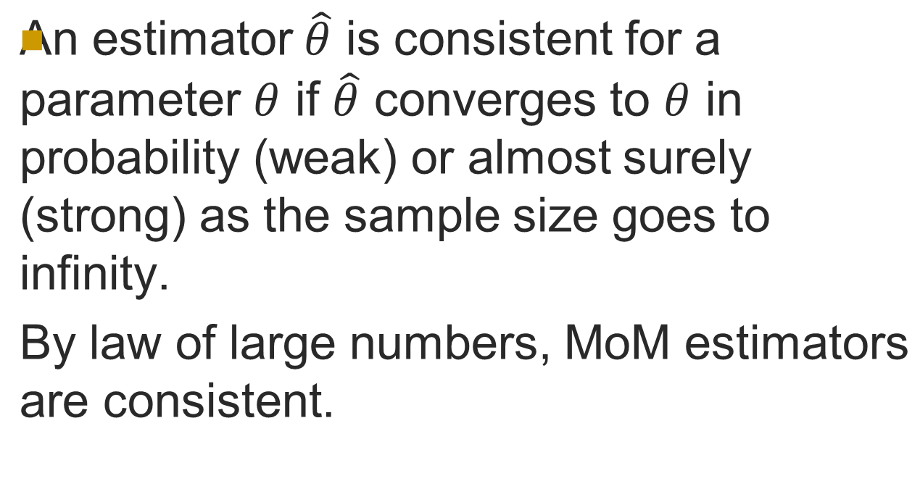
6.4 Consistency and asymptotic normality

Slide 14
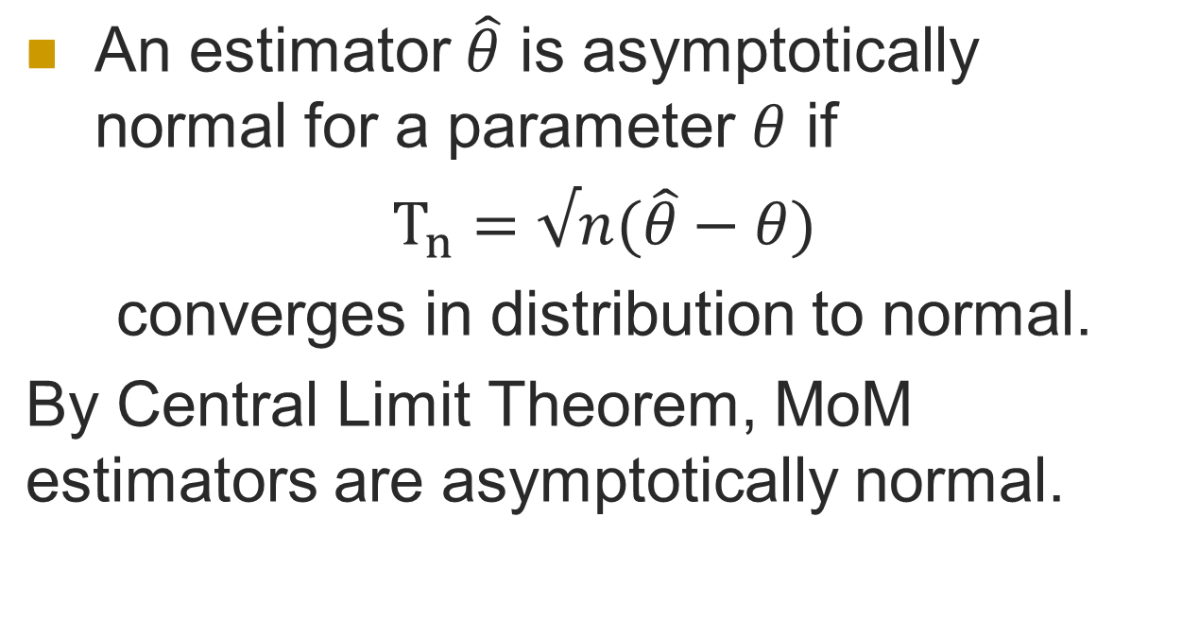
6.4 Consistency and Asymptotic normality

