Slide 1
Statistics
Chapter 1: Introduction

Slide 2
Where We’re Going
Introduction to the field of statistics
How statistics applies to real-world problems
Establish the link between statistics and data
Differentiate between population and sample data
Differentiate between descriptive and inferential statistics

Slide 3
1.1: The Science of Statistics
Statistics is the science of data. This involves collecting, classifying, summarizing, organizing, analyzing and interpreting numerical information.

Slide 4
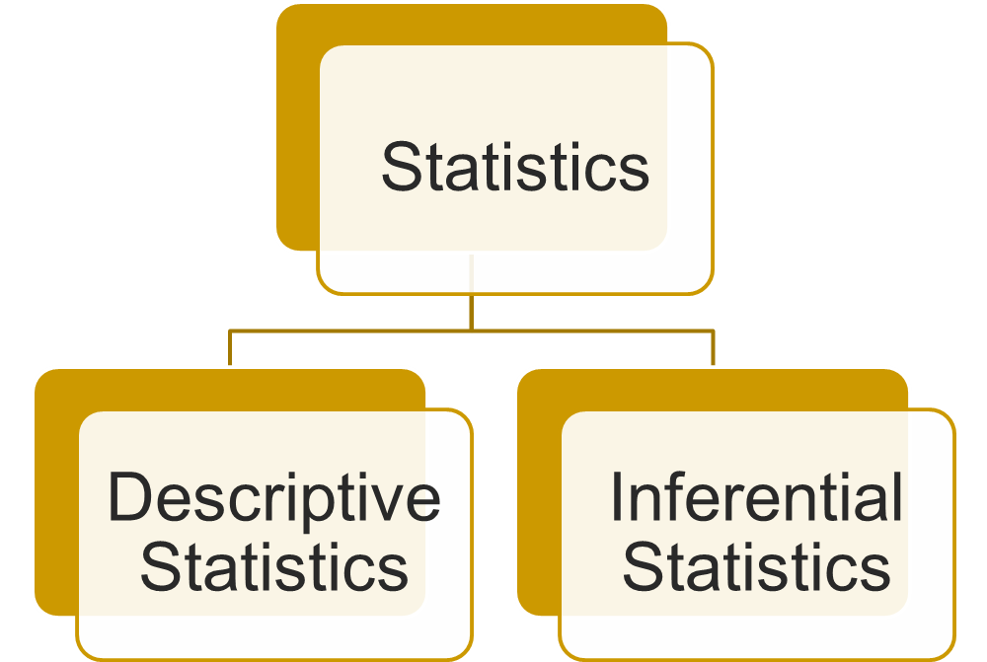
1.2: Types of Statistical Applications

Slide 5

1.2: Types of Statistical Applications
Descriptive statistics utilizes numerical and graphical methods to look for patterns in a data set, to summarize the information revealed in a data set and to present that information in a convenient form.

Slide 6

1.2: Types of Statistical Applications
Inferential statistics utilizes sample data to make estimates, decisions, predictions or other generalizations about a larger set of data.

Slide 7
1.3: Randomness and Variability
Experiments & Processes Are Not Deterministic
Statistical techniques are useful for describing and understanding variability.

Slide 8
1.3: Randomness and Variability
By variability, we mean successive observations of a system or phenomenon do not produce exactly the same result.
Statistics gives us a framework for describing this variability and for learning about potential sources of variability.

Slide 9
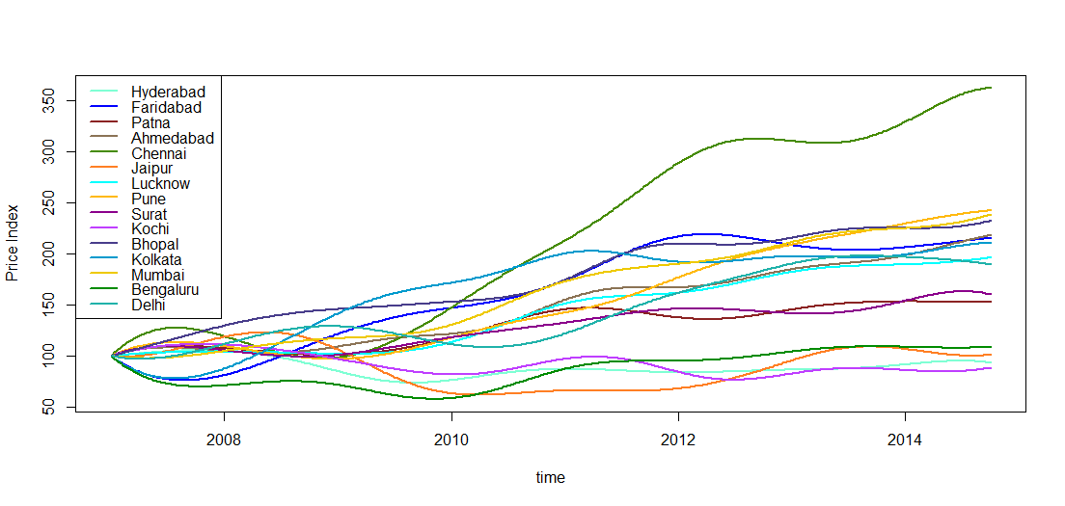
1.3: Randomness and Variability
An Example of Variability
Price Index (Residex) of different cities with 2007 as base.

Slide 10
1.3: Randomness and Variability
Systematic errors, also called fixed errors, are errors associated with using an inaccurate instrument. These errors can be detected and avoided by properly calibrating instruments

Slide 11
1.3: Randomness and Variability
Random errors are generated by a number of unpredictable variations in a given measurement situation.
  Randomness often displays an underlying order that can be quantified, and thus used to advantage.

Slide 12


Air traffic Example
1.3: Randomness and Variability
Based on joint project with BOBASMA, AAI & ISI (Antar and Deepayan, ISI Delhi)

Slide 13
Air traffic example
1.3: Randomness and Variability
An airspace is safe, if under the nominal flying condition, the risk of occurrence of a fatal collision between two aircrafts flying in the airspace is smaller that the International standard, known as the Target Level of Safety (TLS), which is 0.000000005 (8 zeros) number of fatal accidents per flight hour.

Slide 14
Air traffic example
1.3: Randomness and Variability
This means, an airspace is safe, when out of 2 crores flights flying nominally in that airspace in an hour time, on an average we will observe at most 1 fatal accident involving two such flights.
Indian airspace consists of three large water bodies, namely, Bay of Bengal, Arabian Sea and Indian Ocean and the vast Indian Sub-Continent. It is typically known as the BOBASIO region.

Slide 15
Air traffic example
1.3: Randomness and Variability
Till 2011, the safety monitoring of this airspace was done by agencies outside of India.
Then the separation standards were
50 NM lateral separation between all the parallel routes;
10 minutes/80 NM longitudinal separation between the front and behind aircrafts.

Slide 16
Air traffic example
1.3: Randomness and Variability
Since 2011, following this work, a reduced horizontal separation has been introduced in sixteen routes in the region:
50 NM lateral separation between all the parallel routes;
50 NM longitudinal separation between the front and behind aircrafts.

Slide 17

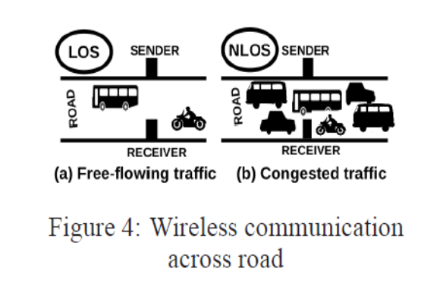
Computer Engineering
1.3: Randomness and Variability
Kyun Queue: A Sensor Network System To Mon itor Road Traffic Queues
ACM India Doctoral Dissertation Award 2014: Rijurekha Sen (IIT Bombay)
Thesis Title: "Different Sensing Modalities for Traffic Monitoring in Developing Regions"

Slide 18
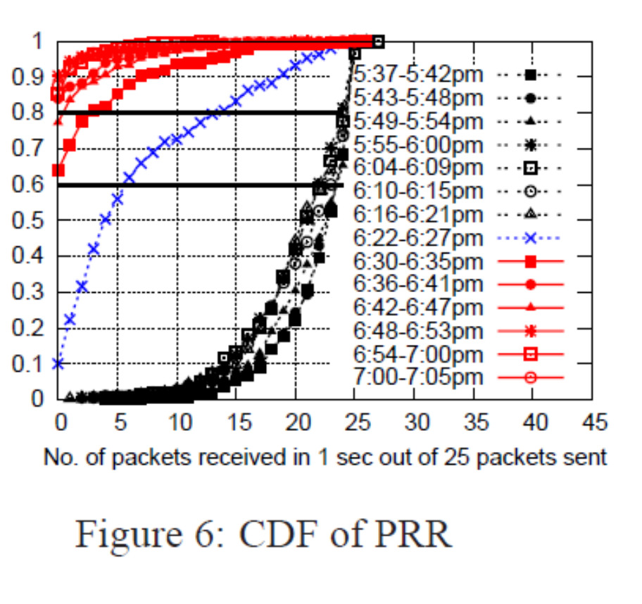
Computer Engineering
1.3: Randomness and Variability

Slide 19

Data Mining
1.3: Randomness and Variability
ASA Sections on Statistical Computing: Student paper competition winner 2001: Rituparna Sen, University of Chicago
Jointly with Mark Hansen, Bell Labs
Predicting Web Users' Next Access Based on Log Data

Slide 20
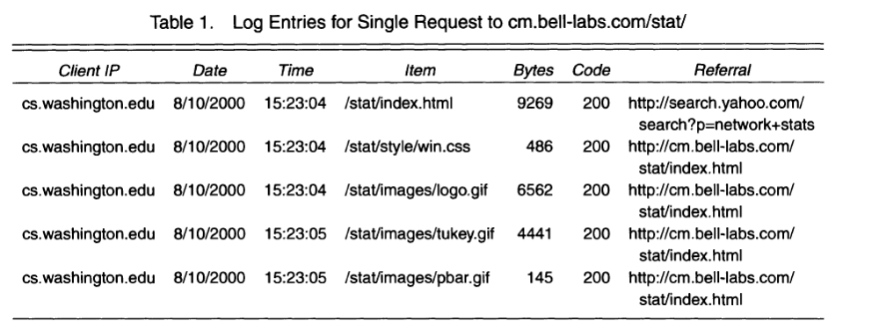
Data Mining
1.3: Randomness and Variability
Given a visitor's previous activities on the site, we propose models that predict their next page request.

Slide 21
Data Mining
1.3: Randomness and Variability
If the prediction is reasonably accurate, we might consider "prefetching" the page before the visitor requests it.
A more conservative use for such predictions would be to simply update the freshness records in a proxy or network cache, eliminating unnecessary Get-If-Modified-Since requests.

Slide 22
1.4: Fundamental Elements of Statistics
An experimental unit is an object about which we collect data.
  Person
  Place
  Thing
  Event

Slide 23
1.4: Fundamental Elements of Statistics
An population is a set of units in which we are interested.
Typically, there are too many experimental units in a population to consider every one.
If we can examine every single one, we conduct a census.

Slide 24
1.4: Fundamental Elements of Statistics
A variable is a characteristic or property of an individual unit.
The values of these characteristics will, not surprisingly, vary.
Examples: Highest daily temperature of Bangalore, white blood cell count of a person, time to crashing of a laptop.

Slide 25
1.4: Fundamental Elements of Statistics
  How many variables have you measured?
Univariate data: One variable is measured on a single experimental unit.
Bivariate data: Two variables are measured on a single experimental unit.
Multivariate data: More than two variables are measured on a single experimental unit.

Slide 26
1.4: Fundamental Elements of Statistics
A sample is a subset of the population.
From all professors in StatMath Bangalore, take a sample of size 3.
One such sample can be:
Mohan, Suresh, Jaydeb.
How to draw a random sample in R?
Siva Athreya
B.V. Rajarama Bhat
Jishnu Gupta Biswas
Mohan Delampady
Shreedhar
Manish Kumar
Aniruddha C. Naolekar
Anita Naolekar
Suresh Nayak
V.R. Padmawar
C.R.E. Raja
B. Rajeev
Jaydeb Sarkar
Ramesh Sreekantan
B. Sury
Yogeshwaran D
Parthanil Roy
Mathew Joseph
Maneesh Thakur
Soumyashant Nayak

Slide 27
1.4: Fundamental Elements of Statistics
Descriptive Statistics
Inferential Statistics
The population or sample of interest
One or more variables to be investigated
Tables, graphs or numerical summary tools
Identification of patterns in the data
Population of interest
One or more variables to be investigated
The sample of population units
The inference about the population based on the sample data
A measure of reliability of the inference

Slide 28
1.4: Fundamental Elements of Statistics
Exercise
Suppose1000 cola consumers are given a blind taste test (i.e., a taste test in which the two brand names are disguised). Each consumer is asked to state a preference for brand A or brand B.
a. Describe the population.
b. Describe the variable of interest.
c. Describe the sample.
d. Describe the inference.

Slide 29
1.4: Fundamental Elements of Statistics
a. Because we are interested in the responses of cola consumers in a taste test, a cola consumer is the experimental unit. Thus, the population of interest is the collection or set of all cola consumers.
b. The characteristic that the experimenter wants to measure is the consumer’s cola preference as revealed under the conditions of a blind taste test, so cola preference is the variable of interest.

Slide 30
1.4: Fundamental Elements of Statistics
c. The sample is the 1,000 cola consumers selected from the population of all cola consumers.
d. The inference of interest is the generalization of the cola preferences of the 1,000 sampled consumers to the population of all cola consumers. In particular, the preferences of the consumers in the sample can be used to estimate the percentage of all cola consumers who prefer each brand.

Slide 31
1.4: Fundamental Elements of Statistics
A measure of reliability is a statement about the degree of uncertainty associated with a statistical inference.
Based on our analysis, we think 56% of soda drinkers prefer Pepsi to Coke, ± 5%.

Slide 32
1.5: Types of Data
Quantitative
Qualitative
Discrete
Continuous

Slide 33
1.5: Types of Data
Qualitative Data are measurements that cannot be recorded on a natural numerical scale, but are recorded in categories.
  Live on/off campus
  Choice of elective course
  Gender
  Favourite IPL team

Slide 34
1.5: Types of Data
Quantitative Data are measurements that are recorded on a naturally occurring numerical scale.
  Age
  Marks in exam
  Salary
  Cost of books this semester

Slide 35
1.5: Types of Data
For each orange tree in a grove, the number of oranges is measured.
  Quantitative discrete
For a particular day, the number of cars entering a college campus is measured.
  Quantitative discrete
Time until a light bulb burns out
  Quantitative continuous

Slide 36
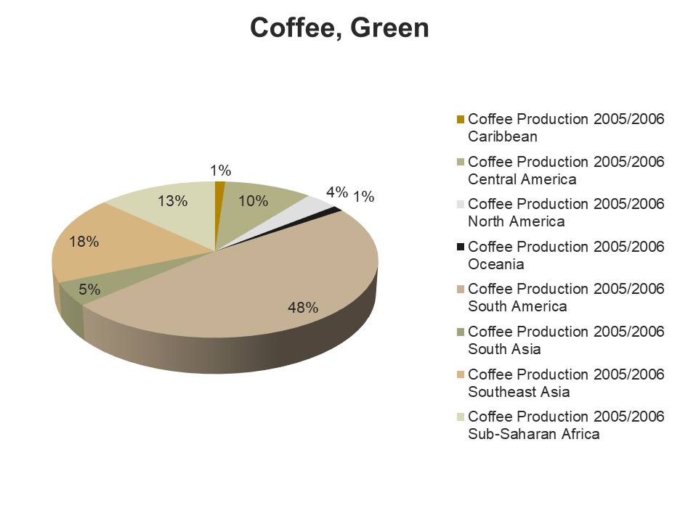
1.6: Collecting Data
Published Source
Designed Experiment
Observational Study
SOURCE: United States Department of Agriculture
Foreign Agricultural Service

Slide 37
1.6: Collecting Data
Published Source
  Journal
  Book
  Newspaper
  Magazine
  (Reliable) Web Site

Slide 38
1.6: Collecting Data
Designed Experiment
  Strict control over the experiment and the units in the experiment

Slide 39
1.6: Collecting Data
Designed Experiment
A designed experiment in the medical field involving human subjects is referred to as a clinical trial. One recent clinical trial was designed to determine the potential of using aspirin in preventing heart attacks. Volunteers were randomly divided into two groups—the treatment group and the control group.

Slide 40
1.6: Collecting Data
Designed Experiment
Each volunteer in the treatment group took one aspirin tablet a day for one year, while the volunteers in the control group took an aspirin-free placebo made to look identical to an aspirin tablet. Because the volunteers did not know which group, treatment or control, they were assigned to, such a clinical trial is called a blind study.

Slide 41
1.6: Collecting Data
Observational Study
  Observe units in natural settings
  No control over behavior of units

Slide 42
1.6: Collecting Data
Example of Observational Study: Survey
How do consumers feel about using the Internet for online shopping? To find out, United Parcel Service (UPS) commissioned a nationwide survey of 5,118 U.S. adults who had conducted at least two online transactions in 2015. One finding from the study is that 74% of online shoppers have used a smartphone to do their shopping.

Slide 43
1.6: Collecting Data
A representative sample exhibits characteristics typical of those possessed by the target population.
A random sample of n units is selected in such a way that every different sample of size n has the same chance of being selected.

Slide 44
1.7:Sources of bias and error
Statistical thinking involves applying rational thought and the science of statistics to critically assess data and inferences.

Slide 45
1.7: Sources of bias and error
Selection bias results when a subset of the experimental units in the population have been excluded so that these units have no chance of being selected in the sample.
Eg, Online surveys will leave out the section of population who do not have access to the internet.

Slide 46
1.7: Sources of bias and error
Response bias: Responses obtained are systematically biased
This is common with sensitive issues: “Do you wear a mask when going out?”

Slide 47
1.7: Sources of bias and error
Nonresponse bias results when the researchers conducting a survey or study are unable to obtain data on all experimental units selected for the sample.
This becomes important if the non-respondents and respondents differ greatly on the issue at hand.
For eg, for a survey of passengers regarding service of an airline, passengers who are dissatisfied are more like to respond than satisfied customers.

Slide 48
1.7: Sources of bias and error
Measurement error refers to inaccuracies in the values of the data recorded. In surveys, this kind of error may be due to ambiguous or leading questions and the interviewer’s effect on the respondent.
This can happen due to leading questions as: “Do you prefer Candidate X, father of two and university professor, or Candidate Y, who got the nomination despite his shady past?”

