Slide 1
Statistics
Chapter 2: Descriptive Statistics

Slide 2
Where we’ve been
Descriptive and Inferential Statistics
Randomness and Variability
Experimental unit, variable
uni/bi/multi-variate data
Population, census, sample
Measure of reliability
Qualitative, Quantitative: Discrete, Continuous
Sources: Published, Observational Study, Designed Experiment
Errors: Selection, Response, Nonresponse, Measurement

Slide 3
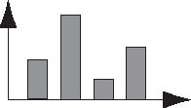
Where We’re Going
Describe Data by Using Graphs
Describe Data by Using Numerical Measures
  Summation Notation
  Central Tendencies
  Variability
  The Standard Deviation
  Relative Standing
  Outliers
  Graphing Bivariate Relationships
  Distorting the Truth

Slide 4
2.1: Describing Qualitative Data
Qualitative Data are nonnumerical
Summarized in two ways:
  Class Frequency
  Class Relative Frequency

Slide 5
2.1: Describing Qualitative Data
Class Frequency
  A class is one of the categories into which qualitative data can be classified
  Class frequency is the number of observations in the data set that fall into a particular class

Slide 6
2.1: Describing Qualitative Data
Example: Adult Aphasia
Subject | Type of Aphasia | Subject | Type of Aphasia
1 | Broca’s | 12 | Broca’s
2 | Anomic | 13 | Anomic
3 | Anomic | 14 | Broca’s
4 | Conduction | 15 | Anomic
5 | Broca’s | 16 | Anomic
6 | Conduction | 17 | Anomic
7 | Conduction | 18 | Conduction
8 | Anomic | 19 | Broca’s
9 | Conduction | 20 | Anomic
10 | Anomic | 21 | Conduction
11 | Conduction | 22 | Anomic

Slide 7
2.1: Describing Qualitative Data
Example: Adult Aphasia
Type of Aphasia | Frequency
Anomic | 10
Broca’s | 5
Conduction | 7
Total | 22

Slide 8
2.1: Describing Qualitative Data
Class Relative Frequency
  Class frequency divided by the total number of observations in the data set
Class Percentage
  Class relative frequency multiplied by 100

Slide 9
2.1: Describing Qualitative Data
Example: Adult Aphasia
Type of Aphasia | Relative Frequency | Class Percentage
Anomic | 10/22 = .455 | 45.5%
Broca’s | 5/22 = .227 | 22.7%
Conduction | 7/22 = .318 | 31.8%
Total | 22/22 = 1.00 | 100%

Slide 10
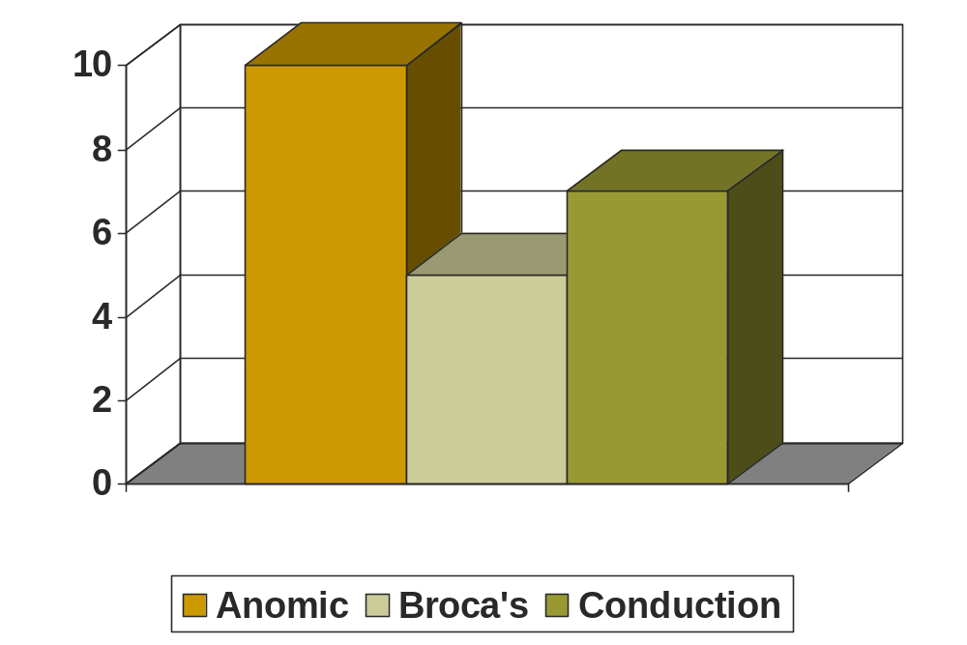
2.1: Describing Qualitative Data
Example: Adult Aphasia
Bar Graph: The categories (classes) of the qualitative variable are represented by bars, where the height of each bar is either the class frequency, class relative frequency or class percentage.

Slide 11
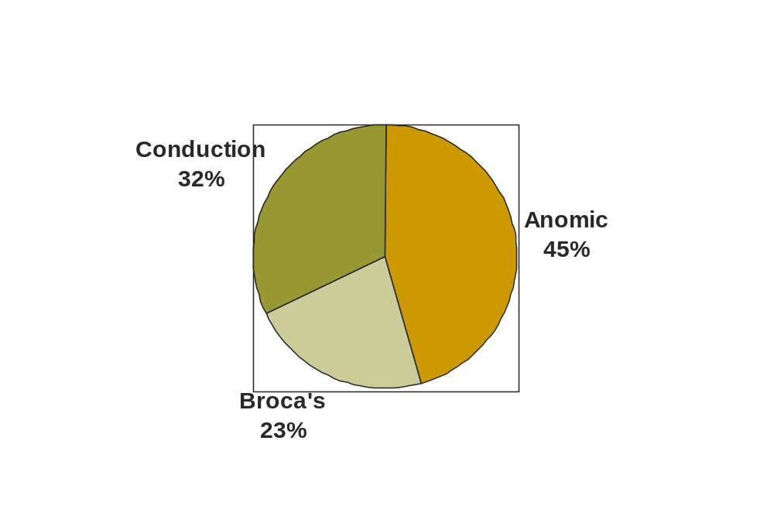
2.1: Describing Qualitative Data
Example: Adult Aphasia
Pie Chart: The categories (classes) of the qualitative variable are represented by slices of a pie. The size of each slice is proportional to the class relative frequency.

Slide 12
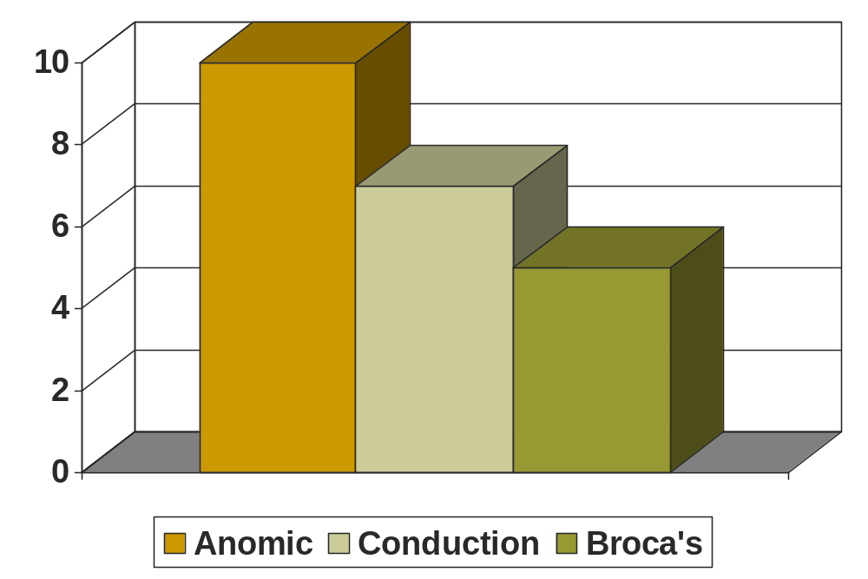
2.1: Describing Qualitative Data
Example: Adult Aphasia
Pareto Diagram: A bar graph with the categories (classes) of the qualitative variable (i.e., the bars) arranged in height in descending order from left to right.

Slide 13
2.2: Graphical Methods for Describing Quantitative Data
Quantitative Data are recorded on a meaningful numerical scale
  Income
  Sales
  Population

Slide 14
2.2: Graphical Methods for Describing Quantitative Data
Dot plots
Stem-and-leaf diagrams
Histograms

Slide 15
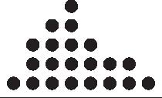
2.2: Graphical Methods for Describing Quantitative Data
Dot plots display a dot for each observation along a horizontal number line
  Duplicate values are piled on top of each other
  The dots reflect the shape of the distribution

Slide 16
Dotplots
2.2: Graphical Methods for Describing Quantitative Data
The simplest graph for quantitative data
Plots the measurements as points on a horizontal axis, stacking the points that duplicate existing points.
Example: The set 4, 5, 5, 7, 6
4 5 6 7

Slide 17
Interpreting Graphs: Location and Spread
2.2: Graphical Methods for Describing Quantitative Data
Where is the data centered on the horizontal axis, and how does it spread out from the center?

Slide 18
2.2: Graphical Methods for Describing Quantitative Data
Mound shaped and symmetric (mirror images)
Skewed right: a few unusually large measurements
Skewed left: a few unusually small measurements
Bimodal: two local peaks

Slide 19
Interpreting Graphs: Outliers
2.2: Graphical Methods for Describing Quantitative Data
No Outliers
Outlier
Are there any strange or unusual measurements that stand out in the data set?

Slide 20

2.2: Graphical Methods for Describing Quantitative Data
Example: A quality control process measures the diameter of a gear being made by a machine (cm). The technician records 15 diameters, but inadvertently makes a typing mistake on the second entry.
1.991 1.891 1.991 1.988 1.993 1.989 1.990 1.988
1.988 1.993 1.991 1.989 1.989 1.993 1.990 1.994

Slide 21
2.2: Graphical Methods for Describing Quantitative Data
Dot Plots
  Dots on a horizontal scale represent the values
  Good for small data sets
Stem-and-Leaf Displays
  Divides values into “stems” and “leafs.”
  Good for small data sets

Slide 22
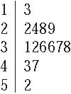
2.2: Graphical Methods for Describing Quantitative Data
A Stem-and-Leaf Display shows the number of observations that share a common value (the stem) and the precise value of each observation (the leaf)
Example: 13, 22, 24, 28, 29, 31, 32, 36,
36, 37, 38, 43, 47, 52.
Stem-and-Leaf Display of these observations
is shown above.

Slide 23
2.2: Graphical Methods for Describing Quantitative Data
Dot Plots and Stem-and-Leaf Displays are cumbersome for larger data sets
Histograms
  Frequencies or relative frequencies are shown for each class interval
  Useful for larger data sets, but the precise values of observations are not shown

Slide 24
2.2: Graphical Methods for Describing Quantitative Data
A relative frequency histogram for a quantitative data set is a bar graph in which the height of the bar shows “how often” (measured as a proportion or relative frequency) measurements fall in a particular class or subinterval.
Create intervals
Stack and draw bars

Slide 25
2.2: Graphical Methods for Describing Quantitative Data
Divide the range of the data into 5-12 subintervals of equal length.
Calculate the approximate width of the subinterval as Range/number of subintervals.
Round the approximate width up to a convenient value.
Use the method of left inclusion, including the left endpoint, but not the right in your tally.

Slide 26
2.2: Graphical Methods for Describing Quantitative Data
Create a statistical table including the subintervals, their frequencies and relative frequencies.
Draw the relative frequency histogram, plotting the subintervals on the horizontal axis and the relative frequencies on the vertical axis.

Slide 27
2.2: Graphical Methods for Describing Quantitative Data
The height of the bar represents
  The proportion of measurements falling in that class or subinterval.
  The probability that a single measurement, drawn at random from the set, will belong to that class or subinterval.

Slide 28
2.2: Graphical Methods for Describing Quantitative Data
The ages of 50 professors at a university.
34 48 70 63 52 52 35 50 37 43 53 43 52 44
42 31 36 48 43 26 58 62 49 34 48 53 39 45
34 59 34 66 40 59 36 41 35 36 62 34 38 28
43 50 30 43 32 44 58 53
We choose to use 6 intervals.
Minimum class width = (70 – 26)/6 = 7.33
Convenient class width = 8
Use 6 classes of length 8, starting at 25.

Slide 29
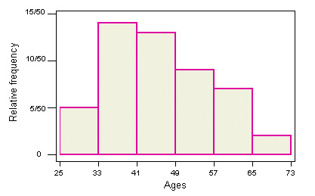
Age | Tally | Frequency | Relative Frequency | Percent
25 to < 33 | 1111 | 5 | 5/50 = .10 | 10%
33 to < 41 | 1111 1111 1111 | 14 | 14/50 = .28 | 28%
41 to < 49 | 1111 1111 111 | 13 | 13/50 = .26 | 26%
49 to < 57 | 1111 1111 | 9 | 9/50 = .18 | 18%
57 to < 65 | 1111 11 | 7 | 7/50 = .14 | 14%
65 to < 73 | 11 | 2 | 2/50 = .04 | 4%

Slide 30
2.2: Graphical Methods for Describing Quantitative Data
Describing the
Distribution
Shape?
Outliers?
What proportion of professors are younger than 41?
What is the probability that a randomly selected professor is 49 or older?
Skewed right
No.
(14 + 5)/50 = 19/50 = 0.38
(9 + 7 + 2)/50 = 18/50 = 0.36

Slide 31
2.2: Graphical Methods for Describing Quantitative Data
How many classes?
  <25 observations: 5-6 classes
  25-50 observations 7-14 classes
  >50 observations 15-20 classes

Slide 32
2.3: Summation Notation
Individual observations in a data set are denoted
x₁, x₂, x₃, x₄, … x_{n} .

Slide 33
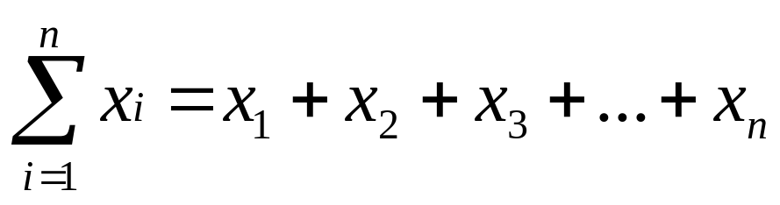
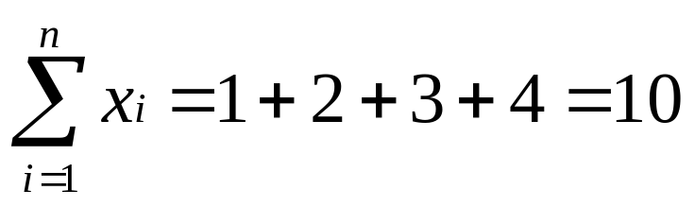
2.3: Summation Notation
We use a summation symbol often:
This tells us to add all the values of variable x from the first (x₁) to the last (x_{n}).
If x₁ = 1, x₂ = 2, x₃ = 3 and x₄ = 4,

Slide 34
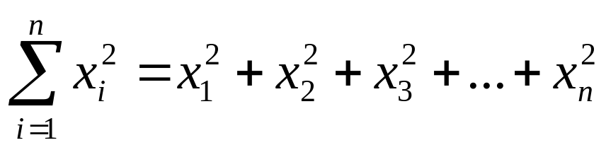
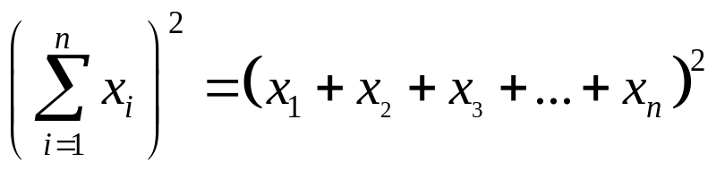
2.3: Summation Notation
Sometimes we will have to square the values before we add them:
Other times we will add them and then square the sum:

Slide 35
2.4: Numerical Measures of
Central Tendency
Summarizing data sets numerically
  Are there certain values that seem more typical for the data?
  How typical are they?

Slide 36
2.4: Numerical Measures of
Central Tendency
Central tendency is the value or values around which the data tend to cluster
Variability shows how strongly the data cluster around that (those) value(s)

Slide 37
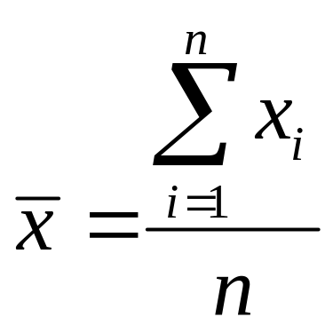
2.4: Numerical Measures of
Central Tendency
The mean of a set of quantitative data is the sum of the observed values divided by the number of values

Slide 38

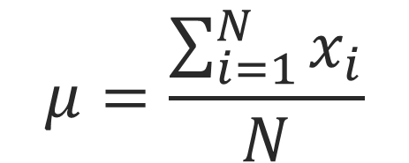
2.4: Numerical Measures of
Central Tendency
The mean of a sample is typically denoted by x-bar, but the population mean is denoted by the Greek symbol μ.

Slide 39
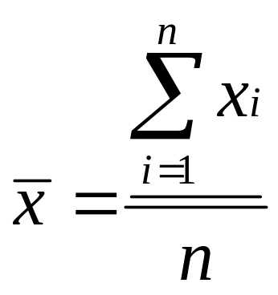
2.4: Numerical Measures of
Central Tendency
If x₁ = 1, x₂ = 2, x₃ = 3 and x₄ = 4,
        = (1 + 2 + 3 + 4)/4 = 10/4 = 2.5

Slide 40
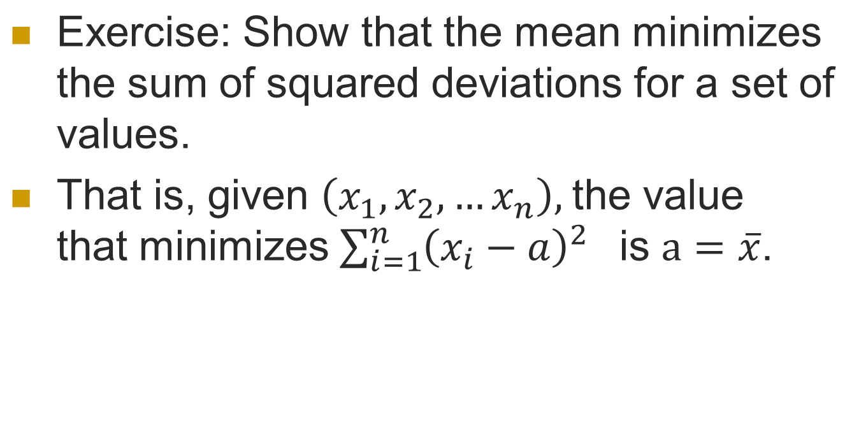
2.4: Numerical Measures of
Central Tendency

Slide 41
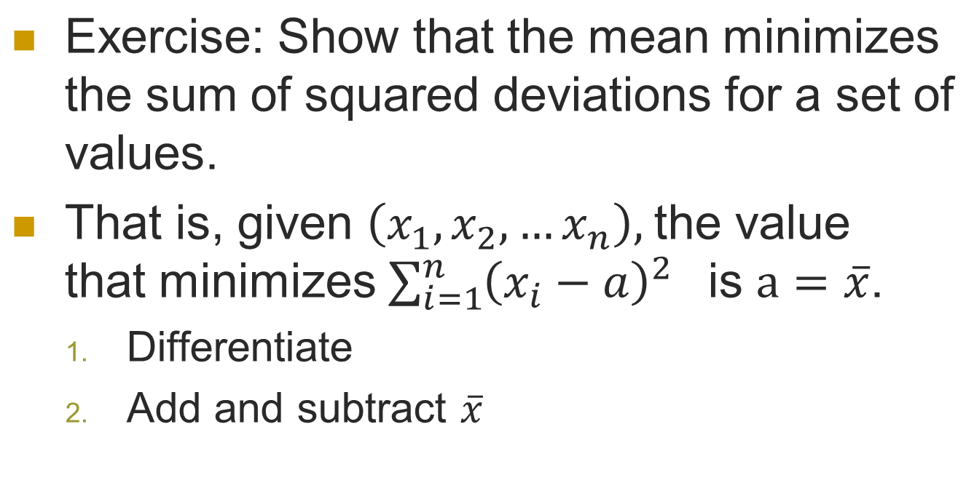
2.4: Numerical Measures of
Central Tendency

Slide 42
2.4: Numerical Measures of
Central Tendency
The median of a set of quantitative data is the value which is located in the middle of the data, arranged from lowest to highest values (or vice versa), with 50% of the observations above and 50% below.

Slide 43
2.4: Numerical Measures of
Central Tendency
50%
50%
Lowest Value
Median
Highest Value

Slide 44
2.4: Numerical Measures of
Central Tendency
Finding the Median, M:
  Arrange the n measurements from smallest to largest
    If n is odd, M is the middle number
    If n is even, M is the average of the middle two numbers

Slide 45
Examples
2.4: Numerical Measures of
Central Tendency
The set: 2, 4, 9, 8, 6, 5, 3 n = 7
Sort: 2, 3, 4, 5, 6, 8, 9
Position: .5(n + 1) = .5(7 + 1) = 4th
Median = 4th largest measurement =8
The set: 2, 4, 9, 8, 6, 5 n = 6
Sort: 2, 4, 5, 6, 8, 9
Position: .5(n + 1) = .5(6 + 1) = 3.5th
Median = (5 + 6)/2 = 5.5 — average of the 3rd and 4th measurements

Slide 46
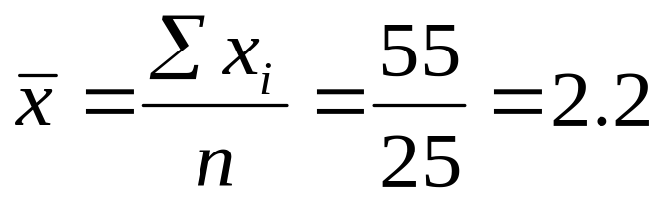

2.4: Numerical Measures of
Central Tendency
The number of litres of milk purchased by 25 households:
0 0 1 1 1 1 1 2 2 2 2 2 2 2 2 2 3 3 3 3 3 4 4 4 5
Mean?
Median?

Slide 47
2.4: Numerical Measures of
Central Tendency
The mean is more easily affected by extremely large or small values than the median.
In the previous example, if the consumption of the household buying 5 litres changes to 10 litres, the median remains same, but mean changes to 60/25=2.4

Slide 48
2.4: Numerical Measures of
Central Tendency
The mode is the most frequently observed value.
The modal class is the class with the highest relative frequency.
For grouped data, the mode is the midpoint of the modal class.
For the data on age of professors, the modal class is 33-40, hence the mode is 36.5.

Slide 49
2.4: Numerical Measures of
Central Tendency
Perfectly symmetric data set:
  Mean = Median = Mode
Extremely high value in the data set:
  Mean > Median > Mode
    (Rightward skewness)
Extremely low value in the data set:
  Mean < Median < Mode
  (Leftward skewness)

Slide 50
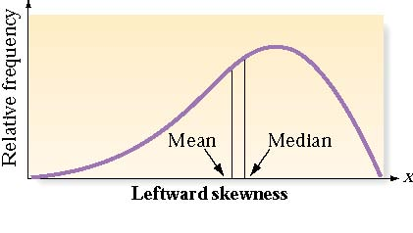
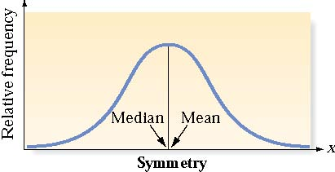
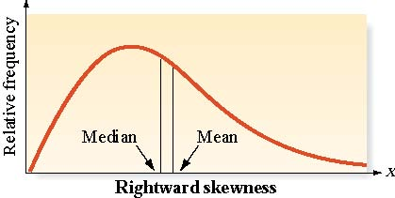
2.4: Numerical Measures of
Central Tendency
A data set is skewed if one tail of the distribution has more extreme observations that the other tail.

Slide 51
2.5: Numerical Measures of
Variability
The mean, median and mode give us an idea of the central tendency, or where the “middle” of the data is.
Variability gives us an idea of how spread out the data are around that middle. We shall discuss
    Range
    variance,
    standard deviation
    interquartile range.

Slide 52
2.5: Numerical Measures of
Variability
The range is equal to the largest measurement minus the smallest measurement.
  Easy to compute, but not very informative
  Considers only two observations (the smallest and largest)

Slide 53
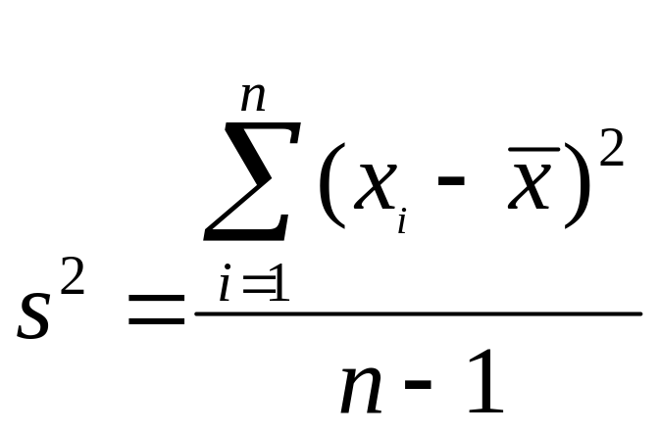
2.5: Numerical Measures of
Variability
The sample variance, s², for a sample of n measurements is equal to the sum of the squared distances from the mean, divided by (n – 1).

Slide 54
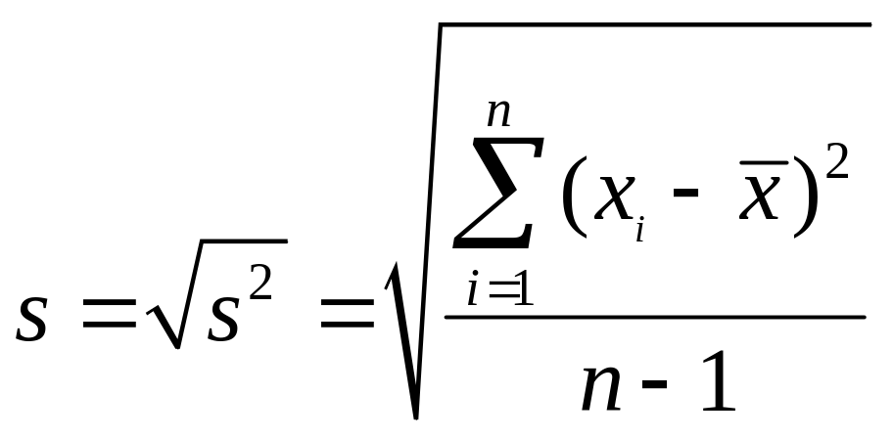
2.5: Numerical Measures of
Variability
The sample standard deviation, s, for a sample of n measurements is equal to the square root of the sample variance.

Slide 55
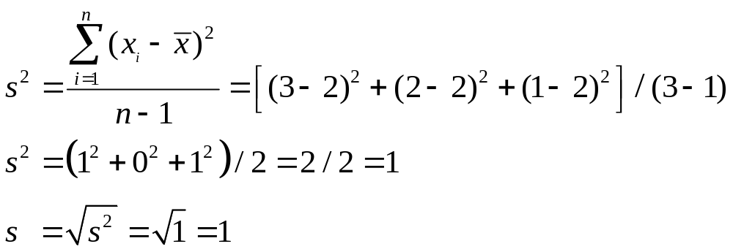
2.5: Numerical Measures of Variability
Say a small data set consists of the measurements 1, 2 and 3.
  μ = 2

Slide 56
2.5: Numerical Measures of Variability
Greek letters are used for populations and Roman letters for samples
  s² = sample variance
  s = sample standard deviation
  σ² = population variance
  σ = population standard deviation

Slide 57
2.5: Numerical Measures of Variability
The value of s is ALWAYS positive.
The larger the value of s² or s, the larger the variability of the data set.
Why divide by n –1?
  The sample standard deviation s is often used to estimate the population standard deviation s. Dividing by n –1 gives us a better estimate of s.

Slide 58
2.5: Numerical Measures of Variability
The lower quartile (Q₁) is the value of x which is larger than 25% and less than 75% of the ordered measurements.
The upper quartile (Q₃) is the value of x which is larger than 75% and less than 25% of the ordered measurements.
The range of the “middle 50%” of the measurements is the interquartile range,
IQR = Q₃ – Q₁

Slide 59
2.5: Numerical Measures of Variability
The lower and upper quartiles (Q₁ and Q₃), can be calculated as follows:
The position of Q₁ is
.25(n + 1)
The position of Q₃ is
.75(n + 1)
once the measurements have been ordered. If the positions are not integers, find the quartiles by interpolation.

Slide 60
2.5: Numerical Measures of Variability
The prices (in Rs 100) of 18 brands of walking shoes:
60 65 65 65 68 68 70 70
70 70 70 70 74 75 75 90 95
Position of Q₁ = .25(18 + 1) = 4.75
Position of Q₃ = .75(18 + 1) = 14.25
Q₁is 3/4 of the way between the 4th and 5th ordered measurements, or
  Q₁ = 65 + .75(65 - 65) = 65.

Slide 61
2.5: Numerical Measures of Variability
The prices (in Rs 100) of 18 brands of walking shoes:
60 65 65 65 68 68 70 70
70 70 70 70 74 75 75 90 95
Position of Q₁ = .25(18 + 1) =4.75
Position of Q₃ = .75(18 + 1) = 14.25
Q₃ is 1/4 of the way between the 14th and 15th ordered measurements, or
Q₃ = 74 + .25(75 - 74) = 74.25
  and IQR = Q₃ – Q₁ = 74.25 - 65 = 9.25

Slide 62
2.6: Interpreting the Standard Deviation
Chebyshev’s Rule
The Empirical Rule
  Both tell us something about where
  the data will be relative to the mean.

Slide 63
2.6: Interpreting the Standard Deviation
Chebyshev’s Rule
Valid for any data set
For any number k >1, at least (1-1/k²)% of the observations will lie within k standard deviations of the mean
k | k² | 1/ k² | (1- 1/ k^{2)%}
2 | 4 | .25 | 75%
3 | 9 | .11 | 89%
4 | 16 | .0625 | 93.75%

Slide 64

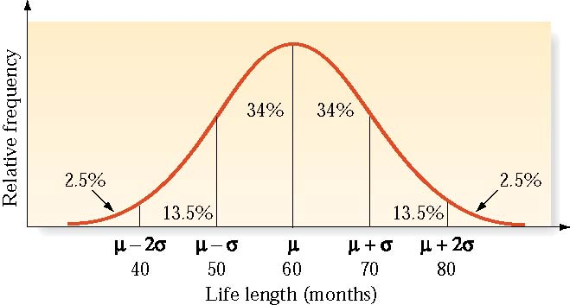

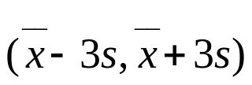
2.6: Interpreting the Standard Deviation
The Empirical Rule
  Useful for mound-shaped, symmetrical distributions
  If not perfectly mounded and symmetrical, the values are approximations
For a perfectly symmetrical and mound-shaped distribution,
  ~68% will be within the range
  ~95% will be within the range
  ~99.7% will be within the range

Slide 65
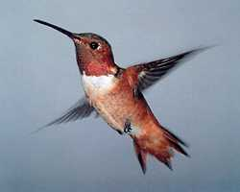
2.6: Interpreting the Standard Deviation
Hummingbirds beat their wings in flight an average of 55 times per second.
Assume the standard deviation is 10, and that the distribution is symmetrical and mounded.
  Approximately what percentage of hummingbirds beat their wings between 45 and 65 times per second?
  Between 55 and 65?
  Less than 45?

Slide 66
2.6: Interpreting the Standard Deviation
Hummingbirds beat their wings in flight an average of 55 times per second.
Assume the standard deviation is 10, and that the distribution is symmetrical and mounded.
  Approximately what percentage of hummingbirds beat their wings between 45 and 65 times per second?
  Between 55 and 65?
  Less than 45?
Since 45 and 65 are exactly one standard deviation below and above the mean, the empirical rule says that about 68% of the hummingbirds will be in this range.

Slide 67
2.6: Interpreting the Standard Deviation
Hummingbirds beat their wings in flight an average of 55 times per second.
Assume the standard deviation is 10, and that the distribution is symmetrical and mounded.
  Approximately what percentage of hummingbirds beat their wings between 45 and 65 times per second?
  Between 55 and 65?
  Less than 45?
This range of numbers is from the mean to one standard deviation above it, or one-half of the range in the previous question. So, about one-half of 68%, or 34%, of the hummingbirds will be in this range.

Slide 68
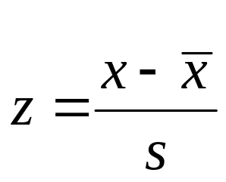
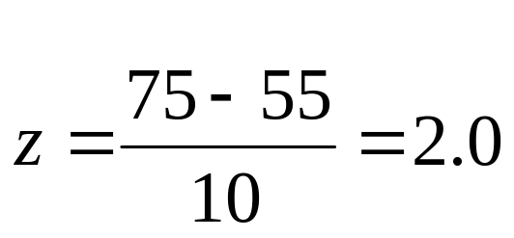
2.6: Interpreting the Standard Deviation
Hummingbirds beat their wings in flight an average of 55 times per second.
Assume the standard deviation is 10, and that the distribution is symmetrical and mounded.
An individual hummingbird is measured with 75 beats per second. What is this bird’s z-score?

Slide 69
2.6: Interpreting the Standard Deviation
Hummingbirds beat their wings in flight an average of 55 times per second.
Assume the standard deviation is 10, and that the distribution is symmetrical and mounded.
  Approximately what percentage of hummingbirds beat their wings between 45 and 65 times per second?
  Between 55 and 65?
  Less than 45?
Half of the entire data set lies above the mean, and ~34% lie between 45 and 55 (between one standard deviation below the mean and the mean), so ~84% (~34% + 50%) are above 45, which means ~16% are below 45.

Slide 70
2.7: Numerical Measures of Relative Standing
Percentiles: for any (large) set of n measurements (arranged in ascending or descending order), the p^{th} percentile is a number such that p% of the measurements fall below that number and (100 – p)% fall above it.
p %
(100-p) %
x
p-th percentile

Slide 71
2.7: Numerical Measures of Relative Standing
Finding percentiles is similar to finding the median – the median is the 50th percentile.
  If you are in the 50th percentile for the GRE, half of the test-takers scored better and half scored worse than you.
  If you are in the 75th percentile, you scored better than three-quarters of the test-takers.
  If you are in the 90th percentile, only 10% of all the test-takers scored better than you.

Slide 72
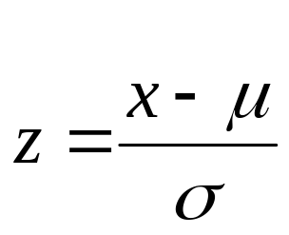
2.7: Numerical Measures of Relative Standing
The z-score tells us how many standard deviations above or below the mean a particular measurement is.
Sample z-score
Population z-score

Slide 73
2.7: Numerical Measures of Relative Standing
Z scores are related to the empirical rule:
For a perfectly symmetrical and mound-shaped distribution,
  ~68 % will have z-scores between -1 and 1
  ~95 % will have z-scores between -2 and 2
  ~99.7% will have z-scores between -3 and 3

Slide 74
2.8: Methods for Determining Outliers
An outlier is a measurement that is unusually large or small relative to the other values.
Three possible causes:
  Observation, recording or data entry error
  Item is from a different population
  A rare, chance event

Slide 75
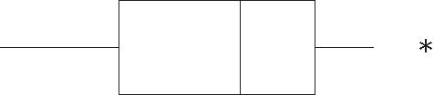
2.8: Methods for Determining Outliers
The box plot is a graph representing information about certain percentiles for a data set and can be used to identify outliers

Slide 76
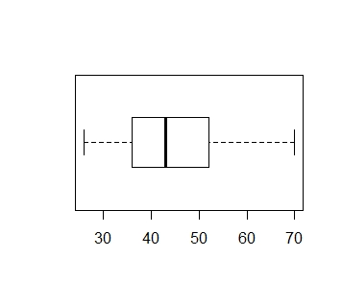
2.8: Methods for Determining Outliers
Boxplot: Data on age of professors
No value is outside the whiskers (1.5 times the IQR)
Lower Quartile
(Q_{L})
Median
Upper Quartile
(Q_{U})
Minimum Value
Maximum Value

Slide 77
2.8: Methods for Determining Outliers
Outliers and z-scores
  The chance that a z-score is between -3 and +3 is over 99%.
  Any measurement with |z| > 3 is considered an outlier.

Slide 78
2.8: Methods for Determining Outliers
#Observations | n = 50
Mean | 44.90
Sample Variance | 115.07
Sample Standard Deviation | 10.73
Minimum | 26
Maximum | 70
Here are the descriptive statistics
The z score corresponding to age 70 is (70-44.9)/10.73=2.34
So it is not an outlier.

Slide 79
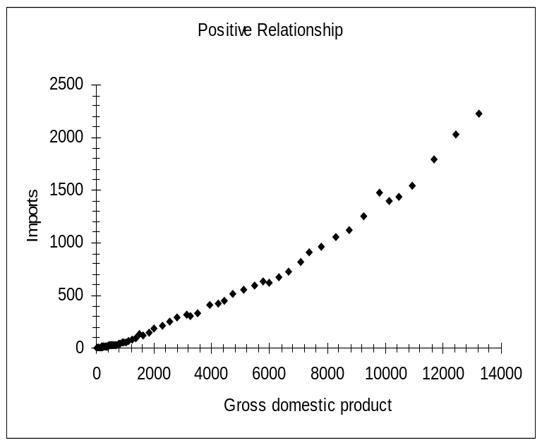
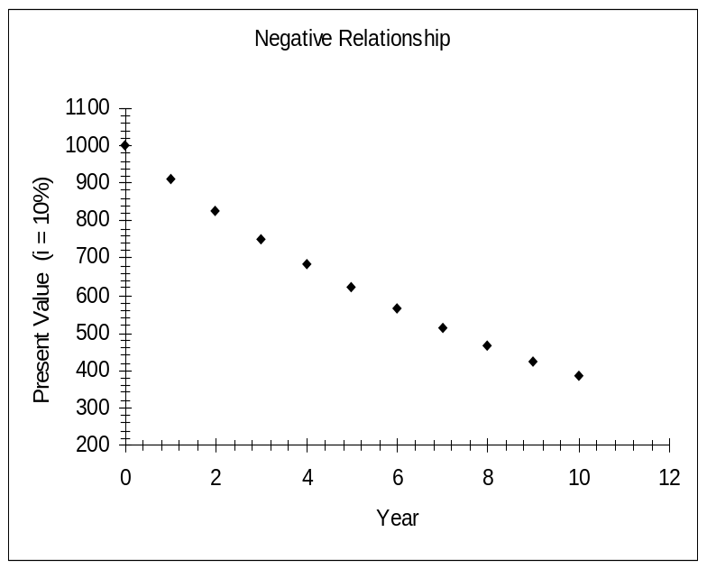
2.9: Graphing Bivariate Relationships
Scattergram (or scatterplot) shows the relationship between two quantitative variables

Slide 80
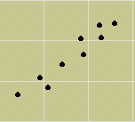
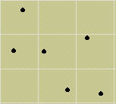
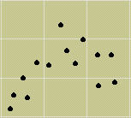
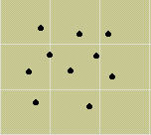
2.9: Graphing Bivariate Relationships
If there is no linear relationship between the variables, the scatterplot may look like a cloud, a horizontal line or a more complex curve.
Positive linear - strong
Negative linear -weak
Curvilinear
No relationship

Slide 81
2.10: Distorting the Truth with Deceptive Statistics
Distortions
  Stretching the axis (and the truth)
  Is average average?
    Mean, median or mode?
  Is average relevant?
    What about the spread?

