Slide 1
Statistics
Chapter 5: Distributions with R

Slide 2
5.1: Descriptive Methods for Assessing Normality
If the data are normal
  A histogram or stem-and-leaf display will look like the normal curve
  The mean ± s, 2s and 3s will approximate the empirical rule percentages
  The ratio of the interquartile range to the standard deviation will be about 1.3
  The skewness is close to 0 and kurtosis is close to 3.
  A normal probability plot , a scatterplot with the ranked data on one axis and the expected z-scores from a standard normal distribution on the other axis, will produce close to a straight line

Slide 3
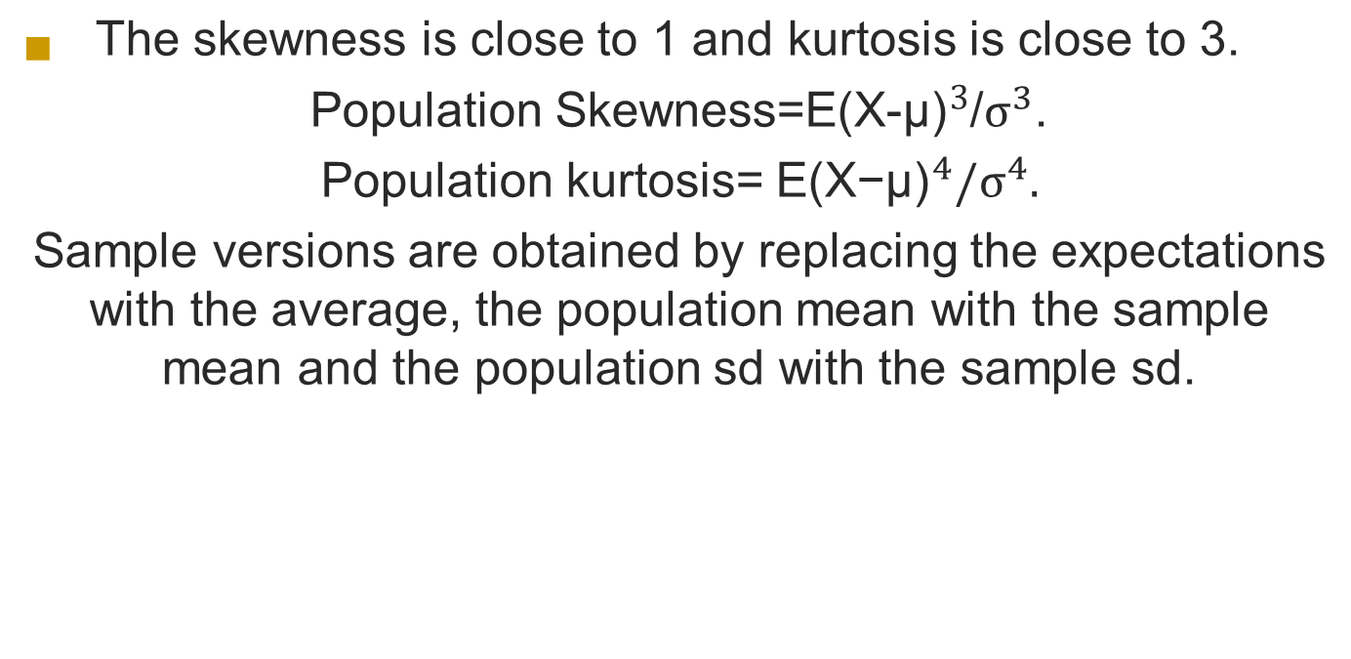
5.1: Descriptive Methods for Assessing Normality

Slide 4
5.1: Descriptive Methods for Assessing Normality
A normal probability plot is a scatterplot with the ranked data on one axis and the expected z-scores from a standard normal distribution on the other axis

Slide 5
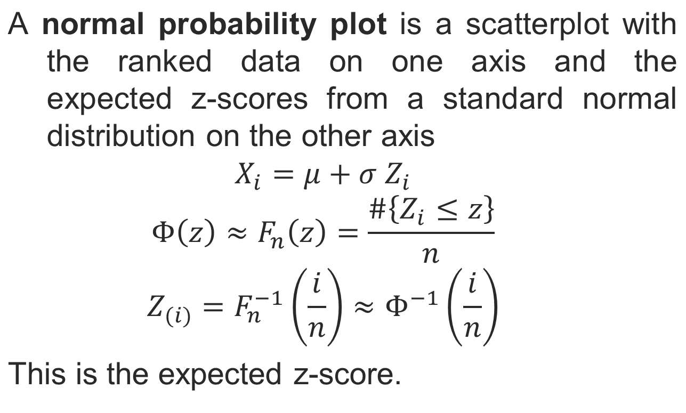
5.1: Descriptive Methods for Assessing Normality

Slide 6
5.1: Descriptive Methods for Assessing Normality
Beginning in 2017, public companies will be required to disclose the ratio of CEO pay to median worker pay. The Glassdoor Economic Research Blog has published the data for 2014. The data includes CEO identities, companies, CEO compensation, median worker compensation (compiled by Glassdoor), and the ratio of CEO to worker compensation.
You can download the data from here: https://dasl.datadescription.com/download/data/3105

Slide 7
5.1: Descriptive Methods for Assessing Normality
attach(ceo.compensation.2014)
x<-log(Ratio)
library(timeDate)
skewness(x) # 0.08324829
kurtosis(x,method="moment") #3.873771
IQR(x)/sd(x) #1.201651

Slide 8
5.1: Descriptive Methods for Assessing Normality
hist(x)
length(which(x<mean(x)+sd(x)&x>mean(x)-sd(x)))/length(x)
length(which(x<mean(x)+2*sd(x)&x>mean(x)-2*sd(x)))/length(x)
length(which(x<mean(x)+3*sd(x)&x>mean(x)-3*sd(x)))/length(x)
pnorm(1)-pnorm(-1)
pnorm(2)-pnorm(-2)
pnorm(3)-pnorm(-3)
qqnorm(x)
abline(mean(x),sd(x))
0.7211982 | 0.6826895
0.9562212 | 0.9544997
0.9907834 | 0.9973002

Slide 9
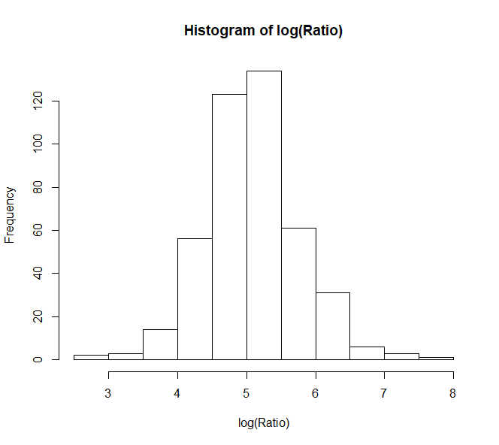
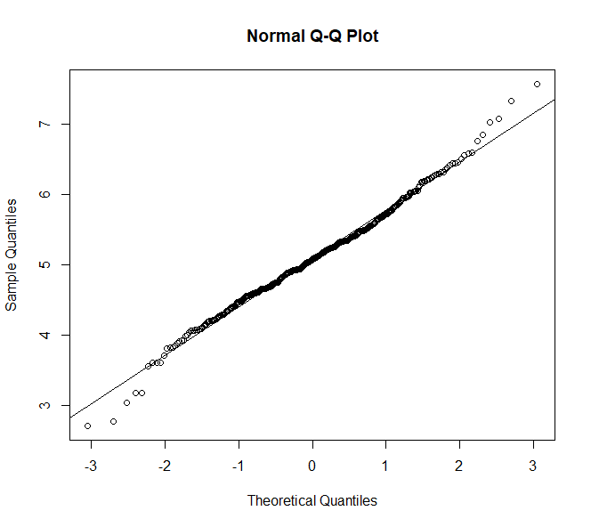
5.1: Descriptive Methods for Assessing Normality

Slide 10
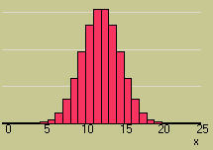
5.2: Approximating a Binomial Distribution with the Normal Distribution
We can calculate binomial probabilities using
  The binomial formula
  The cumulative binomial table
When n is large, and p is not too close to zero or one, areas under the normal curve with mean np and variance npq can be used to approximate binomial probabilities.

Slide 11
5.2: Approximating a Binomial Distribution with the Normal Distribution
Discrete calculations may become very cumbersome
The normal distribution may be used to approximate discrete distributions
  The larger n is, and the closer p is to .5, the better the approximation
Since we need a range, not a value, the correction for continuity must be used
  A number r becomes r+.5

Slide 12

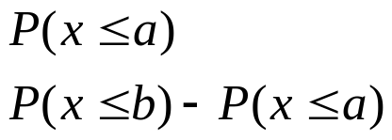
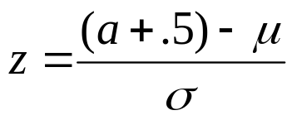
5.2: Approximating a Binomial Distribution with the Normal Distribution
Calculate the mean plus/minus 3 standard deviations
If this interval is in the range 0 to n,
the approximation will be reasonably close
Express the binomial probability as a range of values
Find the z-values for each binomial value
Use the standard normal distribution to find
the probability for the range of values you calculated

Slide 13
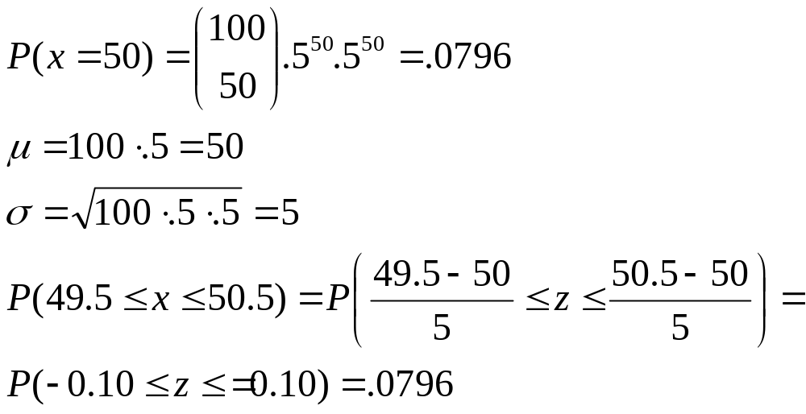
5.2: Approximating a Binomial Distribution with the Normal Distribution
Flip a coin 100 times and compare the binomial and normal results
Binomial:Normal:

Slide 14
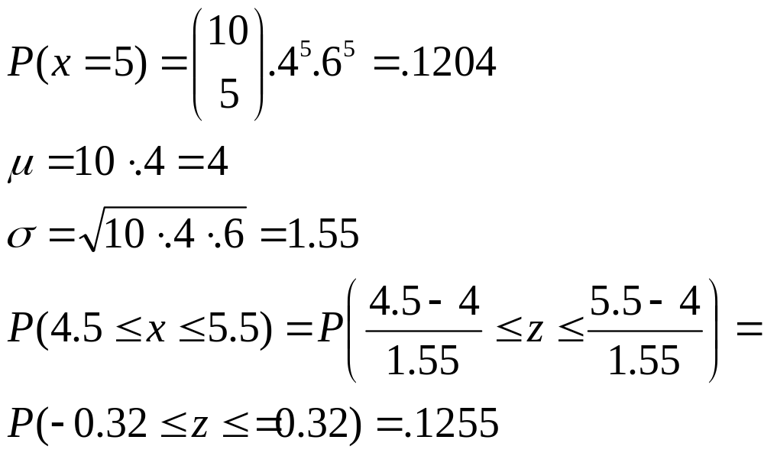
5.2: Approximating a Binomial Distribution with the Normal Distribution
Flip a weighted coin [P(H)=.4] 10 times and compare the results
Binomial:Normal:

Slide 15
5.2: Approximating a Binomial Distribution with the Normal Distribution
Flip a weighted coin [P(H)=.4] 10 times and compare the results
Binomial:Normal:
The more p differs from .5,
and the smaller n is,
the less precise the
approximation will be

Slide 16
5.2: Approximating a Binomial Distribution with the Normal Distribution
p<-0.1
b<-rep(0,11)
n<-b
for (i in 1:11) b[i]<-dbinom(i-1,10,p)
m<-10*p
s<-sqrt(10*p*(1-p))
for (i in 1:11)n[i]<-pnorm((i-.5-m)/s)-pnorm((i-1.5-m)/s)
max(abs(b-n))
barplot(rbind(n[1:5],b[1:5]),beside=T,names.arg=c(0:4))

Slide 17
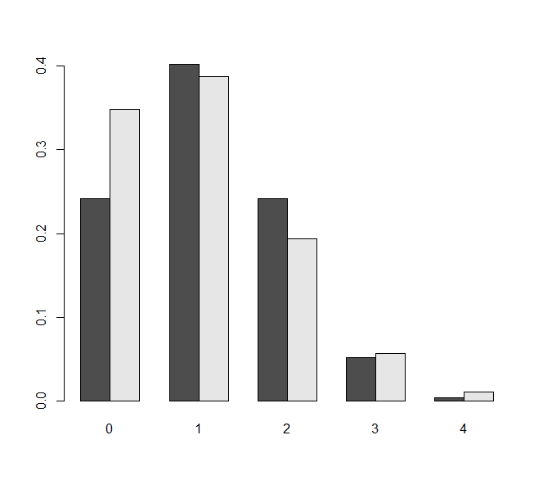
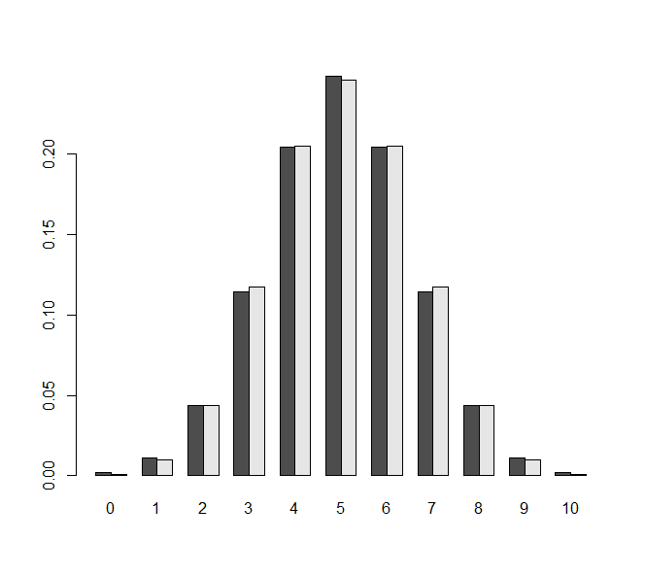
5.2: Approximating a Binomial Distribution with the Normal Distribution
p=0.5, n=10
MaxDiff=0.0027
p=0.1, n=10
MaxDiff=0.1065

Slide 18
5.3: Sampling Distributions
In practice, sample statistics are used to estimate population parameters.
  A parameter is a numerical descriptive measure of a population. Its value is almost always unknown.
  A sample statistic is a numerical descriptive measure of a sample. It can be calculated from the observations.

Slide 19
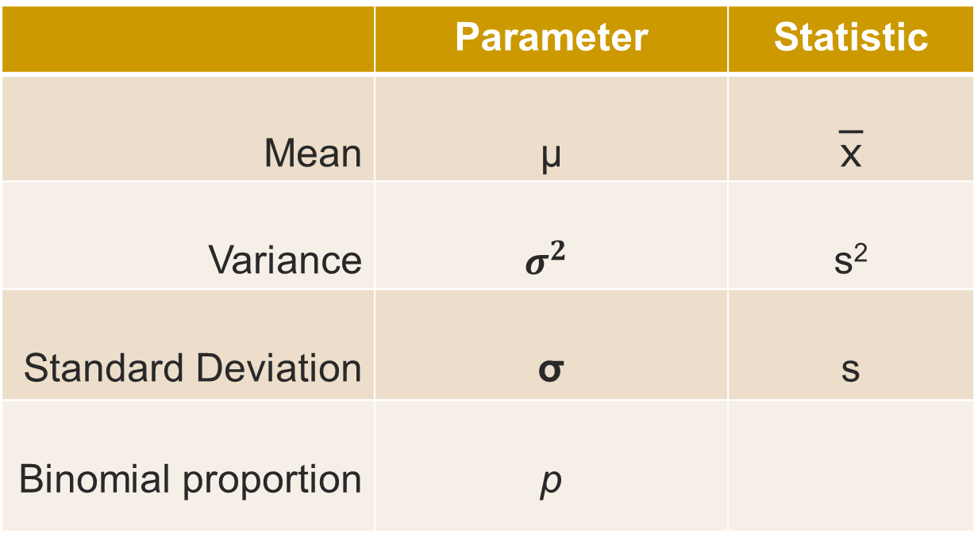

5.3: Sampling Distributions

Slide 20
5.3: Sampling Distributions
Numerical descriptive measures calculated from the sample are called statistics.
Since we could draw many different samples from a population, the sample statistic used to estimate the population parameter is itself a random variable.

Slide 21
5.3: Sampling Distributions
The sampling distribution of a sample statistic calculated from a sample of n measurements is the probability distribution of the statistic.
In repeated sampling, they tell us what values of the statistics can occur and how often each value occurs.

Slide 22

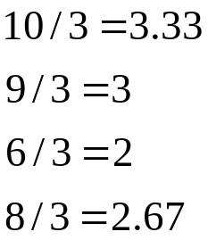
5.3: Sampling Distributions
Population: 3, 5, 2, 1
Draw samples of size n = 3 without replacement
Possible samples
3, 5, 2
3, 5, 1
3, 2, 1
5, 2, 1
Each value of x-bar is equally likely, with probability 1/4
p(x)
1/4
x
2 3

Slide 23

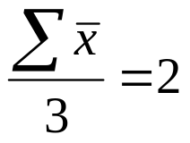
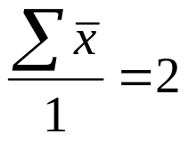
5.3: Sampling Distributions
Imagine a very small population consisting of the elements
(N=population size=3) 1, 2 and 3. Below are the possible
samples (without replacement) of sample size n that could
be drawn, along with the means of the samples.
n = 1 | 
1 | 1
2 | 2
3 | 3
n = 2 | 
1, 2 | 1.5
1, 3 | 2
2, 3 | 2.5
n = 3 ( = N) | 
1, 2, 3 | 2

Slide 24
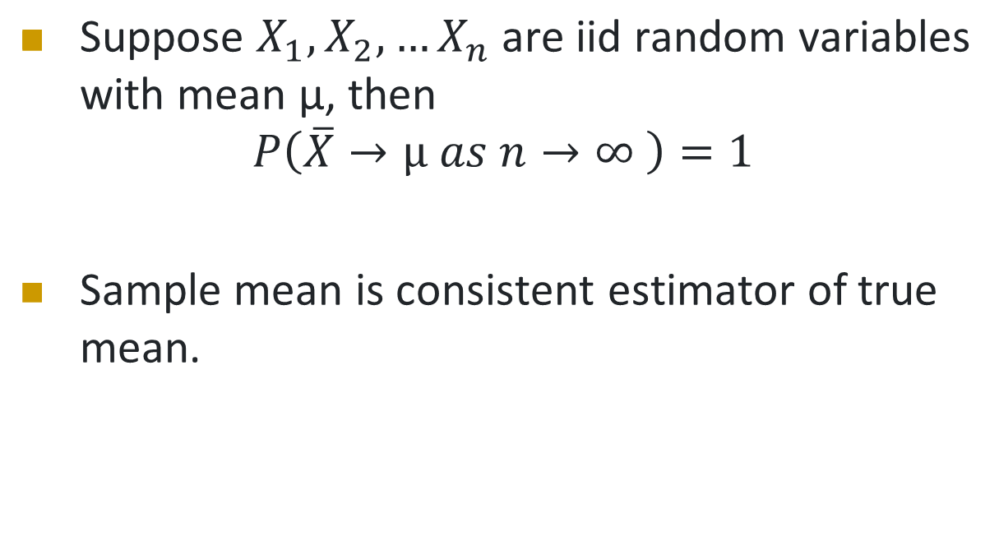
5.4: Strong Law of Large Numbers

Slide 25
5.4: Strong Law of Large Numbers
runningmean = function (x,N){
y = sample(x,N, replace=TRUE)
c = cumsum(y)
n = 1:N
c/n
}
u = runningmean(c(0,1), 1000)
x=1:1000; plot(u~x, type="l");
replicate(10, lines(runningmean(c(0,1), 1000)~x, type="l", col=rgb(runif(3),runif(3),runif(3))))

Slide 26
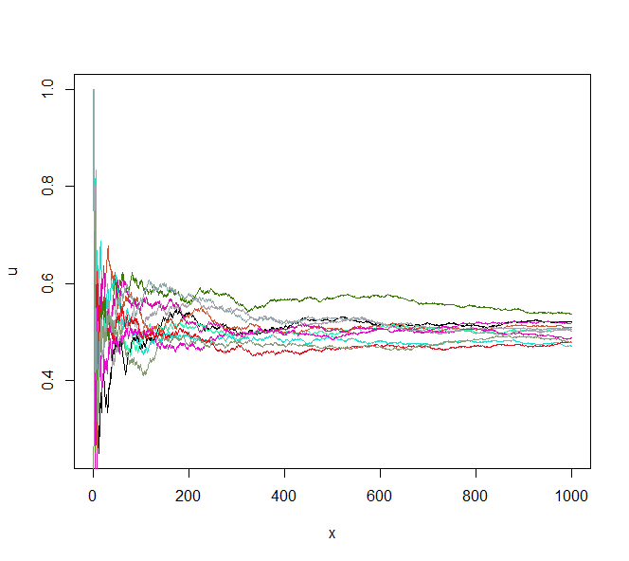
5.4: Strong Law of Large Numbers
Running average of x Bernoulli random variables

Slide 27
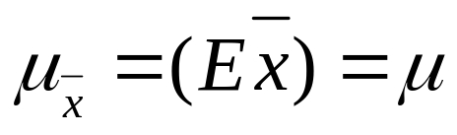
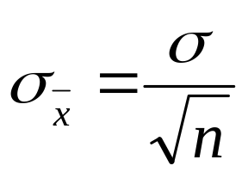
5.5: The Central Limit Theorem
Properties of the Sampling Distribution of 
The mean of the sampling distribution equals the mean of the population
The standard deviation of the sampling distribution [the standard error (of the mean)] equals the population standard deviation divided by the square root of n

Slide 28
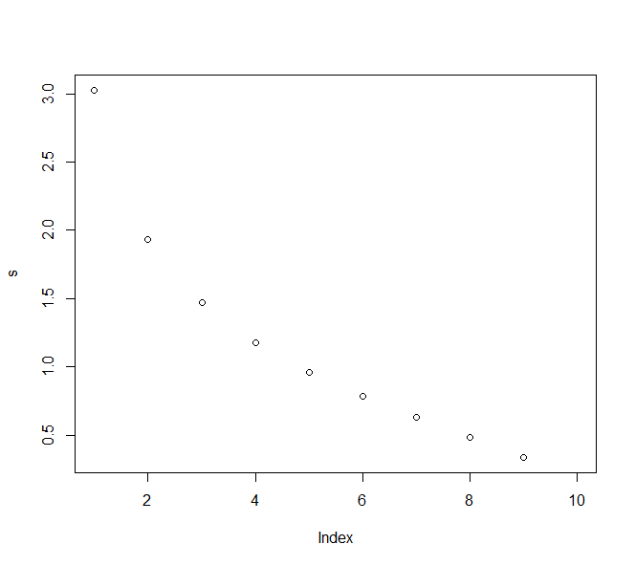
5.5: The Central Limit Theorem
S<-rep(0,9)
for(i in 1:9){
m <- combn(10, i,mean)
s[i]<-sd(m)}
plot(s)
This is sampling without replacement. The result on the previous page is for sampling with replacement.

Slide 29
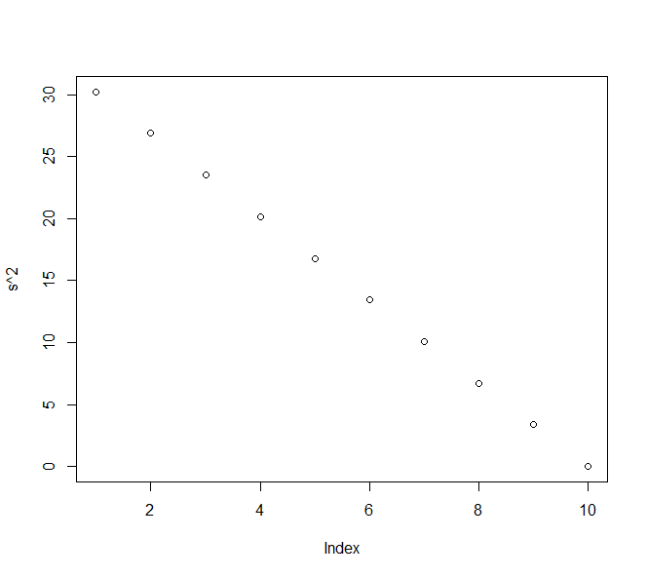
5.5: The Central Limit Theorem
S<-rep(0,9)
for(i in 1:9){
m <- combn(10, i,mean)
s[i]<-sqrt(10-i)*sd(m)/3}
plot(s^2)
Finite population correction (N-n)/(N-1) for variance.

Slide 30

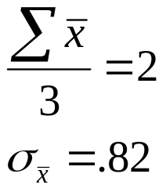
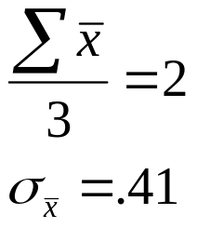
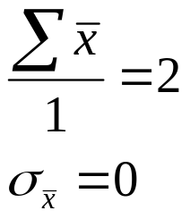
5.5: The Central Limit Theorem
Here’s our small population again, this time with the standard deviations of the sample means. Notice the mean of the sample means in each case equals the population mean and the standard error falls as n increases.
n = 1 | 
1 | 1
2 | 2
3 | 3
n = 2 | 
1, 2 | 1.5
1, 3 | 2
2, 3 | 2.5
n = 3 ( = N) | 
1, 2, 3 | 2

Slide 31
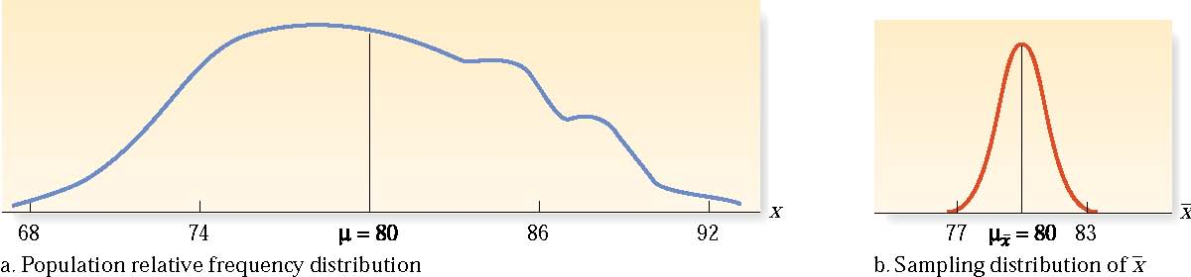
5.5: The Central Limit Theorem
If a random sample of n observations is drawn from a normally distributed population, the sampling distribution of  will be normally distributed

Slide 32
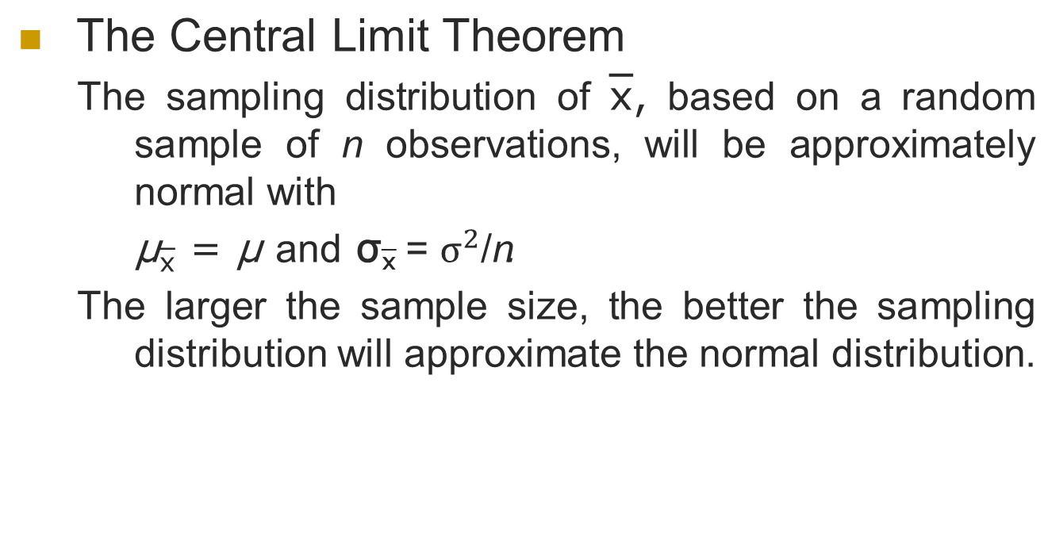
5.5: The Central Limit Theorem

Slide 33

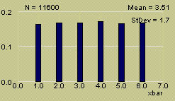
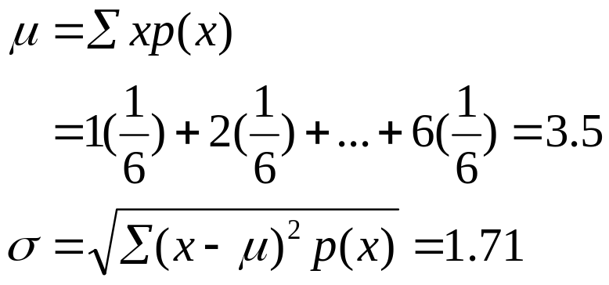
5.5: The Central Limit Theorem
Roll a fair die n = 1 time. The distribution of x the number on the upper face is flat or uniform.

Slide 34
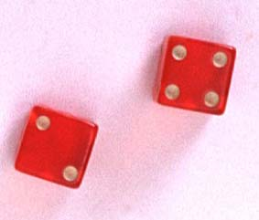
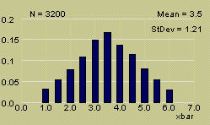
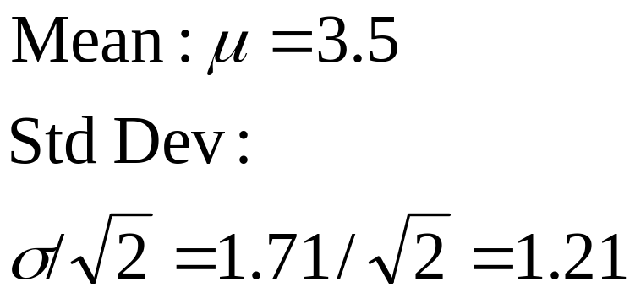
5.5: The Central Limit Theorem
Roll a fair die n = 2 time. The distribution of x the average number on the two upper faces is mound-shaped.

Slide 35

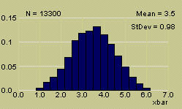
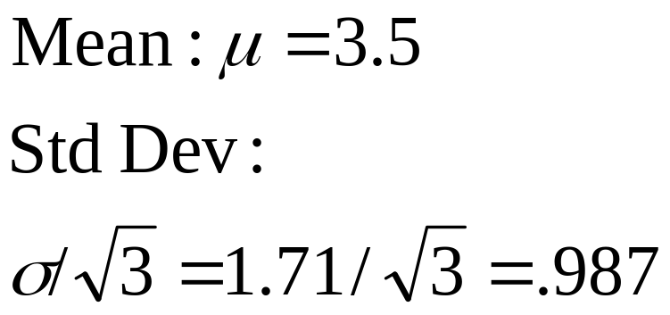
5.5: The Central Limit Theorem
Roll a fair die n = 3 time. The distribution of x the average number on the two upper faces is approximately normal.

Slide 36
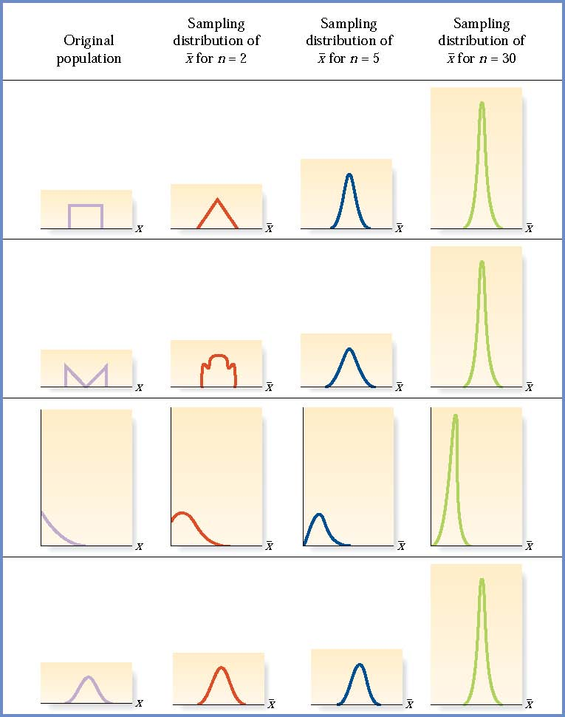
5.5: The Central Limit Theorem

Slide 37
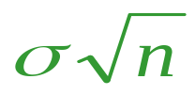
5.5: The Central Limit Theorem
The Central Limit Theorem also implies that the sum of n measurements is approximately normal with mean nμ and standard deviation .
Many statistics that are used for statistical inference are sums or averages of sample measurements.
This will allow us to describe their behavior and evaluate the reliability of our inferences using the normal distribution, even if we do not know the original distribution.

Slide 38


How large is large?
If the sample is normal, then the sampling distribution of will also be normal, no matter what the sample size.
When the sample population is approximately symmetric, the distribution becomes approximately normal for relatively small values of n.
When the sample population is skewed, the sample size must be at least 30 before the sampling distribution of becomes approximately normal.

Slide 39
5.5: The Central Limit Theorem
Suppose existing houses for sale average 2200 square feet in size, with a standard deviation of 250 ft².
What is the probability that a randomly selected house will have at least 2300 ft² ?

Slide 40
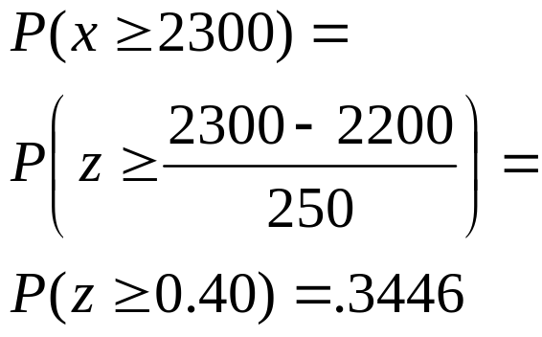
5.5: The Central Limit Theorem
Suppose existing houses for sale average 2200 square feet in size, with a standard deviation of 250 ft².
What is the probability that a randomly selected house will have at least 2300 ft² ?

Slide 41
5.5: The Central Limit Theorem
Suppose existing houses for sale average 2200 square feet in size, with a standard deviation of 250 ft².
What is the probability that a randomly selected sample of 16 houses will average at least 2300 ft² ?

Slide 42
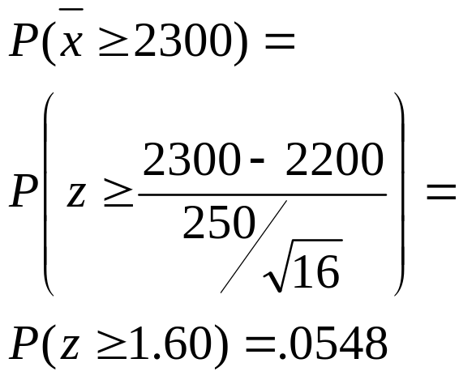
5.5: The Central Limit Theorem
Suppose existing houses for sale average 2200 square feet in size, with a standard deviation of 250 ft².
What is the probability that a randomly selected sample of 16 houses will average at least 2300 ft² ?

Slide 43
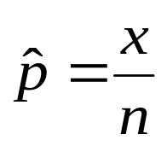

5.5: The Central Limit Theorem
The Central Limit Theorem can be used to conclude that the binomial random variable x is approximately normal when n is large, with mean np and standard deviation npq .
The sample proportion, is simply a rescaling of the binomial random variable x, dividing it by n.
From the Central Limit Theorem, the sampling distribution of will also be approximately normal, with a rescaled mean and standard deviation.

Slide 44
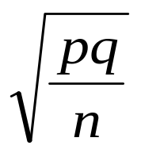
5.5: The Central Limit Theorem
A random sample of size n is selected from a binomial population with parameter p.
The sampling distribution of the sample proportion,
will have mean p and standard deviation
If n is large, and p is not too close to zero or one, the sampling distribution of will be approximately normal.

Slide 45
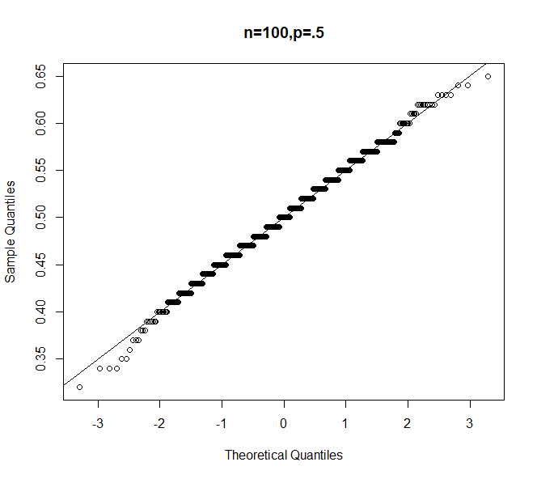
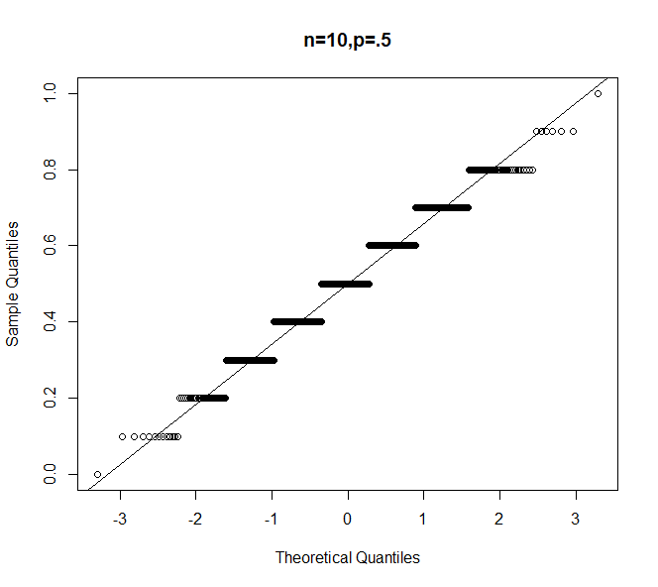
5.5: The Central Limit Theorem
x<-rbinom(1000,n,p)/n; qqnorm(x); abline(p,sqrt(p*(1-p)/n))

Slide 46
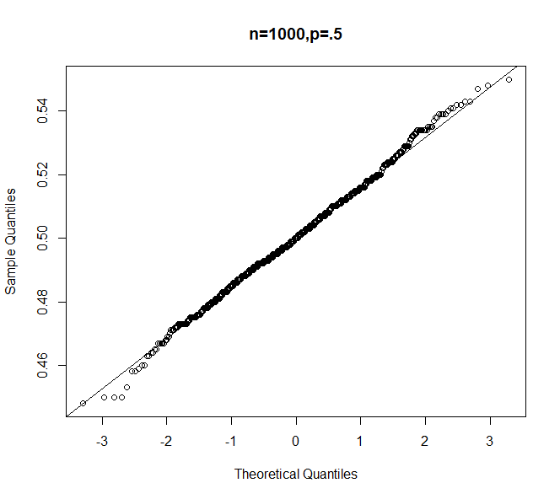
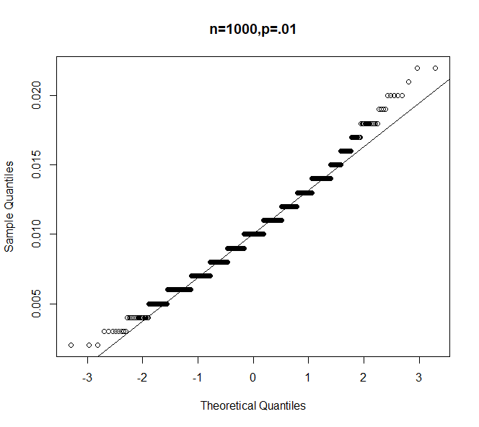
5.5: The Central Limit Theorem
x<-rbinom(1000,n,p)/n; qqnorm(x); abline(p,sqrt(p*(1-p)/n))

