Slide 1
Statistics
Chapter 7: Interval Estimation

Slide 2
Where We’re Going
Use the sampling distribution of the statistic to form a confidence interval for the parameter
Select the proper sample size when estimating a parameter

Slide 3
7.1: Large-Sample Confidence Interval for a Population Mean
Suppose a sample of 225 college students spend an average of 7 hours per week on social media, with a standard deviation of 3 hours.
  What can we conclude about all college students’ social media time?

Slide 4
7.1: Large-Sample Confidence Interval for a Population Mean
Suppose a sample of 225 college students spend an average of 7 hours per week on social media, with a standard deviation of 3 hours.
Since the sample size is large, it is not unreasonable to assume that the sample mean is approximately normally distributed (CLT).

Slide 5
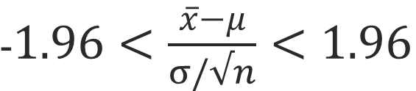
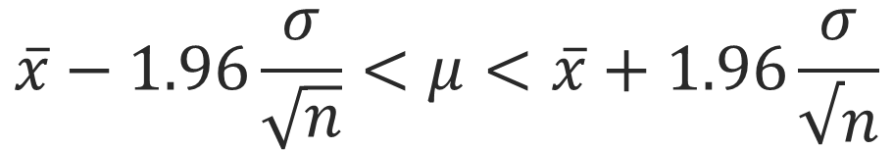
7.1: Large-Sample Confidence Interval for a Population Mean
We can be 95%* sure that
Rewriting this, we get
*In the standard normal distribution, exactly 95% of the area under the curve is in the interval
-1.96 … +1.96

Slide 6
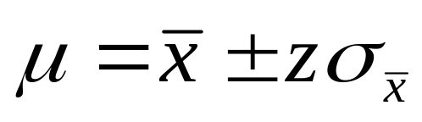
7.1: Large-Sample Confidence Interval for a Population Mean
An interval estimator or confidence interval is a formula that tell us how to use sample data to calculate an interval that estimates a population parameter.
In the college student social media example, the 95%
confidence interval is (7-1.96*3/15,7+1.96*3/15)
(6.608,7.392)

Slide 7
7.1: Large-Sample Confidence Interval for a Population Mean
The confidence coefficient is the probability that a randomly selected confidence interval encloses the population parameter.
The confidence level is the confidence coefficient expressed as a percentage.
(90%, 95% and 99% are very commonly used.)
95% sure

Slide 8
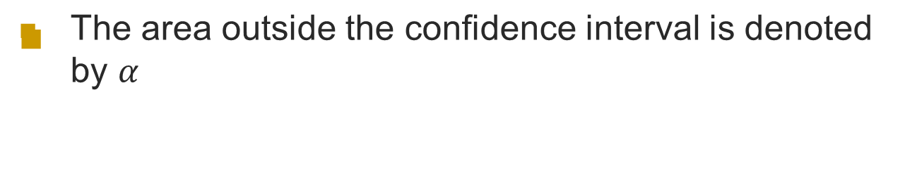
7.1: Large-Sample Confidence Interval for a Population Mean

Slide 9
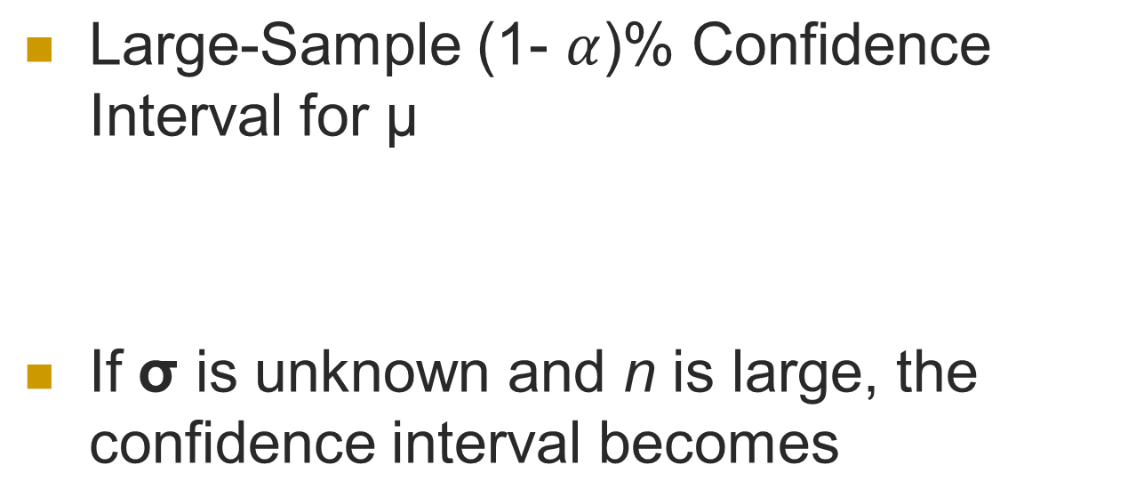
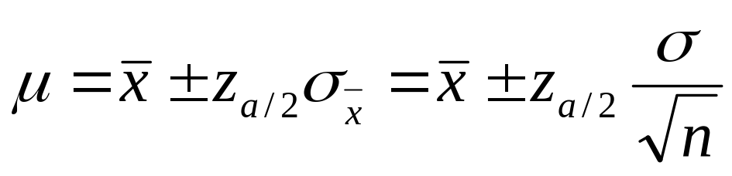
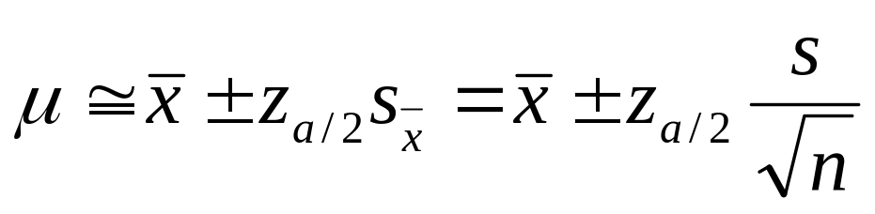
7.1: Large-Sample Confidence Interval for a Population Mean

Slide 10
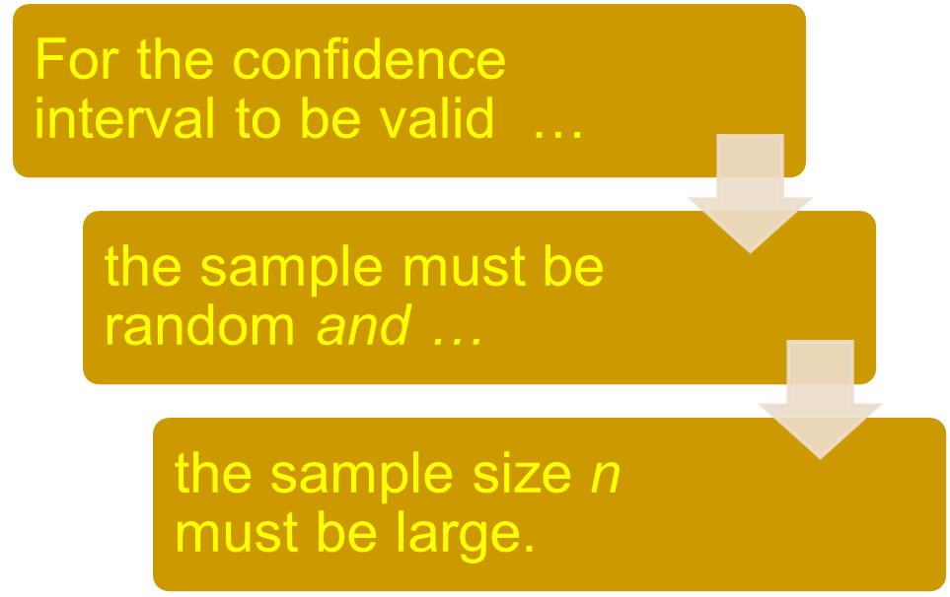
7.1: Large-Sample Confidence Interval for a Population Mean
    If n is large, the sampling distribution of the sample
    mean is normal, and s is a good estimate of σ

Slide 11
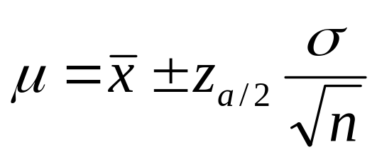
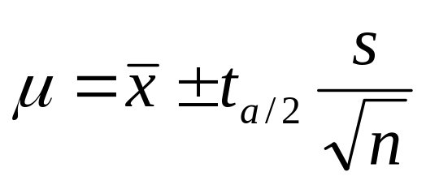
7.2: Small-Sample Confidence Interval for a Population Mean
Large Sample
Small Sample
Distribution on X can be anything
s is close to σ or σ is known.
Standard Normal (z) Distribution
Distribution on X is normal
Unknown σ and small n
Student’s t Distribution (with n-1 degrees of freedom)

Slide 12
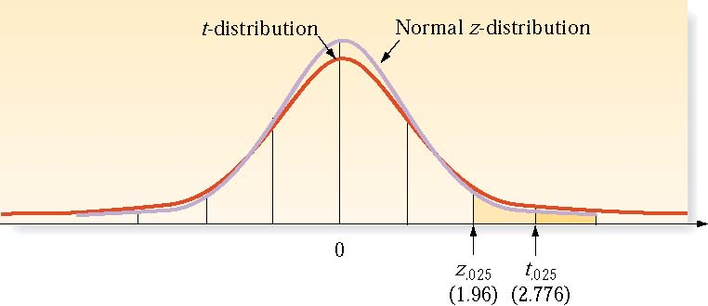
7.2: Small-Sample Confidence Interval for a Population Mean
Large Sample
Small Sample

Slide 13
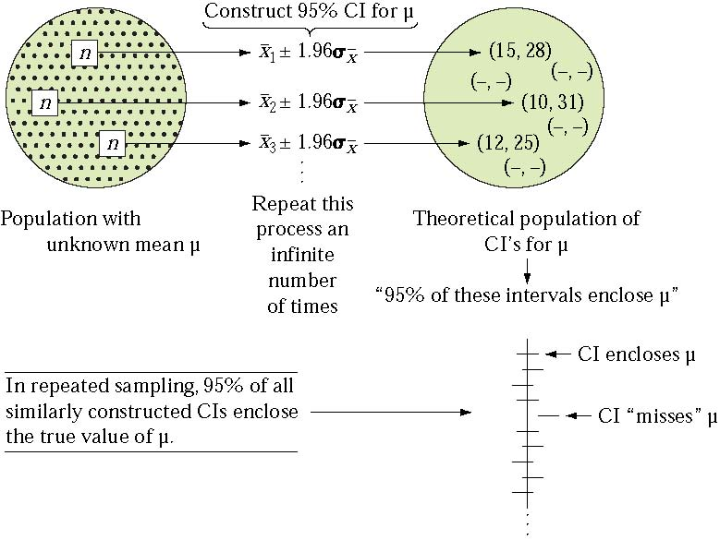
7.2: Small-Sample Confidence Interval for a Population Mean

Slide 14
7.2: Small-Sample Confidence Interval for a Population Mean
Suppose a sample of 25 college students spend an average of 7 hours per week on social media, with a standard deviation of 3 hours.
  What can we conclude about all college students’ social media time?

Slide 15
7.2: Small-Sample Confidence Interval for a Population Mean
Assuming a normal distribution for social media engagement, we can be 95% sure that the average is in the interval
(7-2.064*3/5,7+2.064*3/5)
(5.76,8.24)
Note : qt(0.975,24)=2.064

Slide 16
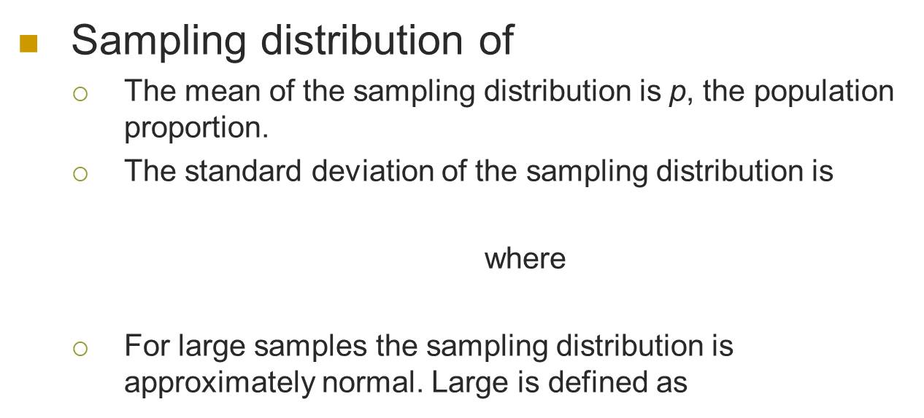

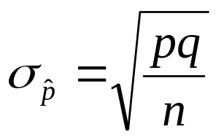

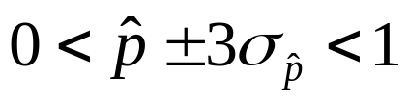
7.3: Large-Sample Confidence Interval for a Population Proportion

Slide 17
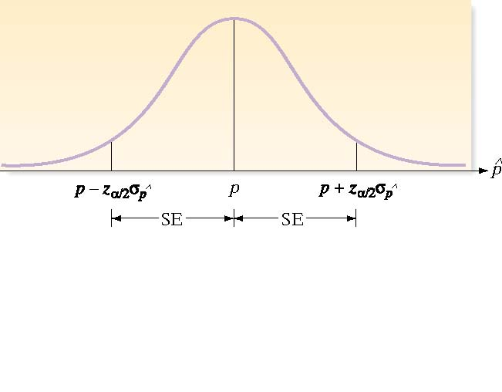
7.3: Large-Sample Confidence Interval for a Population Proportion
Sampling distribution of

Slide 18
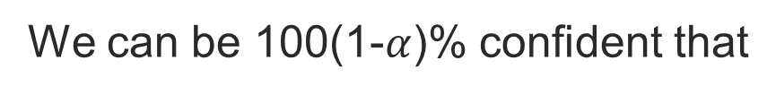
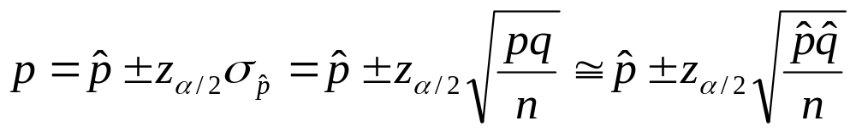
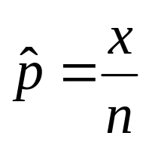
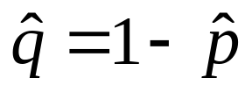
7.3: Large-Sample Confidence Interval for a Population Proportion
where and

Slide 19

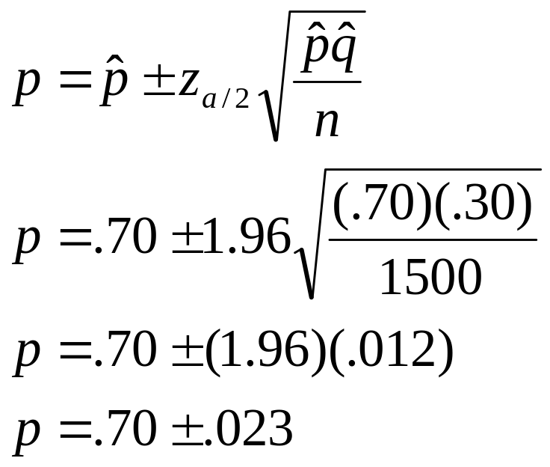
7.3: Large-Sample Confidence Interval for a Population Proportion
A nationwide poll of nearly 1,500 people … conducted by the syndicated cable television show Dateline: USA found that more than 70 percent of those surveyed believe there is intelligent life in the universe, perhaps even in our own Milky Way Galaxy.
What proportion of the entire
population agree, at the 95%
confidence level?

Slide 20
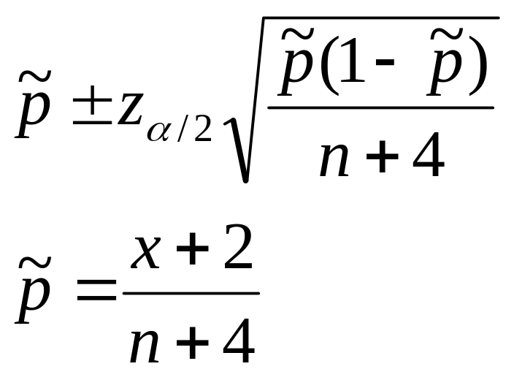
7.3: Large-Sample Confidence Interval for a Population Proportion
If p is close to 0 or 1, Wilson’s adjustment for estimating p yields better results
where

Slide 21
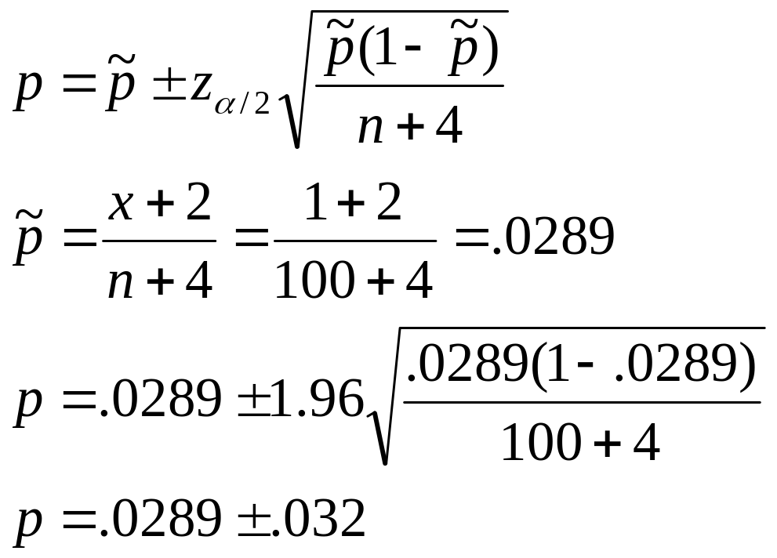
7.3: Large-Sample Confidence Interval for a Population Proportion
Suppose in a particular year the percentage of firms declaring bankruptcy that had shown profits the previous year is .002. If 100 firms are sampled and one had declared bankruptcy, what is the 95% CI on the proportion of profitable firms that will tank the next year?

Slide 22
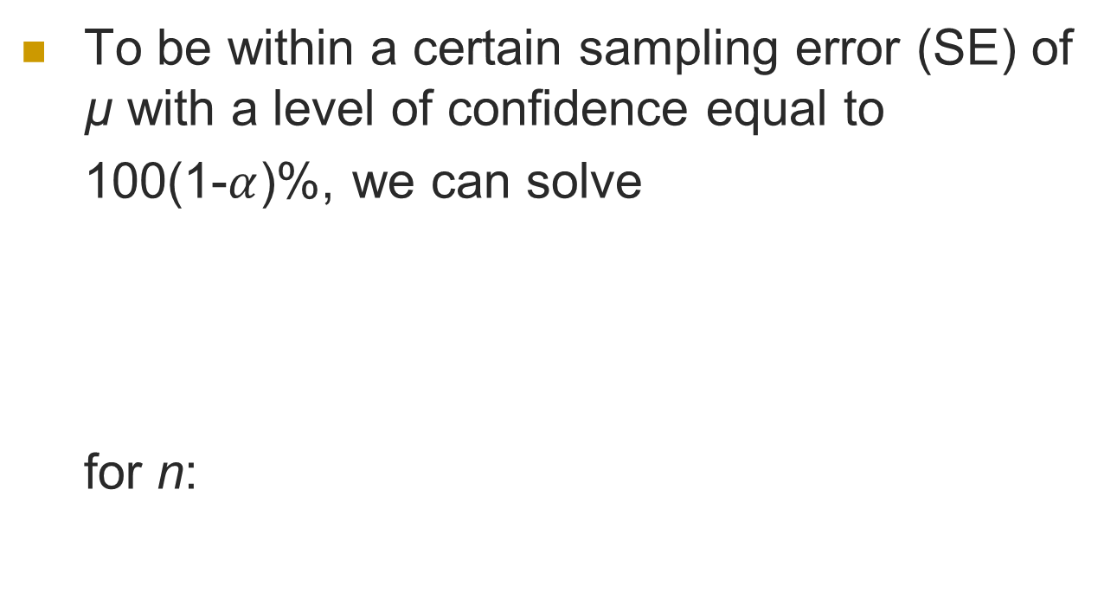
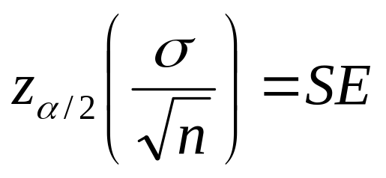
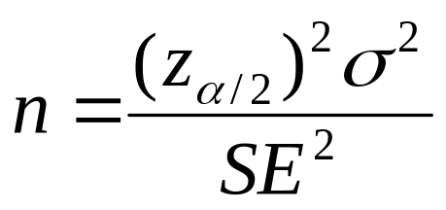
7.4: Determining the Sample Size

Slide 23
7.4: Determining the Sample Size
The value of σ will almost always be unknown, so we need an estimate:
  s from a previous sample
  approximate the range, R, and use R/4
Round the calculated value of n upwards to be sure you don’t have too small a sample.

Slide 24
7.4: Determining the Sample Size
Suppose we need to know the mean driving distance for a new composite golf ball within 3 yards, with 95% confidence. A previous study had a standard deviation of 25 yards. How many golf balls must we test?

Slide 25
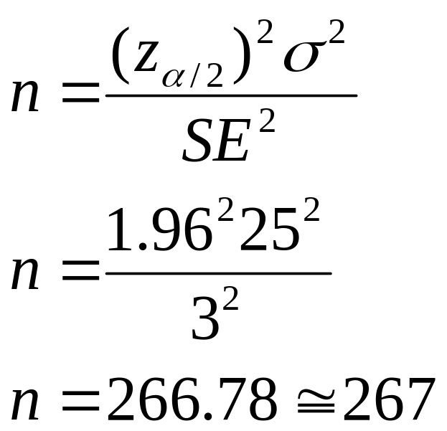
7.4: Determining the Sample Size
Suppose we need to know the mean driving distance for a new composite golf ball within 3 yards, with 95% confidence. A previous study had a standard deviation of 25 yards. How many golf balls must we test?

Slide 26
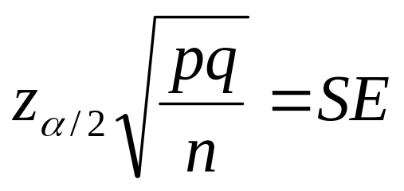
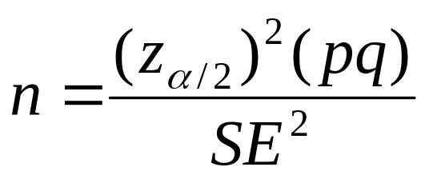
7.4: Determining the Sample Size
To estimate p, use
the sample proportion
from a prior study, or
use p = .7.
Round the value of n
upward to ensure the
sample size is large
enough to produce the
required level of
confidence.
For a confidence interval on the population proportion, p, we can solve
for n:

Slide 27
7.4: Determining the Sample Size
How many cellular phones must a manufacturer test to estimate the fraction defective, p, to within .01 with 90% confidence, if an initial estimate of .10 is used for p?

Slide 28
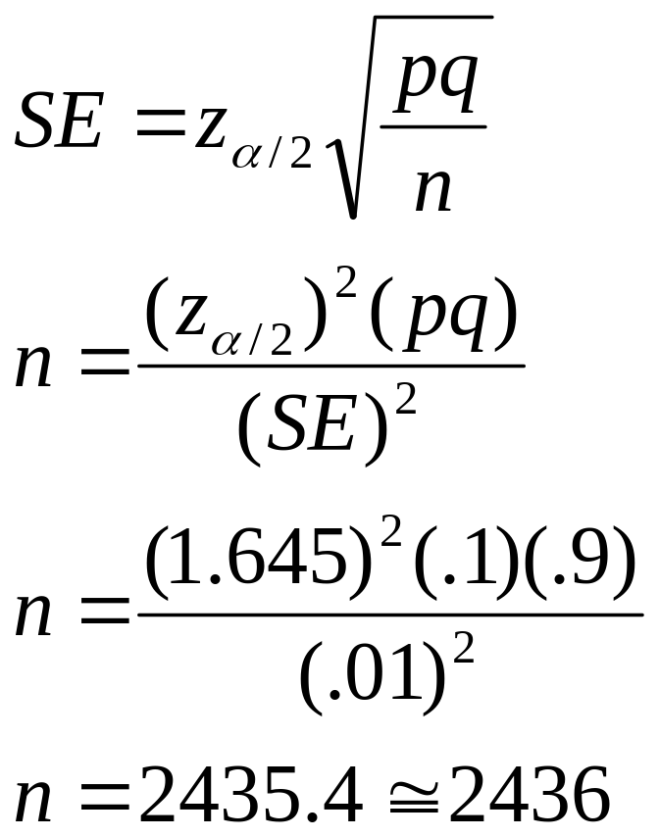
7.4: Determining the Sample Size
How many cellular phones must a manufacturer test to estimate the fraction defective, p, to within .01 with 90% confidence, if an initial estimate of .10 is used for p?

Slide 29
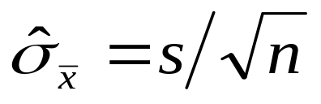
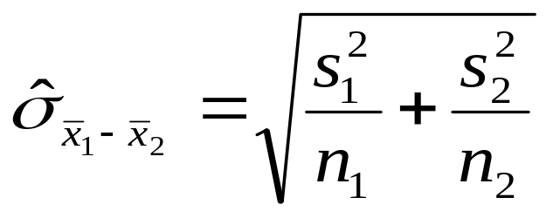
7.5: Comparing Two Population Means: Independent Sampling
Point Estimators
 → µ
₁ - ₂ → µ₁ - µ₂
To construct a confidence interval or conduct a
hypothesis test, we need the standard deviation:
Singe sample
Two samples

Slide 30
7.5: Comparing Two Population Means: Independent Sampling
The Sampling Distribution for (₁ - ₂)
The mean of the sampling distribution is (µ₁-µ₂).
If the two samples are independent, the standard deviation of the sampling distribution (the standard error) is
The sampling distribution for (₁ - ₂) is approximately normal for large samples.

Slide 31
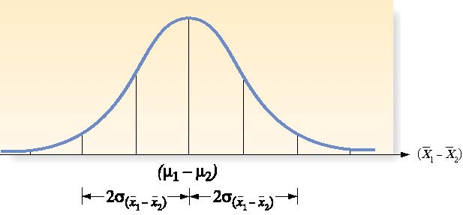
7.5: Comparing Two Population Means: Independent Sampling
The Sampling Distribution for (₁ - ₂)

Slide 32
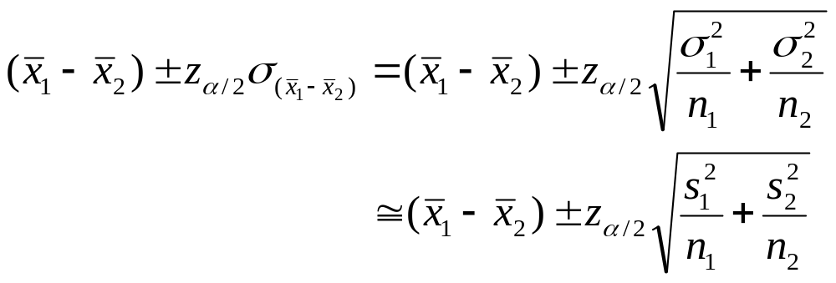
7.5: Comparing Two Population Means: Independent Sampling
Large Sample Confidence Interval for (µ₁ - µ₂ )

Slide 33
7.5: Comparing Two Population Means: Independent Sampling
Two samples concerning retention rates for first-year students at private and
public institutions were obtained from the Department of Education’s data
base to see if there was a significant difference in the two types of colleges.
Private Colleges
Public Universities
n: 71
Mean: 78.17
Standard Deviation: 7.35
Variance: 91.17
n: 32
Mean: 84
Standard Deviation: 7.88
Variance: 97.64
What does a 95% confidence interval tell us about retention rates?
Source: National Center for Education Statistics

Slide 34
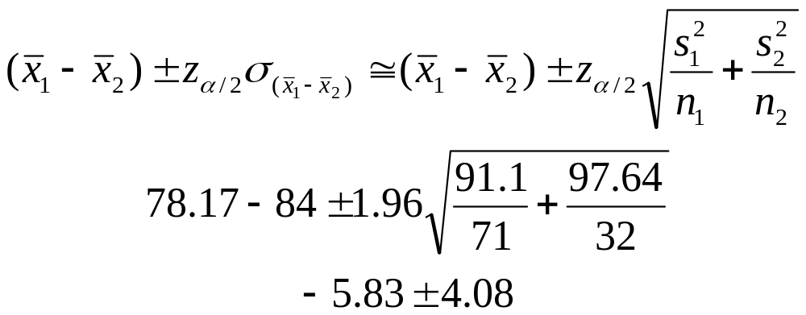
7.5: Comparing Two Population Means: Independent Sampling
Private Colleges
Public Universities
n: 71
Mean: 78.17
Standard Deviation: 7.35
Variance: 91.17
n: 32
Mean: 84
Standard Deviation: 7.88
Variance: 97.64

Slide 35
7.5: Comparing Two Population Means: Independent Sampling
Private Colleges
Public Universities
n: 71
Mean: 78.17
Standard Deviation: 7.35
Variance: 91.17
n: 32
Mean: 84
Standard Deviation: 7.88
Variance: 97.64
Since 0 is not in the confidence interval, the difference in the sample means appears to indicate a real difference in retention.

Slide 36
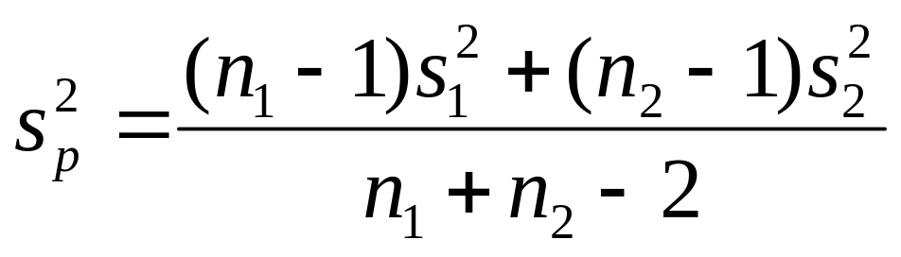
7.5: Comparing Two Population Means: Independent Sampling
For small samples, the t-distribution can be used with a pooled sample estimator of σ², s_{p}²

Slide 37
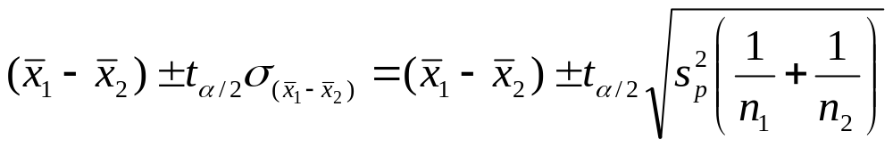
7.5: Comparing Two Population Means: Independent Sampling
Small Sample Confidence Interval for (µ₁ - µ₂ )
The value of t is based on (n₁ + n₂ -2) degrees of freedom.

Slide 38
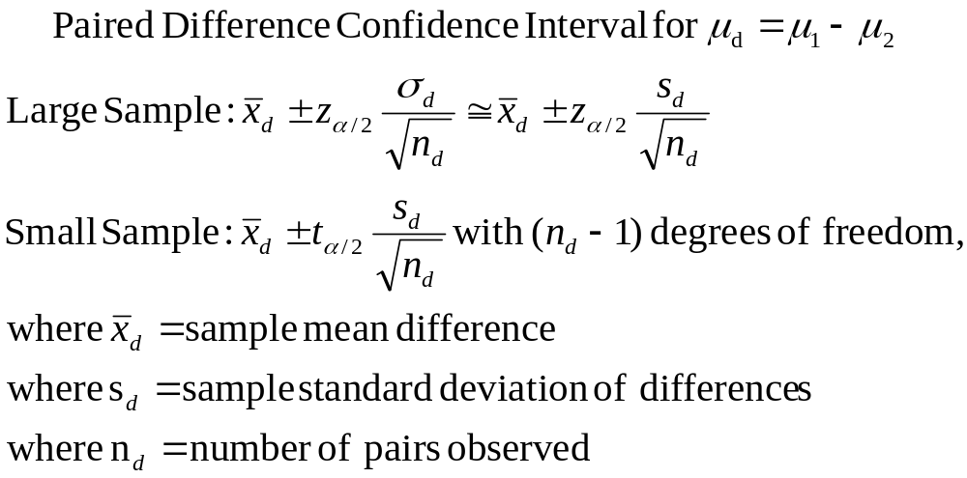
7.6: Comparing Two Population Means: Paired Difference Experiments

Slide 39
7.6: Comparing Two Population Means: Paired Difference Experiments
Suppose ten pairs of puppies were housetrained using two different methods: one puppy from each pair was paper-trained, with the paper gradually moved outside, and the other was taken out every three hours and twenty minutes after each meal. The number of days until the puppies were considered housetrained (three days straight without an accident) were compared. Nine of the ten paper-trained dogs took longer than the other paired dog to complete training, with the average difference equal to 4 days, with a standard deviation of 3 days.
What is a 90% confidence interval on the difference in successful training?

Slide 40
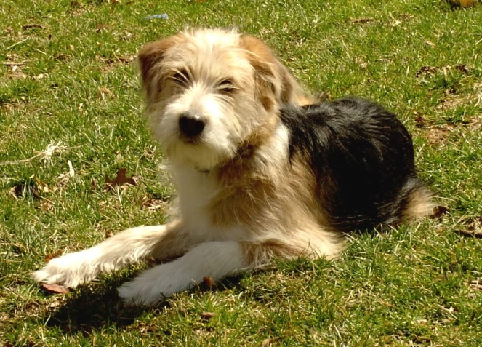
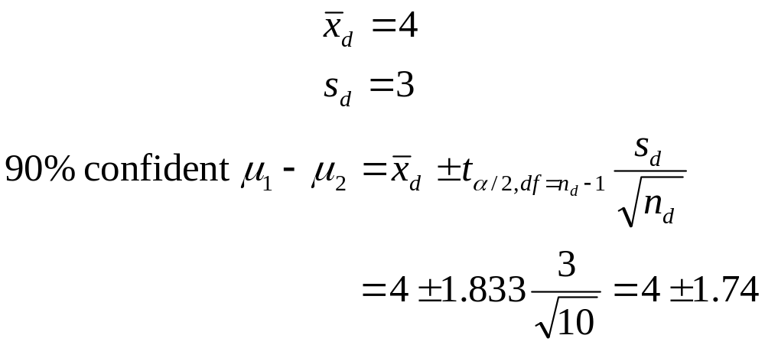
7.6: Comparing Two Population Means: Paired Difference Experiments
Since 0 is not in the interval, one program does seem to work more effectively.

Slide 41

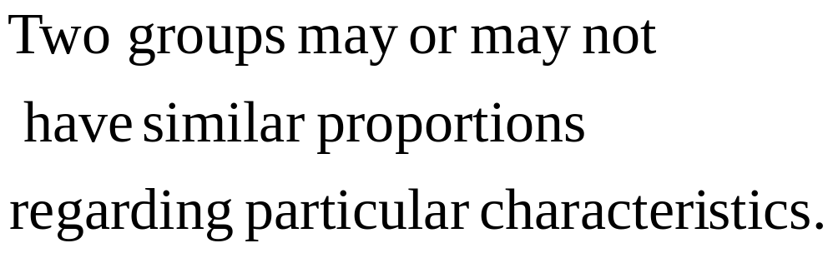

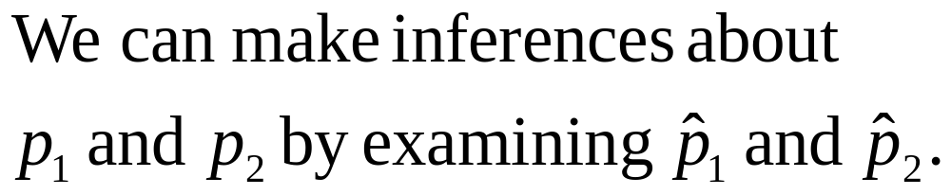
7.7: Comparing Two Population Proportions: Independent Sampling

Slide 42
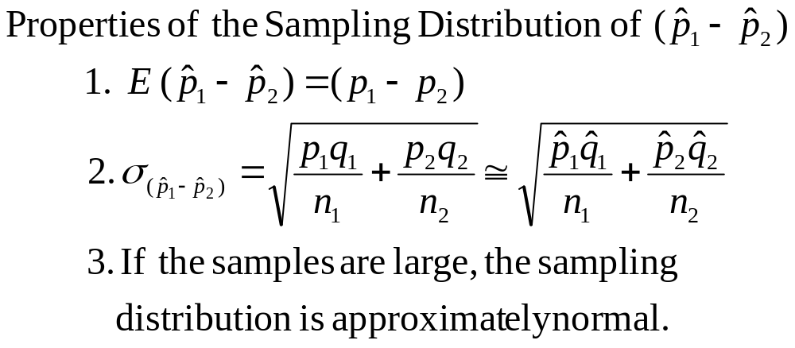
7.7: Comparing Two Population Proportions: Independent Sampling

Slide 43
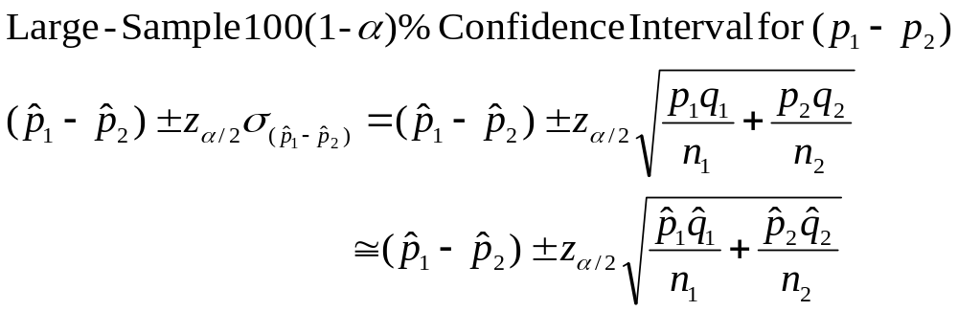
7.7: Comparing Two Population Proportions: Independent Sampling

Slide 44
7.7: Comparing Two Population Proportions: Independent Sampling
A group of men and women were asked their opinions on the following important issue:
Are the Three Stooges funny?
The results are as follow:
 | Men | Women
Yes | 290 | 200
No | 50 | 50
n | 340 | 250

Slide 45
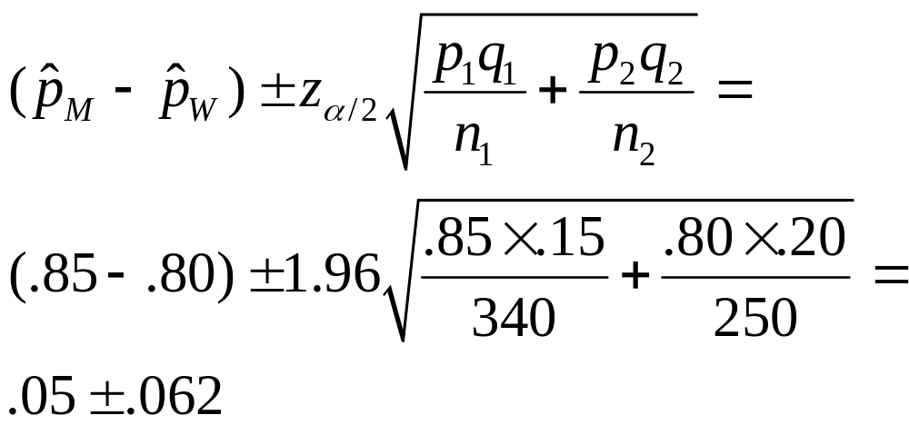
7.7: Comparing Two Population Proportions: Independent Sampling
Calculate a 95% confidence interval on the difference in the opinions of men and women.
 | Men | Women
p | .85 | .80
q | .15 | .20
n | 340 | 250

Slide 46
7.7: Comparing Two Population Proportions: Independent Sampling
Calculate a 95% confidence interval on the difference in the opinions of men and women.
Since 0 is in the confidence interval, we cannot rule out the possibility that both genders find the Stooges equally funny.
Nyuk nyuk nyuk.
 | Men | Women
p | .85 | .80
q | .15 | .20
n | 340 | 250

