Slide 1
Statistics
Chapter 8: Tests of Hypotheses

Slide 2
Where We’ve Been
Calculated point estimators of population parameters
Used the sampling distribution of a statistic to assess the reliability of an estimate through a confidence interval

Slide 3
Where We’re Going
Test a specific value of a population parameter
Measure the reliability of the test

Slide 4
8.1: The Elements of a Test of Hypotheses
Confidence Interval
Where on the number line do the data point us?
(No prior idea about the value of the parameter.)
µ?
µ?
Hypothesis Test
Do the data point us to this particular value?
(We have a value in mind from the outset.)
µ₀?

Slide 5
8.1: The Elements of a Test of Hypotheses
Null Hypothesis: H₀
This will be supported unless the data provide evidence that it is false
The status quo
Alternative Hypothesis: H_{a}
This will be supported if the data provide sufficient evidence that it is true
The research hypothesis

Slide 6
8.1: The Elements of a Test of Hypotheses
If the test statistic has a high probability when H₀ is true, then H₀ is not rejected.
If the test statistic has a (very) low probability when H₀ is true, then H₀ is rejected.

Slide 7
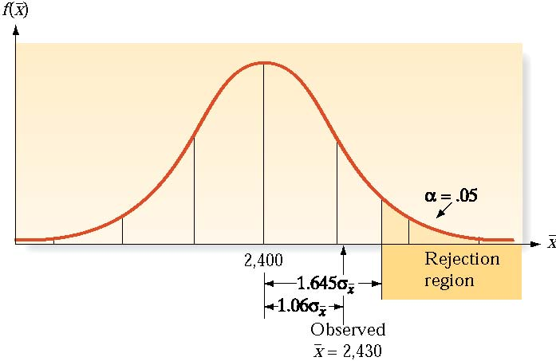
8.1: The Elements of a Test of Hypotheses

Slide 8
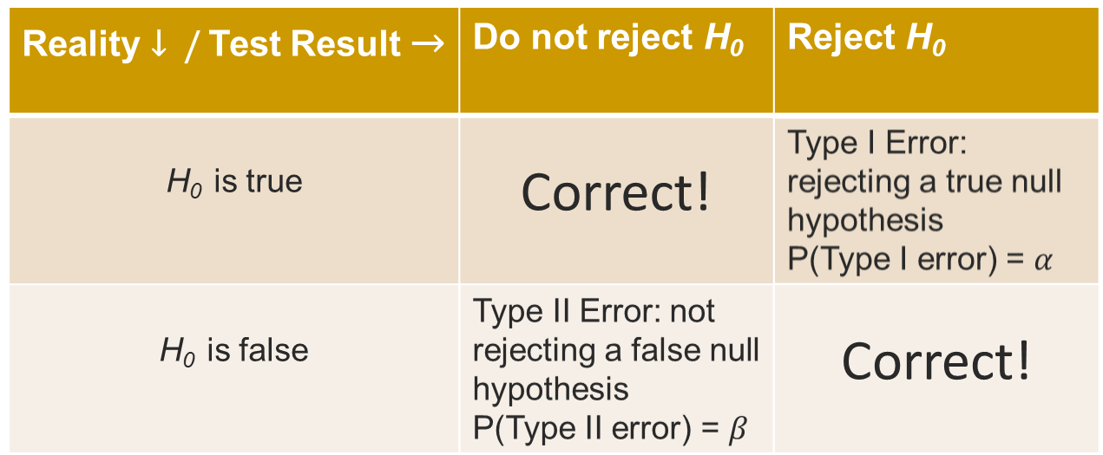
8.1: The Elements of a Test of Hypotheses

Slide 9
8.1: The Elements of a Test of Hypotheses
Note: Null hypotheses are either rejected, or else there is insufficient evidence to reject them. (I.e., we don’t accept null hypotheses.)

Slide 10
8.1: The Elements of a Test of Hypotheses
Null hypothesis (H₀): A theory about the values of one or more parameters
  Ex.: H₀: µ = µ₀ (a specified value for µ)
Alternative hypothesis (H_{a}): Contradicts the null hypothesis
  Ex.: H₀: µ ≠ µ₀
Test Statistic: The sample statistic to be used to test the hypothesis
Rejection region: The values for the test statistic which lead to rejection of the null hypothesis
Assumptions: Clear statements about any assumptions concerning the target population
Experiment and calculation of test statistic: The appropriate calculation for the test based on the sample data
Conclusion: Reject the null hypothesis (with possible Type I error) or do not reject it (with possible Type II error)

Slide 11
8.1: The Elements of a Test of Hypotheses
Suppose a new interpretation of the rules by soccer referees is expected to increase the number of yellow cards per game. The average number of yellow cards per game had been 4. A sample of 121 matches produced an average of 4.7 yellow cards per game, with a standard deviation of .5 cards. At the 5% significance level, has there been a change in infractions called?

Slide 12
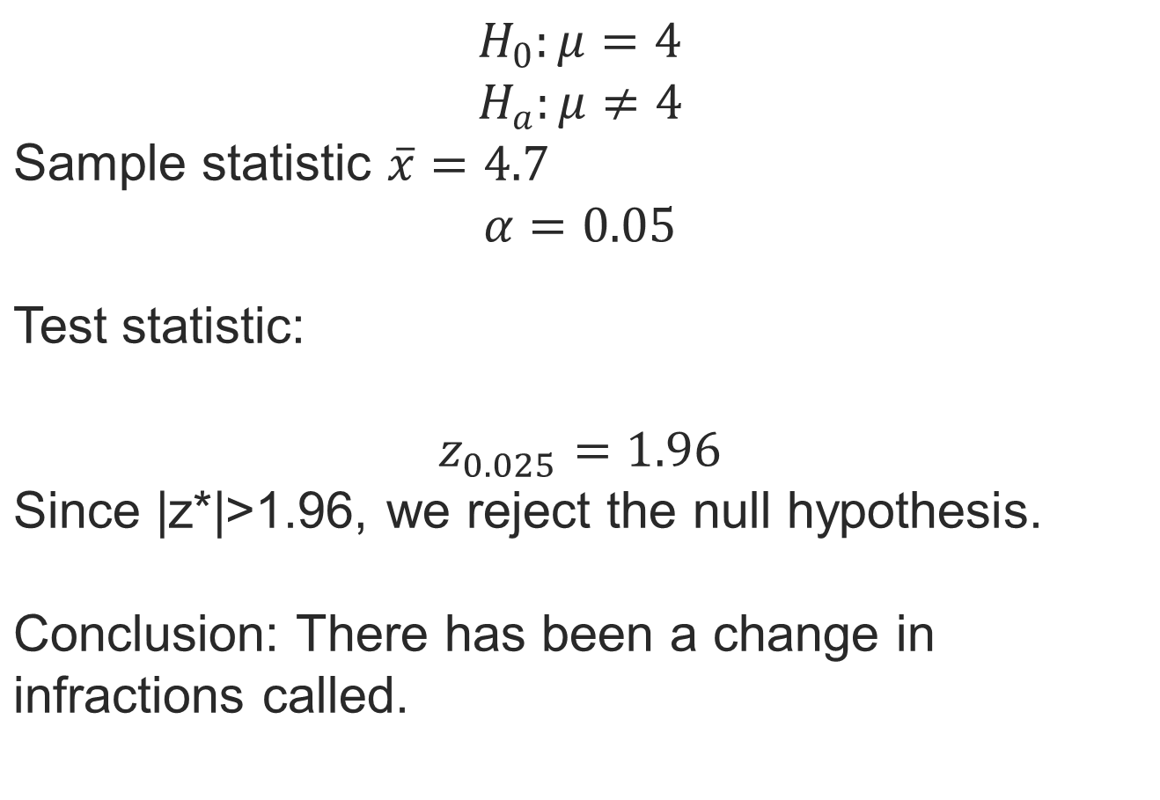
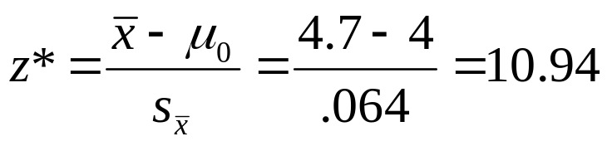
8.1: The Elements of a Test of Hypotheses

Slide 13
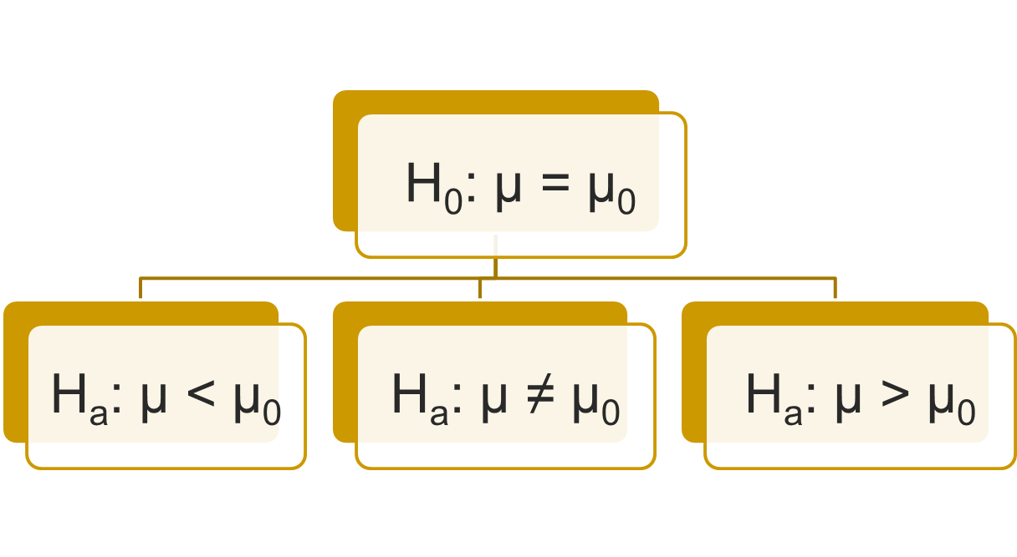
8.2: Large-Sample Test of a Hypothesis about a Population Mean
The null hypothesis is
usually stated as an
equality …
… even though the alternative hypothesis can be either an equality or an inequality.

Slide 14
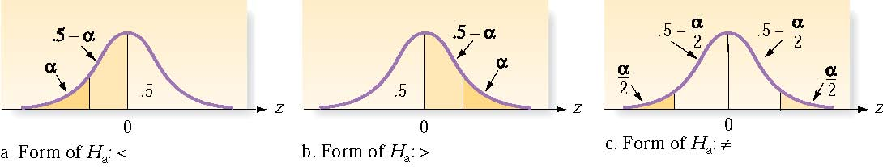
8.2: Large-Sample Test of a Hypothesis about a Population Mean

Slide 15
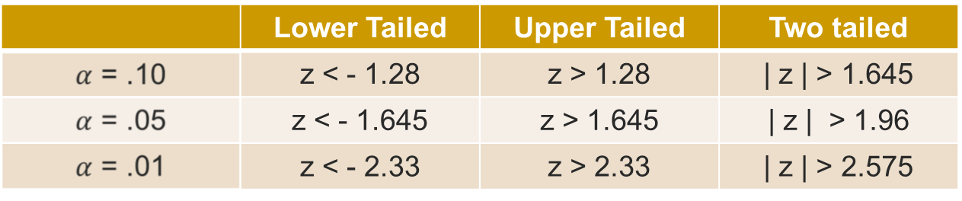
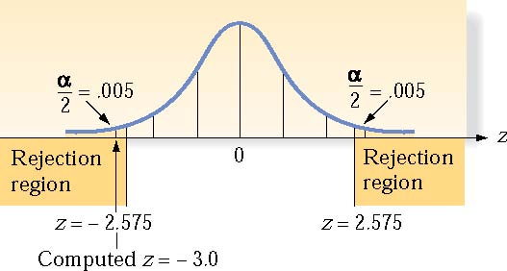
8.2: Large-Sample Test of a Hypothesis about a Population Mean

Slide 16
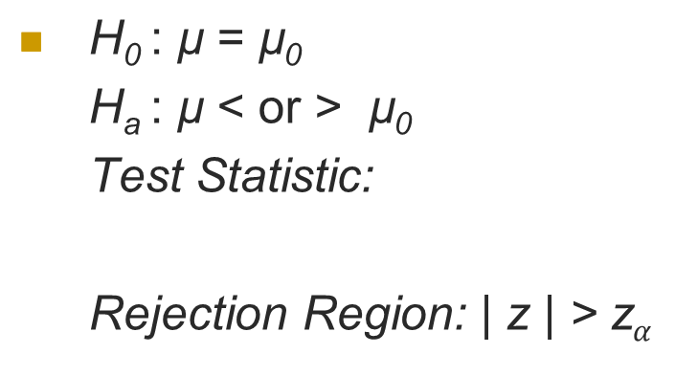
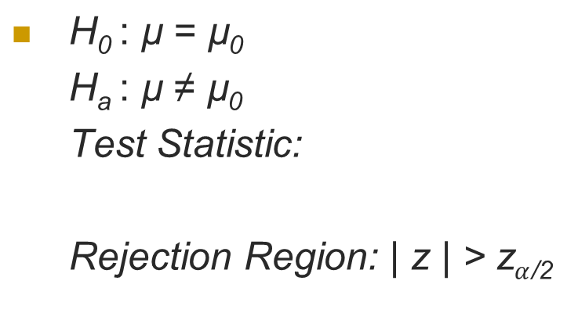
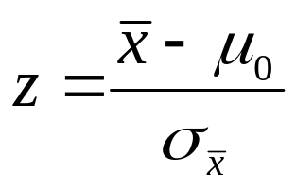
8.2: Large-Sample Test of a
Hypothesis about a Population Mean
One-Tailed Test
Two-Tailed Test
Conditions: 1) A random sample is selected from the target population.
2) The sample size n is large.

Slide 17
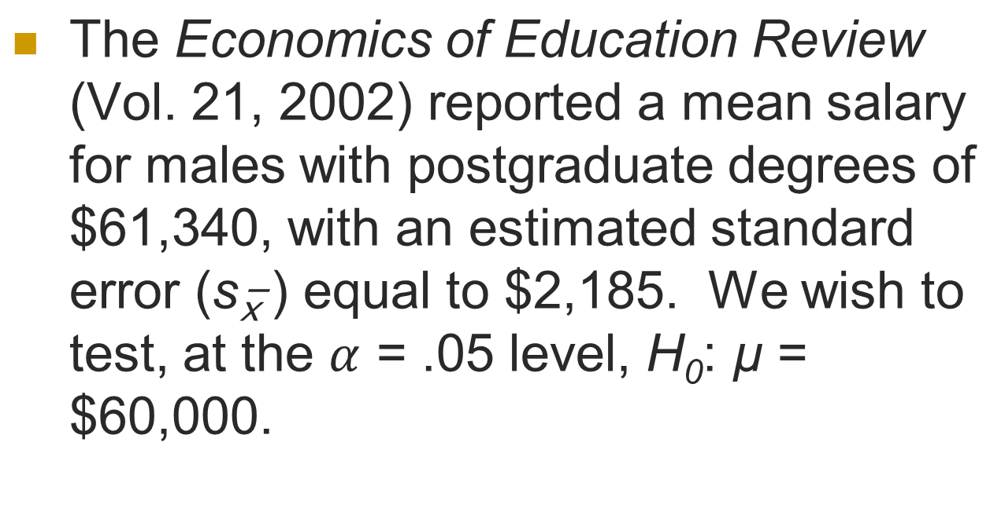
8.2: Large-Sample Test of a Hypothesis about a Population Mean

Slide 18
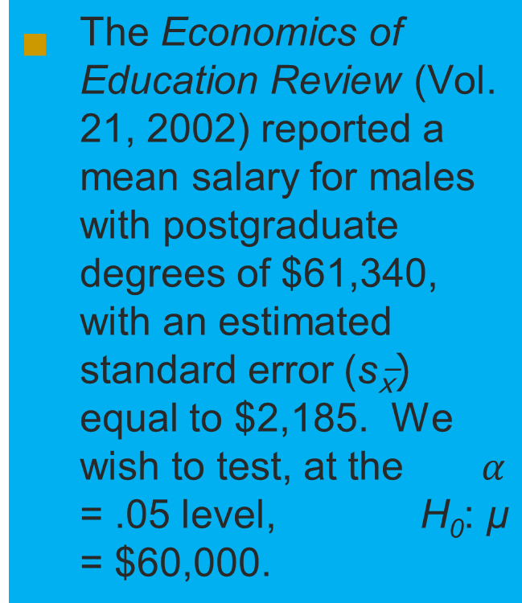
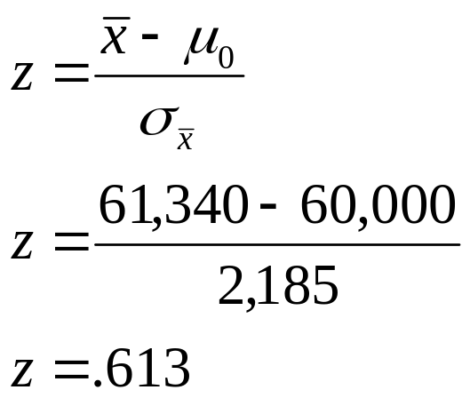
8.2: Large-Sample Test of a Hypothesis about a Population Mean
H₀ : µ = 60,000
H_{a} : µ ≠ 60,000
Test Statistic:
Rejection Region: | z | > z_{.025} = 1.96
Do not reject H₀

Slide 19


8.3:Observed Significance Levels: p - Values
Suppose z = 2.12. P(z > 2.12) = .0170.
But it’s pretty close, isn’t it?

Slide 20
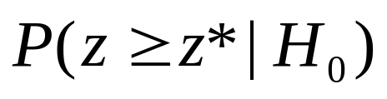
8.3:Observed Significance Levels: p - Values
The observed significance level, or p-value, for a test is the probability of observing a test statistic as extreme or more than the one actually observed (z*) assuming the null hypothesis is true.
The lower this probability, the less likely H₀ is true.

Slide 21
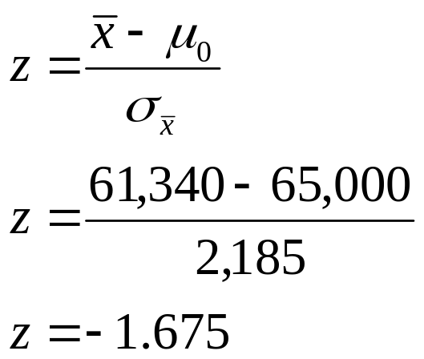
8.3:Observed Significance Levels: p - Values
Let’s go back to the Economics of Education Review report (= $61,340, s = $2,185). This time we’ll test H₀: µ = $65,000.
H₀ : µ = 65,000
H_{a} : µ ≠ 65,000
Test Statistic:
p-value: 2P(< 61,340 |H₀ ) = P(|z| > 1.675) = .0475

Slide 22
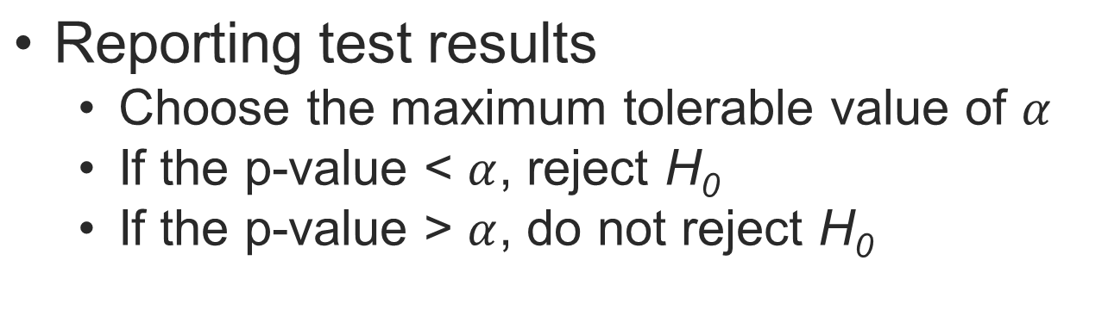
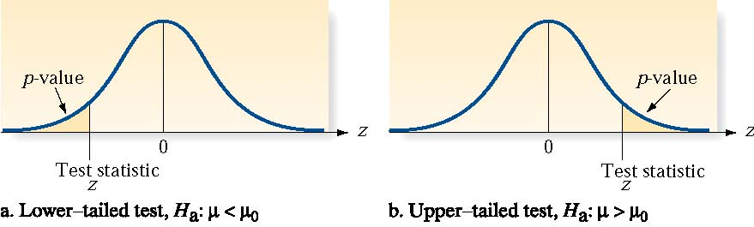
8.3:Observed Significance Levels: p - Values

Slide 23
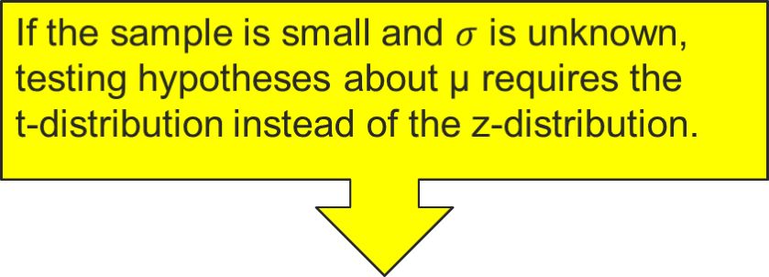
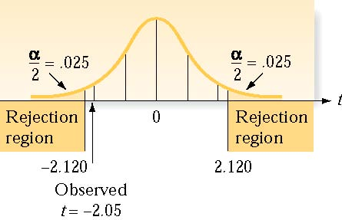
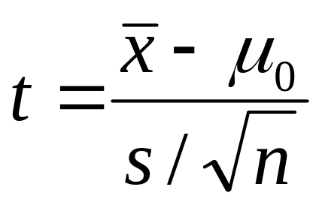
8.4: Small-Sample Test of a Hypothesis about a Population Mean

Slide 24
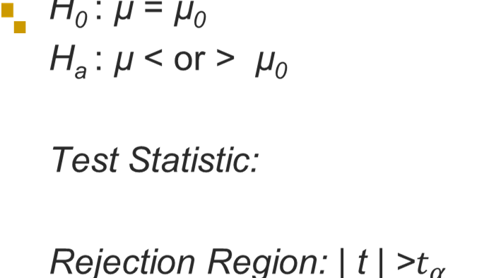
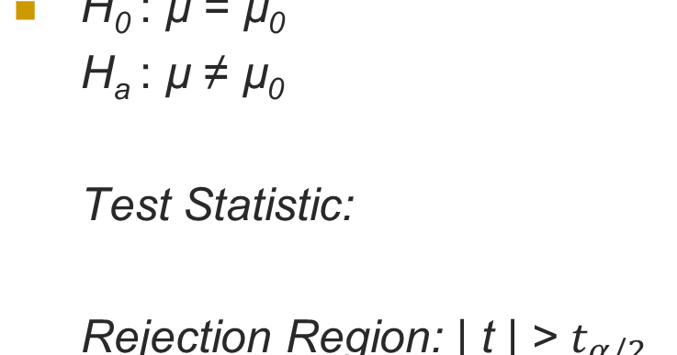
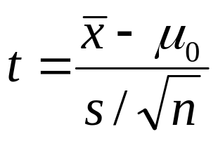
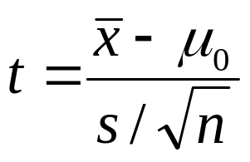

8.4: Small-Sample Test of a
Hypothesis about a Population Mean
One-Tailed Test
Two-Tailed Test

Slide 25
8.4: Small-Sample Test of a Hypothesis about a Population Mean
Suppose copiers average 100,000 between paper jams. A salesman claims his are better, and offers to leave 5 units for testing. The average number of copies between jams is 100,987, with a standard deviation of 157. Does his claim seem believable?

Slide 26
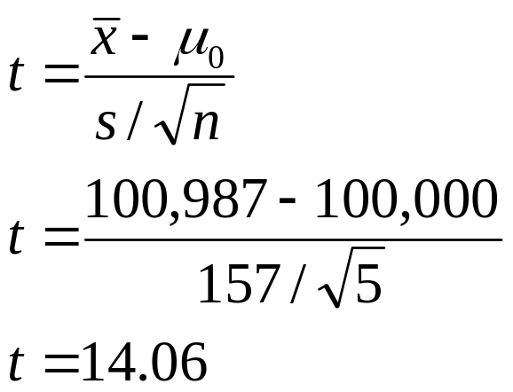
8.4: Small-Sample Test of a Hypothesis about a Population Mean
Suppose copiers average 100,000 between paper jams. A salesman claims his are better, and offers to leave 5 units for testing. The average number of copies between jams is 100,987, with a standard deviation of 157. Does his claim seem believable?
H₀ : µ = 100,000
H_{a} : µ > 100,000
Test Statistic:
p-value: P( > 100,987|H₀ ) = P(t_{df=4} > 14.06) < .001

Slide 27
8.4: Small-Sample Test of a Hypothesis about a Population Mean
Suppose copiers average 100,000 between paper jams. A salesman claims his are better, and offers to leave 5 units for testing. The average number of copies between jams is 100,987, with a standard deviation of 157. Does his claim seem believable?
H₀ : µ = 100,000
H_{a} : µ > 100,000
Test Statistic:
p-value: P( >100,987|H₀ ) = P(t_{df=4} > 14.06) < .001
Reject the null hypothesis based on the very low probability of seeing the observed results if the null were true.
So, the claim does seem plausible.

Slide 28
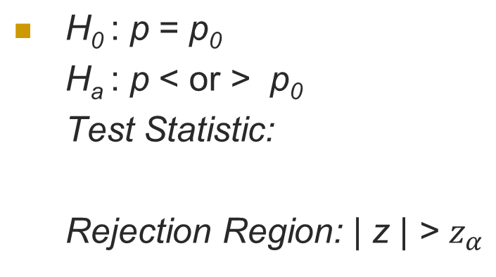
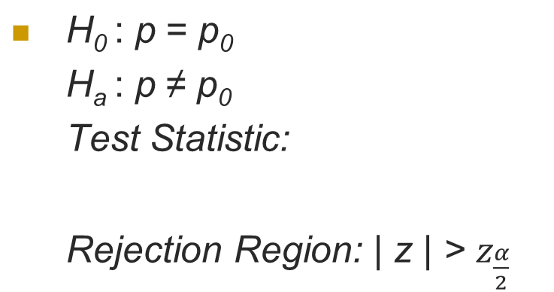
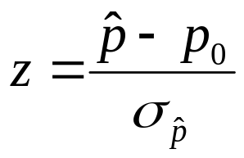
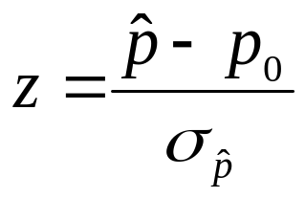
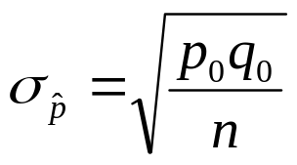
8.5: Large-Sample Test of a Hypothesis about a Population Proportion
One-Tailed Test
Two-Tailed Test
p₀ = hypothesized value of p, , and q₀ = 1 - p₀
Conditions: 1) A random sample is selected from a binomial population.
2) The sample size n is large (i.e., np₀ and nq₀ are both > 15).

Slide 29
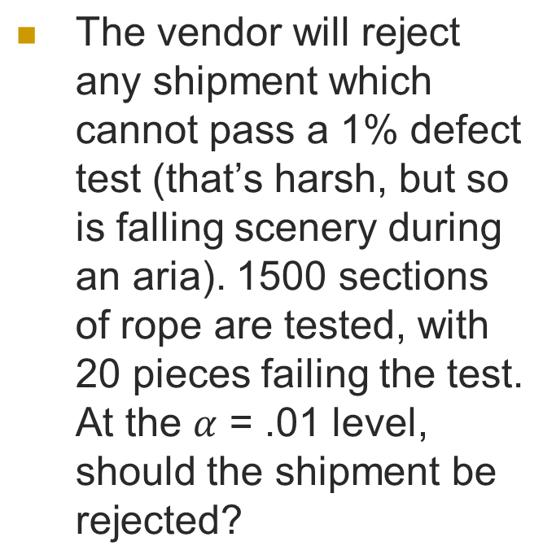
8.5: Large-Sample Test of a Hypothesis about a Population Proportion
Rope designed for use in the theatre must withstand unusual stresses. Assume a brand of 3” three-strand rope is expected to have a breaking strength of 1400 lbs. A vendor receives a shipment of rope and needs to (destructively) test it.

Slide 30
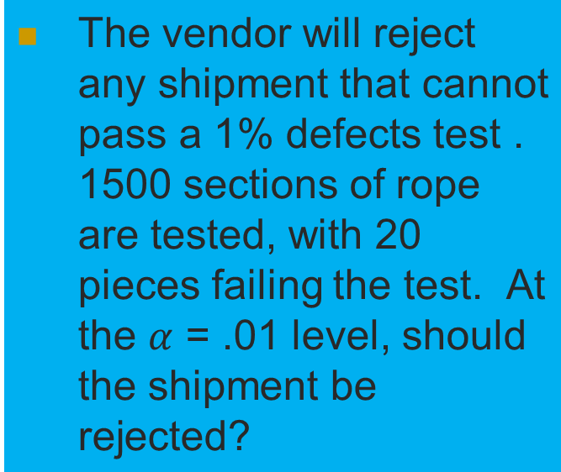
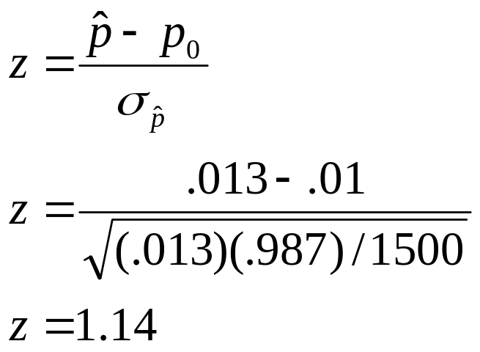
8.5: Large-Sample Test of a Hypothesis about a Population Proportion
H₀: p = .01
H_{a}: p > .01
Rejection region: z > 2.236
Test statistic:

Slide 31
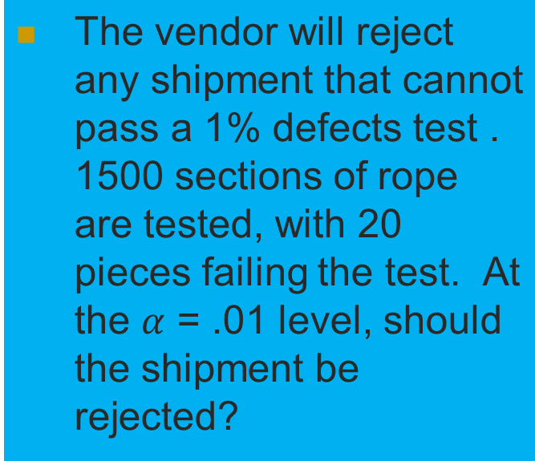
8.5: Large-Sample Test of a Hypothesis about a Population Proportion
H₀: p = .01
H_{a}: p > .01
Rejection region: |z| > 2.236
Test statistic:
There is insufficient evidence to reject the null hypothesis based on the sample results.

Slide 32
8.6: A Nonparametric Test About a Population Median
The sign test provides inferences about population medians, or central tendencies, when skewed data or an outlier would invalidate tests based on normal distributions.

Slide 33
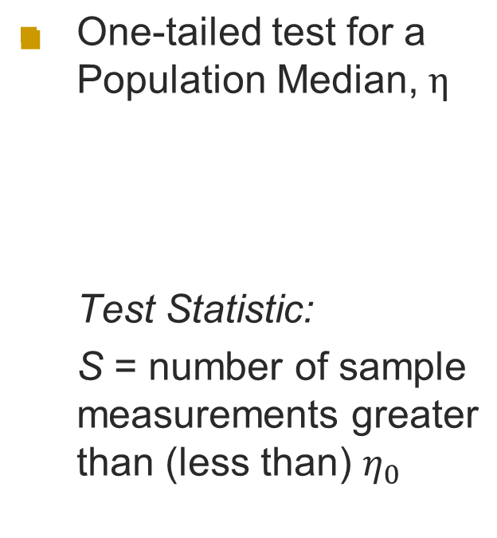
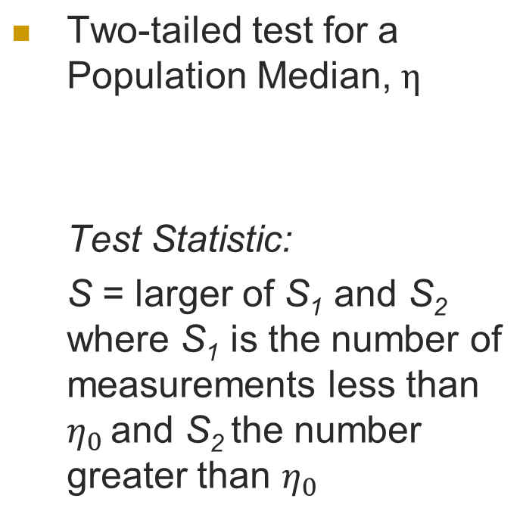
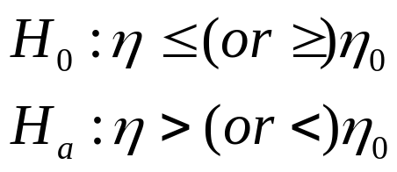
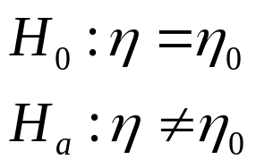
8.6: A Nonparametric Test About a Population Median

Slide 34
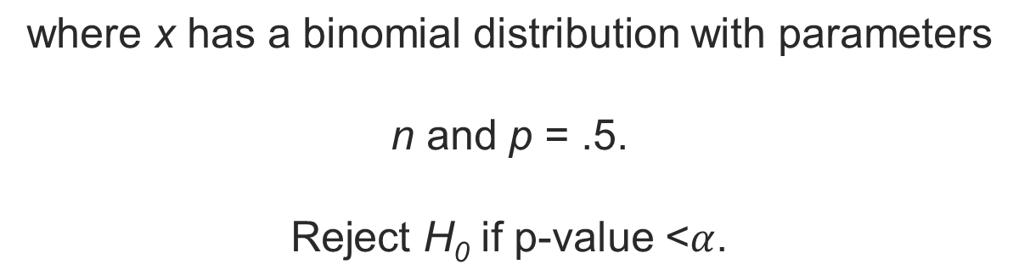
8.6: A Nonparametric Test About a Population Median
One-tailed test for a Population Median
Observed significance level:
p-value = P(x>S)
Two-tailed test for a Population Median
Observed significance level:
p-value = 2P(x>S)

Slide 35
8.6: A Nonparametric Test About a Population Median
Median time to failure for a band of compact disc players is 5,250 hours. Twenty players from a competitor are tested, with failure times from 5 hours to 6,575 hours. Fourteen of the players exceed 5,250 hours.
Do the competitor’s machines perform differently?

Slide 36
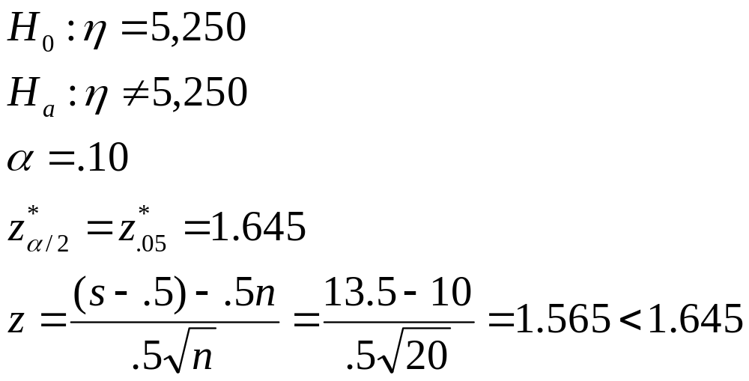
8.6: A Nonparametric Test About a Population Median
Median time to failure for a band of compact disc players is 5,250 hours. Twenty players from a competitor are tested, with failure times from 5 hours to 6,575 hours. Fourteen of the players exceed 5,250 hours.
Do the competitor’s machines perform differently?

Slide 37
8.6: A Nonparametric Test About a Population Median
Median time to failure for a band of compact disc players is 5,250 hours. Twenty players from a competitor are tested, with failure times from 5 hours to 6,575 hours. Fourteen of the players exceed 5,250 hours.
Do the competitor’s machines perform differently?
Do not reject H₀

Slide 38
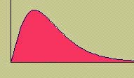
8.7: Inference concerning a Population Variance
  Sometimes the primary parameter of interest is not the population mean μ but rather the population variance σ².
  We choose a random sample of size n from a normal distribution.

Slide 39
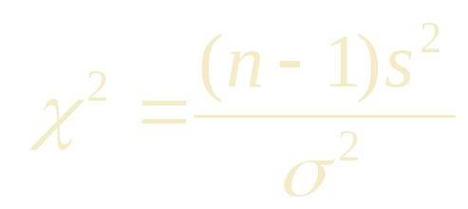
8.7: Inference concerning a Population Variance
  The sample variance s² can be used in its standardized form:
  which has a Chi-Square distribution with n - 1 degrees of freedom.

Slide 40
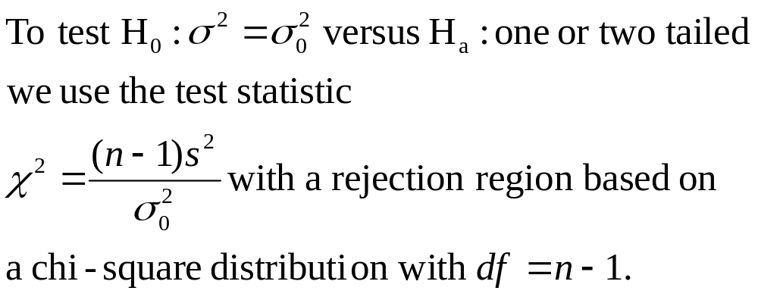
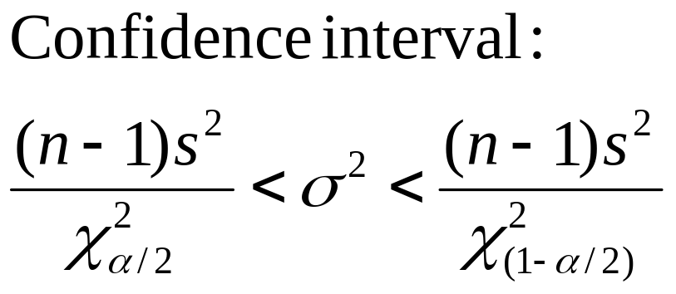
8.7: Inference concerning a Population Variance

Slide 41

8.7: Inference concerning a Population Variance
  A cement manufacturer claims that his cement has a compressive strength with a standard deviation of 10 kg/cm² or less. A sample of n = 10 measurements produced a mean and standard deviation of 312 and 13.96, respectively.

Slide 42
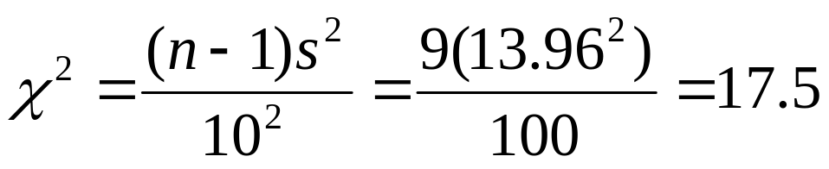
8.7: Inference concerning a Population Variance
  A cement manufacturer claims that his cement has a compressive strength with a standard deviation of 10 kg/cm² or less. A sample of n = 10 measurements produced a mean and standard deviation of 312 and 13.96, respectively.
A test of hypothesis:
H₀: σ = 10 (claim is correct)
H_{a}: σ > 10 (claim is wrong)
uses the test statistic:

Slide 43
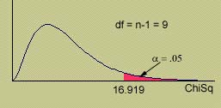
8.7: Inference concerning a Population Variance
  Do these data produce sufficient evidence to reject the manufacturer’s claim? Use α = .05.
Rejection region: Reject H₀ if χ² > 16.919 (α = .05).
Conclusion: Since χ²= 17.5, H₀ is rejected. The standard deviation of the cement strengths is more than 10.

Slide 44
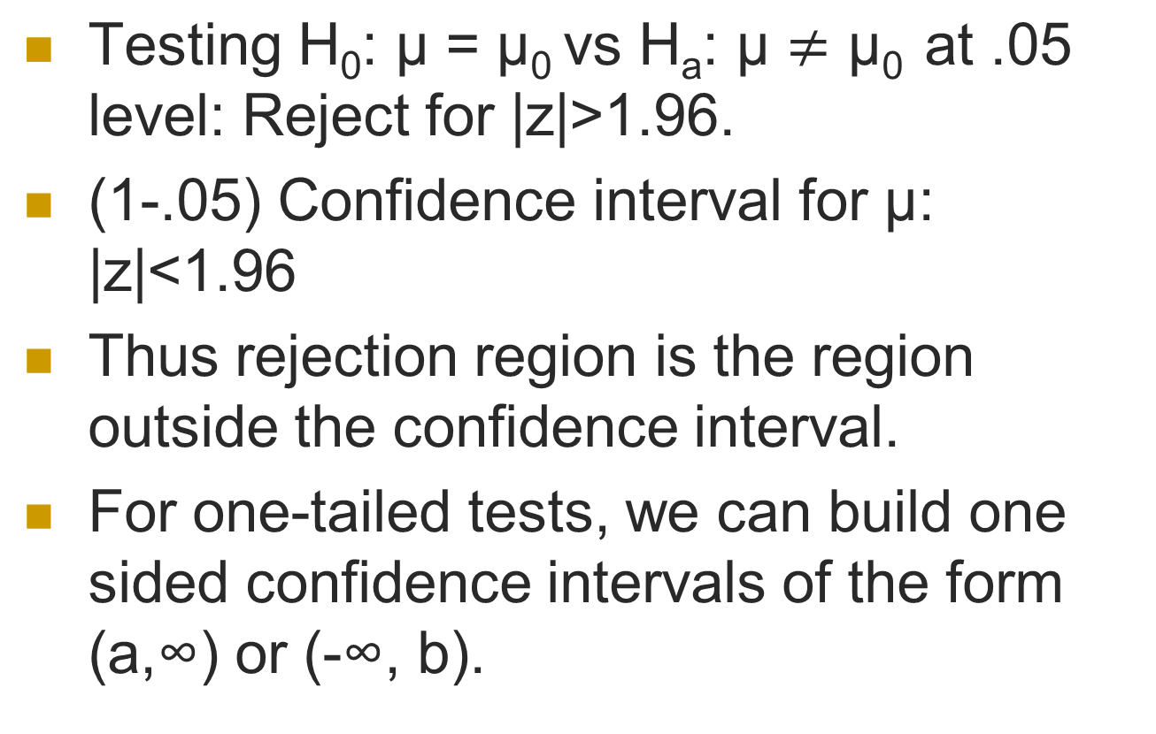
Equivalence of Confidence Interval & Testing

Slide 45
Exercises
The average number of minutes of a television commercial is 4.8. Write down the null and alternative hypothesis for testing the above statement. Assuming the commercial time is normally distributed, give the appropriate rejection region for each of the following sample sizes and significance levels.
a. n = 6, α= 0.01
b. n = 12, α = 0.05
c. n = 20, α= 0.1

Slide 46
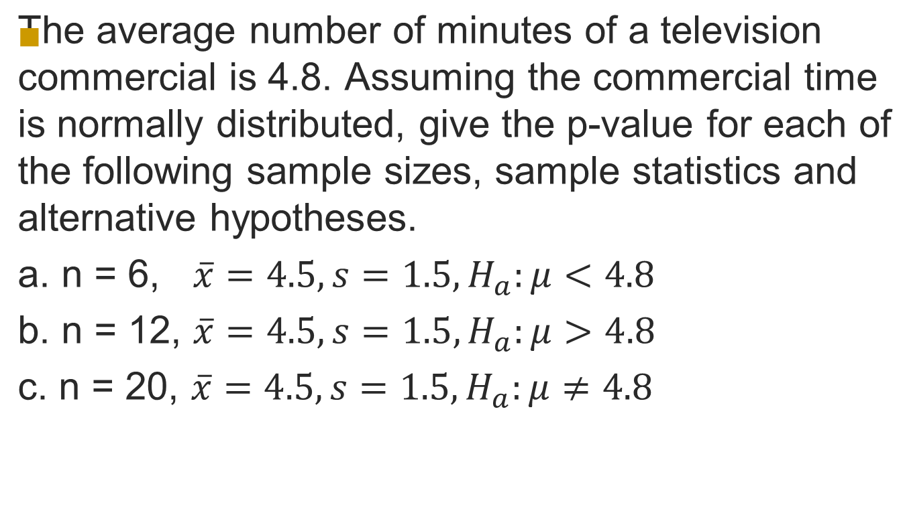
Exercises

